Slide 1
MASS MEDIA

Slide 2
THE MEDIA :
all the organizations, such as television, radio, and newspapers, that provide news and information for the public, or the people who do this work;
STUDY NOTE: Grammar
do not use media without 'the‚; people sometimes use a singular verb after media but it is better to use a plural verb The media were widely distrusted.;
the media reach a very large audience the mass media ;

Slide 3
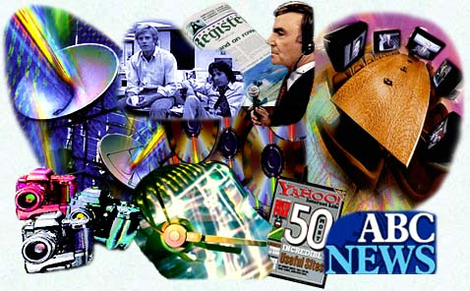
MASS MEDIA
newspapers
magazines
television
radio
the Internet
print media
broadcast media

Slide 4
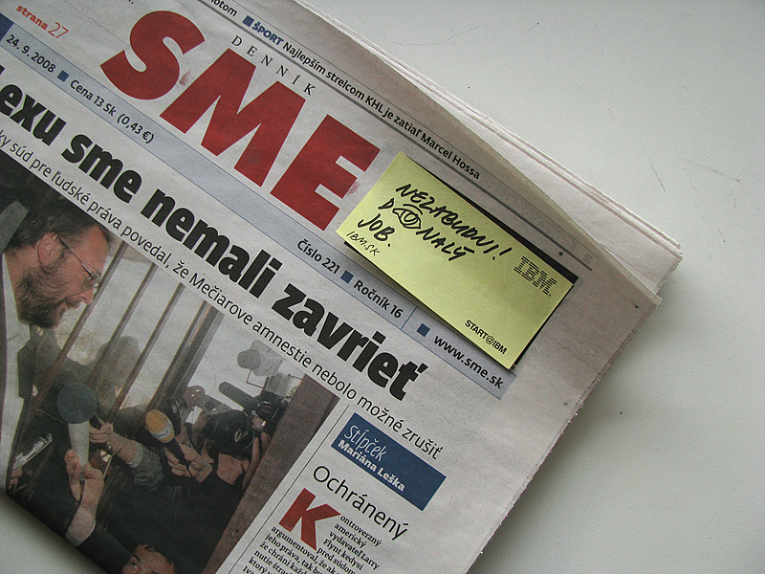
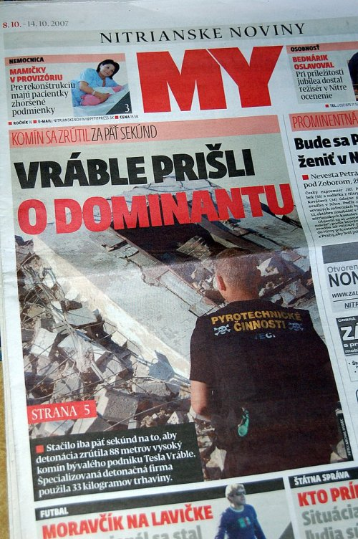
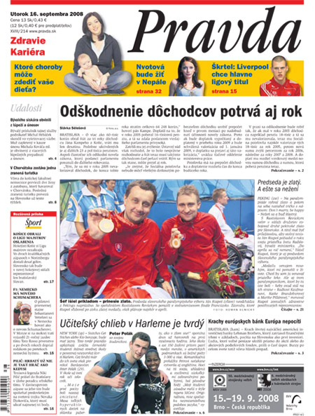
NEWSPAPERS I
national local

Slide 5

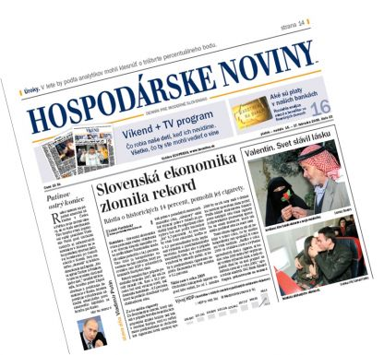
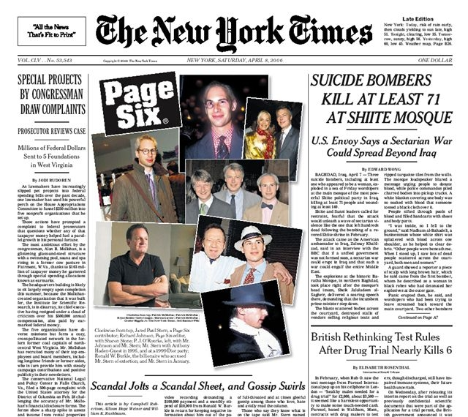
NEWSPAPERS II
quality (serious, broadsheet): - politics
- economics
- culture
- sports
- weather
- fashion
(news, reports,
reviews, features)

Slide 6



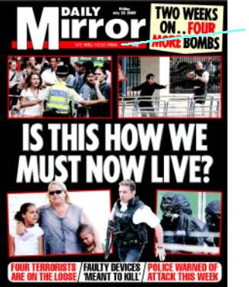
NEWSPAPERS II
popular (tabloids): - scandals
- celebrities
- crime
- accidents
- photographs

Slide 7

MAGAZINES
related to hobbies (photography, gardening,...)
different ages or genders (teenagers, women,...)
journals – serious magazines on a particular subject (doctors, scientists, experts in different fields)
published weekly, monthly

Slide 8



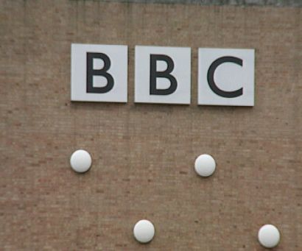


RADIO
commercial radio stations
non-commercial: public, educational, religious
different types of programmes: news, music, chat show, quiz show, weather forecast, educational, lifestyle show, radio drama

Slide 9




TELEVISION
commercial – non-commercial TV channels
wide variety of TV programmes (news, business, political discussions, children programmes, lifestyle programmes, films, documentaries, soap operas, weather forecast, quiz shows, talk shows, music shows, sports, educational programmes, drama )

Slide 10
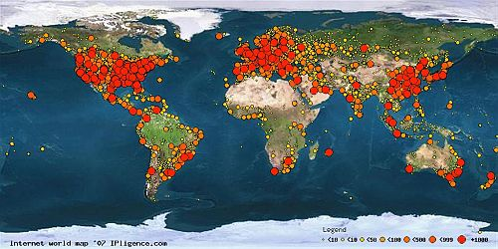

THE INTERNET
all kinds of information
includes newspapers,magazines, radio, television
books, dictionaries, encyclopedias
communication
business
entertainment

Slide 11

DISCUSSION
typical features of the mass media
advantages/disavantages, credibility
your favourite type of the media, station, channel, programmes
influence of the media on you, your family
the media power in the society

