Slide 1
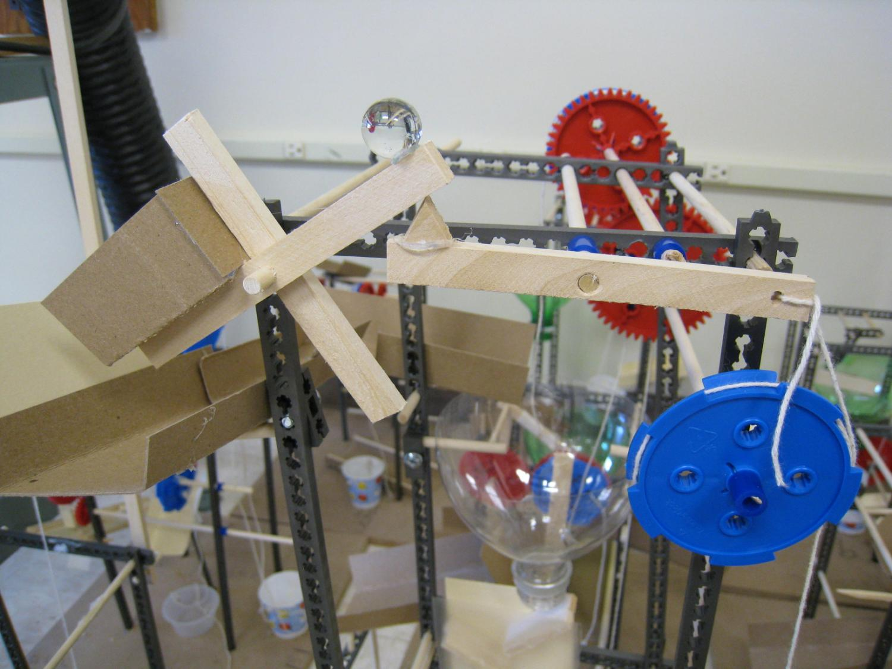
Using TeacherGeek® Crazy Contraptions with Activity 1.5 Rube Goldberg Device

Slide 2
A Set of resources to help your students succeed.
The Crazy Contraptions Activity is not a replacement for Activity 1.5 Rube Goldberg Device.
It is a set of resources for your students to use that will increase safety, rigor, efficiency, and success.

Slide 3
Increased Safety
Hot Glue tends to be the number one cause of injury for students working on Rube Goldberg Devices. The TeacherGeek® Easy Engineering System significantly reduces the usage of hot glue.
Few (if any) power tools are required

Slide 4

Increased Rigor
Make the most of the time your students spend working on the Rube Goldberg Activity.
Incorporate concepts such as the design process, mechanical advantage, creating and using a design matrix, and more.

Slide 5
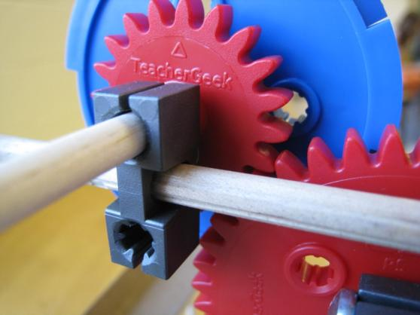
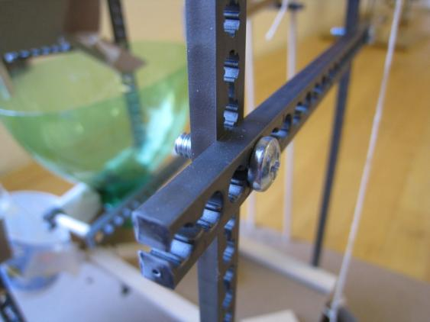
Increased Efficiency
Mechanical Fastening Techniques cut down on time wasted waiting for hot glue to solidify.
Do you have a design change? It’s no big deal with the Easy Engineering System
Parts move freely with little friction

Slide 6
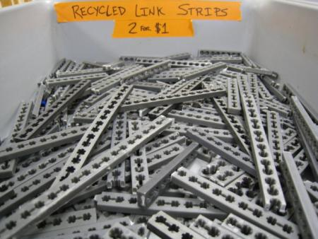
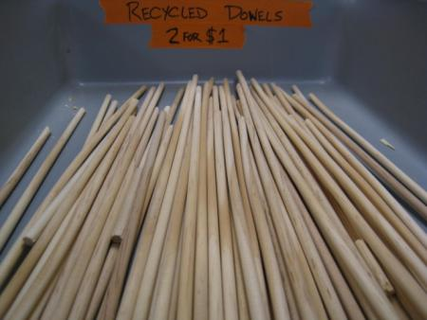
Increased Cost Efficiency
One stop shop – All of the components needed to build Rube Goldberg Devices are included.
Recycle – Contraptions can be taken apart and the parts can be reused for many classes. The more parts you recycle, the less you need to purchase.

Slide 7
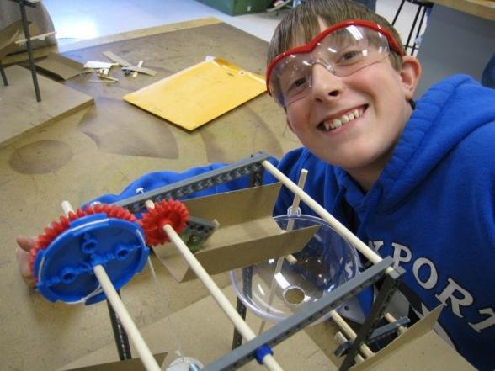
Increased Success
Once students understand how to use the Easy Engineering system, they can easily turn their designs into reality.
Reduce the “I’m Done” comments. Students can continually refine and improve their designs.

Slide 8
Overview of Crazy Contraptions Resources
Documents
Crazy Contraptions Activity Guide
Crazy Contraptions Student Portfolio
Crazy Contraptions Base Drilling Guide
Easy Engineering Guide & Ruler
Easy Engineering System
Tools
Supplies

Slide 9
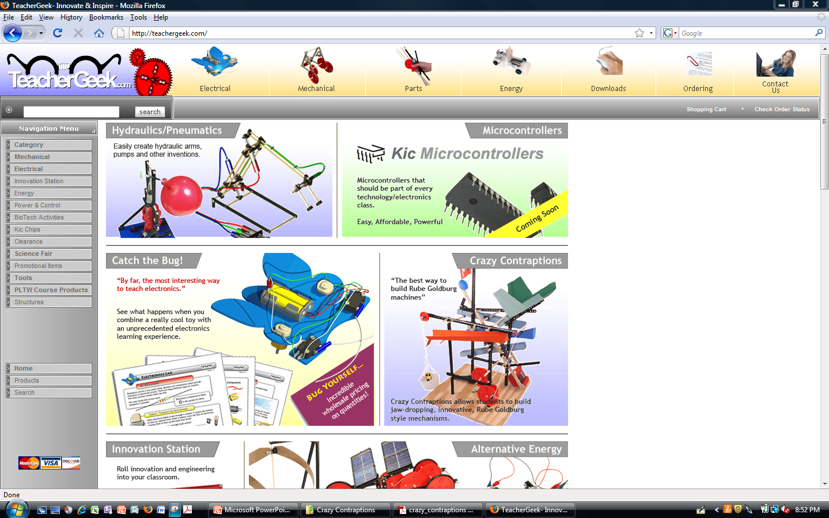

Where to download these resources Go to www.teachergeek.com and click on downloads button.

Slide 10
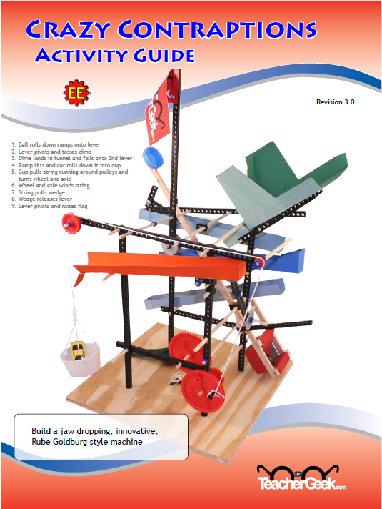
Crazy Contraptions Activity Guide
The TeacherGeek Crazy Contraptions Activity Guide is centered around the engineering design process.
Resources are provided for each design process step.
Copy one class set

Slide 11
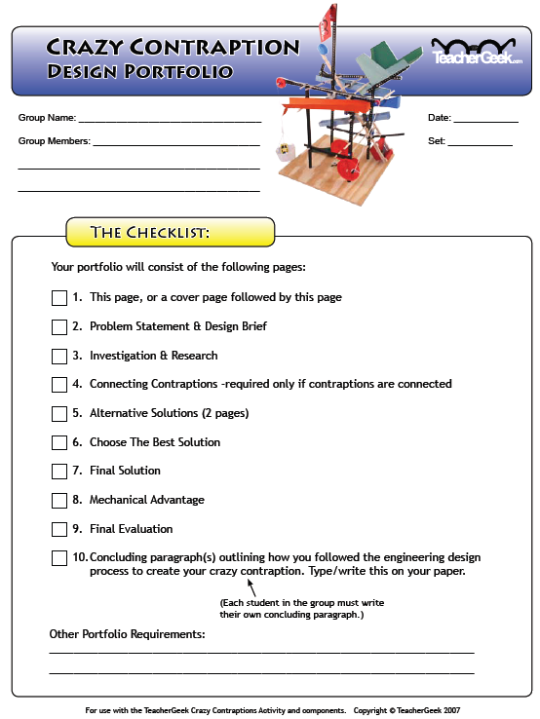
Crazy Contraptions Student Portfolio
This document interfaces with the activity guide
Students use this document to record their progress as they navigate the design process
Copy one portfolio per student

Slide 12
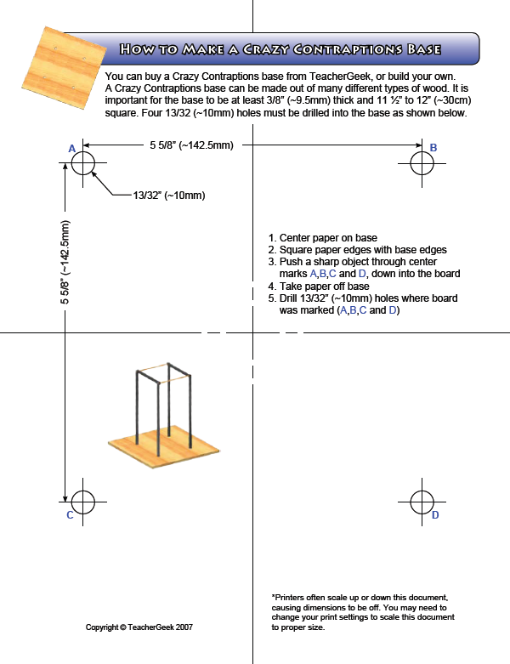
Crazy Contraptions Base Drilling Guide
You can buy Crazy Contraptions bases from TeacherGeek, or build your own.
If you build your own, this template is used to locate the holes in the base

Slide 13
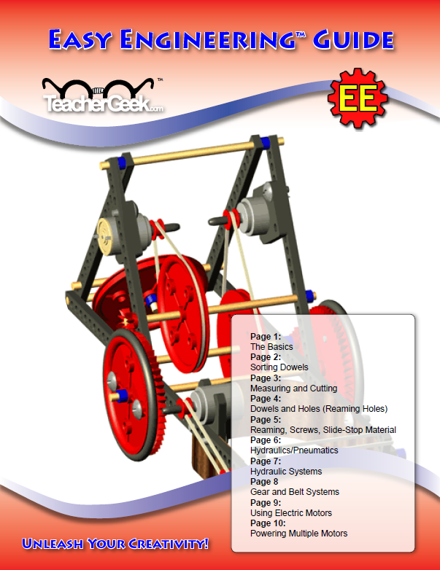
Easy Engineering Guide
This guide will give you a basic understanding of Easy Engineering components, and how they can be used.
This guide will be used during the prototyping phase of the design process.
Copy one class set

Slide 14
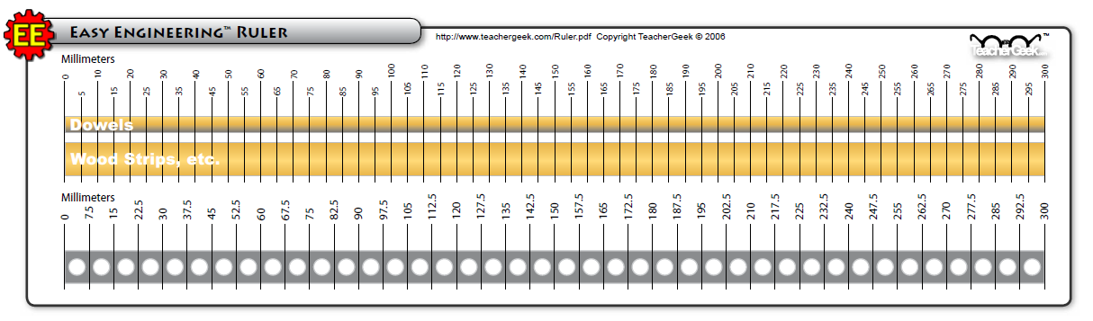
Easy Engineering Ruler
The Easy Engineering Ruler is used to measure lengths of dowels, connector strips, and wood strips
The Easy Engineering system uses the Metric Measurement System
Tip: Laminate the rulers so they last longer.

Slide 15
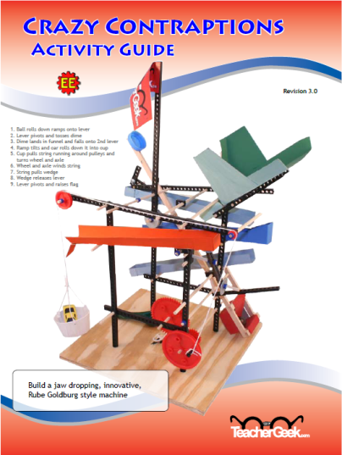


Take some time to read through these documents

Slide 16
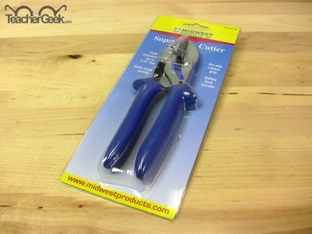
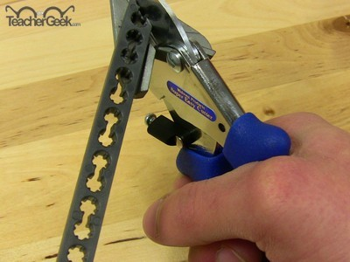
Easy Engineering Tools – Easy Cutter

Slide 17
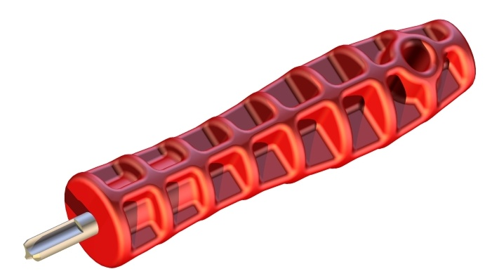
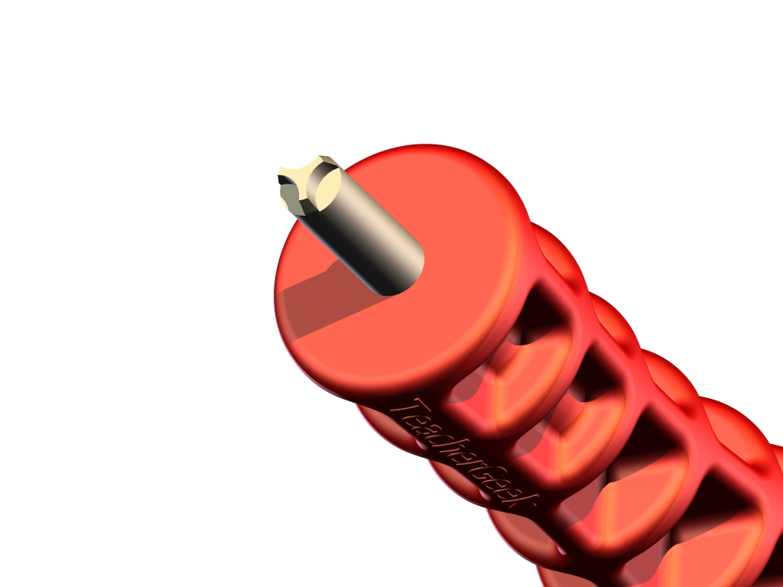
Easy Engineering Tools – Reamers

Slide 18
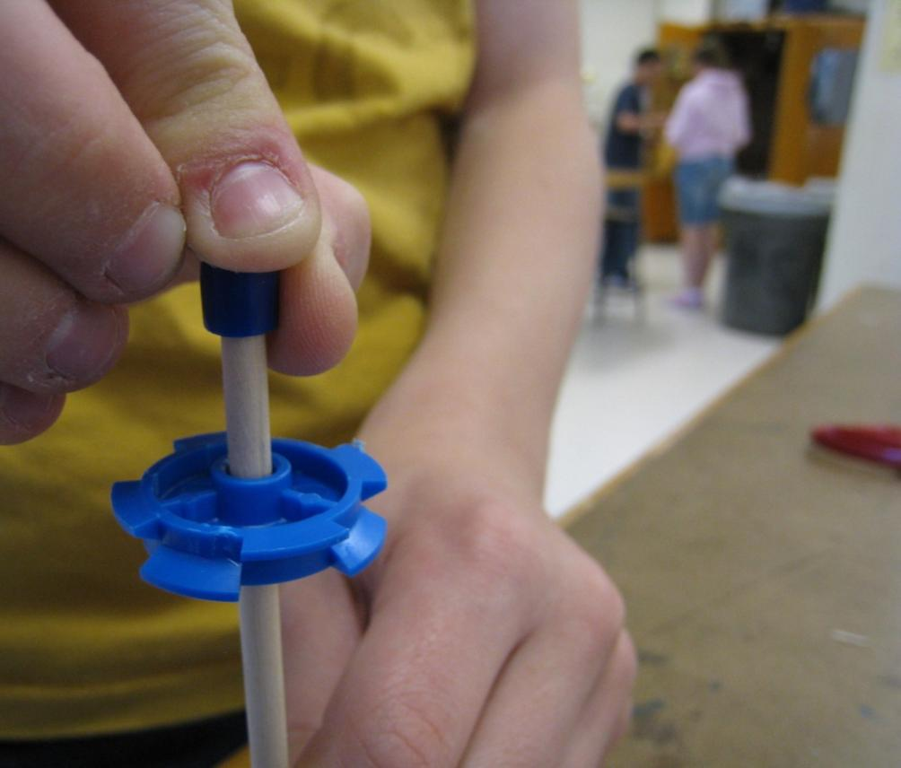
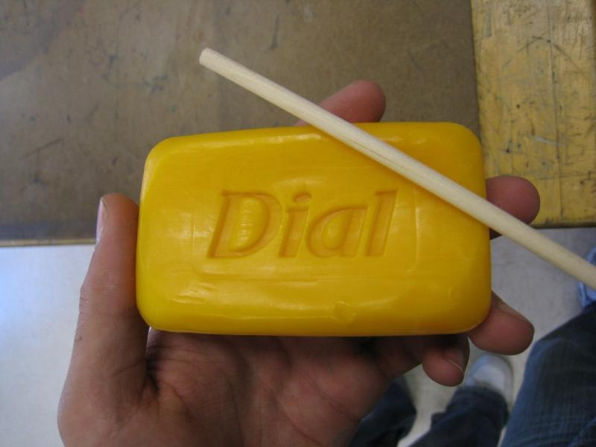
Use bar soap to help assemble parts with dowels

Slide 19
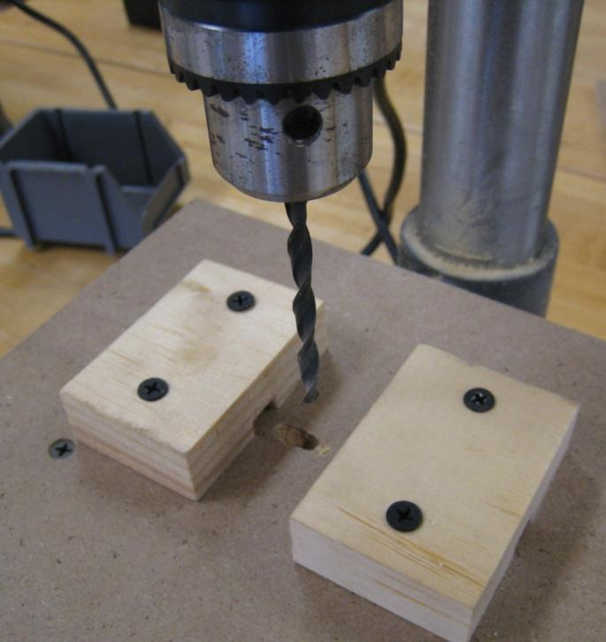
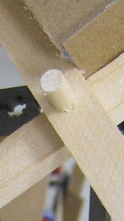
Sample drill press setup to drill dowel sized holes in wood strips

Slide 20
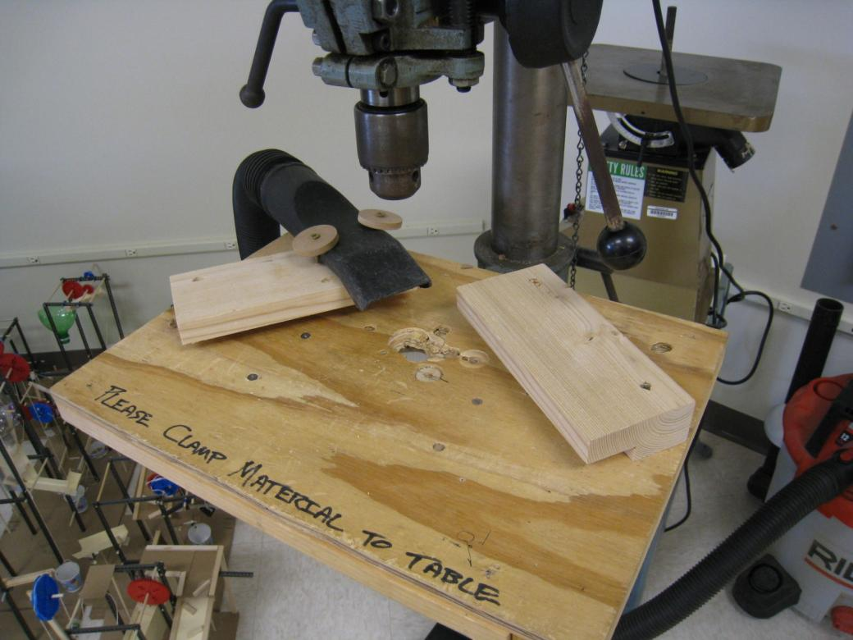
Sample drill press setup to drill holes in bases

Slide 21
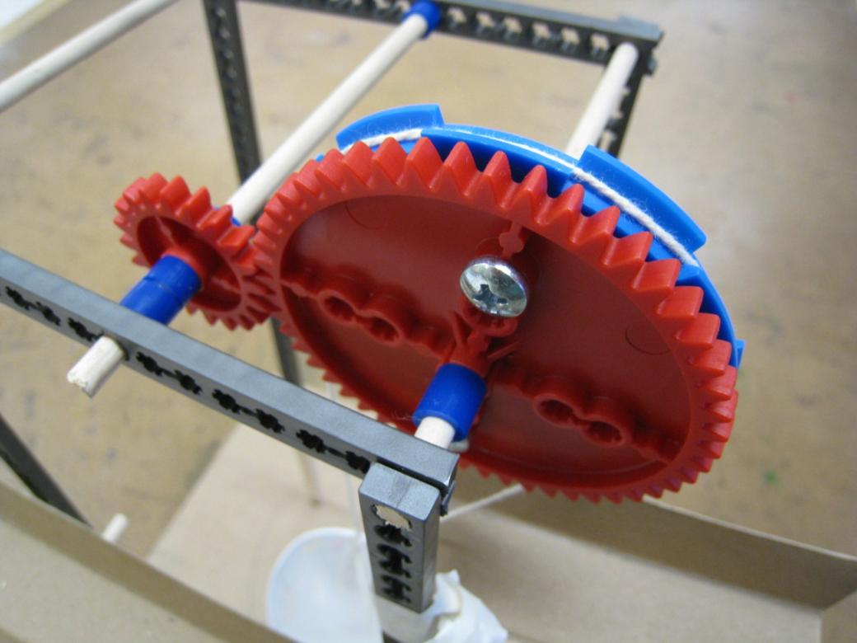
Sample Contraptions

Slide 22
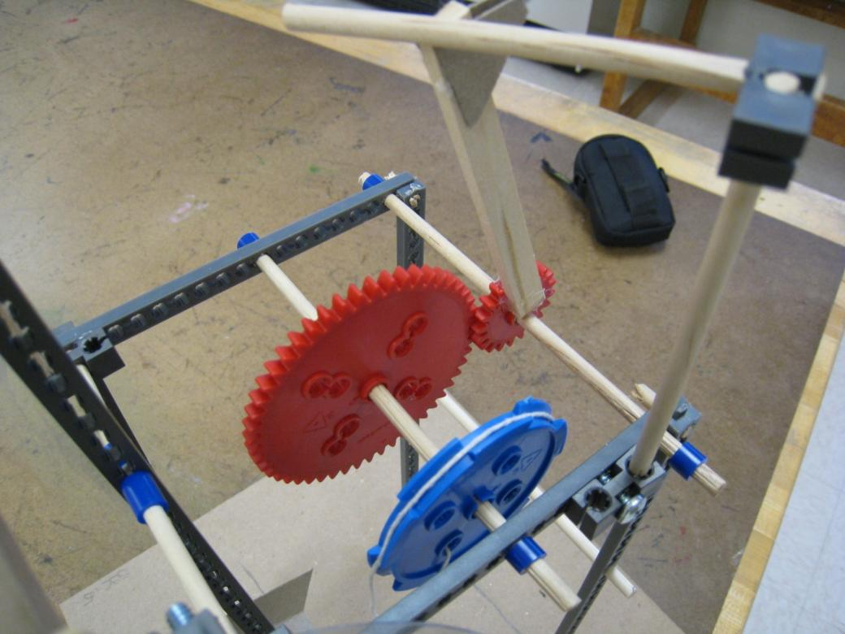
Sample Contraptions

Slide 23
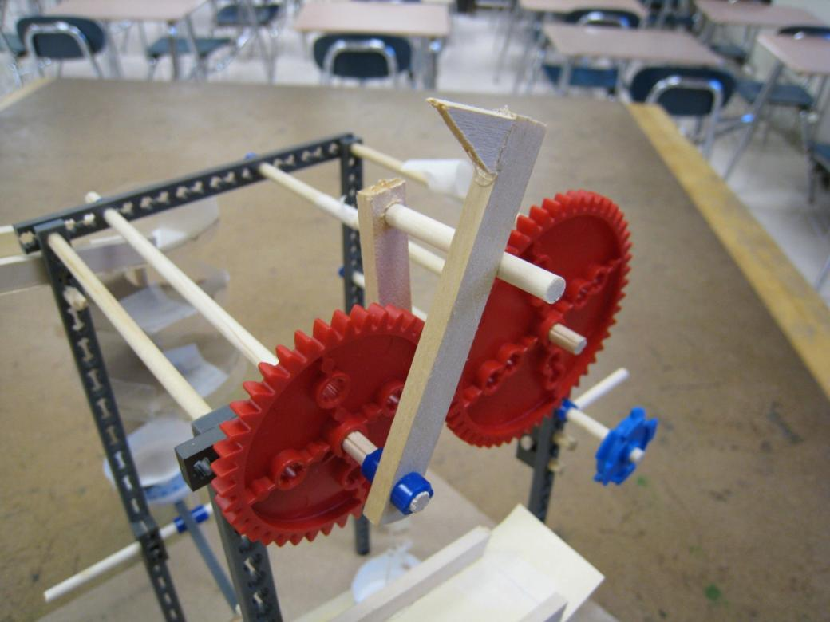
Sample Contraptions

Slide 24
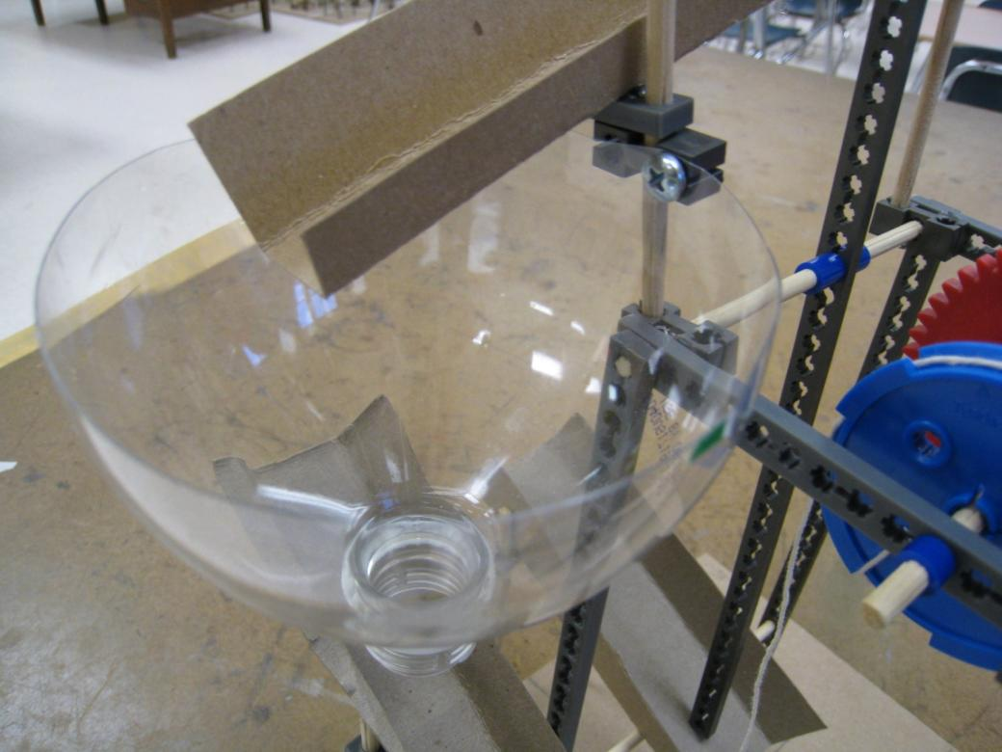
Sample Contraptions

Slide 25
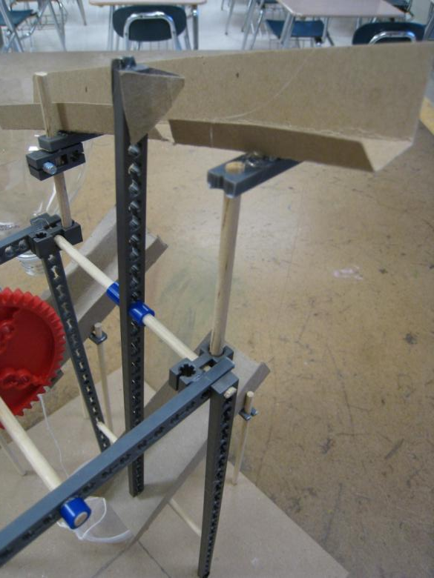
Sample Contraptions

Slide 26
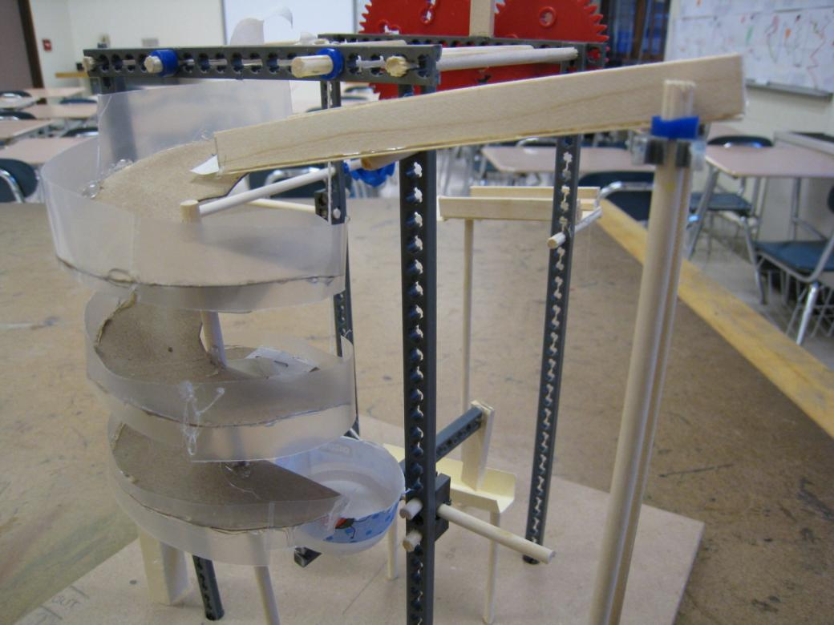
Sample Contraptions

Slide 27
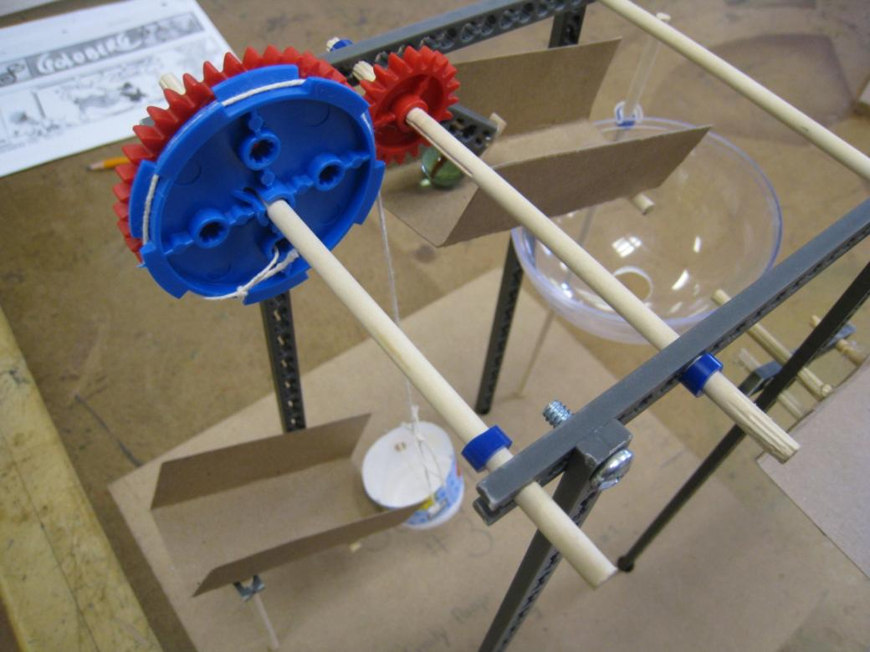
Sample Contraptions

Slide 28
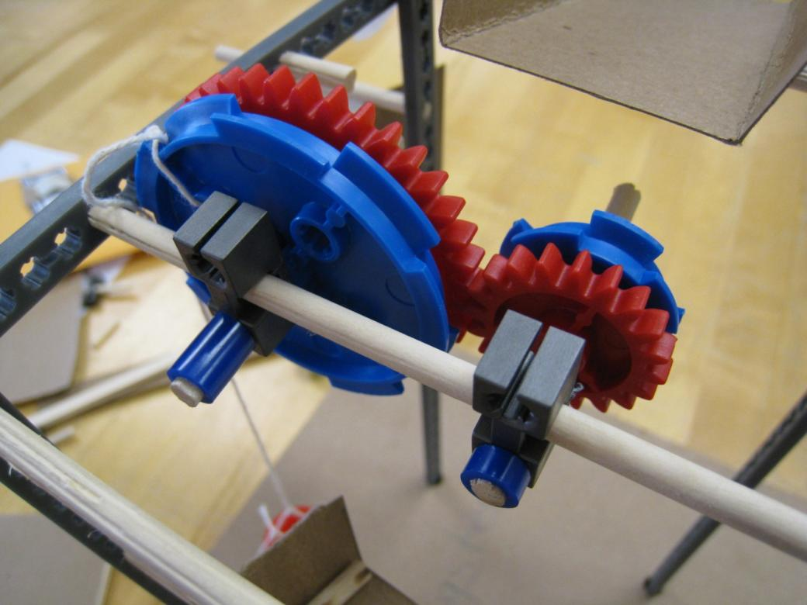
Sample Contraptions

Slide 29
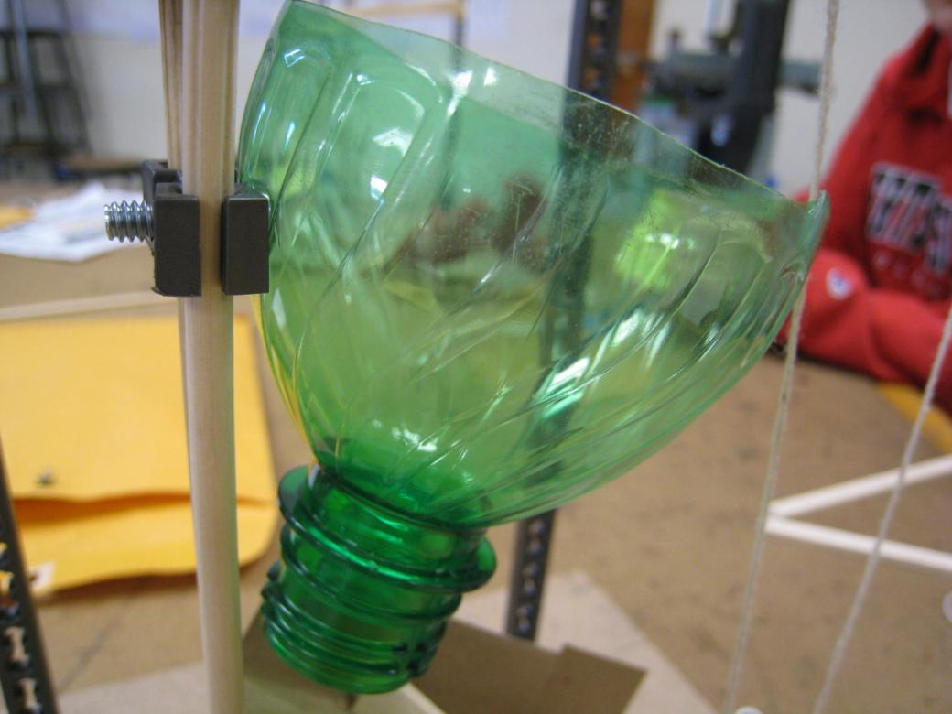
Sample Contraptions

Slide 30
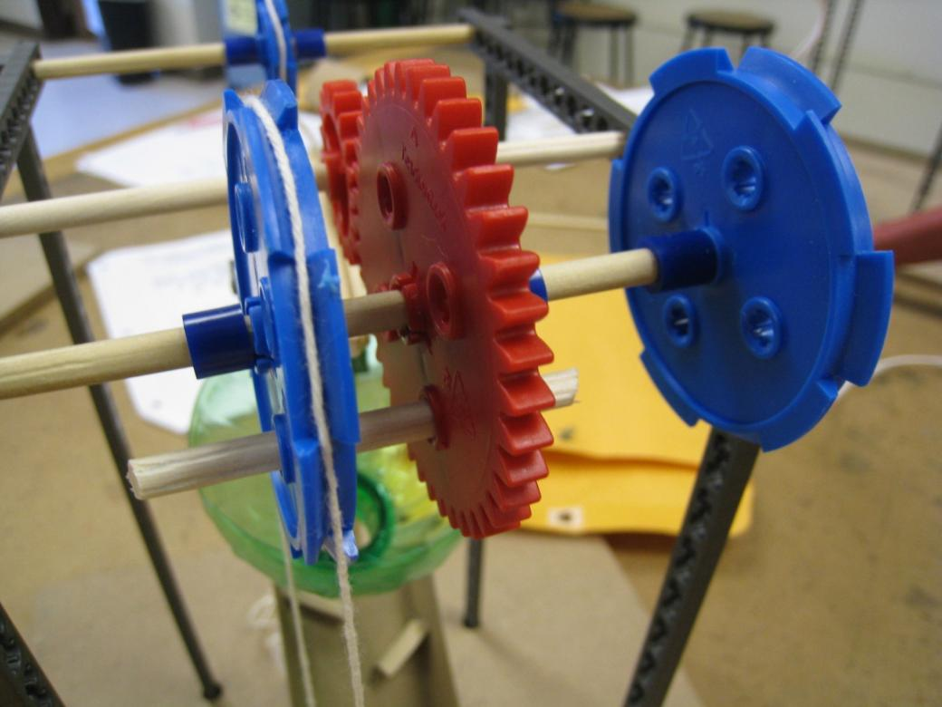
Sample Contraptions

Slide 31
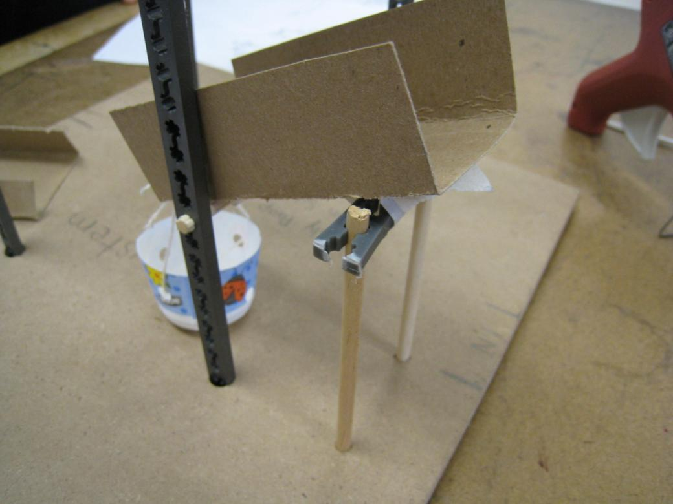
Sample Contraptions

Slide 32
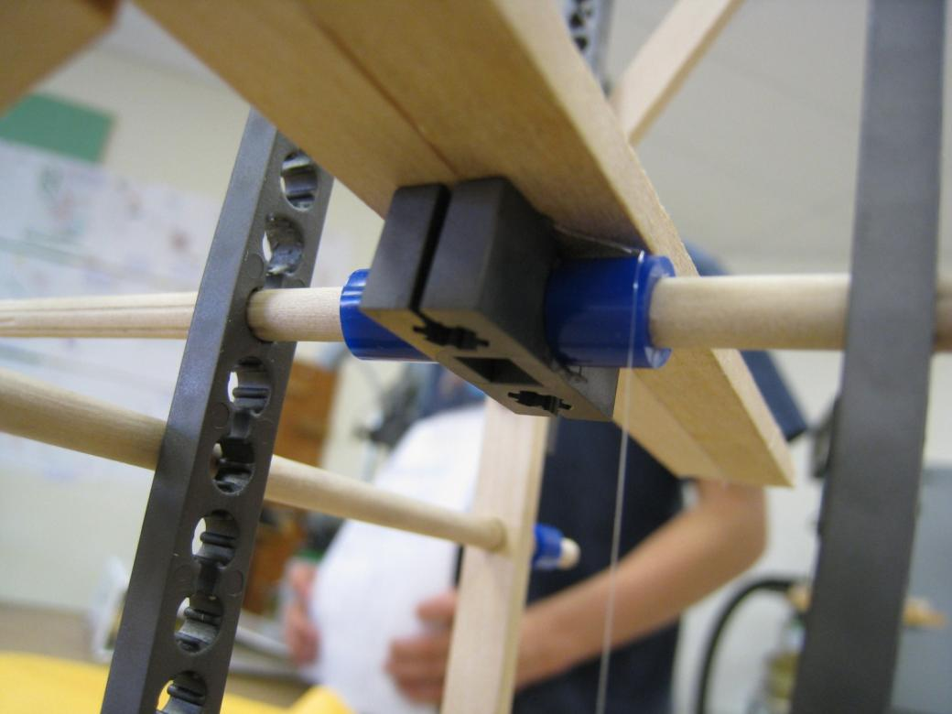
Sample Contraptions

Slide 33
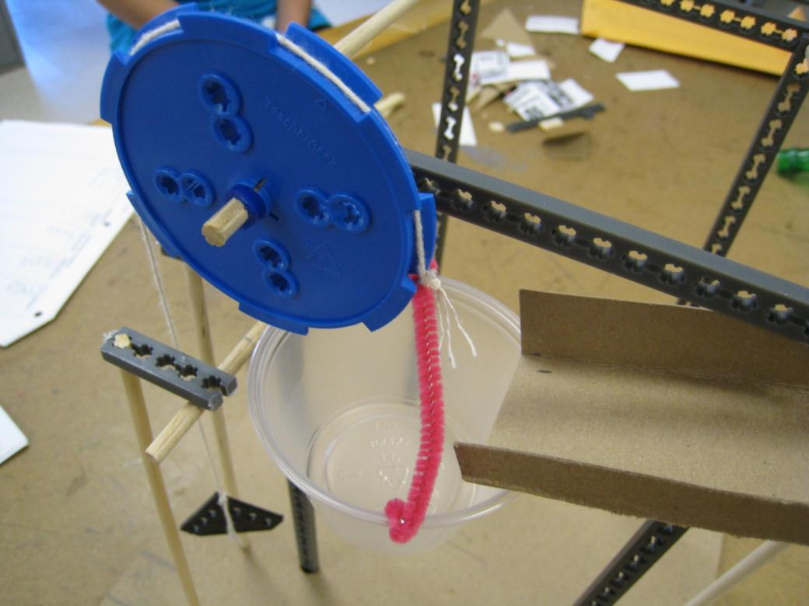
Sample Contraptions

Slide 34
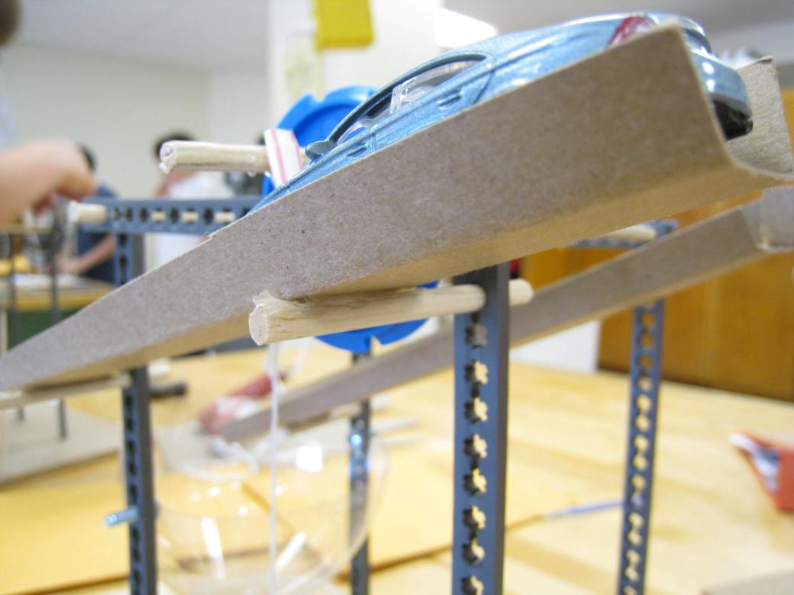
Sample Contraptions

Slide 35
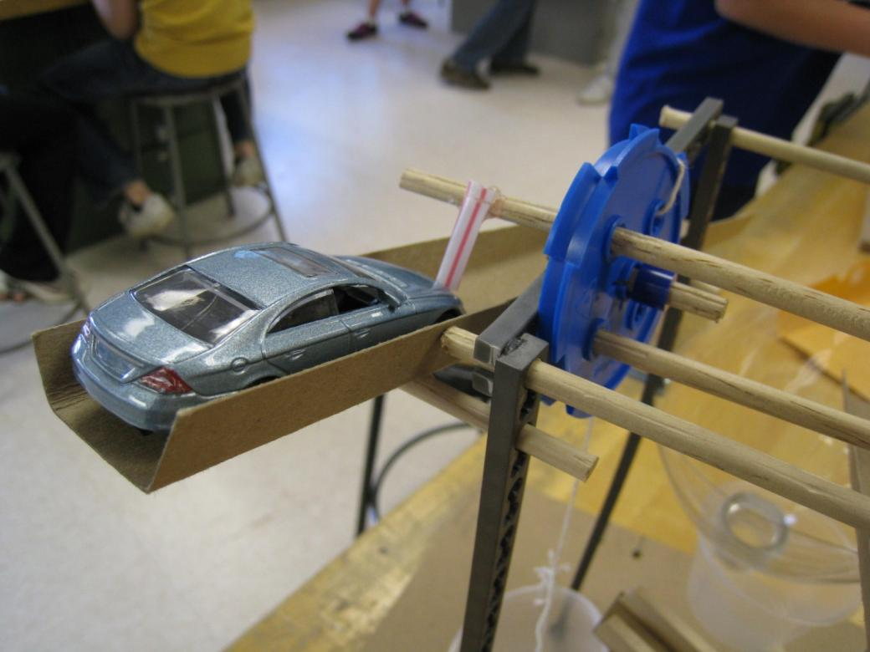
Sample Contraptions

Slide 36
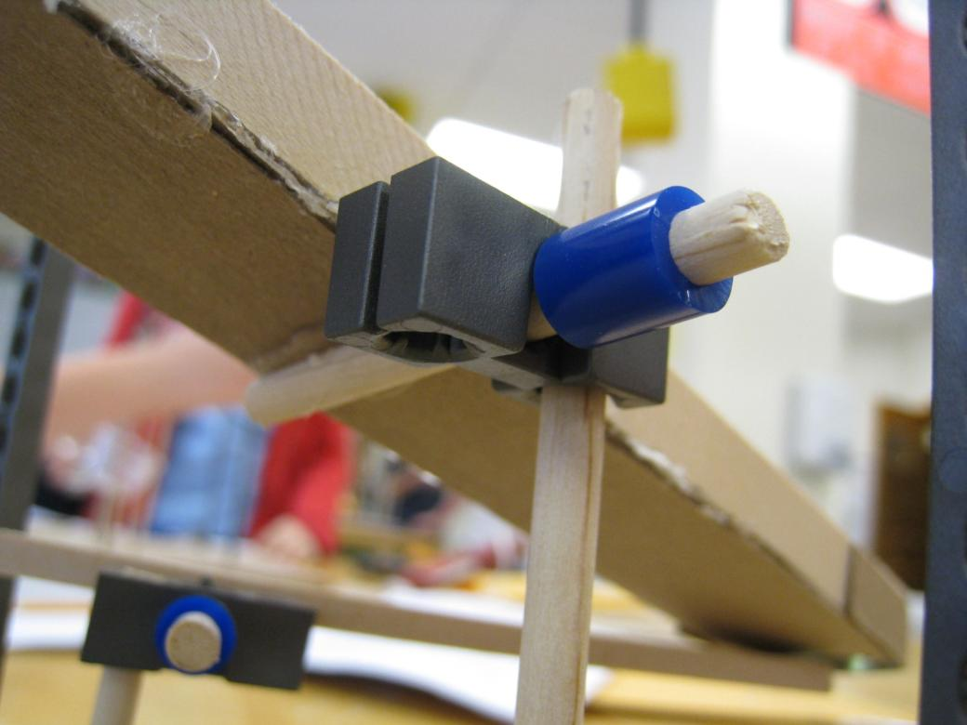
Sample Contraptions

Slide 37
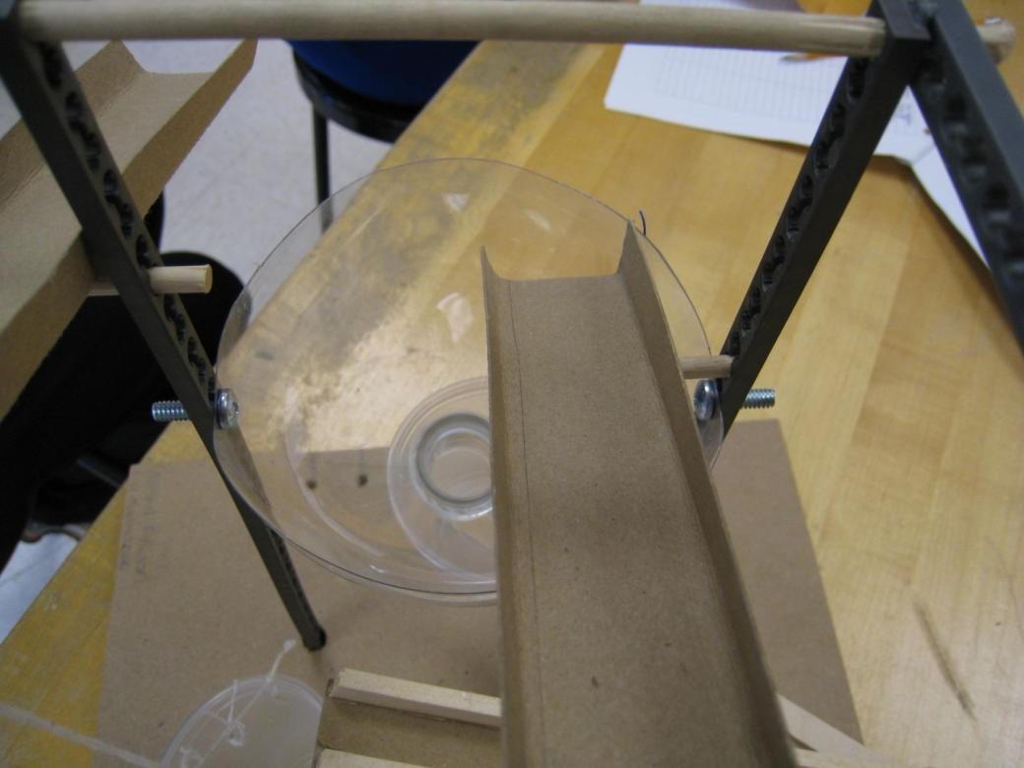
Sample Contraptions

Slide 38
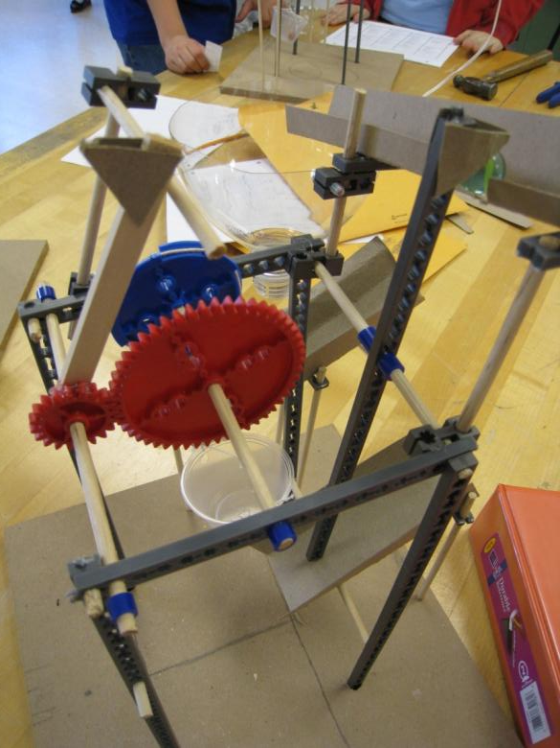
Sample Contraptions

Slide 39
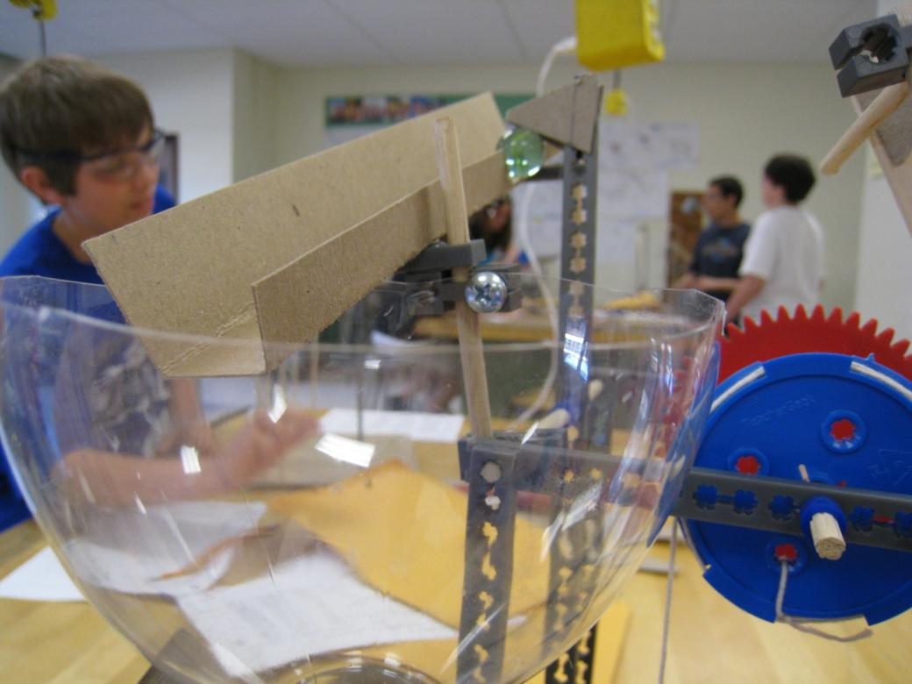
Sample Contraptions

Slide 40
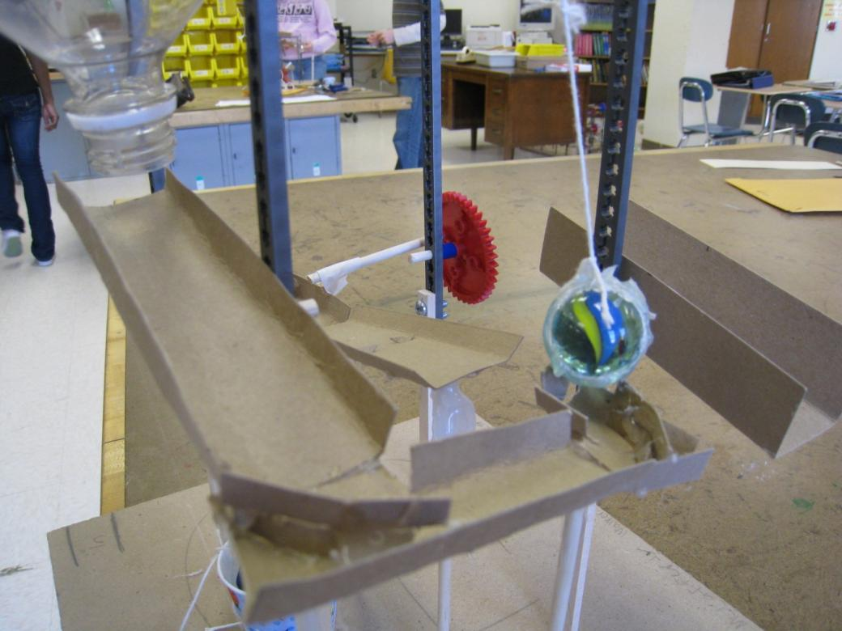
Sample Contraptions

Slide 41
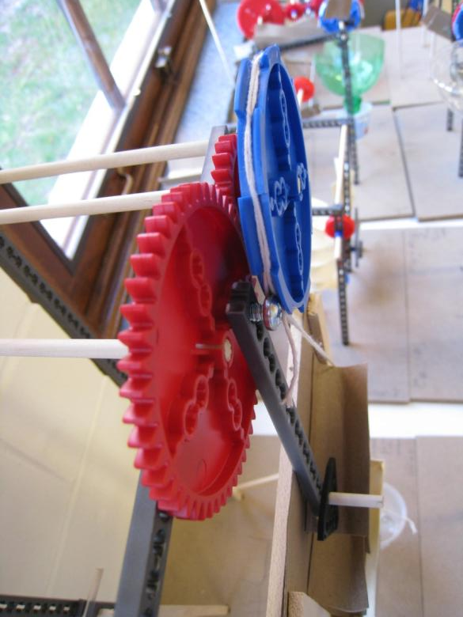
Sample Contraptions

Slide 42
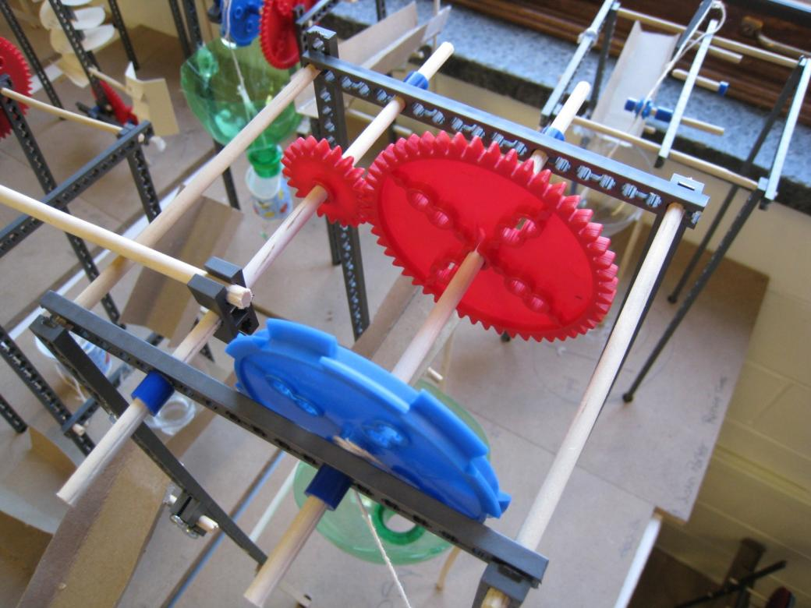
Sample Contraptions

Slide 43
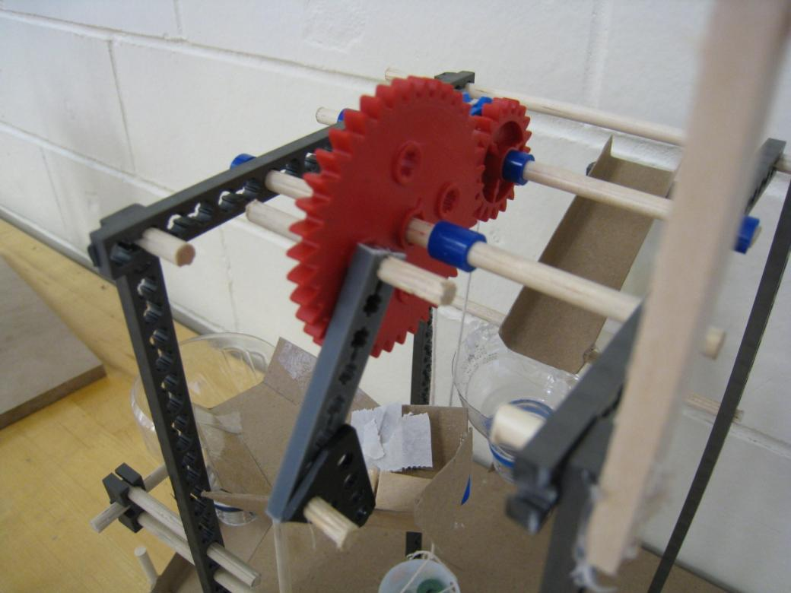
Sample Contraptions

Slide 44
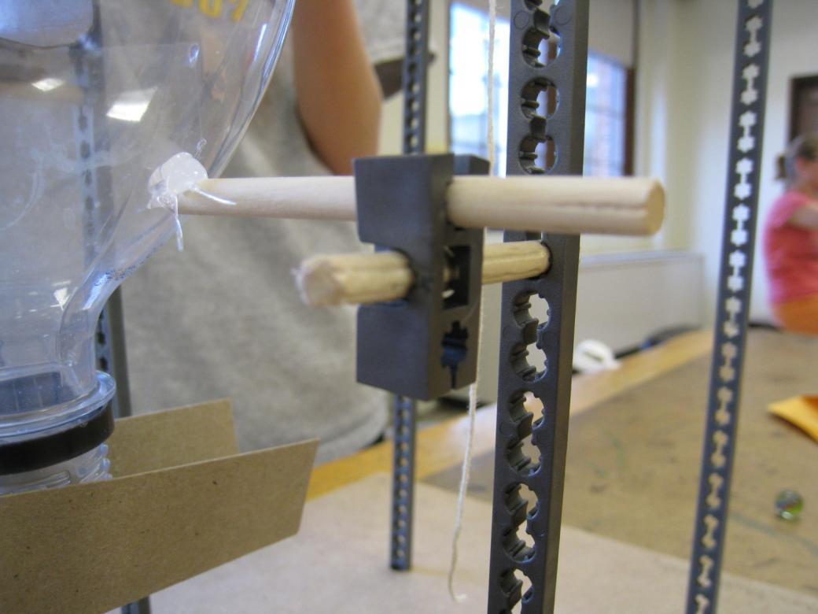
Sample Contraptions

Slide 45
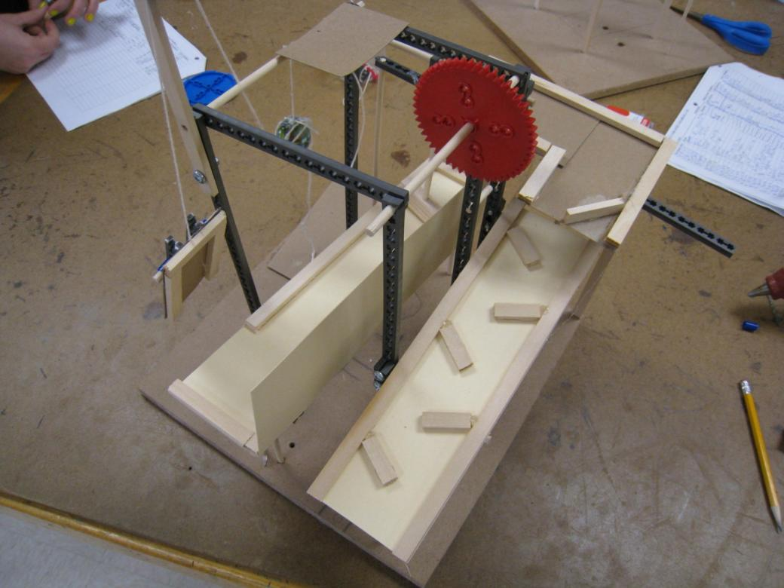
Sample Contraptions

Slide 46
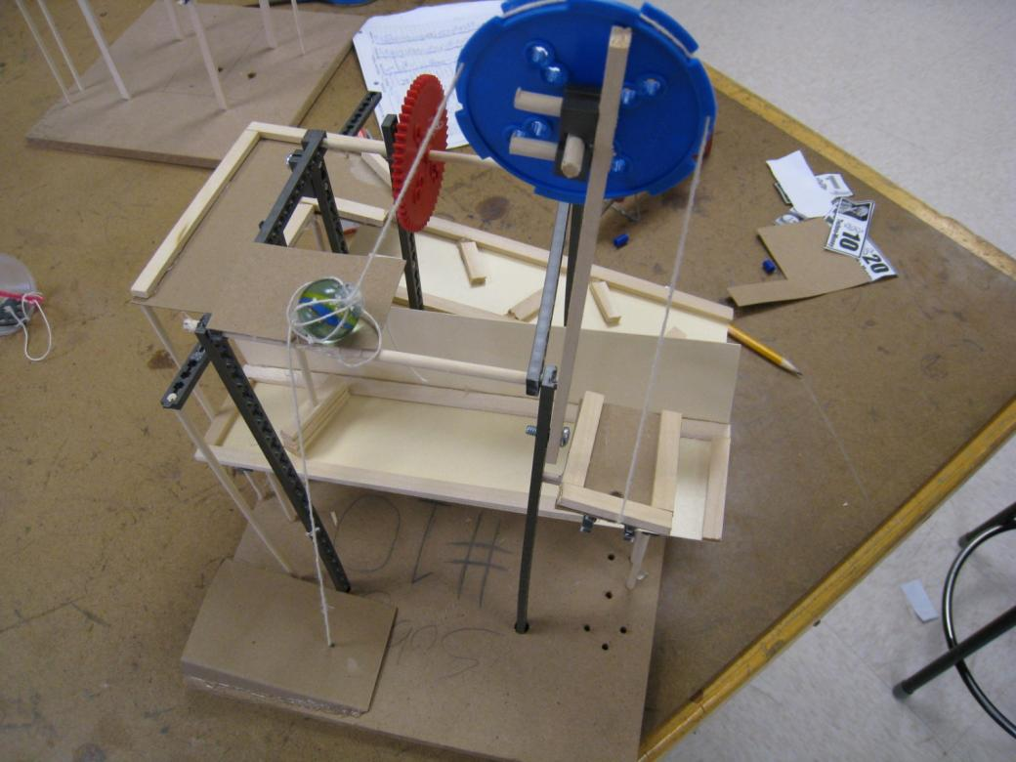
Sample Contraptions

Slide 47

Sample Contraptions

Slide 48
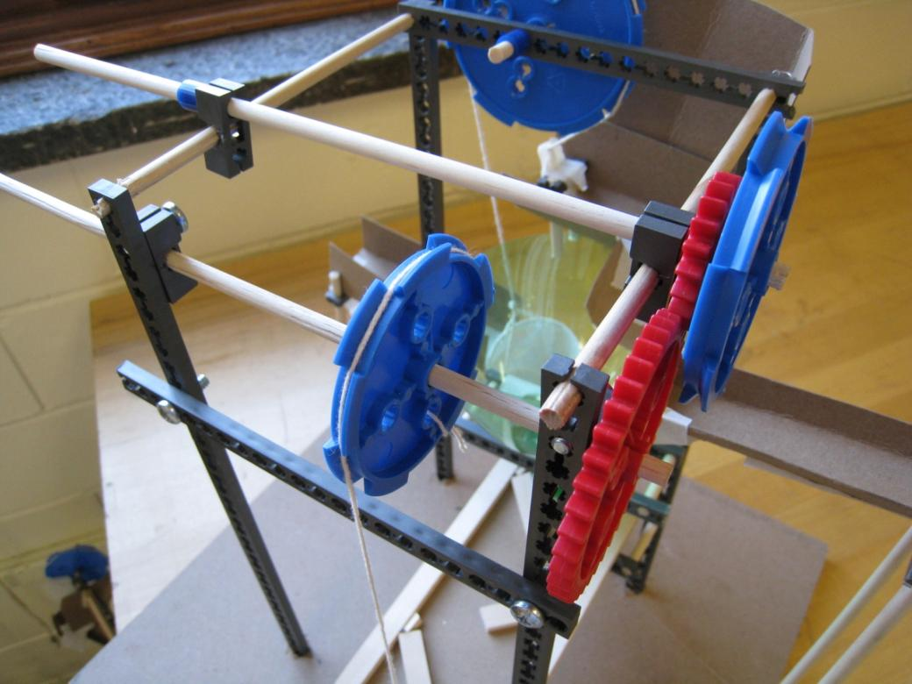
Sample Contraptions

Slide 49

Sample Contraptions

Slide 50
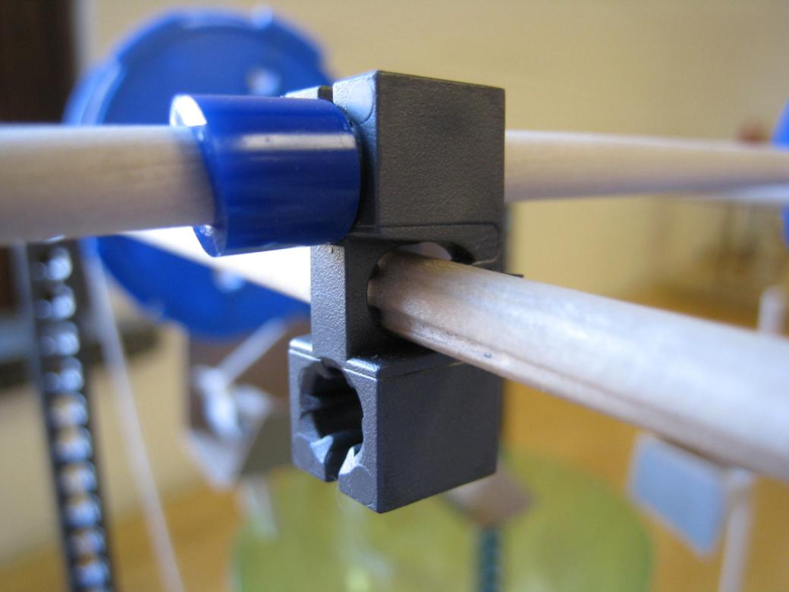
Sample Contraptions

Slide 51

Sample Contraptions

Slide 52

Sample Contraptions

Slide 53

Sample Contraptions

Slide 54

Sample Contraptions

