Slide 1
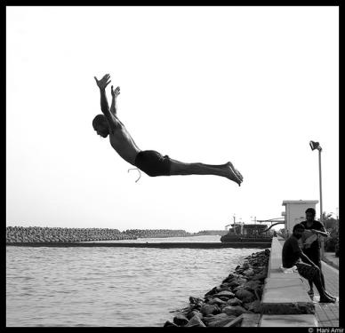
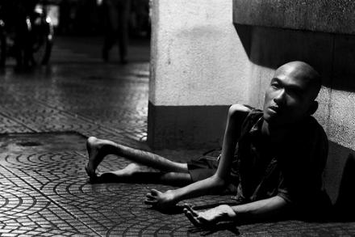
Affective Image Classification
using features inspired by psychology and art theory
Jana Machajdik, Vienna University of Technology
Allan Hanbury, Information Retrieval Facility

Slide 2
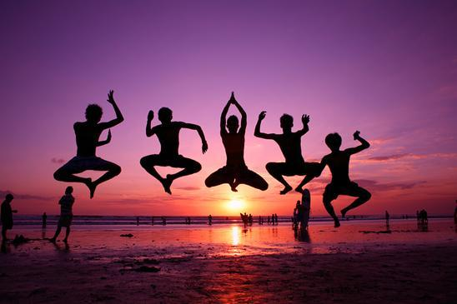

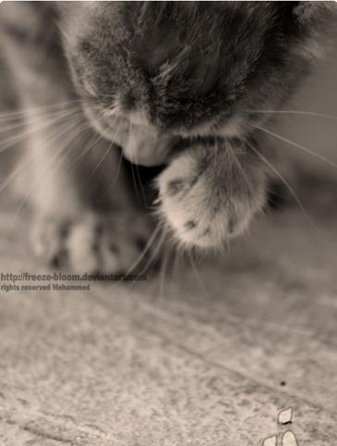
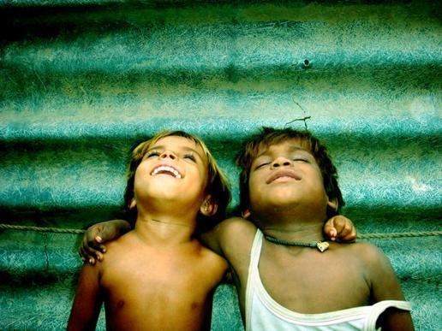
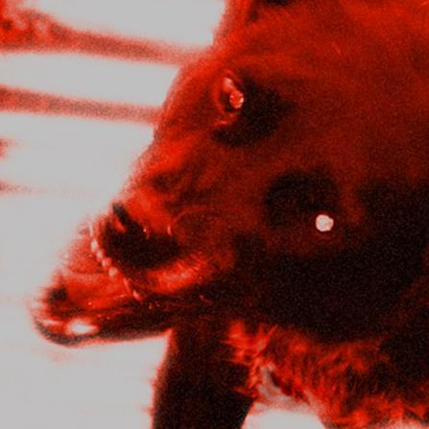
Images & emotions

Slide 3


Slide 4
Context & Motivation
Retrieval of „emotional“ images?
Publications few, recent and not comparable
Critique of State of the Art | Contribution
- arbitrary emotional categories | + emotional categories from an extensive psychological study (IAPS)
- Unknown image sets | + Available sets
- Unclear evaluation | + Unbiased correct rate
- General features with implicit relationship to output emotions | + Specific features designed to express emotional aspects

Slide 5
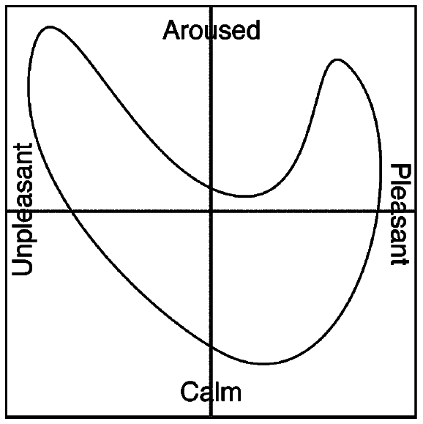
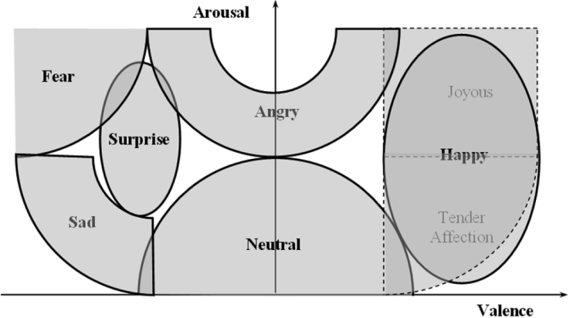
How to measure affect?
“Affect”- definition: The conscious subjective aspect of feeling or emotion.
Individual vs. common
Psychological model
Valence
Arousal
(Dominance)
Emotional categories by Mikels et al.:
Amusement
Awe
Excitement
Contentment
Anger
Disgust
Fear
Sad

Slide 6
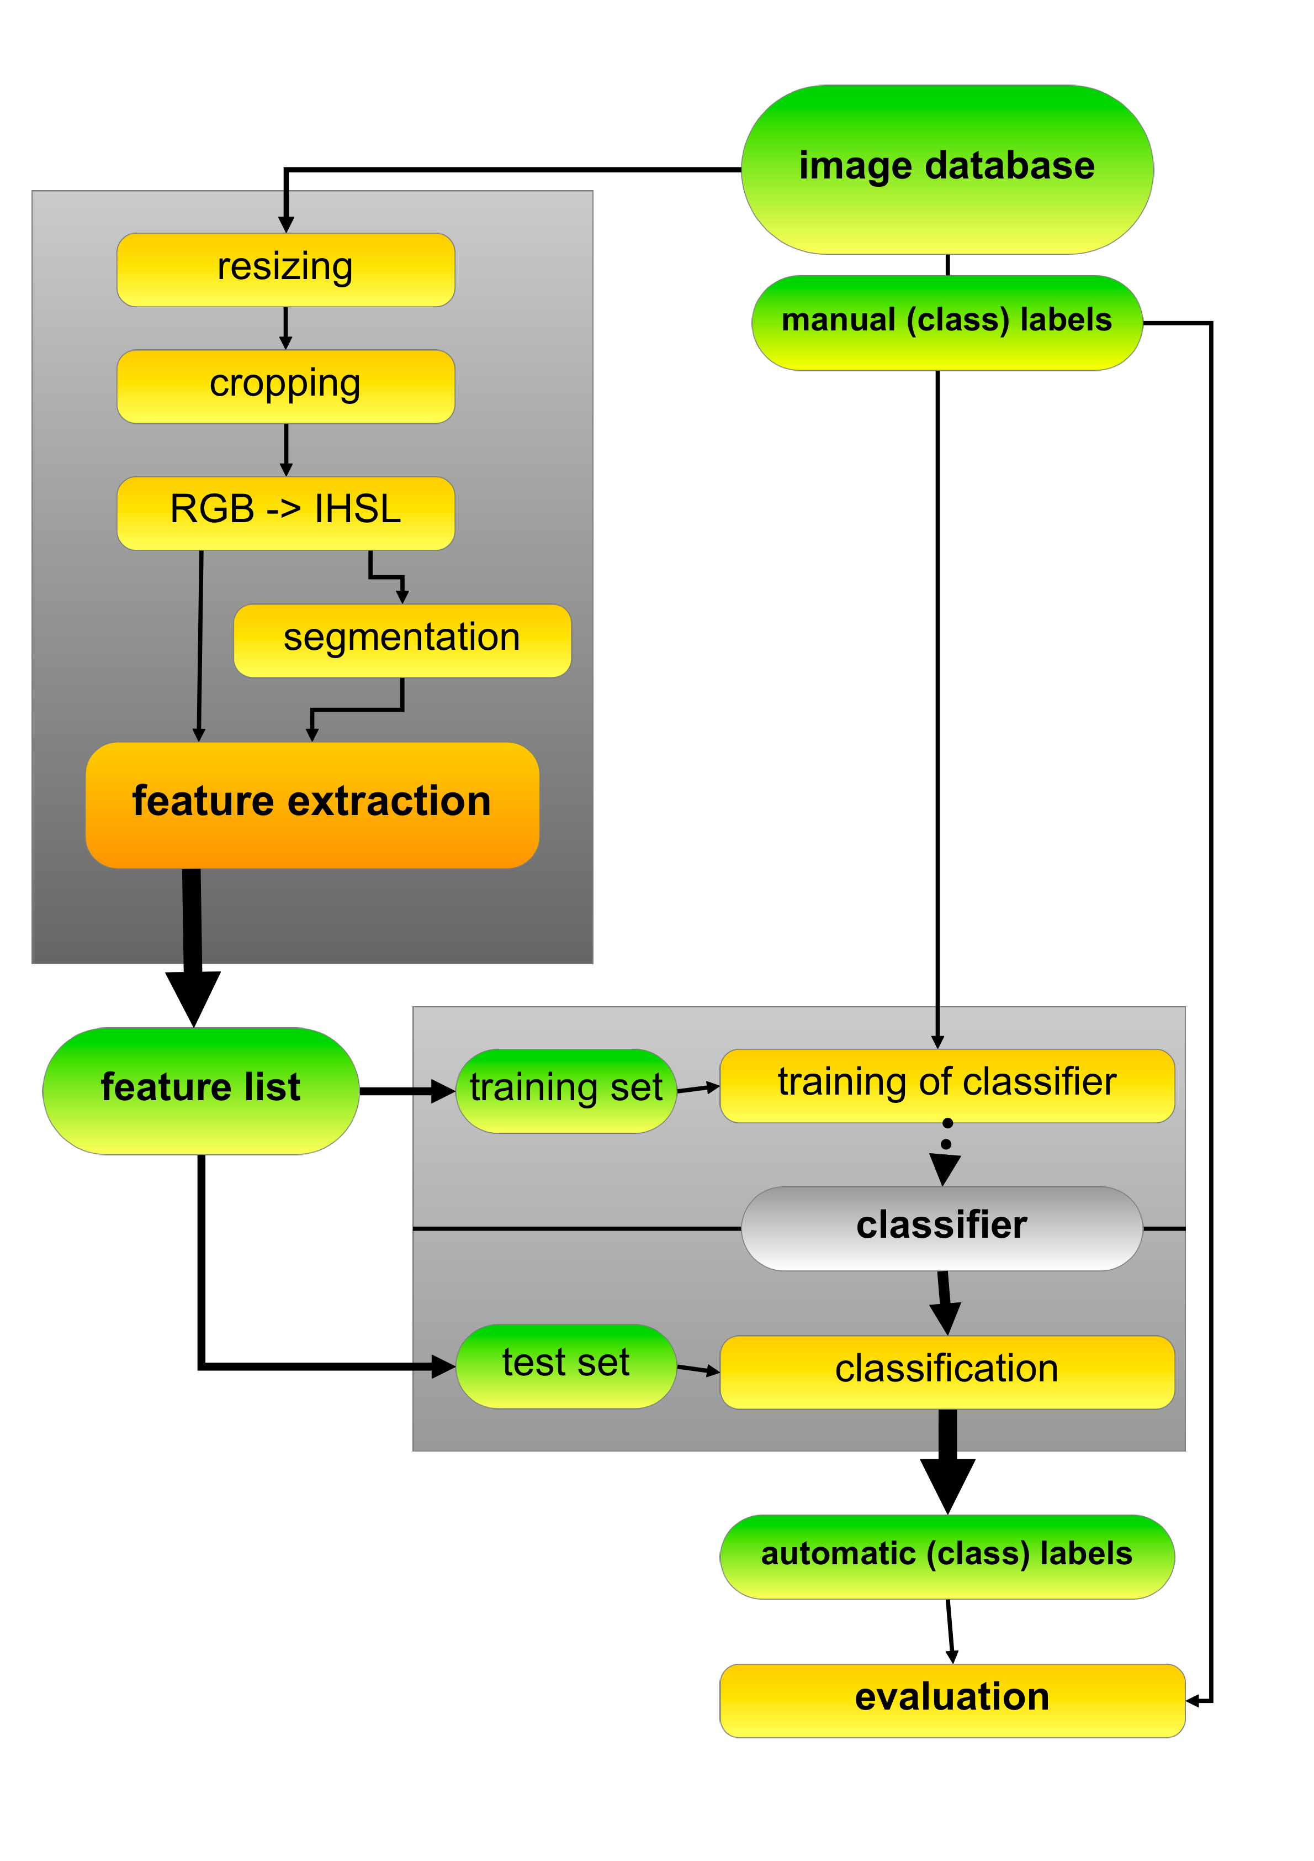
System flow:
Feature vector: 114 numbers
K-Fold Cross-Validation
Separates the data into training and test sets
Machine Learning approach
Naive Bayes classifier

Slide 7
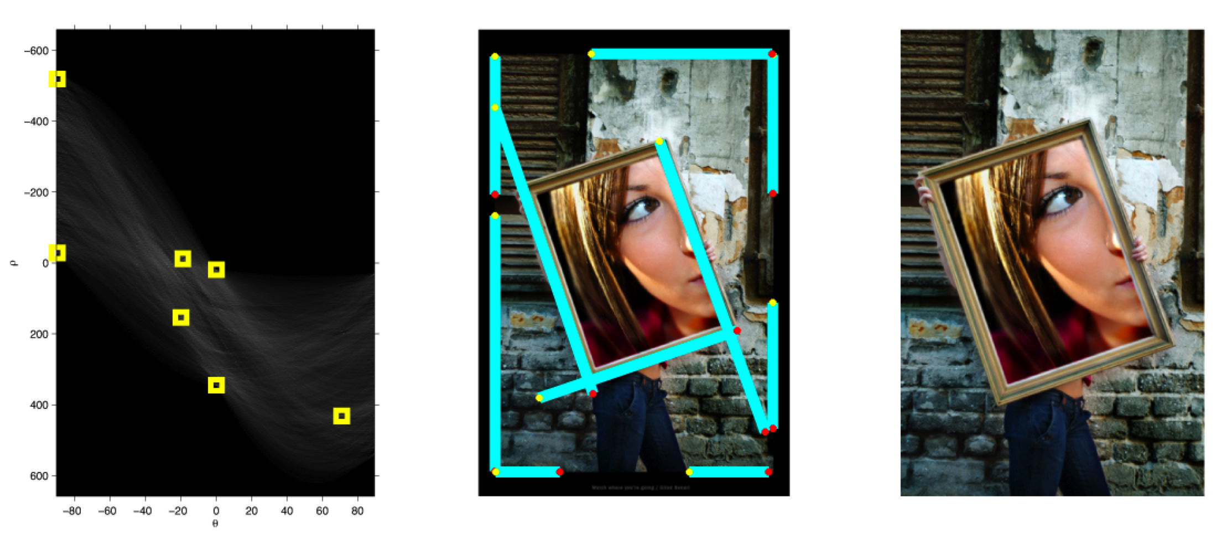
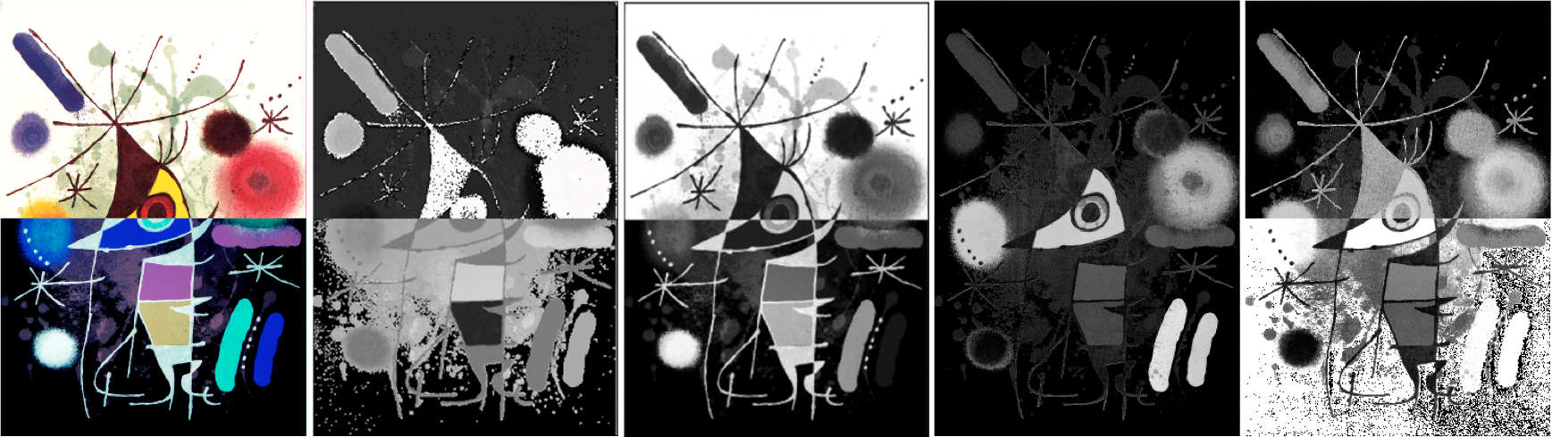
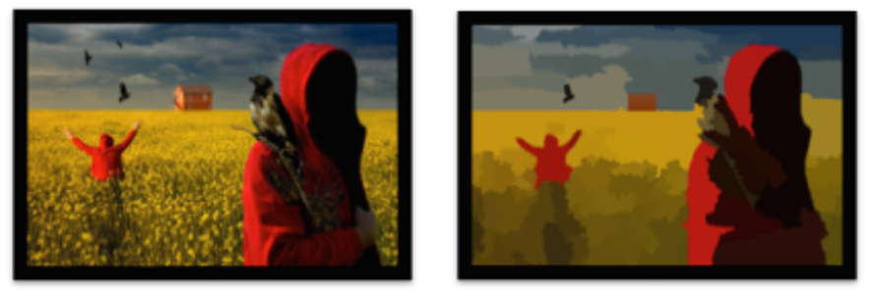
Preprocessing
Resizing
Cropping
Hough transform
Canny edge
Color space
RGB to IHSL
Segmentation
Watershed/waterfall algorithm
Hough space
main lines
cropped image
original
Hue
Brightness
Saturation
S in HSV
original
segmented

Slide 8
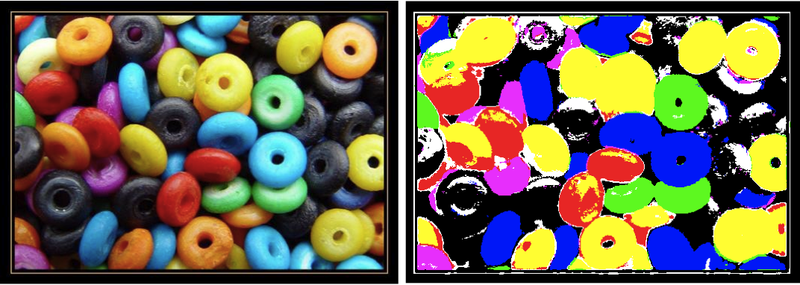
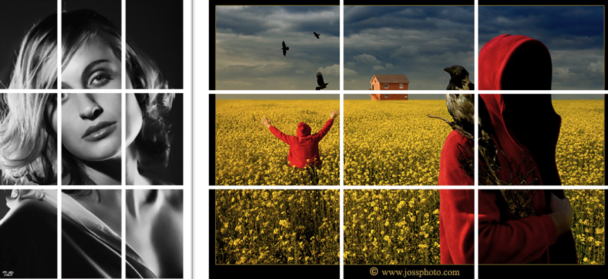

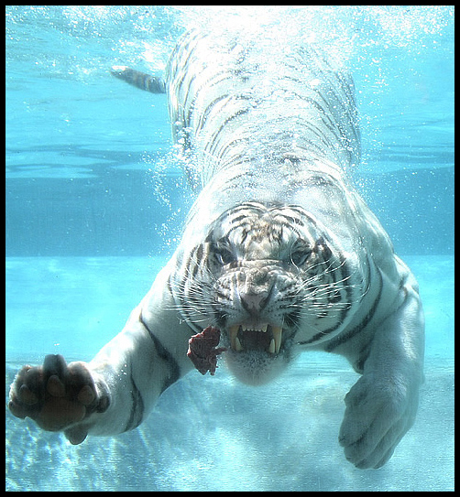
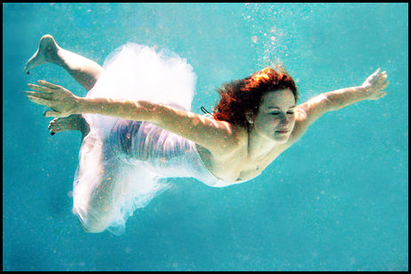
Feature extraction
Color
Texture
Composition
Content

Slide 9
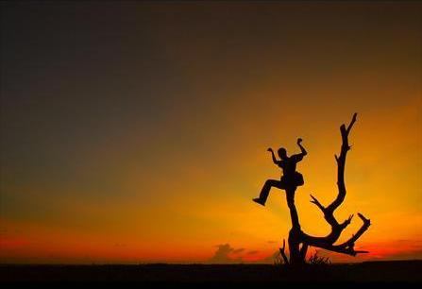
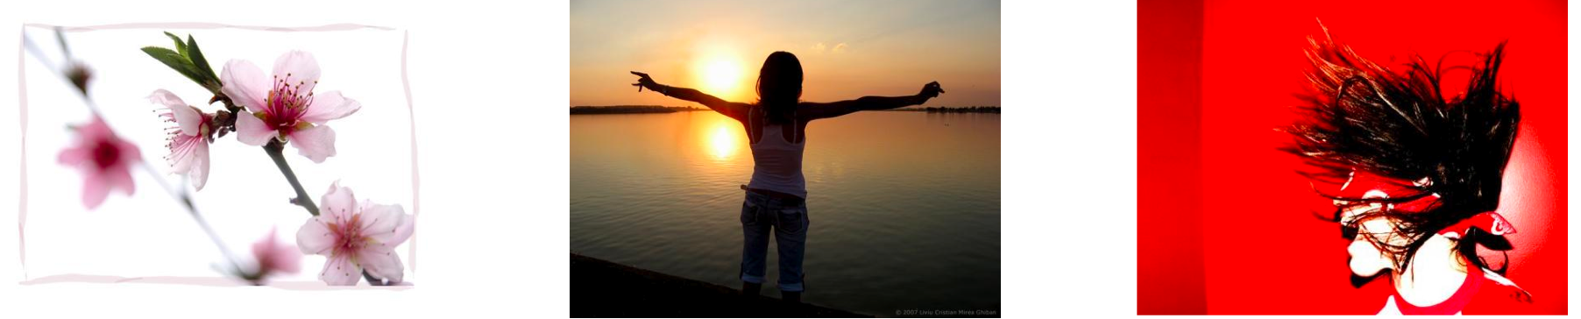
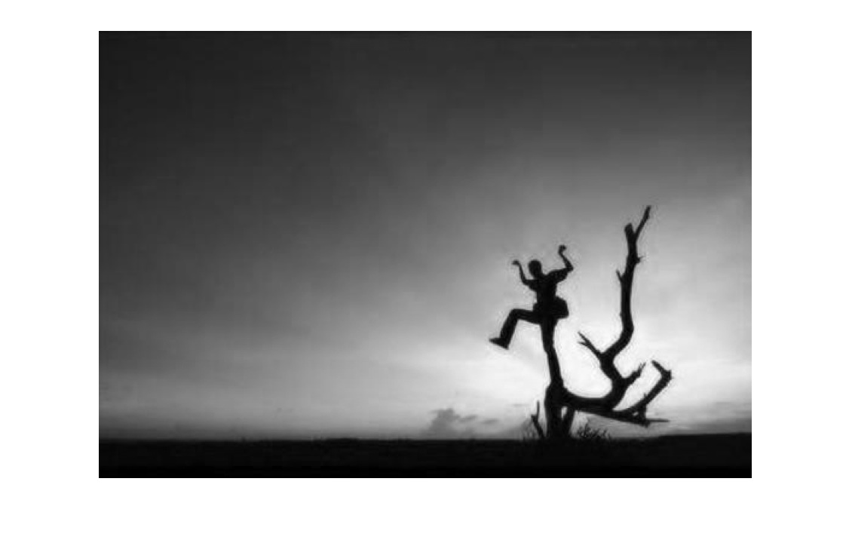
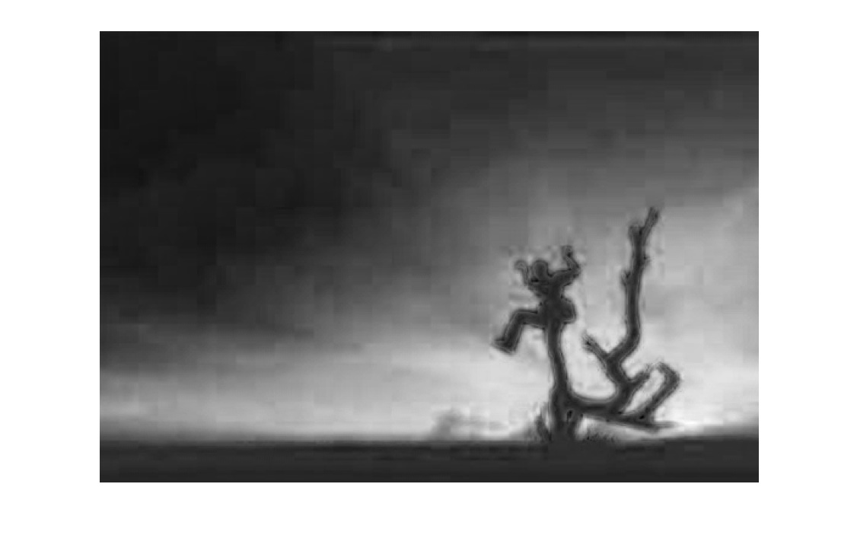
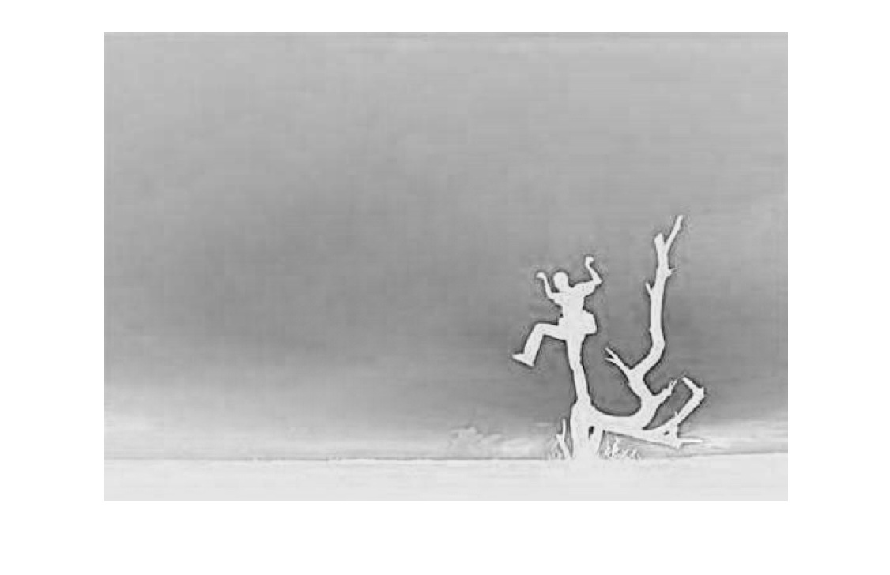
Color Features
Pleasure
Arousal
Dominance
Saturation and Brightness statistics
+ Arousal, Pleasure, Dominance
Hue statistics
Vector based
Rule of thirds
Colorfulness
Color Names
Itten contrasts
Art theory
Affective color histogram by Wang Wei-ning, ICSMC 2006
Arousal: ascending

Slide 10
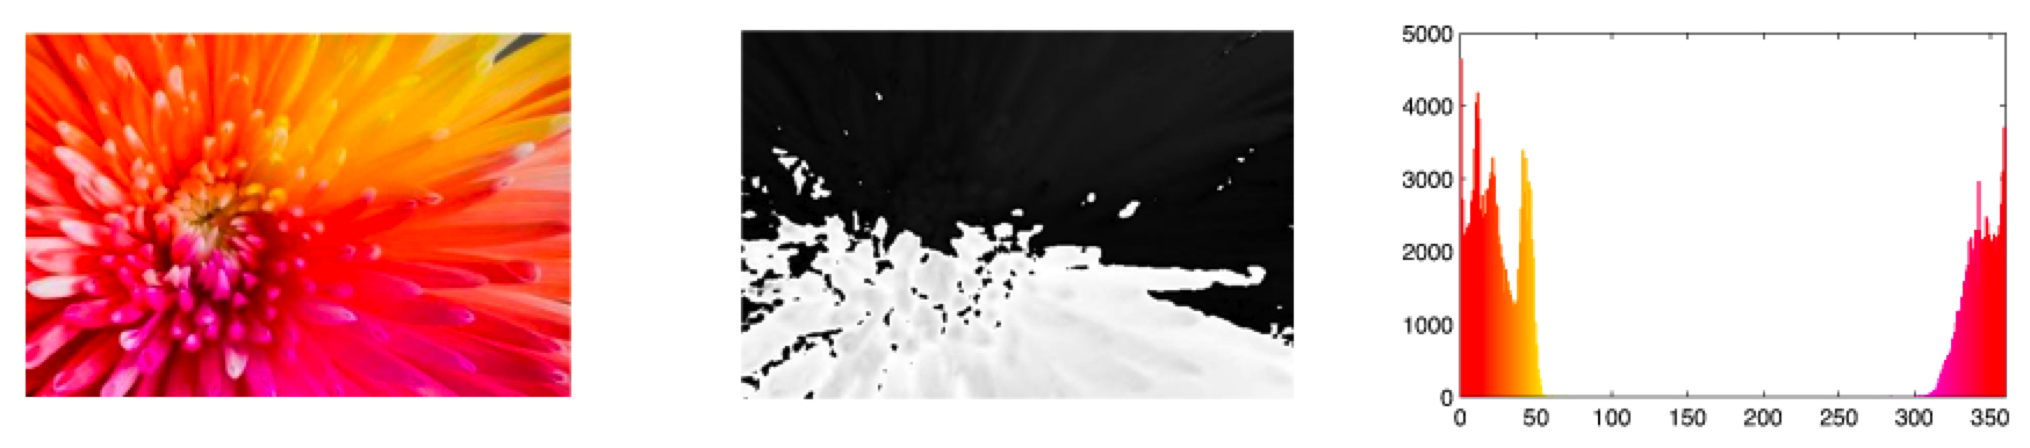
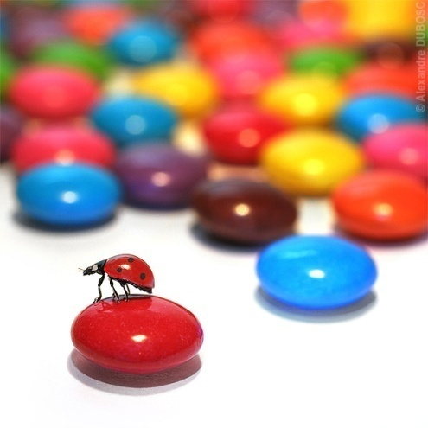
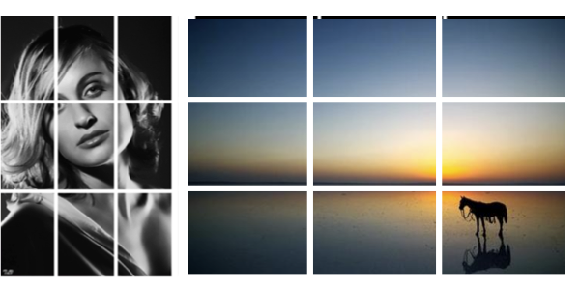
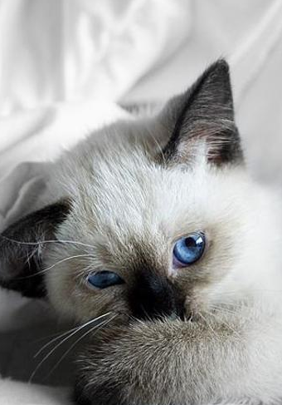
Color Features
Saturation and Brightness statistics
+ Arousal, Pleasure, Dominance
Hue statistics
Vector based
Rule of thirds
Colorfulness
Color Names
Itten contrasts
Art theory
Affective color histogram by Wang Wei-ning, ICSMC 2006
Arousal: ascending
original
Hue channel
Hue histogram

Slide 11

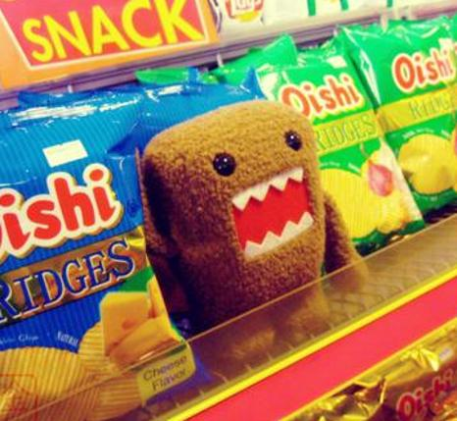
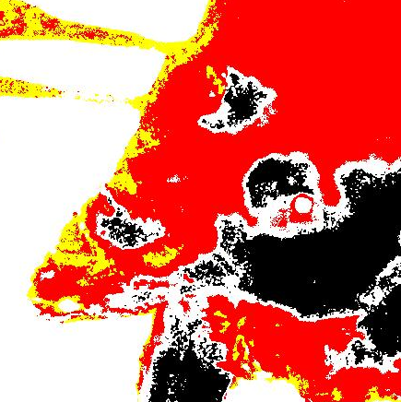
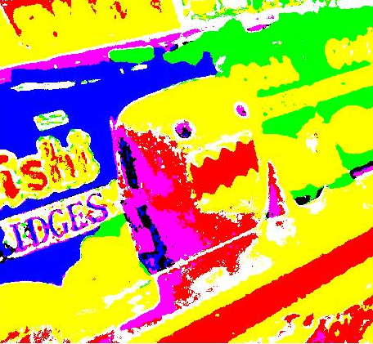

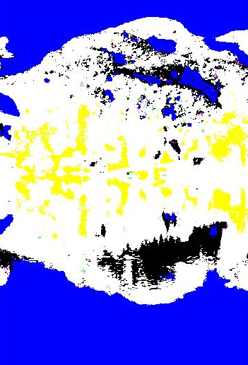
Color Features
Saturation and Brightness statistics
+ Arousal, Pleasure, Dominance
Hue statistics
Vector based
Rule of thirds
Colorfulness
Color Names
Itten contrasts
Art theory
Affective color histogram by Wang Wei-ning, ICSMC 2006

Slide 12

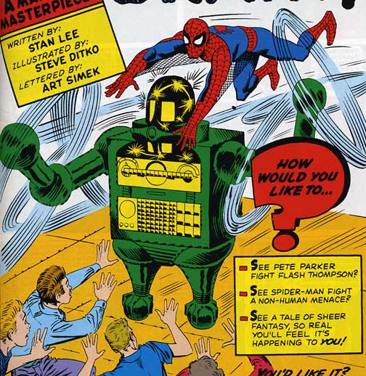

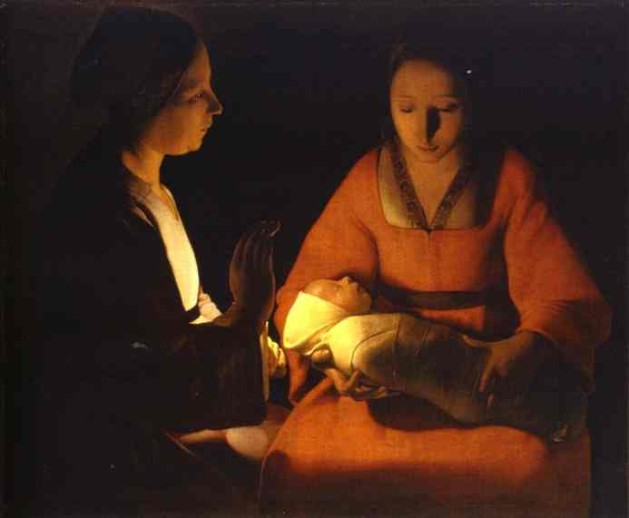
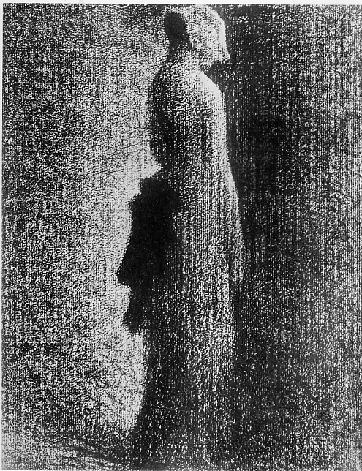

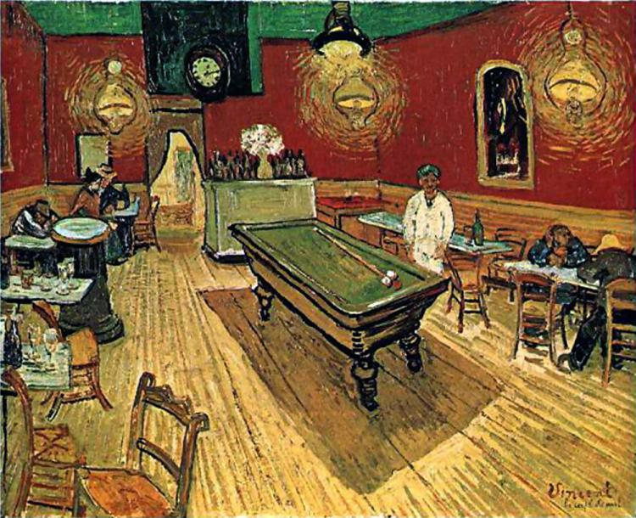

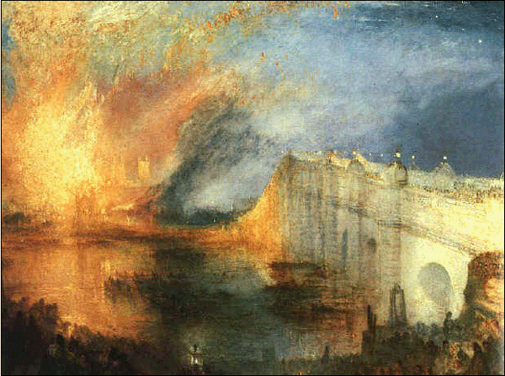


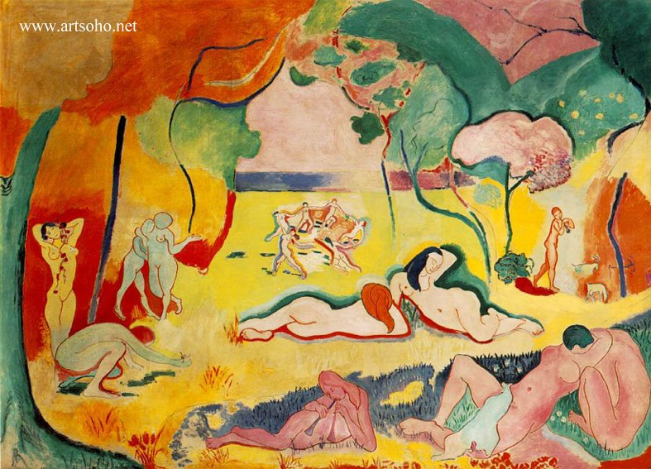
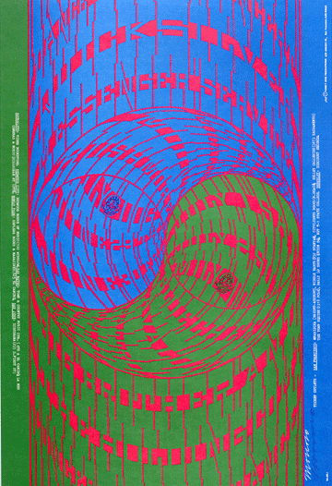

Color Features
Contrast of hue
Contrast of saturation
Contrast of light and dark
Contrast of complements
Contrast of warmth
Contrast of extension
Simultaneous contrast
Saturation and Brightness statistics
+ Arousal, Pleasure, Dominance
Hue statistics
Vector based
Rule of thirds
Colorfulness
Color Names
Itten contrasts
Art theory
Affective color histogram by Wang Wei-ning, ICSMC 2006

Slide 13
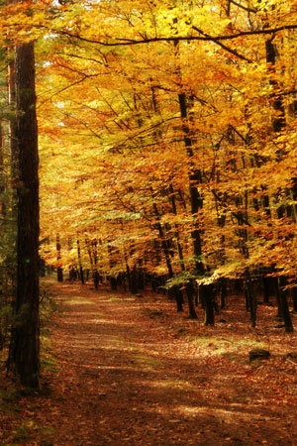
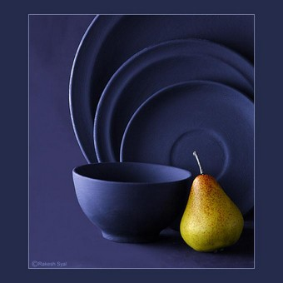
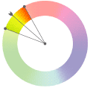
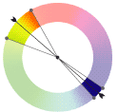
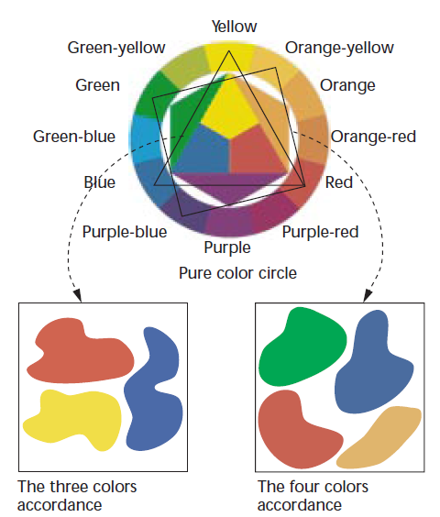
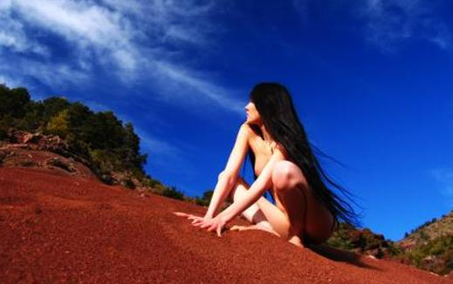
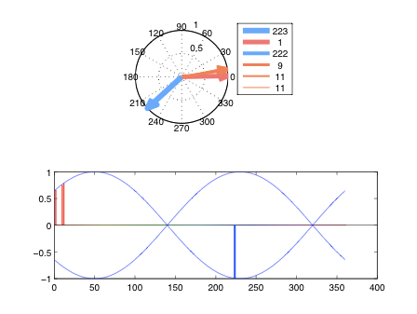
Color Features
Saturation and Brightness statistics
+ Arousal, Pleasure, Dominance
Hue statistics
Vector based
Rule of thirds
Colorfulness
Color Names
Itten contrasts
Art theory
Affective color histogram by Wang Wei-ning, ICSMC 2006
warm
cold

Slide 14
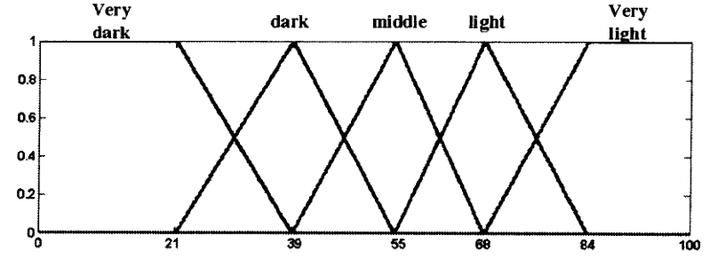
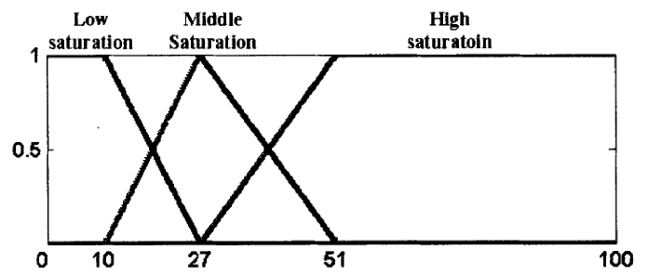
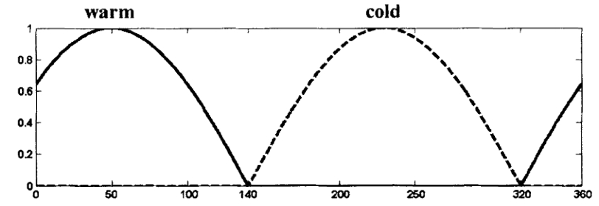
Color Features
Saturation and Brightness statistics
+ Arousal, Pleasure, Dominance
Hue statistics
Vector based
Rule of thirds
Colorfulness
Color Names
Itten contrasts
Art theory
Affective color histogram by Wang Wei-ning, ICSMC 2006

Slide 15
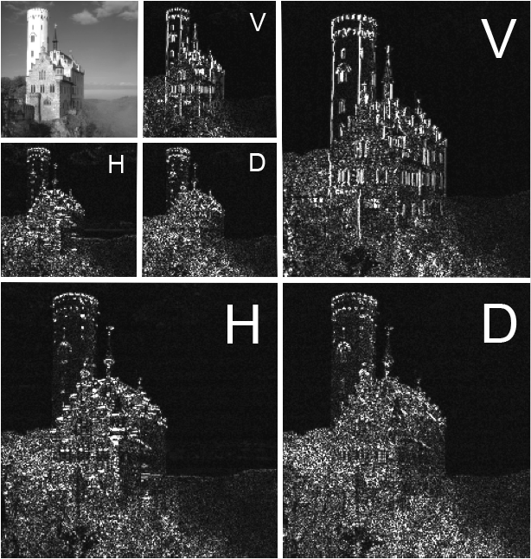
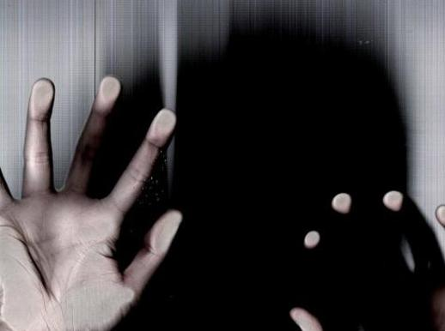
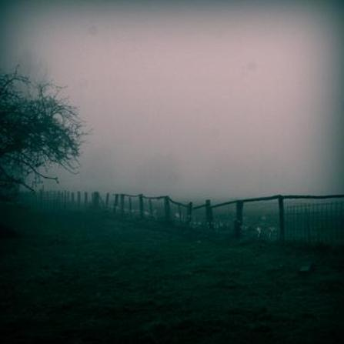
Texture Features
Wavelet-based
Daubechies wavelet transform
Tamura features
Coarseness
Contrast
Directionality
Gray-Level-Co-occurrence Matrix (GLCM)
Contrast
Correlation
Energy
Homogeneity

Slide 16
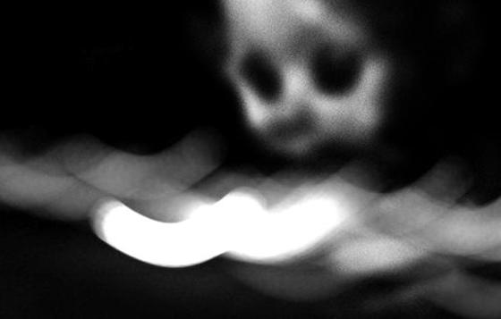
Texture Features
Wavelet-based
Daubechies wavelet transform
Tamura features
Coarseness
Contrast
Directionality
Gray-Level-Co-occurrence Matrix (GLCM)
Contrast
Correlation
Energy
Homogeneity

Slide 17





Composition Features
Level of Detail
Low Depth of Field
Dynamics
Level of Detail: original
segmented
Low Depth of Field Indicator

Slide 18




Content Features
Human Faces
Viola-Jones frontal face detection
Skin

Slide 19



Dataset 1
IAPS – International Affective Picture System
369 general, “documentary style” photos, covering various scenes
e.g. insects, puppies, children, poverty, diseases, portraits, etc.
Rated with affective words in psychological study with 60 participants
Notes:
IAPS - Collection of standardized emotional images

Slide 20



Dataset 2
„Art“ photos from an art-sharing web-site
„art“ = images with intentional expression & conscious use of design
Artists use tricks (or follow guidelines) to create the proper atmosphere of their images
Data set assembled by searching for images with emotion words in image title or keywords/tags
Images are from the art-sharing web community deviantArt.com
807 images
Notes:
IAPS - Collection of standardized emotional images

Slide 21



Dataset 3
Abstract paintings
How do we perceive/rate images without semantic context?
Peer rated through a web-interface
280 images rated by ~230 people
20 images per session
Each image rated ~14 x

Slide 22


Web survey

Slide 23
Experiments

Slide 24

Feature selection

Slide 25

Results
Ground truth
Results of study
Artist‘s labels
Web votes
Feature selection results in paper
Compare resutls with Yanulevskaya, ICIP 2008
Evaluation
Unbiased correct rate
Mean of the true positives per class for all categories
Notes:
Best features

Slide 26

All data sets

Slide 27

Classifier vs. human?
Abstract paintings
Humans don’t agree on category either…

Slide 28
Conclusions
Emotion-specific features make sense
Abstract paintings survey shows that even humans are unsure about emotion without context
www.imageemotion.org
Future work
look for other, better or fine-tuning of features and classification algorithms (e.g. more context features (e.g. grin detection), saliency based local features, etc.),..
More (bigger) labeled image sets (ground truth)
Other types of “classification”
“emotion distribution”
Notes:
Make datasets available…

Slide 29



Slide 30



Thank you!
Reference: Wang Wei-ning, Jiang Sheng-ming, Yu Ying-lin. Image retrieval by emotional se- mantics: A study of emotional space and feature extraction. IEEE International Conference on Systems, Man and Cybernetics, 4(Issue 8-11):3534 – 3539, Oct. 2006.
V. Yanulevskaya, J. C. van Gemert, K. Roth, A. K. Herbold, N. Sebe, and J. M. Geusebroek. Emotional valence categorization using holistic image features. In IEEE International Conference on Image Processing, 2008.

