Slide 1
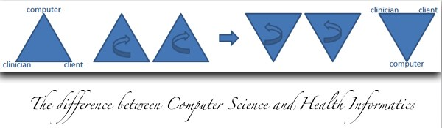
The Usability (or not) of Health Informatics Standards
Stephen Kay
MSc PhD FACMI FBCS CITP

Slide 2
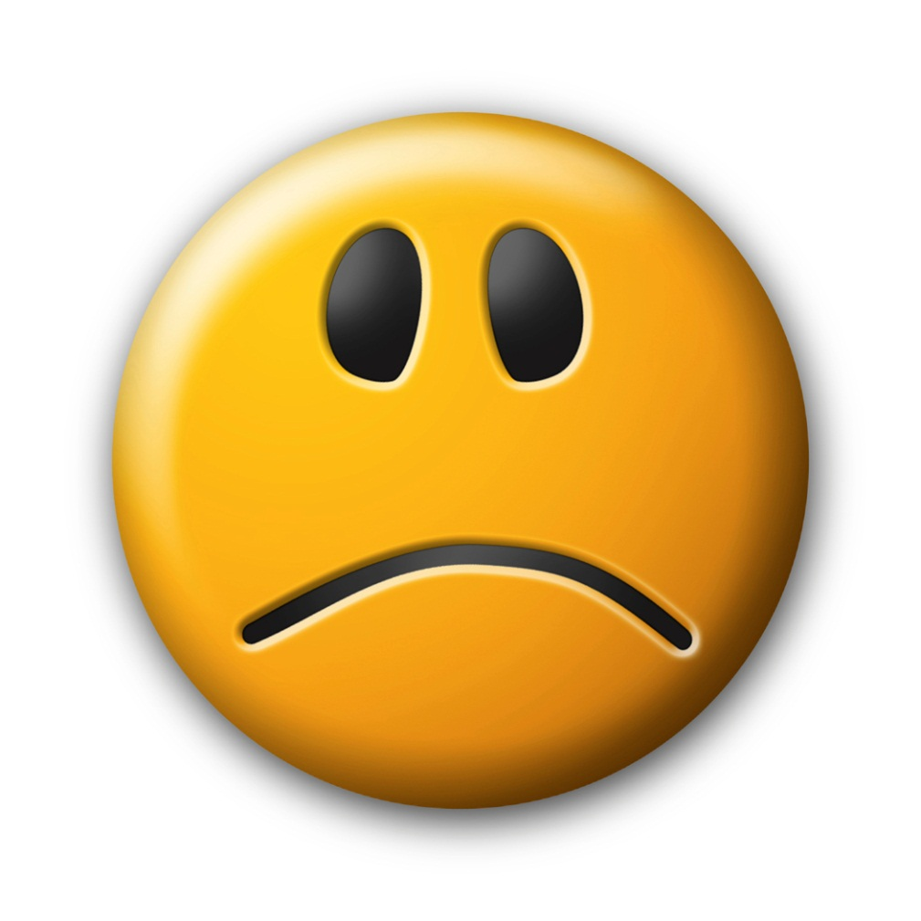
Imagine what life would be like if…
Yet, in Healthcare…
…credit cards were different sizes?
…light bulbs didn't fit into lamps?
…railway lines were different widths?
…microwave ovens emitted large amounts of harmful radiation?
… records had different structures & semantics?
… clinical systems were functionally incompatible?
… different interchange capabilities existed?
… systems were designed without appropriate patient safety standards?
…

Slide 3
Not, “Why do you care?” But perhaps more, “Why does no else seem to care?”

Slide 4

Always look on the bright side …

Slide 5
Reality shows and the blame culture begins.
Select from the following: (you may choose more than one)
Complex, different and distinct domain
Evaluation not systemised
Organisational culture is problematic
Research required
Simply hard
Technology not up to the challenge
Technical staff are comparatively poor
Users are unavailable, techno-phobic and/or resistant
Under resourced
Unique
HI
apologists

Slide 6

Aspirations cloud the horizon…
“The answer is…”
The silver bullets of EMR, EHR, PHR…
By David Goldman, CNNMoney.com staff writer
January 12, 2009: 4:05 AM ET
President-elect Barack Obama, as part of the effort to revive the economy, has proposed a massive effort to modernize health care by making all health records standardized and electronic.
Here's the audacious plan: Computerize all health records within five years. The quality of health care for all Americans gets a big boost, and costs decline.
Sounds good. But it won't be easy.

Slide 7
Aspirations cloud the horizon…
Too simplistic to say “The answer is…”
The silver bullets of EMR, EHR, PHR…
‘instant results’ are available
The promise of Google Health…
Jun 27 2011
Google Inc. announced that its PHR service will be retired on Jan. 1, 2012. A senior product manager for Google Health, said the product has not achieved the “broad impact” … hoped. Though “tech-savvy patients and their caregivers, and more recently fitness and wellness enthusiasts” have been using Google Health, the company could not “translate that limited usage into widespread adoption”

Slide 8
Aspirations cloud the horizon…
Dr Anthony Nowlan, described the programme as “back to front”, He pointed out the sheer absurdity of a consensus document produced by the programme stating:
“Now that the architecture for England has been commissioned, designed and is being built, there is a need for clarity concerning how it will be used”….
From a speech by Mr Richard Bacon MP entitled ‘How can we stop computer disasters?’ Public Accounts Committee, 29th June 2011
Too simplistic to say “The answer is…”
The silver bullets of EMR, EHR, PHR…
Too naive to expect nothing but ‘instant results’
The demise of Google Health…
‘engagement and participation’ will turn it all around
The English NHS National Programme for IT

Slide 9
Aspirations cloud the horizon…
Too simplistic to say “The answer is…”
The silver bullets of EMR, EHR, PHR…
Too naive to expect nothing but ‘instant results’
The promise of Google Health…
Too easy to assume that ‘engagement and participation’ will turn it all around
The English NHS National Programme for IT

Slide 10
Standards are…
Not, and can never be THE Solution…
Not a cheap, quick-fix…
1st Electronic Health Record Architecture, circa 1990
1995 ENV 12265
2000 EN 13606; parts 1-4
2011 ISO/EN 13606 ; parts 1-5
2012 planned systematic review and 1st revision of current standard
"In all affairs it's a healthy thing to hang a question mark on the things you have long taken for granted." – Bertrand Russell
So, are HI Standards of value?
How can we show, tell or even know?

Slide 11
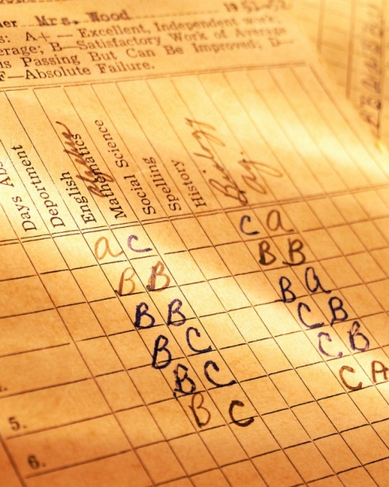
Critics of HI Standardisation
The time the process takes to complete vis a vis the rapid change in technology;
The duplication, over-lapping and contradictory outputs from standard development organisations (SDOs);
The distance from the consumer.
And they say…
"The nice thing about standards is there are so many of them,” &
"When you’ve seen one implementation of standard 'x’, then you have just seen one implementation.”
Interoperability Review: Why have Information Models in Health Informatics Standards?
May/June 2010
Vol. 1 No. 1
Contributed by Stephen Kay, PhD, FBCS, FACMI
http://www.amia.org/news-and-publications/volume-1-number-1

Slide 12

Answering Critics …
Reviewing SDO structures & processes nearing completion
Establishment of the Joint Initiative Council comprising: CDISC, CEN, GS1, HL7, IHTSDO, ISO
http://www.jointinitiativecouncil.org/
However, reducing the distance from the Developer of the standards to the Consumer is proving to be challenging…
Consider IHTSDO and the SNOMED CT standard…

Slide 13

Value Proposition
A value proposition is a promise of value to be delivered and a belief from the customer of value that will be experienced

Slide 14
Value Proposition of IHTSDO: SNOMED CT
“The delivery of a standard clinical terminology for use across the world's health information systems can make a significant contribution towards improving the quality and safety of healthcare…
…
Ultimately, patients will benefit from the use of SNOMED CT to more clearly describe and accurately record their care, in building and facilitating better communication and interoperability in electronic health record exchange, and in creating systems that support health care decision making.”
www.ihtsdo.org August 2011

Slide 15
CAP STS
“Our Value Proposition/Mission Statement— What We Can Offer You
Are patient safety, clinical/operational efficiency, reimbursement, data sharing and compliance important to you?
SNOMED Terminology Solutions (STS) develops solutions for customers around the world that maximize results in these critical areas.
Let STS show you how to improve your organization’s use of a controlled medical vocabulary (CMV) and to achieve what is important through semantic interoperability for your electronic health record (EHR) and other health information technology systems.”
www.cap.org/ Aug 2011

Slide 16
Usability & Standardisation
SDOs are under increasing pressure to show their value to the market; IHTSDO has deployed the ‘value proposition’
The value proposition is explicitly a positioning of value from the customer’s perspective.
Usability is not just about the end-products’ ease of use, but also the process used to achieve it.
A case of ‘Physician heal yourself’?

Slide 17
Usability is…
“the extent to which a product can be used by specified users to achieve specified goals with effectiveness, efficiency and satisfaction in a specified context of use”
ISO 9241
Usability includes methods of measuring usability, e.g.
Needs analysis, focusing upon the human elements of the requirements, its main purpose is the user's satisfaction.
The study of the principles behind an object's perceived efficiency or elegance.
Usability embraces usefulness and therefore is also about methods for improving ‘ease of use’ throughout the design process, e.g. specification, UCD, user testing, implementation.

Slide 18
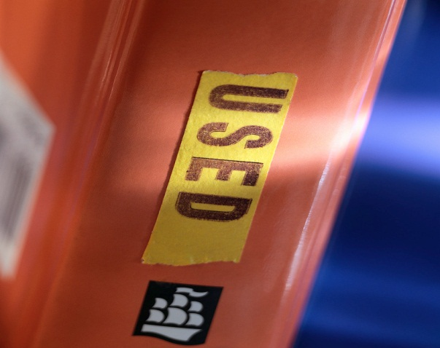
More generally…
What evidence is there to substantiate the value proposition of HI Standards? Customer satisfaction?
A standard means "something that is generally accepted".
Begs the questions, “accepted by ‘who’?”
And “how”?
More specifically,
are HI standards
Needed?
Usable?
Useful?
Bottom line: Do they do what users’ need?

Slide 19


The user in CEN TC251 and ISO TC215
The ‘users’ are representatives and experts from organizations with a vested interest in the standard…
but not usually the ‘clinician’ and not the ‘patient’, although often these are the ultimate consumers.
It is assumed that the standards’ makers have drawn upon such input to understand needs and to establish requirements before the process is formally launched.

Slide 20

Alas poor User, I knew him well.
‘Needed’ is for others to answer…
Not so for ‘usability’ ... usefulness and user satisfaction must be the concern of SDOs
Discussion
Draft
Comments
Versions
Publication
users
Post Publication
Formative evaluation…
Summative evaluation…

Slide 21

Life Cycles
To publish is an end point for some
Implementation is assumed
Typically maintenance takes the form of a ‘systematic review’ after a relatively brief period of time…
If not supported then dropped…
‘sun setting’

Slide 22
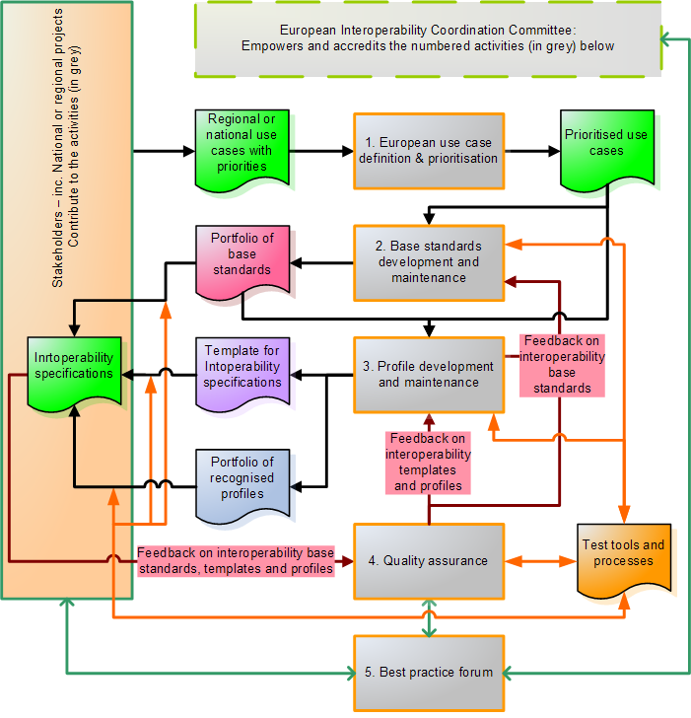
Best Practice
The feedback loop for the majority of HI standards today is not supported…
*Figure from the Interop report,
http://www.ehealth-interop.nen.nl/

Slide 23
Re-enter the Value Proposition
The value proposition is also a positioning of value from the customer’s perspective, where
Value = Benefits - Cost (cost includes risk)
The effectiveness of the value proposition depends on gathering real customer feedback…

Slide 24
That Check-list again…
Select from the following: (you may choose more than one)
Complex, different and distinct domain
Evaluation not systemised
Organisational culture is problematic
Research required
Simply hard
Technology not up to the challenge
Technical staff are comparatively poor
Users are unavailable, techno-phobic and/or resistant
Under resourced
Unique
HI
apologists

Slide 25

Perhaps there is a bright side…
We need to look outside of our traditional areas:
In social sciences, including economics, a standard is useful if it is a solution to a coordination problem: it emerges from situations in which all parties can realize mutual gains, but only by making mutually consistent decisions.
The value proposition is from the Marketing and Sales domain and is a business tool about belief, selling and convincing…
We need to revisit old friends…
Usability refocuses the attention back to the users’ role and to the principles behind specification.
Aspirations are not always doomed… but do take time to realise!
Cf. patient-centric rather than disease-centric healthcare!

Slide 26

Imagine what life would be like if…
… records had different structures & semantics?
… clinical systems were functionally incompatible?
… different interchange capabilities existed?
… systems were designed without appropriate patient safety standards?
there are no HI standards
… “its easy if you try.”
But, seriously, is that what the users’ need?

Slide 27
In Summary
SDOs need to consider what usability means for their business.
The proponents of HI standardisation need to make people believe again that it can make a contribution to healthcare and to the quality of a person’s life.
Or to put it another way, to convince them, by evidence this time, that its benefits significantly outweigh the costs and risks of unusable or non-existent standards.

Slide 28
Thank you for listening
Stephen Kay
The Health Informatics Standards Consultancy
www.histandards.eu
computer
clinician
client
clinician
client
computer

