Slide 1
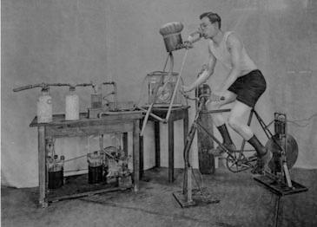
A Brief History of Endurance Testing in Athletes
Stephen Seiler
Faculty of Health and Sport Sciences University of Agder
Kristiansand, Norway
Notes:
This presentation was originally given in November, 2010 at the Norwegian Sports Medicine federation’s annual meeting. As part of the organizing committee, I had invited Professor Frank Katch to give a lecture with this same title, but he had to bow out in October due to a serious family health issue. So, the task fell to me to create and deliver this lecture. Dr. Katch can therefore not be faulted for any weaknesses in the content (or delivery), but he should be warmly acknowledged for contributing his thoughts on the topic as I prepared the talk, as well as some nice pictures from his textbook.
This presentation represents on the one hand a compromise between the demand for brevity and flow that a brief lecture requires, and the completeness that a historical treatment deserves on the other. I chose to focus on a very specific part of the history of endurance/fitness testing and that is some key history that traces forward to our current “best practice” model for the physiological testing of endurance athletes. This presentation is a narrow aspect of a rich history related to fitness assessment and testing. The reader interested in a broader historical sweep of the development of physical fitness testing is directed to the wonderful introduction material in McArdle Katch & Katch’s Exercise Physiology text (mine is the 7th edition version).

Slide 2
Two historical roads to modern endurance testing
1. Using exercising athletes to better understand human physiology
2. Using human physiology to better understand how to train athletes
Notes:
As Professor Katch and I agreed in early exchanges, most exercise physiologists find themselves in one or both of two basic research situations involving the physiological testing of athletes during exercise. Historically, we have often used athletes to better understand key questions in work physiology. And, of course, we use human physiology to attempt to better understand the training process and make connections between methods and mechanisms.

Slide 3
Endurance Capacity Model
Endurance Performance Power
Maximal oxygen consumption
(VO₂max)
Fractional utilization
(LT/VT/MLSS)
Work efficiency
(power per VO₂)
Anaerobic Capacity
Notes:
Together these two roads have led us to a model of endurance capacity that has gained strong acceptance in the international exercise physiology community. So I have chosen to frame my short presentation of the historical pathway to the laboratory based testing of endurance athletes around this model and what I believe to be key events or publications that contributed to its stepwise development and acceptance.
Abreviations:
LT: Lactate Threshold
VT: Ventilatory Threshold
MLSS: Maximal Lactate Steady State (velocity or power)
The following are examples of references discussing this basic three-determinant physiological model for endurance performance.
Coyle EF and Joyner M. Endurance exercise performance: the physiology of champions. Journal of Physiology 586, 35-44, 2008.
Coyle EF et al. Determinants of endurance in well-trained cyclists. Journal of Applied Physiology 64, 2622-2630, 1988.
Hagberg JA and Coyle EF. Physiological determinants of endurance performance as studied in competitive racewalkers. Medicine and Science in Sports and Exercise 5, 287-289, 1983

Slide 4
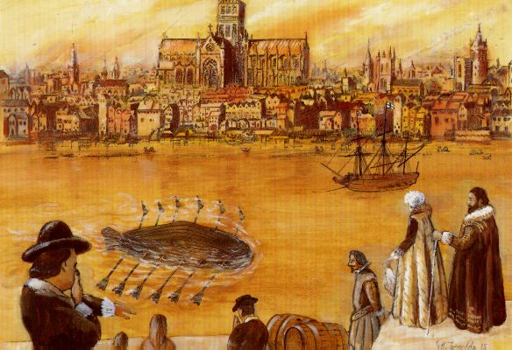
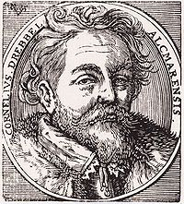
The very, very beginning?
Cornelius Drebbel
1572-1633
Dutchman who built a submarine that rowed up the Thames in 1621 and stayed
underwater for up to 3 hours. Probably used oxygen generated by burning potassium
nitrate to keep rowers from becoming hypoxic during exercise.
Notes:
At the heart of endurance performance is oxygen and the body’s dependence on it. So, perhaps the very, very beginning of the endurance testing saga can be traced to the Thames river in 1621. There, it seems that Cornelius Drebbel made the link between the gas later named oxygen and work capacity, whether he understood it or not.

Slide 5
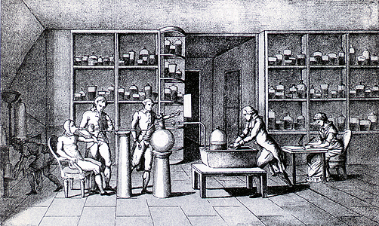
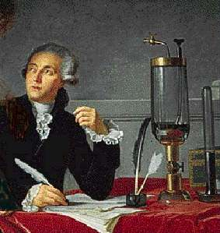
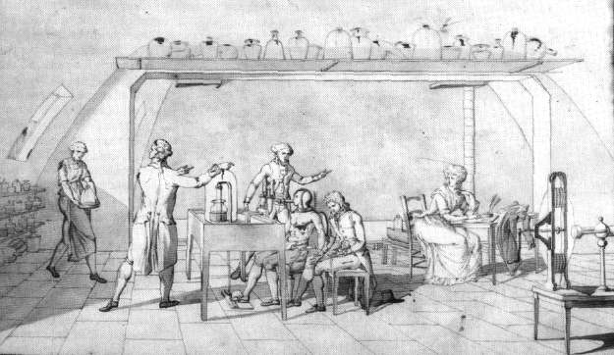
First “laboratory exercise test”?
Breathing mask
Oxygen recovery system
Foot pedal
Antoine Lavoisier (1743-1794)
Measured increased consumption of “vital air” during sustained exercise
Photos and labels courtesy of Prof. Frank Katch
Notes:
But it seems to be Antoine Lavoisier that first made a systematic attempt to link muscular work to the utilization of an invisible, but measureable substance he named ”vital air”, only later to be identified by Joseph Priestly and named oxygen. The picture above depicts a laboratory situation where muscular work could be performed on a foot pedal, and expired gasses collected. So, the two key ingredients of modern laboratory testing of endurance athletes were there at a rudimentary level: ergometry and the measurement of metabolic responses using gas exchange.
Lavoisier later was beheaded in the French revolution, apparently for being too smart.

Slide 6
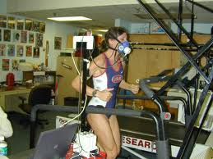
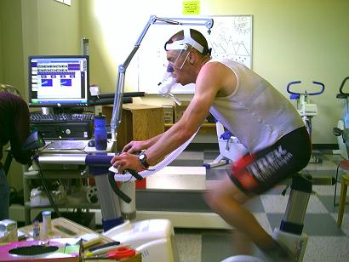
Key elements of the endurance testing evolution
Physiological limitations and connections revealed
Devices developed to apply measurable workloads-ergometry
Instruments developed for practical, valid physiological measurements
Notes:
But, it would be more than 100 years later that 3 elements began to come together to drive the evolution of our current approach to endurance testing that has taken root internationally.
ADDITIONAL NOTES:
The normal laboratory model makes some assumptions about the physiological limitations to endurance performance. These are well founded in the exercise physiology literature, but a detailed critique of the mechanistic support base is beyond the scope of this presentation. One important assumption of typical laboratory testing is that under normal testing conditions (well hydrated athlete , temperature controlled environment, relatively short testing time, etc.), the athlete is able to mobilize maximal capacity (if called for in the test) and is NOT limited by the brain’s ability to mobilize muscular work.
This is an important assumption that may not be true during all tests, and may not be totally relevant to the conditions of competition with respect to event duration, environmental conditions, etc.
Laboratory testing is designed to maximize internal validity and reproducibility. This can come at the expense of external validity, particularly when event conditions move well outside of normal laboratory parameters in different ways.

Slide 7

Sweden
USA
England
Denmark
Role mouse pointer over
dots for links to other interesting
articles about labs and people
highlighted in this presentation
Notes:
Scientists in Sweden, Denmark, the USA, and England were important contributors in the development of the current laboratory model of endurance capacity profiling
Highlighted laboratories represented by the dots (Scroll over a dot in the presentation for a link to the lab or more information) are:
Gymnastikk Høchskolen and Karolinska Institutt (2 dots, so one is out of position) in Stockholm, Sweden
Harvard Fatigue Laboratory, Boston Mass.; Laboratory of Physiological Hygiene, U. of Minnesota; Stanford and UCLA in California (Wasserman, Beaver)
Cambridge University, Cambridge, England (2 dots here also)
Krogh Laboratory, Copenhagen Denmark

Slide 8
Maximal oxygen consumption
Endurance Performance Power
Maximal oxygen consumption
(VO₂max)
Fractional utilization
(LT/VT/MLSS)
Work efficiency
(power per VO₂)
Anaerobic capacity
Notes:
The first component of the endurance model to be revealed by systematic testing was the maximal oxygen consumption. Some references related to maximal oxygen consumption and discussion regarding mechanisms and limitations are listed below:
Saltin B and Strange S. Maximal oxygen uptake: "old" and "new" arguments for a cardiovascular limitation. Med. Sci Sports Exerc. 24(1)30-37, 1992.
Basset BR & Howley ET. Maximal oxygen uptake: "classical" versus"contemporary" viewpoints. Med. Sci Sports Exerc. 29(5):591-603, 1997.
Hawkins et al. Maximal Oxygen Uptake as a Parametric Measure of Cardiorespiratory Capacity. Med. Sci Sports Exerc. 39(1):103-107, 2007.
Levine B. VO2max: what do we know, and what do we still need to know? J. Physiol. 586(1):25-34, 2008.
I also include here some references to the “central governor hypothesis” which Noakes has championed. This hypothesis represents perhaps the key “opposition” to the widely accepted endurance performance model. The references below will open the door to this line of discussion for the interested reader.
5. Noakes TD. Maximal oxygen uptake: "classical" versus "contemporary" view-points: a rebuttal. Med. Sci. Sports Exerc., Vol. 30, No. 9, pp. 1381-1398, 1998.
6. Weir et al. Is fatigue all in your head? A critical review of the central governor model. British J. Sports Med. 40(7):573-86; discussion 586], 2006.
7. Noakes T & Marino F. Point:Counterpoint: Maximal oxygen uptake is/is not limited by a central nervous system governor. J Appl Physiol 106: 338–342, 2009
8. Hopkins WG. The Improbable Central Governor of Maximal Endurance Performance. Sport science 2009 http://www.sportsci.org/2009/wghgov.htm

Slide 9
Stroke volume comes into focus
“The stroke volume of the heart is….the most important quantitative function of the whole body…. ….for the amplitude of the heart’s volume change multiplied by the pulse rate gives the total volume of arterial blood supplied to the entire body”. Yandell Henderson, 1923 Yale University physiologist
Q = HR x SV
Notes:
Already in 1923, Yandell Henderson identified the stroke volume of the heart as critical to physical capacity.

Slide 10
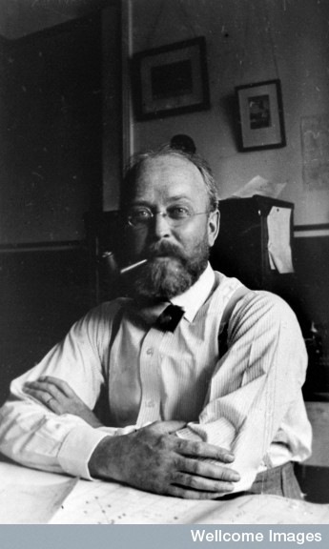
Connecting cardio-pulmonary function to muscular work
”….the lungs, heart and circulation should be thought of as a single apparatus for the transfer of oxygen and carbon dioxide between the atmosphere and the working tissues.”
Lawrence J. Henderson, 1929
founder of the Harvard Fatigue Laboratory
Notes:
In chemistry, LJ Henderson is best known for his contribution to our understanding acid-base chemistry and the Henderson-Hasselbalch equation, but for exercise scientists his place in history is forever linked to his role as founder of the Harvard Fatigue Laboratory in 1927.

Slide 11
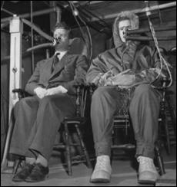
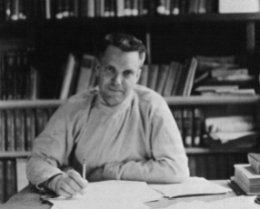
The Harvard Fatigue Lab 1927-1947
Established by the Harvard Business School at a time when human factors in industrial factories was a major interest.
Performed wartime research on nutrition and environmental factors.
Exercise was one of several stresses such as heat and high altitude that were studied.
Over 350 publications, but greatest contribution was a generation of “exercise physiologists” who built up research programs all over the United States and Europe.
David Bruce Dill
Notes:
Not only did LJ Henderson anticipate our modern view of cardiopulmonary testing but also started the Harvard Fatigue Laboratory, a laboratory that had a lasting impact on exercise physiology in the United States and Europe through the many talented scientists who left there to establish other laboratories.

Slide 12
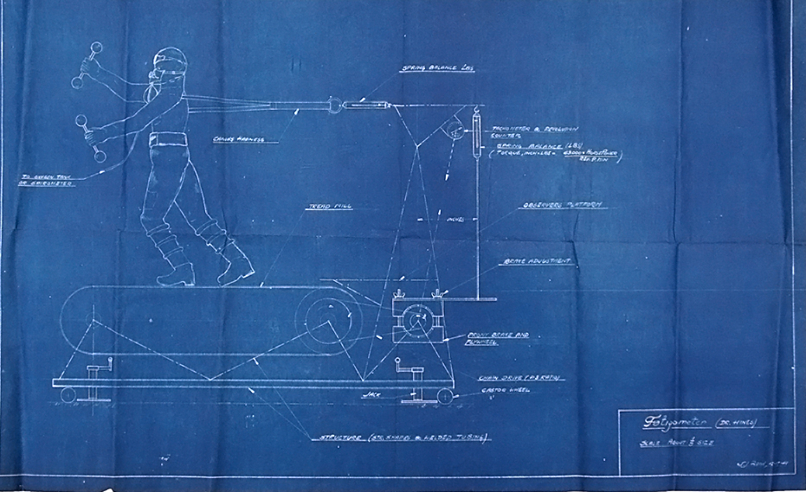
“Fatigometer” Harvard Fatigue Lab
Notes:
This drawing from the HFL depicts a ”fatigometer” (lower right corner) and demonstrates the fundamental challenge of applying measureable work loads to exercising humans while measuring metabolic and other physiological responses. Much of the focus at the HFL went towards military oriented research in the time around WWII. Sadly, already in 1946 after only about 20 years in existence, the HFL was closed when Harvard dropped its funding of the lab. But, their interest in measuring work accurately and the physiological responses associated with it moved us towards the modern work capacity testing laboratory that is common today.

Slide 13
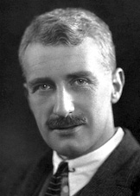
”The VO2max” is born (1923-25)
Demonstrated that oxygen uptake increased linearly with running speed, but eventually….”reaches a maximum beyond which no effort can drive it.”
Archibald Vivian (AV) Hill
1886-1977
Notes:
At about the same time, Nobel Prize winner AV Hill from Cambridge found time in his various physiological studies to propose the concept of the VO₂max that remains fundamental to our understanding of endurance performance limitations today. But it is important to recall that at the time of this discovery, subjects would perform running tests at a single running speed each day and that data would be accumulated over several days to construct the VO2-workload relationship. It would take several decades before maximal VO2 testing would become systematic and practical.
Frank Katch wrote about AV Hill in his History Makers series some years ago. You can read that here:
http://www.sportsci.org/news/history/hill/hill.html

Slide 14
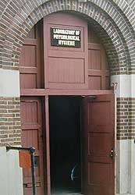
VO2max testing becomes standardized- 1955
Laboratory of Physiological Hygiene, University
of Minnesota. USA
“During the Second World War, this laboratory studied the relationships between performance in its broadest
sense and biological stress.”
Taylor, HL, Buskirk, E. and Henschel, A. Maximal oxygen intake as an objective measure of the cardiorespiratory performance. J. Applied Physiology 8:73-80, 1955.
Notes:
Most of the basics of performing valid VO2max tests was painstakingly determined by Henry Longstreet Taylor and coworkers over 12+ years at his lab at the U. of Minnesota. His classic paper from 1955 is a wonderfully entertaining read for any exercise physiology nerd and reveals a body of work that would fill an entire journal edition today. His subjects were generally military draftees who were conscientious objectors. Consequently, they were pretty much 100% at the laboratory’s disposal and lived and trained according to the protocols established by Taylor and colleagues.

Slide 15
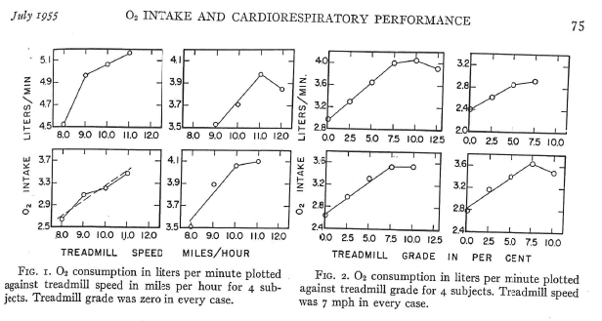
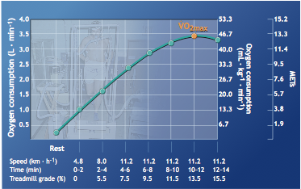
Taylor et al. findings:
Mouthpiece diameter- limitations on ventilation
Speed vs grade changes for eliciting VO₂ plateau on treadmill
Importance of warm-up
Temperature conditions- Not too hot
Test-retest reliability- Standard error of ~2.5%
Criteria for identification of a plateau in VO₂
Notes:
For example, Taylor was able to make 12 subjects exercise for 1 hour a day 6 days a week for one year while living on campus. He then performed repeated VO2max tests on them over the 12 month period to determine the reliability of his methods. The repeatability of those test results performed 55 years ago remains unsurpassed today.

Slide 16
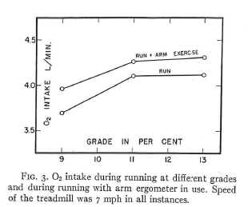
Legs only or arms+legs?
Taylor, HL, Buskirk, E. and Henschel, A. Maximal oxygen intake as an objective measure of the cardiorespiratory performance. J. Applied Physiology 8:73-80, 1955.
Notes:
One issue that Taylor et al.’s findings ultimately did NOT settle was the question of whether it was necessary to use both the arms and legs during maximal testing to elicit the maximal oxygen consumption. Put another way, they did not answer the fundamental question of whether VO2max was peripherally limited by the amount of active muscle mass, or centrally by oxygen delivery (or some combination of both depending on training status). They presented the data above that suggested that running alone was insufficient to elicit maximal mobilization of oxygen consumption.

Slide 17
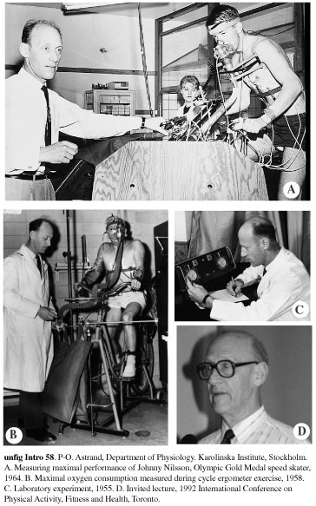
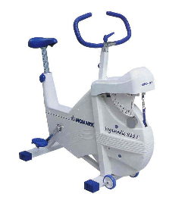
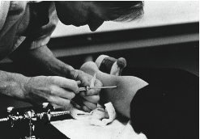
The Swedish Influence
GIH- Gymnastik och idrettshögskolan (founded 1813)
Karolinska Institute (founded 1810)
Integrated physiological and performance focus; dozens of classic studies published
Photo courtesy of Prof. Frank Katch
Notes:
That question brings us to Scandinavia, and specifically Sweden. You would be hard pressed to find two institutions that have had a more profound impact on exercise physiology, particularly the physiology of endurance performance, than The Swedish Sport University and Karolinska Institute, both of which are about 200 years old.

Slide 18
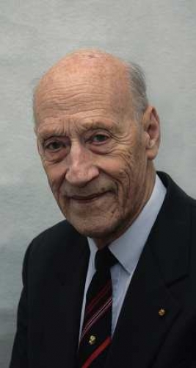
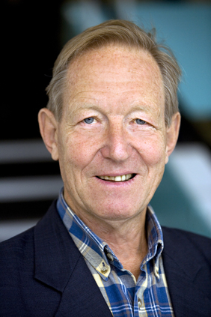
Per Åstrand & Bengt Saltin
Scientific Citations
as of Nov 2011*
Åstrand: 140+ publications
>6,000 citations
H factor 35
Saltin: 340+ publications
>21,000 citations
H factor 76
Photos provided courtesy of Prof. Frank Katch
Notes:
Arguably, the heart and soul of the Swedish contribution to this area resides in these two men. Per Åstrand for me will always be associated with the classic Textbook of Work Physiology he co-authored with Kaare Rodahl already in 1970. Their chapters on physical performance, evaluation of performance, and physical training were particularly influential. Saltin was a student of Åstrand initially, but of course went on to a brilliant career of his own and made contributions to the work of scientists across the northern hemisphere.
* The publication data used here is taken from Harzings Publish or Perish, which is based on Google Scholar data. This program can be downloaded for free here:
http://www.harzing.com/resources.htm

Slide 19
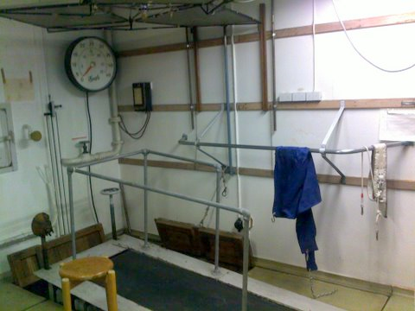
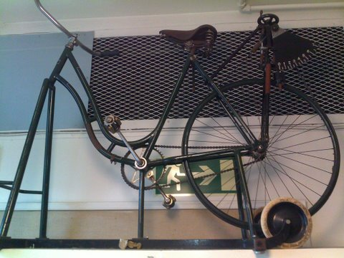
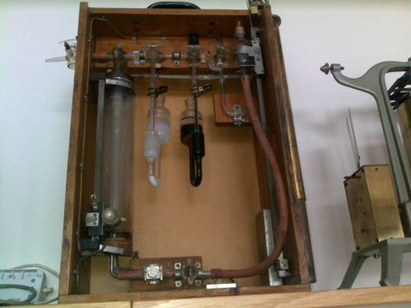
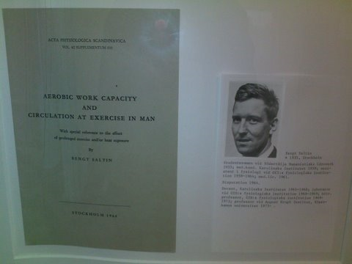
The Åstrand laboratory
The treadmill used in
early studies
The very first Monark
cycle ergometer
Scholander apparatus for
measuring oxygen
concentration in gas samples
A picture of the front cover of Bengt Saltin’s doctoral
dissertation. He was Åstrand’s first PhD student.
Notes:
These pictures were taken during a visit to The Swedish Sport University in March 2011, after the original presentation.

Slide 20
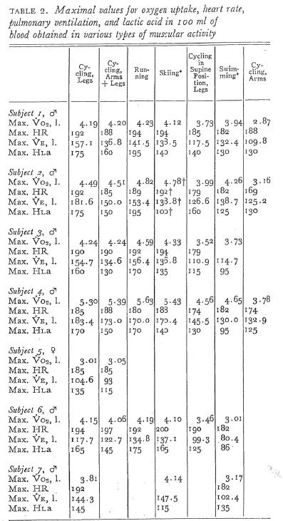
PO Åstrand & Bengt Saltin
Maximal oxygen uptake and heart rate
In various types of muscular activity
J. Appl. Physiol. 16(6):977-981, 1961
Demonstrated that running was sufficient to elicit the maximal oxygen consumption
Arms + legs did not further increase VO₂
Swimming or arms-only activity was insufficient to elicit VO2max
VO₂ peak concept born?
Notes:
What you see on the left of the screen is the individual data for all subjects performing maximal tests under up to 7 different conditions. This one table makes this paper a classic and a wonderful teaching resource. One of my favorite parts of this classic paper is the early discussion, where the authors admit a “disagreement” regarding what factors limited oxygen transport from air to tissue. Åstrand had favored a peripheral limitation (e.g. vascular bed in muscles, or venous return to the heart). Saltin proposed that heart pumping capacity was the actual limitation, based initially on the observation from the above data that oxygen uptake appeared to be independent of active muscle mass once a certain mass was exceeded. This question and related hypotheses would drive research for years to come. See slide 8 for more references on this issue.

Slide 21
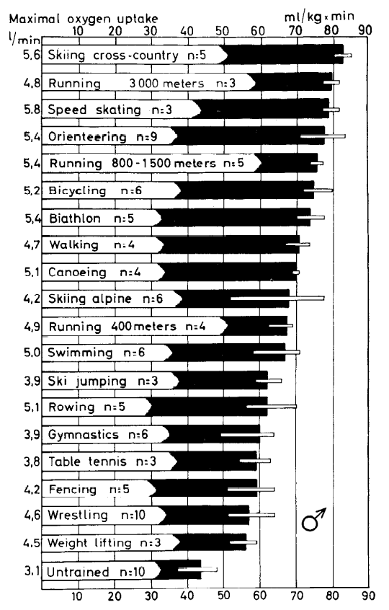
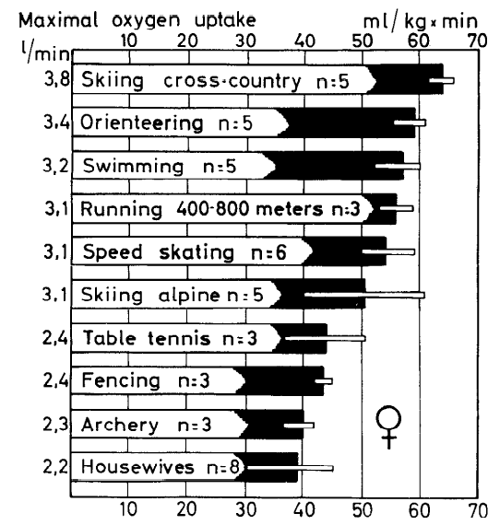
Saltin B & Åstrand PO.
Maximal oxygen uptake
in athletes. J. Appl. Physiol.
23(3), 1967.
Notes:
If you have not seen these figures, or variations based on them, than I don’t think you have ever read an exercise physiology textbook! They could perhaps use some updating after over 4 decades, but their influence is unquestioned and contributed to making a “high VO2max” synonymous with high endurance capacity.

Slide 22
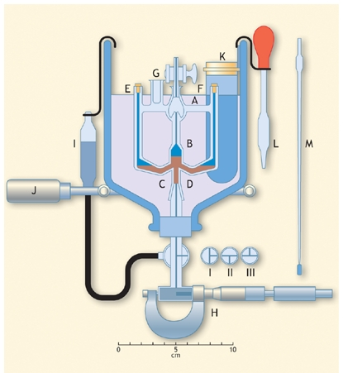
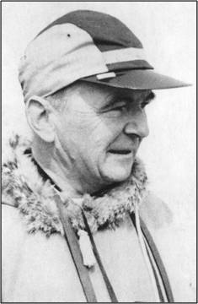
Most important Norwegian contribution to endurance testing?
PF Scholander. Analyzer for accurate
estimating of respiratory gasses in one-half
cubic centimeter samples. J. Biol. Chem.
167:235-2359, 1947.
Figure above from McArdle, Katch, & Katch,
Exercise Physiology. 7th ed.
Notes:
Since I am giving this lecture to a Norwegian audience, I will go a little out of my way to highlight the contributions of Per Scholander. He was Swedish, but grew up in Norway and studied at the University of Oslo! Scholander was another of those scientists of his era who seemed to be able to move elegantly across very different disciplines, leaving a mark wherever her went. Scholander was actually a botanist turned marine physiologist, but as young man he found time to develop an apparatus for measuring oxygen concentration in small samples that found its way into exercise physiology laboratories around the world and remained a gold standard for the calibration of oxygen analyzers up to the
early 1990s.
An actual Scholander apparatus from the Åstrand Laboratory is shown in slide 19.

Slide 23
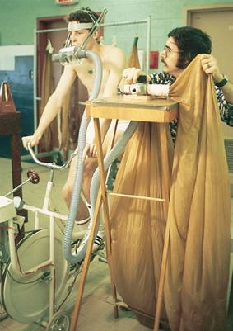
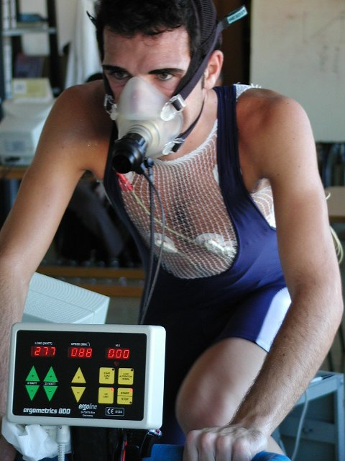
THEN
NOW
Photo provided by Prof. Frank Katch
Photo provided by Dr. AG Zapico
Notes:
Sport scientists trained in the pre-PC era will appreciate the amazing technological developments that have changed the way we perform physiological testing. From those early days of Taylor and Hill, when a single maximal oxygen consumption test might require days to complete, to our modern breath-by breath, real time window into physiological responses, the contributions of scientists who could link physiology and technology have not always been so well recognized, but they have been staggering none the less. Both the equipment and Professor Edward Coyle’s hairstyle in the picture on the left reveal the laboratory scene to be from the late 1970s. The picture on the right depicts current testing
conditions for elite Spanish cyclists.

Slide 24
Fractional O₂ utilization
Endurance Performance Power
Maximal oxygen Consumption
(VO₂max)
Fractional utilization
(LT/VT/MLSS)
Work efficiency
(power per VO₂)
Anaerobic capacity
Notes:
Now we turn our attention to the concept of the ”threshold”. Historically we have searched for the exercise intensity that represents a critical point demarcating clearly submaximal and sustainable work intensity, from the intense, fatigue provoking, and ultimately unsustainable intensity range that characterizes many of the endurance events our athletes perform.

Slide 25
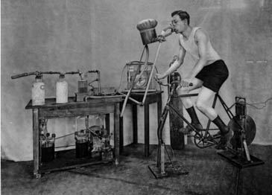
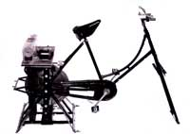
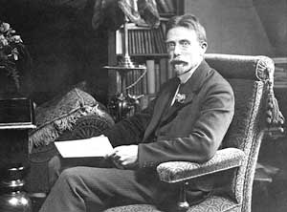
August Krogh (1879-1949) Denmark
Krogh established one of first exercise physiology laboratories
Built accurate bicycle ergometer already by 1910
Measured gas exchange (RER) during exercise of different
intensities with great accuracy. Early forerunner to
LT testing testing
Notes:
This time, the history leads me to Copenhagen, Denmark and the remarkable scientist and gifted instrument builder, August Krogh. While there is no clear evidence that he thought in terms of a well defined physiological intensity ”threshold”, he was clearly interested in exercise metabolism as a function of work rate. He developed state of the art tools for establishing the relationship between gas exchange variables and exercise intensity. His work seems to have laid the foundation for “anaerobic threshold” concepts that followed.
You can read more about the Nobel Prize winning physiologist August Krogh in this article by Frank Katch:
http://www.sportsci.org/news/history/krogh/krogh.html

Slide 26
Early connections between exercise and lactic acid
Swedish chemist Berzelius detected blood lactate in ”exercised” deer (1808).
Englishman AV Hill connected lactic acid production to muscle contraction (1922).
German Otto Meyerhoff associated increase in lactate concentration with muscle fatigue in frog muscle (1922).
Margaria and Dill – Formulated oxygen debt hypothesis (1933).
O. Bang- Showed that lactate production and removal were continuous (1936).
Norwegian Lars Hermansen (1972). Explained lactate appearance and removal responses.
Notes:
An entire lecture could easily be built around the topic of the history of lactic acid measurement and its interpretation during exercise. So, I will merely list a few highlights in that history that now extends over 200 years.

Slide 27
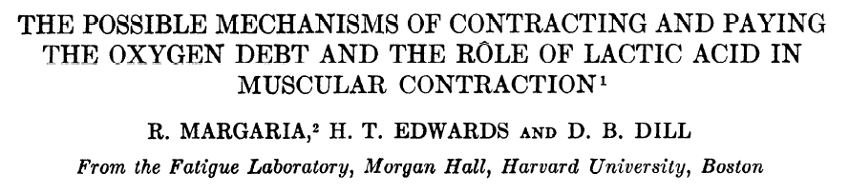
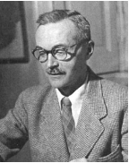
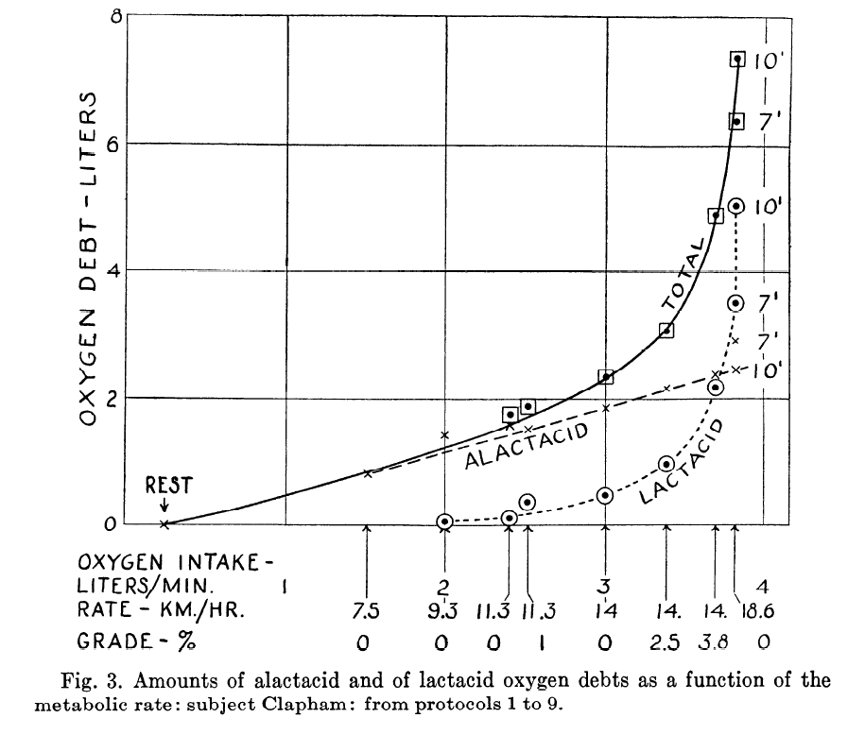
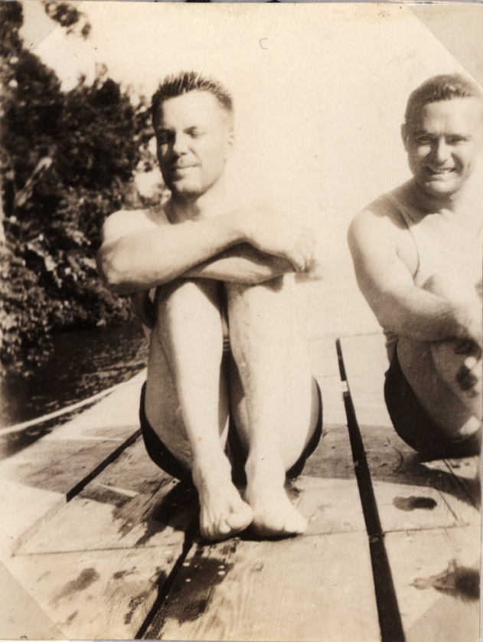
1933
R. Margaria
David Dill and Harry Edwards
in Panama
Lactate seen as a
metabolic dead end
produced only under
tissue hypoxia. This
view would live on into
the 80s.
Notes:
There is probably no area of exercise physiology that has been more debated and also more dynamic than that dealing with our understanding of lactate production and removal during exercise. This article from 1933 influenced thinking about lactate and metabolism for decades to come, but it was ultimately wrong because it concluded that lactate acid production was exclusively a consequence of cellular anaerobiosis. This myth has proven difficult to kill!
While the figure above is actually an ”oxygen debt-exercise intensity” curve, the similarities with the modern lactate profile test are clear.

Slide 28
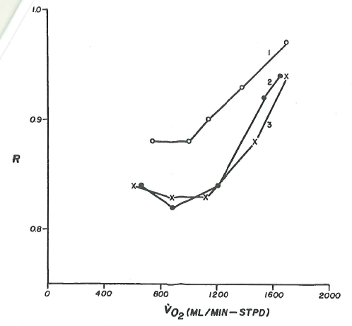
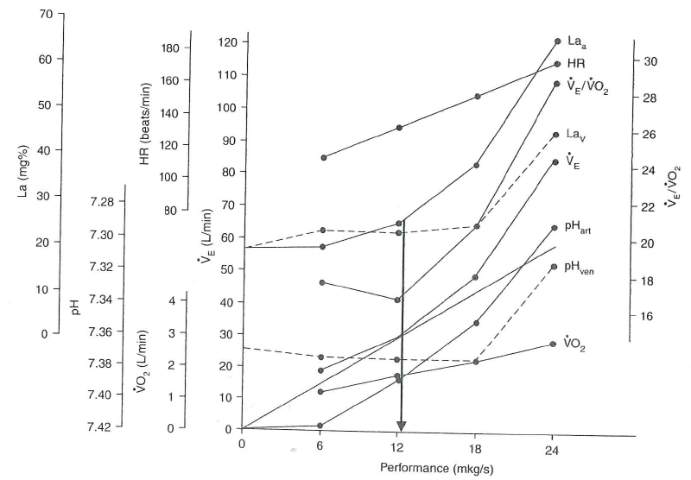
Who invented the ”anaerobic”/lactate threshold test?
Karlmann Wasserman, 1964?
Wildor Hollmann, 1959
(unpublished congress presentation)
Notes:
So, who invented the ”concept” of the anaerobic threshold? And who coined the term “threshold”? The answers to those two questions appear to be different.
Karlman Wasserman was the first to introduce the word ”threshold” in its now exhaustively familiar context. He coined the term anaerobic threshold initially based on the changes in the respiratory exchange ratio as a function of workload. He later teamed with William Beaver to develop technology for breath by breath measurements that facilitated the ventilatory gas exchange approach to threshold testing. His cooperation with Beaver was an example of the interaction between academic and private industry partners that came to typify the famous “Silicone Valley,” where they met at the time while Wasserman was at Stanford. Without Beaver´s ability to develop the digital computing interface necessary to achieve the high frequency and short sampling time of the BxB method, Wasserman would not have been able to put his theory into action.
But Wildor Hollman, from the German University of Sport in Cologne, was almost certainly the first to integrate ventilatory and blood lactate responses as a function of intensity and identify a breakpoint. Unfortunately for him he did not choose the right term for the concept (his term translated to Point of Optimal Respiratory Efficiency), and he did not publish these findings in English. By the way, “threshold” translates to “Zwelle” in German.

Slide 29
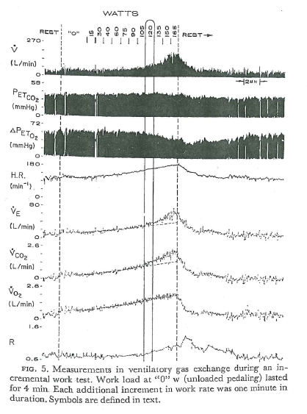
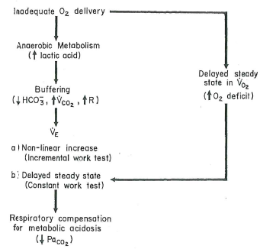
Threshold yes, but anaerobic?
Wasserman, K, Whipp BJ, Koyal, SN, Beaver WL. Anaerobic threshold and respiratory
Gas exchange during exercise. J. Applied Physiol. 35(2):1973.
Notes:
The threshold concept continues to be useful today, but our mechanistic interpretation of the responses we quantify has changed extensively thanks to numerous investigators like the late Lars Hermansen in Oslo and George Brooks at Cal Berkeley to name just two. There is substantial research demonstrating that increased blood lactate concentration during exercise can occur without evidence of oxygen deficiency in working muscle. The lactate molecule itself does not seem to be mechanistically connected to muscle contractile fatigue either. Three important papers regarding these controversial topics are listed below.
Brooks GA. Anaerobic threshold: review of the concept and directions for future research. Med Sci. Sports Exerc. 17(1):22-34, 1985.
James et al. Lactate is an unreliable indicator of tissue hypoxia in injury or sepsis. The Lancet. 354:505508, 1999.
Gladden LB. Lactate metabolism: a new paradigm for the third millennium. J. Physiology . 558(1):5-30, 2004.

Slide 30
”The anaerobic threshold is a useful concept.”
in Wasserman et al, 1973.
~ 5,500 studies involving terms anaerobic threshold- or lactate threshold published since!
Notes:
Is this the all-time understatement in a sport science publication?

Slide 31
A dear child has many names
Point of Optimal Respiratory Efficiency ( Hollman, 1959)
Anaerobic Threshold (Wasserman, 1964)
Aerobic-Anaerobic threshold (Mader, 1976)
Aerobic Threshold (Kindermann, 1979)
Individual Anaerobic Threshold (IAT, Stegmann and Kindermann, 1981)
Respiratory Compensation Point (Beaver, Whipp, & Wasserman, 1986)
Onset of Blood Lactate Accumulation (OBLA, Sjodin & Jakobs, 1981)
Maximal Lactate Steady State (MLSS, Mader and Heck, 1974-86)
Notes:
Various terms used to identify the «threshold». Both ventilatory and blood based measurement approaches, as well as evolving views of the role of tissue oxygen availability as a central explanatory variable for increased appearance of lactate in the blood, contribute to the proliferation of different names for this physiological threshold.

Slide 32
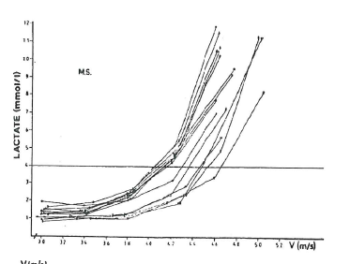
Heck, H, Mader, G., Hess, S., Muller, R., and Hollmann W. Justification of the
4 mmol/l Lactate Threshold. Int. J. Sports Med. 6:117-130, 1985.
Notes:
These multiple lactate profiles from the same athlete demonstrate the now expected “right shift” in the profile with long term training. However, Heck argued for a fixed threshold value of 4mM. This fixed value has been shown to be less valid for some sport disciplines than others.
The maximal lactate steady state methodology reveals this problem. Individual performers can be shown to achieve steady blood lactate while performing up to 60 min at workloads eliciting blood lactate concentrations well exceeding 4 mM (with individuals as high as 10 mM). There is also a sport specificity component to the MLSS, with sports employing smaller total active muscle mass tending towards higher blood lactate concentration at MLSS.
A couple of interesting studies in this regard are referenced below:
Beneke R. & Von Duvillard SP. Determination of maximal lactate steady state response in selected sports events. Med Sci Sports Exerc 28(2):241-6, 1996
Beneke et al. Dependence of the maximal lactate steady state on the motor pattern of exercise. Br J Sports Med. 2001 June; 35(3): 192–196.

Slide 33
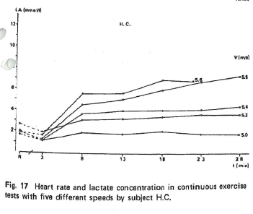
The Maximal Lactate Steady State
A. Mader & H. Heck, 1974-1986
Later studies have shown
that MLSS bLa conc.
can vary between 3
and 10 mmol/L due to
Individual differences
Active muscle mass
differences (run vs cycle)
Notes:
A more modern and physiologically correct view of the lactate threshold emerges from the Maximal Lactate Steady State test. The different responses seen provide a bases for identifying 2 different «threshold» points that envelop a «threshold range».
What makes this model more appealing physiologically is that it moves away from the idea of a specific ON/OFF point on the physiological intensity scale where blood lactate concentration suddenly increases.
The MLSS is not a very practical test to administer, but it conceptually underscores the blood lactate concentration as the integration of two continually varying rates, the rate of appearance of lactate into the blood from active muscle, and the rate of removal by relatively inactive muscle, and other organs, such as the heart and liver.
The lactate threshold range thus represents an intensity zone where blood lactate appearance increases, but can be and is compensated for by increased removal rates, albeit at a higher concentration set point.

Slide 34
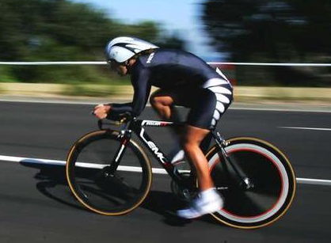
3- Intensity Zone Model
LT₁
LT₂ (MLSS)
VT₁
VT₂
[La⁻]
Exercise Intensity
Notes:
Numerous publications over the last 15 years have used a «two threshold» model for interpreting lactate and ventilatory threshold tests, as well as demarcating intensity ranges.
See for example:
Lucia et al. Heart rate response to professional road cycling: the Tour de France. Int. J. Sports Med. 20:167-172, 1999.
Lucia et al. Tour de France versus Vuelta a Espana: which is harder? Med Sci. Sports Exerc. 35:872-878, 2003.
Esteve-Lanao A. et al. How Do Endurance Runners Actually Train? Relationship with Competition Performance. Med Sci. Sports Exerc. 37(3):496-504, 2005.
Foster C. et al. Regulation of Energy Expenditure during Prolonged Athletic Competition. Med Sci. Sports Exerc. 37:4: 670-675, 2005.
Seiler & Kjerland. Quantifying training intensity distribution in elite endurance athletes: is there evidence for an “optimal” distribution? Scand. J. Med. Sci. Sports. 16(1):49-56, 2006.
Zapico et al. Evolution of physiological and haemotological parameters with training load in elite male road cyclists: a longitudinal study. J. Sports Med Phys. Fitness. 47:191-196, 2007.

Slide 35
Work efficiency/economy
Endurance Performance Power
Maximal oxygen consumption
(VO₂max)
Fractional utilization
(LT/VT/MLSS)
Work efficiency
(power per VO2)
Anaerobic capacity
Notes:
Finally, we move to the variable «Work Efficiency» Efficiency/Economy measurements connect the internal «cost of work» to the externally produced power. There are several important research studies on energetic efficiency during muscular work that were performed in the 1970s and influenced work efficiency’s incorporation into the 3-variable endurance performance model. The reader is directed to these references as examples:
Pendergast et al. Quantitative analysis of the front crawl in men and women. Journal of Applied Physiology 43( 3): 475-479.
Gaesser & Brooks. Muscular efficiency during steady-rate exercise: effects of speed and work rate. Journal of Applied Physiology 38(6):1132-1139, 1975.
Cavagna & Kaneko. Mechanical work and efficiency in level walking and running. The Journal of Physiology, 268, 467-481, 1977.

Slide 36
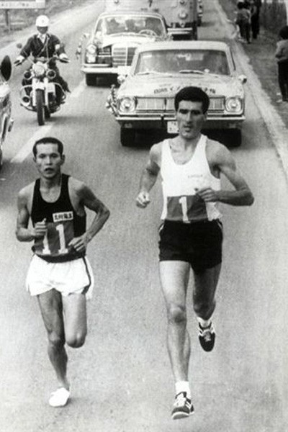
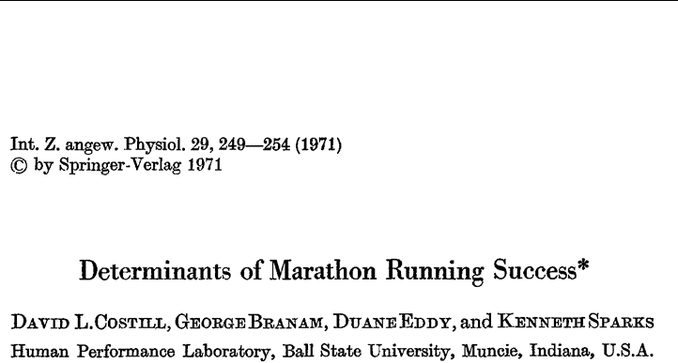
His barrier breaking performances could only be explained by a high running economy to compensate for his good but not great maximal oxygen consumption.
Derek Clayton, 2:08:34 in 1969
VO₂max 70 ml.min.kg⁻¹, LT 86% of VO2max
Notes:
A key applied study that brought increased attention to the issue of work efficiency as a discriminating factor in endurance performance even among well trained, even elite performers was this case study of former world record holder Derek Clayton. His marathon performances just did not make sense in light of his relatively modest VO2 max. Therefore, this case study demonstrated the potential importance of variation in running economy in explaining endurance performance variation among otherwise similar athletes.

Slide 37
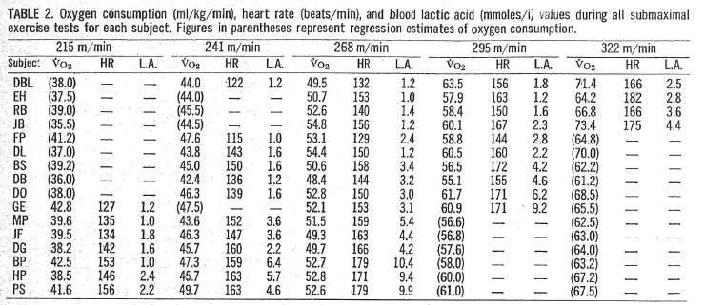
Efficiency/Economy testing
David L. Costill, H. Thomason, & E. Roberts. Fractional utilization of the aerobic capacity during distance running. Med. Sci. Sports. Exerc. 5(4):248-252, 1973.
Notes:
David Costill followed up the case study with more descriptive work demonstrating the substantial range in oxygen cost observed at any given running speed among a large group of trained runners.

Slide 38

Two athletes
with same
performance
time but 14%
difference in
estimated
oxygen cost
Costill DL et al. Fractional utilization of the aerobic capacity during distance running. Med Sci Sports 5(4), 248-252, 1973.
Notes:
Here I highlight data from two runners with the same performance level who appear to «solve» the energetic demands of achieving the same running speed over 50 minutes using different combinations of VO2max, fractional utilization capacity, and running economy.
In a highly cited paper from 1980, Douglas Conley and Garly Krahenbuhl showed that in a group of highly trained runners of similar ability, running economy accounted for almost 2/3 of the variation in 10km running performance.
Conley DL and Krahenbuhl GS. Running Economy and distance running performance of highly trained athletes. Medicine and Science in Sports and Exercise 12, 357-360, 1980.

Slide 39



David Costill- leads a new generation of applied sport scientists in 70’s-80’s
Notes:
For me, David Costill’s work in the 1970s and 80s seemed to really crystalize the current physiological model for endurance performance into a physiological testing triad that remains useful today. He also attempted to link these measurements to training methodology and popularize the science of training. I am also biased here, because it was a chapter about David Costill in the famous book by the late James Fixx that I read at age 15 that made me decide to study exercise science.

Slide 40





No change
in VO2max
1992
2003
25% increase in velocity at 2mM blood lactate
15% improvement
in running
economy
2:15:25 WR Marathon
Jones, AM. Int. J. Sports Science & Coaching
1(2), 2006.
Notes:
Today, these three tests are well known to any exercise physiologist and continue to inform decision making regarding training of high performance athletes. I use the example above not because it is unique conceptually, but because the longitudinal testing data from a champion athlete such as Paula Radcliffe remains a rare contribution to the applied sport science literature.

Slide 41
Anaerobic Capacity
Endurance Performance Power
Maximal oxygen consumption
(VO₂max)
Fractional utilization
(LT/VT/MLSS)
Work efficiency
(power per VO2)
Anaerobic capacity
Notes:
I will not take up the history of measurement of anaerobic capacity here. Anaerobic capacity has no explanatory value for long endurance events performed at sub-maximal intensity, such as a running marathon which is often the example used in validating this model. However, I include anaerobic capacity for completeness because, for event durations below 10 minutes, this energy contribution to work output plays an important to decisive role in performance. The term itself may be problematic because it reinforces a kind of dichotomy where muscle works either aerobically OR anaerobically. It is more correct to say that muscular contraction can be supported energetically with rates of glycolysis markedly exceeding the capacity for oxidative metabolism. This is conceptualized and presumably quantified with the maximal accumulated oxygen deficit approach (MAOD). The anaerobic capacity expressed as equivalents of oxygen utilization approximates the energy provision of 1 minute of maximal oxidative metabolism. In practical settings there is little interest in performing laboratory tests on elite athletes to quantify the MAOD because of the time and stress load involved.

Slide 42
Evolving measurement tools

Slide 43





Sport specific ergometry
Notes:
Technological advances continue to make physiological testing more sport specific while adhering to the strict demand for valid and reliable quantification of work rate.

Slide 44




New technology moves testing out of lab
Notes:
And, technology advances are also allowing us to move out of the laboratory for field tests of physiological capacity. At present, it seems that when the goal is maximal internal validity and test-retest reliability to monitor longitudinal training responses, laboratory testing remains the gold standard internationally.
However, it should be pointed out that field methods of controlling training intensity based on power or velocity measurements from modern instrumented bicycles, GPS watches, etc. can be extremely useful tools for training monitoring and periodization planning that do not really depend on laboratory based measurement of oxygen consumption or blood lactate responses to standard workloads. The SRM power monitoring system used in cycling is an excellent example of this development.

Slide 45

Do all athletes and their coaches NEED laboratory testing to train best and WIN?
Notes:
They almost certainly do not. Just as one example, we know there are still a lot of East African runners who become international successes without ever seeing the inside of a laboratory. And coaches can certainly coach well without the numbers generated by laboratory testing. However, there is a clear trend for some degree of testing to be integrated into the training monitoring programs of national teams throughout much of Europe, the US, Canada, Australia, South Africa, and New Zealand. The amount varies from one to 4-6 lab visits per year. Work by both Foster and Lucia have demonstrated that the HR at lactate threshold remains stable over at least a season, suggesting that frequent lab visits are probably not necessary for intensity calibration purposes. We also typically stop testing once the season begins.
Some athletes and their coaches seem to like to use standard testing at specific times of the year just to give them reassurance that they are on track. However, day to day variation in form can make interpreting small 1-3% variations in test results extremely tricky. If the variation is positive, we call it a training effect. If the variation is on the negative side, we are tempted to instead chalk it up to daily variation.

Slide 46
Conclusions
Laboratory testing of endurance athletes has a ~100 year history.
Most of what we now know was established between 1950 and 1980; best practice has not changed meaningfully.
Modern testing is faster, more convenient and potentially more sport specific, but not more accurate.
We are indebted to many extremely smart and innovative ”forefathers” who paved the way for modern physiological testing of athletes.
Notes:
The fundamentals of physiological profiling of endurance athletes have withstood rigorous testing by good sport science laboratories around the world and remain well accepted. The basic testing approach used in laboratories around the world is well rooted in the basic endurance model used as a framework for this presentation. These principles and the testing methodology are firmly anchored in classic studies performed decades ago. These publications from the 50s-80s remain excellent resources for the student wishing to build a strong foundation in applied exercise physiology.

