Slide 1
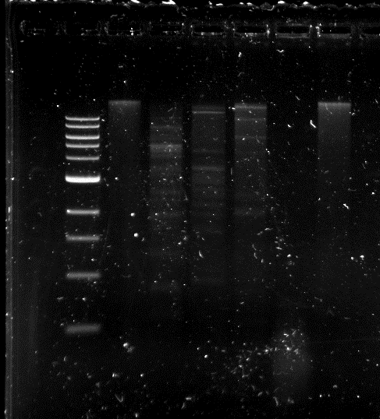
Undigested
DNA
ClaI
HaeIII
Ladder
BamHI
EcoRI
HindIII

