Slide 1
HIV in Flux

Slide 2
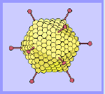
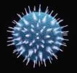

Viruses
Notes:
Latin for “slimy liquid” or “poison”
Definition of a virus
Infectious particle composed of genetic information in form of DNA or RNA
Protected by a shell/coat made from proteins
Envelope made from lipids/cholesterol
Cause of many infections
Dependent on the cells of the host to survive and replicate
Takes over the cell’s machinery to successfully replicate

Slide 3
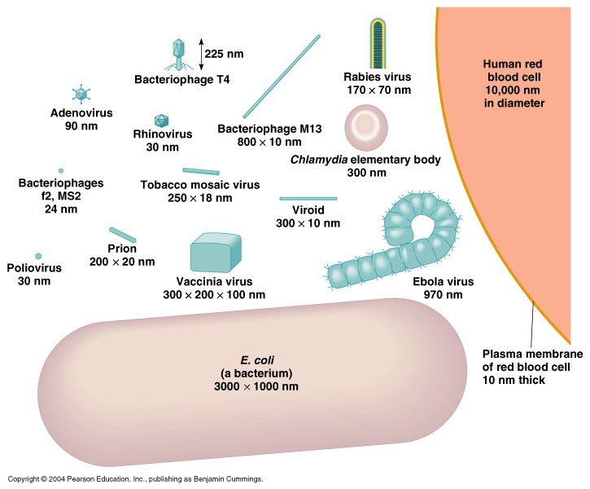
We’re talking tiny: 110 – 150 nm That’s 150 billionths of a meter
Notes:
Nanometer: one billionth of a meter

Slide 4
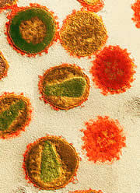
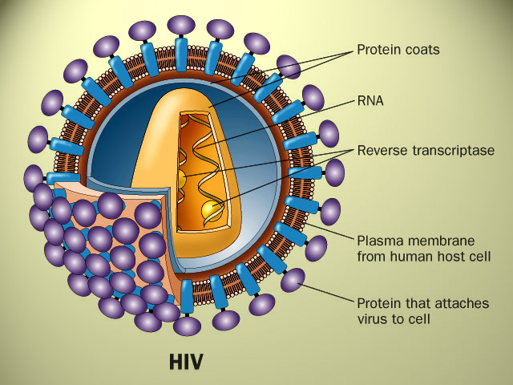
The bad guy

Slide 5

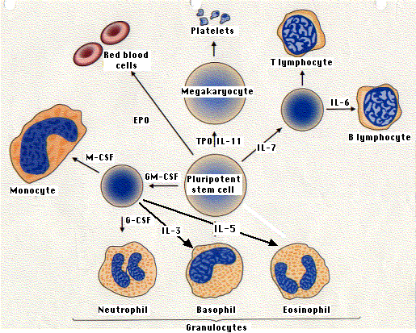
The good guys

Slide 6
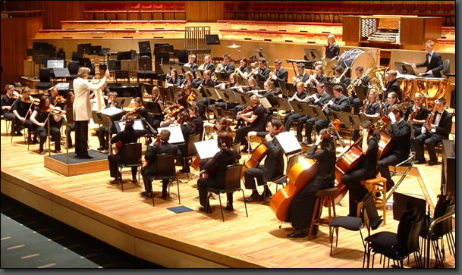
The Immune System

Slide 7
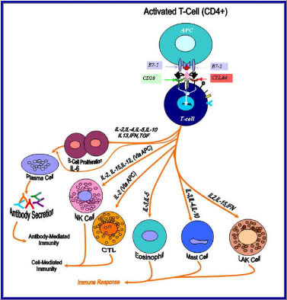
The Immune System
Innate Immunity
Adaptive Immunity
Antibodies
Cells

Slide 8
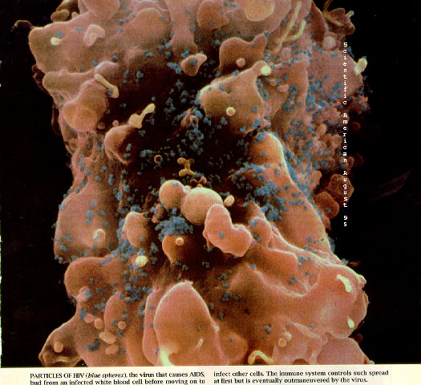
HIV Attacking the Conductor (Helper T-cell, CD4 + cell)

Slide 9
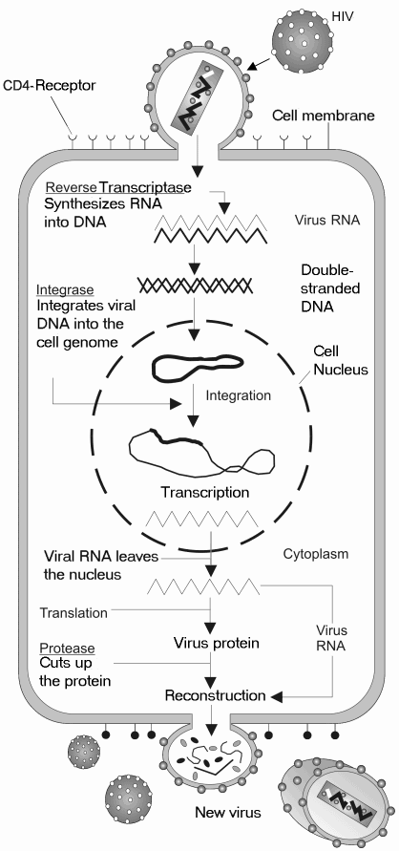

Slide 10
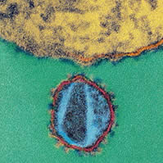
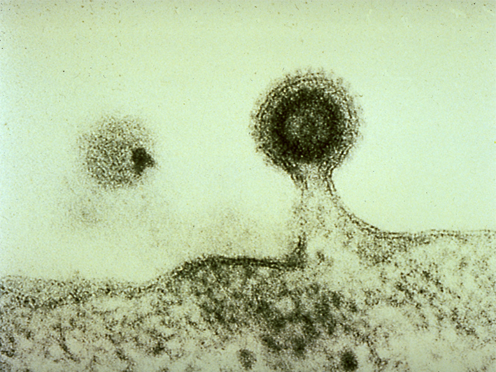
Entering and leaving

Slide 11
How does HIV make you sick ?
Directly
Acute HIV syndrome: like a bad flu
HIV dementia: memory loss
HIV wasting syndrome
HIV nephropathy: kidney disease
HIV retinopathy
Indirectly
Pneumonia
Tuberculosis
Fungal infection in mouth/esophagus
Kaposi sarcoma
Toxoplasmosis
Cryptosporidiosis
CMV retinitis
Lymphoma

Slide 12
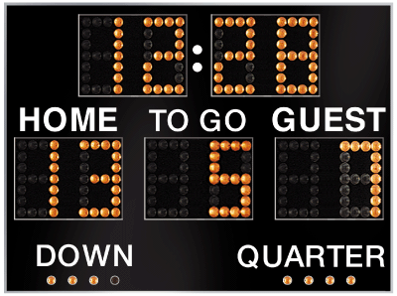
Keeping score: who’s ahead Home team:T-cells vs Visitor: HIV
??? years left in the game
T-cell count
viral load

Slide 13
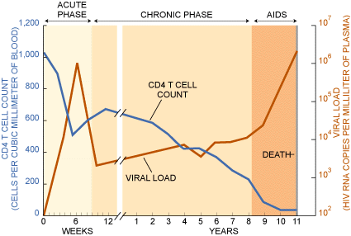
HIV over time

Slide 14
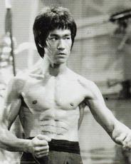
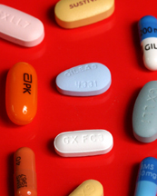
How to fight back
+

Slide 15
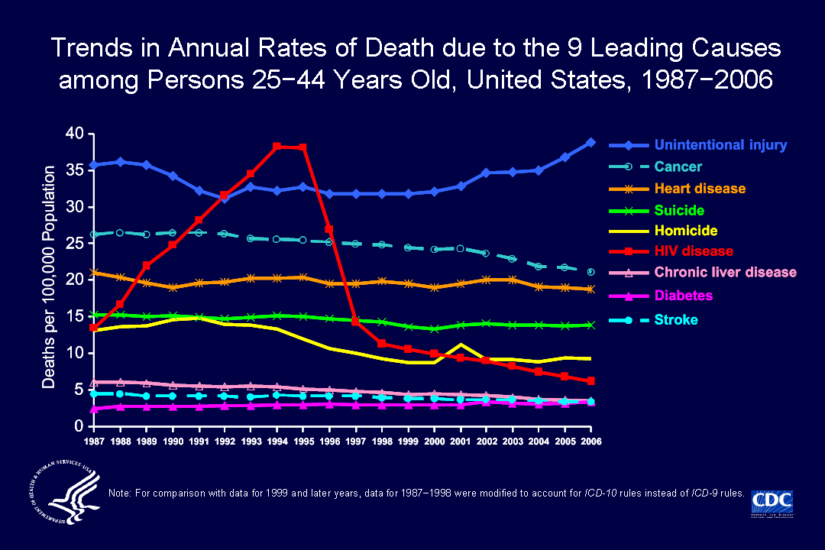
Combination Antiretroviral Therapy
December 6th, 1995: FDA Approved Saquinavir

Slide 16
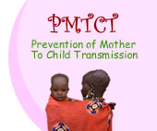
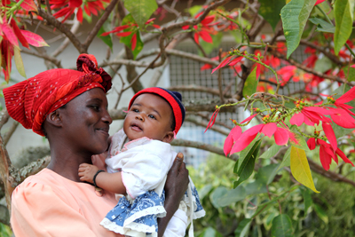
Prevention of maternal to child transmission (PMTCT)
1996: New ACTG 076 Analysis Emphasizes Importance of Offering AZT Therapy to All HIV-Infected Pregnant Women

Slide 17
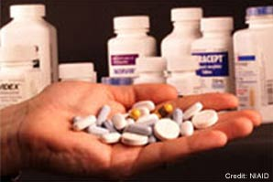
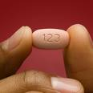
Making it simple
2006: Atripla FDA approved

Slide 18
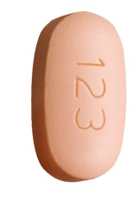
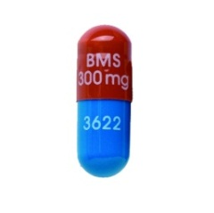
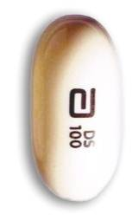


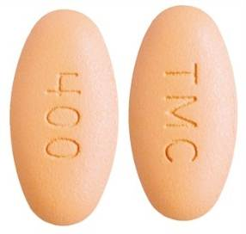
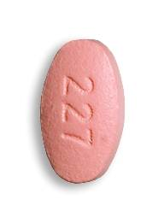
Recommended regimens: DHHS Guidelines 2011
Efavirenz/Emtricitabine/Tenofovir
FTC/Tenofovir+Atazanavir+Ritonavir
FTC/Tenofovir+Ritonavir+Darunavir
FTC/Tenofovir+Raltegravir
www.aidsinfo.nih.gov
Notes:
The attractiveness of atripla rest not only in its once daily dosing
Protease based inhibitors are potent and durable and have higher barrier to resistance, but the larger pill burden and concern about metabolic side effects dissuaded us away from that regimen
Raltegravir is a great option but it is a twice daily dosing

Slide 19
ARVs come in families
Entry Inhibitors
Reverse Transcriptase Inhibitors
Nucleosides
Nucleotides
Non-nucleosides
Integrase Inhibitors
Protease Inhibitors

Slide 20
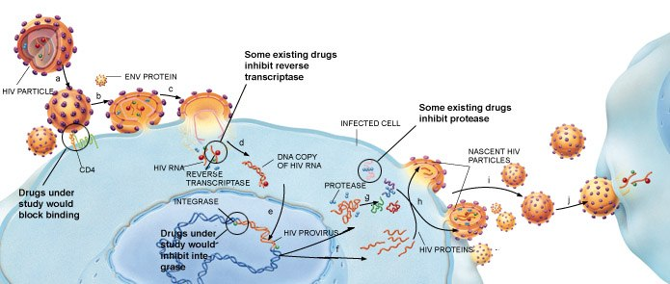
HIV infecting a Helper T-cell

Slide 21
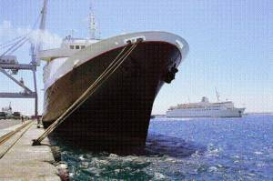
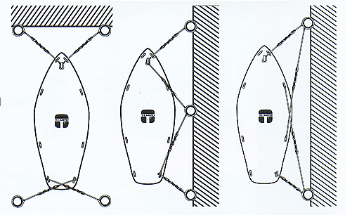
Entry Inhibitors

Slide 22
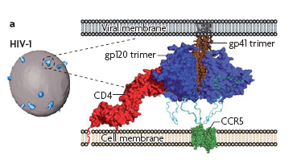
HIV mooring ropes: targets for treatment and vaccine

Slide 23
Things to think about
When to start?
What to choose?
Individualize
Personal preference
Other health problems
Drug interactions
Adherence
Resistance

Slide 24
When to Start Antiretrovirals
Pathogenesis of disease: prevent immune system destruction
Greater likelihood of complete suppression
Public health benefit: decreased risk of transmission to others?
Toxicity of treatment
Cost
Risk of resistance
Effect on quality of life
Early
Late
Notes:
Patient’s disease stage: Symptomatic status. CD4 cell count. Plasma HIV-1 RNA level
Patient’s commitment to therapy
Philosophy of treatment
Pros and cons of ‘early’ intervention
Pros of early:
Pathogenesis of disease: preserve HIV directed CTL
Greater likelihood of viral suppression
Greater potential for immune preservation and earlier, more complete immune restoration
?Diminished HIV transmission in population
?Long-term clinical benefit
Should we save Rx for later? What about those 5% of individuals who never progress – are we subjecting them to unnecessary Rx – how can we identify those who don’t need treatment?
What was the impetus for early treatment, rationale for early Rx: one of the important data was a study

Slide 25

When to start

Slide 26
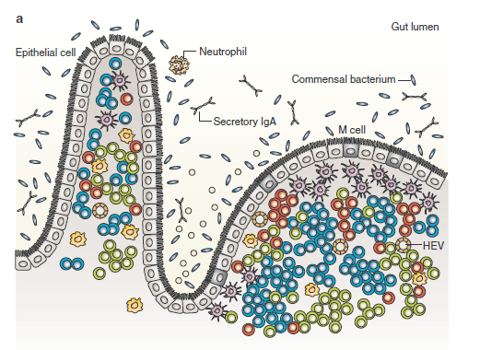

HIV-associated damage to the GI tract: Early CD4 depletion
Healthy HIV negative gut
Chronically infected HIV-positive gut
Bacterial translocation
Increased permeability
Depletion of CD4 cells
Systemic Immune activation
Notes:
In a healthy Hiv-neg gut there is lots of CD4 and CD8 cells and intact mucosa, bacteria are contained within the lumen. In chronic HIV, loss of mucosal cells and profound delpletion of CD4 cells and those that remainare infect with HIV. What ensues is loss of integrity of the gut and bacterial translocation. This in turns leads to systemic inflammation and imflammatory response that is thought to lead to chrinic immune activation and immune sydregulation in ppl with HIV
HIV-associated damage to the GI tract. (a) A healthy GI tract with villi, crypts, macrophages, dendritic cells, maintenance of the epithelial barrier, T cells, B cells, and luminal defensin peptides. (b) A chronically HIV-infected GI tract with (1) blunted villi, (2) crypt hyperplasia, (3) damage to the epithelial barrier with enterocyte apoptosis, (4) decreased luminal defensin, (5) massive CD4 T-cell depletion, (6) high frequencies of infected CD4 T cells with release of virions, (7) microbial translocation, and (8) increased permeability.

Slide 27
Initiation of ART DHHS Guidelines 2011
CD4 Cell count (cells/mL) | Recommendation to start | Comments
<=200 | Strongly recommended
<350 | Strongly Recommend
350-500 | Recommend | Strong: 55% Moderate: 45% of the panel
>500 | Consider | Favor: 50% of panel Optional: 50% of panel
Clinical HBV, Pregnancy, HIVAN, AIDS | Strongly recommend
Notes:
Guidelines that changed in 2009. most recent in 2011
Anybody below 350. Anybody with OI or AIDS defining malignancy, pregnancy, chronic hep B bc therapies overlap and rx of hep B alone can lead to resistance wrt hiv treatment
Hiv assoc nephropathy because kidneycan be a viral reservoir and hivan is virally mediated and rx leading to viral suppression leads to imrpov of renal fxn
Most would rx less than 500 – controversy among dhhs panel members whether to say strongly or moderately recommend. We see lot od co-morbidiites subst abuse that we like to control
Panel also split on point of treating everyone for HIV – we are not there yet because of resources and pt acceptability and need to take ART for life

Slide 28
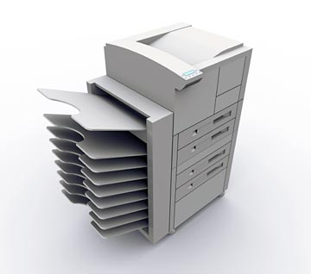
HIV replication: fast but error prone

Slide 29
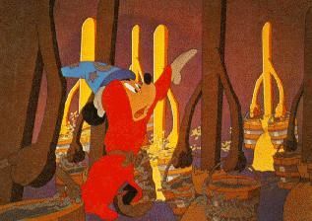

HIV: The Master Magician
Rapid replication: 10,000,000,000 HIV viruses are produced per day
Rapid mutation: the man of a thousand faces
Notes:
If HIV were humans it would take under 17 hours to go from 0 population to the current world population of 6.94 billion.

Slide 30
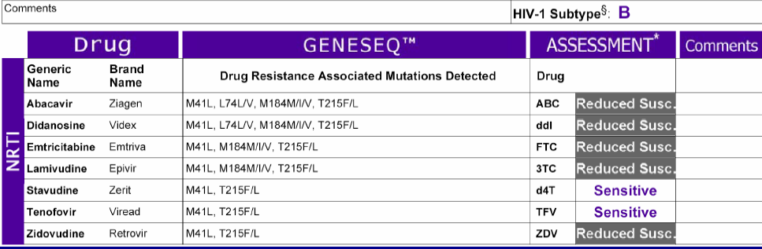
Drug resistance

Slide 31

Let’s take a step back

Slide 32
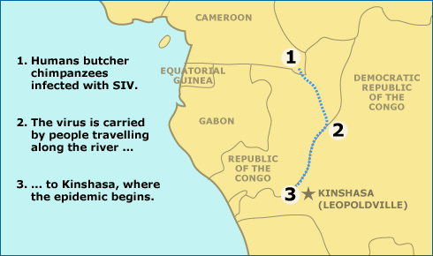
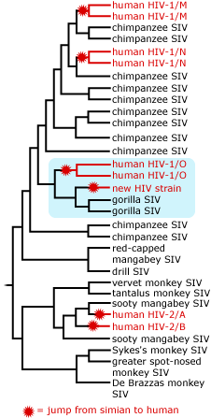
Origins of HIV

Slide 33
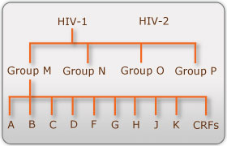
HIV Sub-types

Slide 34
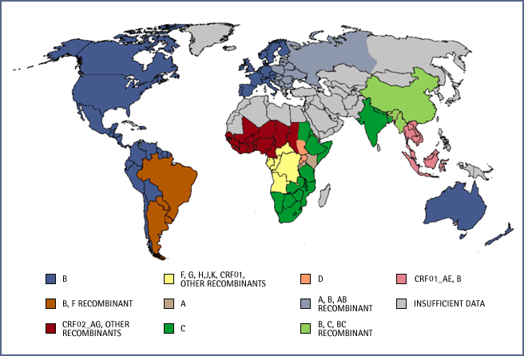
IAVI

Slide 36
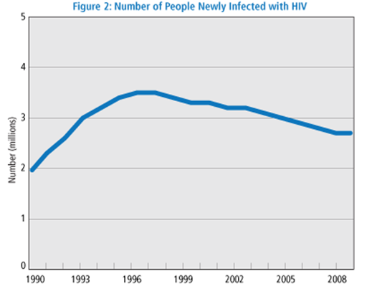
(globally)
McEnery R. Update on pandemic shows new HIV infections steadily declining. IAVI Report 13:017, Nov/Dec 2009.

Slide 37
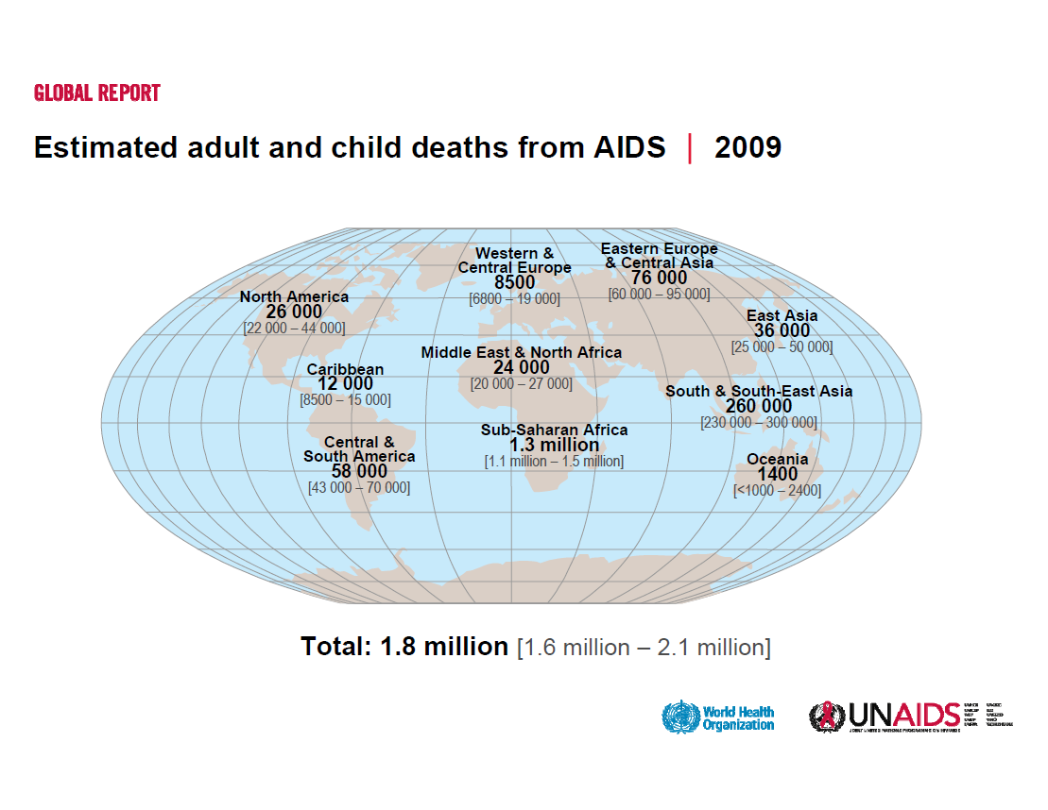

Slide 38
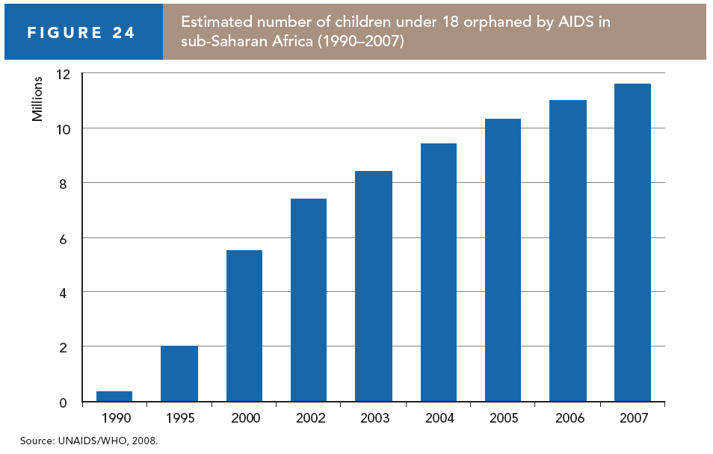

Slide 39
http://www.gapminder.org/world

Slide 40
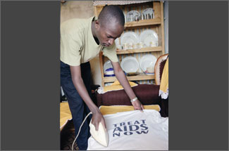
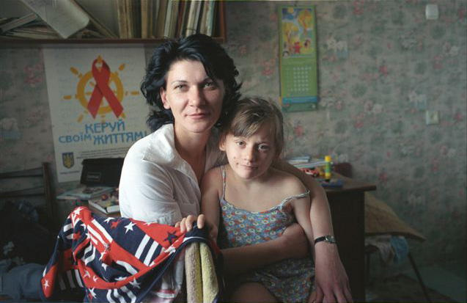
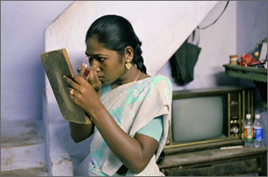
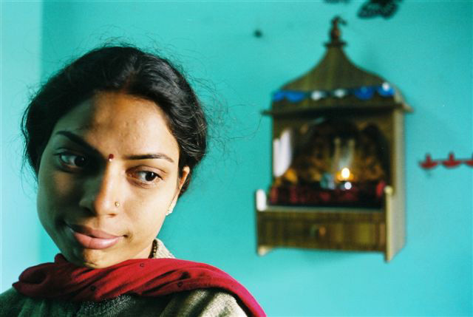
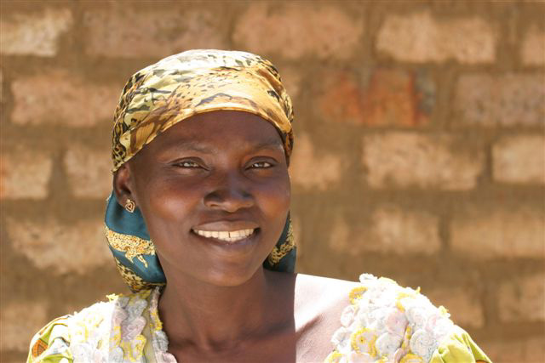
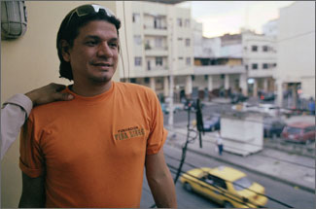
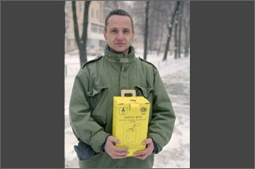
Human

Slide 41
Progress in prevention

Slide 42
Model for prevention
*
____________________________
O

Slide 43
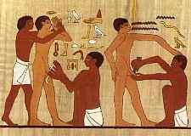
Progress in Prevention
Circumcision (2007) reduces vaginal-to-penile transmission by 51-60%.
3 randomized controlled:
South Africa, Kenya and Uganda

Slide 44
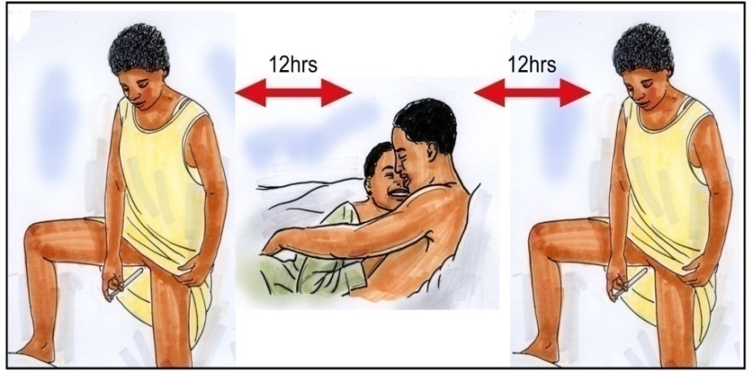

2010
CAPRISA 004: n=889 South Africa Microbicide 1% Tenofovir Gel → 39% reduction in HIV incidence (54% with >80% adherence)
Malawi study: n=3796 adolescent girls and young women age 13-22, monthly cash incentives to go to school → 60% lower HIV prevalence
http://www.caprisa.org/joomla/index.php/component/content/article/1/225

Slide 45

2010
iPrEx: Pre-exposure Prophylaxis (PREP)
n=2499: High risk men and transgender women who have sex with men.
Peru, Ecuador, South Africa, Brazil, Thailand, and the United States (9%)
Daily Truvada → 44% decreased risk of HIV
If took >90% → 72% decreased risk of HIV
Renal toxicity and resistance
Access: 12-14K per year

Slide 46
Awareness of Serostatus Among People with HIV and Estimates of Transmission
~21% Unaware of Infection
54-70% of New Infections
Transmission
~79% Aware of Infection
30-46% of New Infections
People Living with HIV/AIDS: ~1.1 million
New Infections Each Year: ~32,000
Marks, et al
AIDS 2006;20:1447-50
Notes:
Diagnosis impacts transmission: KNOWING ONE’S STATUS MAKES A DIFFERENCE
It is estimated that sexual transmission accounts for 32,000 of the 40,000 new infections each year.
Conservative estimates based on the changes in behavior observed once people find out they are infected with HIV indicate that the 25% of people who are unaware that they are infected account for at least 54%, and potentially as much as 70%, of the new sexually transmitted infections each year. The transmission rate among those who don’t know they are infected is 3.5 times higher than for people who know about their HIV infection.
The importance of getting these individuals tested and into care that includes both treatment and prevention interventions is critical.

Slide 47
HIV viral load and risk of heterosexual HIV transmission
The higher the HIV-1 viral load, the higher the risk of transmission in heterosexual couples
HIV-1 RNA copies/ml
Quinn et al. NEJM 2000
Notes:
This is an old study now that showed that the higher the vl, the higher the risk of transmisison – this was in hetero couples;
In that study: Mean (+SE) Rate of Heterosexual Transmission of HIV-1 among 415 Couples, According to the Sex and the Serum HIV-1
RNA Level of the HIV-1–Positive Partner. At base line, among the 415 couples, 228 male partners and 187 female partners were HIV-1–positive. The limit of detection of the assay was 400 HIV-1 RNA copies per milliliter. For partners with fewer than 400 HIV-1 RNA copies per milliliter, there were zero transmissions.
more recently lancet 2010 study connie celum: 92% reduction of transmission to seronegative partner in serodoscordant couples
post ART initiation: HIV seroincidence 0.39
There was only one linked transmission
ON no ART: hiv seroincidence was 2.23 and there were 102 linked transmissions

Slide 48
FOR IMMEDIATE RELEASE:
Thursday, 12 May 2011, 11 am EST
Initiation of Antiretroviral Treatment
Protects Uninfected Sexual Partners from HIV Infection (HPTN Study 052)
96% reduction in HIV transmission, according to study conducted
by HIV Prevention Trials Network

Slide 49


Slide 50



variolae vaccinae
Smallpox was responsible for an estimated 300–500 million deaths during the 20th century
Edward Jenner
The arm of Sarah Nelmes, a dairy maid, who had contracted cowpox. Jenner used material from her arm to vaccinate an eight year old boy, James Phipps.
http://www.nlm.nih.gov/exhibition/smallpox/sp_vaccination.html

Slide 51
Vaccines save lives Baseline 20th century and 1998 annual morbidity in children, US
Annual no. of cases
Disease Baseline year Baseline no. 1998
Smallpox 1900-04 48,164 0
Diphtheria 1920-22 175,885 1
Pertussis 1922-25 147,271 6,279
Tetanus 1922-26 1,314 34
Polio (paralytic) 1951-54 16,316 0
Measles 1958-62 503,282 89
Mumps 1968 152,209 606
Rubella 1966-68 47,745 345
MMWR, CDC
Notes:
During the 18th, 19th and early 20th century, ID were the major cause of M&M. This table presents….for some common ID for which we have vaccines, of varying efficacy.
In 1900, mortality rates ranged from 200 per 100,000 pop for influenza and pneumonia to 12 for pertussis. By 1970, only influenza and pneumonia were associated with mortality rates over 3 per 100,000.

Slide 52


It will take time to find an effective HIV vaccine
Notes:
The new trial of the VRC vaccine regimen is only one piece of the HVTN’s research agenda. The HVTN’s research includes many trials and many key research topics.
Trials of other vaccine concepts will continue to be developed and implemented. HVTN 073, 077, 205, 905, 906/907, 404 and 802 have either opened recently or are planned to open within the next six months. The HVTN will continue its research, dedicated to the dream of a day on which we have an effective HIV vaccine for everyone. And as these pictures remind us, it took 47 years to find a polio vaccine!

Slide 53
Vaccine Research in Perspective
Vaccine Discovery Vaccine Years
of cause developed elapsed
Pertussis 1906 1926 20
Polio 1908 1955 47
Measles 1953 1983 30
Hepatitis A 1973 1995 22
Hepatitis B 1965 1981 16
HIV 1983 ???? As of 2011, 27
years & counting
Notes:
Read slide.
Just to put things in perspective, the timeline for vaccine development for existing vaccines is demonstrated here. Based on the time it has taken to develop a vaccine for other illnesses, the search for an HIV vaccine is running at about the same pace. I might mention at this point that all of these vaccines were developed and licensed only through volunteer participation in clinical trials.

Slide 54
The Immune System

Slide 55


How do vaccines work?
Adaptive Immunity
Stimulate the immune system
The conductor (Helper T-cell or CD4+ cell)
Antibodies (humoral)
kill virus floating free
T cells (cellular)
Cytotoxic T-Cells (CTLs or CD8+ cells)
attack and kill cells infected by viruses
Memory
respond fast and strong
Think: “mug shot”

Slide 56
Vaccine Design/Development
Vaccine type? – live, killed, subunit, recombinant DNA, etc.
If DNA: what parts? gag, pol, nef, tat, env?
Vector – Adenoviral, VEE, MVA, px virus
Prime → Boost – what to use?
Subtype?
Adjuvant? – boost the immune response. What to use? Freud’s, alum, cytokine (IL-2, 12, 15)
Schedule? – every month, boost @ 6-9 mo.
Delivery? – IM, SC, Biojector
IMPORTANT:
It is IMPOSSIBLE to become HIV infected from an HIV vaccine: They do not contain any weakened of killed HIV

Slide 57

Vaccine strategies: what parts?

Slide 58


DNA: instructions on how to make the parts
HIV Genome (RNA)

Slide 59


Viral Vectors
Adenovirus
Modified Vaccinia Ankara

Slide 60

Thai Vaccine Study (RV144)
ALVAC HIV (vCP1521)
AIDSVAX B/E (gp120)
N=16,402
 | ITT | MITT | PP
Participants | 16,402 | 16,395 | 12,452
Infections (placebo) | 76 | 74 | 50
Infections (vaccine) | 56 | 51 | 36
Vaccine efficacy | 26.4% | 31.2% | 26.2%
P-value | 0.08 | 0.04 | 0.16
Significant | No | Yes | No

Slide 61

Thai Vaccine Study (RV144)
Hint of a possible immune correlate
60 vaccinated volunteers who remained HIV uninfected: high CD4+ T-cell → epitopes (peptides 44 and 49) in V2 loop of gp120.
Peptide 44 targets integrin α4β7 a receptor on CD4+ T-cells in cervix and rectum that is highly susceptible to HIV infection
James Arthos and colleages in Tony Fauci’s lab (Nat. Immunol. 9, 301,208)

Slide 62

Donor 45
Almost all HIV infected individuals produce Antibodies to the envelope protein: 10-25% have broadly reactive neutralizing antibodies
NIH Vaccine Research Center used probes to go fishing with probes (RSC3) for broadly neutralizing antibodies → 3 antibodies bound strongly to RSC3: (VRC01, VRC02 and VRC03)
Tested against 190 viral strains representing all major circulating HIV-1 infections.
VRC01 and VRC02 neutralized 91%, (VRC03 neutralized 57%)
Peter D. Kwong, Ph.D., John R. Mascola, M.D., and Gary J. Nabel, M.D., Ph.D
Atomic structure of the antibody VRC01 (blue and green) binding to HIV (grey and red). The precise site of VRC01-HIV binding (red)

Slide 63


A Global Network to Test HIV Vaccines

Slide 64
Closer to home

Slide 65

El-Sadr WM, Mayer KH, Hodder SL. AIDS in America - Forgotten but not gone. NEJM 362(11):969, 2010.

Slide 66

El-Sadr WM, Mayer KH, Hodder SL. AIDS in America - Forgotten but not gone. NEJM 362(11):968, 2010.

Slide 67


