Slide 1


FHWA Traveler Analysis Framework Part II Status Report
AMPO Travel Modeling Meeting
Washington, D.C.
November 5, 2010
Daniel Jenkins, FHWA
Don Vary, WSA

Slide 2
FHWA TAF Part II
FHWA Leading Office and Program Manager
Office of Highway Policy Information (OHPI)
Danny Jenkins, PE.
Daniel.Jenkins@DOT.GOV
Team
Roger Mingo, WSA, RSG, Matt Coogan
Aided by expert panel
Academicians, practitioners (MPO, state DOT), private sector

Slide 3
Traveler Analysis Framework
Background/Purpose
Development of long-distance multimodal passenger flows for demand analysis
Motivation
Inconsistent/non-existent data
Expense of “one-off” surveys
Growing importance of multi-regional, corridor and multinational analysis
Need for policy analysis – price, demographics
Travel market: high VMT, often high-value

Slide 4
TAF - Evolutionary Process
2010 FHWA OHPI Travel “Roadmap” – Track 1
Use of existing data for current and future flows
Assign to national network
Focus of this study
2010 FHWA OHPI Travel “Roadmap” – Track 2
Design/implement new household travel survey
Develop new models
Notes:
OHPI: Office of Highway Policy Information

Slide 5
Preliminary Thoughts and Approached Offered by the Team

Slide 6
FHWA TAF Part II
Status
First panel meeting November 18 to lay out basic methodology
18 month timeframe

Slide 7
Data Sources
Long Distance Annual Trips (greater than 100 Miles) from National Household Travel Surveys
 | CAR | AIR | BUS | RAIL | OTHER | TOTAL
 | Expanded Trips (>100 MI) by Main Travel Mode
1995 ATS | 1,641,892,400 | 343,283,810 | 42,326,649 | 9,533,141 | 3,215,997 | 2,040,252,100
Modal Share | 80.5% | 16.8% | 2.1% | 0.5% | 0.2% | 100%
2001 NHTS | 2,336,093,693 | 193,289,524 | 55,443,050 | 21,144,317 | 11,155,783 | 2,617,126,367
Modal Share | 89.3% | 7.4% | 2.1% | 0.8% | 0.4% | 100%
2008 NHTS | 3,205,130,326 | 201,646,048 | 43,234,705 | 16,886,134 | 41,565,117 | 3,508,462,329
Modal Share | 91.4% | 5.7% | 1.2% | 0.5% | 1.2% | 100%
 | Number of Sampled Trips (>100 MI) by Main Travel Mode
1995 ATS | 449,009 | 83,336 | 10,238 | 2,477 | 916 | 545,974
Modal Share | 82.2% | 15.3% | 1.9% | 0.5% | 0.2% | 100%
2001 NHTS | 40,333 | 3,347 | 933 | 392 | 160 | 45,165
Modal Share | 89.3% | 7.4% | 2.1% | 0.9% | 0.4% | 100%
2008 NHTS | 9,847 | 661 | 183 | 28 | 143 | 10,862
Modal Share | 90.7% | 6.1% | 1.7% | 0.3% | 1.3% | 100%

Slide 8
Additional Data Sources
Air
FAA – FACT 2 (county-county)
ACRP 3-10 project
True origin-destination for East/West coast locations
Rail – Estimates based on available data
Bus – ABA
Private sector household surveys
Cross border data
NHTS

Slide 9
Issues/Parameters
Data questions
Inbound international air travel
Cross border origin/destination flows
Availability of recent rail data
Trip purposes
Business, tourist, other

Slide 10
Issues/Parameters
Long distance >= 100 miles
Geography
Build from smallest geography to state level

Slide 11
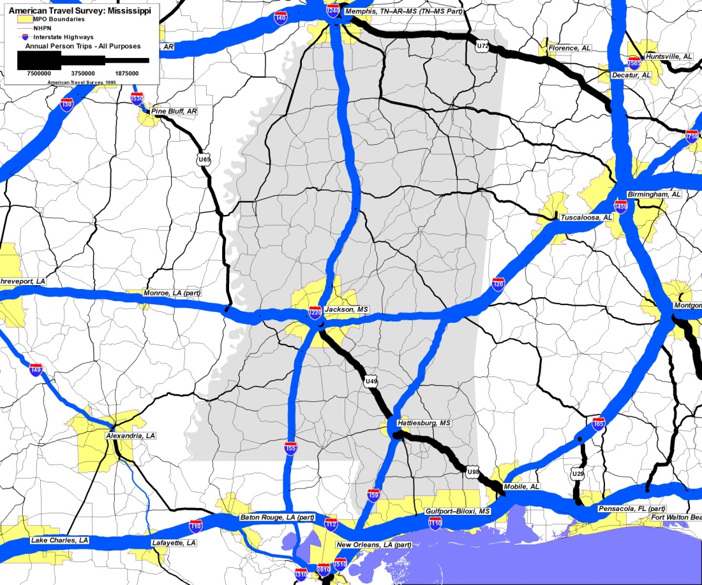
Validation
Reviews of flows relative to activity centers
Comparison of flows as percentage of total from HPMS

Slide 12
Auto Passenger Travel

Slide 13
Air Passenger Travel

Slide 14
Rail Passenger Travel

Slide 15
Questions?
Contact:
Daniel Jenkins
daniel.jenkins@dot.gov

