Slide 1

“Linked-Data-Ready” Software For Libraries: The eXtensible Catalog (XC)
Jennifer Bowen, University of Rochester
code4lib 2012
February 7, Seattle, WA

Slide 2
Monitoring IRC…
Randall Cook, XCO Co-Executive Director
Péter Király, XCO Software Developer
John Brand, XCO Software Developer

Slide 3
Calls for linked data
W3C Library Linked Data Incubator Group
Report and Use cases
http://www.w3.org/2005/Incubator/lld/XGR-lld-20111025/
Stanford Linked Data Workshop
“Manifesto for Linked Libraries (and Museums and Archives and…)”
http://www-sul.stanford.edu/about_sulair/news_and_events/Stanford_Linked_Data_Workshop_Report_FINAL.pdf

Slide 4
LC Requirements for a New Bibliographic Framework Environment
Broad accommodation of content rules and data models
Provision for types of data that logically accompany or support bibliographic description
Accommodation of textual data, linked data with URIs instead of text, and both
Consideration of the relationships between and recommendations for communications format tagging, record input conventions, and system storage/manipulation
Consideration of the needs of all sizes and types of libraries, from small public to large research
Continuation of maintenance of MARC until no longer necessary
Compatibility with MARC-based records
Provision of transformation from MARC 21 to a new bibliographic environment

Slide 5
Why should an individual library create linked data?
Libraries need to embrace a new paradigm – a new way of thinking about data
Take advantage of new opportunities, new roles for library expertise
Create linked data for local resources
Opportunities to influence best practices
Encourage vendors to implement linked data

Slide 6
To create linked data, we need…
… a tool or tools that will enable us to move from legacy library metadata to library linked data.
… a roadmap for how to make this transition.

Slide 7
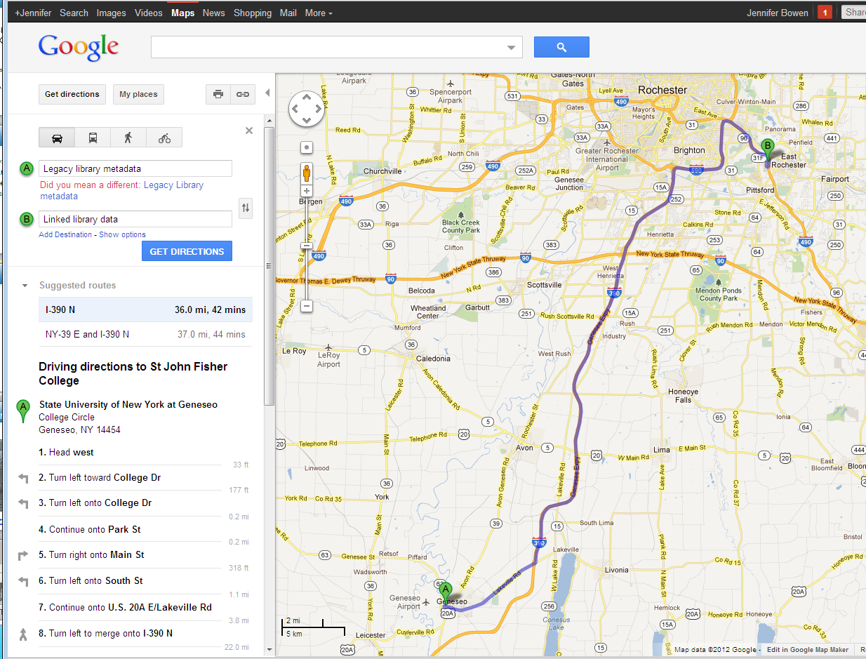
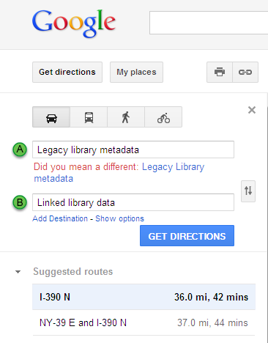
Google Maps = not the right tool!

Slide 8
Is XC software the right tool?
Vision – where we need to go
Starting Point – what XC software does now
Plan – how XC can achieve the vision

Slide 9
Vision
Discovering library resources on the open web, through applications that potential readers are already using
Search engines
Mobile apps
Social media
We can’t expect users to search our silos!

Slide 10



An example…Mt. Hope Cemetery
Photo credits: ROCHESTER’S SPEAKING STONES By Th. Emil Homerin; University of Rochester Department of Religion and Classics http://www.rochester.edu/College/REL/faculty/homerin/REL167/reports.htm

Slide 11
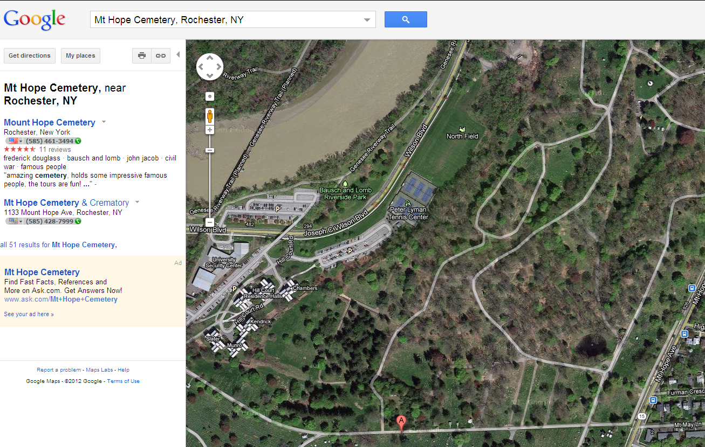
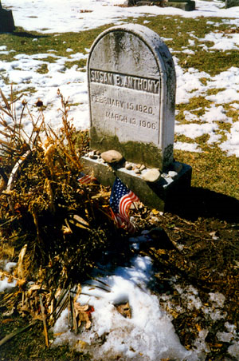
An example…Mt. Hope Cemetery
Photo credit: www.findagrav.com/cgi-bin/fg.cgi?page=pv&GRid=31&PIpi=76016

Slide 12
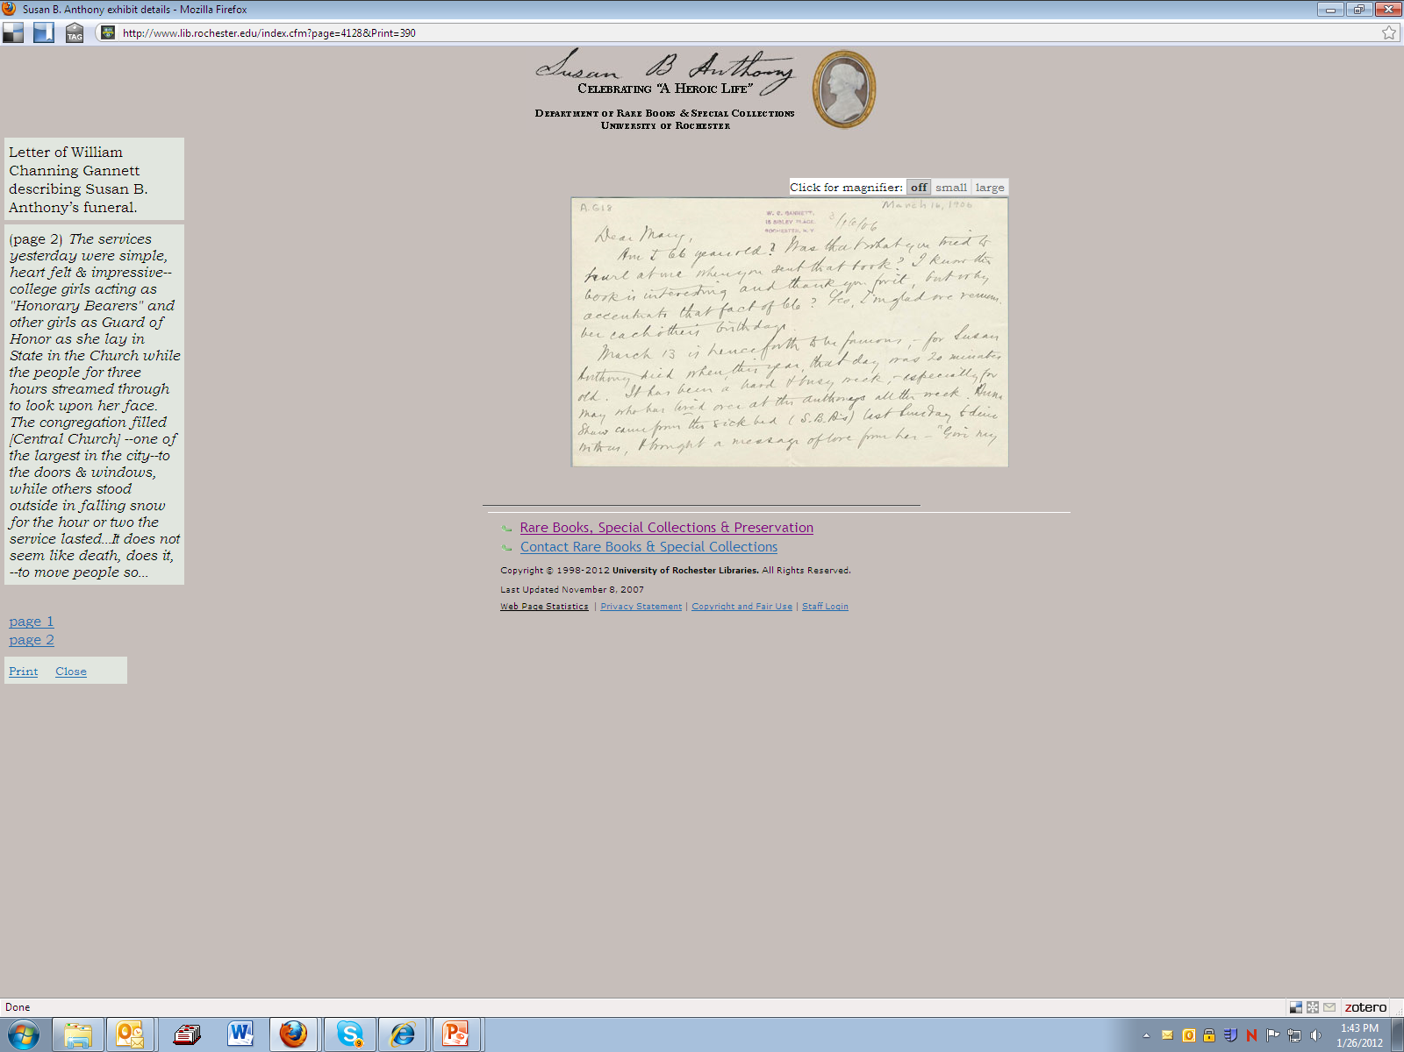
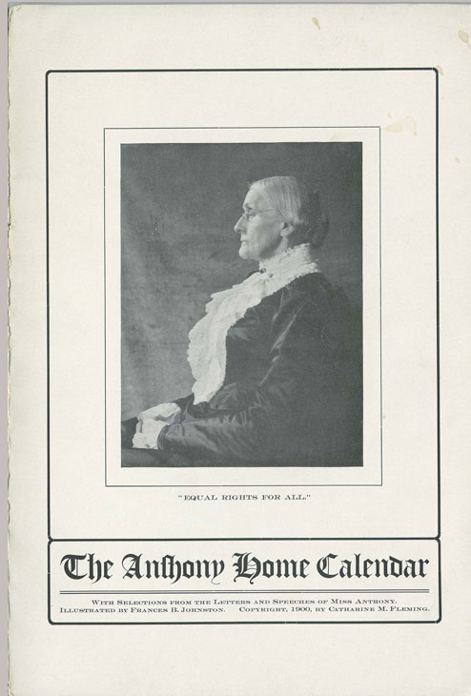

Slide 13
Is XC software the right tool?
Vision – where we need to go
Starting Point – what XC software does now
Plan – how XC can achieve the vision

Slide 14
What is XC Software?
Notes:
Translating User Research Findings into XC Functionality

Slide 15
What is XC software?
eXtensible Catalog (XC) is open source, user-centered, next generation software for libraries.
XC provides a discovery system and a set of tools for libraries to manage metadata and build applications.

Slide 16
“FRBRized” MARC records
Parsing MARCXML records into linked
FRBR-based XC Schema records
XC
Work
Work Expressed
XC
Expression
MARCXML
Bibliographic
Expression Manifested
XC Manifestation

Slide 17
XC discovery interface demo
http://www.extensiblecatalog.org/software/drupaltoolkit/demo
Notes:
User Interface – faceted browse
Show what’s underneath – not MARC data anymore although data came from our ILS
Sample search: supercapitalism
Choose any result
Looking at a full record
View XC Schema (I’m logged in)
Work, scroll down to expression and manifestation.
Uplinks.

Slide 18
Setting the Stage for Linked Data in XC

Slide 19
XC linked data accomplishments
Converting MARC data to FRBR entities as an interim step to produce better linked data
Designed underlying XC Schema to ensure easy conversion to RDF triples
Develop a plan for enabling linked data output form XC

Slide 20
RDF triple
Subject
Predicate
Object
oai:mst.rochester.edu: MST/
MARCToXCTransformation/
10081
http://id.loc.gov/authorities/sh85103735#concept
http://www.
extensiblecatalog.info/Elements/subject
This resource
has subject
Poets, American
Notes:
Uses terms from registered vocabularies

Slide 21
With and without FRBR
Without FRBR:
<MARCBibRecord-number> has_author “J K Rowling”
With FRBR:
<Work-id> has_creator “J K Rowling”
<Expression-id> has_language “English”
<Expression-id> has_parent_work <Work-id>
<Manifestation-id> has_isbn <ISBN-number>
<Manifestation-id> has_parent_expression <Expression-id>

Slide 22
Why use FRBR for linked data?
Provides a useful view of relationships between library resources, etc.
Facilitates transformation of MARC to FRBR-based RDA in a non-MARC environment
A logical place to start – other data models can be supported in the future

Slide 23
RDF Triple - Registered Data Elements
Subject
Predicate
Object
oai:mst.rochester.edu: MST/
MARCToXCTransformation/
10081
http://id.loc.gov/authorities/sh85103735#concept
http://www.
extensiblecatalog.info/Elements/subject
This resource
has subject
Poets, American

Slide 24
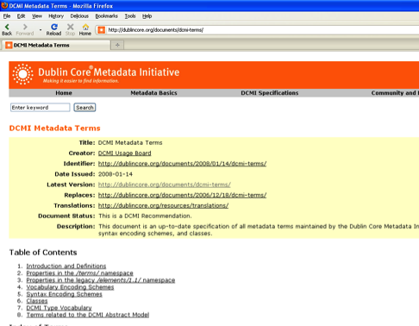
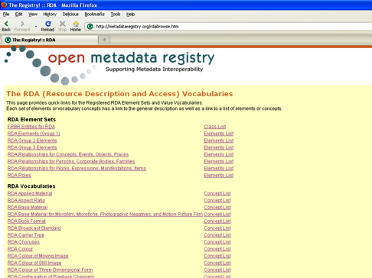
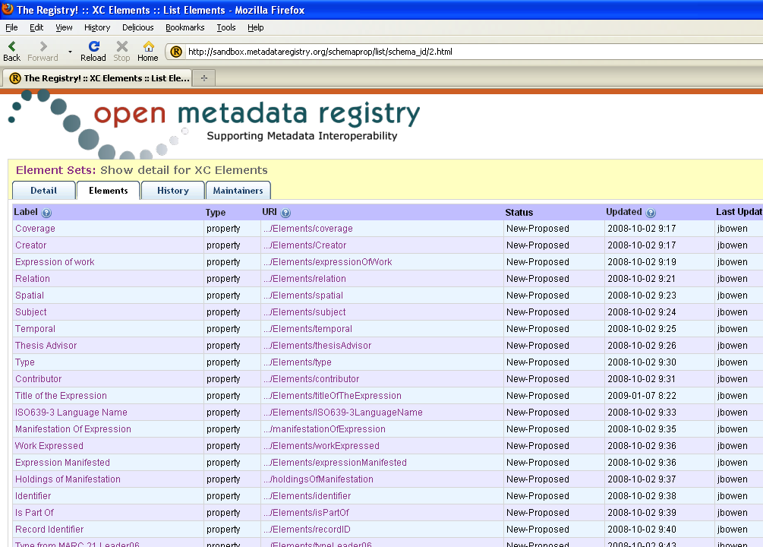
XC Schema Properties
DC
Dublin Core terms (all)
RDA – subset of elements and role designators
XC elements (newly-defined) – when necessary
All properties are from registered element sets.
RDA
XC
Notes:
Pull some elements from here and there…
OLD:
DC lacks frequency and numbering of serials
Role designator: composer, director

Slide 25
Our Plan for Linked Data in XC

Slide 26
XC: A platform for creating linked data
Bulk conversion of existing library metadata
Sync data conversion to existing systems
Allow libraries to do it themselves
Provide a way to experiment with data
Make linked data available to developers in formats that they need

Slide 27

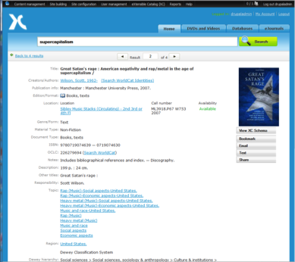
XC software
Drupal
Toolkit
MST
Toolkit
OAI
Toolkit
NCIP
Toolkit
User Interface
- Search
- Browse
Metadata Services
- Cleanup
- Format Convert
ILS Connectivity
Synchronize
data with XC
ILS Connectivity
- Circ. status
- Account info
Voyager
“Driver”
Voyager
“Driver”
Digital Repository
Voyager ILS
User Interface
Metadata
Live Circ. Data

Slide 28
XC linked data options
Drupal
Toolkit
MST
Toolkit
User Interface
- Search
- Browse
Metadata Services
- Cleanup
- Format Convert
RDFa (Drupal 7)
SPARQL Endpoint
RDF/XML Output Service/s
Notes:
[click] RDF/XML: Enable output from the Metadata Services Toolkit in RDF/XML records
Facilitate transformation from “records” to “statements”
Harvestable record sets
First: XC Schema; later: other MST services to transform other schemas to RDF/XML (not tied to FRBR)
[click] Provide a SPARQL query interface
Enable SPARQL by incorporating an existing Java framework for developing Semantic Web applications
Enable XC Metadata Service Writer’s API to enable storage and retrieval to and from linked data storage
What developers want…query for information on demand
Data from XC Schema first (FRBR-based), then conversion from other XML schemas
[click] RDFa
Web crawlers make use of tags in XML documents, so we will expose data as RDFa embedded in XHTML pages
Upgrade XC Drupal Toolkit to Drupal 7.x
First two are based on bulk conversion of existing metadata. This one presents opportunities to augment linked data based on user interaction with the discovery layer and the website

Slide 29
XC: A platform - for creating linked data tools!
Tools to create and manage local vocabularies
Tools to enable experts, etc. to augment instance data
Tools to create linked data as part of the scholarly process

Slide 30
Use cases for linked data tools
“This dissertation is based on this dataset…”
“My research cites this other research…”
“I need to manage these ten categories and subcategories of data in these tables…”
“This photograph is of the same person as in these other photographs…”
“This is a performance of the music in this manuscript…”
“My blog entry is a review of this video…”

Slide 31
Making the vision a reality
An invitation to:
Developers to contribute to testing and developing XC software code
Libraries to partner with us as we seek funding for linked data development

Slide 33
Download XC software at eXtensibleCatalog.org

Slide 34
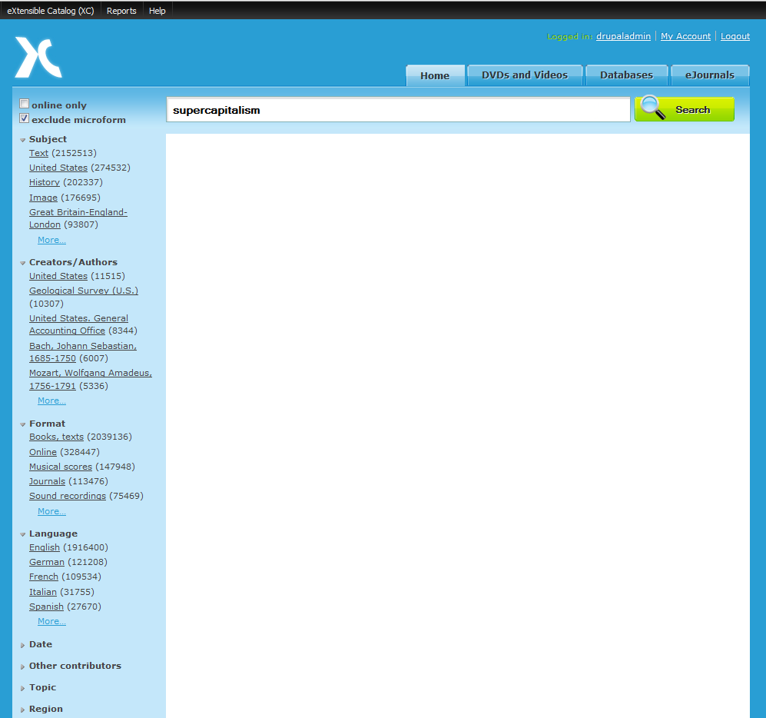

Slide 35
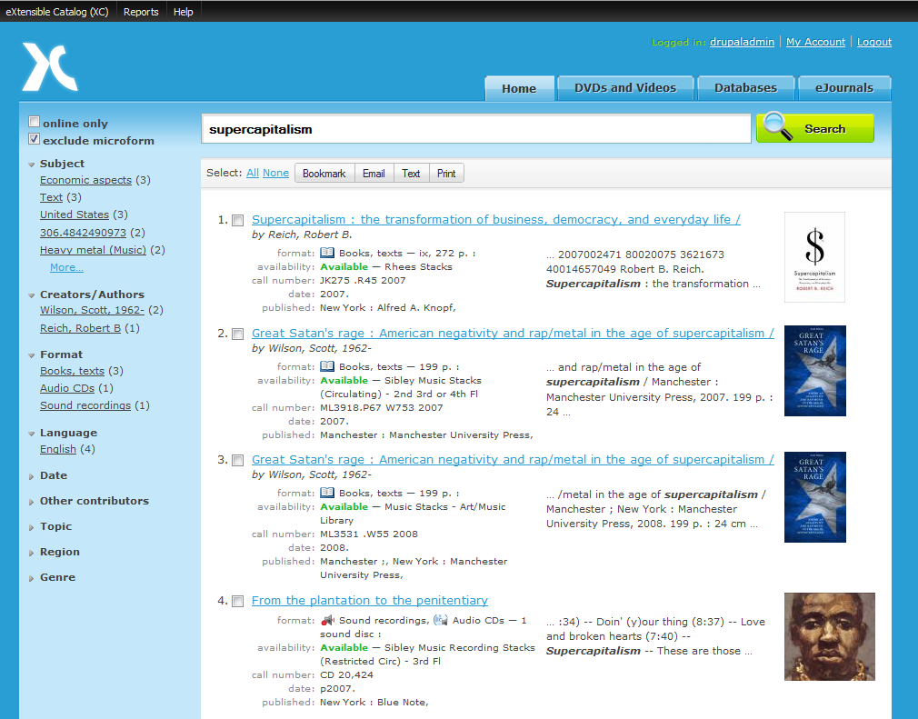

Slide 36
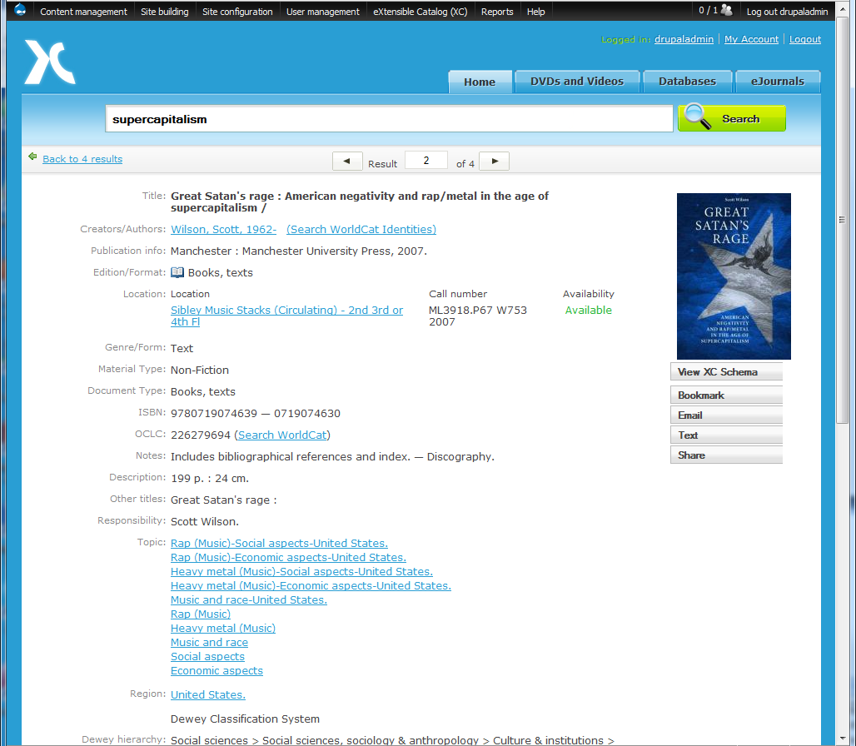
“View XC Schema”

Slide 37
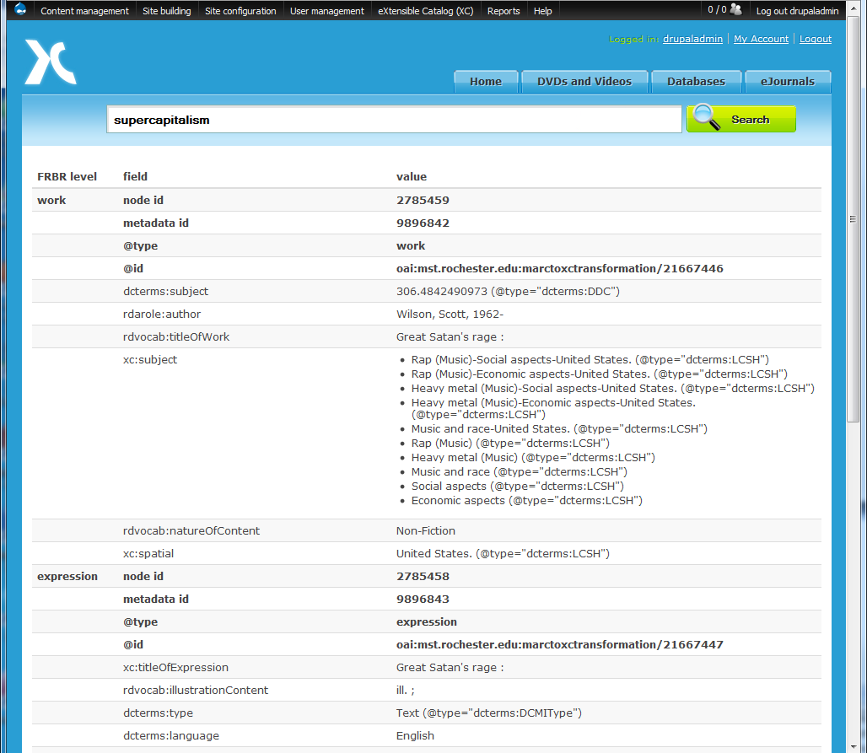

Slide 38
