Slide 1

We Are Not Alone:
A Guide to Using Social Media
RUC Social Media Workgroup Members:
Erin Winstanley, Meg Brunner, Gloria Miele, Nancy Sutherland, Lynn Kunkel, Raymond Anderson & Ed Weiss
Notes:
Social media may seem foreign to some of you
You might think it is a fad
You might think that it has no value in the professional world
So today we’d like to get you thinking about how we can use social media to disseminate information and build our virtual social networks to achieve the goals of the NIDA CTN

Slide 2
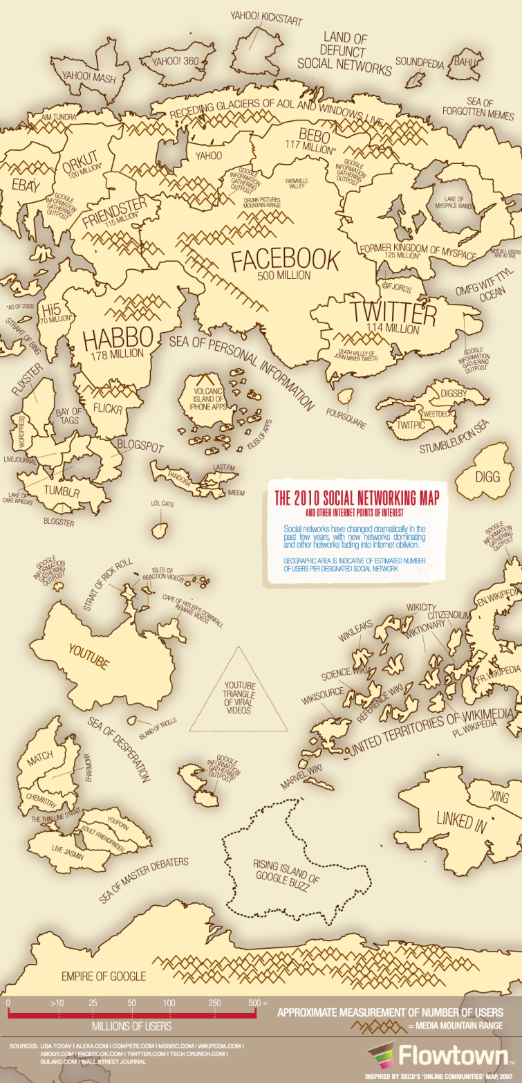
Social Media Revolution
Social media can be used to:
1) Disseminate information
2) Connect with individuals & groups
3) Research topics & trends
Notes:
Map is a hyperlink to a video (http://www.youtube.com/watch?v=x0EnhXn5boMideo)
According to the Pew Research Center:
78% of American adults access the internet
59% of adults have looked online for health information
70% of businesses are using social media

Slide 3
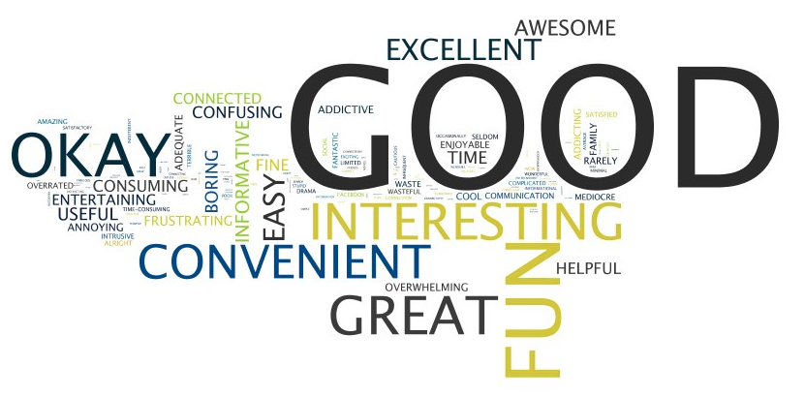
Overview of Social Media
“What is one word that describes your experience using social networking sites?”
Notes:
People are not social media resistant, we do not need an intervention to get them to log-on – they are already doing it
Social media is a communication mechanism that at least 50% of American Adults are using ….. which is a far greater reach than our journals or e-mail distribution lists
It’s even greater distribution than the most widely circulated newspaper (The WJS has a daily circulation of approx. 2 million)

Slide 4

Facebook
Most frequently used social media tool
More than 500 million users worldwide
50% of users log-on everyday
FACEBOOK FEATURES | WHAT YOU CAN DO
Posting information, pictures, videos, weblinks, or notes | Post the PAMI video, post links to CTN articles in the library, share links for important conferences
Communicating via mail or instant chat | Communicate with individuals within groups/organizations when you don’t have their email address
Schedule events, track RSVPs, & link to directions | Advertise your dissemination/training events, quickly notify participants of any agenda or location changes
Choose your friends & manage dissemination | Disseminate information to only targeted groups

Slide 5
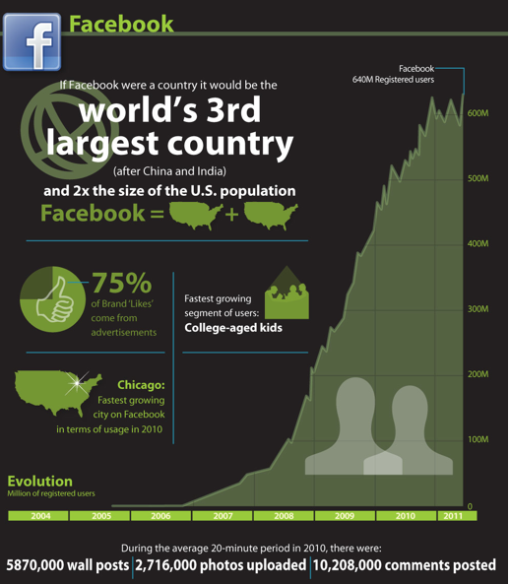
Facebook Stats

Slide 6
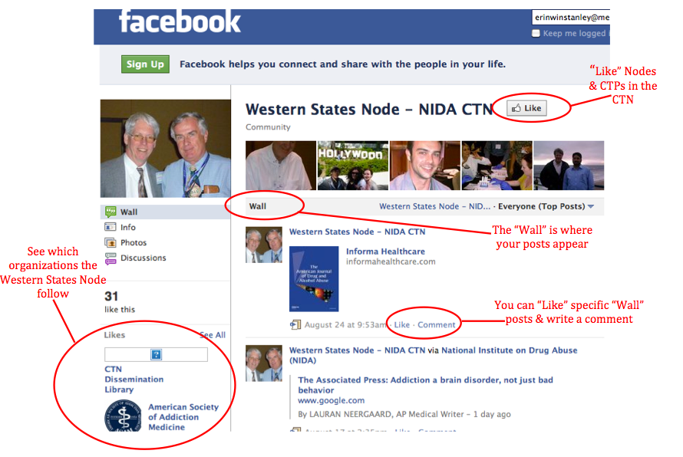
Facebook Examples

Slide 7
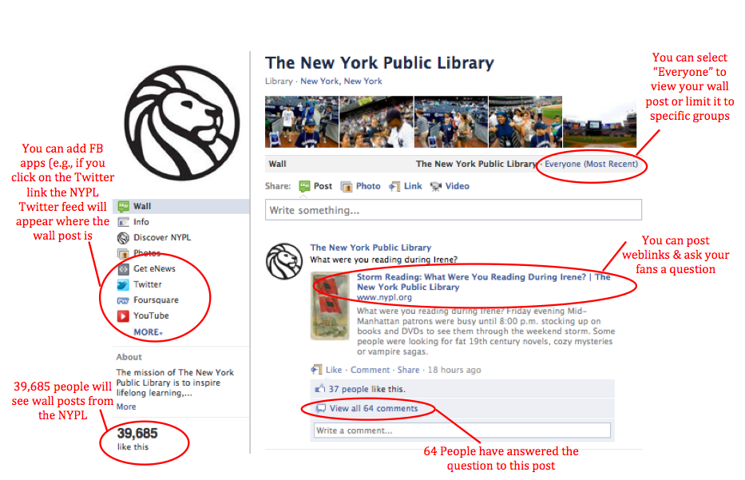
Facebook Examples

Slide 8

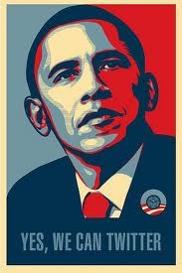
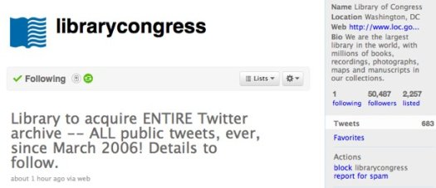
Twitter
Limits communications to 140 characters
Over 200 million users
155 million Tweets per day worldwide
Notes:
President Obama is the most frequently followed person on Twitter – he has 9 million followers
The health department of Alexandria, Virginia used Twitter & text messages to disseminate information on H1N1 vaccine locations with a near-immediate effect
To make this a little more relevant for us, after Hurricane Katrina the distribution of methadone was severely disrupted & therefore perhaps social media & text messaging may have a role in disaster planning for addiction & mental health treatment centers

Slide 9
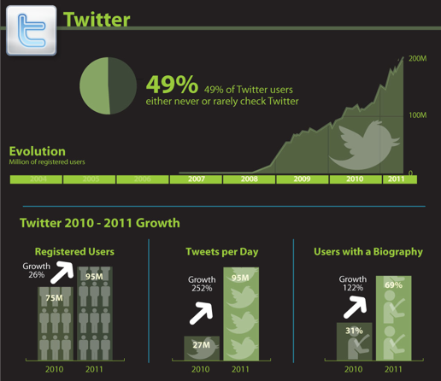
Twitter Stats
Notes:
While social media have provided us with a mechanism to widely disseminate information at virtually zero cost, that does not mean the message is being heard
We are not advocating that anyone of these social media platforms be used as a stand-alone tool for dissemination

Slide 10
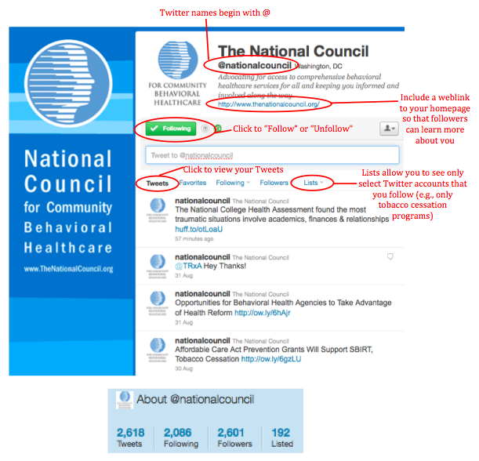
Twitter Example

Slide 11
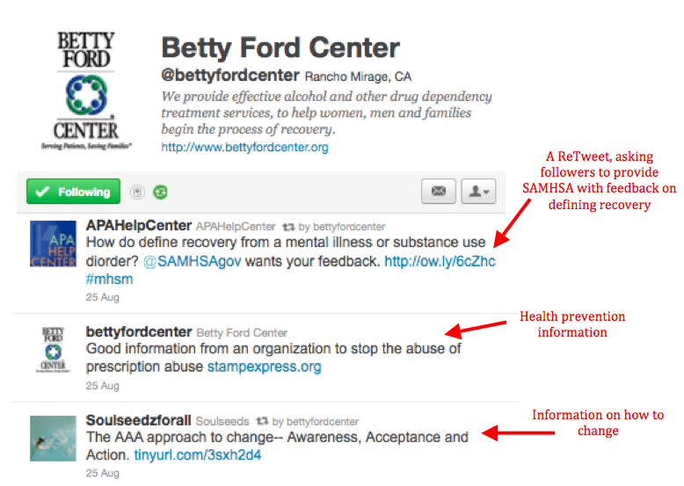
What Should I Post?

Slide 12
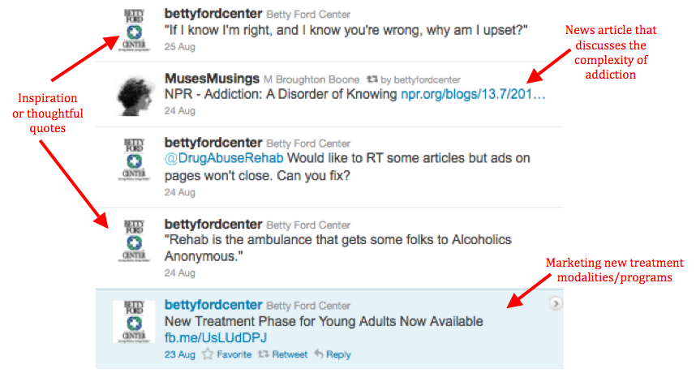
What Should I Post?

Slide 13
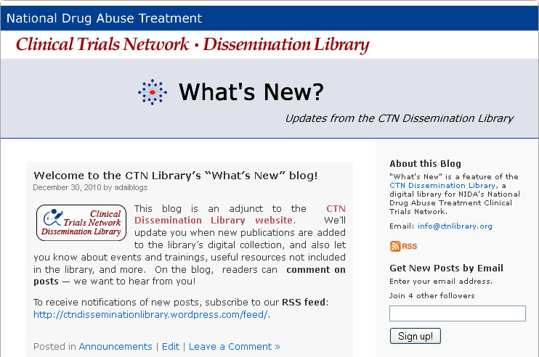
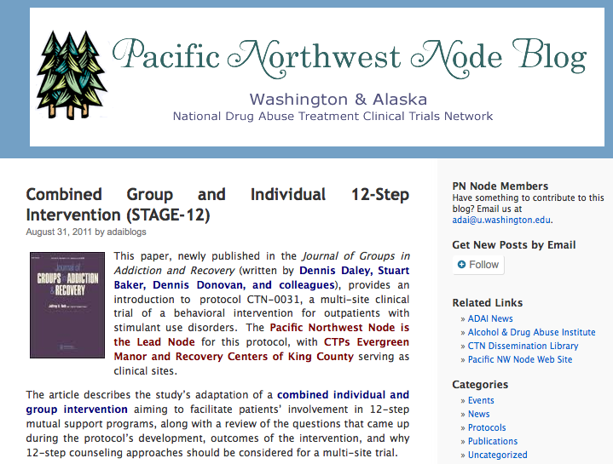
Blogs
Blogs are a social media platform
Interactive & can combine text, video, photos, audio & links
Readers can leave comments
Free blog platforms Wordpress.com or Blogger.com

Slide 14
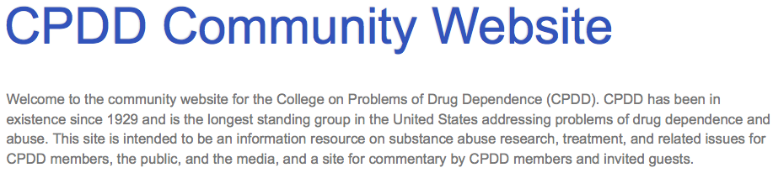
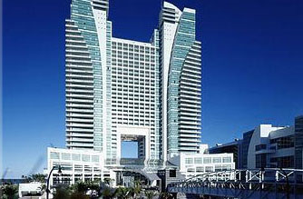

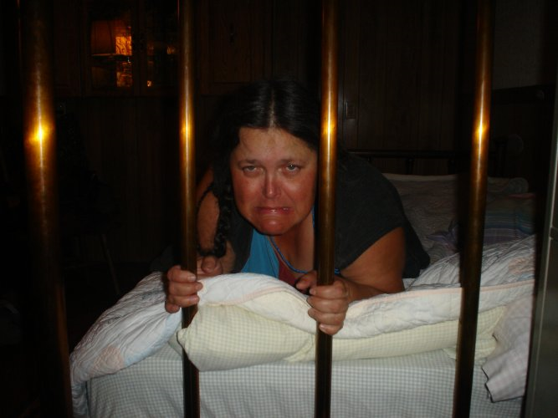
Blog Examples
“Highlights from the NIDA Director’s Address at the joint Plenary Session of the College on Problems of Drug Dependence and the International Narcotics Research Conference”
Notes:
I was not able to attend CPDD this year, but I was able to catch up with some of the information presented at CPDD on the CPDD Blog

Slide 15

LinkedIn
Over 100 million professionals
Connect with professionals & seek employment
Forum for job-related questions
Very easy to use, very professional
Cool Applications within LinkedIn:
Use Box to post documents
Use SlideShare to share presentations
Use TripIt to connect with your network when you travel

Slide 16
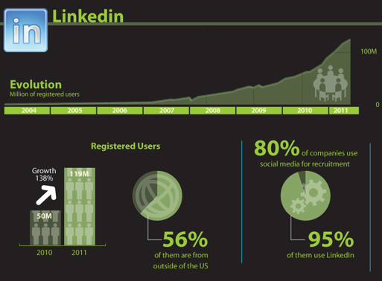
LinkedIn Stats

Slide 17
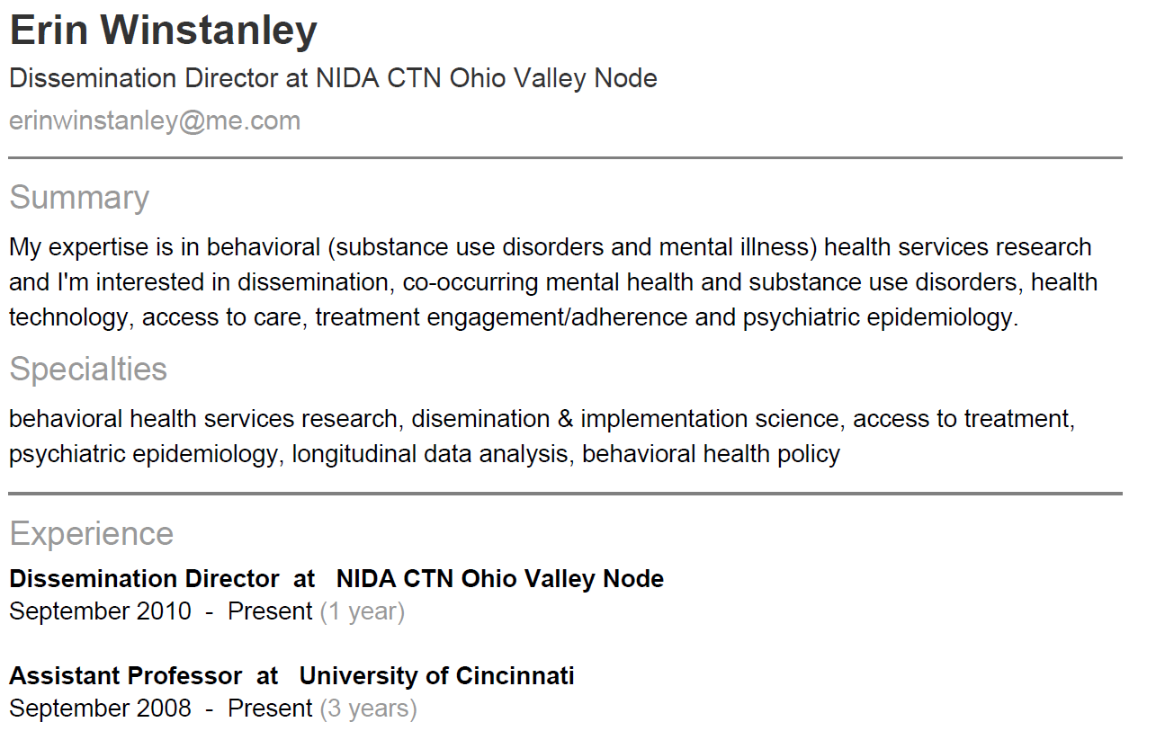
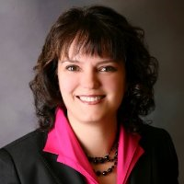
LinkedIn Example

Slide 18
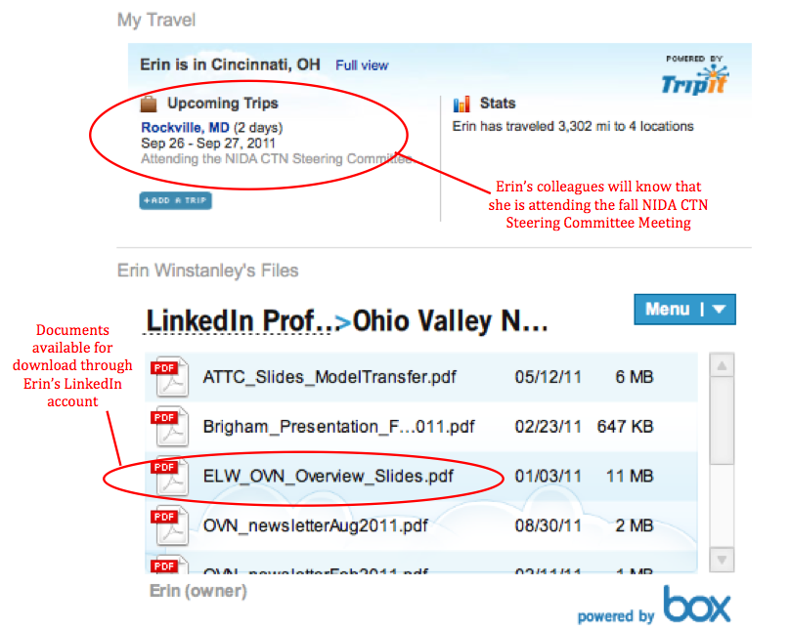
LinkedIn Example
Notes:
The information on LinkedIn may be better posted on an organizational website, but this lets me connect with my professional colleagues who are unlikely to visit the OVN website – they know what I do & this allows me to disseminate information quickly to them, they have the option of whether they want to learn more about a particular topic that I post or not

Slide 19
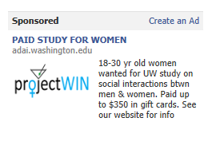
Research Tool
Social media tools are being used as a tool to recruit study participants & follow-up with study participants
CTN 0044 is using social media to contact and locate study participants for follow-up
Not all IRBs are open to using social media in research, with concerns about confidentiality
Standard guidelines for using social media in clinical research do not exist and could be valuable to the research community

Slide 20

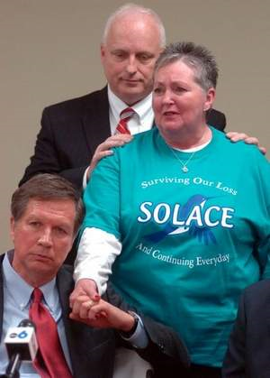
Example of Using Social Media to Fight Prescription Drug Abuse in Ohio
Fix the Scioto County Problem of Drug Abuse, Misuse, and Overdose
3,874 Members on Facebook (group), public forum to discuss prescription drug abuse & what is being done in the community to respond to the problem
Portsmouth Ohio Rx Drug Task Force
Meets monthly, representatives from various State & local agencies attend
SOLACE
Support group for people who have lost someone due to drug addiction or drug-related crimes
Facebook group
Notes:
These groups meet in person, but have significantly expanded their networks by including virtual members
Picture description: Gov. John Kasich holds Barb Howard's hand Monday while State Rep. Terry Johnson gives her shoulders a comforting squeeze, as Howard shares the story of her daughter's death from prescription drug abuse during a news conference at The Counseling Center. / Heather Cory, Gazette
Jo Anna Krohn founder of SOLACE (Surviving Our Loss & Continuing Everyday) lost her son Wes to an overdose in 2008 (he was 19 years old)
SOLACE is working with ODADAS to expand State-wide

Slide 21
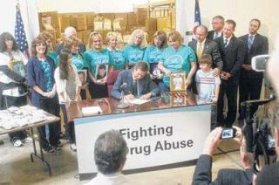
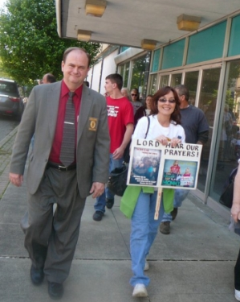
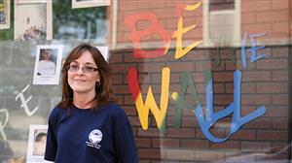
Grassroots Community Organizing via Social Media
Pill mill protests
Share information, photos, & videos
T-shirts
“Be The Wall”
National Day of Prayer
Seven Marches in Seven Days
Local pain clinic ordinances
Tax levy to fund prevention efforts
The Facebook group allowed them to rapidly disseminate information on 1) events, 2) progress towards reaching goals, & 3) immediately share successes
Notes:
The grassroots group has used Facebook to organize several different types of events
Based on participation in this group, I can tell you that the following people are on FB:
Director of ODADAS
Scioto County Public Health Commissioner
Portsmouth Chief of Police

Slide 22
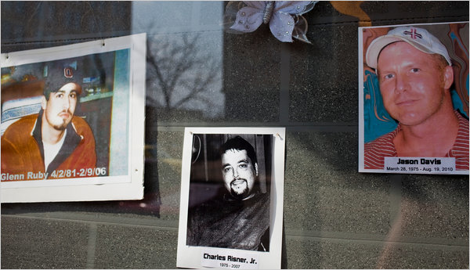





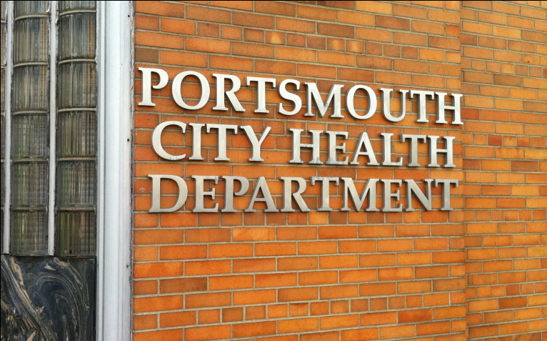
Ohio County Losing Its Young to Painkillers’ Grip (April 14, 2011)
Drug Czar Warns About Prescription Painkillers
Americans take 80 percent of all prescription painkillers taken in the world
.
Gov. Kasich vows to drive the devil out of Scioto County
Ohio’s Opiate Epidemic: A Summit on Policy, Prevention & Treatment
Notes:
There has been a tremendous amount of national media attention on Scioto County and in fact, the head of Public Health in Portsmouth (Dr. Aaron Adams) declared drug abuse a “public health emergency” in January 2010
A&E’s Intervention called “Hillbilly Heroin”
Nightline
PBS
National Geographic
60 Minutes
NY Times
Men’s Health (magazine)
It’s difficult to keep-up with all of the media attention

Slide 23
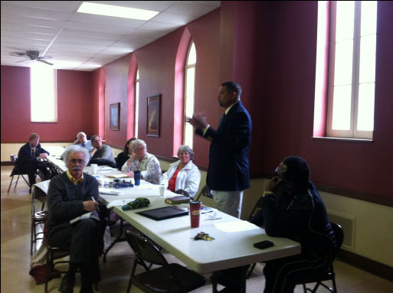
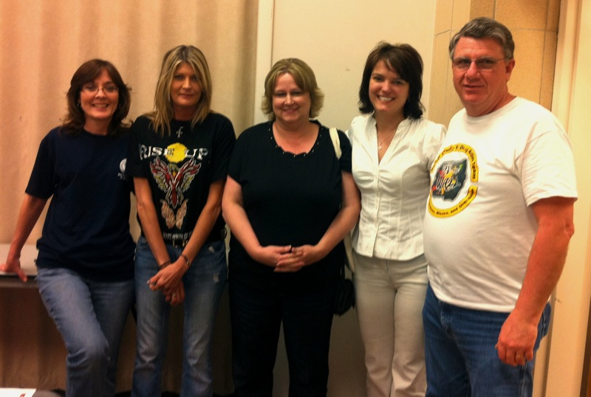
Connecting Virtual & Real Networks
Social media can be a mechanism to:
Connect with community-based organizations
Maintain relationships across geographic space

Slide 24
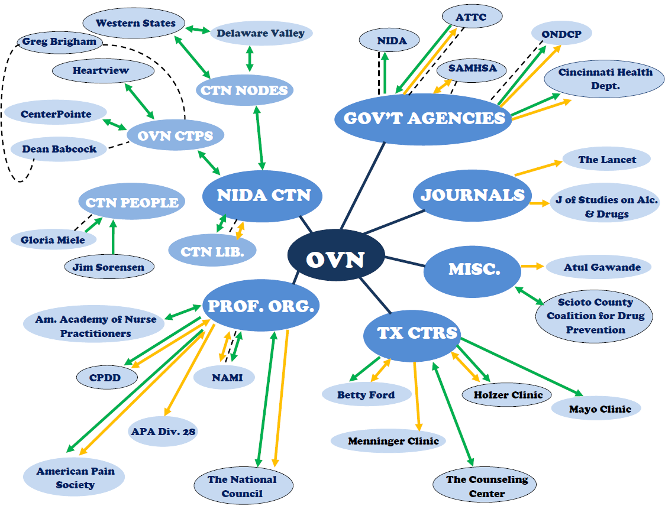
N=305
Notes:
We aren’t alone ….this is just an example of the OVN’s social media virtual network
Green arrows represent Facebook relationships, Orange represents Twitter relationships, black circles represents that we have a in-person relationship & dotted lines represents LinkedIn connections
We’ve had over 350 tweets
This year our Facebook page has had over 29,000 views, 49 people/groups like us & about an average of 80 monthly users (peak of 350)
We have a 137 followers on Twitter

Slide 25
Pros & Cons
Advantages:
Rapid dissemination
Connect with people & organizations that are geographically remote
Reinforce existing relationships
Expand social networks
Disadvantages:
Limited reach to older persons & disadvantaged
Fast pace
Changing technologies
Confidentiality & anonymity
NEED MORE DATA!!
Notes:
One CTP that I spoke with said that it is exciting, but a little scary because it’s such a different way of doing business

Slide 26
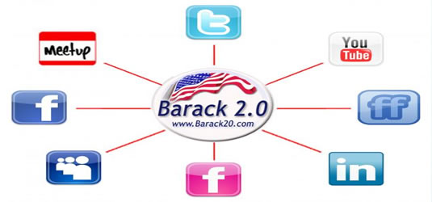
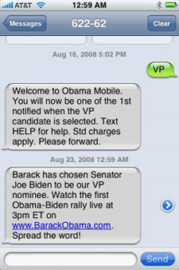
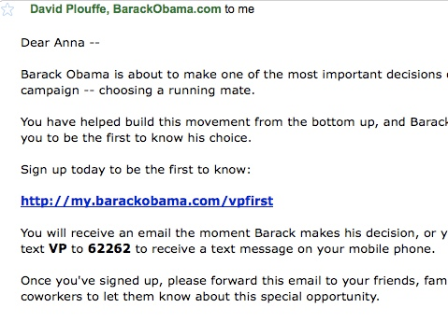
Obama=115,623
McCain=4,911
Obama=117,873
McCain=2,902
TEXT
Obama=3,000,000
McCain=319,000
E-MAIL
Notes:
Moving forward, what do we know?
We know that social media is one tool, with a limited purpose & reach, but that can be combined with other internet-based strategies make social change happen despite the odds …. All of these activities are anchored by the website change.gov
Some candidates ignored the blogger in favor of the legitimate press, Obama listened to the bloggers
The “Yes we can” video was produced by WilliamIam and directed by Jesse Dylan (Bob Dylan’s son) – this video immediately went viral and since it has been viewed over 22 million times
Can you imagine how awesome it would be if a CTN publication or video got only 100,000 hits?

Slide 27
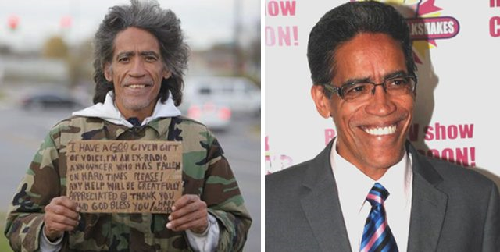
Final Remarks
Social media tools are about relationships
Dissemination is far reaching & immediate
Bridge geographic distances
Enhanced value when combined with other dissemination strategies
Be mindful of that which you cannot see
Utility as a clinical tool is unknown at this time
Notes:
We should consider a strategic and coordinated approach towards social media, as well as determine how best to anchor & centralize these sorts of activities

Slide 28

Next Steps
Develop a coordinated NIDA CTN social media strategy
Create a venue for CTPs to share their own experiences using social media tools
Develop a survey to determine social media use & interest
Develop a webinar or presentation on the basics of using Facebook & Twitter for CTPs
Expand our knowledge of using social media tools to recruit & follow-up research participants
Notes:
We should consider a strategic and coordinated approach towards social media, as well as determine how best to anchor & centralize these sorts of activities

