Slide 1

The South-Eastern Norway Regional Health Authority
Grete Solli,
Senior Adviser CSR

Slide 2
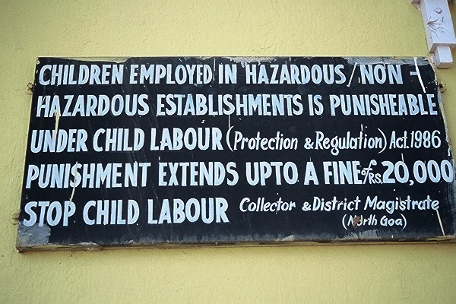
To walk the talk
- Taking corporate responsibility in public procurement
Brussels Oct. 19th,2012

Slide 3

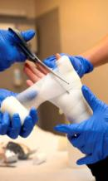

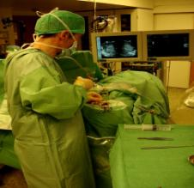

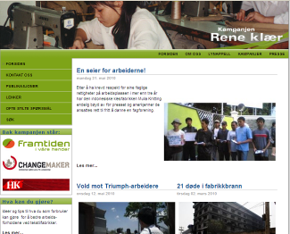
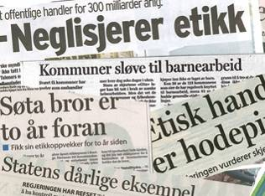
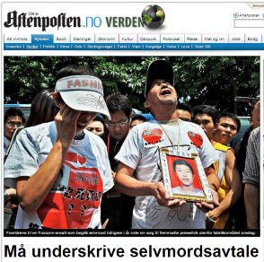
Purchasing products from low cost countries
Textiles
Bandages
Medical equipment
Furniture
…is taking a high risk
Textile industry
Public procurments
Electronics – Foxconn…

Slide 4
Our Board 10.12.2009:
The South-Eastern Norway Regional Health Authority shall be a driving force for ethical trading and undertakes to set requirements for an ethical supply chain wherever this is a relevant issue.

Slide 5

Asking or demanding?

Slide 6

Our success criteria
Dialogue
Cooperation
Capacity building
Time
Demand
Following up
But never:

Slide 7

What is important for the supplier?
Dialogue
Standards
Procedures
Trust
Time
Predictability
---------
Reputation
Sustainbility
Competition advantage

Slide 8
Following up
Standards make it easier for all parts
Use the ILO conventions and national laws
Public procures should share their results
Be aware of audit fatigues
Start by checking the suppliers systems, not a far-distant factory
Demand improvements and cooperation, not guarantees
Be reasonable and predictable
Not ”compliance or die”, but ”cooperation or no new contract…”
Communicate the importance from the top level management
AND: Following up etichal demands as a integrated part of generell following up of the supplier contract

Slide 9
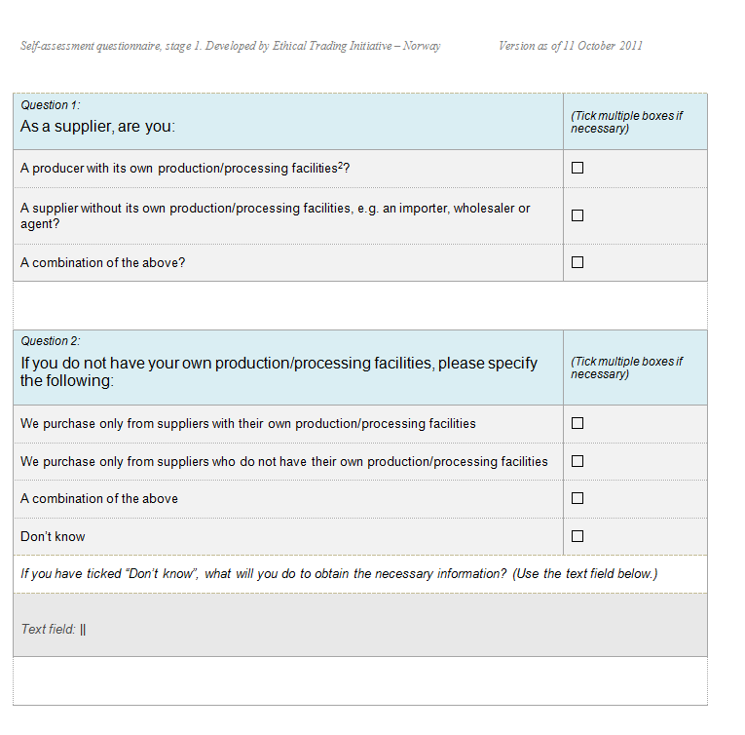

Slide 10
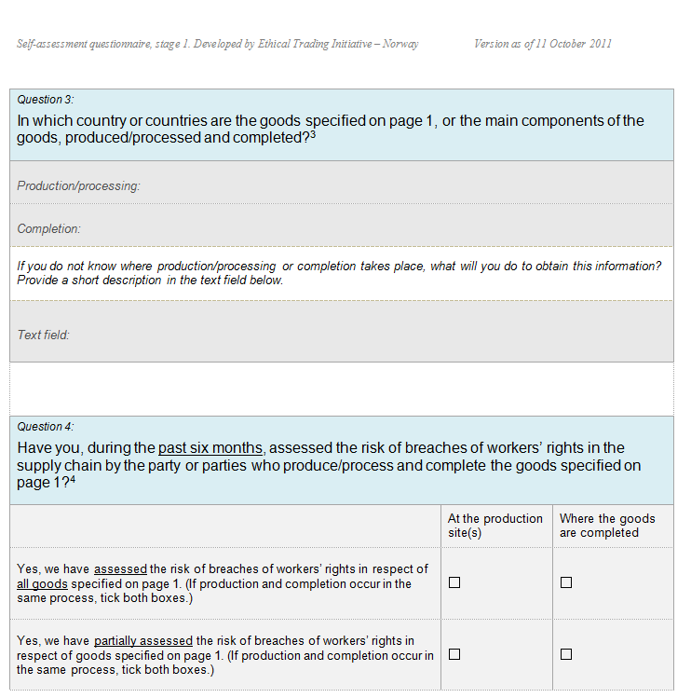

Slide 11
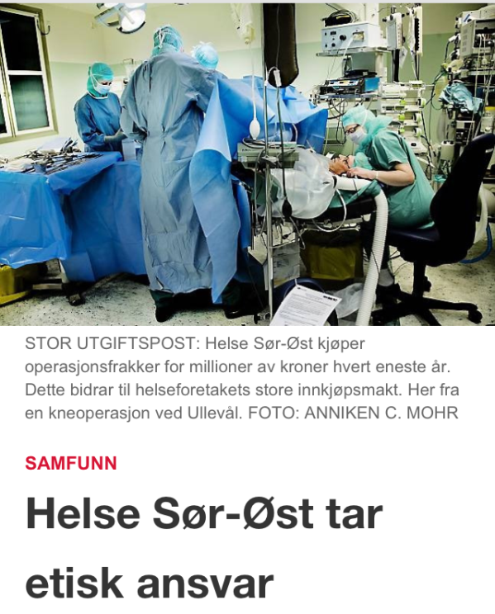
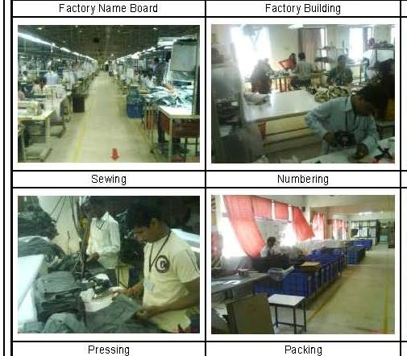
But we have to show that we mean it
AUDIT IN INDIA
THAILAND

Slide 12
Case 1, Textiles in India
October 2010
Nov. 2011
Jan. 2011
April 2011
Sept. 2011
04.10.2010: Kontraktsmøte
Dato: Egenrapp.skjema trinn 1til leverandører. Svarfrist 25.10.2010.
Dato: Egenrapp.skjema til produsenter. Returnert 05.11.2011
Dato: Risikoanalyse av skjema for produsenter
Dato: Vurdering av skjema trinn 1 for leverandører
Des.: Besluttet å foreta kontroll hos produsent i India
Des: Oppdragsbeskrivelse utarbeides, forespørsel til tre leverandører per e-post
Jan.: Level Works tildeles oppdraget
Medio feb.: Semi-annonsert kontroll. Rapport og CAP
Medio mars: Brev til SWM med rapport, CAP og vedleggsbrev med frister for utbedring
Mai: Oppfølging hos produsent. God fremdrift.
Notes:
Innledningsvis: Kort forklare roller og ansvar: Helse Sør-Øst, Sykehuspartner og IEH
04.10.2010: Si noe om hva som ble sagt om etiske krav i kontraktsmøtet
Dato: Kort beskrive hensikten med egenrapporeringsskjema trinn 1. Vise skjema. Ble fristen overholdt? Hadde Sverre Monsen spørsmål til skjemaet?
Dato: Kort beskrive hensikten med egenrapp.skjema for produsenter. Risikoanalyse i RAID
Dato: Vurdering av svarene i trinn 1, samt risikorapport fra RAID. Vise vurderingsskjema
Des. 2010: Besluttet å gjennomføre kontroll. Hvordan ble dette formidlet til SWM?
Des. 2010: IEH utarbeider ToR (oppdragsbekreftelse). Si kort hva som står i denne.
Jan 2011: Oppdraget tildeles Level Works. Si litt om selskapet (utbrytere fra Bureau Veritas)
14. og 15. februar 2011 foretar LW en semi-annonsert kontroll hos produsent i India, dvs. underleverandør til SWM. Rapporten foreligger 19 februar og viser fire avvike fra de etiske kravene. Corrective Action Plan, eller forbedringsplan, beskriver manglene, hvordan de kan utbedres og tidsfrister.
Mars 2011: Helse Sør-Øst sender rapport og CAP til SWM, sammen med et vedleggsbrev.
Mai 2011: LW gjør ny kontroll. Produsenten viser god fremdrift i arbeidet.
September: Status og planer ….
Grete: Si litt om hvor mye jobb det har vært, om læring og erfaringer.

Slide 13
Letter to the fabric in India
Dear sir As you will know our company are supplying the type of garments we are now going to produce in Karlegroup to the Norwegian public hospitals.
As part of the tender we got, are also the rules with e.i. the Code of Conduct you were signing. One rule which we also have to comply with is that the companies with whom we are dealing / producing must open for a so called Social Audit. For what I know you might be familiar with this from others of your international customers. However I herewith inform that this Social Audit will be carried out by a company called: Level Works, a worldwide reckoned company doing this type of work. They have in mind being there on the 18. and / or the 19. of January, but will contact you for further details. For the sake of good order, and to avoid any insecureness regarding our relation I herewith state that: We will not penalize the factory / Karlegroup if for some reason the audit should show that you are breaching local law or ILO Convention. We have given you and xx as contact persons. In case you would want anyone else, or someone in addition, to be involved; please let me know. Best regards

Slide 14
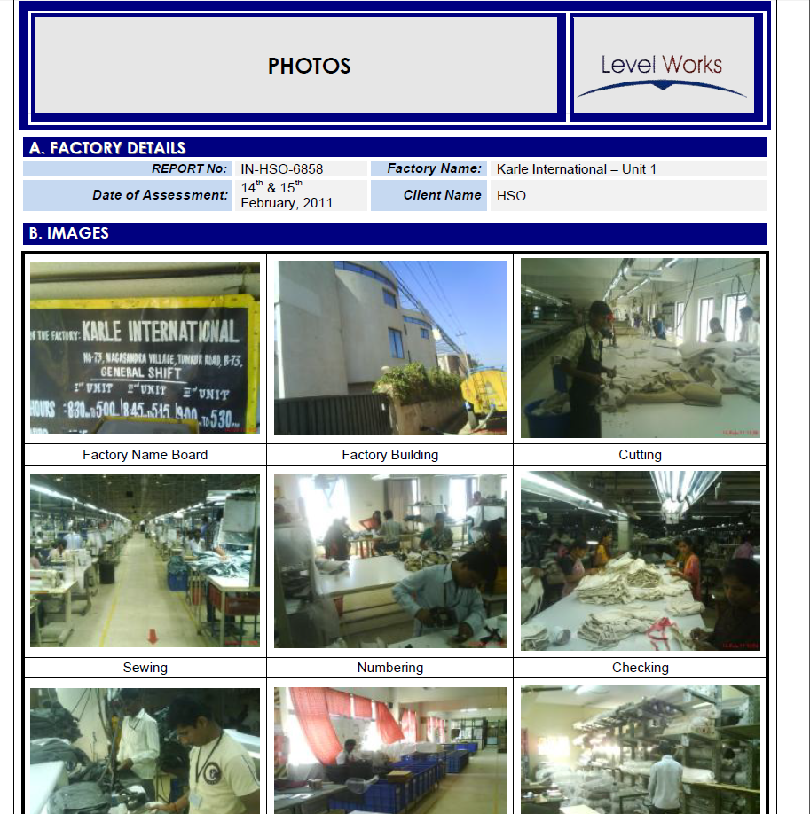
Some pictures

Slide 15
Cap – Correction Action Plan
An important tool for improvements
Corrective Action Plan
Non-Compliance Number The reference number of the non-compliance from the Audit Report, for example, Discrimination No.7 | New or Carried Over Is this a new non-compliance identified at the follow-up or one carried over (C) that is still outstanding | Details of Non-Compliance Details of Non-Compliance | Recommended Corrective Actions Details of actions to be taken to clear non-compliance | Recommended Completion Timescale Timescale (Immediate, 30, 60, 90,180,365) | Verification Method Desktop / Follow-Up | Agreed by Management and Name of Responsible Person: Note if management agree to the non-compliance, and document name of responsible person | Verification Evidence and Comments Details on corrective action evidence | Status Open/Closed or comment
Health & Safety 1 | New | In accordance with The Factories Act, 1948 Sec 45 adequate number of workers have to be rained for first aid use. During the current assessment, it was noted that the factory had trained only 7 workers besides having the ambulance room, which is inadequate considering the number of workers in the factory, shifts and availability of first aid boxes. | The factory should train adequate number of workers for use of first aid to cover both the shifts according to the strength. | 30 days | Follow up | Yes. Responsible person Mr. xx
Hours of Work 2 | New | In accordance with The Factories Act, 1948, Sec 51, 54 & 64 the total working hours in this factory (including overtime) should not exceed 60 hours in a week or 12 hours a day and the total overtime should not exceed 75 hours in a quarter. During the current assessment, it was noted that about 5% of the workers in the factory were working up to 16 hours a day and/or 100 hours in a week or doing overtime of about 150 hours a month. Such excess overtime was more prominent in finishing. | Working hours to be limited to a maximum of 60 hours a week and overtime to be restricted to a maximum of 4 hours a day and 75 hours in a quarter. | 180 days | Follow up | Yes. Responsible person Mr. xx

Slide 16
Fair competition
Supplier number 1 – Control of supply chain according to human rights and working conditions
Supplier number 2 – Do not care about these issues
Is it fair competition to treat them equally?

Slide 17
Interesting links
British Medical Association:
http://www.youtube.com/watch?v=iJ_vvac2tyE&list=UUkIrTSRB-QmCldJKquf_8BQ&index=3&feature=plcp
IEH- Ethical Trading Initiativ Norway
http://etiskhandel.no/English/index.html
ETI – Etichal Trading Initiative Britain
http://www.ethicaltrade.org/

Slide 18
Thank you!
grete.solli@helse-sorost.no

