Slide 1
Basics of Nuclear Data Evaluation and Perspectives
H. Leeb
Atominstitut,TU Wien, Austria

Slide 2
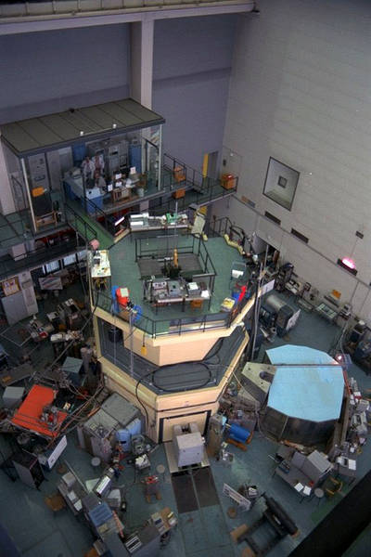
Research at the Atominstitut
atomic physics, quantum optics
(J. Schmiedmayer)
radiation physics
(Ch. Streli)
low-temperature physics,
Super conductivity
(H. Weber)
applied quantum physics
(N.N.)
nuclear and particle physics
(H. Leeb)
neutron and quantum physics
(H. Abele)

Slide 3
Nuclear and Particle Physics
Nuclear Physics and Nuclear Astrophysics (H. Leeb)
scattering and reaction theory, nuclear data evaluation
Hadron Physics and Fundamental Interactions (M.Faber,
H. Markum)
exotic atoms, lattice gauge theory
Experimental Particle Physics (Ch. Fabjan)
detector developments, data analysis techniques
directly linked to the Institute of High Energy Physics
of the Austrian Academy of Sciences

Slide 4
Nuclear Physics and Nuclear Astrophysics
Theoretical description of scattering and reaction processes
and the interpretation of observables with regard to interactions
and underlying structures in basic and applied physics
Scattering and reaction theory
inverse scattering techniques
optical potentials and specific reactions
phase problem in quantum mechanics
Neutron-induced reactions
nuclear data evaluation
nuclear astrophysics
involvement in the experiments
at n_TOF@CERN and in Geel

Slide 5
Experiments: n-induced cross sections
n_TOF@CERN
(n,γ) cross sections for transmutation and astrophysics
GELINA (JRC)
(n,2n) cross sections via prompt γ-decay
Experiments performed within collaboration:
TU Wien and University of Vienna
G. Badurek, E. Jericha, H. Leeb, A. Pavlik, A. Wallner

Slide 6
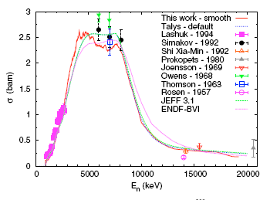
(n,xn) cross sections
E. Jericha (TU Wien)
A. Pavlik (Univ. Wien)
GELINA (JRC)
²⁰⁹Bi(n,2n) cross sections
Measurement of prompt
γ-rays of the residual
nucleus (even A)
4⁺
2 ⁺
0 ⁺
Mihailescu et al. ND2007

Slide 7
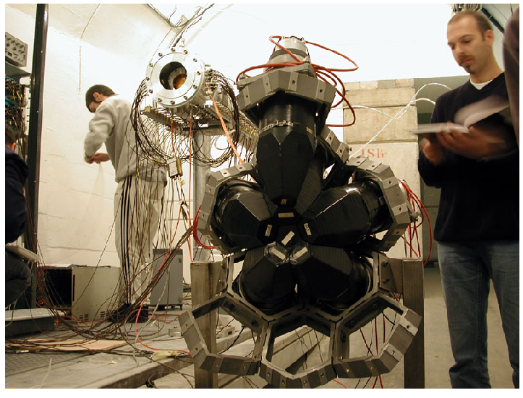
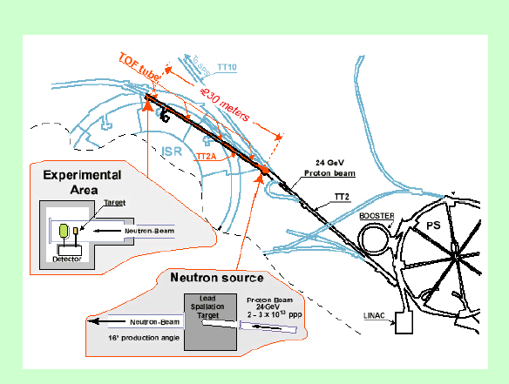
(n,γ) cross sections
n_TOF@CERN
(n,γ) (n,f)
4π total absorption
calorimeter (TAC)
astrophysical relevance
s-process
main responsibility of TU Wien: proper uncertainty analysis

Slide 8
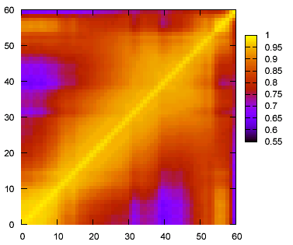
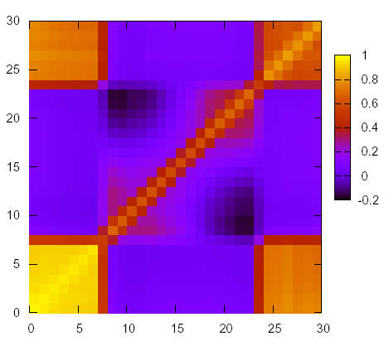
Experimental uncertainties at n_TOF
²³²Th(n,γ)
¹⁵¹Sm(n,γ)
E MeV
E‘ MeV
¹⁵¹Sm(n,γ)
²³²Th(n,γ)
E‘ MeV
E‘ MeV
normalized covariance matrix of the n_TOF experiment

Slide 9
Nuclear data evaluation
Start of Modern Data Evaluation:
recommended values of fundamental physics constants (c, h, α_{f}, ... )
Dunnington (1939); Du Mond and Cohen (1953)
Present Status:
At present Evaluated Nuclear Data Files represent a consistent set of
cross sections and associated quantities for all relevant reaction
processes. Most data files are limited to the energy region below
20MeV.
There exist several nuclear data libraries with evaluated cross section
data, but only few files contain uncertainty information → the reliability
Is still an open question.
JEFF3.1, ENDF/B-VII, JENDL, CENDL, …

Slide 10
Concept of evaluation
Nuclear data evaluation is essentially a procedure following
the rules of Bayesian statistics within a subjective interpretation the probability reflects our expectation → no experimental verification
Evaluation is given in terms of
- expectation values of observables - covariance matrices of observables (cross sections)
BAYESIAN STATISTICS

Slide 11
Bayes theorem
Bayes Theorem (1763):
p(x|σ M) = p(σ |xM) p(x|M) / p(σ |M)
posterior = likelihood x prior / evidence
x ... model parameter σ ... data M ... other information
from experiment
Choice of proper prior ?
Expectation value:
Covariance matrix element:

Slide 12
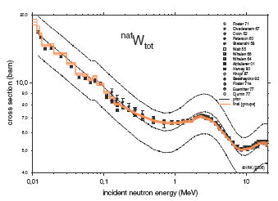
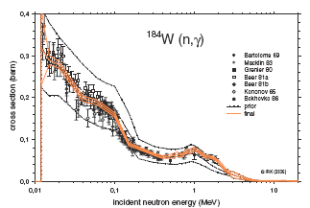
Evaluations done by Vonach et al.
First evaluations in the field of nuclear date which include uncertainties were performed by Vonach et al. (Univ. Vienna) about 1990
They considered nuclei where many experimental data have been available
→ choice of prior not essential
S. Tagesen, H. Vonach, A. Wallner, ND2007

Slide 13
Developments in nuclear data evaluation
Current Demands:
Inclusion of uncertainty information → covariance matrices
Extension of energy range to ~150MeV
Challenges:
Evaluation process and covariance matrices – scarcity of experimental data for E > 20 MeV → quest of uncertainty of nuclear models
Improvement of models: nuclear reactions, fission, …

Slide 14
Bayes theorem
Bayes Theorem (1763):
p(x|σ M) = p(σ |xM) p(x|M) / p(σ |M)
posterior = likelihood x prior / evidence
x ... model parameter σ ... data M ... other information
from experiment
Choice of proper prior ?
Expectation value:
Covariance matrix element:

Slide 15
Choice of proper prior
GOAL
quantitative estimate of the reliability of nuclear model
based evaluations
Define an almost unbiased prior
Account for all apriori knowledge
Minimal use of experimental data

Slide 16
Sources of uncertainties
The contributions to the covariance matrix of the model are
M^{(mod)} = M^{(par)} + M^{(num)} + M^{(def)}
parameter uncertainties
Model defects
non-statistical error
numerical
implementation
error
EFFDOC-1047

Slide 17
Parameter uncertainties
For most cases where there is no obvious prior Baye proposed to apply
Laplace principle of insufficient reasoning, i.e. a uniform distribution
Main criticism from objectivist: the choice of prior is arbitrary !!!
INFORMATION THEORY (Shannon 1949)
Information entropy:
The amount of uncertainty is maximal if the entropy is maximal.
Assumption: Besides the marginalisation we know an expection value

Slide 18
Theory for prior determination
Principle of maximal information entropy
Information Entropy
Constraints
prior
Determination of
Lagrange par. λ
partition
function
variance
Invariant measure to account for continuous parameters:
for scaling parameters:

Slide 19
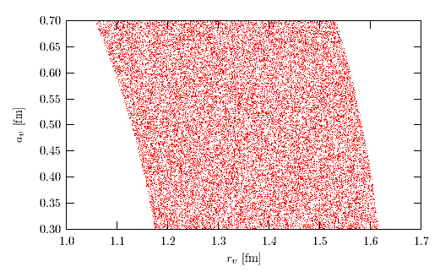
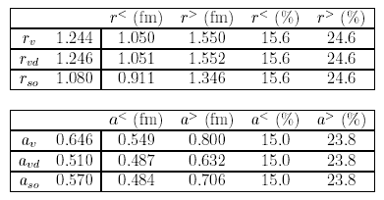


Admissible range of parameters
dependence on a_{v} of
admissible range in r_{v}
admissible range in a_{v}
z defines lower boundary

Slide 20
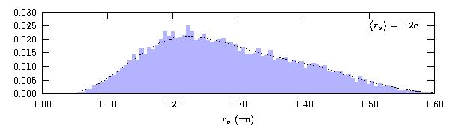
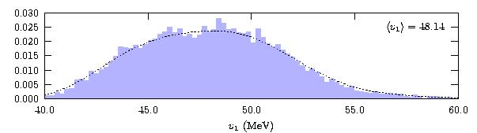
Parameter distribution for ²⁰⁸Pb
potential parameters
r_{v} (fm)
v₁ (MeV)

Slide 21
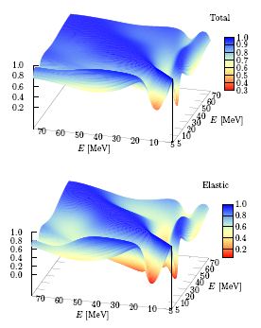
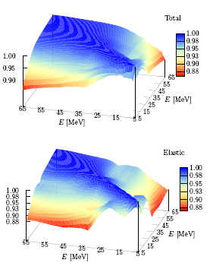
Parameter uncertainties-correlations
σ_{total}
σ_{elastic}
phenomenological optical potentials
microscopic optical potentials

Slide 22
Model defects - scaling
Global scaling factor for
each reaction channel c
Mean value and vairance for
each energy bin E_{m} and
isotope n
This coarse approximation provides a covariance matrix
PROBLEM: not statistically defined

Slide 23
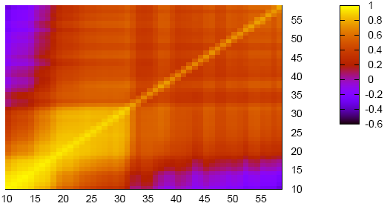
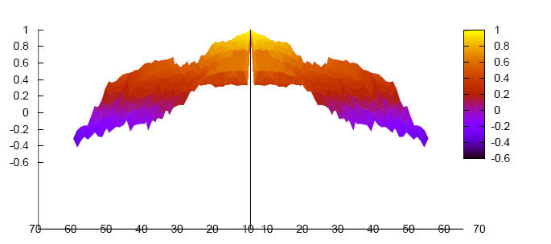
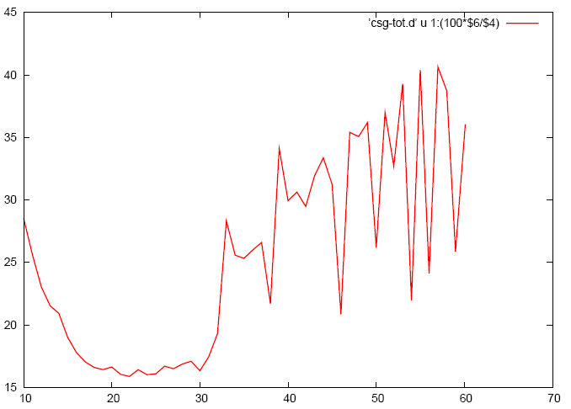
Model defects of ¹⁶O
Example ¹⁶O
total cross section
experimental data for
¹²C,¹⁴N,¹⁹F,²⁰Ne,²³Na,²⁴Mg
E MeV
E‘ MeV
0
relative variance in %
30%
E MeV
20%
60 10 60

Slide 24
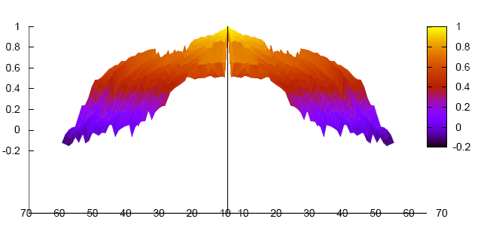
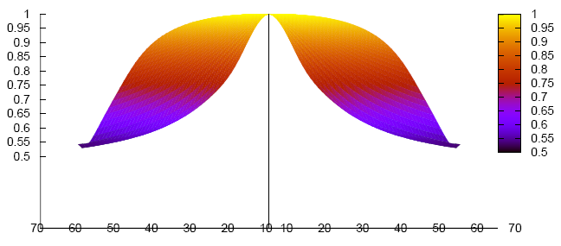
Correlations - comparison
correlations of total cross section uncertainties¹⁶O
cut: E+E‘=const
0.6
0.0
complete prior
E MeV
60 10 60
more details in
Final report of
EFDA-TW6-TTMN-001B-D7a
0.6
E MeV
parameter uncertainties
60 10 60

Slide 25
Importance of uncertainty information
cross section covariances
Safety margins – commissioning
Reduce the number of experimental tests
→ significant economic impact

Slide 26
Implementation of Bayesian statistics
Bayes Theorem (1763):
p(x|σ M) = p(σ |xM) p(x|M) / p(σ |M)
posterior = likelihood x prior / evidence
x ... model parameter σ ... data M ... other information

Slide 27
Bayesian update procedure
prior
x₀ M₀
Exp-01
x₁ M₁
Exp-02
x₂ M₂
Exp-03
x₃ M₃
Exp-m
x_{m} M_{m}
posterior
experiment

Slide 28
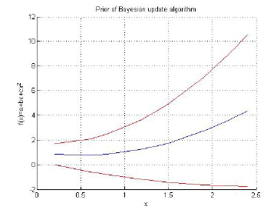
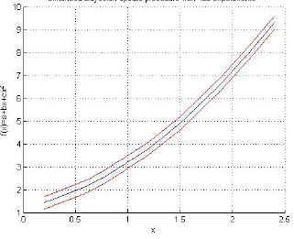
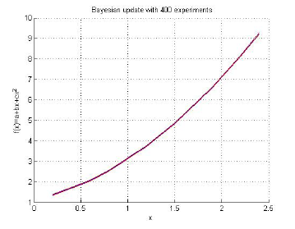
Problem of update procedure
prior
systematic
error
statistical error
Bayes theorem
Bayesian update

Slide 29
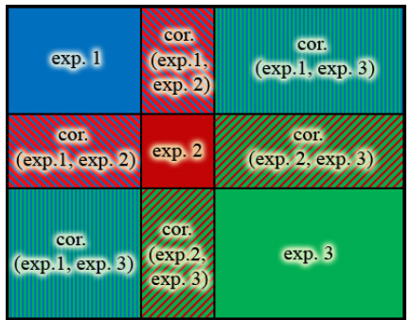
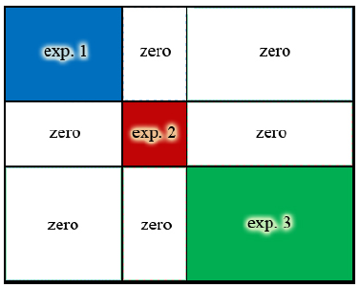
Origin of the difference
The ‚experiments‘ covariance
matrix V contains all experiments
and all correlations
Standard Bayesian update procedure – no correlations
between experiments
Systematic errors are treated like a
statistical uncertainty i.e.

Slide 30

Evaluation Tool GENEUS
still manual
semi-automatic for single
isotope and restricted
reaction channels
not available
ENDF-file
tables
graphics
PRIOR
TALYS
SC2COV
BAYES
SCALE
one-step procedure
EXFOR
Janis-Tables
EXPCOV

Slide 31
Perspectives
Current Demands:
Inclusion of uncertainty information → covariance matrices
Extension of energy range to ~150MeV
Challenges:
Evaluation process and covariance matrices – scarcity of experimental data for E > 20 MeV → quest of uncertainty of nuclear models
Improvement of models: nuclear reactions, fission, …

Slide 32
Topics in nuclear reactions
Future research will focus on challenges in reaction theory:
Reactions involving charged composite nuclei embrittlement due to gas production in structure materials p-process reactions in nuclear astrophysics, (α,γ), (p,γ)
Reactions involving weakly bound nuclei break-up contributions in deuteron involving reactions reaction processes with exotic weakly bound nuclei
(Microscopic) modelling of nuclear fission microscopic understanding of fission process modelling of fission cross sections experimentally not accessible isotopes (MA)

Slide 33
Summary and outlook
Summary:
Neutron-induced cross section measured
Well defined evaluation procedure based on modelling developed
General evaluation tool GENEUS is under construction
Outlook:
Focus is currently changing to topics on reaction theory - composite particle scattering theory - reactions involving weakly bound nuclei

Slide 34
Working Group
J. Gundacker (Master)
J. Haidvogl (PhD)
D. Neudecker (PhD)
Th. Srdinko (Master)
V. Wildpaner
Former students
K. Nikolics
M.T. Pigni (PhD)
I. Raskinyte (PostDoc)
EU Research Projects:
EURATOM P&T:
n_TOF,IP_EUROTRANS
EURATOM Fusion:
EFDA-Projrects, F4E-Grants
EU I3-Project: EURONS
Strong collaboration with the
nuclear data centers NEA, IAEA

Slide 35
THANK YOU FOR YOUR ATTENTION

Slide 36
α-nucleus optical potentials
(semi)microscopic approach for low energies (relevant to astrophysics)
Optical Potential:
direct term
coupling term
Direct part:
evaluated within RGM in order to account
correctly for the antisymmetrisation

Slide 37
Imaginary α-nucleus optical potentials
Imaginary Part:
Intermediate states in RPA
Green function at intermediate state
It can be considered as a nuclear structure approach to α-nucleus
optical potential, which should work satisfactory at low energies
calculations for α-¹⁶O and α-⁴⁰Ca and α-²⁰⁸Pb are in progress

Slide 38
Reactions of weakly bound nuclei
deuteron breaks up easily (E_{B}=2,2 MeV)
breakup leads to additional flux loss
Incoming channel outgoing channel
Elastic d-A channel
Incoming
d-A channel
Breakup of the deuteron
nonelastic due to n-collision
nonelastic due to p-collision
Neglecting breakup leads to non-standard parameters in fitted potentials
Keaton, Armstrong (1973)
Ansatz of a complete wave function of the d-A system
deuteron wave function
p-n scattering wave function (continuum)

Slide 39
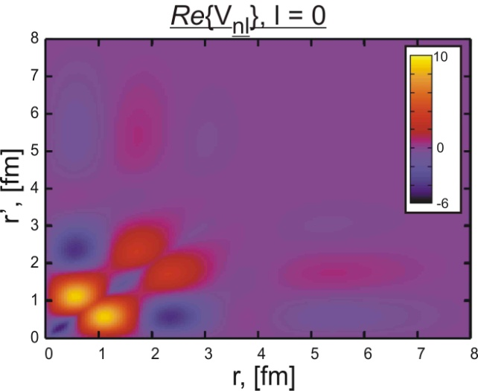
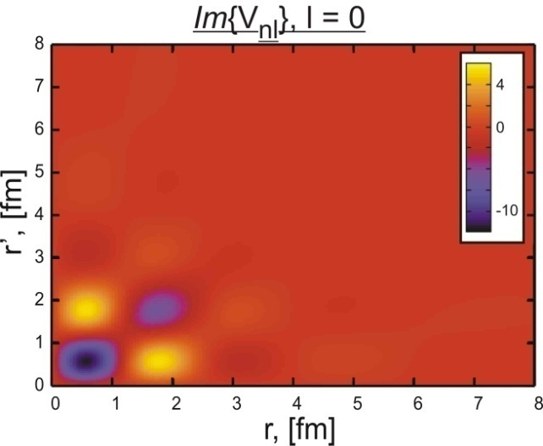
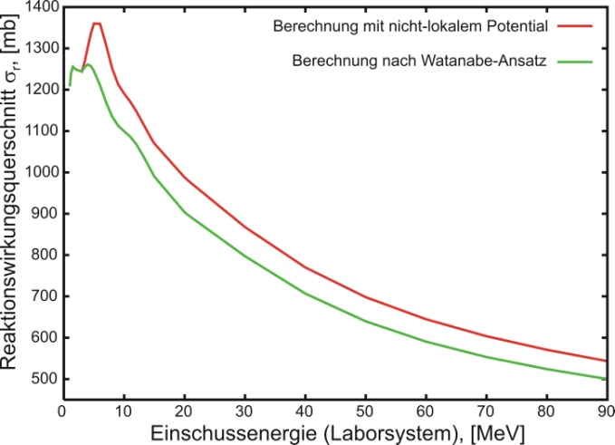
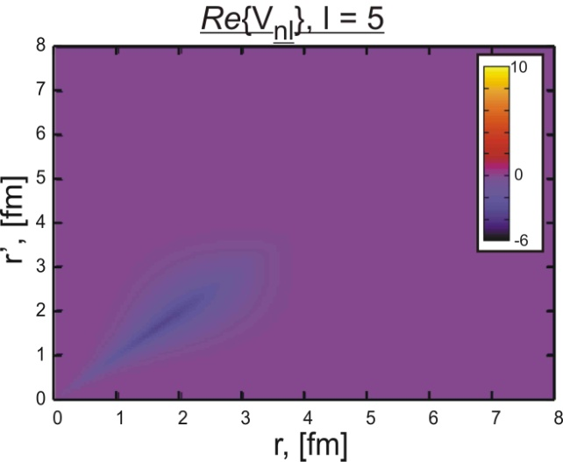
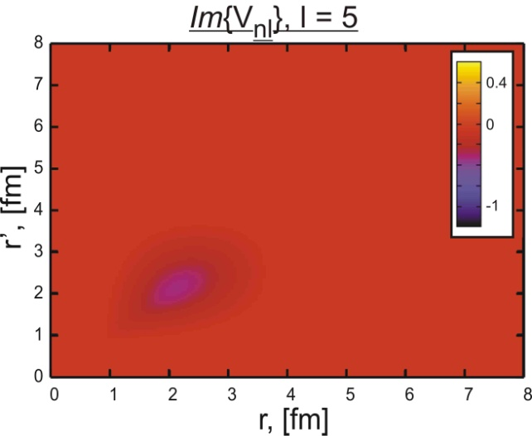
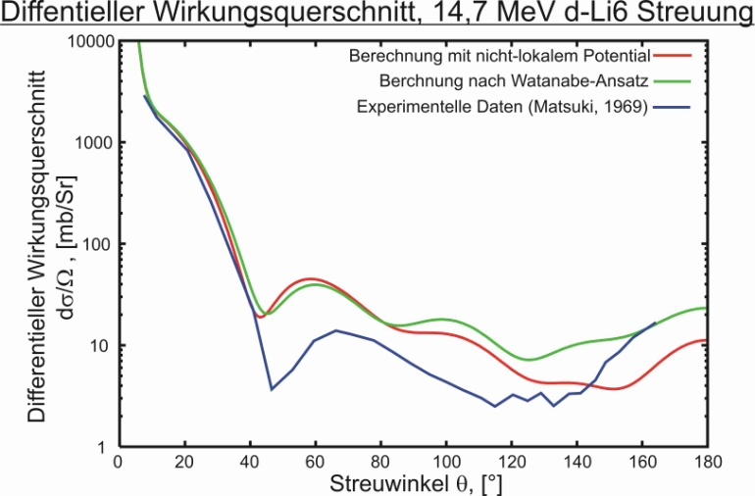
Breakup contribution for d-⁶Li

