Slide 1




NuPECC Meeting Prague, June 2011
SPIRIT
MiDTERM STatus
Wolfhard Möller

Slide 2
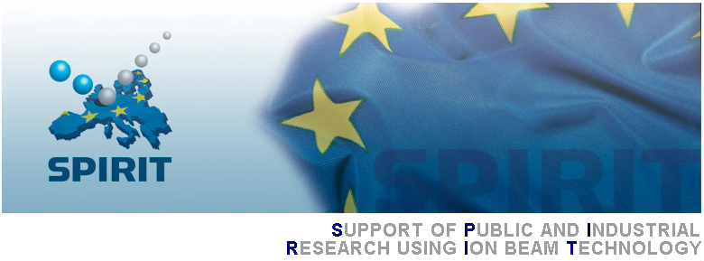

European Access to Ion Technologies
www.spirit-ion.eu
Coordinated by
11 Partners from 6 European Member States and 2 Associated States
Free Access for European Users at 7 European Ion Beam Laboratories
Development of Ion Technologies for Materials Analysis and Modification
Promoting and Training Activities

Slide 3

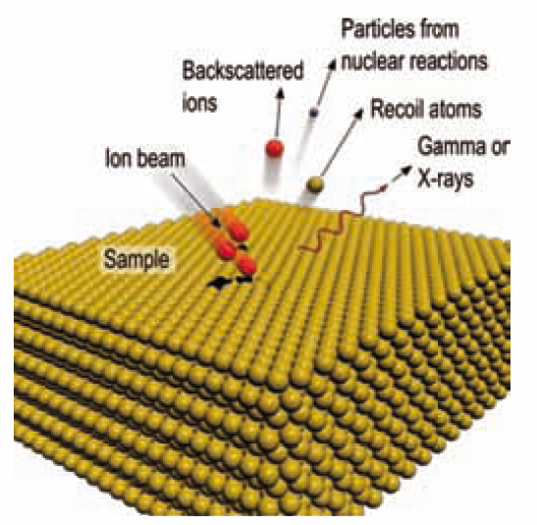
European Access to Ion Technologies
SPIRIT offers
Ion-beam based quantitative materials analysis: Rutherford backscattering (RBS) Elastic Recoil Detection (ERD) Nuclear Reaction Analysis (NRA) Proton-induced X-ray emission (PIXE) ….
Ion-beam modification of materials: Conventional ion implantation Plasma-based ion implantation Ion-assisted thin film deposition
Ion irradiation Nuclear materials Biological cells ….
Free access for European Users User travel and local costs covered by EU
User Proposals: www.spirit-ion.eu

Slide 4
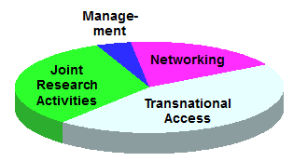
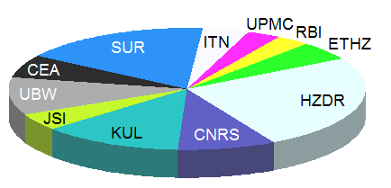
SPIRIT Dates and Numbers
Project Duration 1-March-2009 – 28-Febr-2013
Total EC Funding 6.991.000 €
Total User Time ~ 13.000 h
Distribution
of Activities
Distribution of Budget

Slide 5
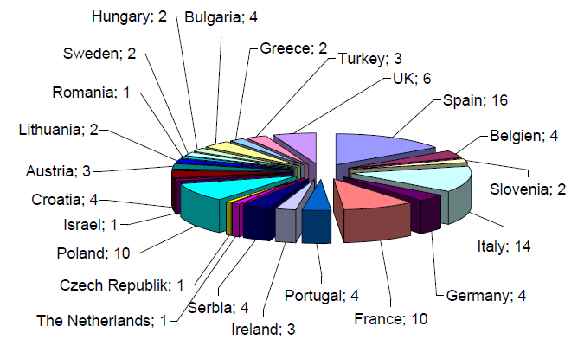
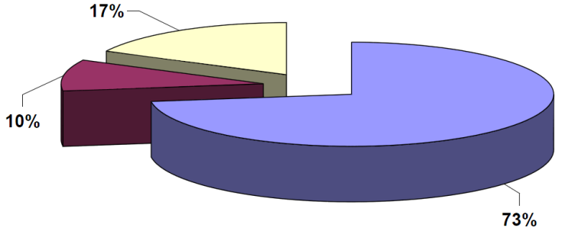
SPIRIT Transnational Access (TNA)
> 90% total delivery of projected user time
varying performance at individual infrastructures
too optimistic view for biomedical applications
underestimation of efforts for user acquisition
redistribution of TNA quota for months 25-48
Environmental & Cultural Heritage
Biomedical
Materials

Slide 6
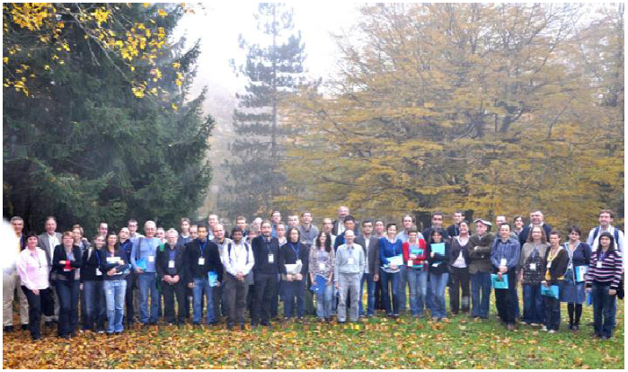
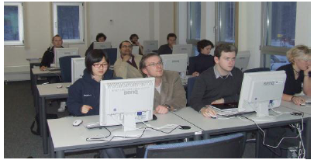
SPIRIT Networking
Workshops and Tutorials (internal and external participants)
Workshop "New Detector Technologies for Advanced Materials Research using Ion Beam Analysis", Plitvice Lakes, Croatia
Tutorial "Ion Implantation and Irradiation", Dresden, Germany
Technician Exchange Program
Detector Development
Reduction of Analysing Beam Effects
Standards and Round Robin Actions for Ion Beam Analysis

Slide 7
SPIRIT Joint “Research” Activities (JRA)
Beams (Work Package 5)
Targeted Irradiation
In-situ Instrumentation
Improving Analysis (Work Package 6)
Detector Development
Reduction of Analysing Beam Effects
Extending into New Fields (Work Package 7)
3-dimensional Analysis
Chemical and Molecular Imaging

Slide 8

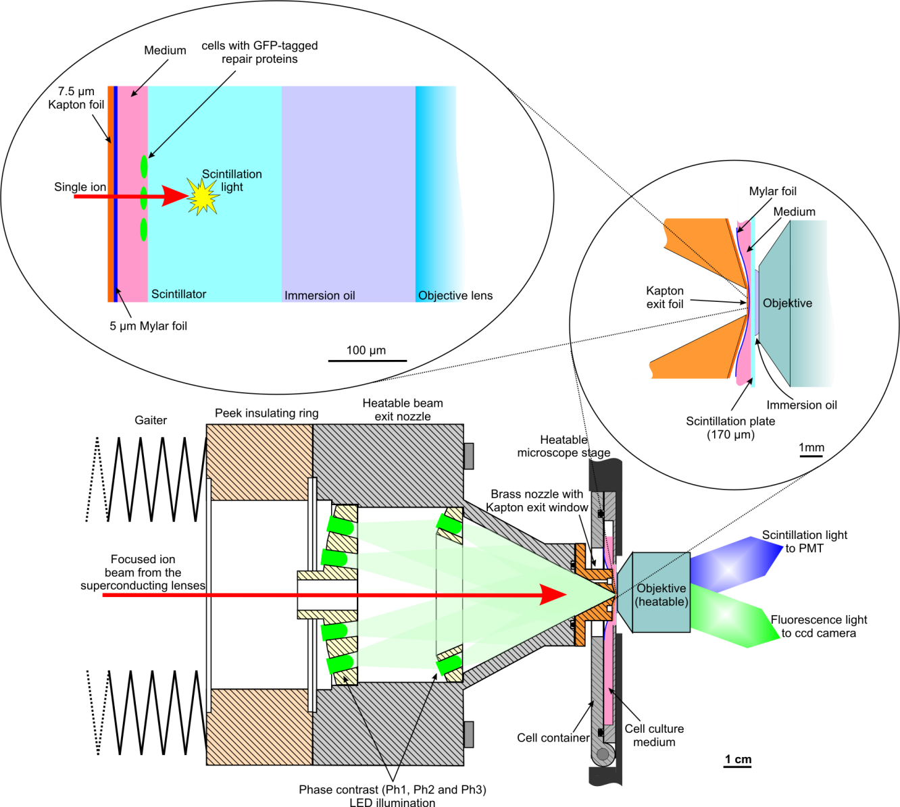
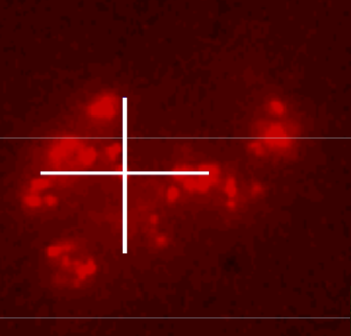

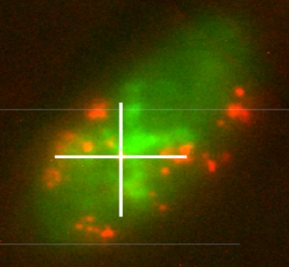
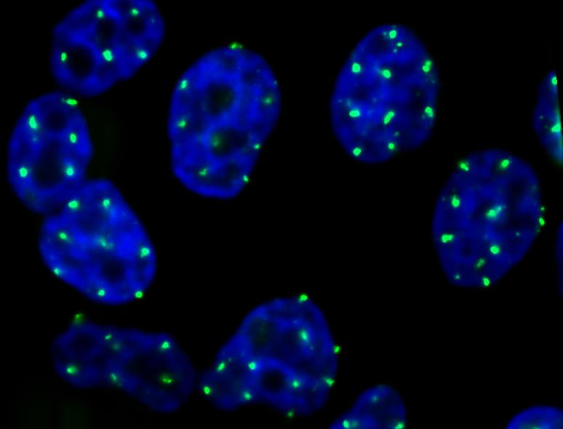
Microbeam Cell Irradiation Facilities
UBW / TU Munich

Slide 9
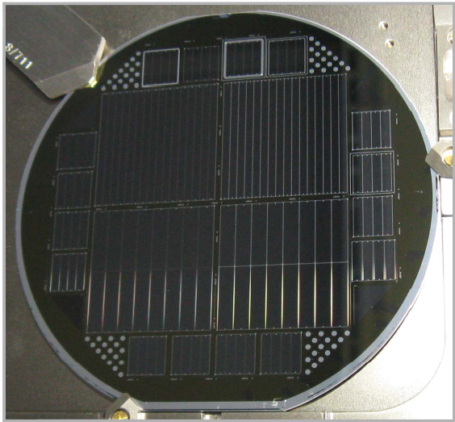
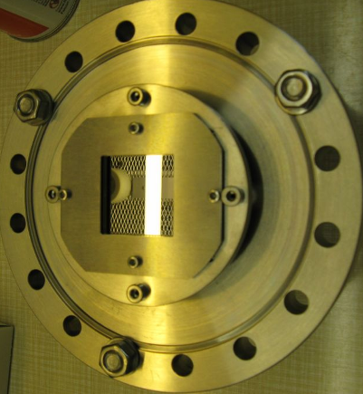
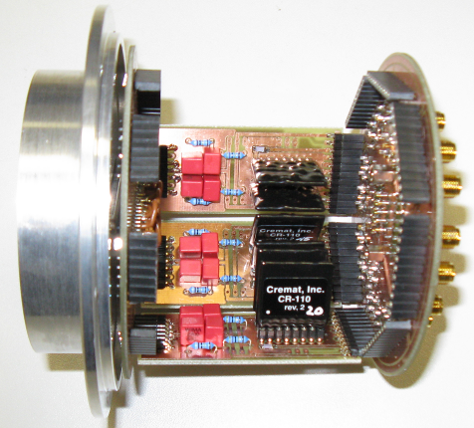
Segmented IBA Detectors
HZDR UPMC Paris
Large detector area
reduces time of analysis
reduces irradiation damage of sample
deteriorates energy resolution due to kinematic spread

Slide 10
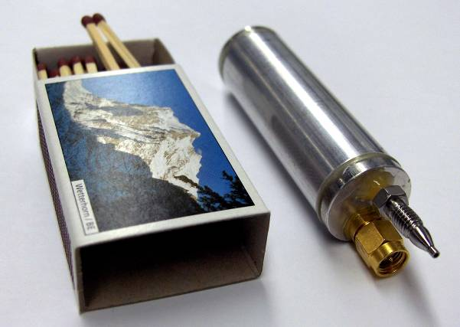
High-resolution gas ionization detectors
ETHZ Zurich RBI Zagreb
no radiation degradation
very high heavy ion energy resolution MeV protons 11 keV 72 MeV Xe ions 1.4 %
miniaturized version available

Slide 11
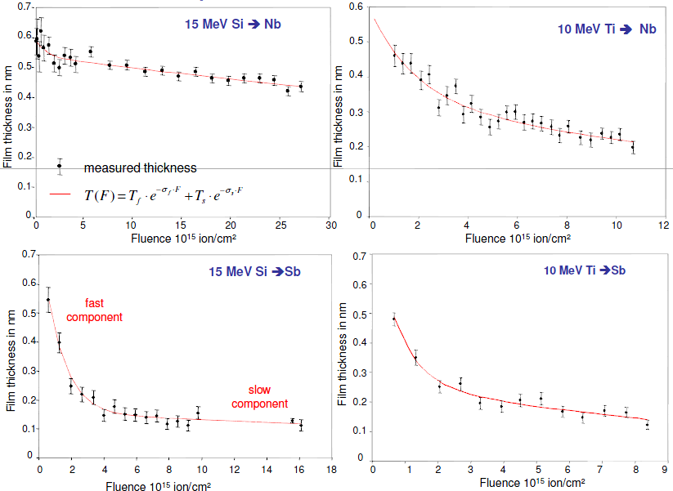
Beam-induced sample deterioration
known for long hydrogen analysis in polymers and glasses strongly dependent on individual problem
better characterization and understanding intended new dedicated experiments compilation of database
ETHZ Zurich UPMC Paris

Slide 12
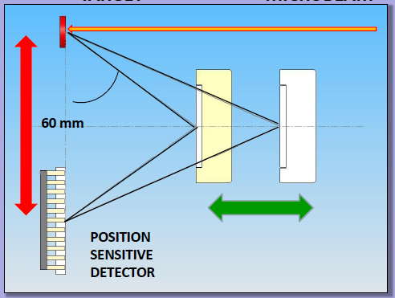
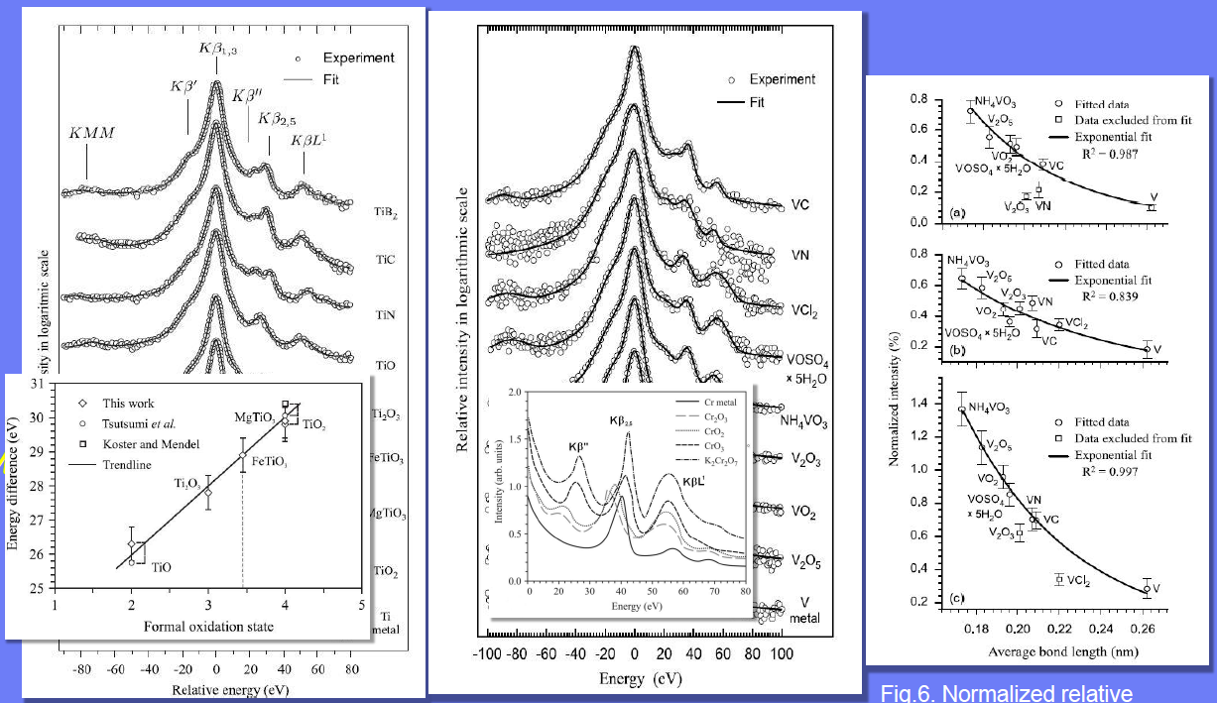
High-resolution PIXE for chemical analysis
wavelength dispersive analysis using crystal spectrometer
RBI Zagreb

Slide 13
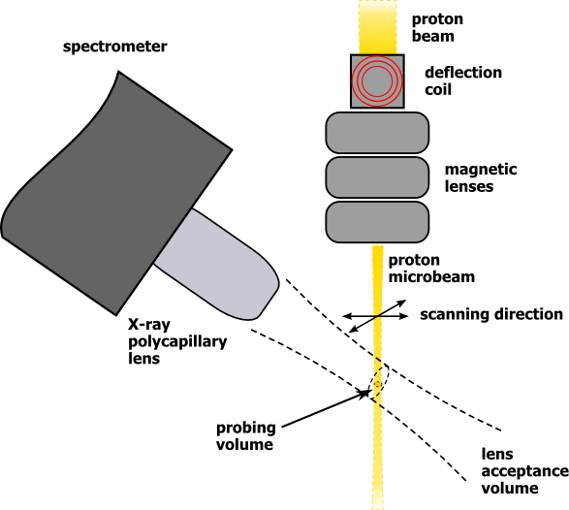
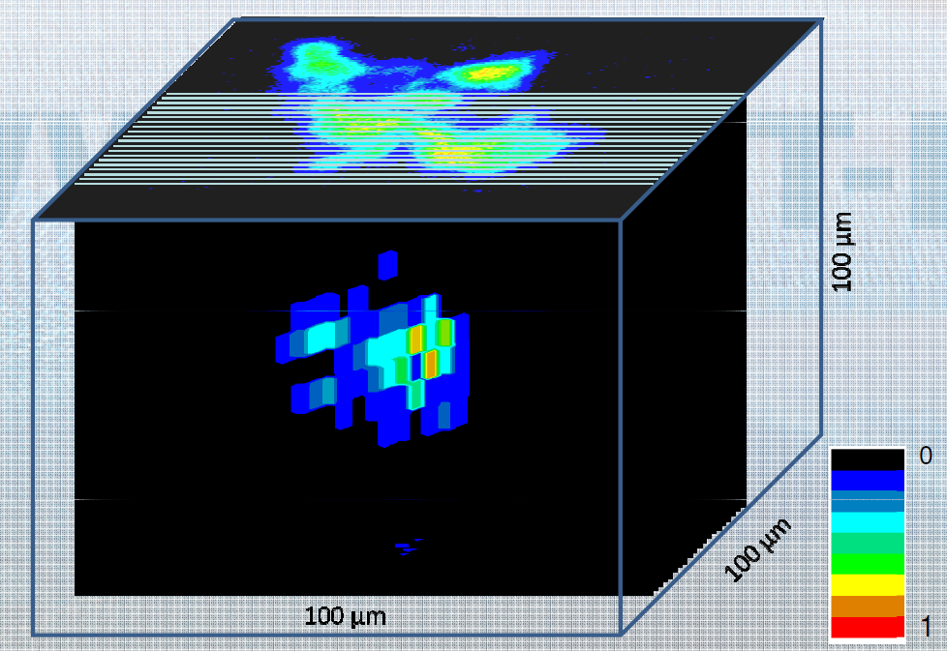
3D Analysis using Confocal PIXE
2D lateral resolution by beam scanning
depth resolution by focused x-ray collection
JSI Ljubljana
from 2D scan w/o lens
hematite particle on a substrate
from 3D measurement and reconstruction

Slide 14
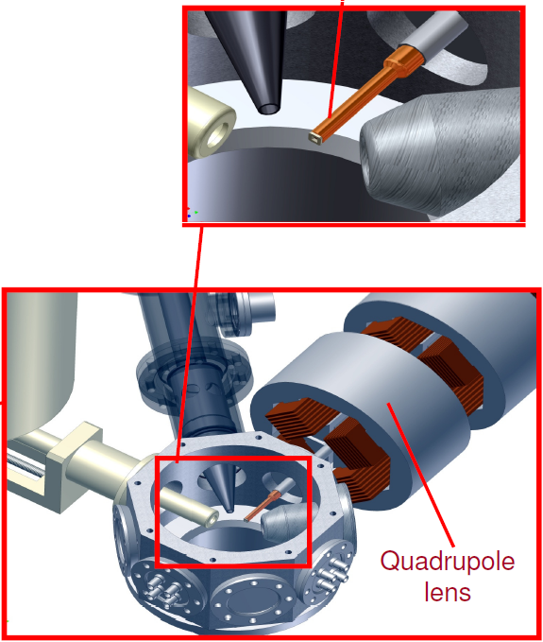
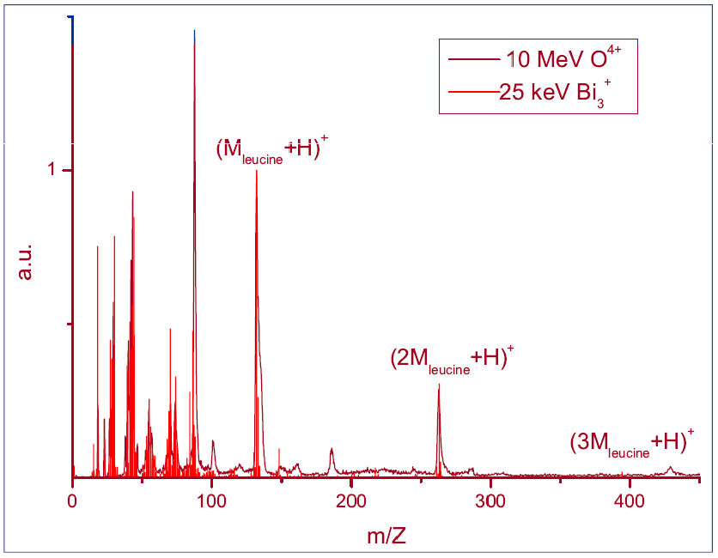
MeV Secondary Ion Mass Spectrometry
Molecular Mapping
"Soft" electronic desorption: more intact large molecules
Option of operation at ambient pressure
U Surrey
leucine (amino acid)

Slide 15
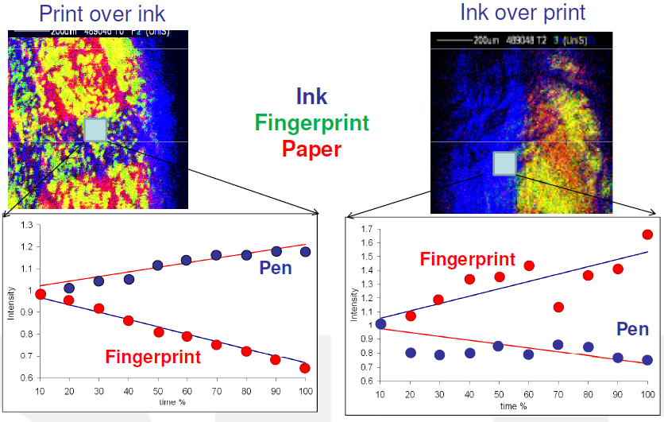
MeV SIMS: Forensic Applications?
U Surrey

Slide 16
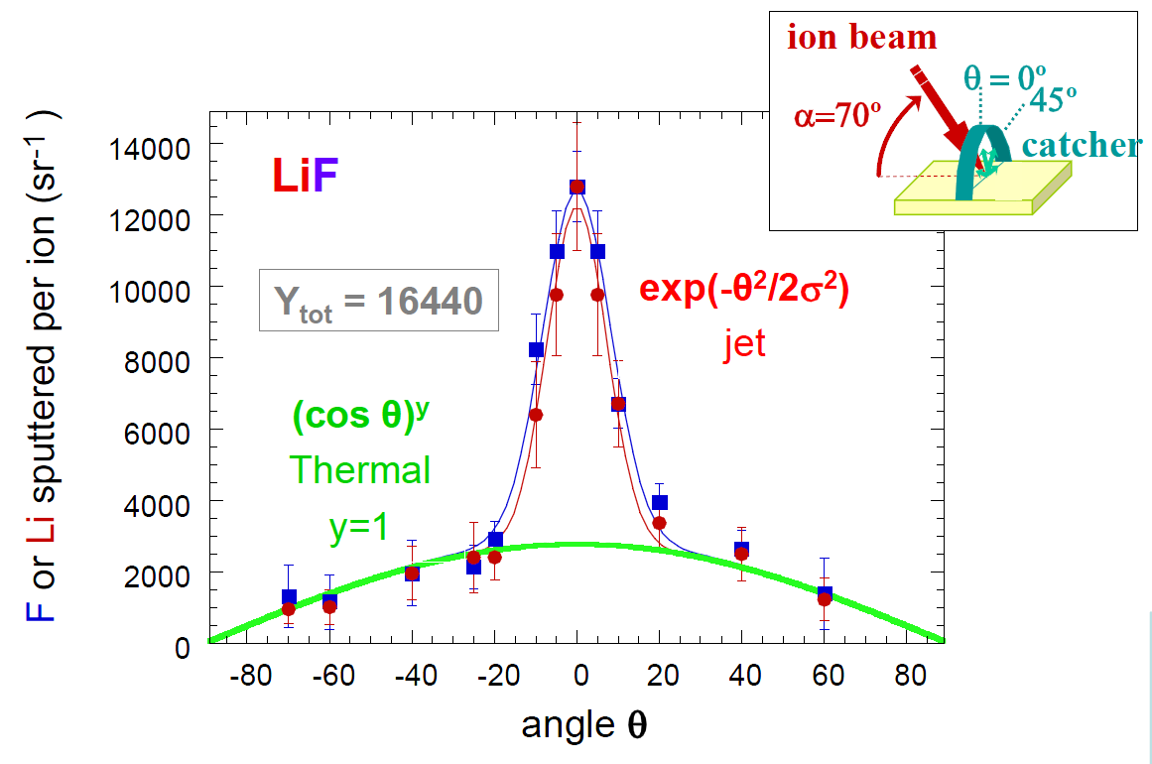

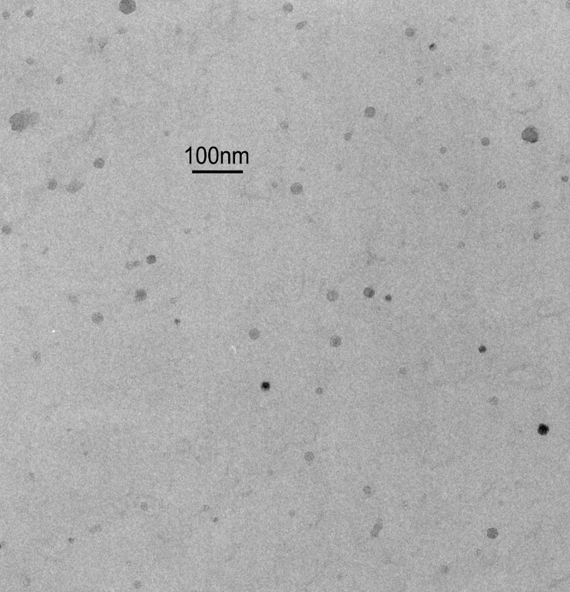
Jet Sputtering by Electronic Energy Loss
Very high sputtering yield
Modified thermal spike description
User Marcel Toulemonde GANIL-CIRIL Caen, France
Heavy ion irradiation 200 MeV Au⁺
Infrastructure UBW/TU Munich
Sputtered clusters on catcher
Thermal component and jet component

Slide 17
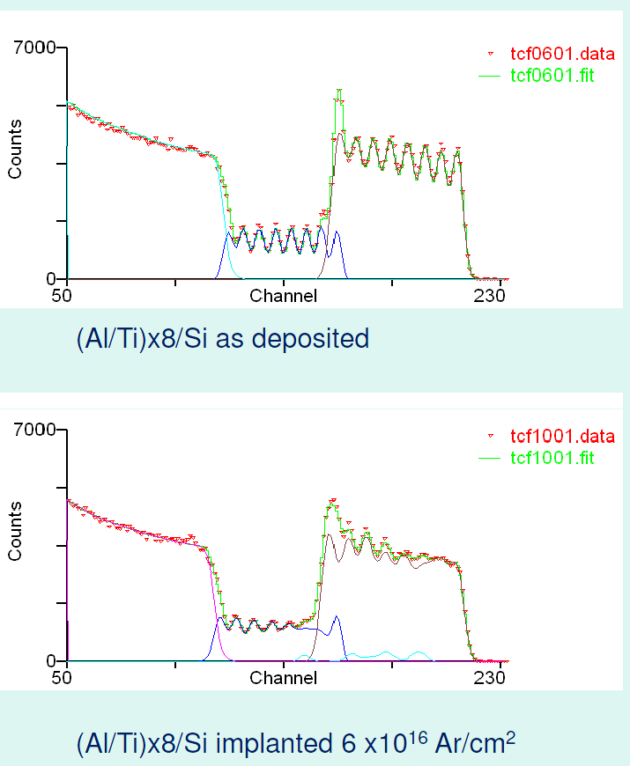
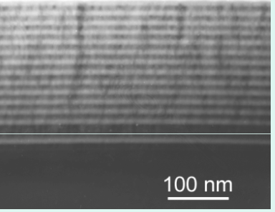
Ion-Induced Intermixing of Metallic Multilayers
Collisional and potential chemical effects
Ion Irradiation and RBS
User Momir Milosavljevic VINCA Institute Belgrade, Serbia
Infrastructure University of Surrey

Slide 18
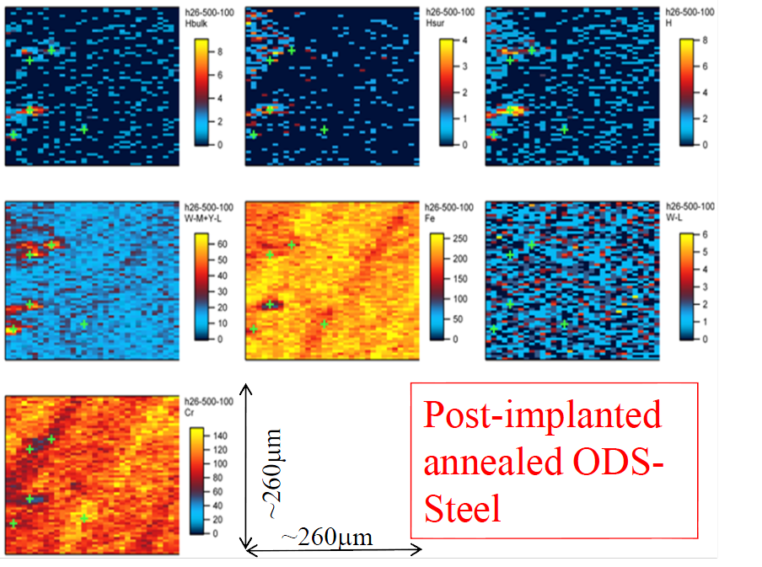
Fusion reactor materials
RBS, ERD, NRA ; H Implantation
User R. Gonzalez Arrabal Inst. Fusion Nuclear Madrid, Spain
Infrastructure HZDR

Slide 19
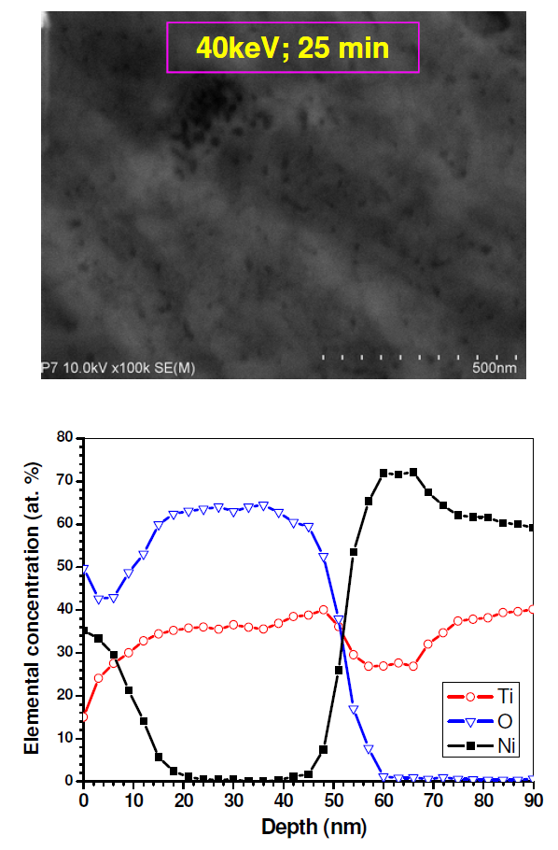
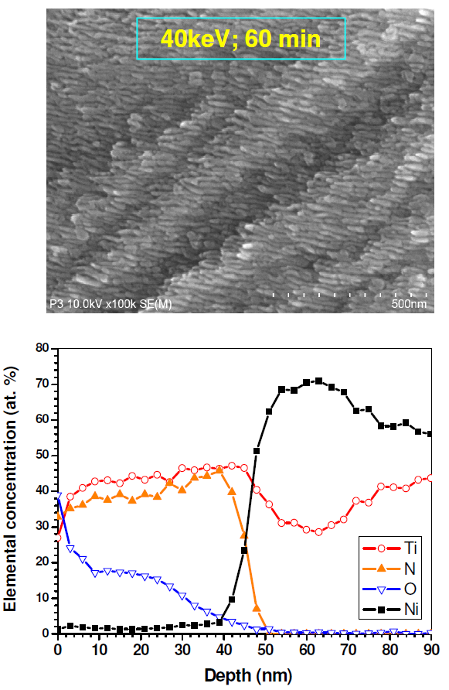
NiTi for prosthetic implants
Superelasticity
Shape-Memory Effects
But: Biotoxicity of Ni
Plasma Immersion Implantation 20...40 keV N⁺+ O⁺
User Rui Martins Inst. Tecnol. e Nuclear Lisbon, Portugal
O⁺
N⁺
Infrastructure HZDR
Surface layer strongly denuded of Ni

Slide 20
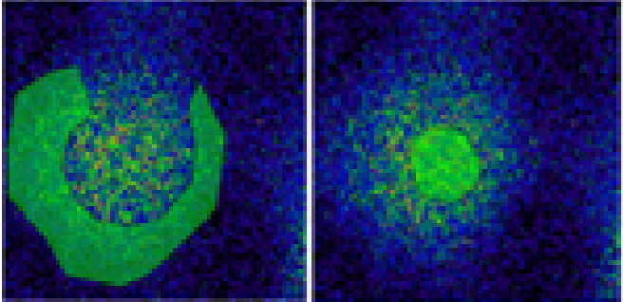
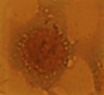
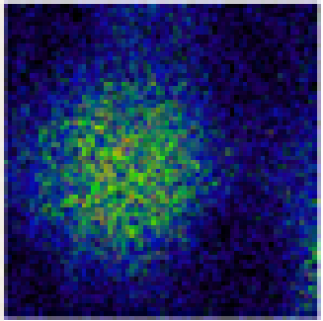
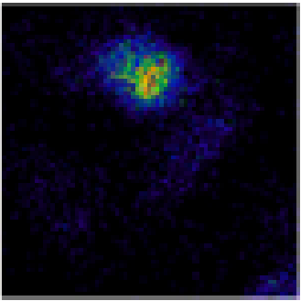
Bioapplication of nanomaterials
Interaction of magnetic nanoparticles and cells
PIXE
Cytosol
Nucleus
User Giacomo Ceccone EC Joint Research Centre Ispra, Italy
Optical
Infrastructure CNRS-CENBG
C
Fe
Nanoparticles decorate the perinuclear region of the cell

Slide 21
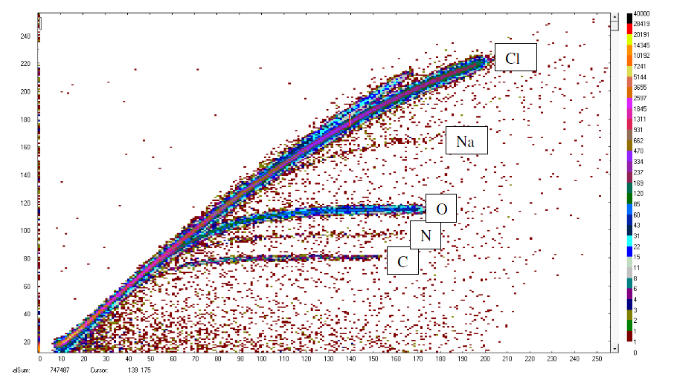
Photocatalytic Thin Films
TiO₂ (anatase) for environmental decontamination
N doping for activation by visible light
Thin film deposition: Reactive DC magnetron sputtering with N codoping
User Nuno Barradas Inst. Tecnol. e Nuclear Lisbon, Portugal
HI-ERD
Infrastructure HZDR
Surprise: there is Na in the films (from glass substrate) Surprise: there is more C than N in the films

Slide 22
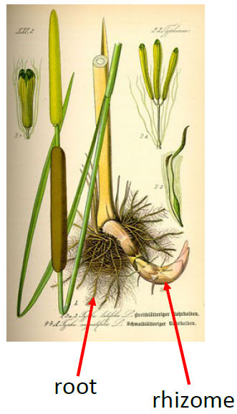
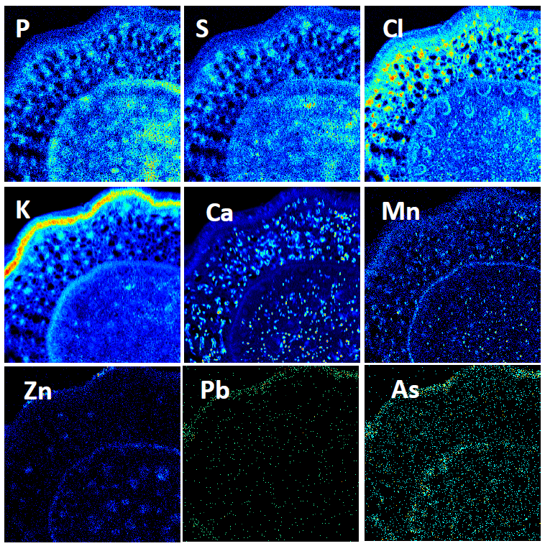
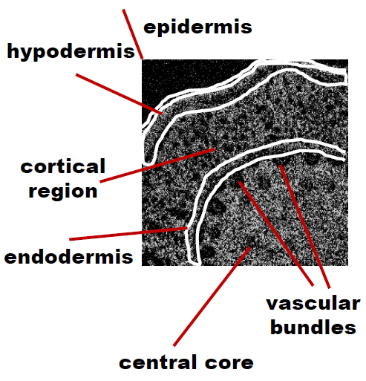
Phytoremediation of Agricultural Pollutants
Localization of nutrition elements and metals in plants
Defence mechanisms against uptake
User Lyudmilla Lyubenova Helmholtz Zentrum München, Germany
μPIXE
Infrastructure JSI Ljubljana

