Slide 1

Leading Advocate for Rural Virginia
Notes:
Rural Center – Presentation from Research and Data
Recognize Sector Investment, Private and Public
Who in Region has most at RISK? How do you minimize their Risk?
Issues that really matter in a Technology/Information Based Economy – Jobs and Education
The Center collaborates and cooperates
Builds networks and coalitions
Utilize research and data
Translates current, formulates new and advocates for Rural Policies
Build Relationships and Trust – Between Government and Private to Reinvent Rura

Slide 2

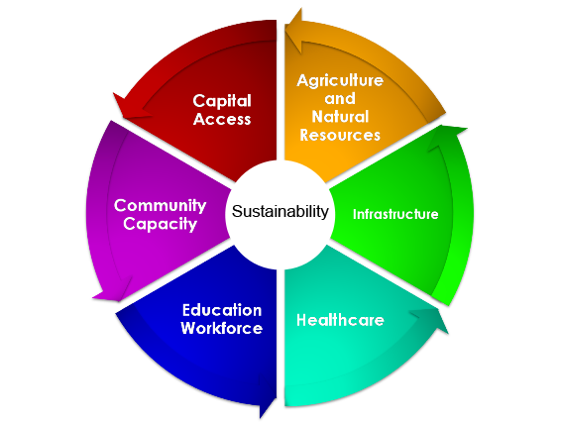
Economic Essentials
Sustainability
Notes:
The Dependence of Communities on Economic Essentials Relationships
Represented by the Wheel – Collaboration, Connection, Networks, Leadership tied together to accomplish sustainable economic essentials
If rural doesn’t have a proactive regional dialogue based on research and data , there is a very good probability that we will be left behind.
People and outside resources will work with you as a community, only, if you take the initiative, lead and establish a vision for your community and work with your neighbors to help yourself.

Slide 3

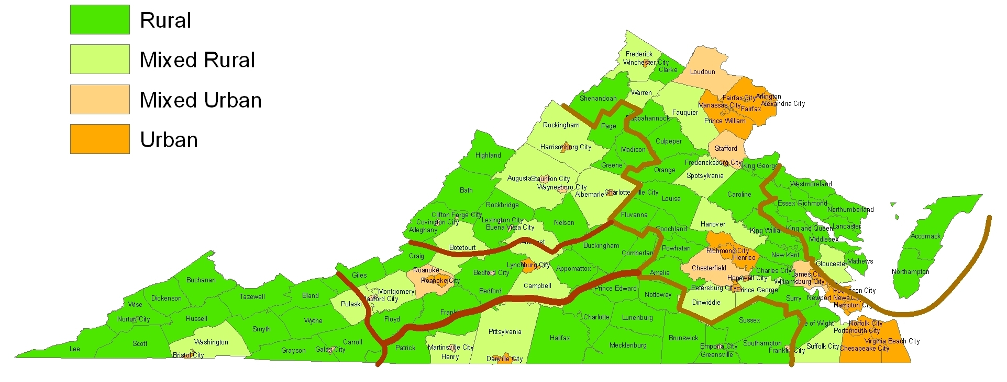
Virginias
Crescent and Rural Regions
Notes:
Map: - Define Regions –
Rural Definition - Dr. Andrew Isserman - Population Density – 500 people per Sq Mile, 90% county population in rural areas, no urban area greater than 10,000 population.
Crescent – The Commonwealth’s economic driver
Valley - An incubator of innovative, entrepreneurial and collaborative people, a population who historically work together.
Eastern – An economy of absentee owners and business communities located on the urban edge.
West Central Piedmont – An amenity rich area of increasing population of Baby Boomers and footloose professionals who can live, work and play anywhere, but have settled in this area in close proximity to cities, airports, healthcare and education.
Southern – A resource dependent area that thrived on agriculture and mill manufacturing, both of which have moved and the area is in transformation.
Southwest – a region with decades of resource extraction and underinvestment, having a legacy of poverty, low education and broken institutions, a region in transformation.
“One size solution or policy does not fit all regions”

Slide 4

Understanding Rural
Population growth
Job Growth
Capacity to generate jobs
Entrepreneurial presence
Per Capital Income
Transfer Payments
Local government services
Local School Districts
Notes:
2010 RVPC Update Overall Findings:
Population growth lags behind state average
Job Growth in areas lags behind state average
Rural Regions lacks the capacity to generate jobs to keep pace with its own population growth, leading to continued out migration.
Lacks entrepreneurial presence in high-skilled services industries
Per Capital Income level lagged behind state average
Transfer Payments help to keep rural income gap stable
Local government rely more on the state government to provide essential government services to their residences
Local School districts depend more on the state for funding their school systems

Slide 5
Agriculture Industry
Industry Workforce Output
Total 357,000 $55 B
Production 60,000 $2.9 B
Value-added 76,000 $26 B
Ag-related 221,000 $26 B
Notes:
Agriculture --The Image of Rural VA. Does the numbers reported present the correct image?
In Rural Economic Opportunity Task Force Study conducted this year at direction of GA.
Agriculture is promoted as Virginia’s largest industry. A 2008 study by the Weldon Cooper Center for Public Service revealed that the total annual impact of the state’s agriculture-related industries was over $55 billion in total industry output and the sector provided more than 357,000 jobs to the Commonwealth.
Production Agriculture (perception and image) represents 6% ($2.9 B) of the output value and nearly 17% (60,000 jobs) of the employment of farmers and workers.
Value-added industries, those that depend on farm commodities, employed an nearly 76,000 workers and generated almost $26 billion in total industrial output.
Finally, agriculture-related industries contributed an additional 221,000 jobs and nearly $26 billion in total output.
The off-farm value-added segment and agriculture–related industry segments represent the largest segments of economic agriculture output and jobs growth.
What is the True Image of Rural Virginia in 2010? Land Based Economy or Technology-Information Based Economy

Slide 6
2000-2010 Rural vs. Virginia Gap
Sector Rural VA
Population +0.85% +1.21%
Employment +0.05% +0.43%
Per Capita Income $32 K $38 K
Transfer Pmt. +4.0% +2.3%
L Gov. Fiscal 51.2% 64.8%
LCI (Education) 37.1% 45.0%
Notes:
2000 – 2010 Rural vs. Va Gaps:
Link --- Education, Jobs and Per Capita Income
Population: Virginia growth - annual rate of 1.21% (decade) – Rural Regions grew - 0.85%
Southside and Southwest Regions experienced declines and out-migration of population.
Areas within regions have population movement similar to the region and state.
Employment: Statewide job growth - annual rate 0.43% - Rural Regions Job growth - 0.05%
Region had variable conditions and industries.
Rural ability to generate jobs does not keep pace with population growth.
Per Capita Income: Rural Average per cap income at $32,702 lagged behind the state average of $43,908 at 72% (including Transfer Payments). –
23.1% plus of personal income in rural regions -from transfer payments vs. 13.6% statewide.
Rural Gap adjusted for Cost of Living - 87% of state average.
Transfer Payments: Residence and local governments in both Southside and Southwest rely heavily on transfer payments. In 2008 - 8 SW Counties and all Southside counties – SS - >25% of income from transfer payments. Rural experienced a 4.0 percentage point increase in transfer payments compared to 2.3% points statewide.
(Southside increased 7.0%)
Local Government Fiscal Conditions: Rural localities increasingly rely on state government transfer payments to provide basic services. Revenue from local sources accounted for 51.2% of rural localities total revenue vs. state average of 64.8%. For every dollar local rural governments receives from the state, rural residences and businesses send to state $0.75 vs. mixed urban $1.22 and urban $1.29.
Education: Rural school districts spend at 91% of statewide average on education resources.
The average statewide composite index is 45% vs. 37.1% for rural school districts.
(Graduation Rate)
Drop Out Rate -- workforce 25 to 64 without high school education is 35 to 40%.
Identify connection of education to jobs.
Link Process and structure of regions workforce needs to education and training programs.
Identify workforce needs and skills available. – Bob Leber culture/attitude about education.
Global Economy - Global Workforce – Technology changing – Job Market transitioning, thus skills changing.

Slide 7
Challenges
Finding an area of economic strength upon which to build –
a competitive advantage
Notes:
Rural Regions Challenge:
What Communities (localities) create a natural region?
Find areas of economic strength upon which to build - a competitive advantage
Utilize research and data to understand your community.
Identify Attributes of Locality and Region
Determine your Values - what is number #1 Value of your Region?
Establish a common and agreed upon VISION.
Establish a link in your community between the Economic Essentials - Education and Industry.
Define who and what you want to be in next decade.
Who is next generation that will drive you to that Vision?
Who will bring Communities together to have a Dialogue?

Slide 8
Solutions
K12, adult education, credentialing, and workforce training
Infrastructure - Broadband
Targeted Incentives for job creation
Access to Capital
Community Capacity – critical mass, scale, collaboration, leadership
Notes:
Rural Solutions: Rural Policy Recommendations
Prioritize and Rank for Locality and Region – Relate Policy Actions to Research and Data
Link Education, Jobs and Per Capita Income
Focus on education and workforce training, up-dating skills of current workforce, credentials training, customized training for expanding and relocating firms.
Create strategies to invest in public infrastructure. Broadband - internet access to homes and businesses, having a critical mass of anchor firms will propagate the buyer-sellers looking to take advantage of clusters and a shared labor force.
Target a tiered (tax) framework and system that encourages job creation. Rural must focus on a framework and structure to encourage potential businesses to locate and remain in area as an incentive for lower education, skills and amenity levels.
Provide financial assistance to entrepreneurial and small business activities.
Develop local leadership in rural areas. Leadership that can be cooperative among localities, that can pool their resources to market and promote the region to potential investors, across boundaries, paired with localities in state-wide economic development efforts.

Slide 9

www.cfrv.org
www.rvpc.vt.edu
Notes:
Priorities: Regions
Foundations for strong localities – education, workforce training, social stability
Regions Priorities - Jobs, Business Retention and Procurement, Economic Development, Workforce Development, Broadband, Transportation systems, Healthcare systems, Community leadership
Regional Aspirations -
Broad Region Goals -

