Slide 1

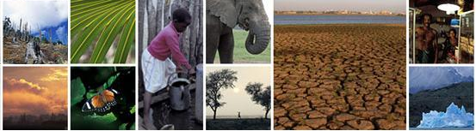
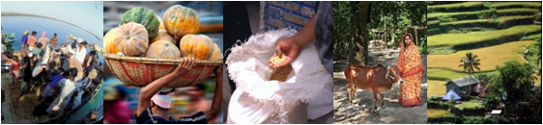
Triple Win Climate Smart Agriculture – Climate Change Adaptation Aspect
Pai-Yei Whung, Ph.D.
Science Adviser
ARD/SDN
World Bank

Slide 2
Climate smart agriculture concept
Triple Wins
Integrated Landscape Approach
http://www.youtube.com/watch?v=i0V2xzEw44Y

Slide 3
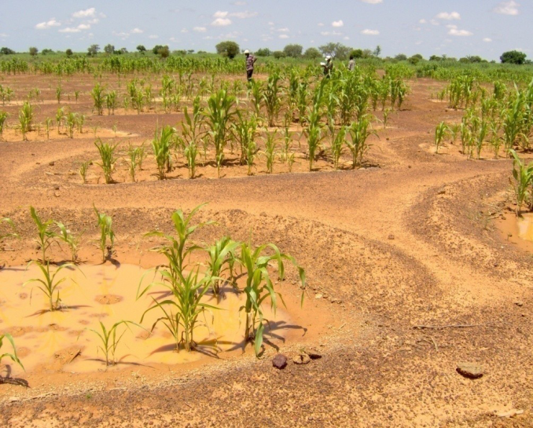
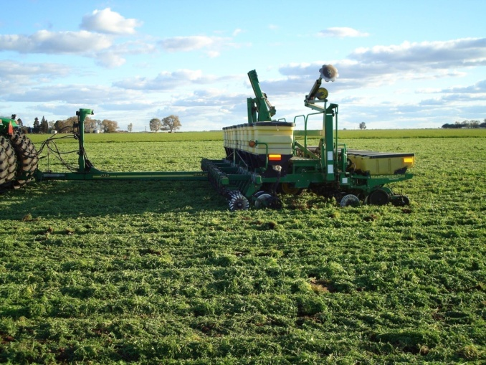
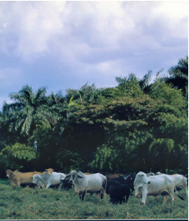
Food production must increase by 70% by 2050 to feed our growing population, with rising demand for livestock and higher value products
Climate change makes meeting this goal more challenging
Societies depend on natural and managed ecosystem resiliency – watersheds, soils, hydrology, forests, wetlands, coral reefs, agriculture and grazing land, fisheries – for fuel, water, fiber, safety, recreation and many other things

Slide 4
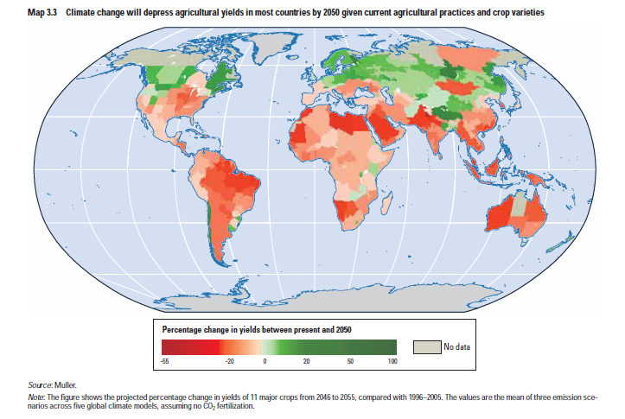
Climate Change means declining yields in most of the world, especially the developing world

Slide 5
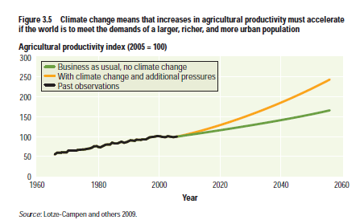
Need massive increase in agricultural productivity to feed 9 billion people

Slide 6
CONSECUTIVE AND PRONOUNCED PRICE SPIKES
Price Index, July 2008 = 100 (Prices through to end January 2011)
Source: World Bank

Slide 7
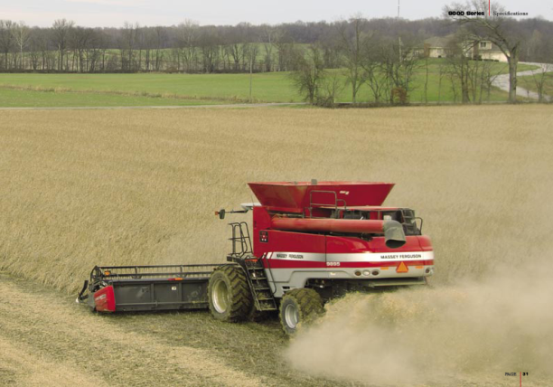
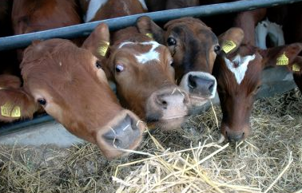
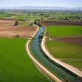
Agriculture: key user of natural resources
70% of fresh water resources
40% of land area
30% of GHG emissions
Contributions to greenhouse gas emissions
Developing country agriculture & deforestation 21%
Industrialized countries
64%
Developing country other sources 15%

Slide 8
Agricultural-based countries spend too little on agriculture (and R&D)
Challenges
Ag GDP/GDP
Notes:
8

Slide 9
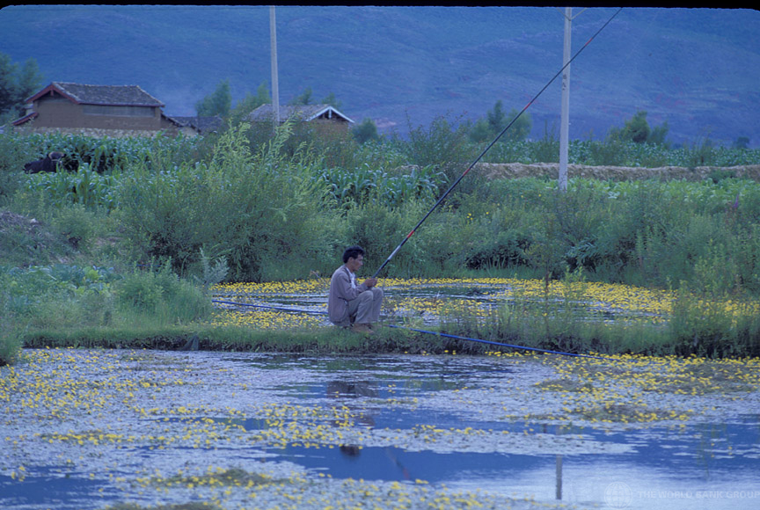
There Are Solutions For a “Triple Win” of:
1. Improved productivity and food security
2. Enhanced resilience to drought, flood, erosion, heat & water stress
3. Low carbon growth
(potential for carbon sequestration in the soil alone is 13% annually of 2010 GHG emissions)
How do we do it?
Notes:
Tackling climate change means meeting competing, sometimes contradictory demands by managing complex natural systems. To meet these competing demands, societies will need to balance producing more from their natural resources and protecting those resources to meet growing demand and reduce vulnerability to climate change. To do that they have to manage water, land, forest, fish, and biodiversity more efficiently to get the services and products they need without destroying them through overuse, pollution or encroachment.

Slide 10
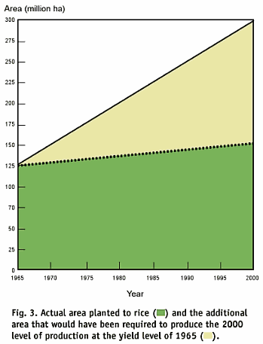
Sustainable intensification of agricultural production
This helps reserve lands for other uses and can use water more efficiently
Notes:
Sustainable intensification of agricultural production – for example though higher yielding varieties, and/or through input use efficiency (fertilizers, water, resistance traits, etc) helps reserve land for other use
Improved input (nutrient, energy, water, land, agrochemical) use efficiency, such as: Nitrogen fixing ability, drought resistant varieties, use of precision technology (water, nutrients), low dose and environmentally ‘friendlier’ pesticides – part of IPM, pest tolerant/resistant varieties, etc (minimize use of potentially environmentally harmful chemicals) – part of IPM

Slide 11
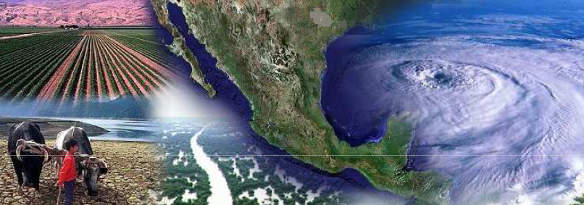

Country Examples: Mexico Building resilience: policies for climate smart agriculture
Agriculture: Only 4% of GDP but a key role in broader landscape management; 15% of employment; 77% of water consumption with forestry 21% of GHG emissions. Forests are 23% of area: pattern of deforestation
Will face rising temperatures, reduced rainfall and more frequent and severe droughts and storms,
More frequent forest fires; impact on productivity especially of maize and pastureland; impact and vulnerability vary widely between regions

Slide 12
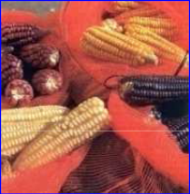
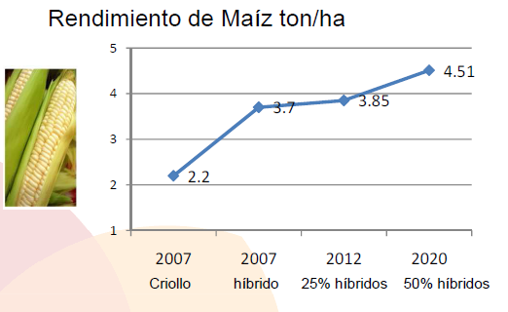
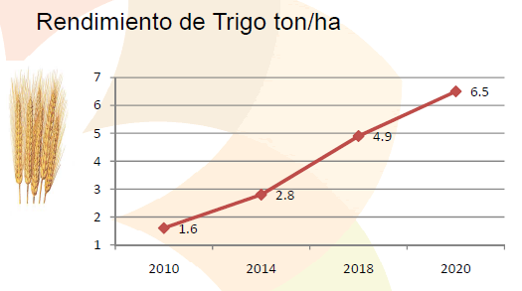
Mexico's adaptation strategy for agriculture and water management
FOR AGRICULTURE: conservation tillage, crop rotation, fertilizer management, research, gene banks, productivity, conservation corridors, wild land conservation: conversion of agricultural land to perennial & mixed crops, control of cropland burning
FOR FORESTRY: reforestation and sustainable forest management, commercial plantations, scaled up support (US$ 27 m budget allocation in 2001, US$ 396 m in 2010)
FOR LIVESTOCK: rangeland restoration, manure management & improved breeding
FOR WATER: Irrigation modernization and water conservation (67% of irrigation is surface), flood and watershed management, rainwater storage

Slide 13
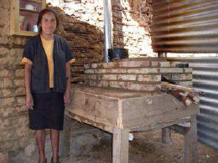
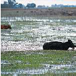
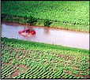
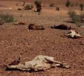
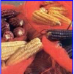
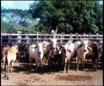
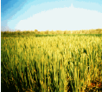
Improved Climate Information
Social protection and risk reduction measures including support for: crop diversification; non-farm income generation (e.g. public works, tourism), cash transfers, remittances and migration.
Insurance and disaster protection: programs including federal support to states for low income producers; mutual insurance cooperatives, index based insurance products and an ex-post disaster fund

Slide 14
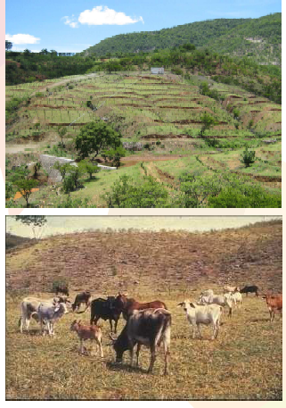
World Bank Support
Water Sector development policy loan (US$ 450m) supports integrated water & watershed management and conservation and institutional strengthening;
Climate Change DPL (US$ 501m) for integration of climate change into sector programs including mitigation
Sustainable Rural Development project (US$ 168m) for environmentally sustainable agri-business
Forests and climate change project (under preparation) focuses on community forestry and REDD
Hydromet project (proposed)
Ecosystems adaptation DPL (propsed)

Slide 15
Morocco Strategies and Policies for Climate-Smart Agriculture
Agriculture is 15% of GDP and 45% of employment
Low productivity rainfed agriculture accounts for 85% of agricultural land: ageing farmers
Irrigation: 15% of land area, 45% of value added, 83% of water use. 75% of agricultural exports
Irrigated lands (1.36 million hectares), which represents only 14.6% of the agricultural areas, contribute for 45% to the added value (up to 75% in dry years) and produce nearly 75% of agricultural exports
Irrigation uses now the major portion (83%) of all collected water resources ;
Moroccan agriculture is still strongly dependent on rainfall, as rainfed areas represent 85% of agricultural lands (7.9 millions hectares);
Rising temperatures, increased aridity and water stress are major climate challenges
Food self-sufficiency or increased value-added for food security?

Slide 16



Impact of Climate Change in Morocco
Higher impacts of climate change on rainfed crops

Slide 17
Morocco's Green Plan (2010-2020)
“A triple bottom line answer to food insecurity, adaptation of agriculture to climate change and sustainable growth of small farmers”
A comprehensive plan to double value added, includes structural reforms in cropping patterns, land tenure, agricultural taxation
Pillar 1 promotes growth in high value crops, trade and irrigation
Pillar 2 aims to reduce rural poverty in low productivity rainfed sector
Adaptation measures focus on more efficient land and water use and intensification:
Irrigation water efficiency: conversion to drip irrigation, "more crop per drop" (700,000 ha, 50% of irrigated area by 2020)

Slide 18
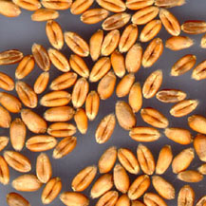
Technologies for agricultural green water management
Improved seeds, drought and disease resistance are priorities
Certified seeds and plants are the first vectors of the technological progress, from research to farmers
Up to 50% yield increase for cereals
Better quality of the harvests due to low infestation by diseases

Slide 19
Technologies for agricultural green water management
Land suitability mapping for landscape based approaches
To provide to farmers and decision makers a support planning tool for technically feasible and profitable options for improved and sustainable land-use.
Almost 6 Millions hectares (≈100%) maps for rainfed areas
Notes:
19

Slide 20
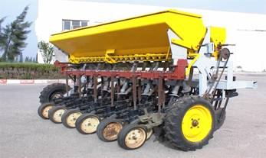
Technologies for agricultural green water management
No tillage for sustainable rainfed agriculture
Experiments at farm level show the superiority of no-till system compared to conventional system.
NT seed drill
+ 30 to 40 % in grain yield | + 3 to 14% of organic matter
+ 60% in WUE | - 70% in energy consumption

Slide 21
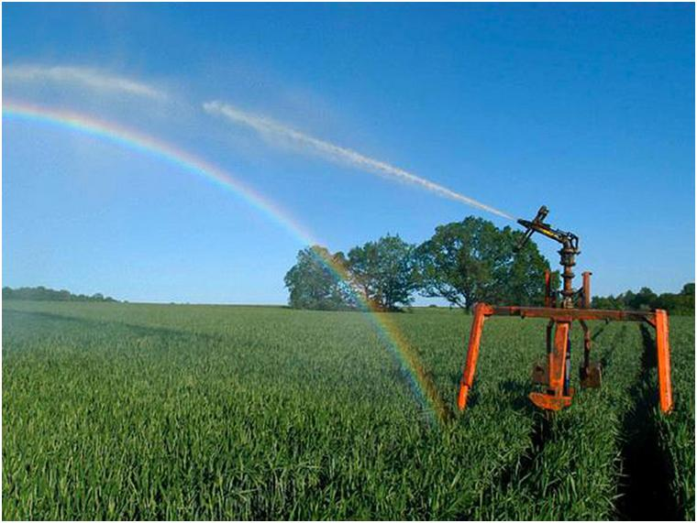
Technologies for agricultural green water management
Supplemental irrigation
Technology for low rainfall areas (200 to 400mm/year) or not well distributed rainfall
20 to 90 % yield increase for cereals (soft and durum wheat)
50 % yield increase for fruit trees (olive, almonds)
SI improves also the quality of the production.

Slide 22
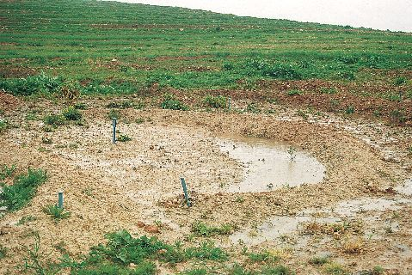
Technologies for agricultural green water management
Water Harvesting
Used for fruit trees and pastures species in low rainfall areas (100 to 300mm/year)
Very high yield increase especially when rainfall is very low
Specific machinery is needed
The plan includes many other measures to promote farmer organization, commercialization, resource conservation…..

Slide 23
World Bank support
World Bank support focuses on improved irrigation and river basin management
DPL Plan Vert support loan (includes policy measures on domestic market liberalization, food and livestock safety, improved transparency, vertical integration and socio-economic impact monitoring of support to small farmers, improvements in agricultural services and research, and enhanced water management including installation of meters, relief on interest rates for irrigation water debt, enhanced irrigation water delivery)
Adaptation and mitigation strategy
Piloting and demonstration of adaptation measures to integrate climate resilience into the Plan Vert

Slide 24
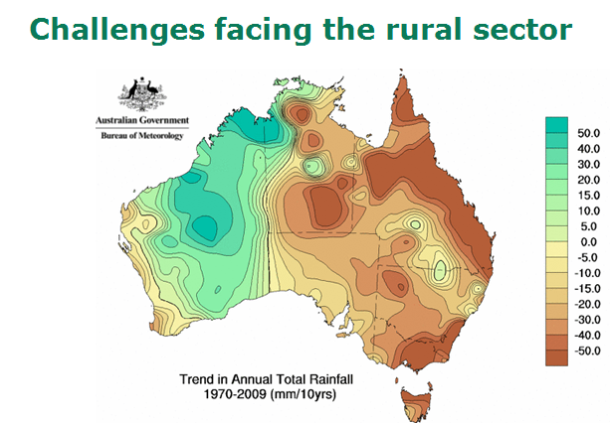
Australia

Slide 25
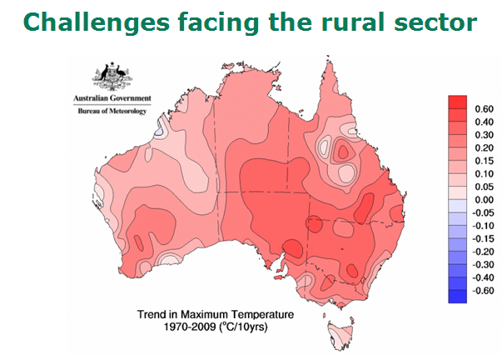
Australia

Slide 26
Australia: The Murray Darling Basin
Murray Darling Basin is a perfect example of Australia’s challenge with managing water and preparing for climate change into the future.
The Murray-Darling Basin comprises 23 rivers and 14% of the total area of Australia
It is an most important agricultural area with over 70% of irrigated agriculture dependent on the Basin.
By the end of this century, in a scenario where there is no mitigation of greenhouse emissions the combination of:
reduced median rainfall,
near complete absence of runoff in the Basin and
the increased frequency of drought
WILL RESULT IN A 92% DECREASE IN IRRIGATED AGRICULTURAL PRODUCTION IN THE MURRAY-DARLING BASIN

Slide 27
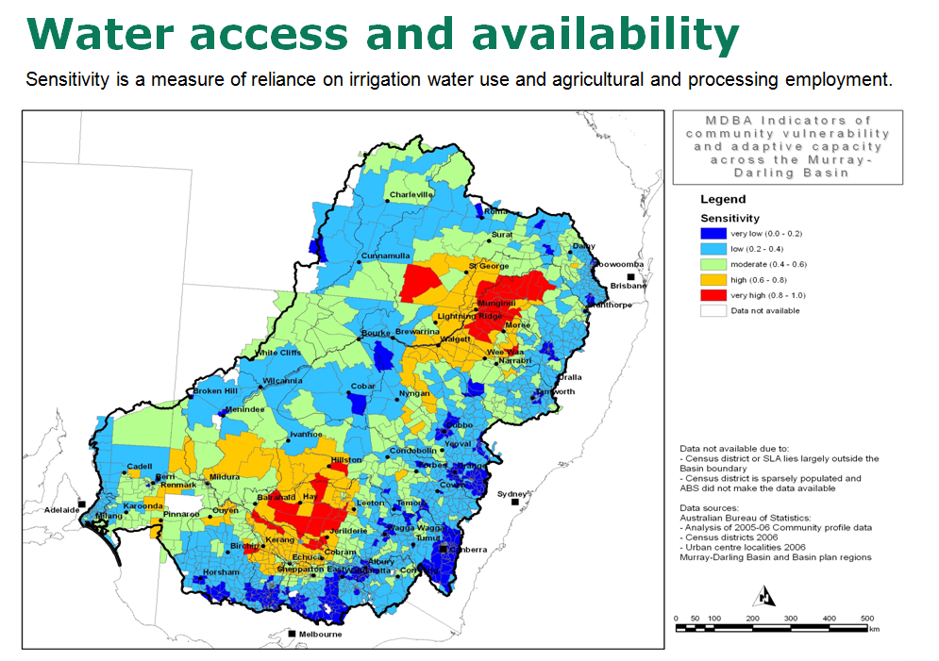
Australia: The Murray Darling Basin
This map highlights the areas most sensitive or how susceptible a community is to pressures and disturbances such as climate change.
Sensitivity here is a measure of the reliance of Basin communities on irrigation water and their dependence on agricultural for employment and income.

Slide 28
Water Policy in the Murray Darling Basin includes:
Australia
$3.1 billion over 10 years to purchase water for the Murray-Darling Basin – this is designed to improve the health of the river system
$5.8 billion to put farming on a more sustainable pathway including expenditure on modernising irrigation infrastructure
Extensive consultation with the sector to set water allocation levels throughout the Basin

Slide 29
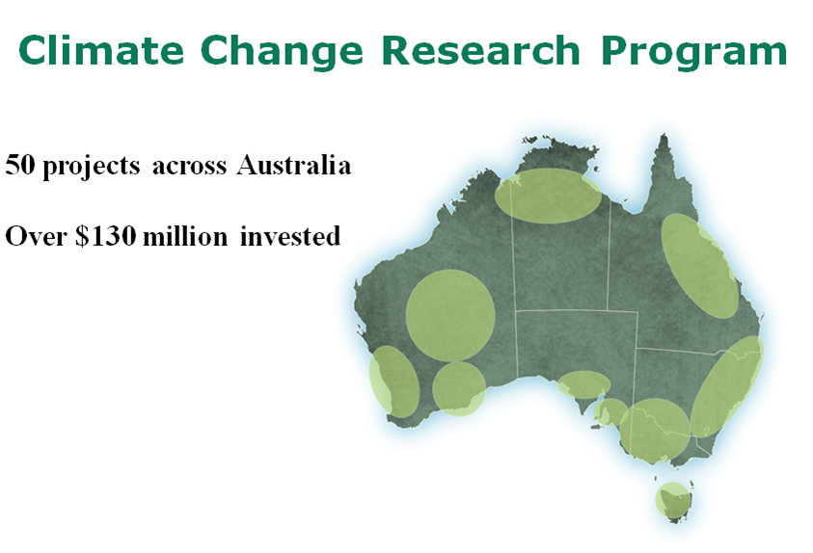
Australia
Soil Carbon Research Program - $20 million
Mitigation (emissions reduction) - $39.5 million
Biochar - $3 million
Adaptation - $38 million
Onfarm demonstrations - $27 million

Slide 30
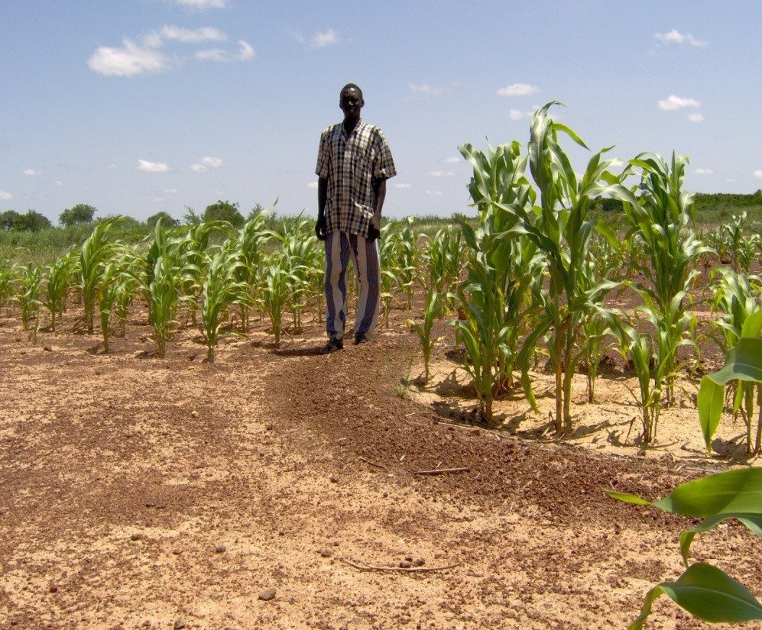
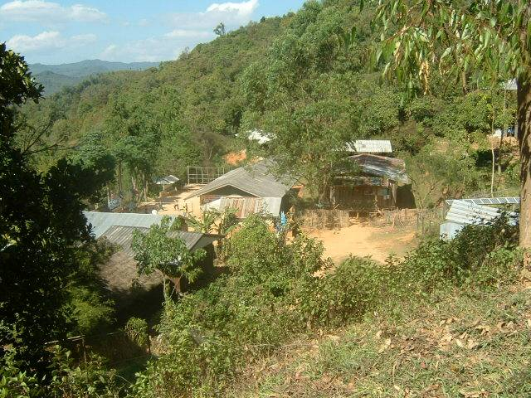
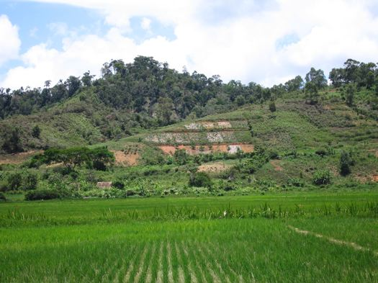
Policies & Strategies for Climate-Smart Agriculture
Bringing together food security, agricultural productivity and climate change.
Enabling policies for
investment in sustainable agriculture and rural development by both small holder and large scale farms;
Access to weather and climate information
inclusive access to finance;
secure access to land by smallholders;
efficient and sustainable use of land, water, energy and other inputs in climate-smart agriculture

Slide 31
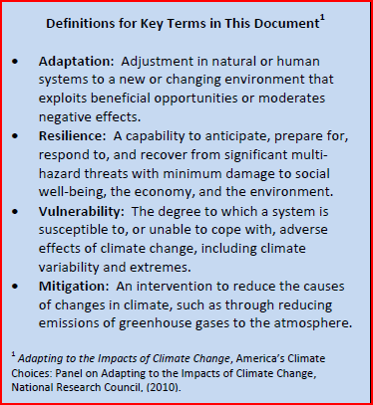

United States The White House Council on Environmental Quality - Climate Change Adaptation Task Force
Guiding Principles for Adaptation
Adopt Integrated Approaches
Prioritize the Most Vulnerable
Use Best-Available Science
Building Strong Partnerships
Apply Risk-Management Methods & Tools
Apply Ecosystem-based Approaches
Maximize Mutual Benefits
Continuously Evaluate Performance

Slide 32
Summary of Policy Goals and Recommended Actions for the Federal Government
1. Encourage and Mainstream Adaptation Planning across the Federal Government
2. Improve Integration of Science into Decision Making
3. Address Key Cross‐Cutting Issues - The Task Force focused on an initial set of cross‐cutting issues and recommends the following actions:
Improve water resource management in a changing climate
Protect human health by addressing climate change in public health activities
Build resilience to climate change in communities
Facilitate the incorporation of climate change risks into insurance mechanisms
4. Enhance Efforts to Support International Adaptation
5. Coordinate Capabilities of the Federal Government to Support Adaptation

Slide 33
United States Building a More Resilient Nation
Agencies will initiate a formal adaptation planning process with the support of the Office of the Federal Environmental Executive (OFEE).
USGCRP will continue efforts to build a robust body of science and critical tools to support decision making.
Interagency workgroups will collaborate to address cross-cutting issues and support international adaptation objectives.
Agencies will continue to develop and strengthen individual and interagency adaptation initiatives (e.g., National Climate Assessment) and efforts to provide climate services (e.g., modeling, decision-support tools).

Slide 34
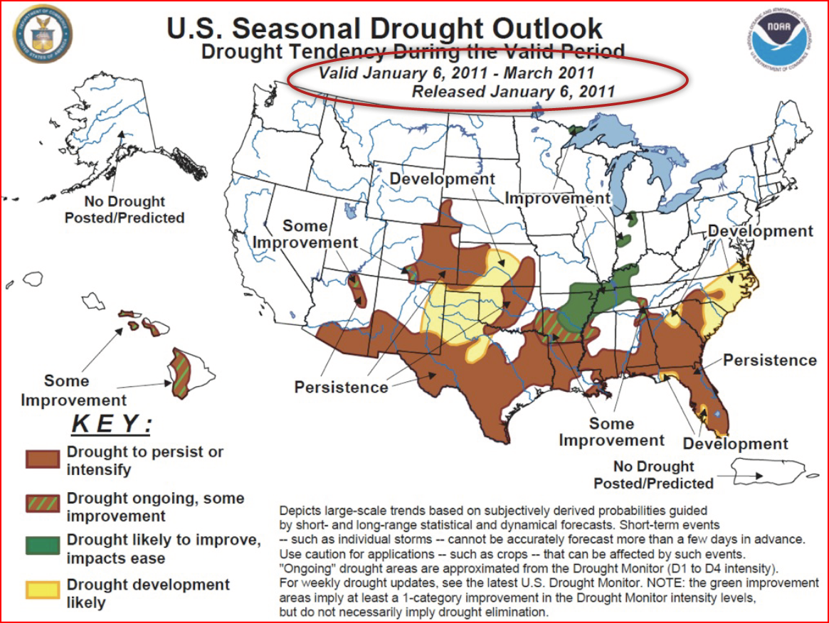
An example of US climate support programs

Slide 35
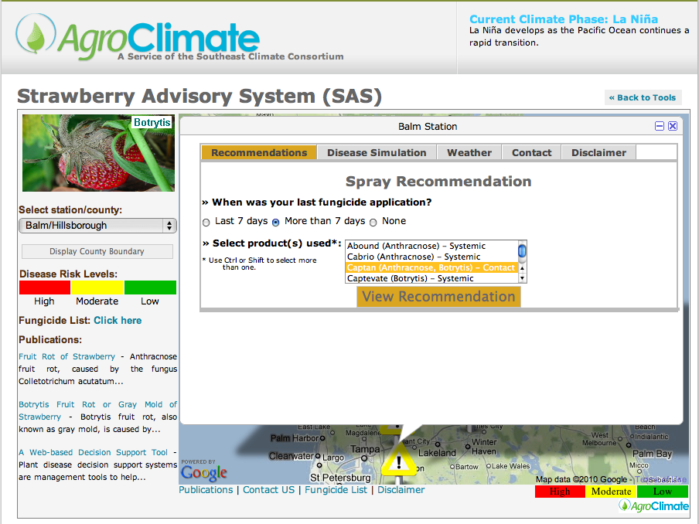
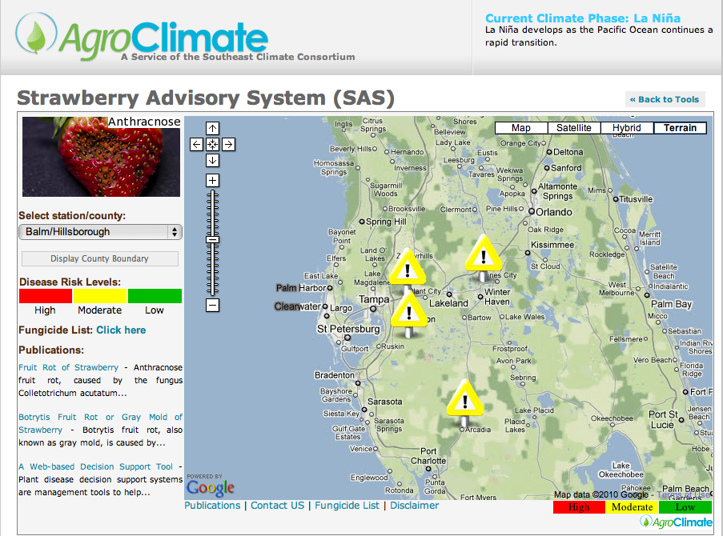
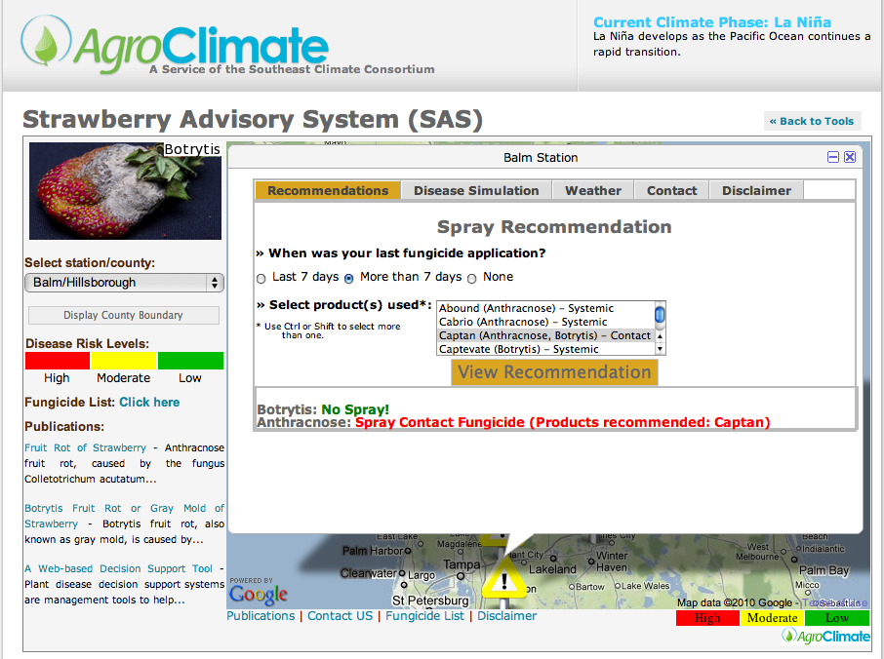
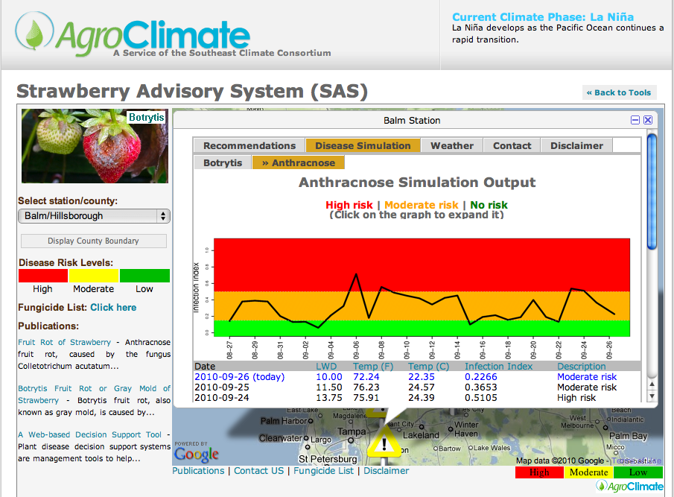

Slide 36
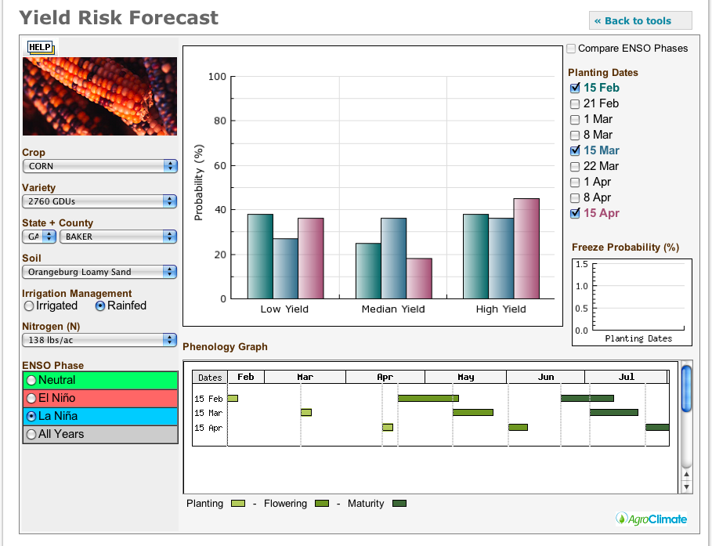
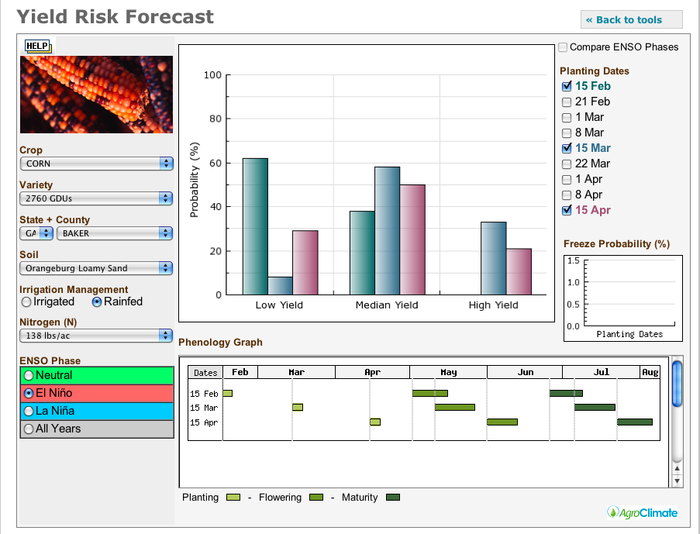
Mais - Optimisation de la date de plantation

Slide 37
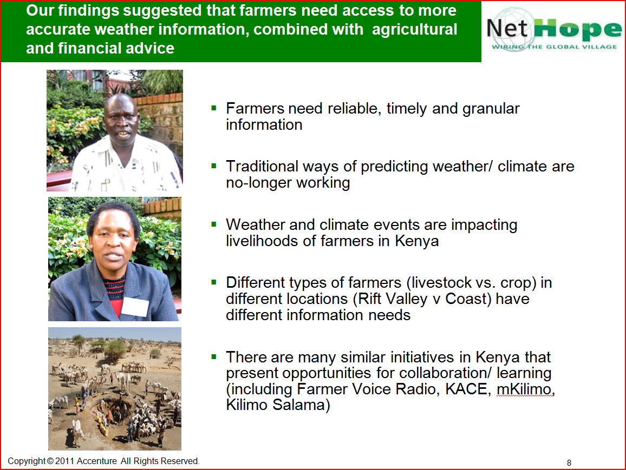

Slide 38
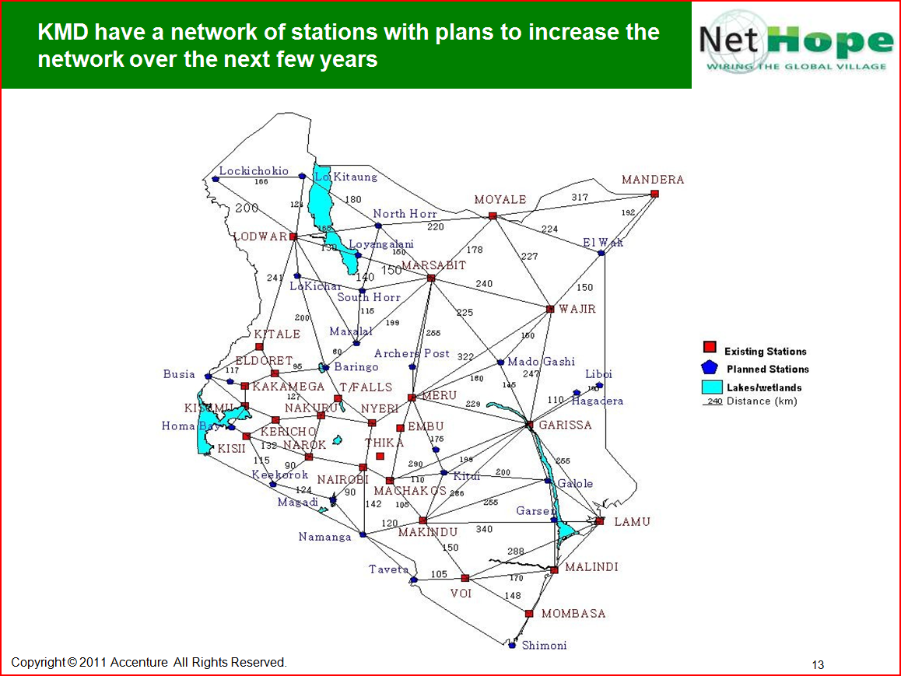

Slide 39
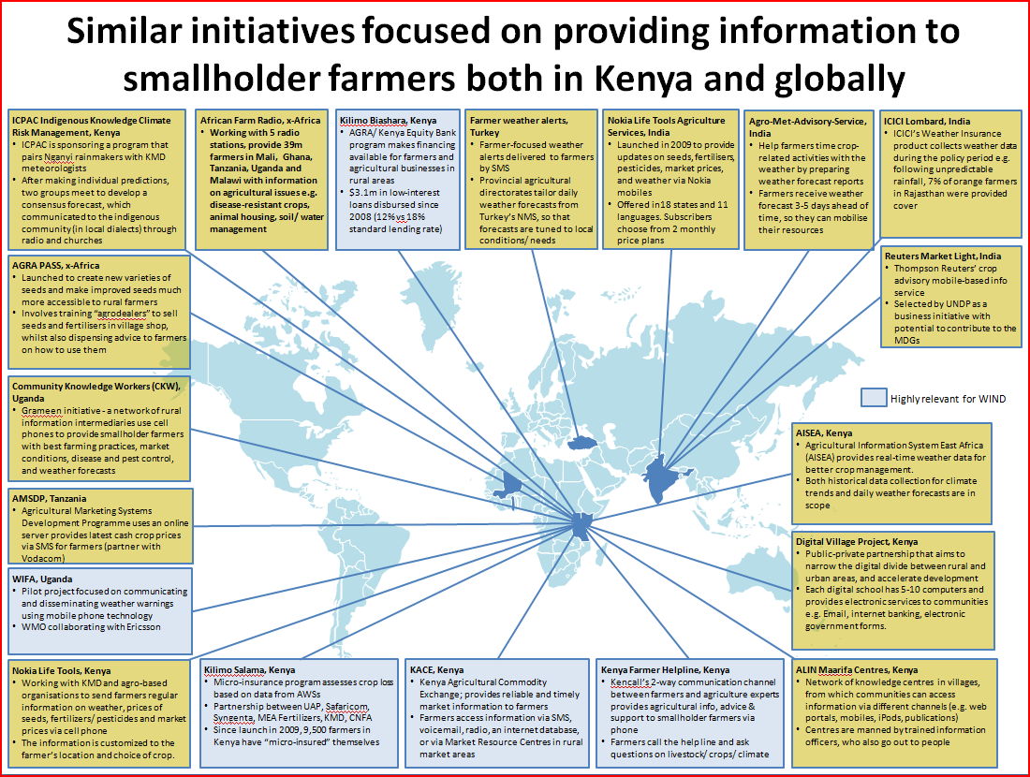

Slide 40
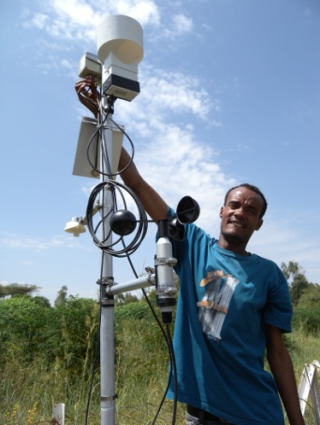
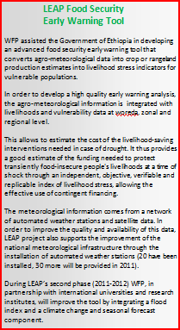
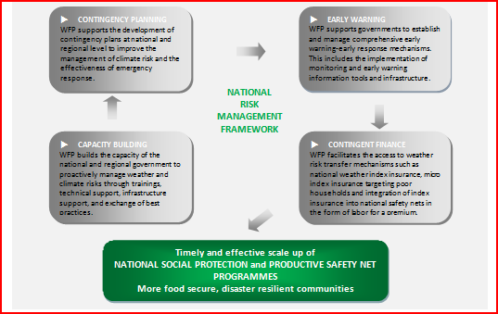
FAO Livelihoods, Early Assessment and Protection (LEAP)
Government of Ethiopia installed 20 automated weather stations, additional 30 in 2011.

Slide 41
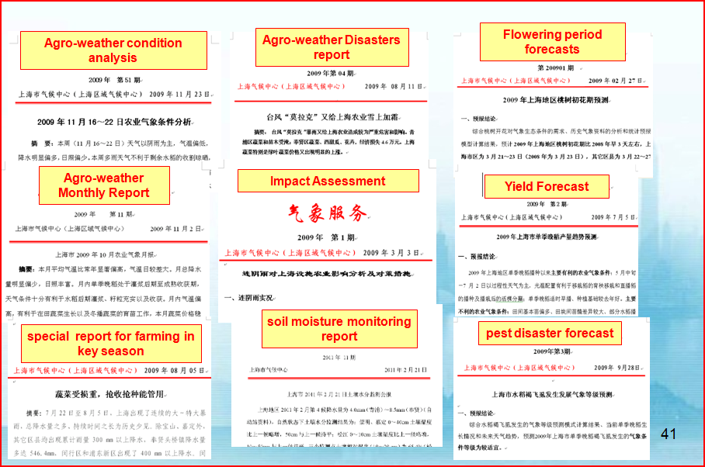
China example - Agriculture services were delivered through SMS, fax, website

Slide 42


A farmer’s voice

Slide 43


Some key areas for policy, supporting measures and research
Agriculture water management; sustainable rice intensification systems
“Greening” the green revolution integrated soil fertility management and minimum tillage
Managing intensive livestock systems; in US in 2007 1 billion kg of milk required 21% of animals, 23% of feed, 35% of water and 10% of land compared to 1944
Forest landscape restoration; India to increase forested area from 25% to 34%
Reversing degradation in less favored areas; greening the Sahel
Scaling up agroforestry and integrated watershed management; (Loess plateau) and
Payments for environmental services. Costa Rica, REDD
Providing relevant weather & climate services to farmers
Policies and regulations matter: but technology helps and political economy, food security, food safety and low prices are key

Slide 44
Climate smart agriculture
http://www.youtube.com/watch?v=rs-pA1Ee02U

Slide 45




Questions & Comments….

