Slide 1
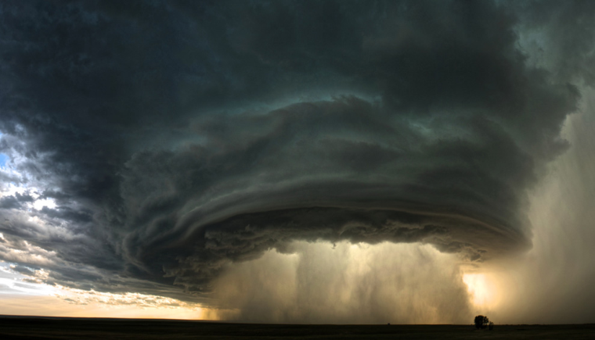
Hazards and Disasters
Picture found from: http://2.bp.blogspot.com/_YtxGNf8GgRA/TOjScQ9kafI/AAAAAAAAFUU/MgQEcbF0gJE/s1600/supercell_storm_sean-heavey.jpg
Outsmart the Quake! Lesson 1
Disasters are Preventable
Notes:
Notes for Teacher:
“Now that we have brainstormed hazards and disasters, now we will discuss the actual definitions of each.”

Slide 2
HAZARD
A hazard is a human made or natural danger that can threaten a group of people, their belongings, and their environment, if they do not take precautions.
Notes:
Notes for Teacher:
Hazards happen every day, but do not necessarily cause a lot of damage. This is the distinguishing factor between a hazard and a disaster. For example, a flood in the middle of a field does not cause such great damage that communities cannot recover without assistance.
Ask the students to brainstorm some ideas of hazards in Washington State. There are examples on the next slide.

Slide 3
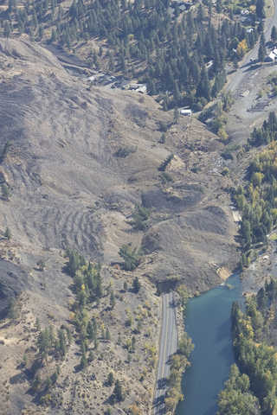
Examples of Hazards
In Washington:
Earthquakes
Flooding
Landslides
Tsunamis
Volcanoes
Other places:
Hurricanes
Tornados
A landslide in Nile Valley, Yakima in 2009 went completely across the Naches River.
http://www.yakima-herald.com/images/photos/2009/10/11/101109_SG_Nilelandslide8.jpg?1255318457
Notes:
Notes for Teacher:
Remember, a hazard is a human made or natural danger that can threaten a group of people, their belongings, and their environment, if they do not take precautions. Below, there are examples of each hazard that gives context to their presence in Washington State.
In Washington:
Earthquakes
Nisqually Earthquake (2001)
Puget Sound Earthquake (1949)
Flooding
Widespread flooding in WA (1996) with the highest flood records in Chehalis, Skookumchuck, and Nisqually Rivers.
Landslides
Nile Valley, Yakima County Landslide (2009)
Tsunamis
1964 – An earthquake in Alaska caused a tsunami in Washington state. In Seaview, WA the waves reached roughly 13 feet high.
Volcanoes
Mount Saint Helens (1980)

Slide 4
DISASTER
A disaster is a hazard that causes such great losses and damage that the affected communities do not have the resources to recover without outside assistance.
Notes:
Notes for Teacher:

Slide 5
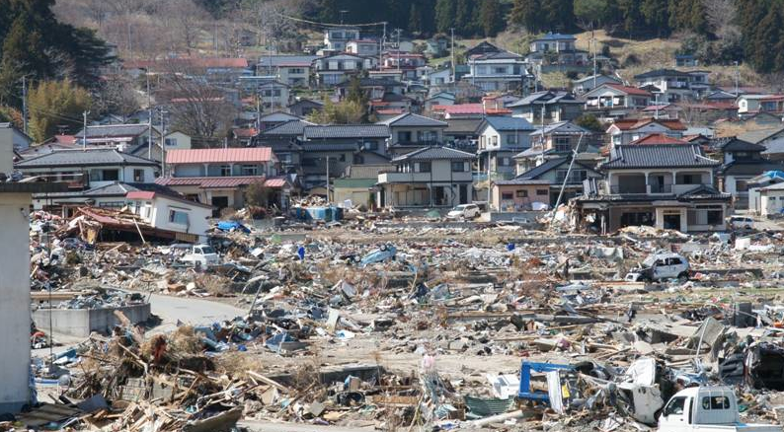
Tsunami Damage
Tsunami damage after the 2011 earthquake in Japan.
Photo: Dr. Norio Maki, Kyoto University
Notes:
Notes for the teacher:
This is a photo of tsunami damage after the 2011 earthquake in Japan. It shows the end of the tsunami inundation zone. Although this photo is a good example of a disaster, it clearly shows that the damage from the tsunami was not random, and that people living outside the inundation zone did not experience any damage to their homes.
Questions to ask the students:
Is the damage all over, or only in some places?
Why do you think some houses were not affected?
If you were in or near one of the houses that was destroyed, what could you have done to stay safe?
Did the tsunami cause damage to people or buildings?

Slide 6
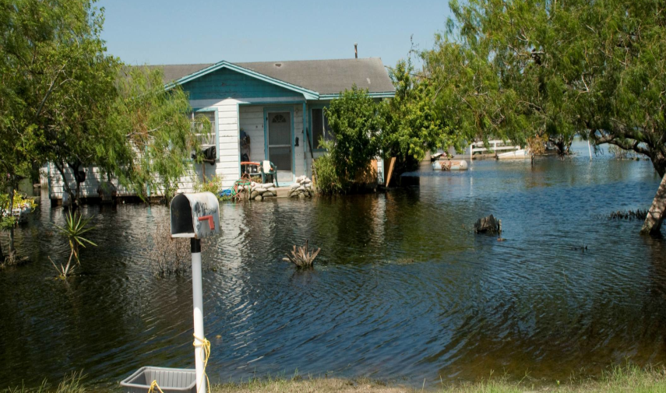
Flood Damage
2008 Flooding in La Feria, Texas.
http://commons.wikimedia.org/wiki/File:FEMA_-_37485_-_Flood_neighborhood_in_Texas.jpg
Notes:
Notes for Teacher:
Flooding in La Feria, TX in 2008. The house is surrounded by flooding, but remains untouched do to preflooding preparation. (These homeowners probably used techniques like raising the foundation and sandbagging around the house to protect the house from flooding) This photo demonstrates that preparation before a flood can protect homes from damage. Floods do not effect every house, houses that have taken measures against flooding will not experience the same amount of damage.
Questions to ask the students:
Did this flood cause damage to people or buildings?
Why do you think this house was not affected by the flood?

Slide 7
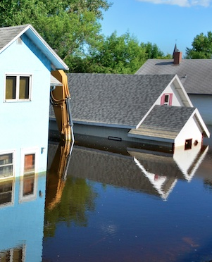
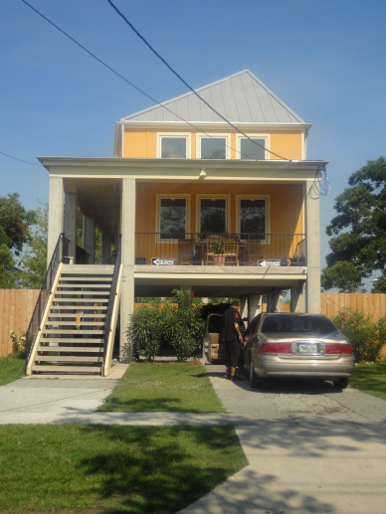
Flood Damage
The owners of these homes did not take measures to protect their property from flood water.
This house in New Orleans has had its foundation raised so that flood water can run underneath.
Photo: FEMA
Photo: Nora Jagielo
Notes:
Notes for Teacher:
The photo on the right is an example of a mitigated home that has had its foundation raised. The houses on the left did not have their foundations raised. When a 5 foot flood occurs, the first floor of the house on the left will be filled with water and mud. Electrical appliances, TVs and computers will be ruined. So will walls, furniture and electrical wiring. The same 5 foot flood will not damage the house on the right. The water will flow underneath the porch. This is an example of how mitigation can successfully protect homes and communities from disasters. Make sure the students know that you are only at risk of flooding like this if you live in a flood plain. Even when you do live in a flood plain, each area is different and is capable of different levels of flooding.
Questions to ask the students:
What do you notice about the house on the left?

Slide 8
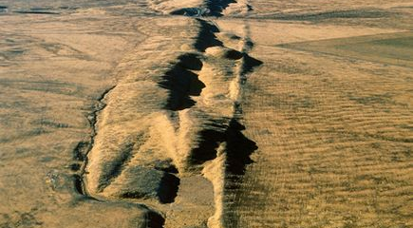
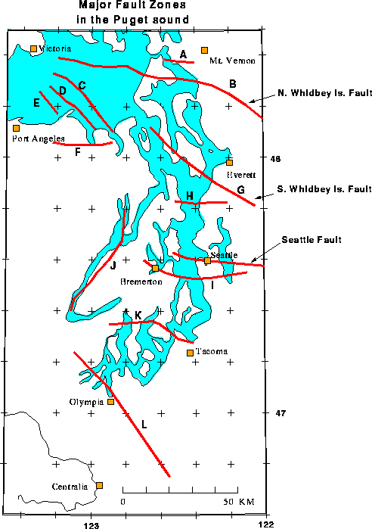
Fault Lines
The San Andreas Fault is visible on the surface of the open field in California. This fault line has caused several large earthquake in southern California in the last century.
The Seattle area has many faults running through it, on which cities and neighborhoods are built. Some of these faults were only discovered in the last few decades.
http://images.nationalgeographic.com/wpf/media-live/photos/000/000/cache/san-andreas-fault_19_600x450.jpg
http://www.healthy-diet-habits.com/images/puget_sound_earthquakes.gif
Notes:
Notes for Teacher:
The fault line on the left is the San Andreas fault in the middle of an open field in California. This photo demonstrates when faults travel through areas that are not developed, an earthquake on the fault will cause little or no damage to houses, towers, pipes and people. The photo on the right shows many fault lines go through the Puget Sound region. A large earthquake on one of these faults could cause widespread damage to buildings, towers, bridges and pipes.

Slide 9
Acknowledgements
Outsmart the Quake! lesson plans are intended to support 6th-8th grade student learning about disaster preparedness in conjunction with the Washington State ShakeOut drill. The lessons were developed in 2012 by Western Washington University students Nora Jagielo, Pamela Griswold, Spencer Andrich, Pat Chappelle and Ryan Bainbridge as part of the Disaster Risk Reduction Planning Studio.
If you have questions, comments or concerns, please contact Dr. Rebekah Green at Western Washington University’s Resilience Institute. Rebekah.green@wwu.edu.

