Slide 1
On-Site Technology Training for Small, Rural Michigan Businesses August 29th, 2012 Eric Frederick, AICP, LEED AP State Program Manager, Connect Michigan

Slide 2
About Connect Michigan
.
Mapping
Research
Community Planning & Outreach
Connect Michigan is a non-profit organization, in partnership with the Michigan Public Service Commission, tasked with facilitating the expansion of broadband access, adoption, and use throughout the state
Backed by Connected Nation, national technology-oriented non-profit.
In-State Staff.
State Program Manager.
Two Community Technology Advisors.
Three major programs.
Mapping.
Research.
Community Planning and Outreach.

Slide 3
Observations
86% of Michigan businesses have fewer than twenty employees.
Small businesses provide 30% of total jobs in Michigan (~1,000,000 jobs).
Facilitated by technology, information and knowledge have become the major factors controlling wealth creation.
Small businesses, particularly in rural areas, adopt broadband and technology at a lower rate than non-rural, larger establishments.

Slide 4
Purpose
Establish the current state of broadband and technology adoption among Michigan’s small businesses, particularly those in rural areas.
Present a review of training models’ literature.
Explore technology training models available to small businesses in Michigan.
Discover other models of technology training from across the United States; and
Curate technology training best practices and establish a framework for local implementation.

Slide 5
Definitions
“Small businesses,” are those employing less than twenty employees.
“Rural areas,” are counties and places designated “rural” by the Census Bureau.
“Broadband,” high-speed Internet connection.
not dial-up.
at least 768 Kbps.
more realistically, 3 Mbps minimum.
various platforms; cable, DSL, satellite, fixes & mobile wireless, fiber, etc.
Focused on small businesses that can utilize technology to enhance and support their primary activity, not technology-oriented businesses.

Slide 6
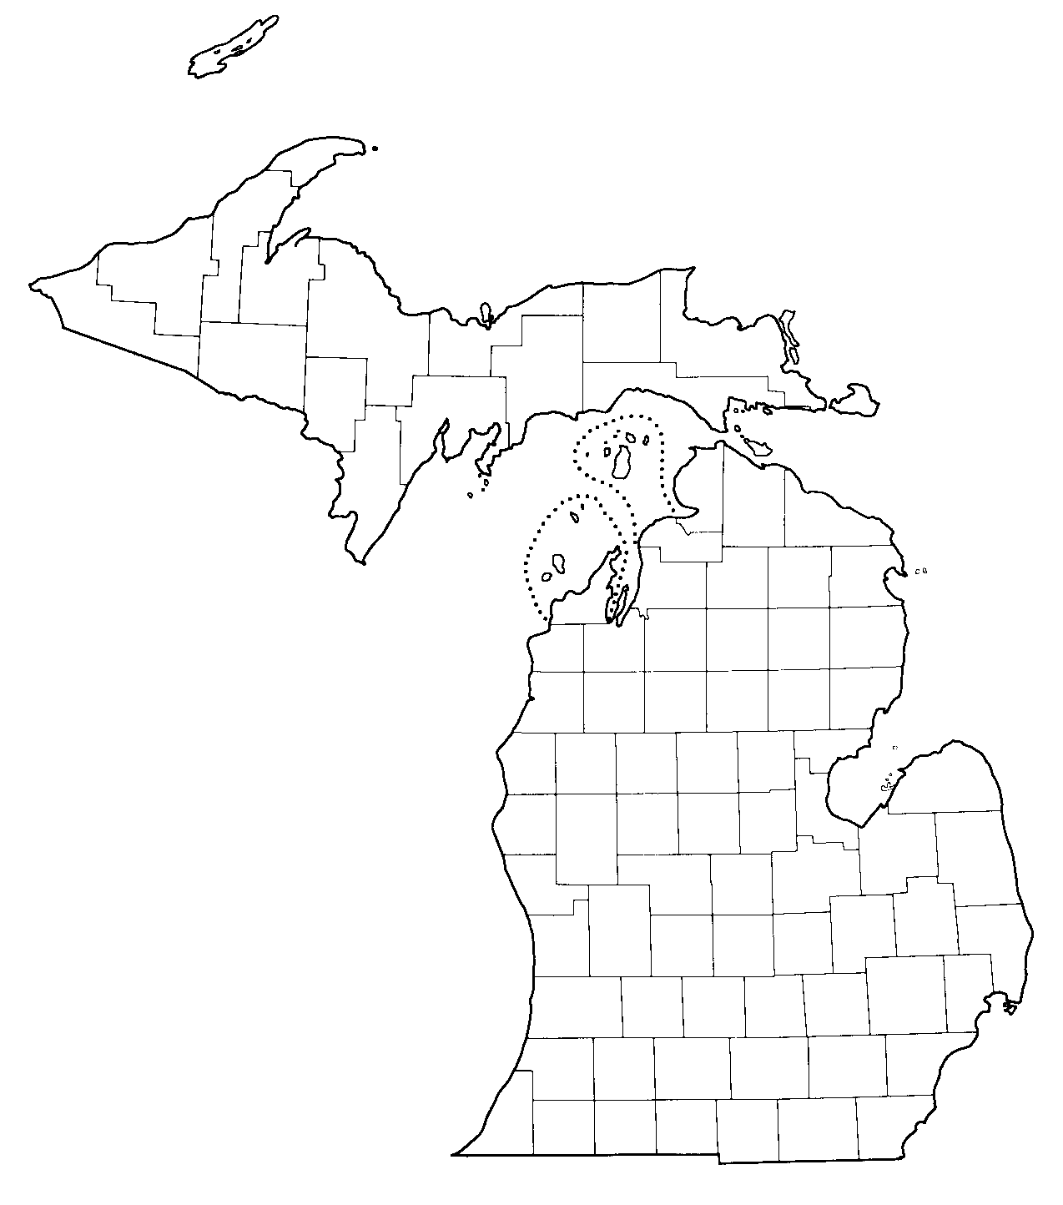
Keweenaw
Houghton
Counties designated rural by the US Census Bureau
Ontonagon
Baraga
Gogebic
Marquette
Luce
Iron
Alger
Schoolcraft
Chippewa
Dickinson
Mackinac
Delta
Meno-
minee
Emmet
Cheboy-
gan
Presque
Isle
Charlevoix
Lee-
lanau
Antrim
Otsego
Montmor-
ency
Alpena
Benzie
Grand
Traverse
Kalkaska
Crawford
Oscoda
Alcona
Wexford
Missa-
ukee
Roscom-
mon
Ogemaw
Iosco
Manistee
Mason
Lake
Osceola
Clare
Gladwin
Arenac
Huron
Oceana
Mecosta
Isabella
Midland
Montcalm
Tuscola
Sanilac
Gratiot
Shiaw-
assee
Allegan
St.
Joseph
Branch
Hillsdale
Lenawee

Slide 7
Benefits of Technology Adoption for Small Businesses
Three primary areas of benefits.
Increased revenue via more thorough connections with existing customers while accessing a vast marketplace of potential customers.
Decreased expenditures from operational efficiencies; and
Information sharing via access to the collective knowledge and experience of others at a global scale.
Examples include.
Social media.
Teleworking (or telecommuting).
Website development and e-commerce.
Automated accounting and inventory.
Off-site file backup and security.
Point-of-sale applications.

Slide 8
Technology Adoption Among Michigan’s Small Businesses

Slide 9
Technology Adoption Among Michigan’s Small Businesses

Slide 10
Technology Adoption Among Michigan’s Small Businesses

Slide 11
Why does it matter?
Median Annual Revenue
$310,000
Broadband Connected
$70,000
No Broadband
Online Sales
29% of small businesses earn at least some revenue from online sales.
On average, small businesses earn 34% of their revenue from online sales, or ~$190,000.
Statewide, this represents $6.9 billion in revenue for Michigan small businesses.

Slide 12
Barriers to Technology Adoption Among Michigan’s Small Businesses
Barriers to Broadband Adoption among Michigan Businesses with Fewer than Twenty Employees.
We don’t need it or we are getting by without it.
-43%
Our business does not use computers.
-15%
Broadband service is not available in our area.
-10%
The monthly cost of service is too expensive.
-5%
It would be too much of a distraction to employees.
-4%
It would take too long to train our employees.
-4%
It poses a security risk.
-2%
The installation cost is too expensive.
-2%
It is too complicated.
-1%
Other.
-5%
Don’t know/Refused.
-9%
Barriers to Broadband Adoption among Michigan Businesses with Fewer than Twenty Employees
We don’t need it or we are getting by without it | 43%
Our business does not use computers | 15%
Broadband service is not available in our area | 10%
The monthly cost of service is too expensive | 5%
It would be too much of a distraction to employees | 4%
It would take too long to train our employees | 4%
It poses a security risk | 2%
The installation cost is too expensive | 2%
It is too complicated | 1%
Other | 5%
Don’t know/Refused | 9%

Slide 13
Technology Adoption Summary
Rural small businesses adopt technology at a lower rate than larger, non-rural businesses.
A clear pattern exists between annual revenue and technology adoption among small businesses.
Awareness of broadband’s benefits is the number one barrier to technology adoption.

Slide 14
Business Training Model Review
Literature review pertaining to various training methodologies among small businesses.
Emergent themes:
Ease of use, make technology less daunting.
Geographic isolation, distance to centralized training.
Flexibility, time and delivery methods.
Industry and topic relevance.

Slide 15
Business Training Model Review
Ease of Use.
Training that makes technology seem less daunting is key to increasing adoption among small businesses.
Small businesses owners’ perceptions about the ease of use of new technology impacts whether they adopt that technology.
Applies not only to owners but employees as well.
Technology training may also help create a more digitally literate workforce.
Industry and Topic Relevance.
Programs must meet the specific needs of the business or be industry specific.
Technology must be directly linked to how it can improve business operations.

Slide 16
Business Training Model Review
Geographic Isolation.
Widely dispersed businesses, or small concentrations of establishments in rural areas lack access to conveniently located training facilities or programs.
In a survey of rural business owners in Great Britain, 30% cited distance and transport as a constraint for participating in training activities.
Flexibility.
The US Small Business Association’s Training Program Survey found respondents valued training programs that were customizable and had flexible times, delivery methods, and locations.
56% of rural small business owners in Great Britain stated that releasing staff from work was the main constraint to providing any type of employee training.

Slide 17
Business Training Model Review
On-Site Technology Training
Distance to training site
Flexibility in time and delivery method
Comfort level and ease of use
Industry/topic relevance, business improvement

Slide 18
Business Training Model Review
On-Site Technology Training.
Research shows that small business owners prefer one-on-one training.
On-site demonstrations and hands-on activities result in the successful and sustainable implementation of new methods and operations.
Training activities on-site are popular due to convenience, ability to tailor training needs, and the social learning environment they provide.

Slide 19
Business Training Model Review
Social Cognitive Theory in Technology Training.
Trainees must actively explore, manipulate, and influence their own environments in order to effectively learn.
Could be performed off-site, but through on-site activities, trainees not only explore new behaviors, they are learning on the equipment they will be using after the trainer has left.
Peer-to-Peer training and support is also developed.

Slide 20
Small Business Technology Training in Michigan
Small business training in Michigan is focused on.
Business plan development.
Marketing; and.
Financing.
Formal technology-related training is conducted via centralized workshops and events and online webinars and videos.
Anecdotal evidence suggests business owners often seek technology advice or training from friends, family members, and fellow business owners.

Slide 21
Small Business Technology Training in Michigan
Several organizations provide small business training and support in Michigan.
Small Business & Technology Development Center.
One-on-one counseling.
Workshops and events (social networking, Quickbooks essentials, etc.).
Network of business resources.
Michigan Get Your Business Online w/Google and Intuit.
Michigan Economic Development Corporation.
Small Business Association.
Regional economic development entities.

Slide 22
National Training Models
Public-private partnerships are the favored model of training in several states.
Partnerships in New Mexico, Arizona, and Tennessee provide technology training via off-site workshops and events at local libraries.
Training in Vermont and Minnesota is provided by educational and economic development entities.
Chicago’s Business Resource Network helps make local businesses profitable and sustainable through free broadband access, business software, and technology workshops.
Private, for-profit groups, New Horizons and KnowledgeWave, provide workshops and training to customers.

Slide 23
A Model for local implementation

Slide 24
A Model for Local Implementation
A loose model and work in progress.
Based on basic planning process.
Leverage existing resources (i.e. no one has money).
Build public-private partnerships.
Assess, catalog, organize, and implement.

Slide 25
A Model for Local Implementation
Select organizing entity and gather local stakeholders and resources.
Assess the need.
Inventory community technology assets.
Create training partnerships.
Build awareness.
Follow-up and support networks.

Slide 26
A Model for Local Implementation
Select organizing entity and gather local, community stakeholders and resources.
Collaboration and cooperation are key.
Community is not defined.
Organize around a geographic area that ultimately benefits the small business community.
Find a champion, create a training team.
Chamber of Commerce.
Regional MI-SBTDC offices.
Regional MEDC staff.
Local and regional ED orgs.
Main Street programs.
DDAs.
Corridor Improvement Auth.
Local business assoc.
MI Smart Zones.
MI Skills Alliances.
MI Works offices.
Local SCORE chapter.
Technology/bus. oriented non-profits.
Community colleges.
Private-sector technology companies (e.g. web developers, etc.).

Slide 27
A Model for Local Implementation
Assess the need
Understand the current technology adoption and use at a local level
Training team members interact with small businesses and provide an opportunity to assess their needs
Develop a technology questionnaire
What types of technology do you use for your business?
Do you subscribe to Internet service?
How has technology improved your operations?

Slide 28

A Model for Local Implementation
Assess the need
Data gathering should be convenient for business owners
Existing, regularly scheduled
business roundtables or
focus groups
Door-to-door or phone
interviews
Individual assessment would
be the most useful

Slide 29
A Model for Local Implementation
Inventory community technology assets.
Comprehensive list of programs, resources, and organizations and individuals with the interest and skill to train small businesses.
Training team may be the best source for this information, but resources may exist outside the team:
High school or vocational school technology students and teachers.
Technology vendors (e.g. broadband providers, software developers, web designers, etc.).
Libraries.

Slide 30

A Model for Local Implementation
Inventory community technology assets
Inventory locations and
facilities too (e.g. Wifi
hotspots, public computer
centers, etc.).
Identify capacity and gaps in
local technology resources.

Slide 31
A Model for Local Implementation
Create training partnerships
Identify topical experts to serve as on-site trainers.
Will need to include hardware and broadband experts for businesses without any technology.
Build a catalog of training services along a continuum of need.
Needs Assessment
Asset Inventory
Public-Private Training Partnerships

Slide 32
A Model for Local Implementation
Create training partnerships - Examples
High school seniors, needing community service requirement, help businesses establish social media accounts
Local web developer offers 4 hours of free on-site assistance and web development for one-year of hosting subscription

Slide 33

A Model for Local Implementation
Build awareness.
Most oft-cited barrier, “we don’t need it,” or “we’re getting by without it.”
Small businesses respond best to
technology when the focus is on
how to achieve business results
instead of solely on technology
for technology’s sake.

Slide 34
A Model for Local Implementation
Build awareness.
Gather stories.
Provide local examples with local businesses.
For training participants, gather before and after accounts.
Develop one-pagers, post videos on training team websites, etc.

Slide 35
A Model for Local Implementation
Follow-up and support networks.
Technology adoption is not a one-time event in the life of a business.
Training experts and resources can help with follow-up questions, but may not be a sustainable means of support.
Transparent diffusion of the needs assessment, case studies, technology resources, and success stories creates an informal network of technology users and support.

Slide 36

A Model for Local Implementation
Follow-up and support networks.
If resources permit, a more
formal, facilitated roundtable of
businesses could be established
to provide support to new
adopters.
Online forums, email list-servs, social media, and other technology means could also be employed.
Inclusive and regular peer-to-peer assistance can create sustainable local technology adoption.

Slide 37
Conclusion
On-site, hands-on training has the potential to increase sustainable technology adoption and use among Michigan’s small, rural businesses.
Technology adoption could help businesses sustain and grow in Michigan by.
increasing revenue.
decreasing expenditures; and.
enabling entrepreneurs.
Local implementation may be a workable model for increasing technology adoption in rural small businesses.
What now?

Slide 38
Questions, Comments, Examples, Assistance, Thoughts?
Eric Frederick, AICP, LEED AP
State Program Manager
efrederick@connectmi.org
517-994-8024
www.connectmi.org
Elizabeth Riesser
Research Analyst
eriesser@connectednation.org
270-846-7644
www.connectednation.org

Slide 39
Primary Sources
Bailey, J.M. and Preston, K. (July 2008) Small Businesses in Rural Nebraska: Their Needs and Thoughts, An Analysis of the Rural Enterprise Assistance Project Small Business Needs Assessment Survey. Center for Rural Affairs, Rural Enterprise Program. Online. Available at http://www.cfra.org/files/Small-Businesses-in-Rural-Nebraska-Their%20Needs-and-Thoughts.pdf
Bennet, R. and Errington, A. (1995) “Training and the Small Rural Business,” Planning Practice and Research, 10(1).
Robinson, S. “A Study of Rural Small Business Owners’ Internet Usage,” paper presented at the Academies International Conference, Proceedings of the Academy of Entrepreneurship, 10(1): 41-46, New Orleans, 2004.
West Virginia Chamber of Commerce (May 2005) Focus Group Report: Broadband and Technology Use Among Small Businesses in West Virginia, The West Virginia Small Business Technology Education & Competitiveness Initiative. Ed. RMS Strategies.

