Slide 1

Devices, Data and Dollars
JOHN BURBANK • NIELSEN

Slide 2
$70
BILLION PER YEAR

Slide 3


Notes:
30 seconds
Challenge – who’s seeing the 30 second spots?
Pepper eyes around slide – figure out who sees them.

Slide 4
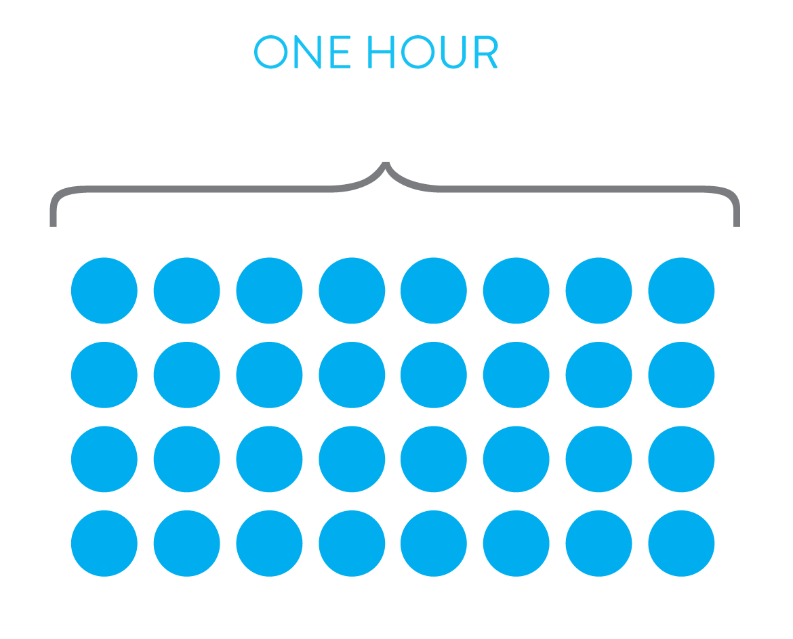
Notes:
Numeric cues

Slide 5
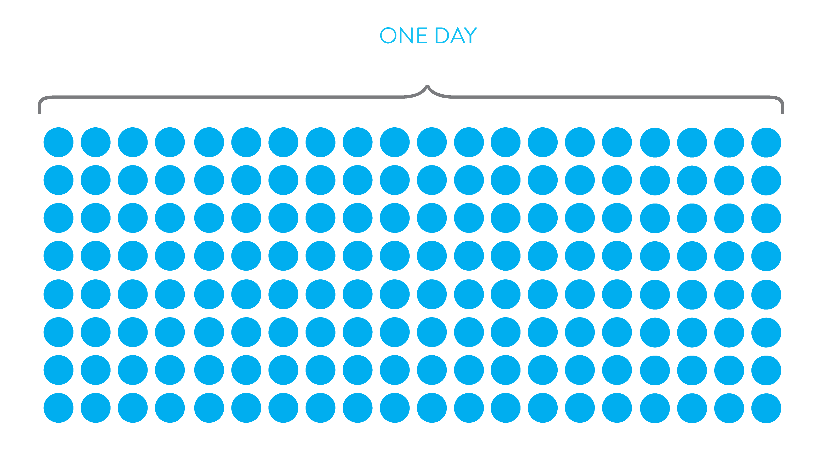

Slide 6




Slide 7


Slide 8
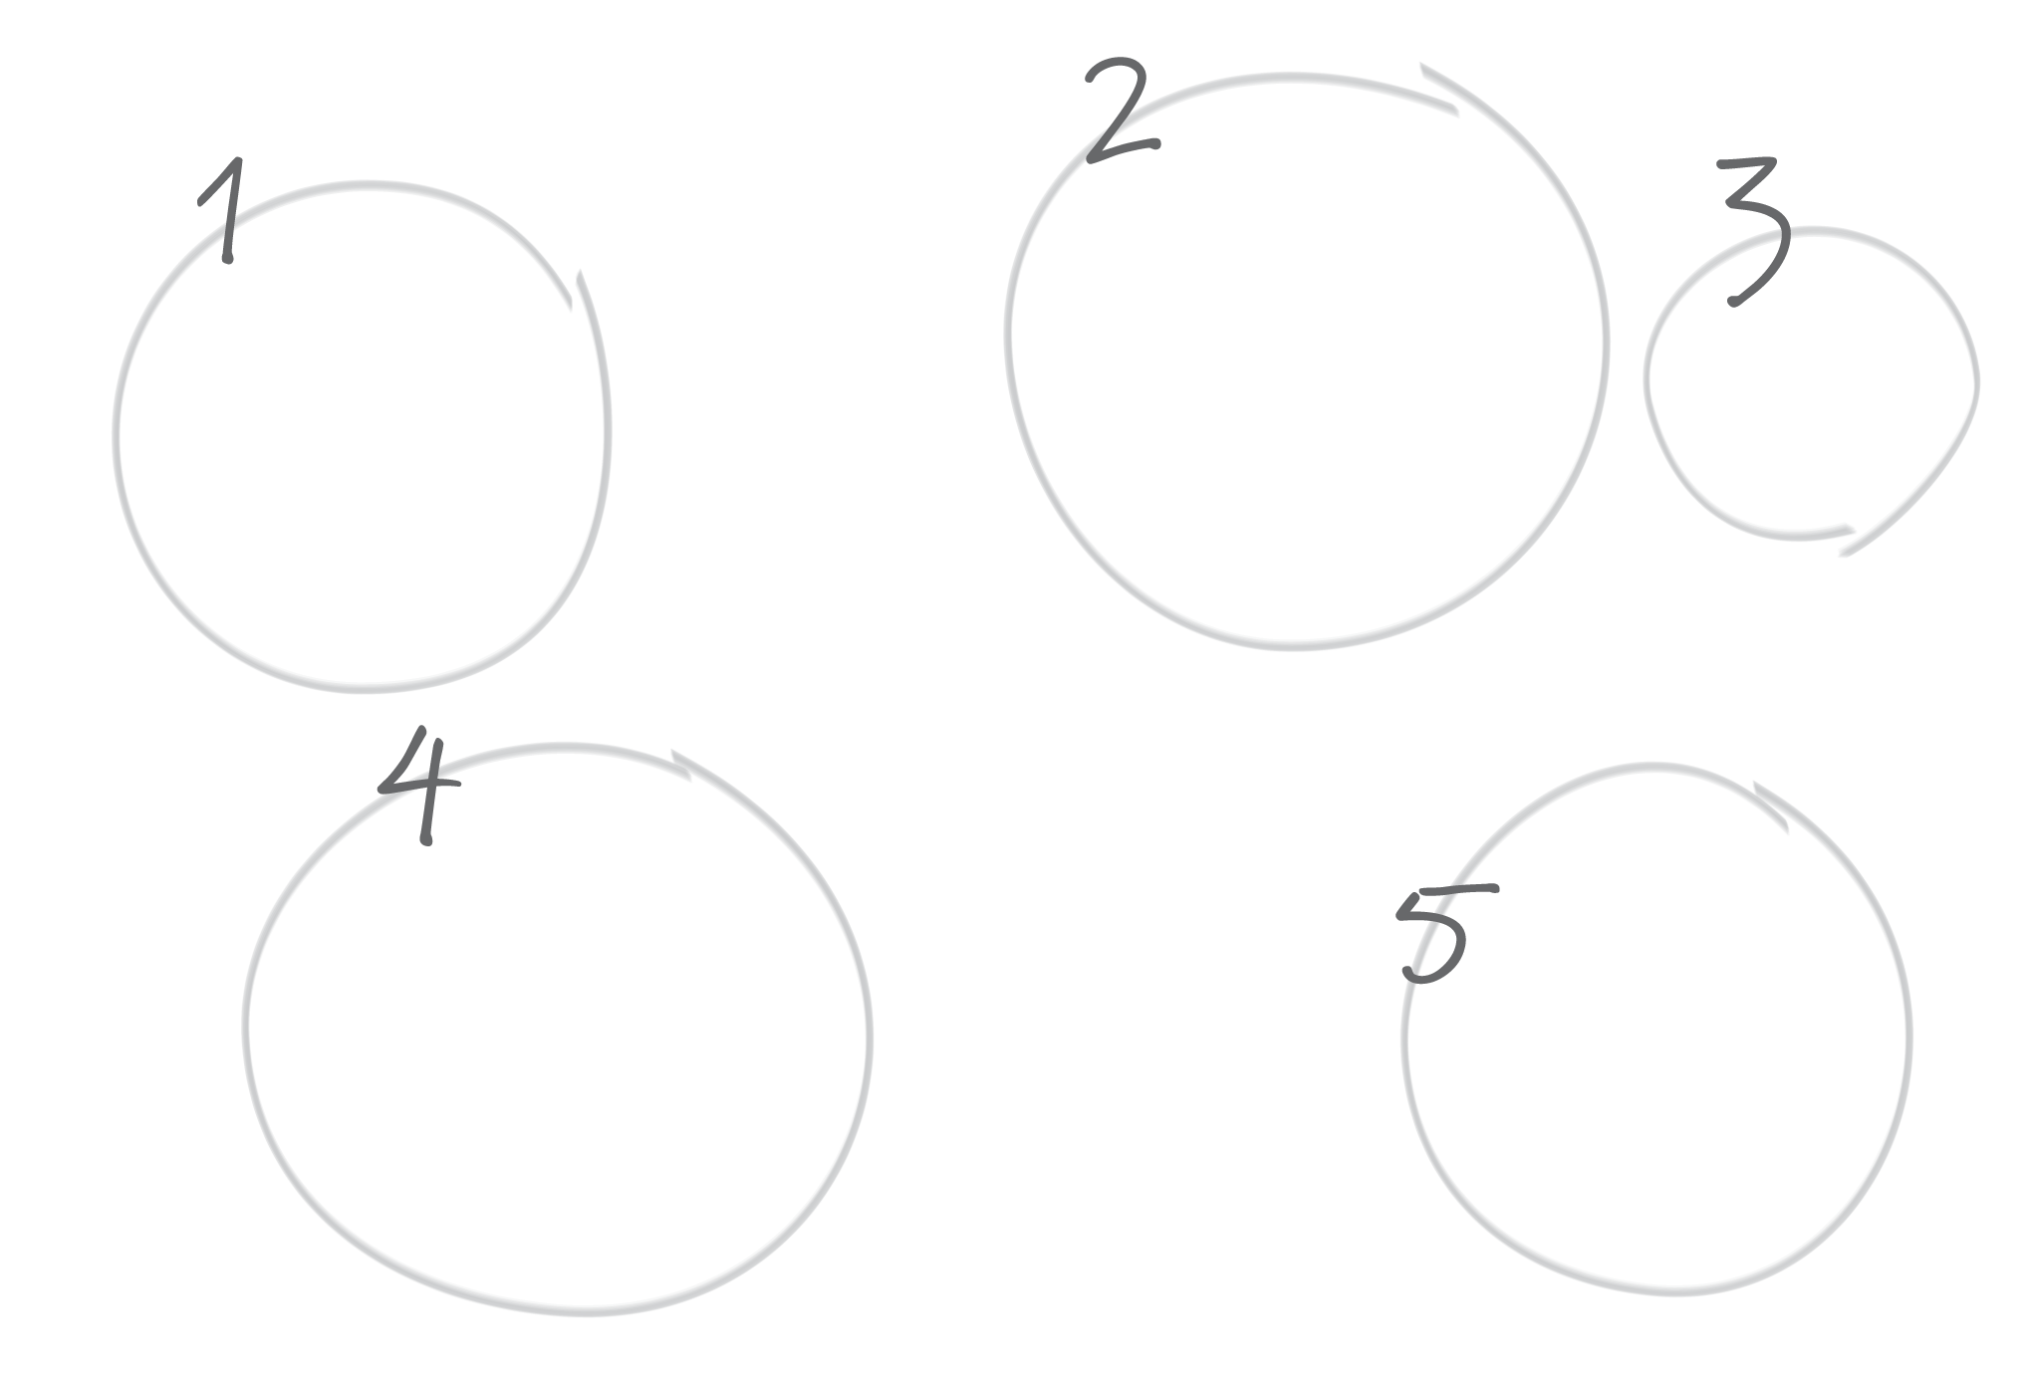


Notes:
Make look more like tv

Slide 9



Slide 10


Slide 11



Slide 12



Slide 13



collaborative data

