Slide 1


Introduction to the Semantic Web
(Tutorial)
2011 Semantic Technologies Conference
6th of June, 2011,
San Francisco, CA, USA
Ivan Herman, W3C

Slide 2
Introduction

Slide 3
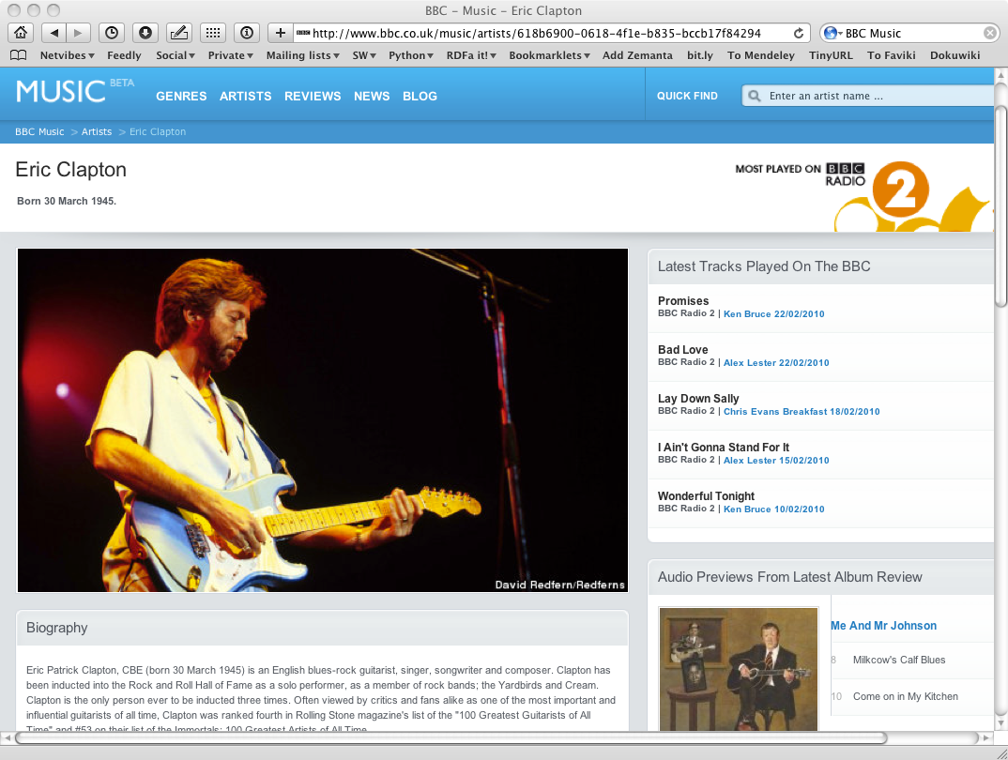
The Music site of the BBC

Slide 4
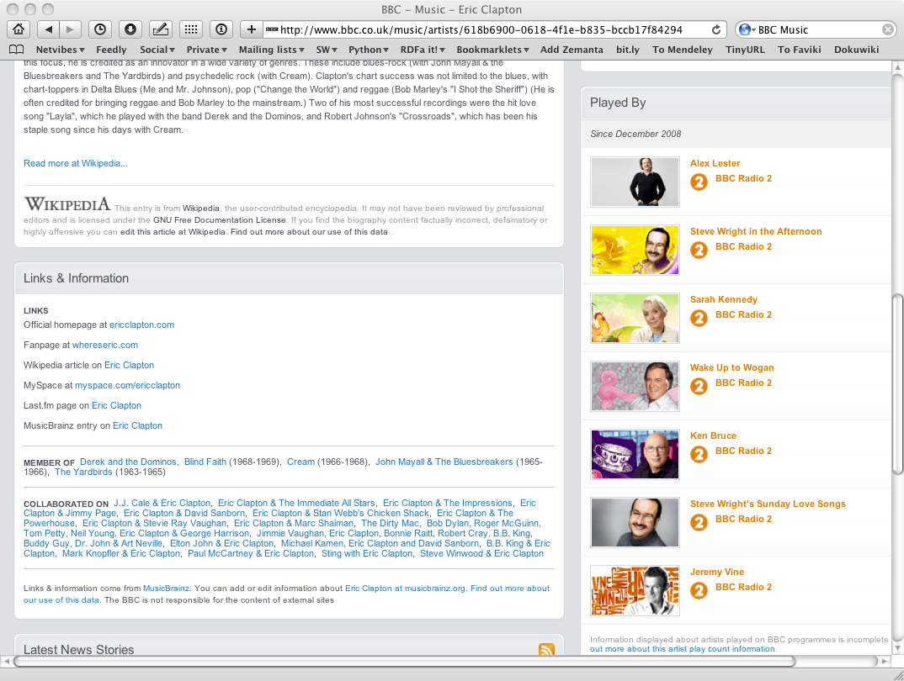
The Music site of the BBC

Slide 5
How to build such a site 1.
Site editors roam the Web for new facts
may discover further links while roaming
They update the site manually
And the site gets soon out-of-date

Slide 6
How to build such a site 2.
Editors roam the Web for new data published on Web sites
“Scrape” the sites with a program to extract the information
Ie, write some code to incorporate the new data
Easily get out of date again…

Slide 7
How to build such a site 3.
Editors roam the Web for new data via API-s
Understand those…
input, output arguments, datatypes used, etc
Write some code to incorporate the new data
Easily get out of date again…

Slide 8
The choice of the BBC
Use external, public datasets
Wikipedia, MusicBrainz, …
They are available as data
not API-s or hidden on a Web site
data can be extracted using, e.g., HTTP requests or standard queries

Slide 9
In short…
Use the Web of Data as a Content Management System
Use the community at large as content editors

Slide 10
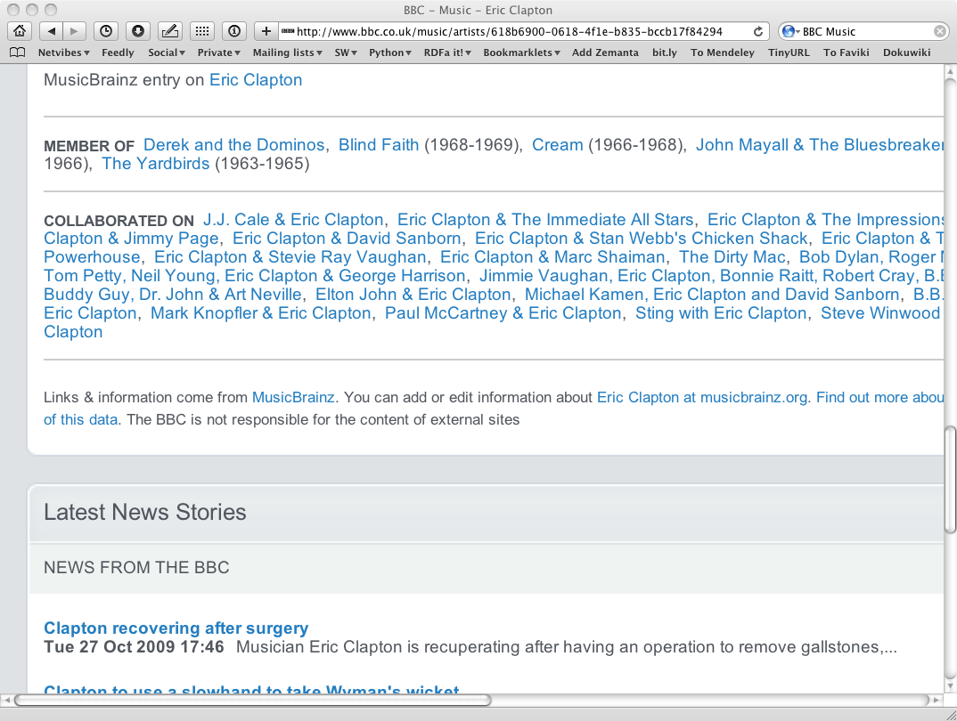
And this is no secret…

Slide 11
Data on the Web
There are more an more data on the Web
government data, health related data, general knowledge, company information, flight information, restaurants,…
More and more applications rely on the availability of that data

Slide 12
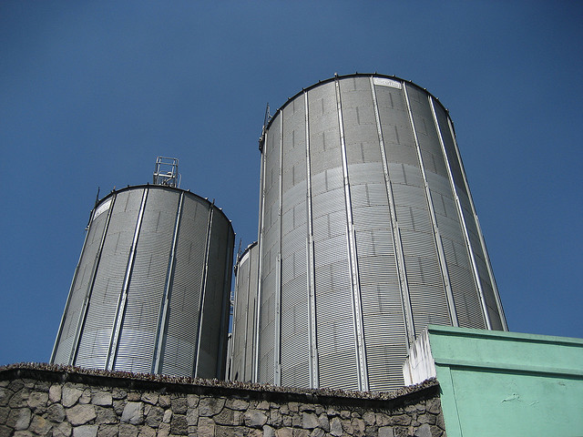
But… data are often in isolation, “silos”
Photo credit “nepatterson”, Flickr

Slide 13
Imagine…
A “Web” where
documents are available for download on the Internet
but there would be no hyperlinks among them

Slide 14
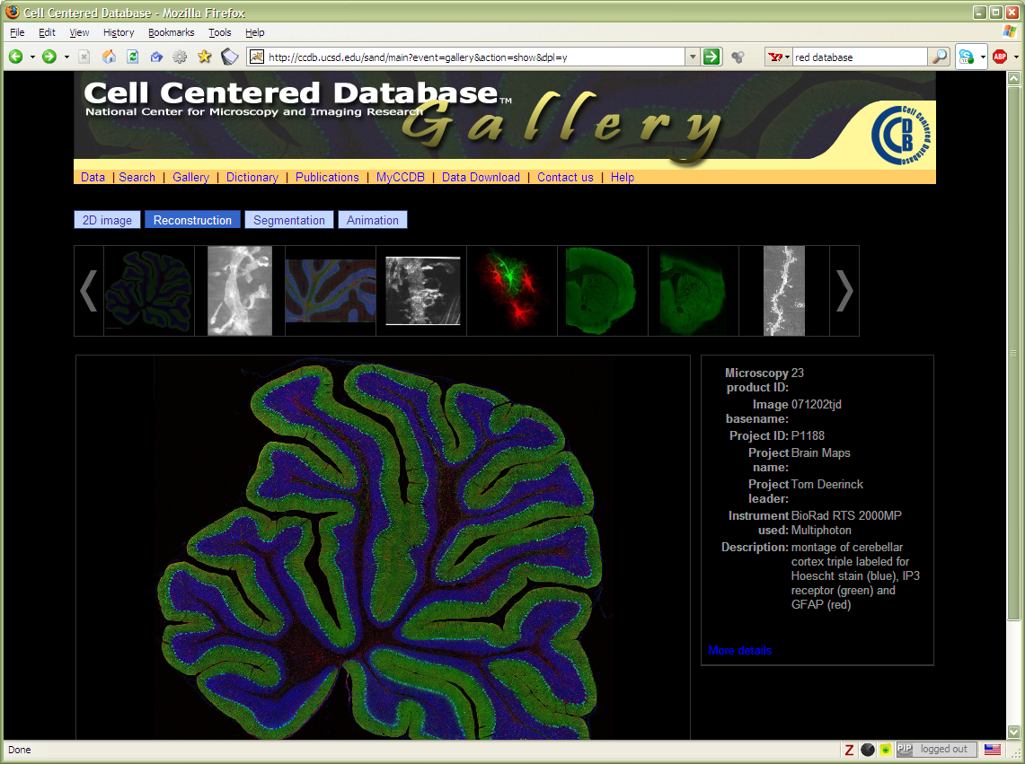
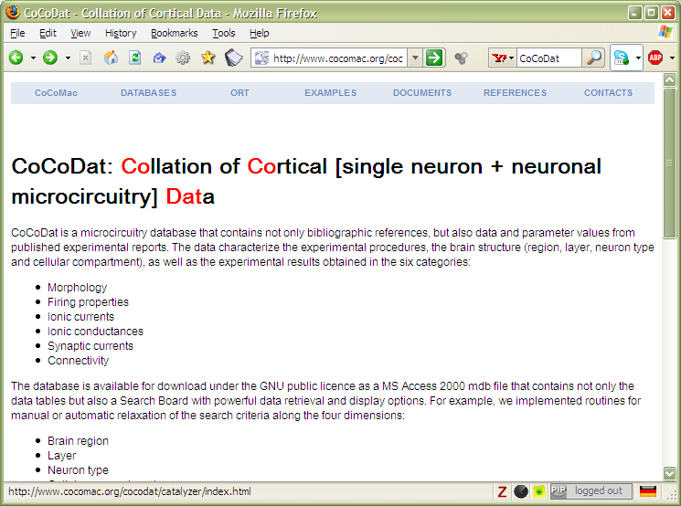
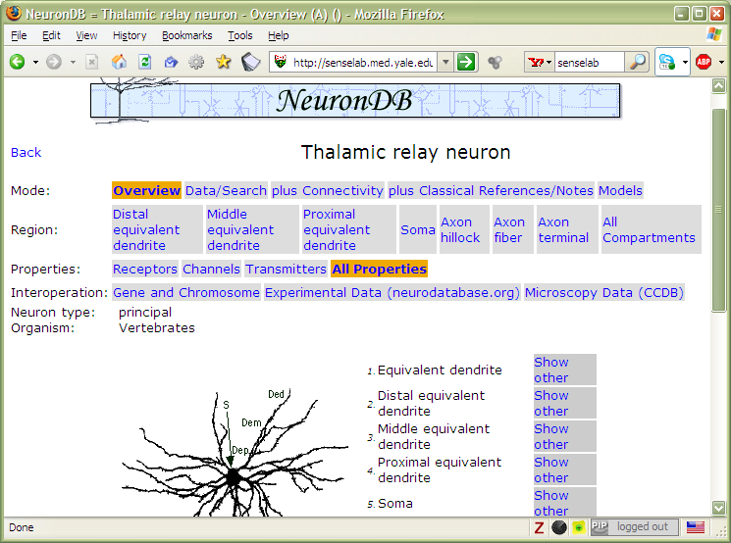
And the problem is real…

Slide 15
Data on the Web is not enough…
We need a proper infrastructure for a real Web of Data
data is available on the Web
accessible via standard Web technologies
data are interlinked over the Web
ie, data can be integrated over the Web
This is where Semantic Web technologies come in

Slide 16
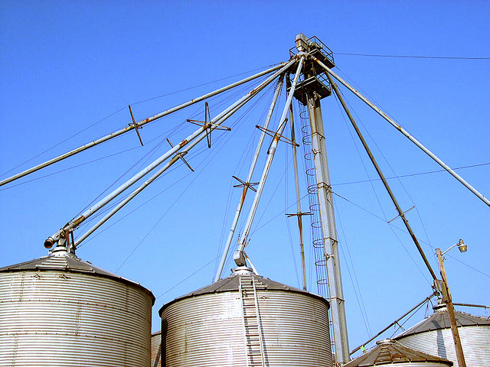
I.e.,… connect the silos
Photo credit “kxlly”, Flickr

Slide 17
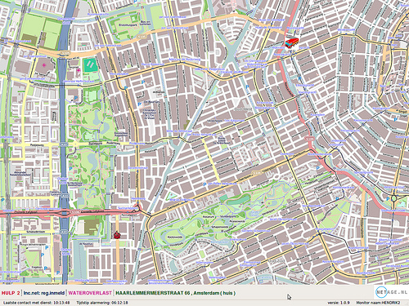
Example: Amsterdam fire brigade routing
Find the best possible route from the station to the fire
e.g., where are the roadblocks?
Use and integrate available city data
Also: republish the structured data for others to use!
Courtesy of Bart van Leeuwen, Amsterdam Fire Service, The Netherlands

Slide 18
In what follows…
We will use a simplistic example to introduce the main Semantic Web concepts

Slide 19
The rough structure of data integration
Map the various data onto an abstract data representation
make the data independent of its internal representation…
Merge the resulting representations
Start making queries on the whole!
queries not possible on the individual data sets

Slide 20

We start with a book...

Slide 21
A simplified bookstore data (dataset “A”)
ISBN | Author | Title | Publisher | Year
0006511409X | id_xyz | The Glass Palace | id_qpr | 2000
ID | Name | Homepage
id_xyz | Ghosh, Amitav | http://www.amitavghosh.com
ID | Publisher’s name | City
id_qpr | Harper Collins | London

Slide 22
1st: export your data as a set of relations
a:title
The Glass Palace
http://…isbn/000651409X
2000
a:year
a:publisher
London
a:city
a:author
Harper Collins
a:p_name
a:name
a:homepage
Ghosh, Amitav
http://www.amitavghosh.com

Slide 23
Some notes on the exporting the data
Relations form a graph
the nodes refer to the “real” data or contain some literal
how the graph is represented in machine is immaterial for now

Slide 24

Same book in French…

Slide 25
Another bookstore data (dataset “F”)
 | A | B | C | D
1 | ID | Titre | Traducteur | Original
2 | ISBN 2020286682 | Le Palais des Miroirs | $A12$ | ISBN 0-00-6511409-X
3
4
5
6 | ID | Auteur
7 | ISBN 0-00-6511409-X | $A11$
8
9
10 | Nom
11 | Ghosh, Amitav
12 | Besse, Christianne

Slide 26
2nd: export your second set of data
http://…isbn/000651409X
Le palais des miroirs
f:original
f:titre
f:auteur
http://…isbn/2020386682
f:traducteur
f:nom
f:nom
Ghosh, Amitav
Besse, Christianne

Slide 27
3rd: start merging your data
The Glass Palace
a:title
http://…isbn/000651409X
2000
a:year
a:city
a:publisher
London
Harper Collins
a:p_name
a:author
a:name
http://…isbn/000651409X
a:homepage
f:original
Le palais des miroirs
Ghosh, Amitav
http://www.amitavghosh.com
f:titre
f:auteur
http://…isbn/2020386682
f:traducteur
f:nom
Ghosh, Amitav
f:nom
Besse, Christianne

Slide 28
3rd: start merging your data (cont)
The Glass Palace
a:title
http://…isbn/000651409X
2000
a:year
a:publisher
Same URI!
London
a:city
Harper Collins
a:p_name
a:author
a:name
http://…isbn/000651409X
a:homepage
f:original
Le palais des miroirs
Ghosh, Amitav
http://www.amitavghosh.com
f:titre
f:auteur
http://…isbn/2020386682
f:traducteur
f:nom
Ghosh, Amitav
f:nom
Besse, Christianne

Slide 29
3rd: start merging your data
The Glass Palace
a:title
http://…isbn/000651409X
2000
a:year
a:city
a:publisher
London
Harper Collins
a:p_name
a:author
f:original
a:name
f:auteur
a:homepage
Le palais des miroirs
Ghosh, Amitav
http://www.amitavghosh.com
f:titre
http://…isbn/2020386682
f:traducteur
f:nom
Ghosh, Amitav
f:nom
Besse, Christianne

Slide 30
Start making queries…
User of data “F” can now ask queries like:
“give me the title of the original”
well, … « donnes-moi le titre de l’original »
This information is not in the dataset “F”…
…but can be retrieved by merging with dataset “A”!

Slide 31
However, more can be achieved…
We “feel” that a:author and f:auteur should be the same
But an automatic merge doest not know that!
Let us add some extra information to the merged data:
a:author same as f:auteur
both identify a “Person”
a term that a community may have already defined:
a “Person” is uniquely identified by his/her name and, say, homepage
it can be used as a “category” for certain type of resources

Slide 32
3rd revisited: use the extra knowledge
The Glass Palace
a:title
http://…isbn/000651409X
2000
a:year
f:original
Le palais des miroirs
a:publisher
f:titre
London
a:city
Harper Collins
a:p_name
a:author
http://…isbn/2020386682
f:auteur
r:type
f:traducteur
a:name
http://…foaf/Person
r:type
f:nom
a:homepage
f:nom
Besse, Christianne
Ghosh, Amitav
http://www.amitavghosh.com

Slide 33
Start making richer queries!
User of dataset “F” can now query:
“donnes-moi la page d’accueil de l’auteur de l’original”
well… “give me the home page of the original’s ‘auteur’”
The information is not in datasets “F” or “A”…
…but was made available by:
merging datasets “A” and datasets “F”
adding three simple extra statements as an extra “glue”

Slide 34
Combine with different datasets
Using, e.g., the “Person”, the dataset can be combined with other sources
For example, data in Wikipedia can be extracted using dedicated tools
e.g., the “dbpedia” project can extract the “infobox” information from Wikipedia already…

Slide 35
Merge with Wikipedia data
The Glass Palace
a:title
http://…isbn/000651409X
2000
a:year
f:original
Le palais des miroirs
a:publisher
f:titre
London
a:city
Harper Collins
a:p_name
a:author
http://…isbn/2020386682
f:auteur
r:type
f:traducteur
a:name
http://…foaf/Person
r:type
f:nom
a:homepage
r:type
f:nom
Besse, Christianne
Ghosh, Amitav
http://www.amitavghosh.com
foaf:name
w:reference
http://dbpedia.org/../Amitav_Ghosh

Slide 36
Merge with Wikipedia data
The Glass Palace
a:title
http://…isbn/000651409X
2000
a:year
f:original
Le palais des miroirs
a:publisher
f:titre
London
a:city
Harper Collins
a:p_name
a:author
http://…isbn/2020386682
f:auteur
r:type
f:traducteur
a:name
http://…foaf/Person
r:type
f:nom
a:homepage
r:type
f:nom
w:isbn
Besse, Christianne
Ghosh, Amitav
http://www.amitavghosh.com
foaf:name
w:reference
http://dbpedia.org/../The_Glass_Palace
w:author_of
http://dbpedia.org/../Amitav_Ghosh
w:author_of
http://dbpedia.org/../The_Hungry_Tide
w:author_of
http://dbpedia.org/../The_Calcutta_Chromosome

Slide 37

Merge with Wikipedia data
The Glass Palace
a:title
http://…isbn/000651409X
2000
a:year
f:original
Le palais des miroirs
a:publisher
f:titre
London
a:city
Harper Collins
a:p_name
a:author
http://…isbn/2020386682
f:auteur
r:type
f:traducteur
a:name
http://…foaf/Person
r:type
f:nom
a:homepage
r:type
f:nom
w:isbn
Besse, Christianne
Ghosh, Amitav
http://www.amitavghosh.com
foaf:name
w:reference
http://dbpedia.org/../The_Glass_Palace
w:author_of
http://dbpedia.org/../Amitav_Ghosh
w:born_in
w:author_of
http://dbpedia.org/../Kolkata
http://dbpedia.org/../The_Hungry_Tide
w:long
w:lat
w:author_of
http://dbpedia.org/../The_Calcutta_Chromosome

Slide 38
Is that surprising?
It may look like it but, in fact, it should not be…
What happened via automatic means is done every day by Web users!
The difference: a bit of extra rigour so that machines could do this, too

Slide 39
It could become even more powerful
We could add extra knowledge to the merged datasets
e.g., a full classification of various types of library data
geographical information
etc.
This is where ontologies, extra rules, etc, come in
ontologies/rule sets can be relatively simple and small, or huge, or anything in between…
Even more powerful queries can be asked as a result

Slide 40

What did we do?
Web of Data Applications
Stand Alone Applications
Browser Applications
Query and Update
Common “Graph” Format &
Common Vocabularies
Inferencing
“Bridges”
Data on the Web

Slide 41
So where is the Semantic Web?
The Semantic Web provides technologies to make such integration possible!
Hopefully you get a full picture at the end of the tutorial…

Slide 42
The Basis: RDF

Slide 43
RDF triples
Let us begin to formalize what we did!
we “connected” the data…
but a simple connection is not enough… data should be named somehow
hence the RDF Triples: a labelled connection between two resources

Slide 44
RDF triples (cont.)
An RDF Triple (s,p,o) is such that:
“s”, “p” are URI-s, ie, resources on the Web; “o” is a URI or a literal
“s”, “p”, and “o” stand for “subject”, “property”, and “object”
here is the complete triple:
(<http://…isbn…6682>, <http://…/original>, <http://…isbn…409X>)
RDF is a general model for such triples (with machine readable formats like RDF/XML, Turtle, N3, RDFa, Json, …)

Slide 45
RDF triples (cont.)
Resources can use any URI
http://www.example.org/file.html#home
http://www.example.org/file2.xml#xpath(//q[@a=b])
http://www.example.org/form?a=b&c=d
RDF triples form a directed, labeled graph (the best way to think about them!)

Slide 46
A simple RDF example (in RDF/XML)
http://…isbn/2020386682
f:titre
f:original
Le palais des miroirs
http://…isbn/000651409X
<rdf:Description rdf:about="http://…/isbn/2020386682">
<f:titre xml:lang="fr">Le palais des mirroirs</f:titre>
<f:original rdf:resource="http://…/isbn/000651409X"/>
</rdf:Description>
(Note: namespaces are used to simplify the URI-s)

Slide 47
A simple RDF example (in Turtle)
http://…isbn/2020386682
f:titre
f:original
Le palais des miroirs
http://…isbn/000651409X
<http://…/isbn/2020386682>
f:titre "Le palais des mirroirs"@fr ;
f:original <http://…/isbn/000651409X> .

Slide 48
“Internal” nodes
Consider the following statement:
“the publisher is a «thing» that has a name and an address”
Until now, nodes were identified with a URI. But…
…what is the URI of «thing»?
London
a:city
a:publisher
http://…isbn/000651409X
Harper Collins
a:p_name

Slide 49
One solution: create an extra URI
The resource will be “visible” on the Web
care should be taken to define unique URI-s
<http://…/isbn/000651409X">
a:publisher <urn:uuid:f60ffb40-307d-…"/> .
<urn:uuid:f60ffb40-307d-…">
a:p_name "HarpersCollins" ;
a:city ”London" .

Slide 50
Internal identifier (“blank nodes”)
<rdf:Description rdf:about="http://…/isbn/000651409X">
<a:publisher rdf:nodeID="A234"/>
</rdf:Description>
<rdf:Description rdf:nodeID="A234">
<a:p_name>HarpersCollins</a:p_name>
<a:city>London</a:city>
</rdf:Description>
<http://…/isbn/2020386682> a:publisher _:A234.
_:A234 a:p_name "HarpersCollins".
Internal = these resources are not visible outside
London
a:city
a:publisher
http://…isbn/000651409X
Harper Collins
a:p_name

Slide 51
Blank nodes: the system can do it
<http://…/isbn/000651409X> a:publisher [
a:p_name "HarpersCollins";
…
].
London
a:city
a:publisher
http://…isbn/000651409X
Harper Collins
a:p_name

Slide 52
Blank nodes when merging
Blank nodes require attention when merging
blanks nodes with identical nodeID-s in different graphs are different
implementations must be careful…

Slide 53
RDF in programming practice
For example, using Python+RDFLib:
a “Graph” object is created
the RDF file is parsed and results stored in the Graph
the Graph offers methods to retrieve:
triples
(property, object) pairs for a specific subject
(subject, property) pairs for specific object
etc.
the rest is conventional programming…
Similar tools exist in Java, PHP, etc.

Slide 54
Python example using RDFLib
# create a graph from a file
graph = rdflib.Graph()
graph.parse("filename.rdf", format="rdfxml")
# take subject with a known URI
subject = rdflib.URIRef("URI_of_Subject")
# process all properties and objects for this subject
for (s,p,o) in graph.triples((subject,None,None)) :
do_something(p,o)

Slide 55
But programming is not for everyone
Not everyone wants to program
On a higher level of abstraction:
RDF graphs are “stored”
physical triple stores, databases, etc.
simple RDF files loaded by underlying tools
etc.
users can “query” the graph via a special query language: SPARQL (see later)
users can change the content of the store via SPARQL 1.1 UPDATE (see later)

Slide 56

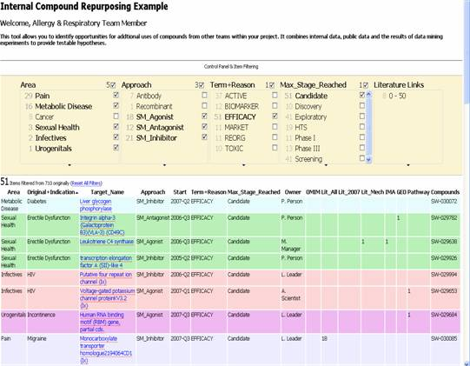
Example: A relatively simple application
Goal: reuse of older experimental data
Keep data in databases or XML, just export key “fact” as RDF
Use a faceted browser to visualize and interact with the result
Courtesy of Nigel Wilkinson, Lee Harland, Pfizer Ltd, Melliyal Annamalai, Oracle (SWEO Case Study)
Notes:
Various types of databases are accessed having an RDF transformation of (part of the data) on the fly. Some of the data may be simple tables, some are the result of continuous background processing analysing the literature (not directly related to the Semantic Web per se).
The integration of the data is done on the RDF level, and is viewed via an off-the-shelf (though experimental) faceted browser (Exhibit). Ie, the Semantic Web portion is very simple but allows for a very quick integration of the data on the screen.

Slide 57
One level higher up (RDFS, Datatypes)

Slide 58
Need for RDF schemas
First step towards the “extra knowledge”:
define the terms we can use
what restrictions apply
what extra relationships are there?
Officially: “RDF Vocabulary Description Language”
the term “Schema” is retained for historical reasons…

Slide 59
Classes, resources, …
Think of well known traditional vocabularies:
use the term “novel”
“every novel is a fiction”
“«The Glass Palace» is a novel”
etc.
RDFS defines resources and classes:
everything in RDF is a “resource”
“classes” are also resources, but…
…they are also a collection of possible resources (i.e., “individuals”)
“fiction”, “novel”, …

Slide 60
Classes, resources, … (cont.)
Relationships are defined among resources:
“typing”: an individual belongs to a specific class
“«The Glass Palace» is a novel”
to be more precise: “«http://.../000651409X» is a novel”
“subclassing”: all instances of one are also the instances of the other (“every novel is a fiction”)
RDFS formalizes these notions in RDF

Slide 61
Classes, resources in RDF(S)
rdfs:Class
rdf:type
http://…isbn/000651409X
rdf:type
#Novel
RDFS defines the meaning of these terms
(these are all special URI-s, we just use the namespace abbreviation)

Slide 62
Inferred properties
#Fiction
rdf:type
rdf:subClassOf
http://…isbn/000651409X
rdf:type
#Novel
(<http://…/isbn/000651409X> rdf:type #Fiction)
is not in the original RDF data…
…but can be inferred from the RDFS rules
RDFS environments return that triple, too

Slide 63
Inference: let us be formal…
The RDF Semantics document has a list of (33) entailment rules:
“if such and such triples are in the graph, add this and this”
do that recursively until the graph does not change
The relevant rule for our example:
If:
uuu rdfs:subClassOf xxx .
vvv rdf:type uuu .
Then add:
vvv rdf:type xxx .

Slide 64
Properties
Property is a special class (rdf:Property)
properties are also resources identified by URI-s
There is also a possibility for a “sub-property”
all resources bound by the “sub” are also bound by the other
Range and domain of properties can be specified
i.e., what type of resources serve as object and subject

Slide 65
What does this mean?
Again, new relations can be deduced. Indeed, if
:title
rdf:type rdf:Property;
rdfs:domain :Fiction;
rdfs:range rdfs:Literal.
<http://…/isbn/000651409X> :title "The Glass Palace" .
then the system can infer that:
<http://…/isbn/000651409X> rdf:type :Fiction .

Slide 66
Literals
Literals may have a data type
floats, integers, Booleans, etc., defined in XML Schemas
full XML fragments
(Natural) language can also be specified

Slide 67
Examples for datatypes
<http://…/isbn/000651409X>
:page_number "543"^^xsd:integer ;
:publ_date "2000"^^xsd:gYear ;
:price "6.99"^^xsd:float .

Slide 68
A bit of RDFS can take you far…
Remember the power of merge?
We could have used, in our example:
f:auteur is a subproperty of a:author and vice versa (although we will see other ways to do that…)
Of course, in some cases, more complex knowledge is necessary (see later…)

Slide 69
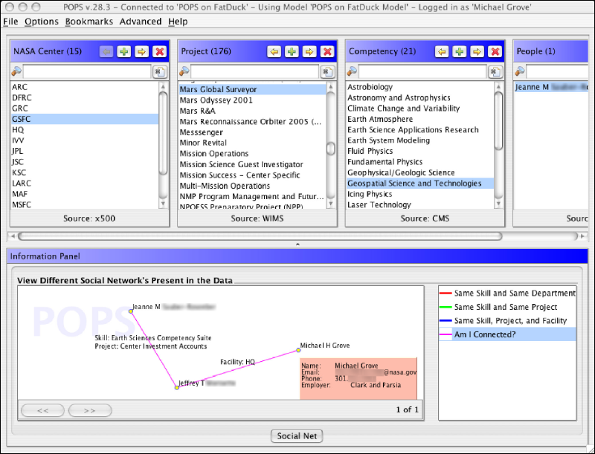
Example: Find the right experts at NASA
Expertise locater for nearly 70,000 NASA civil servants, using RDF integration techniques over 6 or 7 geographically distributed databases, data sources, and web services…
Michael Grove, Clark & Parsia, LLC, and Andrew Schain, NASA, (SWEO Case Study)
Notes:
The use internal ontologies/vocabularies to describe the knowledge areas, and a combination of the RDF data and that ontology to search through the (integrated) databases for a specific knowledge expertise. The dump is from a faceted browser developed by the company to view result data.

Slide 70
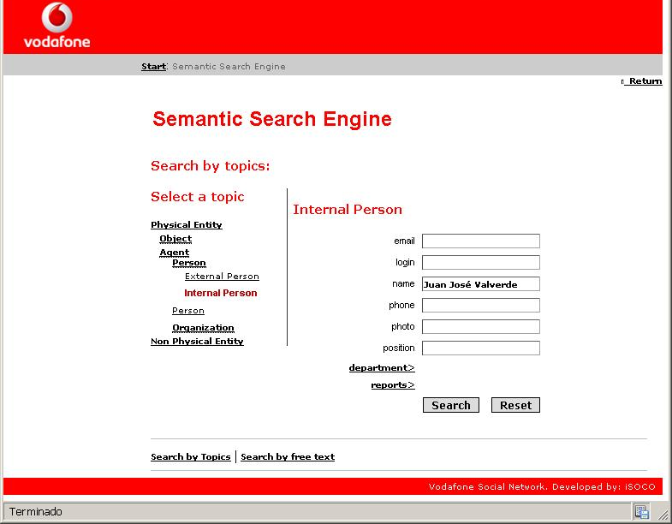
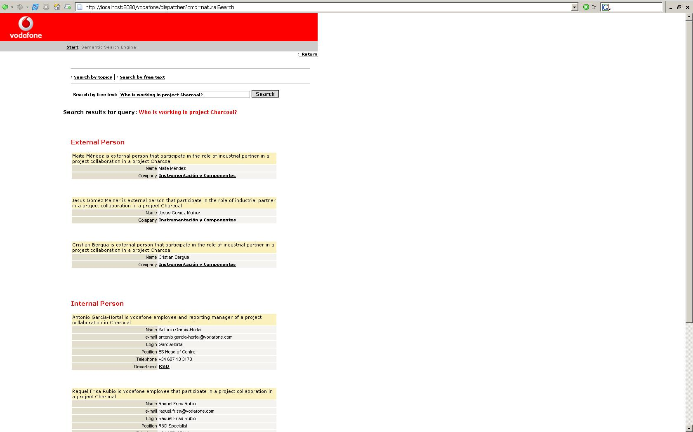
Example: Find the right experts at Vodafone
Very similar to the NASA application, though with different technologies…
Richard Benjamins
Courtesy of Juan José Fúster, Vodafone, and Richard Benjamins, iSOCO, (SWEO Use Case)
Notes:
Similar application to Nasa's, very much the same idea and approach, though by a totally different company (and country...)
It is not yet clear whether it will be deployed or not.

Slide 71
How to publish RDF Data?

Slide 72
Simple approach
Write RDF/XML, RDFa, or Turtle “manually”
in some cases that is necessary, but it really does not scale…
RDF data be generated internal systems (e.g., CMS systems)

Slide 73
RDF with HTML
By adding some “meta” information, the same source can be reused
typical example: your personal information, like address, should be readable for humans and processable by machines
Some solutions have emerged:
use microformats and convert the content into RDF
add extra statements in microdata or RDFa that can be converted to RDF
RDFa is, essentially, a complete serialization of RDF

Slide 74
HTML+* can be generated
CMS systems may generate such data automatically
e.g., Drupal 7 generates pages with RDFa included
There are a number of plugins to blogging systems
generate HTML+RDFa, or
generate HTML with microformats included
etc.

Slide 75
Relational Databases and RDF
Most of the data on the Web is, in fact, in RDB-s
Proven technology, huge systems, many vendors…
Data integration on the Web must provide access to RDB-s

Slide 76
What is “export”?
“Export” does not necessarily mean physical conversion
for very large databases a “duplication” would not be an option
systems may provide “bridges” to make RDF queries on the fly
result of export is a “logical” view of the RDB content
But, in some cases, there may be a physical duplication of the data

Slide 77
Simple export: RDF Direct Mapping
A standard RDF “view” of RDB tables
Valid for all RDB-s, independently of the RDB schema
Fundamental approach:
each row is turned into a series of triples with a common subject (subject URI based on primary key value)
column names provide the predicate names
cell contents are the objects as literals
cross-referenced tables are expressed through URI subjects
Details of the mapping will become a W3C standard by early 2012

Slide 78


What DM processor does
An DM processor has access to:
an RDB schema
a database governed by the schema
… and produces an RDF graph using a standard mapping
RDB Schema
DM Processing
Tables

Slide 79
Result of the Direct Mapping
What do we get?
we have an RDF “view” of the RDB tables
a query against the RDF view may be transformed into an SQL query against the original tables
What do we miss?
an RDF view that is close to our application; a more “natural” view of the data
i.e., the result of the Direct Mapping must be transformed, somehow, into an RDF that an application may use

Slide 80
Enters R2RML
Separate vocabulary for a finer control of the mapping
gets to the final RDF graph with one processing step
Fundamentals are similar:
each row is turned into a series of triples with a common subject
cross-referenced tables linked via URI-s

Slide 81
Enters R2RML
There is a finer control over the structure of the result graph
the format of the (common) subject URI can be controlled
objects might be URI-s generated on the fly via templates from column names
datatypes can be assigned to literal objects
“virtual” tables can be generated through SQL before processing them through R2RML
R2RML can generate the final RDF ready to be used by an application

Slide 82
What R2RML processor does
An R2RML processor has access to:
an RDB schema
an R2RML instance
a database governed by the schema
… and produces an RDF graph
RDB Schema
R2RML Processing
Tables
R2RML Instance

Slide 83
Linked Open Data

Slide 84
Linked Open Data Project
Goal: “expose” open datasets in RDF
Set RDF links among the data items from different datasets
Set up, if possible, query endpoints
Notes:
The important point here is that (1) the data becomes available to the World via a unified format (ie, RDF), regardless on how it is stored inside and (2) the various datasets are interlinked together, ie, they are not independent islands. Dbpedia is probably the most important 'hub' in the project.

Slide 85


Example data source: DBpedia
DBpedia is a community effort to
extract structured (“infobox”) information from Wikipedia
provide a query endpoint to the dataset
interlink the DBpedia dataset with other datasets on the Web

Slide 86
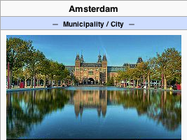
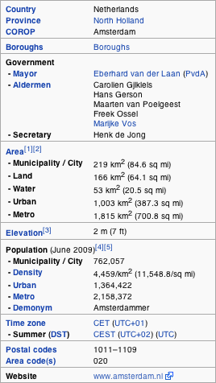
Extracting structured data from Wikipedia
@prefix dbpedia <http://dbpedia.org/resource/>.
@prefix dbterm <http://dbpedia.org/property/>.
dbpedia:Amsterdam dbterm:officialName "Amsterdam" ; dbterm:longd "4" ;
dbterm:longm "53" ;
dbterm:longs "32" ;
dbterm:website <http://www.amsterdam.nl> ;
dbterm:populationUrban "1364422" ;
dbterm:areaTotalKm "219" ;
...
dbpedia:ABN_AMRO
dbterm:location dbpedia:Amsterdam ;
...
Notes:
The right hand portion of the wiki side is what is referred to as 'infobox'. The left side is the dbpedia content as made available.

Slide 87
Automatic links among open datasets
<http://dbpedia.org/resource/Amsterdam> owl:sameAs <http://rdf.freebase.com/ns/...> ;
owl:sameAs <http://sws.geonames.org/2759793> ;
...
<http://sws.geonames.org/2759793>
owl:sameAs <http://dbpedia.org/resource/Amsterdam>
wgs84_pos:lat "52.3666667" ;
wgs84_pos:long "4.8833333";
geo:inCountry <http://www.geonames.org/countries/#NL> ;
...
Processors can switch automatically from one to the other…
Notes:
This is the important point: this is why this is Linking open data. What the community does (and this is a community project) is to make agreements on how the different datasets can be linked and then the linkage is done automatically by the 'bridges' that map the public datasets into RDF. Eg, geonames is a public dataset by geonames.org and dbpedia is, well... wikipedia:-)

Slide 88
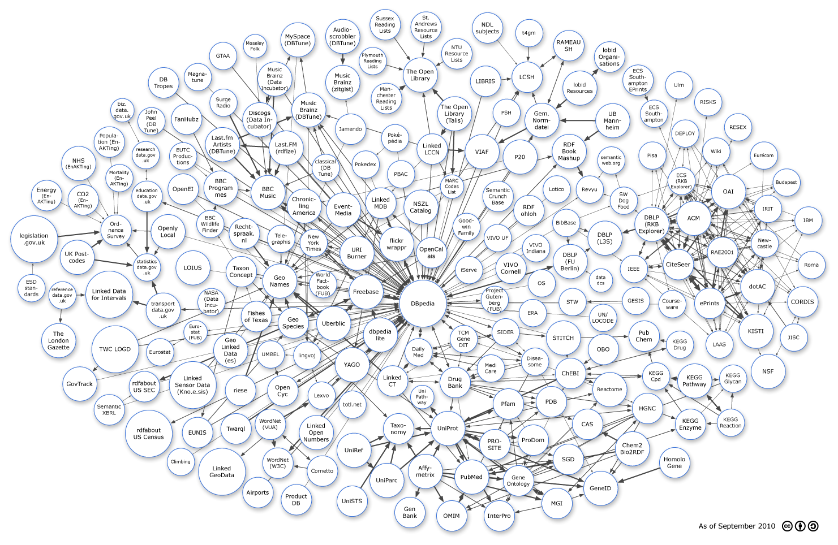
The LOD “cloud”, September 2010

Slide 89
The importance of Linked Data
It provides a core set of data that Semantic Web applications can build on
stable references for “things”,
e.g., http://dbpedia.org/resource/Amsterdam
many many relationships that applications may reuse
e.g., the BBC application!
a “nucleus” for a larger, semantically enabled Web!
For many, publishing data may be the first step into the world of Semantic Web

Slide 90
Some things to remember if you publish data
Publish your data first, care about sexy user interfaces later!
the “raw data” can become useful on its own right and others may use it
you can add your added value later by providing nice user access
If possible, publish your data in RDF but if you cannot, others may help you in conversions
trust the community…
Add links to other data. “Just” publishing isn’t enough…

Slide 91
Remember the BBC?

Slide 92
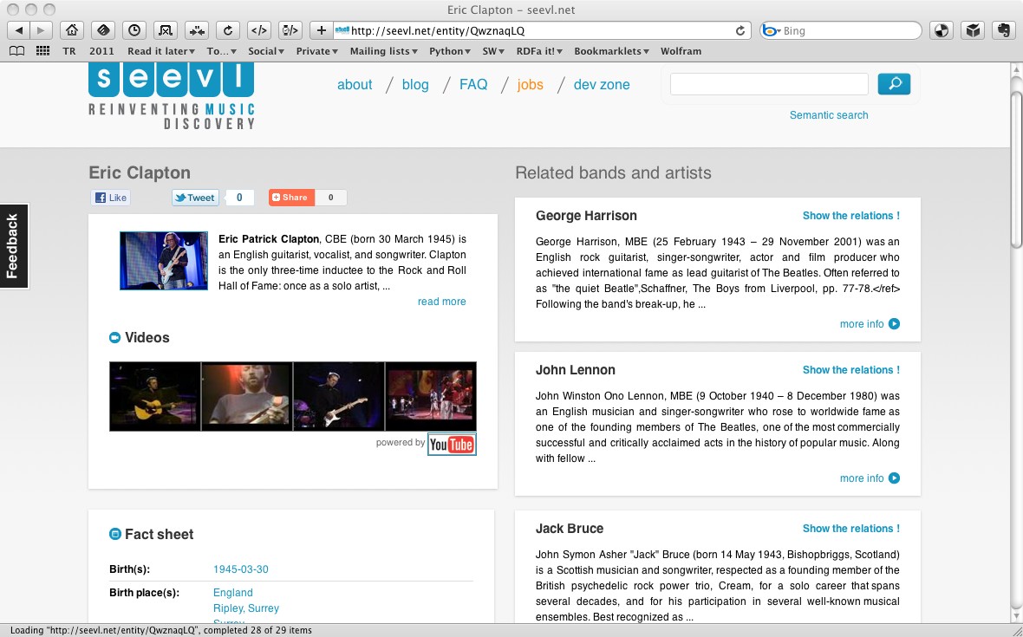
Same dataset, another site

Slide 93
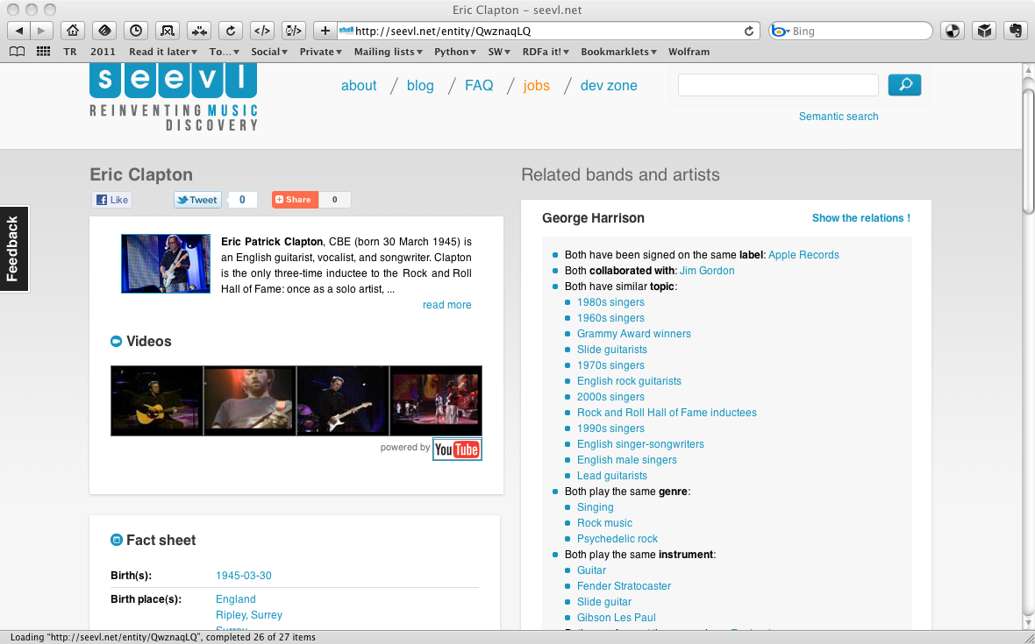
Same dataset, another site

Slide 94
Query RDF Data (SPARQL)

Slide 95
RDF data access
How do I query the RDF data?
e.g., how do I get to the DBpedia data?

Slide 96
Querying RDF graphs
Remember the Python+RDFLib idiom:
for (s,p,o) in graph.triples((subject,None,None)) :
do_something(p,o)

Slide 97
Querying RDF graphs
In practice, more complex queries into the RDF data are necessary
something like: “give me the (a, b) pair of resources, for which there is an x such that (x parent a) and (b brother x) holds” (i.e., return the uncles)
these rules may become quite complex
The goal of SPARQL (Query Language for RDF)

Slide 98
Analyze the Python+RDFLib example
for (s,p,o) in graph.triples((subject,None,None)) :
do_something(p,o)
?p
?o
?p
?o
subject
?p
?o
?p
?o

Slide 99
General: graph patterns
The fundamental idea: use graph patterns
the pattern contains unbound symbols
by binding the symbols, subgraphs of the RDF graph are selected
if there is such a selection, the query returns the bound resources

Slide 100
Our Python example in SPARQL
SELECT ?p ?o
WHERE {subject ?p ?o}
The triples in WHERE define the graph pattern, with ?p and ?o “unbound” symbols
The query returns all p, o pairs
?p
?o
?p
?o
subject
?p
?o
?p
?o

Slide 101
Simple SPARQL example
SELECT ?isbn ?price ?currency # note: not ?x!
WHERE {?isbn a:price ?x. ?x rdf:value ?price. ?x p:currency ?currency.}
a:name
Ghosh, Amitav
a:author
a:author
http://…isbn/000651409X
http://…isbn/2020386682
a:price
a:price
a:price
a:price
rdf:value
p:currency
rdf:value
p:currency
rdf:value
p:currency
rdf:value
p:currency
33
:£
50
:€
60
:€
78
:$

Slide 102
Simple SPARQL example
SELECT ?isbn ?price ?currency # note: not ?x!
WHERE {?isbn a:price ?x. ?x rdf:value ?price. ?x p:currency ?currency.}
Returns: [<…409X>,33,:£]
a:name
Ghosh, Amitav
a:author
a:author
http://…isbn/000651409X
http://…isbn/2020386682
a:price
a:price
a:price
a:price
rdf:value
p:currency
rdf:value
p:currency
rdf:value
p:currency
rdf:value
p:currency
33
:£
50
:€
60
:€
78
:$

Slide 103
Simple SPARQL example
SELECT ?isbn ?price ?currency # note: not ?x!
WHERE {?isbn a:price ?x. ?x rdf:value ?price. ?x p:currency ?currency.}
Returns: [<…409X>,33,:£], [<…409X>,50,:€]
a:name
Ghosh, Amitav
a:author
a:author
http://…isbn/000651409X
http://…isbn/2020386682
a:price
a:price
a:price
a:price
rdf:value
p:currency
rdf:value
p:currency
rdf:value
p:currency
rdf:value
p:currency
33
:£
50
:€
60
:€
78
:$

Slide 104
Simple SPARQL example
SELECT ?isbn ?price ?currency # note: not ?x!
WHERE {?isbn a:price ?x. ?x rdf:value ?price. ?x p:currency ?currency.}
Returns: [<…409X>,33,:£], [<…409X>,50,:€],
[<…6682>,60,:€]
a:name
Ghosh, Amitav
a:author
a:author
http://…isbn/000651409X
http://…isbn/2020386682
a:price
a:price
a:price
a:price
rdf:value
p:currency
rdf:value
p:currency
rdf:value
p:currency
rdf:value
p:currency
33
:£
50
:€
60
:€
78
:$

Slide 105
Simple SPARQL example
SELECT ?isbn ?price ?currency # note: not ?x!
WHERE {?isbn a:price ?x. ?x rdf:value ?price. ?x p:currency ?currency.}
Returns: [<…409X>,33,:£], [<…409X>,50,:€],
[<…6682>,60,:€], [<…6682>,78,:$]
a:name
Ghosh, Amitav
a:author
a:author
http://…isbn/000651409X
http://…isbn/2020386682
a:price
a:price
a:price
a:price
rdf:value
p:currency
rdf:value
p:currency
rdf:value
p:currency
rdf:value
p:currency
33
:£
50
:€
60
:€
78
:$

Slide 106
Pattern constraints
SELECT ?isbn ?price ?currency # note: not ?x!
WHERE { ?isbn a:price ?x. ?x rdf:value ?price. ?x p:currency ?currency.
FILTER(?currency == :€) }
Returns: [<…409X>,50,:€], [<…6682>,60,:€]
a:name
Ghosh, Amitav
a:author
a:author
http://…isbn/000651409X
http://…isbn/2020386682
a:price
a:price
a:price
a:price
rdf:value
p:currency
rdf:value
p:currency
rdf:value
p:currency
rdf:value
p:currency
33
:£
50
:€
60
:€
78
:$

Slide 107
Other SPARQL features
Limit the number of returned results; remove duplicates, sort them, …
Optional patterns
CONSTRUCT new graphs, not only return data
Use datatypes and/or language tags when matching a pattern
Aggregation of the results (min, max, average, etc.)
Path expressions (a bit like regular expressions)

Slide 108
Other SPARQL features
Limit the number of returned results; remove duplicates, sort them, …
Optional patterns
CONSTRUCT new graphs, not only return data
Use datatypes and/or language tags when matching a pattern
Aggregation of the results (min, max, average, etc.)
Path expressions (a bit like regular expressions)
Beware: SPARQL 1.1 Feature!

Slide 109
SPARQL usage in practice
SPARQL is usually used over the network
HTTP request is sent to a SPARQL endpoint
return is the result of the SELECT, the CONSTRUCT,…
Separate documents define the protocol and the result format
SPARQL Protocol for RDF with HTTP and SOAP bindings
SPARQL results in XML or JSON formats
Big datasets usually offer “SPARQL endpoints” using this protocol

Slide 110
SPARQL 1.1 Update
SPARQL CONSTRUCT returns a new, modified graph
the original data remains unchanged!
SPARQL 1.1 Update modifies the original dataset!

Slide 111
Update: insert
INSERT {?isbn rdf:type frbr:Work}
WHERE {?isbn a:price ?x. ?x rdf:value ?price. ?x p:currency ?currency.}
a:name
Ghosh, Amitav
a:author
a:author
http://…isbn/000651409X
http://…isbn/2020386682
a:price
a:price
a:price
a:price
rdf:value
p:currency
rdf:value
p:currency
rdf:value
p:currency
rdf:value
p:currency
33
:£
50
:€
60
:€
78
:$

Slide 112
Update: insert
INSERT {?isbn rdf:type frbr:Work}
WHERE {?isbn a:price ?x. ?x rdf:value ?price. ?x p:currency ?currency.}
frbr:Work
rdf:type
rdf:type
a:name
Ghosh, Amitav
a:author
a:author
http://…isbn/000651409X
http://…isbn/2020386682
a:price
a:price
a:price
a:price
rdf:value
p:currency
rdf:value
p:currency
rdf:value
p:currency
rdf:value
p:currency
33
:£
50
:€
60
:€
78
:$

Slide 113
Update: insert
INSERT {?isbn rdf:type frbr:Work}
WHERE {?isbn a:price ?x. ?x rdf:value ?price. ?x p:currency ?currency.}
frbr:Work
rdf:type
rdf:type
a:name
Ghosh, Amitav
Beware: SPARQL 1.1 Feature!
a:author
a:author
http://…isbn/000651409X
http://…isbn/2020386682
a:price
a:price
a:price
a:price
rdf:value
p:currency
rdf:value
p:currency
rdf:value
p:currency
rdf:value
p:currency
33
:£
50
:€
60
:€
78
:$

Slide 114
Update: delete
DELETE {?x p:currency ?currency}
WHERE {?isbn a:price ?x. ?x rdf:value ?price. ?x p:currency ?currency.}
a:name
Ghosh, Amitav
a:author
a:author
http://…isbn/000651409X
http://…isbn/2020386682
a:price
a:price
a:price
a:price
rdf:value
p:currency
rdf:value
p:currency
rdf:value
p:currency
rdf:value
p:currency
33
:£
50
:€
60
:€
78
:$

Slide 115
Update: delete
DELETE {?x p:currency ?currency}
WHERE {?isbn a:price ?x. ?x rdf:value ?price. ?x p:currency ?currency.}
a:name
Ghosh, Amitav
a:author
a:author
http://…isbn/000651409X
http://…isbn/2020386682
a:price
a:price
a:price
a:price
rdf:value
rdf:value
rdf:value
rdf:value
33
50
60
78

Slide 116
Update: delete
DELETE {?x p:currency ?currency}
WHERE {?isbn a:price ?x. ?x rdf:value ?price. ?x p:currency ?currency.}
a:name
Ghosh, Amitav
Beware: SPARQL 1.1 Feature!
a:author
a:author
http://…isbn/000651409X
http://…isbn/2020386682
a:price
a:price
a:price
a:price
rdf:value
rdf:value
rdf:value
rdf:value
33
50
60
78

Slide 117
SPARQL as a unifying point
Application
SPARQL Endpoint
SPARQL Endpoint
SPARQL Construct
SPARQL Construct
Triple store
SPARQL Processor
Database
RDFa
NLP Techniques
GRDDL, RDFa
SQL⬄RDF
RDF Graph
Relational
Database
HTML
Unstructured Text
XML/XHTML

Slide 118
SPARQL 1.1 as a unifying point
Application
SPARQL Endpoint
SPARQL Endpoint
SPARQL Construct
SPARQL Construct
Triple store
SPARQL Update
SPARQL Processor
SPARQL Update
Database
RDFa
NLP Techniques
GRDDL, RDFa
SQL⬄RDF
RDF Graph
Relational
Database
HTML
Unstructured Text
XML/XHTML

Slide 119
Example: radioactivity data
The Japanese authorities released radioactivity measurements, but:
data in PDF, hardly manageable by a machine
metadata missing (e.g., geographic data)
Volunteers (led by Masahide Kanzaki):
collected and converted the data into RDF
metadata was added
SPARQL endpoint is provided
the data is now suitable for further processing by others

Slide 120
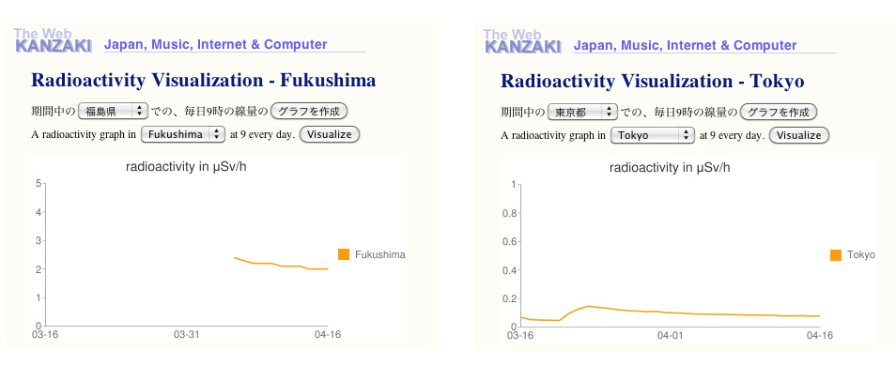
Example: radioactivity data

Slide 121
Vocabularies

Slide 122
Vocabularies
Data integration needs agreements on
terms
“translator”, “author”
categories used
“Person”, “literature”
relationships among those
“an author is also a Person…”, “historical fiction is a narrower term than fiction”
ie, new relationships can be deduced

Slide 123
Vocabularies
There is a need for “languages” to define such vocabularies
to define those vocabularies
to assign clear “semantics” on how new relationships can be deduced

Slide 124
But what about RDFS?
Indeed RDFS is such framework:
there is typing, subtyping
properties can be put in a hierarchy
datatypes can be defined
RDFS is enough for many vocabularies
But not for all!

Slide 125
Three technologies have emerged
To re-use thesauri, glossaries, etc: SKOS
To define more complex vocabularies with a strong logical underpinning: OWL
Generic framework to define rules on terms and data: RIF

Slide 126
Using thesauri, glossaries (SKOS)

Slide 127
SKOS
Represent and share classifications, glossaries, thesauri, etc
for example:
Dewey Decimal Classification, Art and Architecture Thesaurus, ACM classification of keywords and terms…
classification/formalization of Web 2.0 type tags
Define classes and properties to add those structures to an RDF universe
allow for a quick port of this traditional data, combine it with other data

Slide 128
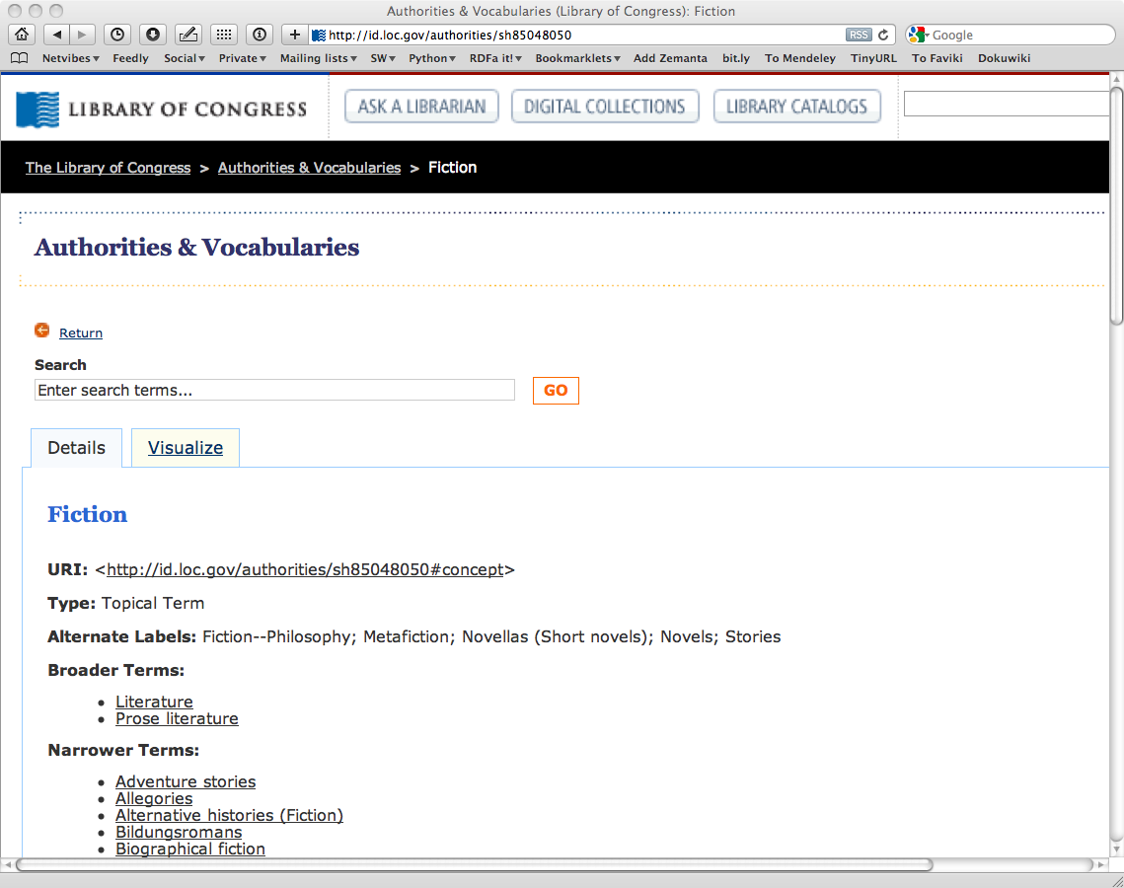
The term “Fiction”, as defined by the Library of Congress

Slide 129
The term “Fiction”, as defined by the Library of Congress

Slide 130
Thesauri have identical structures…
The structure of the LOC page is fairly typical
label, alternate label, narrower, broader, …
there is even an ISO standard for these
SKOS provides a basic structure to create an RDF representation of these

Slide 131
LOC’s “Fiction” in SKOS/RDF
Literature
skos:Concept
Fiction
skos:prefLabel
rdf:type
skos:prefLabel
skos:broader
http://id.loc.gov/…#concept
skos:altLabel
skos:narrower
Metafiction
skos:altLabel
skos:narrower
skos:prefLabel
Novels
Allegories
Adventure stories
skos:prefLabel

Slide 132
Usage of the LOC graph
Fiction
skos:Concept
Historical Fiction
skos:prefLabel
skos:prefLabel
rdf:type
skos:broader
dc:subject
dc:title
http:.//…/isbn/…
The Glass Palace

Slide 133
Importance of SKOS
SKOS provides a simple bridge between the “print world” and the (Semantic) Web
Thesauri, glossaries, etc, from the library community can be made available
LOC is a good example
SKOS can also be used to organize, e.g., tags, annotate other vocabularies, …

Slide 134
Importance of SKOS
Anybody in the World can refer to common concepts
they mean the same for everybody
Applications may exploit the relationships among concepts
eg, SPARQL queries may be issued on the library data+LOC

Slide 135
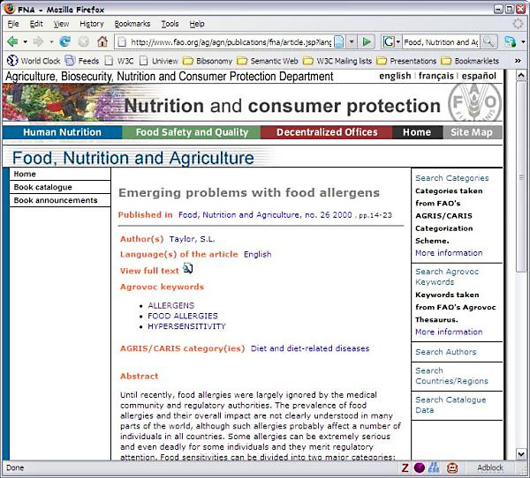
Example: FAO Journal portal
Improved search on journal content based on an agricultural ontology and thesaurus (AGROVOC)
Courtesy of Gauri Salokhe, Margherita Sini, and Johannes Keizer, FAO, (SWEO Case Study)
Notes:
The articles in the Food, Nutrition and Agriculture (FNA) Journal cover topics such as community nutrition, food quality and safety, nutrition assessment, nutrient requirements, food security and rural development. The full-text articles may be in English, French or Spanish.
Metadata about each article in the FNA Journal was available in different formats. Work has been undertaken to combine the metadata and to convert it to a single RDF(S) format, using some ontologies developed internally. A search application was created on top of the ontology and the instance data. A user is guided through the navigation of data by following the links that connect the different metadata elements, such as articles within a specific issue, authors, languages, or keyword.

Slide 136
Ontologies (OWL)

Slide 137
SKOS is not enough…
SKOS may be used to provide simple vocabularies
But it is not a complete solution
it concentrates on the concepts only
no characterization of properties in general
simple from a logical perspective
i.e., only a few inferences are possible

Slide 138
Application may want more…
Complex applications may want more possibilities:
characterization of properties
identification of objects with different URI-s
disjointness or equivalence of classes
construct classes, not only name them
more complex classification schemes
can a program reason about some terms? E.g.:
“if «Person» resources «A» and «B» have the same «foaf:email» property, then «A» and «B» are identical”
etc.

Slide 139
Web Ontology Language = OWL
OWL is an extra layer, a bit like RDF Schemas
own namespace, own terms
it relies on RDF Schemas
It is a separate recommendation
actually… there is a 2004 version of OWL (“OWL 1”)
and there is an update (“OWL 2”) published in 2009
this tutorial presupposes OWL 2

Slide 140
OWL is complex…
OWL is a large set of additional terms
We will not cover the whole thing here…

Slide 141
Term equivalences
For classes:
owl:equivalentClass: two classes have the same individuals
owl:disjointWith: no individuals in common
For properties:
owl:equivalentProperty
remember the a:author vs. f:auteur?
owl:propertyDisjointWith

Slide 142
Term equivalences
For individuals:
owl:sameAs: two URIs refer to the same concept (“individual”)
owl:differentFrom: negation of owl:sameAs

Slide 143
Connecting to French
a:author
owl:equivalentProperty
f:auteur
a:Novel
owl:equivalentClass
f:Roman

Slide 144
Typical usage of owl:sameAs
Linking our example of Amsterdam from one data set (DBpedia) to the other (Geonames):
<http://dbpedia.org/resource/Amsterdam> owl:sameAs <http://sws.geonames.org/2759793>;
This is a major mechanism of “Linking” in the Linked Open Data project

Slide 145
Property characterization
In OWL, one can characterize the behavior of properties (symmetric, transitive, functional, inverse functional, reflexive, irreflexive, …)
OWL also separates data and object properties
“datatype property” means that its range are typed literals

Slide 146
What this means is…
If the following holds in our triples:
:email rdf:type owl:InverseFunctionalProperty.

Slide 147
What this means is…
If the following holds in our triples:
:email rdf:type owl:InverseFunctionalProperty.
<A> :email "mailto:a@b.c".
<B> :email "mailto:a@b.c".

Slide 148
What this means is…
If the following holds in our triples:
:email rdf:type owl:InverseFunctionalProperty.
<A> :email "mailto:a@b.c".
<B> :email "mailto:a@b.c".
then, processed through OWL, the following holds, too:
<A> owl:sameAs <B>.

Slide 149
Keys
Inverse functional properties are important for identification of individuals
think of the email examples
But… identification based on one property may not be enough

Slide 150
Keys
“if two persons have the same emails and the same
homepages then they are identical”
Identification is based on the identical values of two properties
The rule applies to persons only

Slide 151
Previous rule in OWL
:Person rdf:type owl:Class;
owl:hasKey (:email :homepage) .

Slide 152
What it means is…
If:
<A> rdf:type :Person ;
:email "mailto:a@b.c";
:homepage "http://www.ex.org".
<B> rdf:type :Person ;
:email "mailto:a@b.c";
:homepage "http://www.ex.org".
then, processed through OWL, the following holds, too:
<A> owl:sameAs <B>.

Slide 153
Classes in OWL
In RDFS, you can subclass existing classes… that’s all
In OWL, you can construct classes from existing ones:
enumerate its content
through intersection, union, complement
etc.

Slide 154
Enumerate class content
:Currency
rdf:type owl:Class;
owl:oneOf (:€ :£ :$).
I.e., the class consists of exactly of those individuals and nothing else

Slide 155
Union of classes
:Novel rdf:type owl:Class.
:Short_Story rdf:type owl:Class.
:Poetry rdf:type owl:Class.
:Literature rdf:type owl:Class;
owl:unionOf (:Novel :Short_Story :Poetry).
Other possibilities: complementOf, intersectionOf, …

Slide 156
For example…
If:
:Novel rdf:type owl:Class.
:Short_Story rdf:type owl:Class.
:Poetry rdf:type owl:Class.
:Literature rdf:type owl:Class;
owl:unionOf (:Novel :Short_Story :Poetry).
<myWork> rdf:type :Novel .
then the following holds, too:
<myWork> rdf:type :Literature .

Slide 157
It can be a bit more complicated…
If:
:Novel rdf:type owl:Class.
:Short_Story rdf:type owl:Class.
:Poetry rdf:type owl:Class.
:Literature rdf:type owlClass;
owl:unionOf (:Novel :Short_Story :Poetry).
fr:Roman owl:equivalentClass :Novel .
<myWork> rdf:type fr:Roman .
then, through the combination of different terms, the following still holds:
<myWork> rdf:type :Literature .

Slide 158
What we have so far…
The OWL features listed so far are already fairly powerful
E.g., various databases can be linked via owl:sameAs, functional or inverse functional properties, etc.
Many inferred relationship can be found using a traditional rule engine

Slide 159
However… that may not be enough
Very large vocabularies might require even more complex features
typical usage example: definition of all concepts in a health care environment
some major issues
the way classes (i.e., “concepts”) are defined
handling of datatypes
OWL includes those extra features but… the inference engines become (much) more complex

Slide 160
Property value restrictions
Classes are created by restricting the property values on a (super)class
For example: how would I characterize a “listed price”?
it is a price (which may be a general term), but one that is given in one of the “allowed” currencies (€, £, or $)
more formally:
the value of “p:currency”, when applied to a resource on listed price, must take one of those values…
…thereby defining the class of “listed price”

Slide 161
But: OWL is hard!
The combination of class constructions with various restrictions is extremely powerful
What we have so far follows the same logic as before
extend the basic RDF and RDFS possibilities with new features
define their semantics, ie, what they “mean” in terms of relationships
expect to infer new relationships based on those
However… a full inference procedure is hard
not implementable with simple rule engines, for example

Slide 162
OWL “species” or profiles
OWL species comes to the fore:
restricting which terms can be used and under what circumstances (restrictions)
if one abides to those restrictions, then simpler inference engines can be used
They reflect compromises: expressiveness vs. implementability

Slide 163
OWL Species
OWL Full
OWL DL
OWL EL
OWL RL
OWL QL

Slide 164
Some more on OWL RL
Goal: to be implementable through rule engines
Usage follows a similar approach to RDFS:
merge the ontology and the instance data into an RDF graph
use the rule engine to add new triples (as long as it is possible)
This application model is very important for RDF based applications
All our previous examples fit into OWL RL!

Slide 165
Example: Organ Failure Risk Detection
System by IO Informatics and UBC:
data integrated from experimental data, clinical endpoints, public ontologies, LOD, etc.
statistical analysis is performed on the data
SPARQL is used to query the results
a visual interface is provided
for clinicians, a simple web-based alerting of “hits” is provided with statistical scores
Courtesy of Robert Stanley, et al, IO Informatics, USA, and UBC, Canada, (SWEO Case Study)

Slide 166
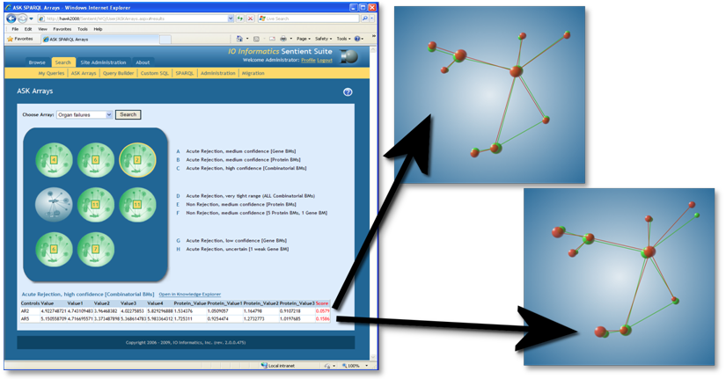
Example: Organ Failure Risk Detection
Courtesy of Robert Stanley, et al, IO Informatics, USA, and UBC, Canada, (SWEO Case Study)

Slide 167
Rules (RIF)

Slide 168
Why rules on the Semantic Web?
Some conditions may be complicated in ontologies (such as OWL)
e.g., Horn rules: (P1 & P2 & …) → C
In many cases applications just want 2-3 rules to complete integration
I.e., rules may be an alternative to (OWL based) ontologies

Slide 169
Things you may want to express
An example from our bookshop integration:
“I buy a novel with over 500 pages if it costs less than €20”
something like (in an ad-hoc syntax):
{
?x rdf:type p:Novel;
p:page_number ?n;
p:price [
p:currency :€;
rdf:value ?z
].
?n > "500"^^xsd:integer.
?z < "20.0"^^xsd:double.
}
=>
{ <me> p:buys ?x }

Slide 170
Things you may want to express
p:Novel
rdf:type
p:page_number
?n
?n>500
?x
me
p:buys
?x
p:price
p:currency
:€
rdf:value
?z
?z<20

Slide 171
Enters RIF (Rule Interchange Format) Core
Simple rule language
formally: definite Horn without function symbols
A Core document is
some directives like import, prefix settings for URIs, etc.
a sequence of logical implications
there are some restrictions (“safety measures”) to make it easily implementable
RIF is not bound to RDF only
eg, relationships may involve more than 2 entities

Slide 172
RIF Core example (using its “presentation syntax”)
Document(
Prefix(cpt http://example.com/concepts#)
Prefix(ppl http://example.com/people#)
Prefix(bks http://example.com/books#)
Group
(
Forall ?Buyer ?Item ?Seller (
cpt:buy(?Buyer ?Item ?Seller):- cpt:sell(?Seller ?Item ?Buyer)
)
cpt:sell(ppl:John bks:LeRif ppl:Mary)
)
)
This infers the following relationship:
cpt:buy(ppl:Mary bks:LeRif ppl:John)

Slide 173
Usage of RIF with RDF?
Typical scenario:
the “data” of the application is available in RDF
rules on that data is described using RIF
the two sets are “bound” (eg, RIF “imports” the data)
a RIF processor produces new relationships
There is a separate document that describes the details

Slide 174
Remember the what we wanted from Rules?
{
?x rdf:type p:Novel;
p:page_number ?n;
p:price [
p:currency :€;
rdf:value ?z
].
?n > "500"^^xsd:integer.
?z < "20.0"^^xsd:double.
}
=>
{ <me> p:buys ?x }

Slide 175
The same with RIF presentation syntax
Document (
Prefix …
Group (
Forall ?x ?n ?z (
<me>[p:buys->?x] :-
And(
?x rdf:type p:Novel
?x[p:page_number->?n p:price->_abc]
_abc[p:currency->:€ rdf:value->?z]
External(pred:numeric-greater-than(?n "500"^^xsd:integer))
External(pred:numeric-less-than(?z "20.0"^^xsd:double))
)
)
)
)

Slide 176
Discovering new relationships…
Forall ?x ?n ?z (
<me>[p:buys->?x] :-
And(
?x # p:Novel
?x[p:page_number->?n p:price->_abc]
_abc[p:currency->:€ rdf:value->?z]
External( pred:numeric-greater-than(?n "500"^^xsd:integer) )
External( pred:numeric-less-than(?z "20.0"^^xsd:double) )
)
)

Slide 177
Discovering new relationships…
Forall ?x ?n ?z (
<me>[p:buys->?x] :-
And(
?x # p:Novel
?x[p:page_number->?n p:price->_abc]
_abc[p:currency->p:€ rdf:value->?z]
External( pred:numeric-greater-than(?n "500"^^xsd:integer) )
External( pred:numeric-less-than(?z "20.0"^^xsd:double) )
)
)
combined with:
<http://…/isbn/…> a p:Novel;
p:page_number "600"^^xsd:integer ;
p:price [ rdf:value "15.0"^^xsd:double ; p:currency :€ ] .

Slide 178
Discovering new relationships…
Forall ?x ?n ?z (
<me>[p:buys->?x] :-
And(
?x # p:Novel
?x[p:page_number->?n p:price->_abc]
_abc[p:currency->p:€ rdf:value->?z]
External( pred:numeric-greater-than(?n "500"^^xsd:integer) )
External( pred:numeric-less-than(?z "20.0"^^xsd:double) )
)
)
combined with:
<http://…/isbn/…> a p:Novel;
p:page_number "600"^^xsd:integer ;
p:price [ rdf:value "15.0"^^xsd:double ; p:currency :€ ] .
yields:
<me> p:buys <http://…/isbn/…> .

Slide 179
RIF vs. OWL?
OWL concentrates on “taxonomic reasoning”
i.e., if you have large knowledge bases, ontologies, use OWL
Rules concentrate on reasoning problems within the data
i.e., if your knowledge base is simple but lots of data, use rules
But these are thumb rules only…

Slide 180
At the end of the day…
Using rules vs. ontologies may largely depend on
available tools
personal technical experience and expertise
taste…

Slide 181
What about OWL RL?
OWL RL stands for “Rule Language”…
OWL RL is in the intersection of RIF Core and OWL
inferences in OWL RL can be expressed with rules
the rules are precisely described in the OWL specification
there are OWL RL implementations that are based on RIF

Slide 182
Vocabularies and SPARQL
Question: how does SPARQL queries and vocabularies work together?
RDFS, OWL, and RIF produce new relationships
on what data do we query?
Answer: in current SPARQL, that is not defined
But, in SPARQL 1.1 it is…

Slide 183
SPARQL 1.1 and RDFS/OWL/RIF
SPARQL Engine with entailment
RDF Data
RDFS/OWL/RIF data
entailment
SPARQL Pattern
RDF Data with extra triples
SPARQL Pattern
Query result
pattern matching

Slide 184
Example: iLaw—Intelligent Legislation support system
Legal services are to government departments, enabling them:
compare to similar legislation home and abroad, eg:
compare terms with those around
trends, academic papers, civil complaints
Based on:
integration of legal cases from US, Japan, and the EU countries, plus legal articles and academic papers in an RDF store
usage of own ontology, OWL and Rules reasoning
Courtesy of Hanming Jung, et al, KISTI and MOJ Korea, (SWEO Case Study)

Slide 185
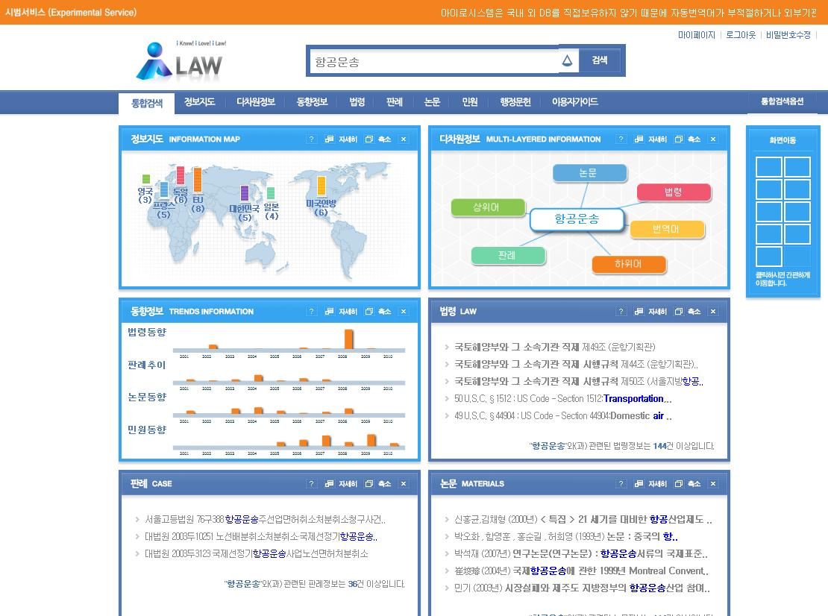

Example: iLaw—Intelligent Legislation support system
Courtesy of Hanming Jung, et al, KISTI and MOJ Korea, (SWEO Case Study)
Notes:
Services are provided via "widgets": international comparisons, related terms, trends,…

Slide 186
What have we achieved? (putting all this together)

Slide 187
Remember the integration example?
Web of Data Applications
Stand Alone Applications
Browser Applications
Query and Update
Common “Graph” Format &
Common Vocabularies
Inferencing
“Bridges”
Data on the Web

Slide 188
The same with what we learned
Semantic Web Applications
Stand Alone Applications
Browser Applications
SPARQL, RDF and/or OWL API-s
RDF Graph with vocabularies in RDFS, SKOS, OWL, RIF, …
Inferencing
RDFa, μFormats,
μData, R2RML, DM …
Data on the Web

Slide 189
Available documents, resources

Slide 190
Available specifications: Primers, Guides
The “RDF Primer” and the “OWL Guide” give a formal introduction to RDF(S) and OWL
SKOS has its separate “SKOS Primer”
GRDDL Primer and RDFa Primer have been published; RIF Primer is on its way
The W3C Semantic Web Activity Wiki has links to all the specifications

Slide 191
“Core” vocabularies
There are also a number “core vocabularies”
Dublin Core: about information resources, digital libraries, with extensions for rights, permissions, digital right management
FOAF: about people and their organizations
DOAP: on the descriptions of software projects
SIOC: Semantically-Interlinked Online Communities
vCard in RDF
…
One should never forget: ontologies/vocabularies must be shared and reused!

Slide 192
Some books
T. Heath and C. Bizer: Linked Data: Evolving the Web into a Global Data Space, 2011
M. Watson: Practical Semantic Web and Linked data Applications, 2010
P. Hitzler, R. Sebastian, and M. Krötzsch: Foundation of Semantic Web Technologies, 2009
G. Antoniu and F. van Harmelen: Semantic Web Primer, 2nd edition, 2008
D. Allemang and J. Hendler: Semantic Web for the Working Ontologist, 2008
…
See the separate Wiki page collecting book references

Slide 193
Further information
Planet RDF aggregates a number of SW blogs:
http://planetrdf.com/
Semantic Web Interest Group
a forum developers with a publicly archived mailing list, and a constant IRC presence on freenode.net#swig
anybody can sign up on the list
http://www.w3.org/2001/sw/interest/
Linked Data mailing list
a forum concentrating on linked data with a public archive
anybody can sign up on the list
http://lists.w3.org/Archives/Public/public-lod/

Slide 194
Lots of Tools (not an exhaustive list!)
Some names:
Jena, AllegroGraph, Mulgara, Sesame, flickurl, 4Store, …
TopBraid Suite, Virtuoso environment, Falcon, Drupal 7, Redland, Pellet, …
Disco, Oracle 11g, RacerPro, IODT, Ontobroker, OWLIM, Talis Platform, …
RDF Gateway, RDFLib, Open Anzo, DartGrid, Zitgist, Ontotext, Protégé, …
Thetus publisher, SemanticWorks, SWI-Prolog, RDFStore…
…
Categories:
Triple Stores
Inference engines
Converters
Search engines
Middleware
CMS
Semantic Web browsers
Development environments
Semantic Wikis
…
More on http://www.w3.org/2001/sw/wiki/Tools

Slide 195
Conclusions

Slide 196
The Semantic Web is there to integrate data on the Web
The goal is the creation of a Web of Data

Slide 197

Thank you for your attention
These slides are also available on the Web:
http://www.w3.org/2011/Talks/0606-SemTech-Tut-IH/

