Slide 1

Model-based UI Meeting November 2010, Lyon
Fabio Paternò
CNR-ISTI, HIIS Laboratory
Pisa, Italy
http://giove.isti.cnr.it

Slide 2
Model-based approaches
Allow designers and developers to concentrate on main semantic aspects
Languages that represent such aspects
Avoid the need to learn and manage many implementation languages
Linking semantic information and implemementation elements
Interoperability through many possible implementation languages
Facilitate support of assistive technology

Slide 3
Abstraction Levels in Interactive Systems
Task and object – Activity oriented
– I want to select a work of art
Abstract Interface – Platform Independent
– Single selection object with high cardinality
Concrete Interface –Platform Dependent
– List Interaction object with X elements
Implementation
– List object in Java or XHTML or ....

Slide 4
Models and related tools in UI development process
Design criteria
Transformations
Designer
Modelling Tools
Development Tools
Analysis Tools
Models
Task & Object
Models
Interactive Application
Abstract UI
Concrete UI
Context of use
Context
Reverse Engineering Tools

Slide 5
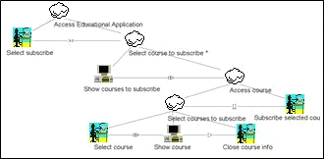
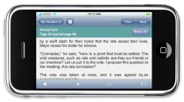
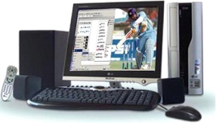
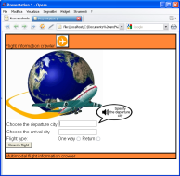
Support for Applications based on Web Services (http://giove.isti.cnr.it/tools/Mariae)
Task
Task
Model
Model
Web
TM
CTT
Services
TM
Language
Language
MARIA
AUI
Multitouch
AUI
Desktop A
Multitouch
Desktop A
UI
UI
PDA AUI
PDA AUI
Language
Phone
Language
Phone
AUI
Specification
AUI
Specification
Specification
Specification
Specification
Specification
Annotations
M
M
-
-
touch
Multitouch
touch
Multitouch
Phone
Desktop
Phone
Multimodal
Desktop
C
C
UI
UI
PDA
C
UI
Multimodal CUI
C
C
UI
Phone C
UI
Phone C
UI
UI
C
C
UI
Specification
UI
Specification
Specification
Specification
Desktop
Language
Desktop
Specification
Language
Specification
Language
Language
C
C
UI
UI
Language
Language
Specifications
Languages

Slide 6
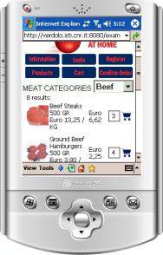
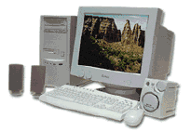
Dynamic User Interface Migration
Use of Logical Description Languages
Existing Web desktop Applications
Automatic user interface generation
Possibility of targeting a variety of interaction platforms
UI Migration Server (Run-Time)
Reverse
Generation
Abstract/
Concrete
Semantic
Abstract/
Concrete
Semantic
Semantic
Semantic
Redesign
Redesign
Redesign
User
Interface
Redesign
+
User
Interface
Interface
State
Precomputed Interface 1
Persistence
Generated
Generated
Implement
Implement
. 2
. 2

Slide 7
SERENOA EU Project :Main Innovations
A new paradigm for context-aware adaptation of SFEs
a more encompassing definition of the Context of Use by combining several dimensions at a time, including the impact of such combinations on others
a new operational notion of adaptation logic that is relying on more expressive and structured mechanisms
being able to learn from user’s feedback or developers knowledge, covering the whole adaptation lifecycle

Slide 8
New WG Goals
Is it timely?
After 20 years research probable yes
Ansi has already standard for task models
What should we do in a charter
Reference Framework? – Create common background
Cameleon framework can be a working group note
Metamodel for task level (ctt + additional related things considering also other proposals in the field,)
Abstract metamodel including dialogue and presentation aspects
Issue on pluggability of tools
Xforms 2.0 is addressing new issues (simplifying, …)
XBL is suitable to abstract-concrete transformations?
We need to consider also large screens, tabletops
Delivery context ontology is going to be simplified
User models?
To consider interoperability (e.g. testing for multimodal interfaces using model-based approaches)

Slide 9
Stakeholders
Minimal level for reccomendation standards is to ensure two or more implementations
Deployment – tool developers
Adoption – developers of context-dependent applications, more accessible applications,
Web site owners or operators (those who pay) e.g. health organizations

Slide 10
Benefits
Benefits for end users and their representatives
Liason with authoring tools in accessibility
Models for communicating with clients and testing
Useful to support development with changing requirements
Support for usability testing and verification of reachability and other properties

Slide 11
Working Group
CNR-ISTI HIIS Lab
DFKI
Telefonica
ProDevelop
CWI
UCL
University of Poitiers/INRIA
PUC Rio
DAI Lab in Berlin

Slide 12
Liaisons & Dependencies
W3C
XForms -> AUI should review Xforms and vice versa
WAI/ARIA -> AUI should review ARIA and vice versa
WAI/Authoring Tools Accessibility Guidelines
MultiModal Group – Specifications consistent with MMI architecture
SMIL – Models consistency, temporal aspects
HCG (Hypertext Coordination Group)
Semantic Web – Feeding back any gaps
Voice Browser – Check abstract vocabulary – relations with statechartxml
Mobile activity

