Slide 1
CEBAF Polarized Electron Source:
Outlook & Horizon
Operations Group Meeting
May 13th & 20th, 2009
Joe Grames
M. Poelker, P. Adderley, J. Clark, J. Grames,
J. Hansknecht, M. Stutzman, R. Suleiman
Graduate Students: J. Dumas, J. McCarter, K. Surles-Law

Slide 2
Following the summer SAD we begin a series of experiments with very demanding requirements of the polarized source (and of the accelerator too!)
These so-called “parity violation” experiments aim to measure tiny physics dependent asymmetries in the scattering of polarized electrons from their targets.
500,001
1,000,000
499,999
Asymmetry = Δ / Σ = (500,001 – 499,999) / (1,000,000) = 2 ppm

Slide 3
Polarization Experiments
The common technique you’ll find for learning the spin physics interaction is to reverse the sign of the beam (or target) polarization and measure the relative difference in detected signal:
(R⁺ - R⁻)
A_{exp} =
= A_{physics} • P_{beam} • P_{target}
(R⁺ + R⁻)
Flip one or other…
For most experiments the z-component is important. This explains why:
Experiments need longitudinal beam polarization.
The word helicity is used (spin parallel/anti-parallel momentum).

Slide 4
The Imperfect World
So, if R+ or R- changes because of anything other than the spin physics of the interaction, it is a false asymmetry. This results in the seemingly unattainable, golden rule for parity experiments:
No beam property other than the beam polarization should change when the beam polarization reverses sign.
But, beam properties do change:
Intensity (first order)
Position (second order)
Energy (second order)
These come in different ways:
Laser light
Photocathode
Accelerator
These happen before the
electrons are even a beam…

Slide 5
Overview of remaining 6 GeV “PV” Program
Experiment | Hall | Start | Energy (GeV) | Current (µA) | Target | A_{PV} | Charge Asym (ppm) | Position Diff (nm)
HAPPEx-III | A | Aug 09 | 3.484 | 85 | ¹H (25 cm) | 16.9±0.4 (ppm) | ✓ | ✓
PV-DIS | A | Oct 09 | 6.068 | 85 | ²H (25 cm) | 63±3 (ppm) | ✓ | ✓
PREx | A | March 10 | 1.056 | 50 | ²⁰⁸Pb (0.5 mm) | 500±15 (ppb) | 0.1 | 2
QWeak | C | May 10 | 1.162 | 180 | ¹H (35 cm) | 234±5 (ppb) | 0.1 | 2

Slide 6
Accelerator
A HC position difference on ANY aperture results in a HC intensity asymmetry. (Note we use absolute difference for position and relative asymmetry for intensity).
Apertures (Profile & Position):
Emittance/Spatial Filters (A1-A4)
Temporal Filter (RF chopping apertures)
Beam scraping monitors.
Any piece of beampipe!
The small apertures and tight spots (separation?)
Adiabatic damping of the beam emittance may gain factors of 10-20 because of the reduction in amplitude of the beam envelope.
Poor optics can reduce this gain by 10x.
Poor optics stability can vary response between source and user.

Slide 7
Benchmarking PARMELA Simulation Results Against Beam-Based Measurements at CEBAF/Jefferson Lab – work of Ashwini Jayaprakash, JLab
Measurements at CEBAF/JLab
PARMELA Simulation Results
Similar Trends
Message: Beam quality, including transmission, improves at higher gun voltage

Slide 8
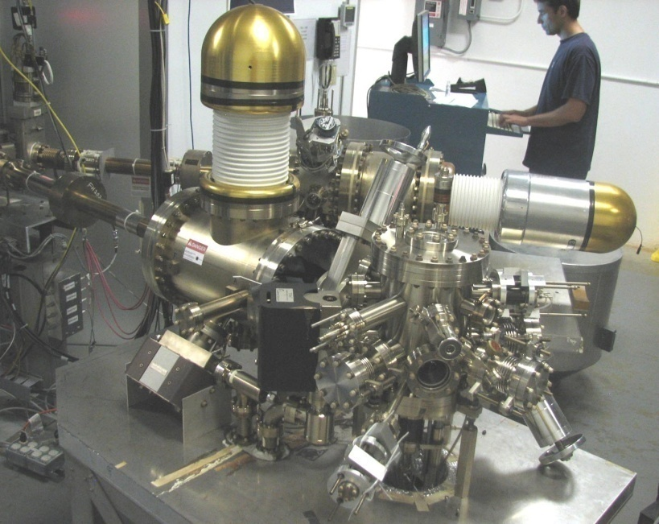
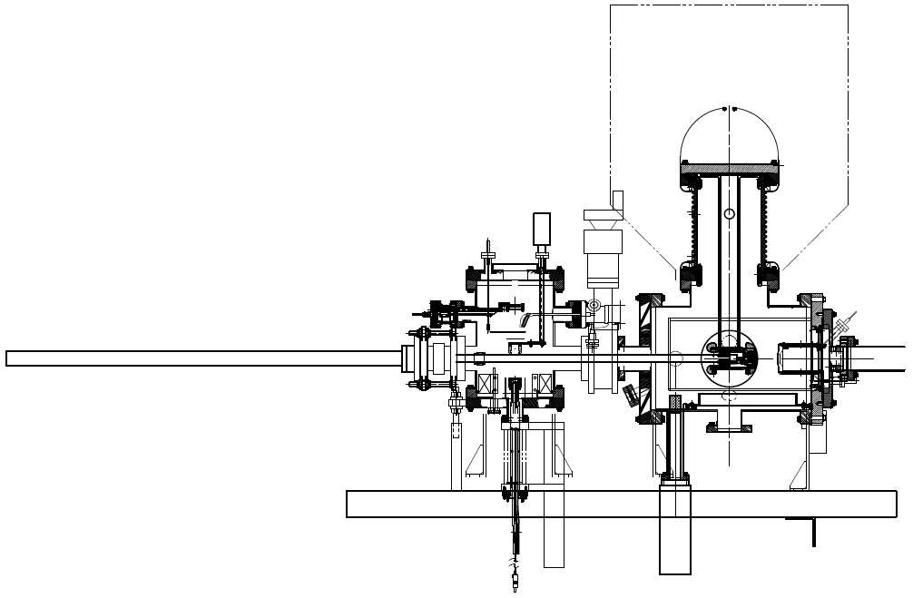
CEBAF LLGun Features
Load-Lock Gun at CEBAF since July 2007
Multiple pucks (8 hours to heat/activate new sample)
Suitcase to add new photocathodes (one day to replace all pucks)
Mask to limit active area, no more anodizing
Vacuum features; NEG coated, smaller surface area, vacuum fired for low out-gassing rate, HV chamber never vented

Slide 9
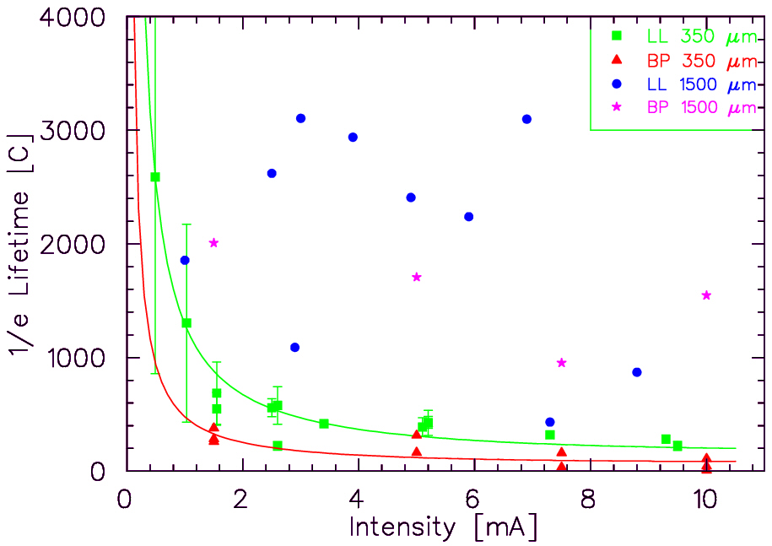
Lifetime with Large/Small Laser Spots
Tough to measure >1000 C lifetimes with 100-200 C runs!
Expectation:
2
1500
≈ 18
350
5
15
This result frequently cited in support of plans for eRHIC at >25mA
“Further Measurements of Photocathode Operational Lifetime at Beam Current > 1mA using an Improved 100 kV DC High Voltage GaAs Photogun,” J. Grames, et al., Proceedings Polarized Electron Source Workshop, SPIN06, Tokyo, Japan

Slide 10
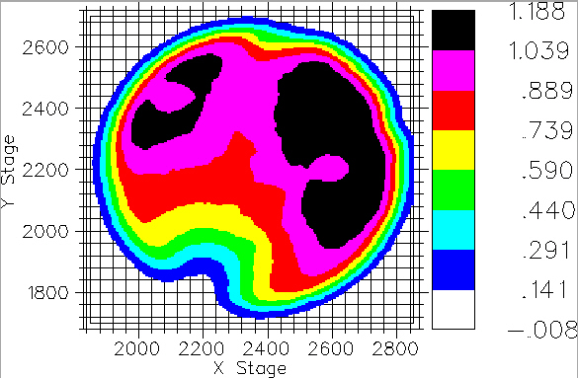
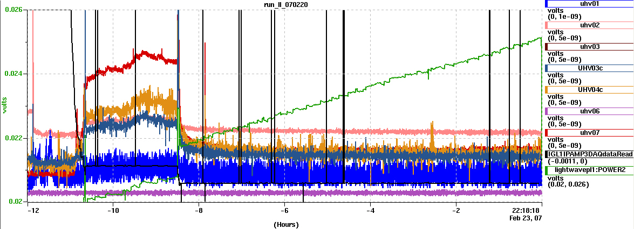
1mA at High Polarization*
Parameter | Value
Laser Rep Rate | 499 MHz
Laser Pulselength | 30 ps
Wavelength | 780 nm
Laser Spot Size | 450 mm
Current | 1 mA
Duration | 8.25 hr
Charge | 30.3 C
Lifetime | 210 C
#How long at 1mA? | 10.5 days
* Note: did not actually measure polarization
High Initial QE
# prediction with 10W laser
Vacuum signals
Laser Power
Beam Current

Slide 11
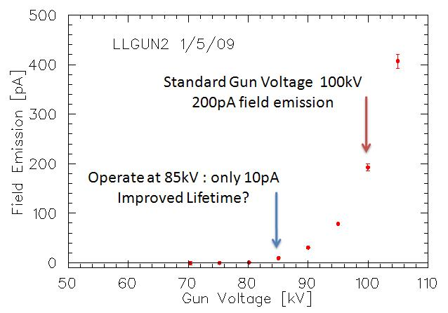
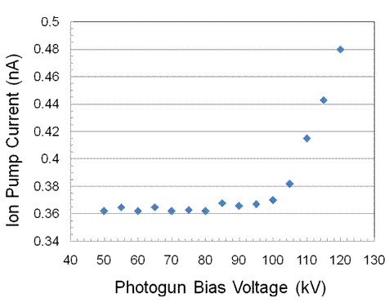
However, we never achieved good lifetime in tunnel…
Ultimately, we believe this is a consequence of field emission.

Slide 12
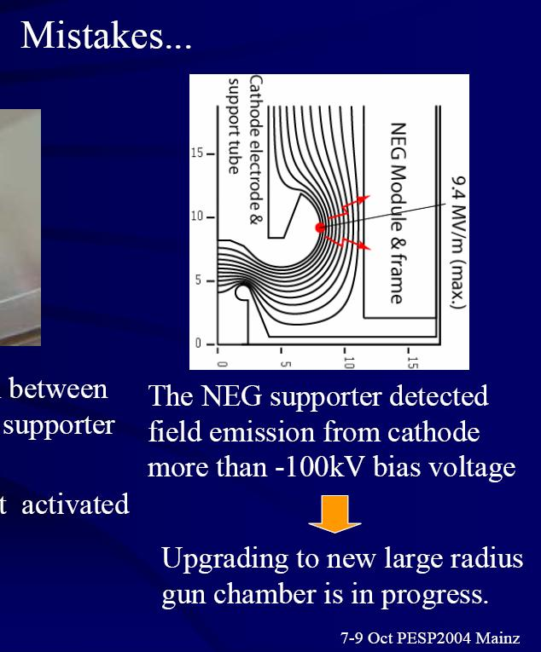
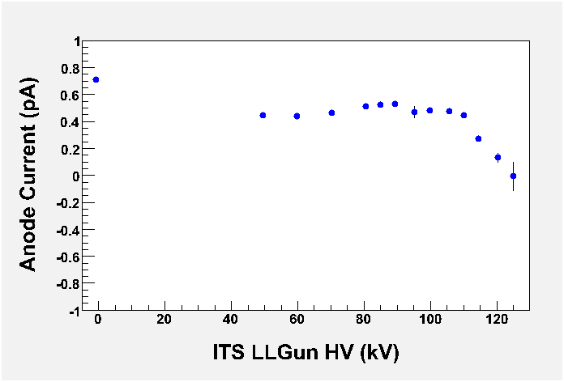
We believed we had identified a leading suspect…
…modified a HV chamber, commissioned at Test Cave, and installed this past SAD…

Slide 13
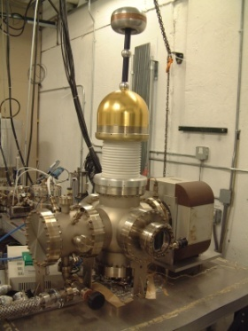
Field Emission – Most Important Issue
Stainless Steel and Diamond-Paste Polishing Good to ~ 5MV/m and 100kV.
5MV/m
Flat electrodes and small gaps not very useful
Want to keep gun dimensions about the same – suggests our 200kV gun needs “quiet” electrodes to 10MV/m
100kV
Work of Ken Surles-Law, Jefferson Lab

Slide 14
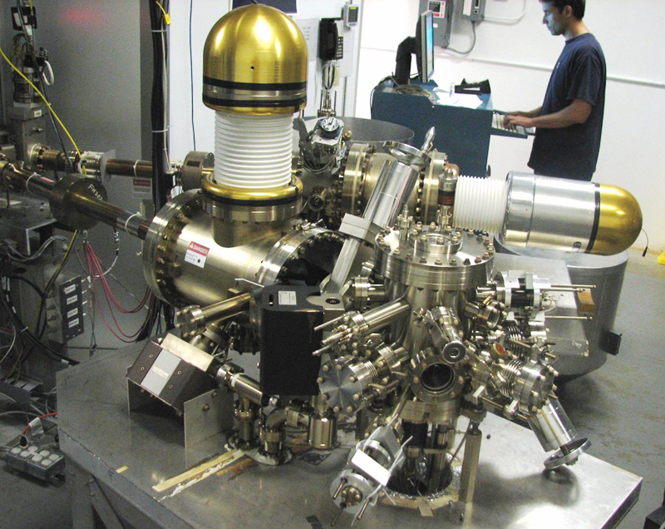
Let’s return to the Higher Voltage Gun…
Helps achieve ALL goals….
More UP time at CEBAF, better beam quality for Parity Violation experiments
Longer lifetime at high average current (good for FEL and positron source)
Emittance preservation at high bunch charge and peak current
High Voltage Issues:
Field emission
Electrode design: reducing gradient and good beam optics
Hardware limitations at CEBAF (Capture, chopper)
Improve Vacuum
Ion pumps
NEG pumps
Outgassing
Gauges

Slide 15

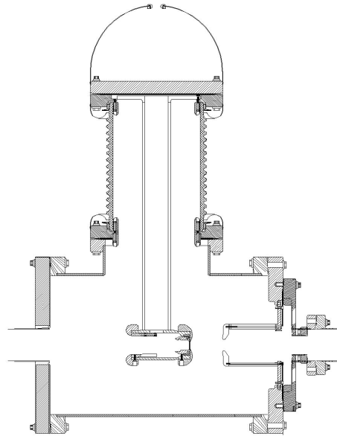
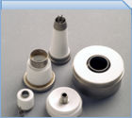
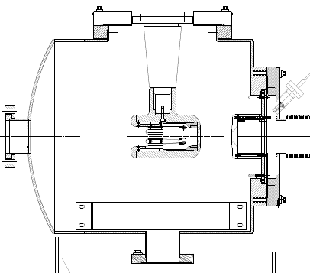
“Inverted” Gun
Present Ceramic
Exposed to field emission
Large area
Expensive (~$50k)
Medical x-ray technology
e⁻
New Ceramic
Compact
~$5k
New design
neg modules
Want to move away from “conventional” insulator used on all GaAs photoguns today – expensive, months to build, prone to damage from field emission.

Slide 16
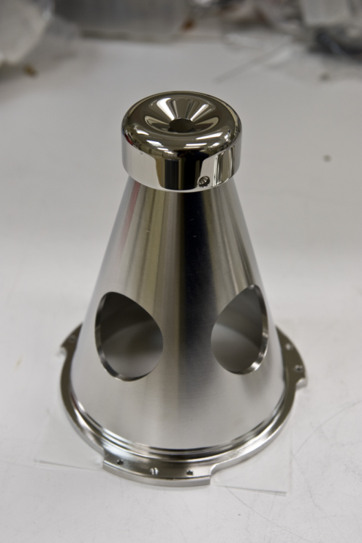
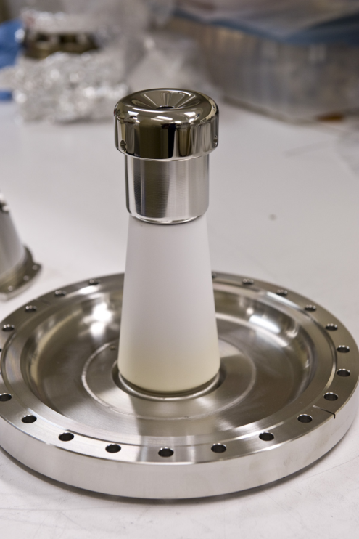
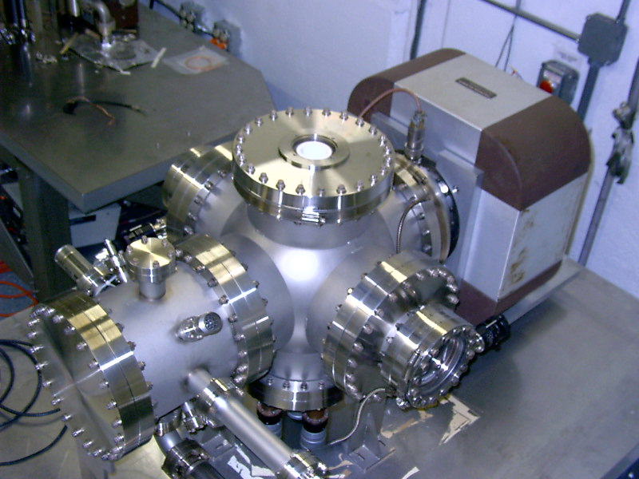
Single Crystal Niobium:
Capable of operation at higher voltage and gradient
Buffer chemical polish (BCP) much easier than diamond-paste-polish
Conventional geometry: cathode electrode mounted on metal support structure
Replace conventional ceramic insulator with “Inverted” insulator: no SF6 and no HV breakdown outside chamber
Work of Ken Surles-Law, Jefferson Lab
Thanks to P. Kneisel, L. Turlington, G. Myneni

Slide 17
The horizon is … NOW
So, our gun plans are…
repair, test the original LL GUN (back in the Test Cave)
build a new inverted style gun (working beginning in EEL/Test Cave)
continue HV modeling gun for acceptable gradient/geometry
preparing new SS and Niobium electrodes for inverted gun
install new 150kV PS
Our plans are to install and operate higher voltage inverted gun, using existing preparation chamber, this summer.
…and if that’s not enough….
The PREX experiment requires the ability to flip the electron polarization 180 degrees. Our plan is to do this with a new, second Wien filter & spin rotation solenoid magnet….

Slide 18
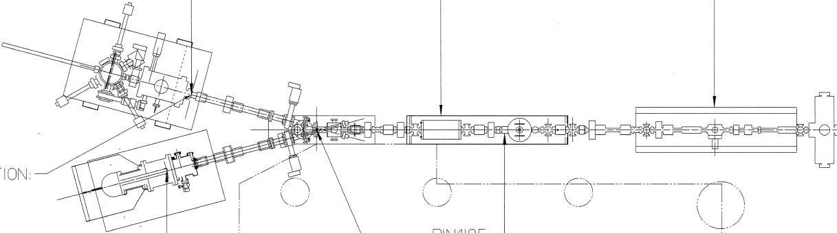
Summer ‘09 SAD
Same good photocathode PREP and LOAD chambers
Spin Flipper: Stage 1
Remove unbaked girder region between valve & chopper
Install new “normal” Wien for Physics program, with quad correction
Thoroughly test & transfer functionality for setting pol.
No need to move laser room.
Install “Inverted” HV chamber with capabilities for higher voltage, anticipating better transmission & photocathode lifetime
Preserve baked region, continue R&D/BS during Fall
H-Wien + Quads
Harp/A2 “match point”

Slide 19
Winter ‘10 SAD
Same good photocathode PREP and LOAD chambers
Spin Flipper: Stage 2
Replace baked region with spin flipper (vertical Wien filter + solenoid(s).
May be tilted pole Wien designed specifically for 90 deg operation at given known gun voltage
Same Wien filter to set longitudinal polarization for Physics
Same “Inverted” Gun, tested at higher voltage
Spin Flip
V-Wien
Spin Flip Solenoid
H-Wien + Quads
Harp “match point”
Harp/A2 “match point”

Slide 20
The End
(unless you want a few more slides…)

Slide 21
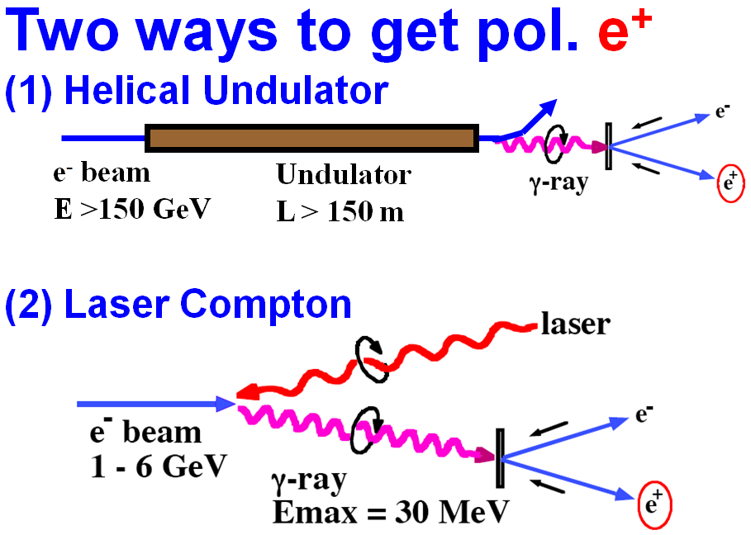
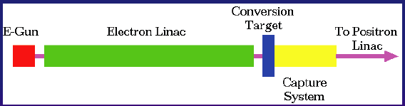
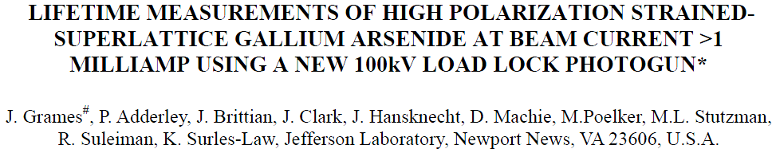
PhD Thesis: Polarized Positrons for JLab, Jonathan DUMAS
Advisors: Eric Voutier, LPSC and Joe Grames, JLab
ILC Polarized e+ Schemes/Demos
(synchrotron/Compton polarized photon)
Conventional un-polarized e+ Scheme
(bremsstrahlung photon)
E = 50 GeV L = 1m E-166 Experiment
OR
High Polarization, High Current e- Gun
(polarized bremsstrahlung photon)
T. Omori, Spin 2006
Positron Yield scales with Beam Power
Replace GeV-pulsed with MeV-CW
Reduce radiation budget
Remain below photo-neutron threshold
Bunch/Capture to SRF linac
Compact source vs. Damping Ring
Unique capabilities
First CW source with helicity reversal
Source Property | E-166 Experiment PRL 100, 210801 (2008) | J. Dumas et al. Proc. Spin 2008
Electron beam energy | 50 GeV - Undulator | 10 MeV - Conversion
Electron beam polarization | Unpolarized | 85%
Photo Production | Synchrotron | Bremsstrahlung
Converter Target | Tungsten Foil | Tungsten Foil
Positron Polarization | 80% (measured) | 40% (Simulation)

Slide 22
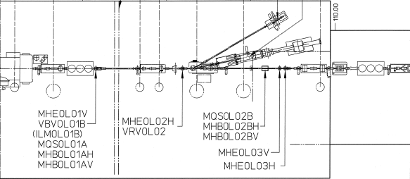
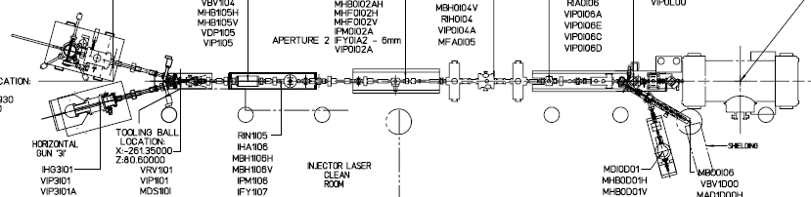
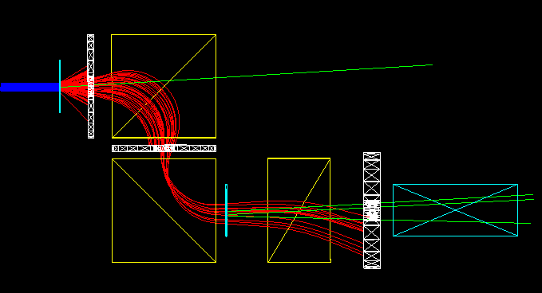
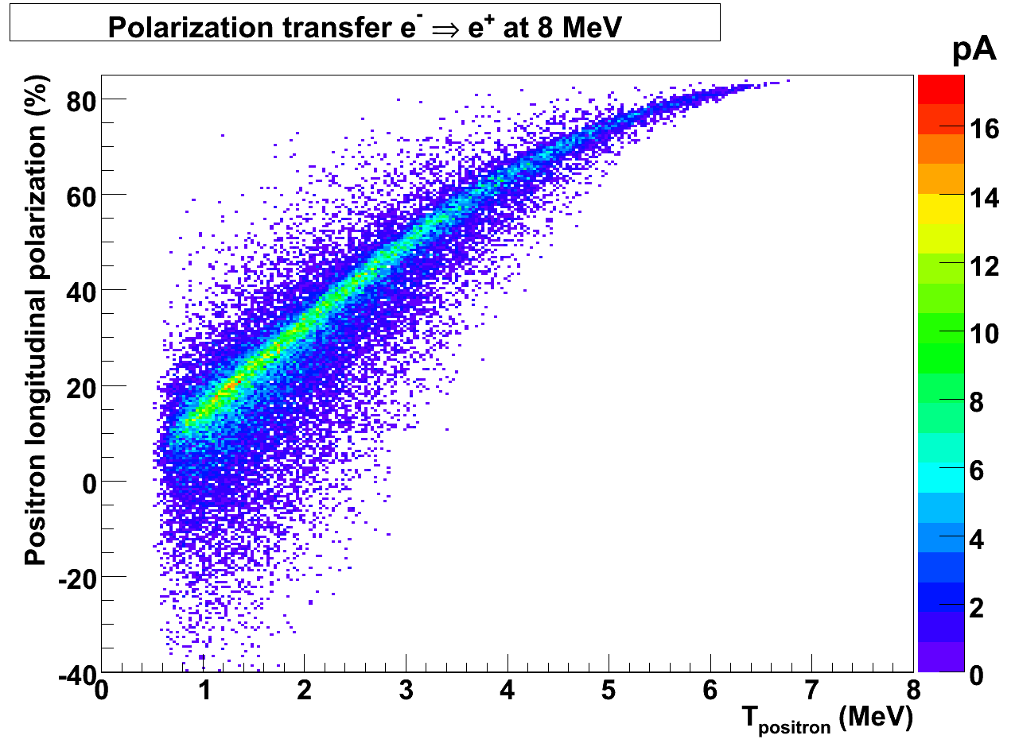
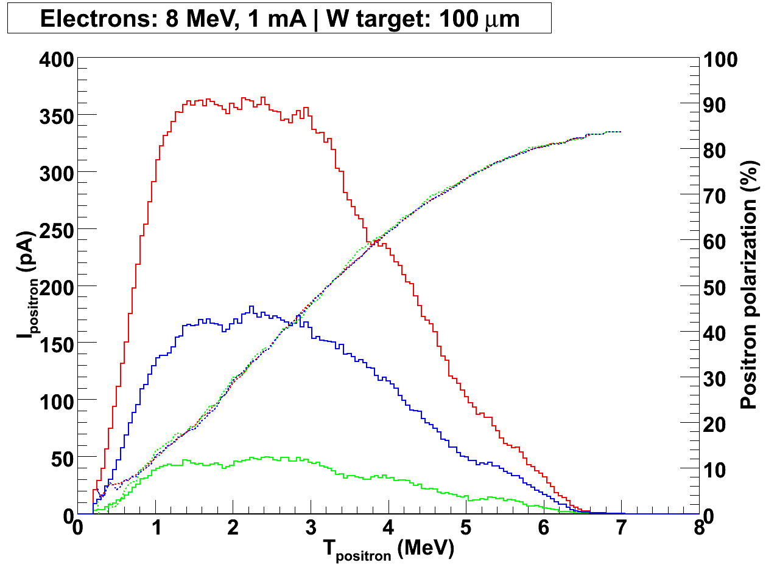
Proof of Principle Experiment: extendible to higher energy (& yield)
Precision Electron
Mott Polarimeter (~1%)
CEBAF Electron Source
High-P (~85%), High-QE (~3mA/500 mW)
e- bunch: 3mA @ 1497MHz demonstrated
Thesis: duty factor => low power, high peak
MeV-Accelerator
Cryounit tested to ~8 MeV
G0 setup ⬄ 1.9mA @ 1497 MHz
Precision Electron
Spectrometer (~3%)
Conversion Target
(Tilted/Normal Tungsten Foils)
G4 Beamline
simulation
e⁻ after target
not shown
e⁻
γ
e⁺
Spec.
Dipole#1
Brem
Pair
e⁻
γ
e⁻
e⁺
ΔΘ = ±20
ΔE = ±250 keV, ΔΦ = 2π
Geant4
simulation
Collimators
Sweep
Dipole
ΔΘ = ±10
γ
Geant4
simulation
ΔΘ = ±5
Spec.
Dipole#2
Analyzer magnet
e⁺ Spectrometer
(or e⁻ & no spin rotation)
γ converter
Transmission Polarimeter (MIT loan)

Slide 23


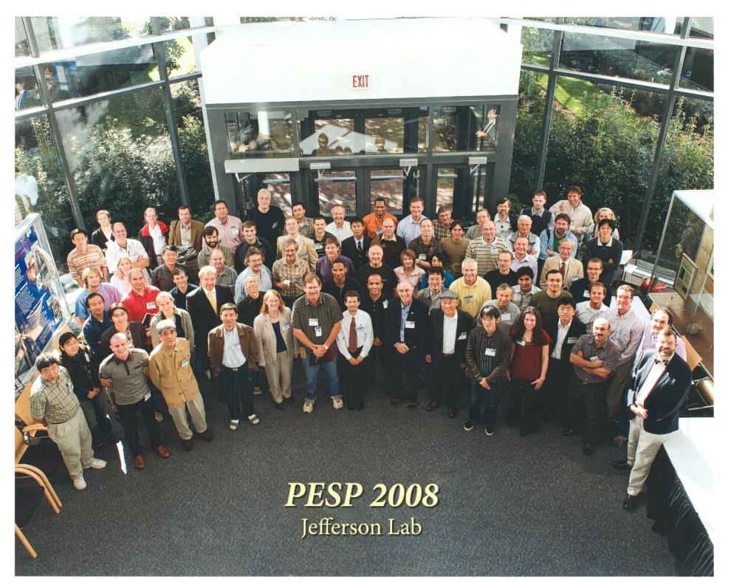
The Source Group hosted two recent workshops:
PESP2008 – Workshop on Polarized Electron Sources and Polarimeters
JPOS09 – International Workshop on Positrons at JLab.

