Slide 1
Jackie Dooley Program Officer, OCLC Research & President, Society of American Archivists
Digital Archives and Society
Center for Jewish History
13 November 2012

Slide 2
Topics
National security
Government records
International activism
“Ephemera”
Email privacy
Crowdsourcing
Digital lives
Digital archivists

Slide 3
Two questions
How would these cases have been different in the analog environment?
What are the implications for our work as archivists?

Slide 4
National Security

Slide 5
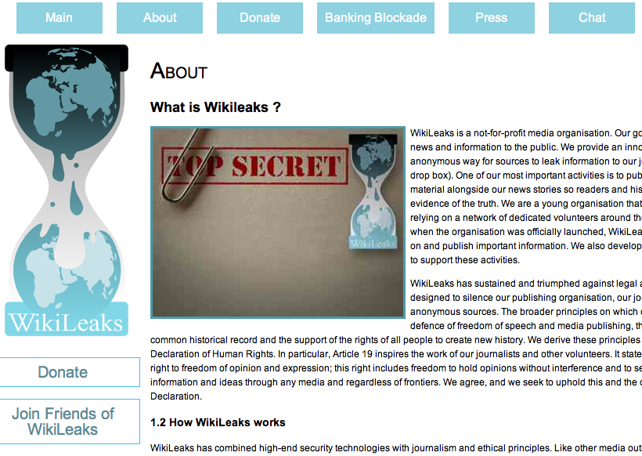
Wikileaks
http://wikileaks.org/About.html
Notes:
WikiLeaks is an international, online, self-described not-for-profit[2] organisation publishing submissions of secret information, news leaks,[5] and classified media from anonymous news sources[2] and whistleblowers. They claim almost two million hits/day.

Slide 6
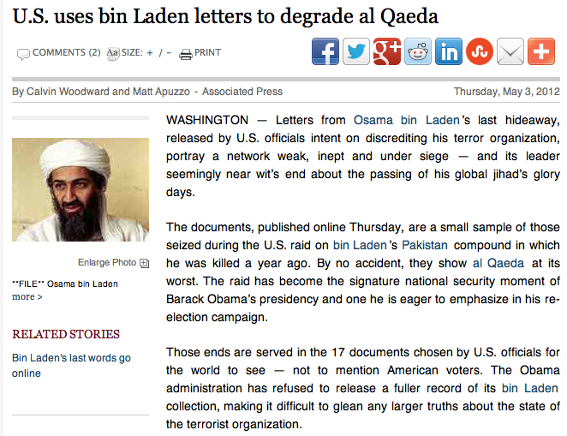
Discrediting al Qaeda
http://www.washingtontimes.com/news/2012/may/3/us-uses-bin-laden-letters-degrade-al-qaeda/

Slide 7
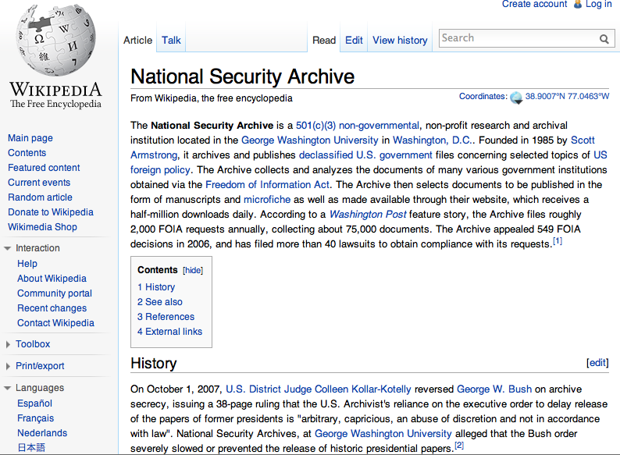
NSC, FOIA, & Declassification of Documents
http://en.wikipedia.org/wiki/National_Security_Archive
Notes:
Website receives 500,000 downloads daily.

Slide 8
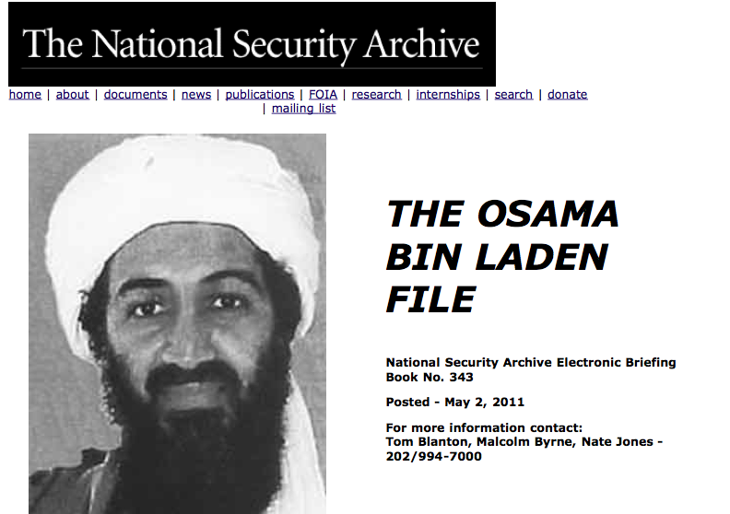
NSA & Access to Declassified Documents
http://www.gwu.edu/~nsarchiv/NSAEBB/NSAEBB343/index.htm

Slide 9
Government Records

Slide 10
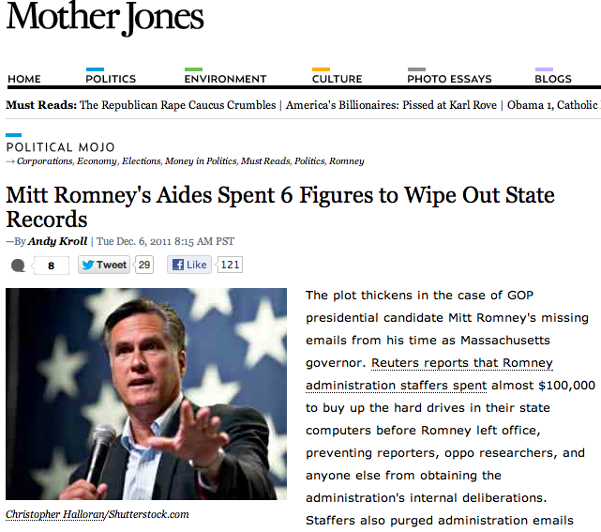
Purged & For Sale
http://www.motherjones.com/mojo/2011/12/mitt-romney-records-massachusetts-governor

Slide 11
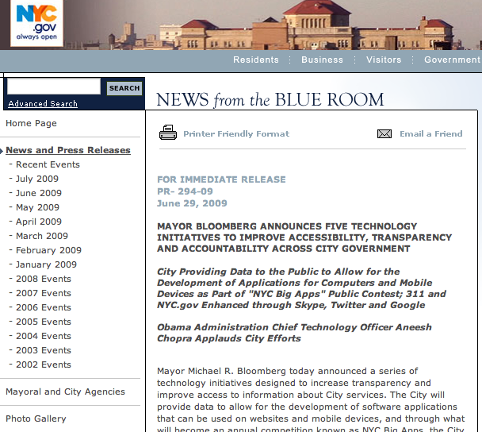
Increasing Transparency
http://www.nyc.gov/portal/site/nycgov/menuitem …

Slide 12
Email Privacy

Slide 13
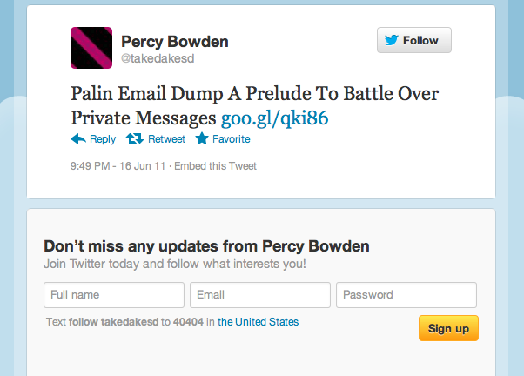
For Politicians?
http://twitter.com/takedakesd/status/81584316295020544

Slide 14
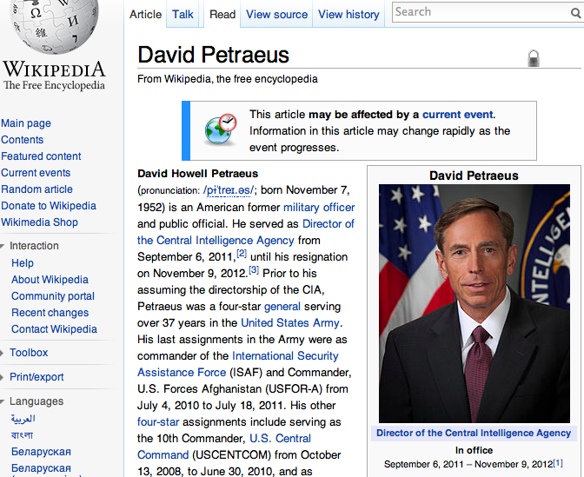
For Government Officials?
http://en.wikipedia.org/wiki/David_Petraeus

Slide 15
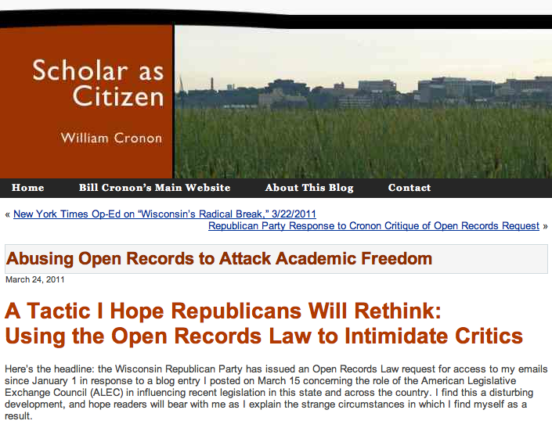
For Citizen Activists?
http://scholarcitizen.williamcronon.net/2011/03/24/open-records-attack-on-academic-freedom/

Slide 16
International Activism

Slide 17
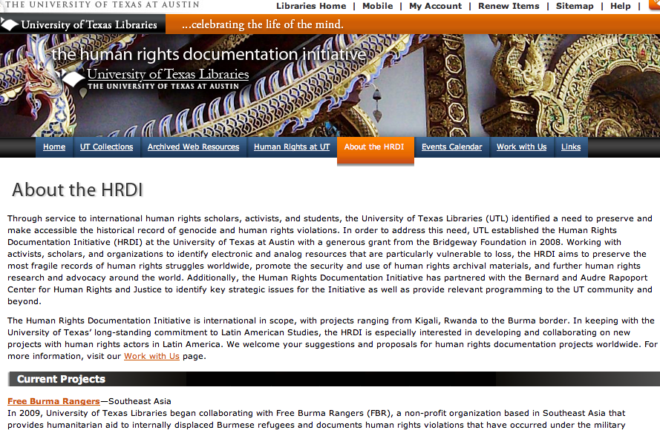
Documenting Genocide
http://www.lib.utexas.edu/hrdi/about

Slide 18
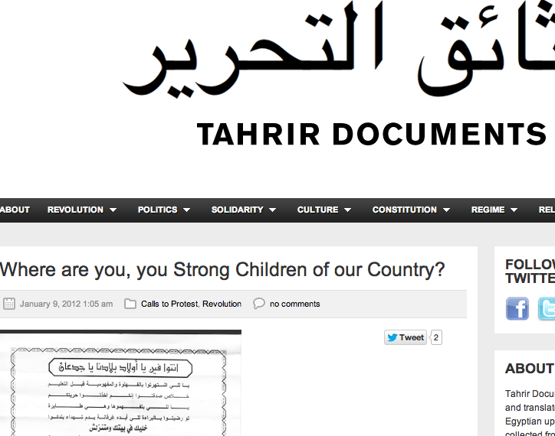
Documenting Revolution
http://www.tahrirdocuments.org/2012/01/where-are-you-you-strong-children-of-our-country/

Slide 19
“Ephemera”

Slide 20
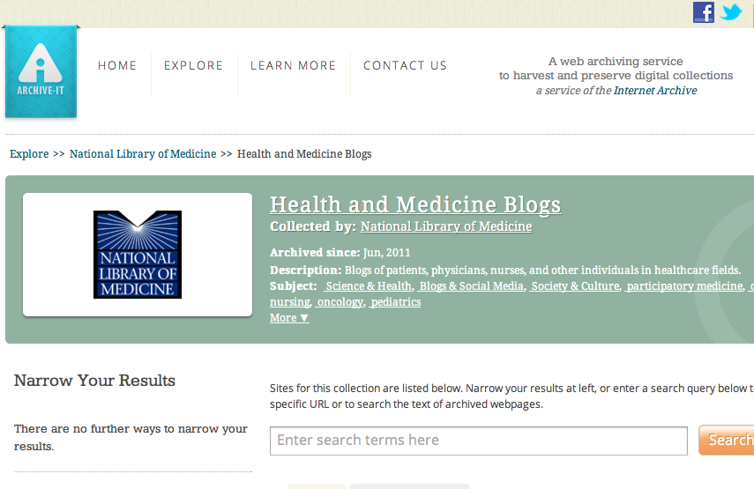
Blogs
http://www.archive-it.org/collections/2722

Slide 21
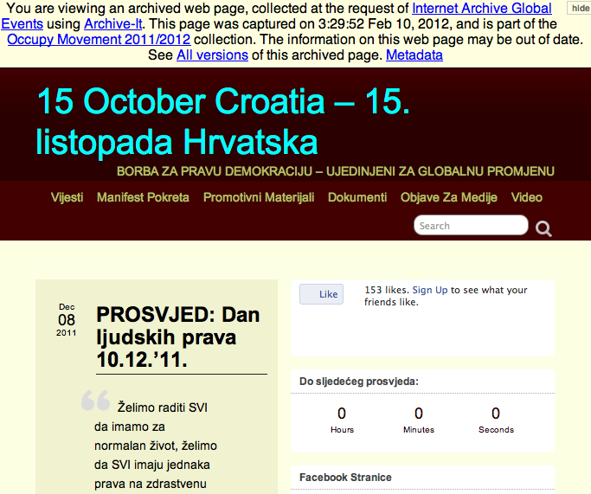
Videos
http://wayback.archive-it.org/2950/20120210032952/http://15ocroatia.org/

Slide 22
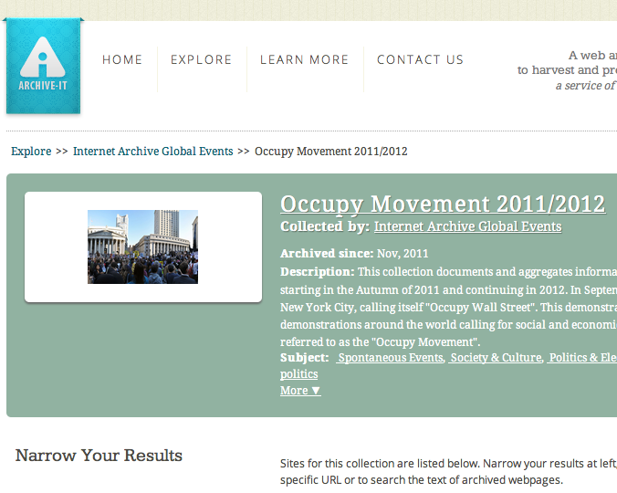
Websites
http://www.archive-it.org/collections/2950

Slide 23
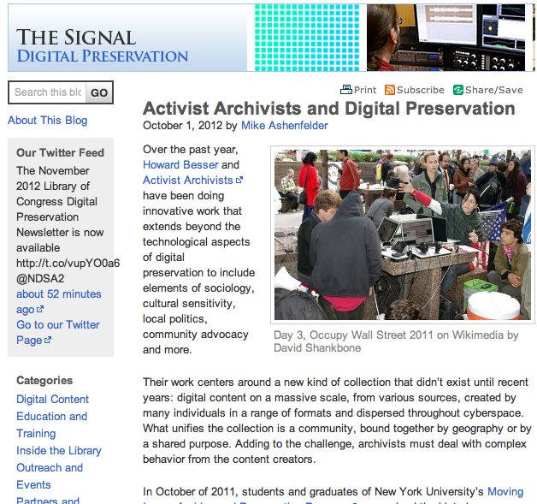
… and Just About Anything Else
http://blogs.loc.gov/digitalpreservation/2012/10/activist-archivists-and-digital-preservation/

Slide 24
Crowdsourcing

Slide 25
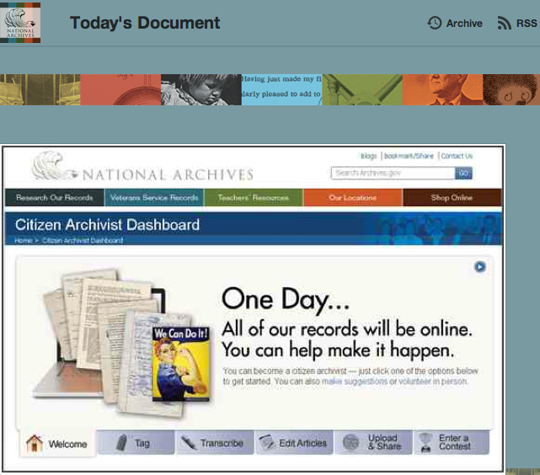
NARA: “Citizen Archivists”
http://todaysdocument.tumblr.com/post/14928295790/from-the-archivist-of-the-united-states-david

Slide 26
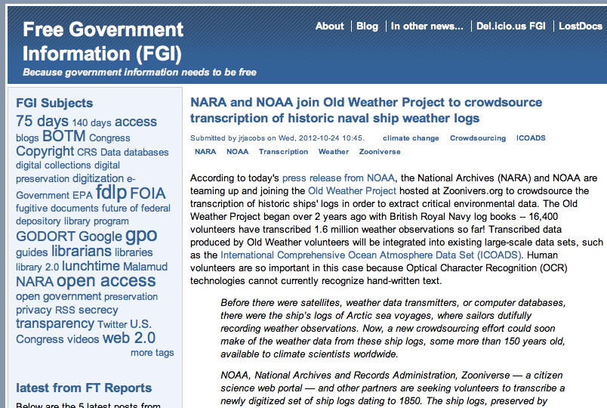
NARA: “Free Government Information”
http://freegovinfo.info/node/3802

Slide 27
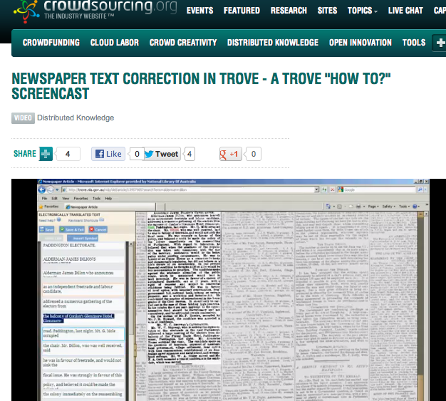
National Library of Australia: Trove
http://www.crowdsourcing.org/video/newspaper-text-correction-in-trove---a-trove-how-to-screencast-/8772
Notes:
As of June 2011: Now we have two million lines corrected every month and this figure continues to increase. There are nearly forty million lines of text corrected to date, by over 30,000 volunteers.

Slide 28
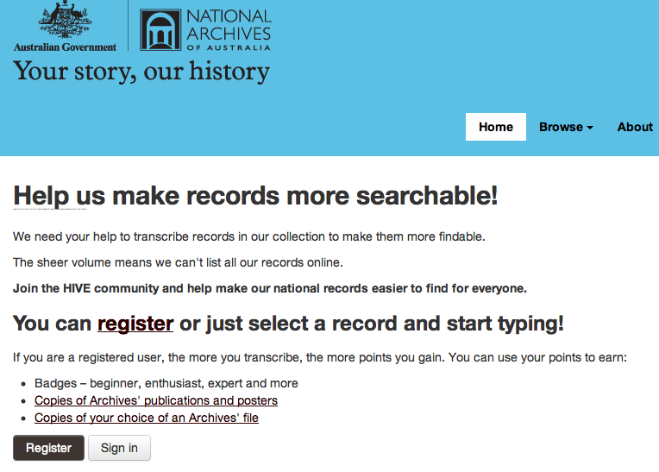
National Archives of Australia: ArcHIVE
http://transcribe.naa.gov.au

Slide 29
Digital Lives

Slide 30
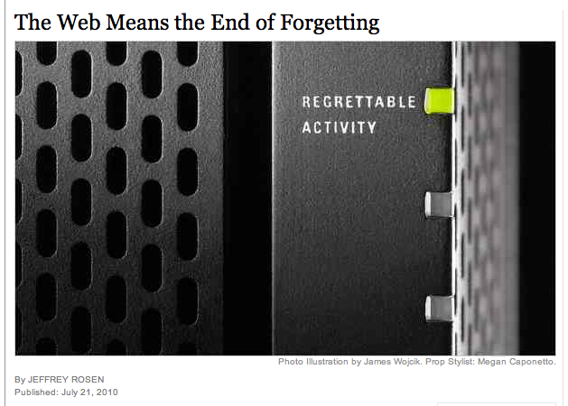
Too Permanent?
http://www.nytimes.com/2010/07/25/magazine/25privacy-t2.html?pagewanted=all

Slide 31
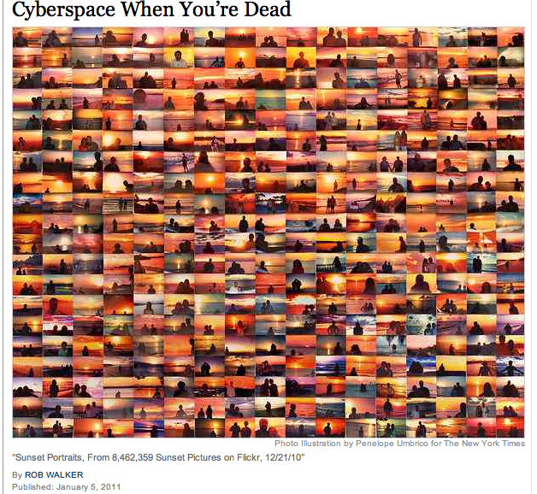
What Happens in …
http://www.nytimes.com/2011/01/09/magazine/09Immortality-t.html?pagewanted=all&_r=0

Slide 32
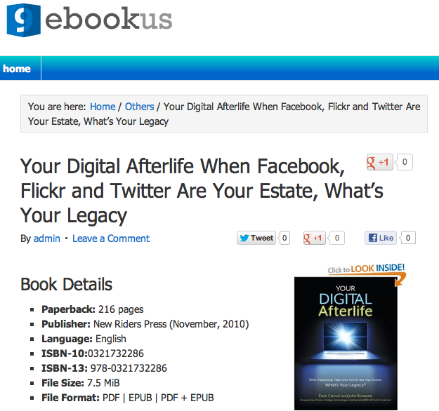
Digital Lives … and After-Lives?
http://9ebookus.com/others/your-digital-afterlife-when-facebook-flickr-and-twitter-are-your-estate-whats-your-legacy.html

Slide 33
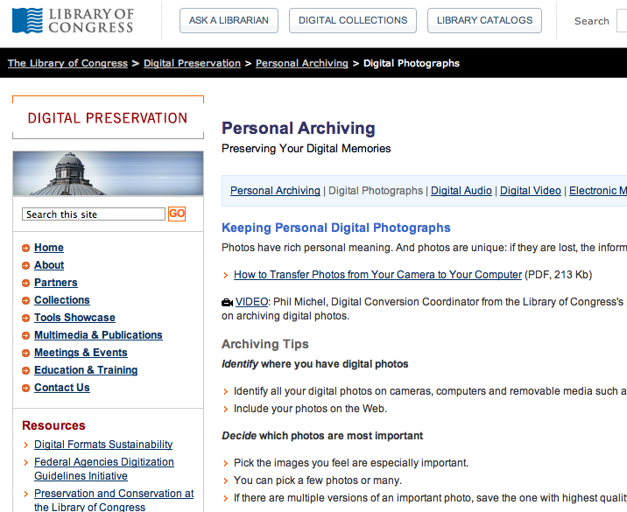
“Personal Archiving”
http://www.digitalpreservation.gov/personalarchiving/photos.html

Slide 34
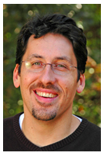
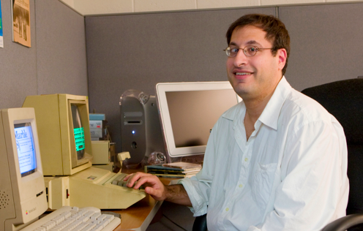
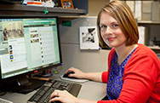
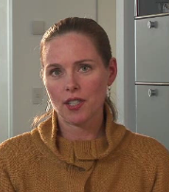
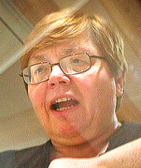
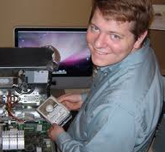
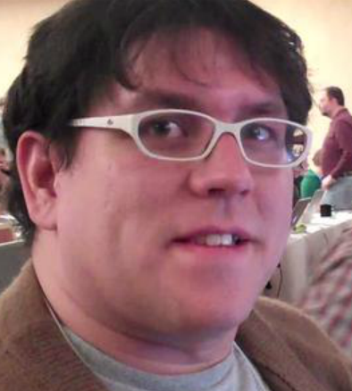
Digital Archivists

Slide 35
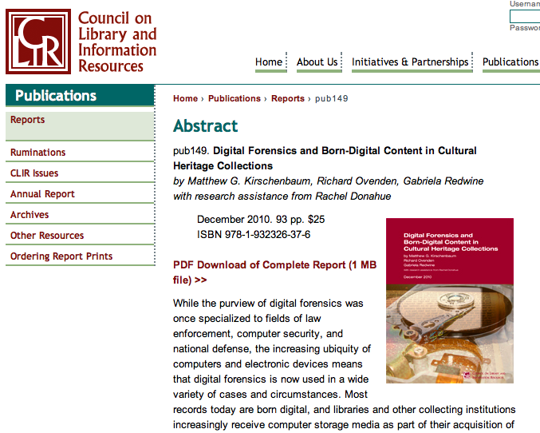
Forensics & Authenticity
http://www.clir.org/pubs/abstract/reports/pub149

Slide 36
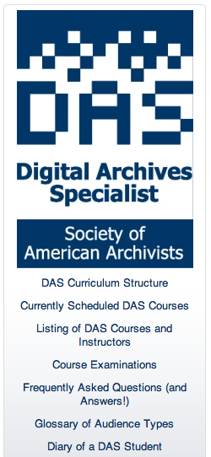
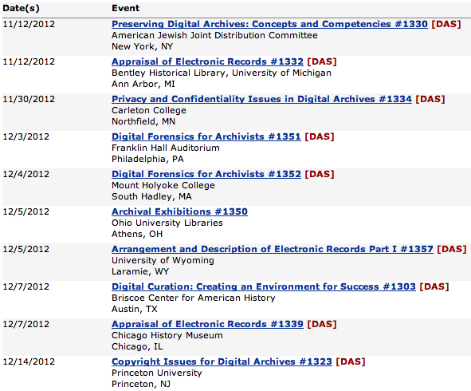
DAS: Re-inventing Our Profession
http://www2.archivists.org/prof-education/das

Slide 37
Your Turn: Discuss
National security
Government records
International activism
“Ephemera”
Email privacy
Crowdsourcing
Digital lives
Digital archivists

Slide 38
Thank you!
Jackie Dooley
dooleyj@oclc.org
@minniedw
http://www.oclc.org/research/people/dooley.html
offtherecord.archivists.org

