Slide 1
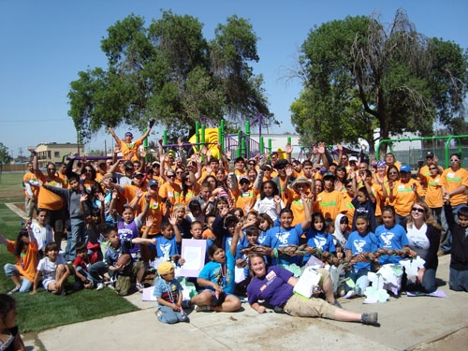
Achieving Broad Public Engagement for Healthy and Inclusive Communities
Keith Woodcock
Community and Regional Planning Center California State University Fresno
Webinar for the
Institute of Local Government
January 15, 2013
Notes:
Thank you for viewing this PowerPoint. If you have any questions, please feel free to contact me at kewoodcock@csufresno.edu.

Slide 2
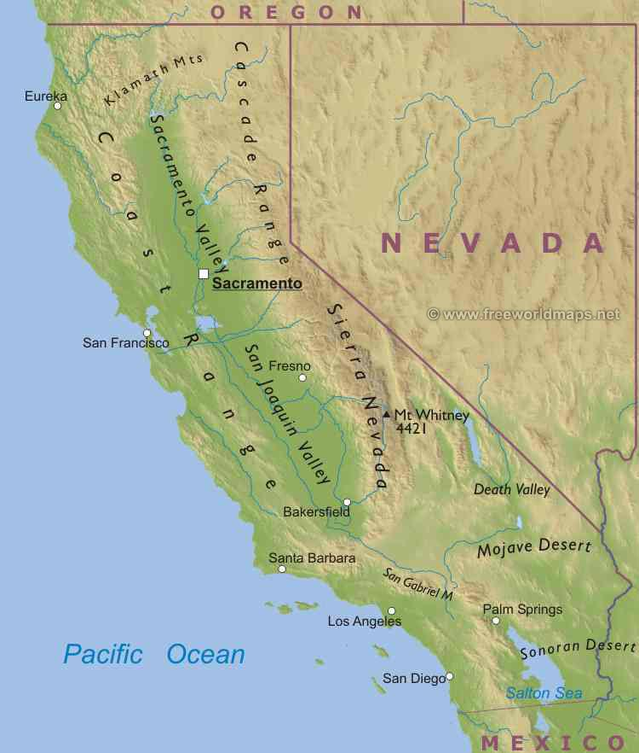
Primer on Delano
Population: 53,041
Hispanic: 71 percent
HH with children: 64 percent
Ave. HH Size: 3.98
Economics: Agriculture
Education: Less that half of 18+ graduated from HS
Of note: Major hub of farmworker organization efforts in the 1950s to 1970s leading to the founding of the United Farmworker (UFW) lead by Cesar Chavez
Delano
Notes:
Selected demographics of Delano

Slide 3

Setting the Stage
What are the issues?
What Do We Wish to Do/Accomplish?
Who is out there?
How do we engage?
Notes:
The public outreach program described in this PowerPoint didn’t occur “out of the blue” or was accomplished in a short time. Rather, we started in the usual manner of holding noticed workshops, etc. However, our attendance was low and often it was the ‘usual suspects.’ So, we (my staff and I) went back to the drawing board and had some self critique. This lead us to redesign the outreach program with much more of a focus on Healthy Eating and Active Living. The first steps we took were to try to define what/where we wanted to go with our public outreach program. What do we really want to do? Etc. The outreach program occurred over close to a four year time period.

Slide 4
The Challenges/Issues
Southern S.J. Valley
Per Capita Income
Social Economic Concerns
Notes:
First, why did Delano start down the path of including health and inclusive communities in its General Plan? This slide shows that the Southern San Joaquin Valley has lost ground over the years in comparison to other regions of the state. As we discuss Health Issues, we will see that these Social Economic factors drive a lot of the discussion about health and social justice/equity.

Slide 5
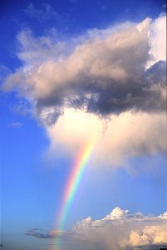
What is a “Healthy Delano”?
Definition?
How Measured?
What Indicators do we use?
What’s the Goal?
To support and encourage good health practices
Notes:
How does one define a ‘Healthy Delano’? Let’s explore what goes into health on an individual level and try to bring that up to a community-wide discussion.

Slide 6
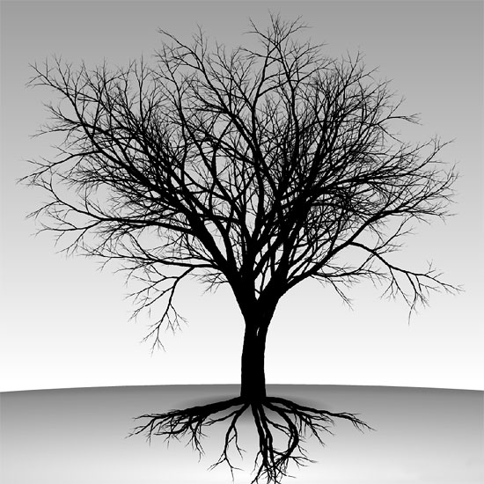
Quantifying “Health”
Determinates of Health
(What are the ‘roots’ of health?)
Indicators of Health
(What are the ‘outcomes’?)
Notes:
Here, we started looking at aspects of Health. How is Health measured and what are the roots to health.

Slide 7
Health Determinates
Income and Social Status
Social Support Networks
Education
Employment and Work Conditions
Social Environment
Physical Environment
Source: US Dept. of Health and Human Services 2010
Healthy People 2020
Which of these are influenced by the ‘Delano’s Built Environment’?
Notes:
Turning to Health Determinates, what are the roots of health? In Delano we formed a ‘Health Discussion Group’. As a group, we placed a relative weight on what health determinates are influenced by the City’s Built Environment. The stronger the perceived relationship, the larger the check mark. This helped us later on to organize the objectives and policies.

Slide 8
Leading Health Indicators
Physical Activity
Overweight and Obesity
Tobacco Use
Substance Abuse
Responsible Sexual Behavior
Mental Health
Injury and Violence
Environmental Quality
Immunization
Access to Health Care
Which of these are influenced by Delano’s ‘Built Environment’?
Notes:
As we look into the relationship between land uses and health, the question we explored in this slide was, “Which indicators are influenced by the built environment?” The greater the relationship, the larger the check mark. This is not scientifically based but more of an intuitive level. You will notice that at first, our discussion group did not believe that there was a strong relationship between the built environment and tobacco use or substance abuse. Later on, it did come up as we looked at advertising for these products, discussion began that perhaps we could control the location of advertising with respect to schools and parks.

Slide 9
BUILDING THE BUILT ENVIRONMENT
PLANNING
Land Use Decisions
PUBLIC HEALTH
Issues
Environmental Consequences
The Built Environment
Notes:
As we have moved through the discussions on health, going back to the health indicators and determinates, we developed a simple model for use in our public education outreach. This helped the public conceptualize the relationships.

Slide 10
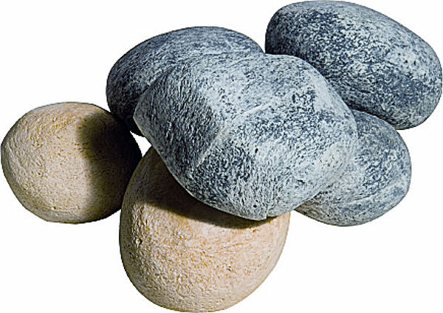
Finding Your “Touchstone”
Notes:
An important “Ah Ha” moment was when came to understand that when we talked about Youth, we got by far and away the biggest response. This became our Touchstone. Each community has its own touchstone. We used this touchstone to further our outreach efforts.

Slide 11
A Health Community Focuses on “Community”
1) membership
2) influence
3) integration and fulfillment of needs
4) shared emotional connection
McMillan and Chavis 1986
“Theory of Psychological Sense of Community”
Notes:
In Delano, we recognized that we need to focus on what helps build a strong community. I.E., Community Development is not just the physical aspects of the environment but Developing the Community itself (building Social Capital). Our Community Outreach program strived to include at least two of the principles shown above for each outreach activity. I liken it to building the “hat rack” for which to put our program together.

Slide 12
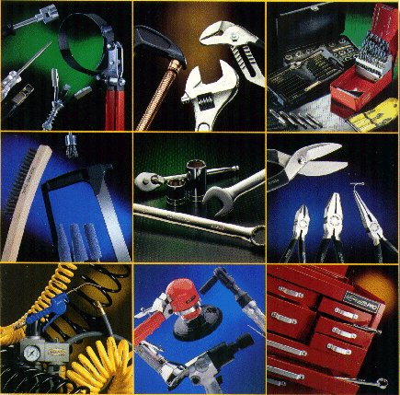
That “thing” called Planning
Starring the usual suspects:
The General Plan
And The
The Tools of Planning
Zoning and Subdivision Ordinances
Design Standards
Notes:
These are important parts of the DNA of the City. Going back to the slides on Roots and Determinates of Health, we could now start to look at the tools used in planning to see where we could affect policy.

Slide 13
Community Outreach
Photovoice
City Walk
Cal Poly, San Luis Obispo
Street Faires
Young Delano Chamber of Commerce
Southwest Delano Revitalization Plan
Notes:
These were the ‘main core’ outreach activities we did in Delano. The events were not necessarily sequential in timing as they often overlapped.

Slide 14
Community Partners
Central California Regional Obesity Prevention Program (CCROPP)
Kern County Public Health Department
Get Moving Kern
Local Government Commission
U.C. Berkeley – Institute of Transportation Studies
Cal Poly SLO – City and Regional Planning Dept.
Delano Chamber of Commerce
Delano Unified School District
Center on Race Poverty and the Environment
Public Health, Law and Policy
Institute for Local Government
Notes:
We did a lot of partnering. Not all of the partners were with us the entire way. But each made very important contributions. For instance, U.C. Berkeley helped do a Pedestrian Safety Assessment for selected areas of the City. Cal Poly worked on developing a Strategic Plan for the update of the General Plan. In a way, it was like Organized Chaos. Some of the partners had their own set of goals or agenda that conflicted. However, we were able to pull it together using a lot of frank and open dialogue. No Game Playing.

Slide 15
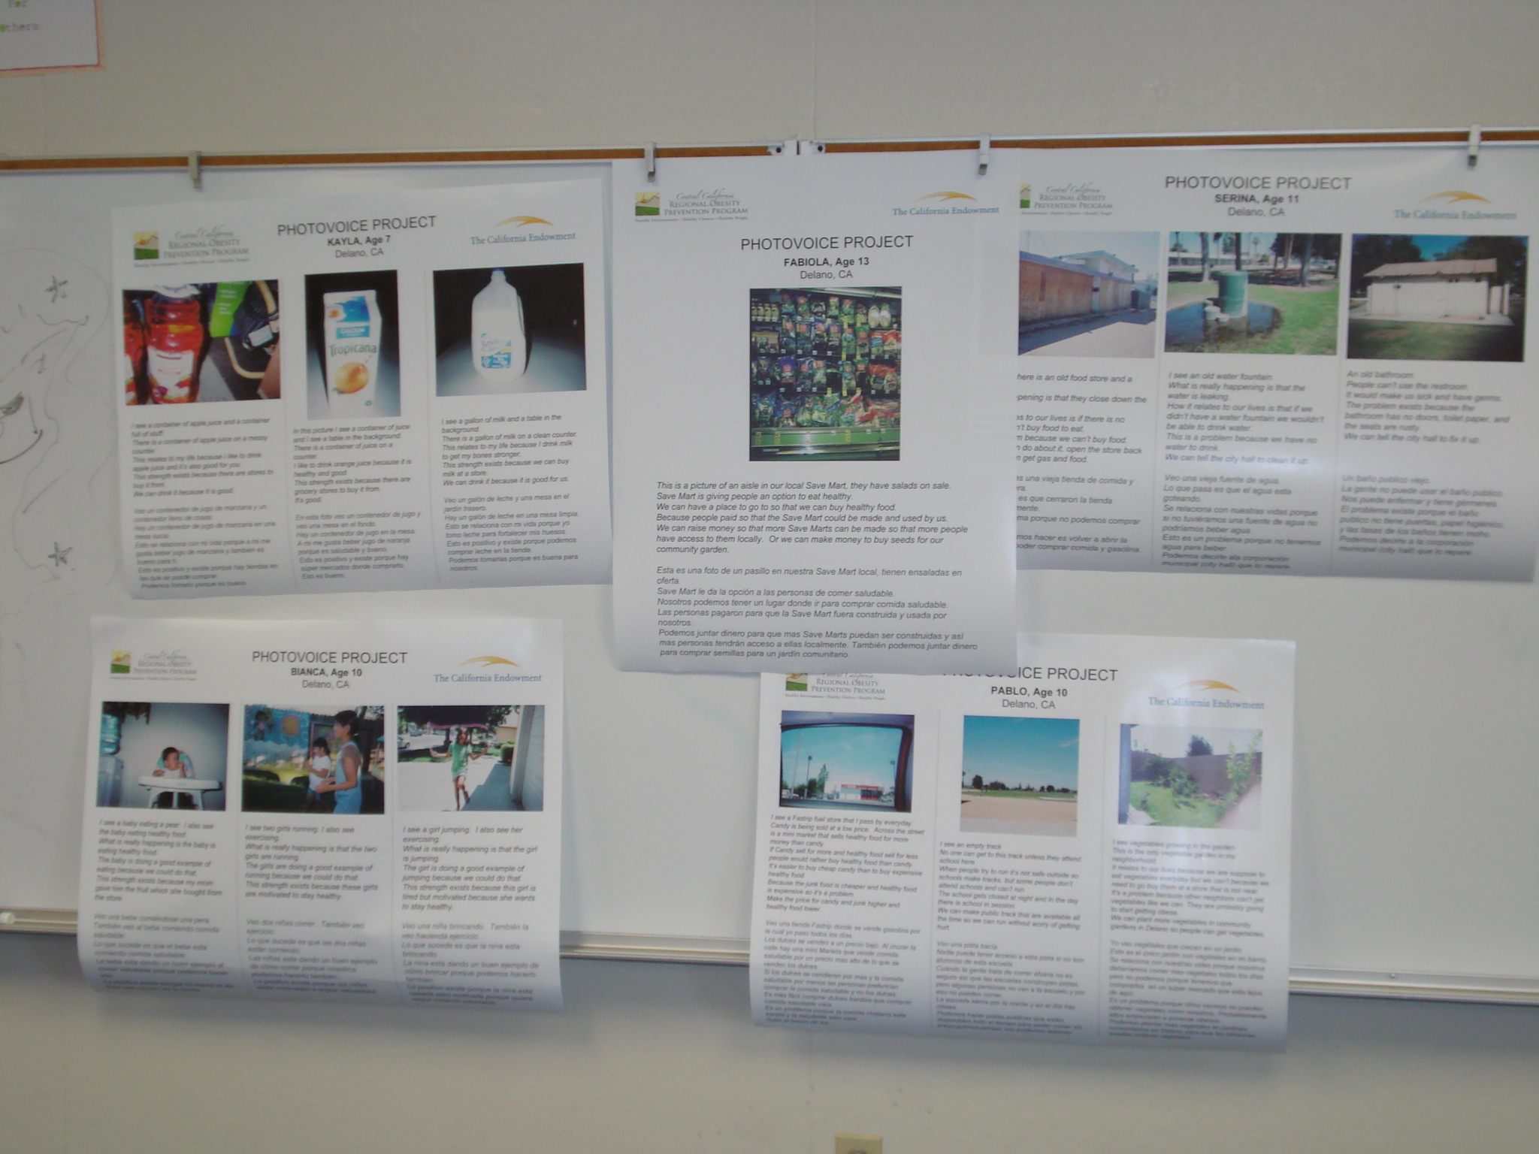
Photovoice Project
Notes:
Photovoice is an important tool in getting youth involved. In Delano, we had 140 youth participate. They were asked to photograph examples of what they saw was healthy in Delano and what was not. We also had them write a narrative about the story they were telling. These are a few examples of the 140 posters that were produced.

Slide 16
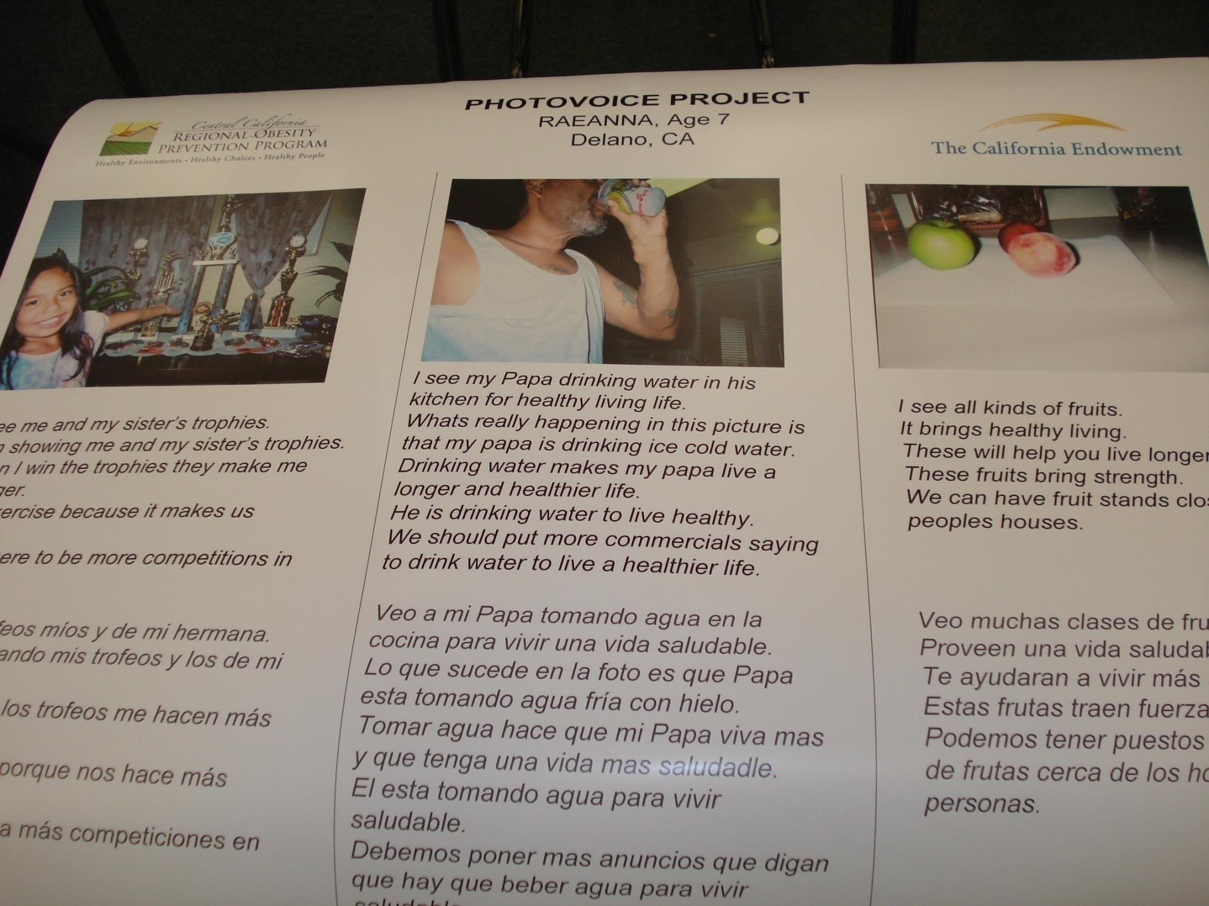
Notes:
Close up of a poster. We had students as young as 7 to age 16.

Slide 17
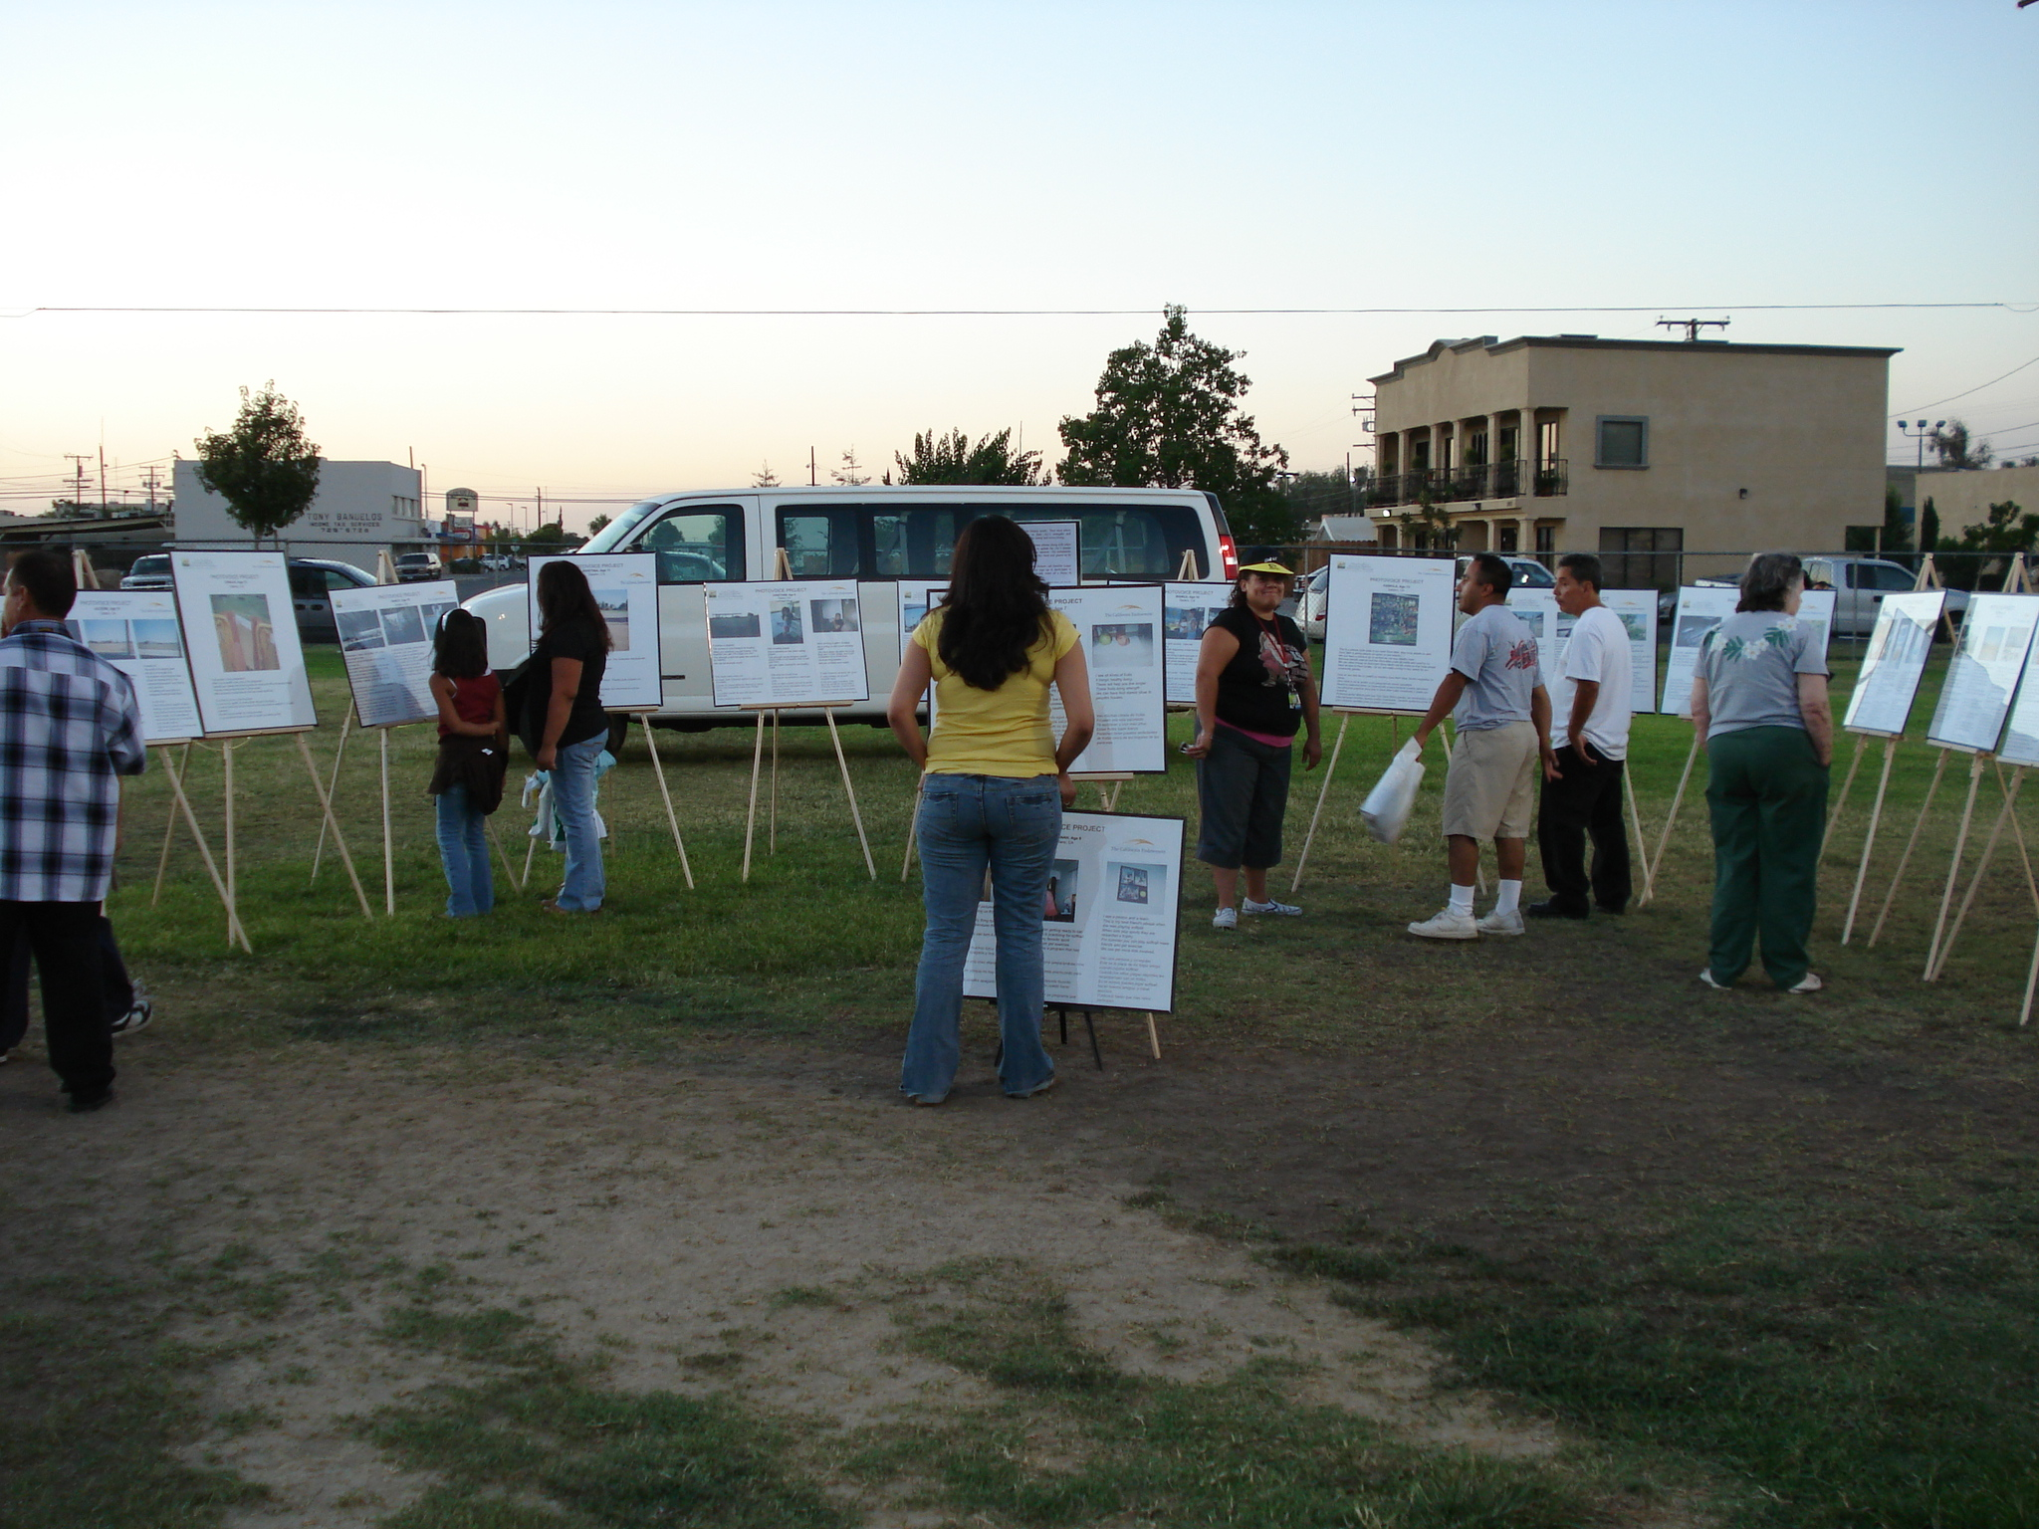
Notes:
This showing of the posters was at the City’s National Night Out event. The posters were also shown in the downtown businesses, City Hall, Banks, Community Street Faires, and another community gathering. Selected students presented their posters to the City Council. The Chamber of Commerce was a very enthusiastic supporter. Again, the touchstone was youth and giving them a voice. As a personal note, after the presentation to the City Council, the Mayor said, “Now, Mr. Woodcock, we expect that these issues will be addressed by your Department.”. I now give monthly reports on progress in implementing or addressing the issues raised. The students do feel empowered in that they have taken pride in showing others, ‘Hey, that’s my poster!’

Slide 18
City Walk
City walk – first city walk in Delano on April 14, 2007
Approximately 1500 people came out for the walk
Participants were of all ages but the walk was successful in engaging youth and obtaining their input about Delano
Walkability survey was conducted/attempted
Notes:
The next project was City Walk. This was coordinated with the High School and Elementary School Districts and various City Departments. It was planned for about 200 persons. However, 1,500 turned out (based on Delano Police Department estimates). The key point we learned was that it was the youth that can be credited for getting their families to participate. That was our touchstone. Going back to the demographics of Delano, one-quarter of the population are under 15 in age. Success in connecting with this age group was instrumental in our planning efforts for future community participation projects. Moral: find the touchstone in your community and use it.

Slide 19
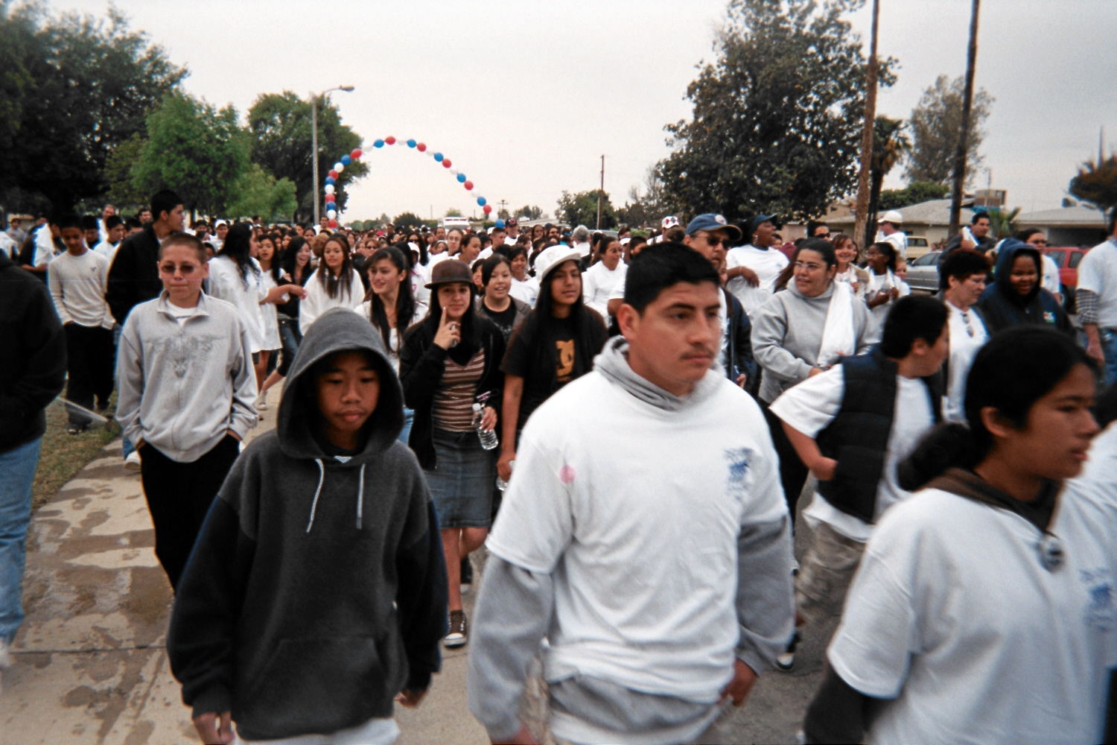
City Walk
Notes:
Picture of the multitudes!

Slide 20
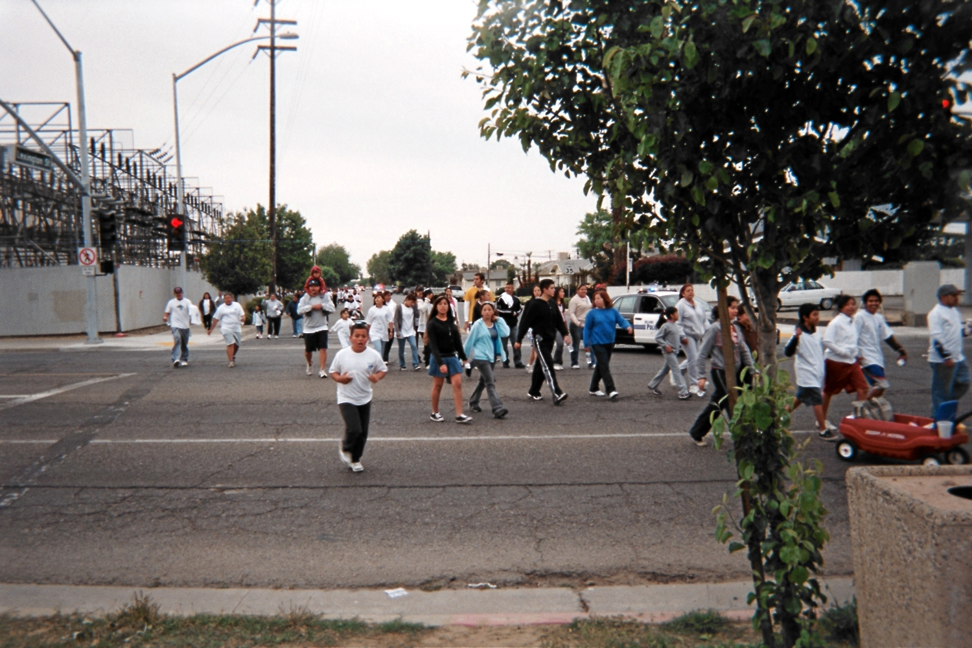
Notes:
City Walk is now an annual event that occurs in April

Slide 21
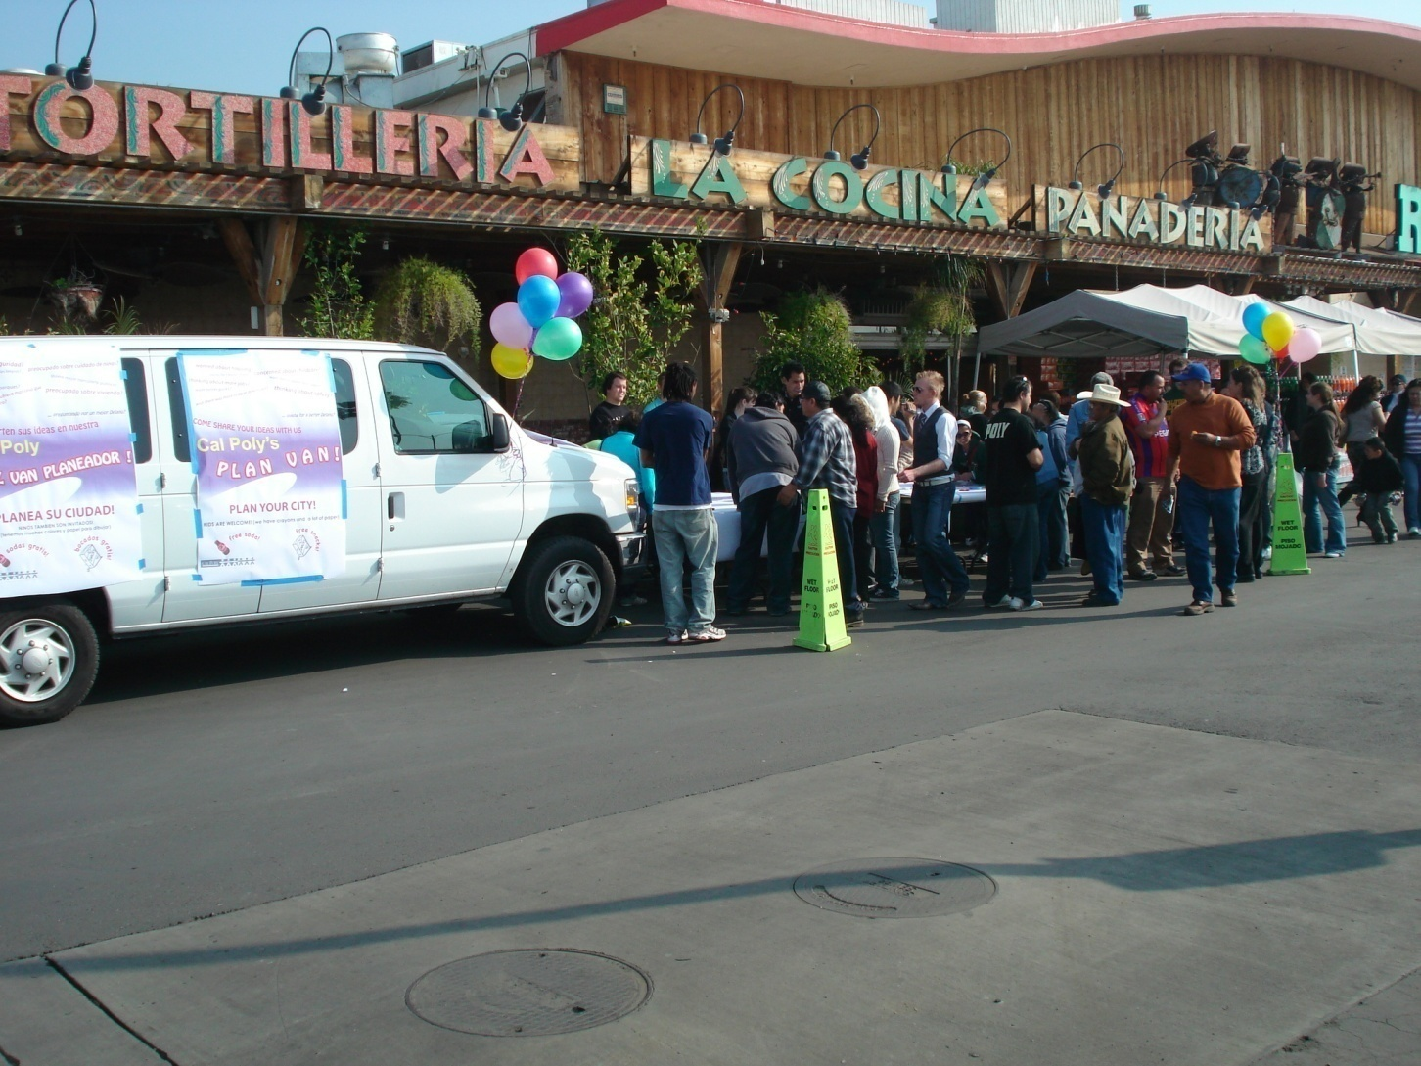
Cal Poly, SLO Plan Van
Notes:
Cal Poly, San Luis Obispo and the City worked on “What do you want in Delano?” We rented a van and had tables and maps set up for shoppers to come over and share their ideas. The Ranch Market in Delano was very supportive of this outreach.

Slide 22
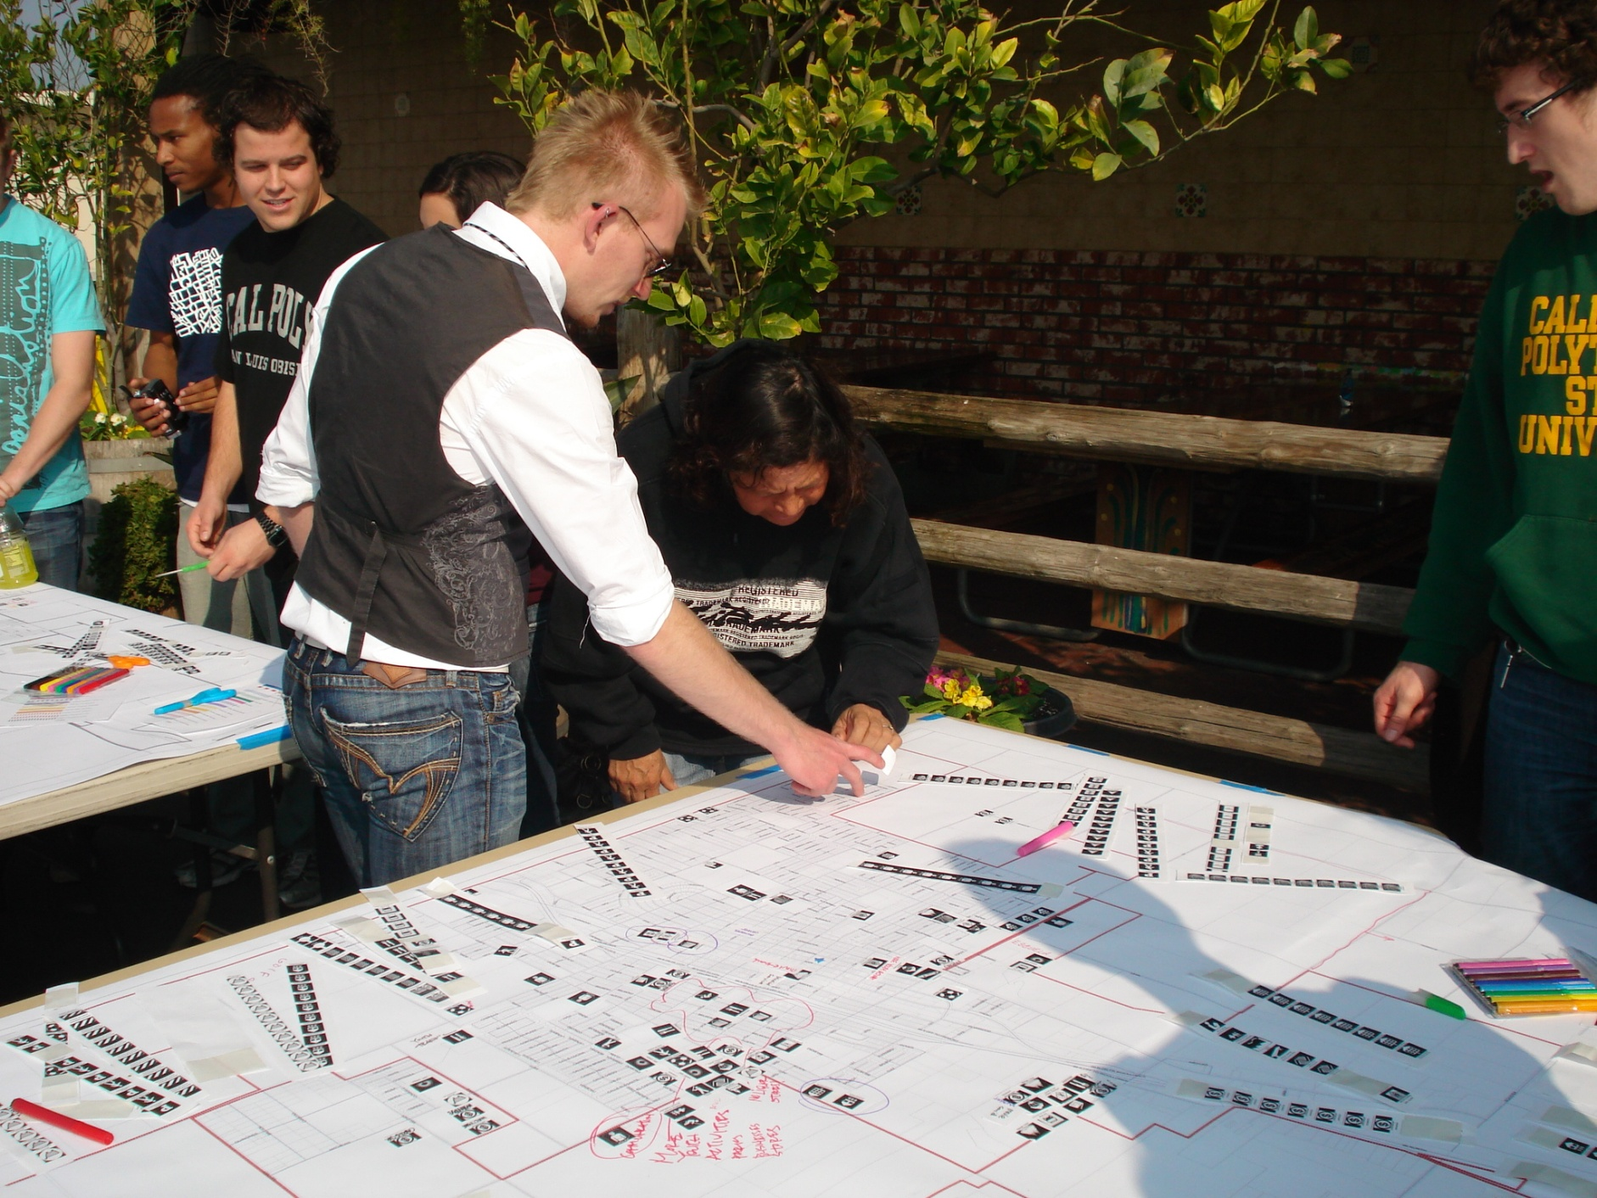
Notes:
Example of one of the tables

Slide 23
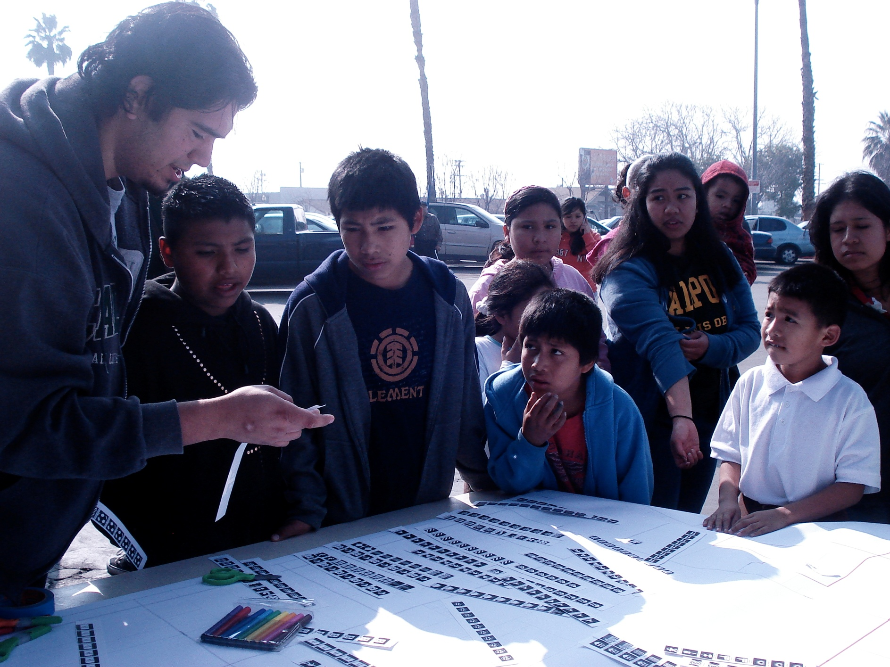
Notes:
We worked with the youth of Delano as well at the Plan Van event. It was a very good match-up as the youth that came by also had a lot of questions about college. They liked being included.

Slide 24
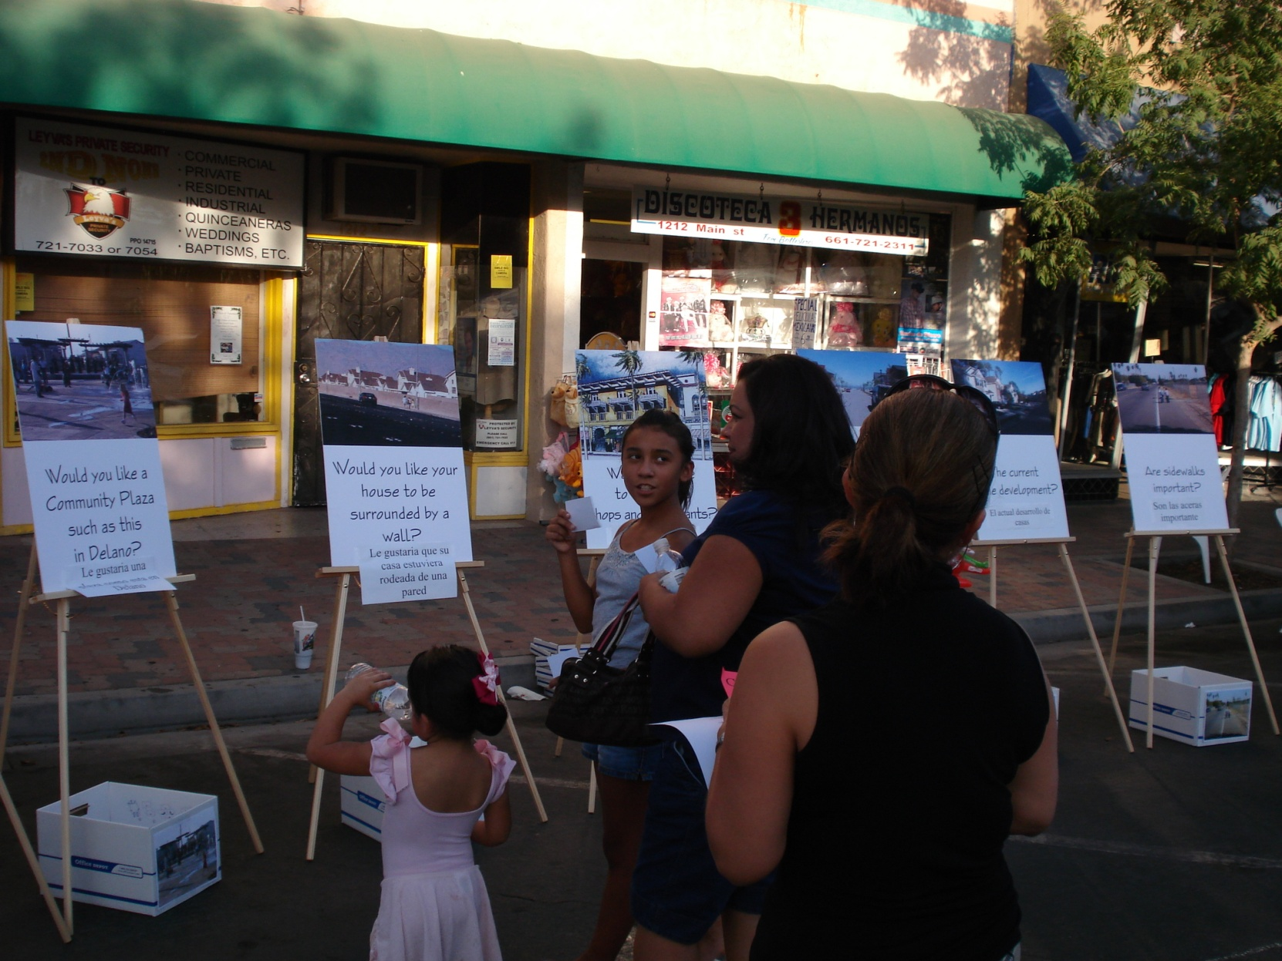
Street Faire
Notes:
At one of Street Faires we had 12 posters showing different planning and development concepts, such as Would you like to see this in Delano? Each participant was given five index cards. If they liked that idea, they voted by placing the card in the box that was below the poster. We had 430 persons participate.

Slide 25
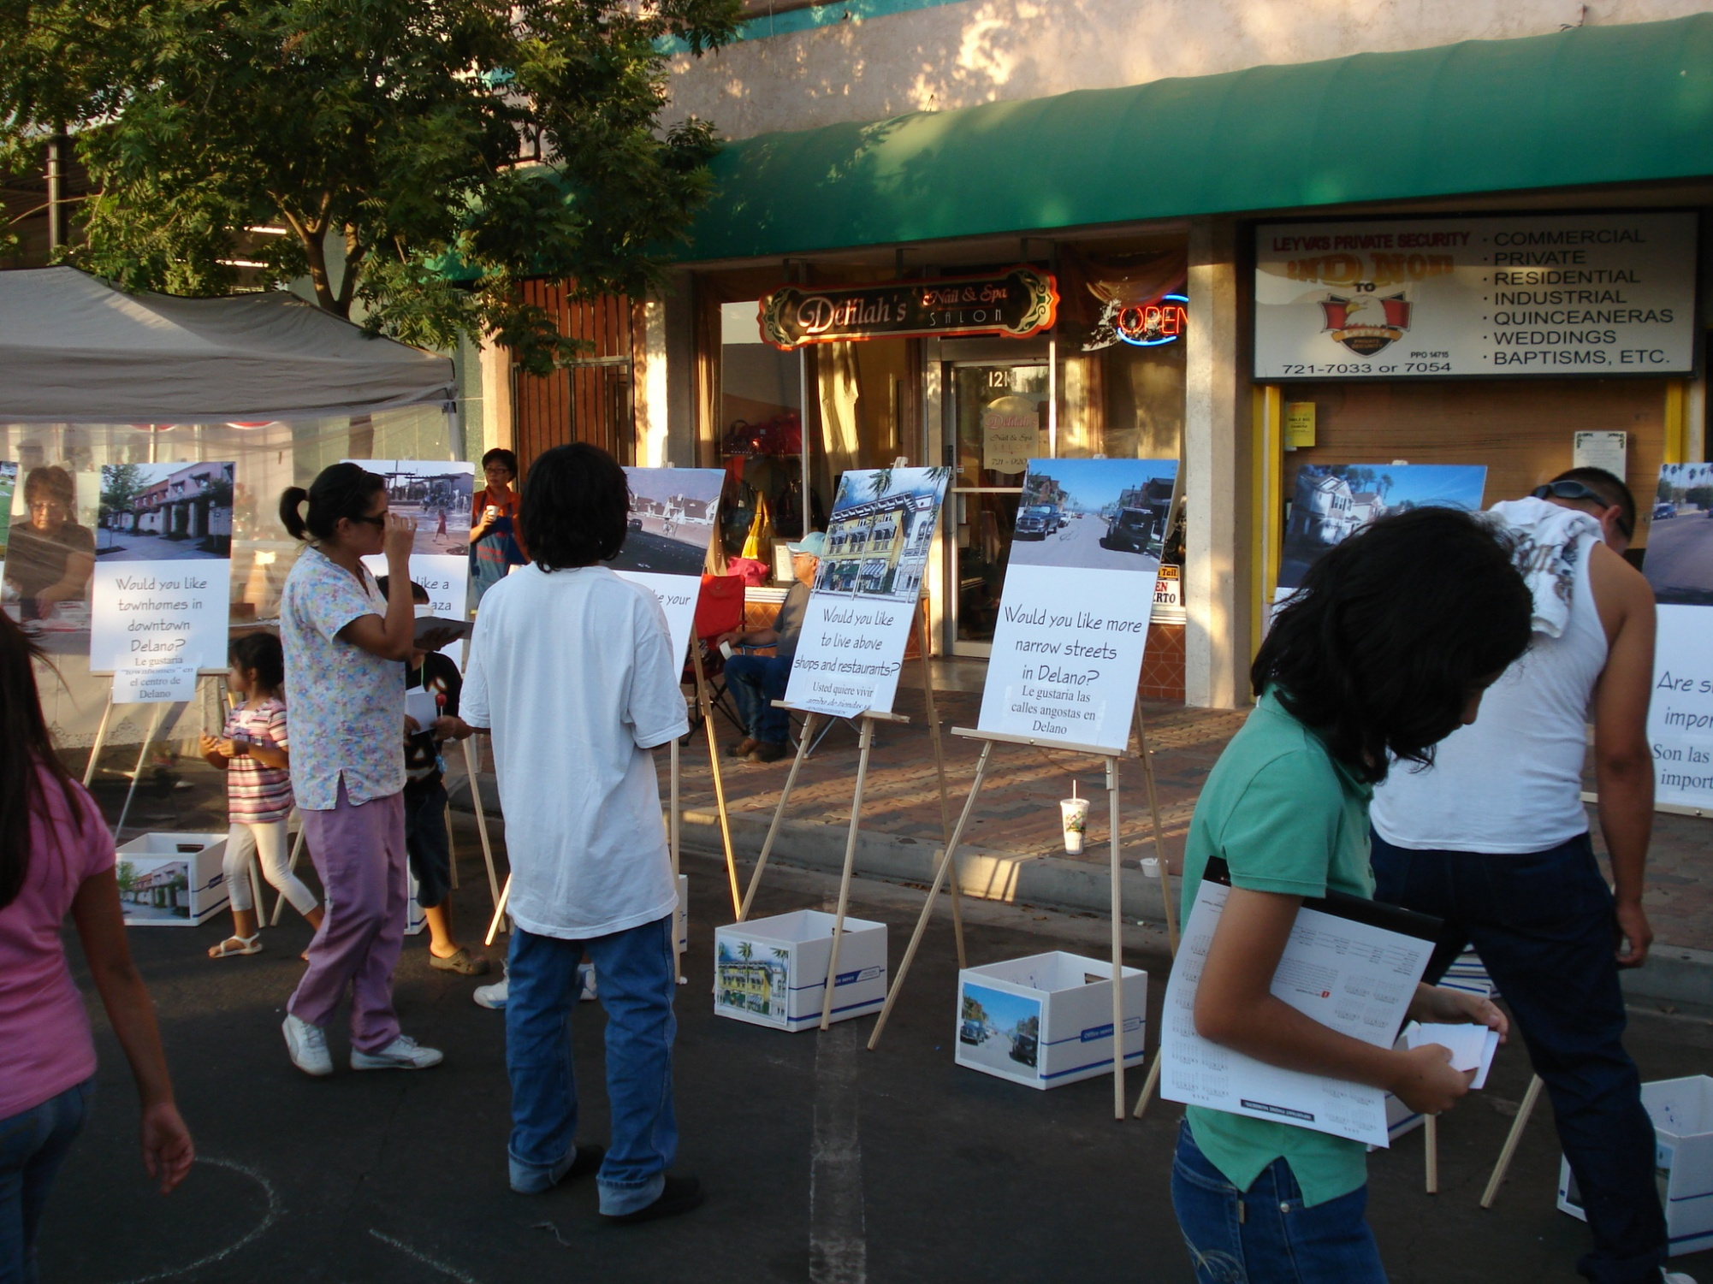
Notes:
People ‘voting’. The big winners: Improve walkability, Improve access to parks, Famer’s Market. The lowest vote: Narrower streets! They liked the wide streets.

Slide 26
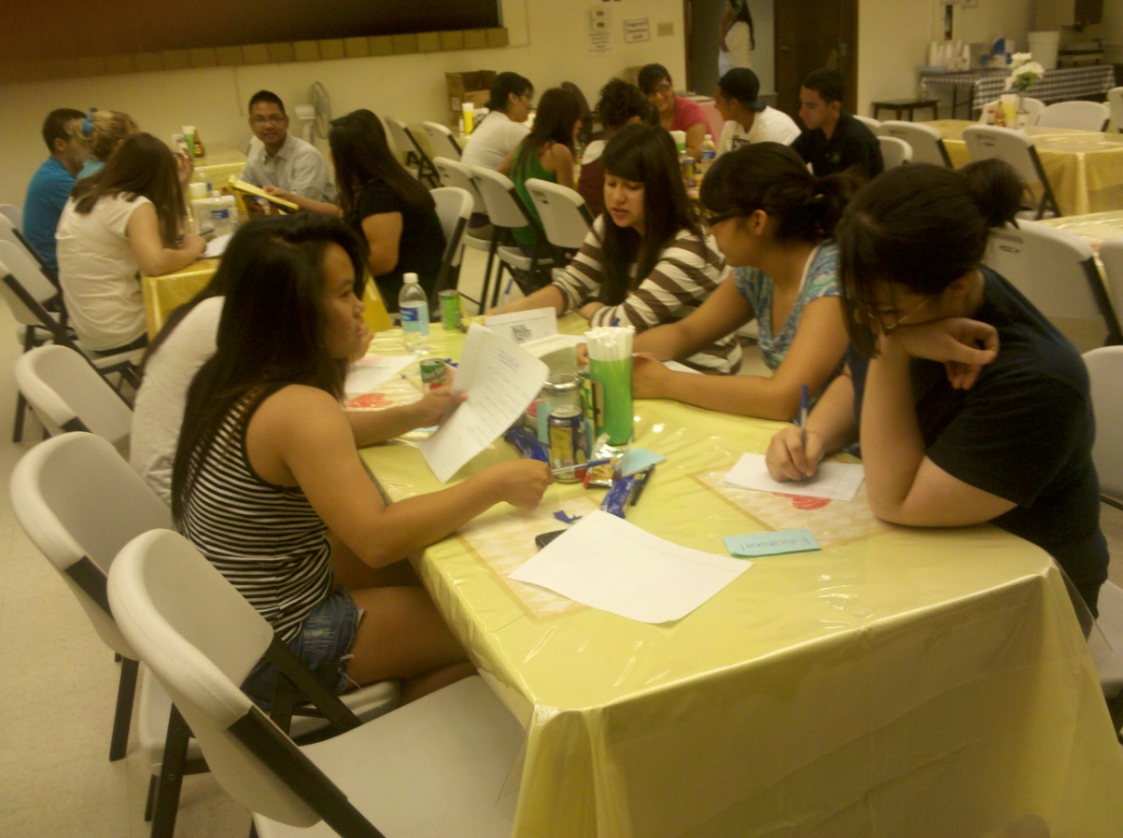
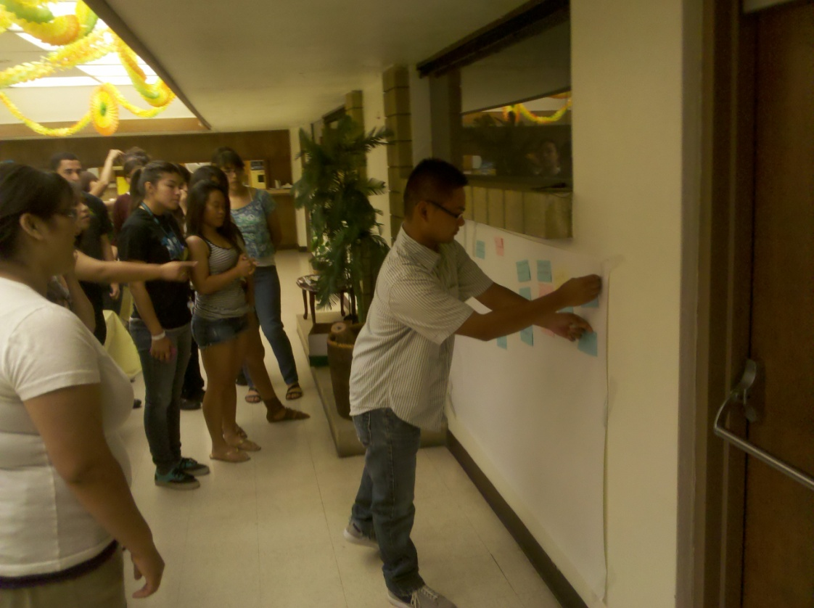
Young Delano
What is
“A Healthy Delano”?
25 Youth Participated
Above, each team developed
five “things” about a Healthy Delano
Right, Teams then one by one post
their notes. After all are posted,
Group reviews and rearrange.
Notes:
We worked with Young Delano, a branch of the Delano Chamber of Commerce. They were asked to complete the sentence, “A healthy Delano is …” Each team came up with five answers. Each team then posted one of their responses. After each team had posted, the whole group looked at the responses and ordered them as to common themes. This was repeated a total of five times.

Slide 27
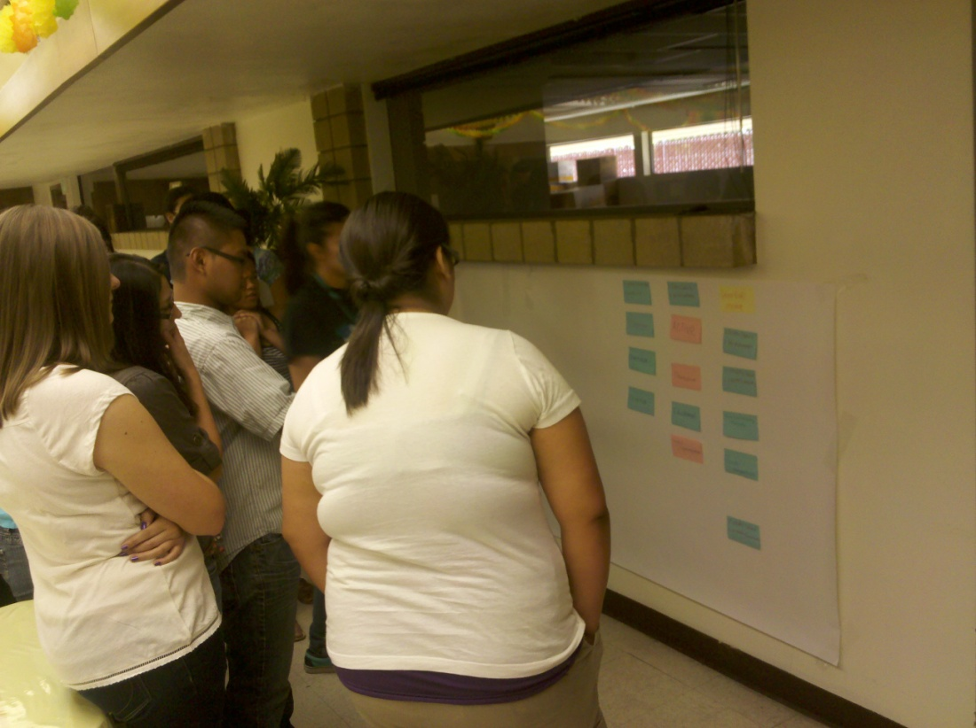
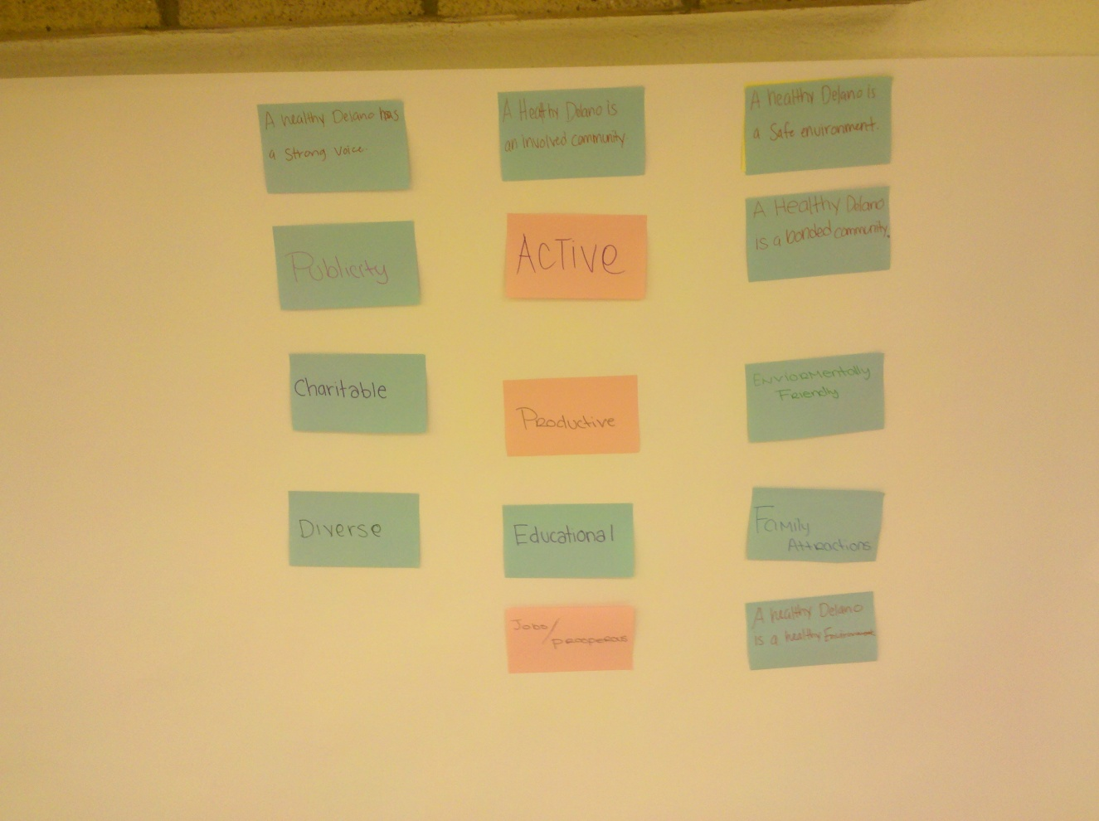
Notes:
Example of the posting and rearranging. The group felt the responses could be grouped into three main categories: A Healthy Delano is Active, is inclusive, is educated on health issues and choices.

Slide 28
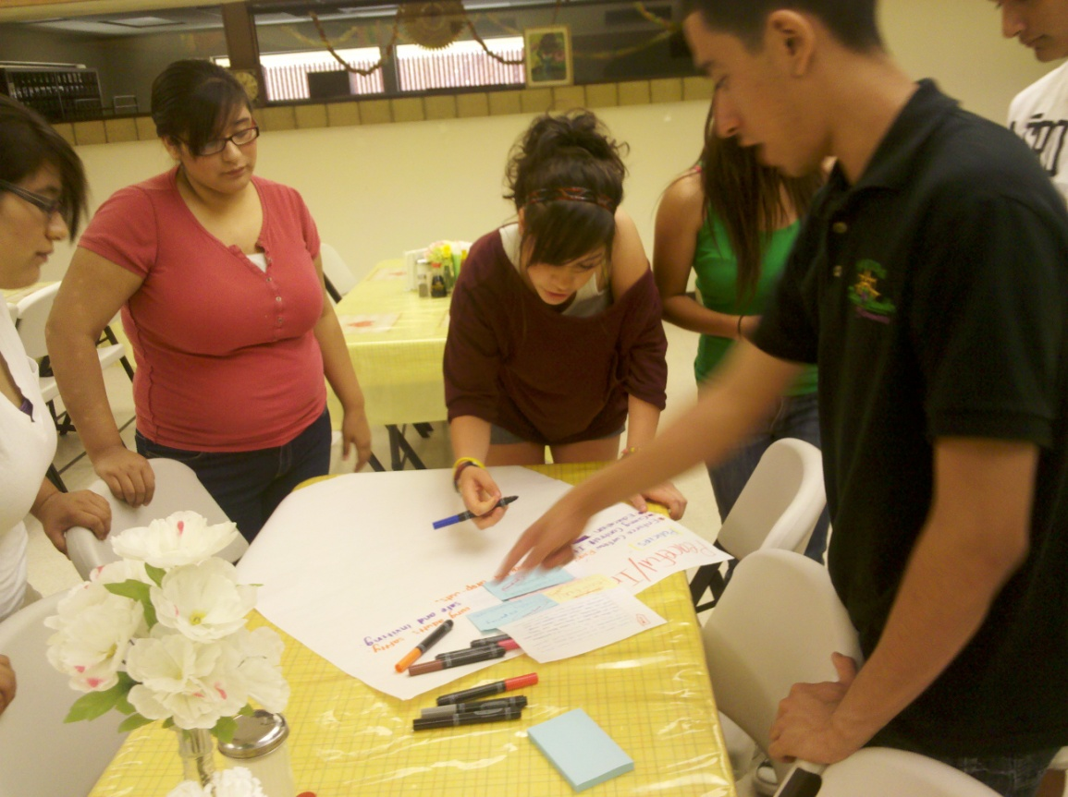
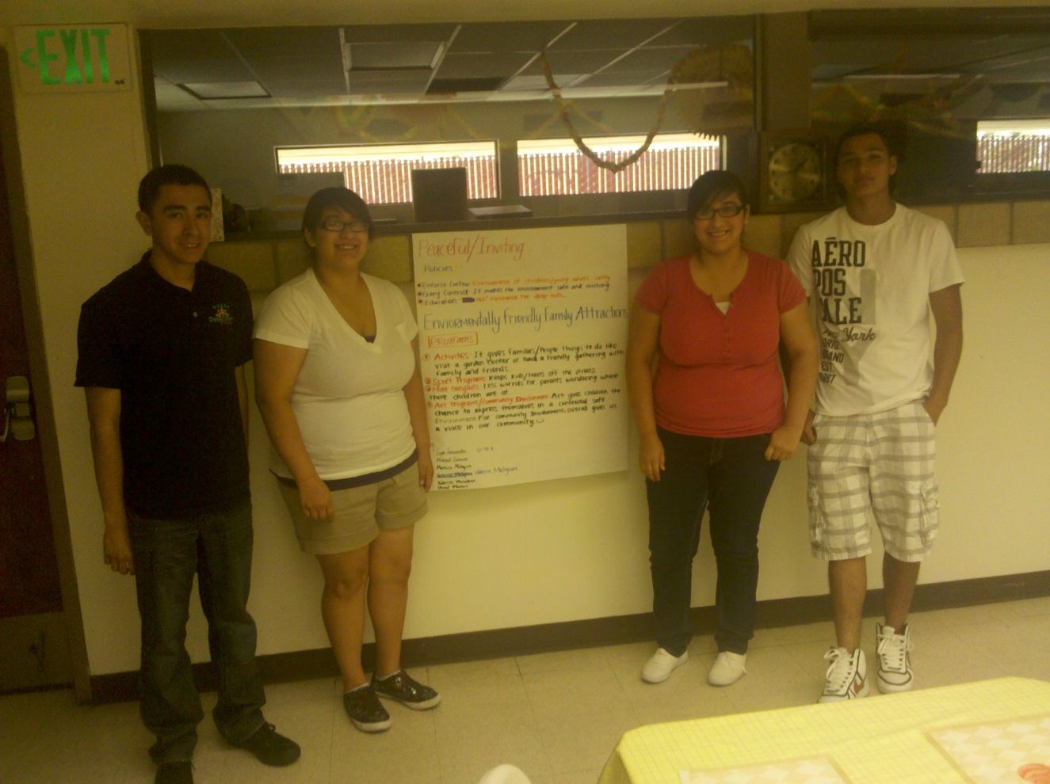
Writing Objectives and Policies
Presentation to Group
Notes:
The final steps in this day long activity was to take the statements of A Healthy Delano is …, and then develop a “road map” on how to get there. We focused on what are objectives, what are policies, and what are programs. Each team worked on their objectives and policies and programs. At the end of the day, each team presented their work to the other members of the group. Then we broke for pizza.

Slide 29
Outcomes
* Amended Land Use Element
Park Dedication Standards
Subdivision Design Standards
* Amended Circulation Element
Bike Routes established
Roundabouts preferred traffic control measure
Improvements to 11th Street Corridor
* KABOOM Playground
* City Walk annual event
* Kaiser Permanente Fitness Zone
Notes:
The process I have been describing took place over a 3 ½ year period. The results are shown on this slide. The KABOOM people took notice about two years into the process and contacted us about building a playground. We immediately said ‘Yes” , and began to organize the community. This was very exciting as we had over 200 volunteers come out and in one day construct a wonderful playground. The introductory slide for this PowerPoint shows most of the volunteers. The Kaiser Permanente Fitness Zone was also a nice bonus to our outreach. This was the first time that Kaiser had constructed a Fitness Zone north of Los Angeles. The Chamber took the lead and inticed Kaiser to consider Delano. The City supported the Chamber’s efforts. Kaiser liked the community involvement and funded the Fitness Zone.

Slide 30
Thoughts on Engaging the Community
Meet people where they are at naturally
Learn what is the Community’s “Touchstone”
Get more “Bang for the Buck” by using tools that help bring policy and environmental change in your community
Tools like Photovoice can be a lasting reminder that prompt policy change
It takes time
Notes:
Some concluding thoughts

Slide 31
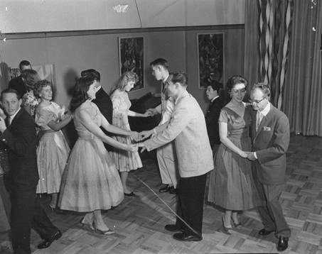
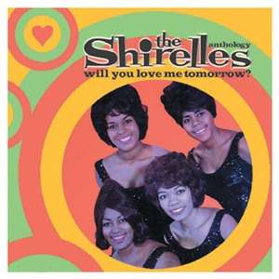
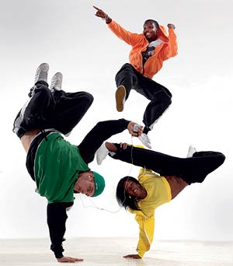
Thoughts on Working with Community Based Groups and Non-Profits
Who to Invite to the Dance?
What’s the Music?
Sustaining the Relationship
Notes:
We learned a lot about working with CBO’s and other Non-profits.

Slide 32
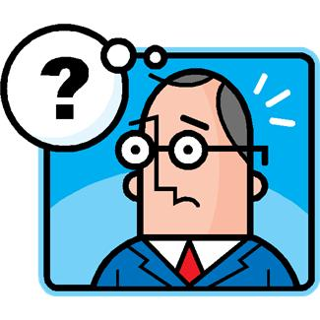
What Do You Do Now?
Notes:
Well, now where do we go with this ‘stuff’? Engaging the elected officials and staff is important. Finding supporters and local “Champions” is critical for the work to be sustaining. We found, again, people who worked with youth were often those that took up the reins.

Slide 33
It Look for Opportunities!
Mixed Use
Energy
Blue Print
HEALTHY COMMUNITY
Air Quality
Transit Oriented Development
Resource Conservation
Green House Gases
Notes:
Putting the Health Lens on, it can be seen that health is part of all the present discussions regarding the community. So, don’t be discouraged!

Slide 34

It Takes a Collaborative Effort
Notes:
Partnerships are vital to getting the work done.

Slide 35
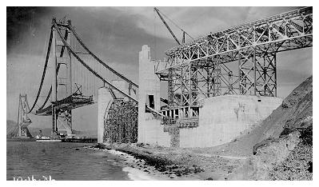
Us here, Right now
Each of us can be “Change Agents”
Golden Gate Bridge 1935
Notes:
A key objective to this presentation is: Light Your Passion. We can build great bridges when we work together to address health issues and the built environment.

Slide 36
THANK YOU!
Notes:
Yes, Thank You!

Slide 37
My Contact Information:
Keith Woodcock, AICP
Community and Regional Planning Center
California State University, Fresno
kewoodcock@csufresno.edu
Notes:
My contact information. Hope you have enjoyed this presentation. Keith

