Slide 1
Sustainable Economics for a Digital Planet: Ensuring Long-term Access to Digital Information
OCLC
Research Webinar
May 20, 2010
Brian Lavoie
Research Scientist
OCLC
lavoie@oclc.org

Slide 2
Roadmap
Background: Blue Ribbon Task Force on Sustainable Digital Preservation and Access
Task Force Final Report highlights
Perspective from the community

Slide 3
Background

Slide 4
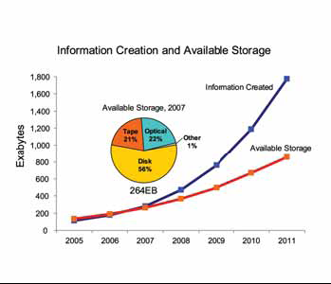
Digital preservation: multi-faceted problem
2007: Amount of digital
information created, captured,
or replicated exceeded
available storage capacity
“Dealing with the digital
universe is not a technical
problem alone”
Perpetuating digital signals
Deciding what is preserved
Accommodating IPR
Matching means to ends
Source: “The Diverse and Exploding Digital
Universe” IDC Whitepaper, March 2008

Slide 5
Blue Ribbon Task Force on Sustainable Digital Preservation and Access
Task Force:
Supported by NSF, Mellon, Library of Congress, JISC, CLIR, NARA
Co-chairs: Brian Lavoie (OCLC), Fran Berman (RPI)
Cross-domain, cross-discipline
http://brtf.sdsc.edu/
Frame digital preservation as sustainable economic activity
Economic activity: deliberate allocation of resources
Sustainable: ongoing resource allocation over long periods of time
Define problem space/provide recommendations & guidelines

Slide 6
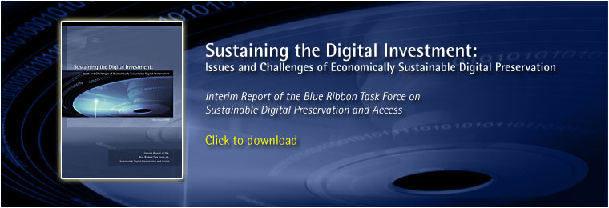
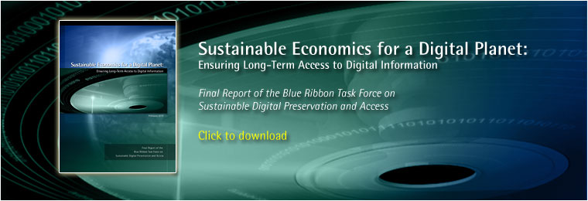

Task Force deliverables
Interim Report (December 2008)
Scope problem space
Understand current practices
Identify systemic challenges
Final Report (February 2010)
Analysis of 4 key contexts
Findings & recommendations
Next steps
Washington , DC
April 1, 2010
London
May 6, 2010
Symposia (April & May 2010)
Community discussion
Catalyze further work

Slide 7
FINAL REPORT

Slide 8
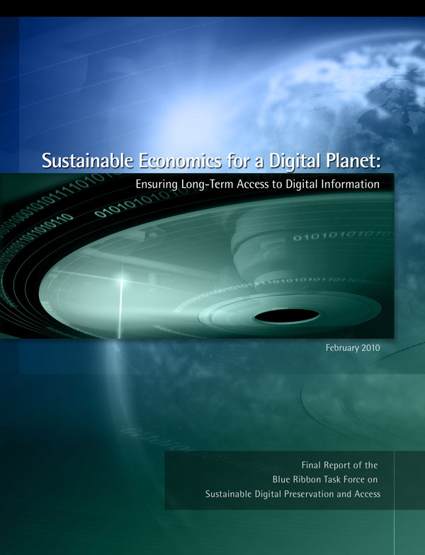
Task Force Final Report (February 2010)
Sustainable Economics for a Digital Planet
http://brtf.sdsc.edu/biblio/BRTF_Final_Report.pdf

Slide 9
Key message
“… sustainable economics for digital preservation is not just about finding more funds. It is about building an economic activity firmly rooted in a compelling value proposition, clear incentives to act, and well-defined preservation roles and responsibilities.”

Slide 10
Key themes
Demand
Value
Expected benefits
Judgment about priorities
Incentives
Motivation to act
Vary across stakeholders & time
Roles & Responsibilities
Who benefits? Preserves? Pays?
Supply
Supply &
Demand

Slide 11
Digital preservation contexts
Scholarly Discourse
Research Data
Commercially-Owned Cultural
Content
Collectively-Produced Web Content

Slide 12
Sustainability principles & actions
Dynamics: Preservation is a series of decisions
Take action early in digital lifecycle
Anticipate and make contingency plans for economic risks
Create mechanisms to transfer preservation responsibilities
Benefits: Manage “demand-side” of preservation
Express value of preservation from use cases
Use proxy organizations to aggregate diffused demand
Use option strategies where future value is highly uncertain

Slide 13
Sustainability principles & actions (continued)
Selection: Scarce resources = prioritization
Prioritize on basis of projected future use
Revisit decisions: “de-selection” often as important as selection
Incentives: Strengthen, align, create
Impose and enforce preservation mandates where appropriate
Create private incentives to preserve in the public interest
Promote 3rd-party archiving via non-exclusive preservation license

Slide 14
Sustainability principles & actions (continued)
Organization: Coordinate preservation interests
Governance: responsibilities, outcomes, strategies, accountability
Formalize/document governance in policy statements, service level agreements, MOUs
Resources: Gather sufficient resources & use efficiently
Use funding mechanisms that reflect community norms
Ensure resource flows are flexible in face of disruptions
Leverage economies of scale & scope to reduce costs

Slide 15
Community Perspective

Slide 16

Sustainability symposia
A National Conversation on the Economic Sustainability of Digital Information
Washington, DC
April 1, 2010
Sustainable Economics for a Digital Planet
London, UK
May 6, 2010
Purpose:
React to and discuss Task Force Final report
Hear from domain experts/practitioners
Move conversation to broader community

Slide 17
Washington program
Introduction: Fran Berman (RPI), Brian Lavoie (OCLC)
Keynote Address: Thomas Kalil, Deputy Director for Policy, Office of Science and Technology Policy
Research Data: Dan Atkins (U. of Michigan), Wayne Clough (Smithsonian), Chris Rusbridge (DCC)
Scholarly Discourse: Derek Law (JISC Advance), Brian Schottlaender (UCSD), Lee Dirks (Microsoft)
Collectively-Produced Timo Hannay (Nature), George Oates (Internet Archive), Anne Van
Web Content: Camp (Smithsonian)
Commercially-Owned Chris Lacinak (Audiovisual Preservation Solutions), Jon Landau
Cultural Content: (Lightstorm Entertainment), Abby Smith Rumsey (Consultant)
Economics of Digital William Bowen (Mellon Foundation), Hal Varian (Google) ,
Information: Dan Rubinfeld (UC Berkeley), Paul Courant (U. of Michigan)
Summary Remarks: Clifford Lynch, Executive Director, CNI

Slide 18
London program
Session 1 (Overview): Paul Ayris (UCL)
Chris Rusbridge (DCC)
Brian Lavoie (OCLC)
DISCUSSION
Session 2 (Contexts): Graham Higley (Natural History Museum)
John Zubrzycki (BBC)
Matthew Woollard (UK Data Archive)
Adam Farquhar (British Library)
DISCUSSION
Session 3 (Agencies): Pat Manson (European Commission)
Sarah Porter (JISC)
DISCUSSION
Closing Remarks: Chris Rusbridge (DCC)

Slide 19
Value
Expected benefits; return on preservation investments
Research Data:
Make preservation of research data “first class” research enterprise
Collectively-produced Web content:
Preservation not a priority for contributors
Integrate preservation into creation to make output more “archivable”
Commercially-owned cultural content:
Often no “culture of preservation”: priority is creation
Education : mutual understanding between creators & preservationists
BBC Creative Archive: establish value beyond “passive use”
“Find it, rip it, mix it, share it”

Slide 20
Incentives
Motivation to act (incentives); obstacles to action (disincentives)
Diffuse “right to preserve” to encourage third-party archiving:
IPR often biggest friction in establishing working relationships with content creators & other stakeholders
Use creative commons licenses
Better documentation of transfers of copyright
Fear can be an important incentive
Utility of “good disaster” to concentrate attention
More use of mandates, particularly at individual scholar level
Economics: Need to turn “free riders” into “paid users”: bundle access with preservation, versioning strategies, shame/envy

Slide 21
Roles & responsibilities
Organization & management: Who benefits? Preserves? Pays?
Role of research library in preserving digital information
Research libraries could /should have key role
Recalibrate resource allocations: access v. preservation; print v. digital
New kinds of on-staff expertise
Public/private partnerships
Transfer of preservation responsibilities
Division of labor: bit preservation (scale, commercial data centers); domain-focused curation services
Many potential solutions point toward collective action
Creating/managing partnerships needs to become core competency

Slide 22
Miscellaneous
How to engage attention of high-level policy-makers: Be realistic; resources are limited; no “preservation czar”; impetus for action is in the community; make targeted requests for specific actions
Critiques of report:
Some recommendations too timid
Discussion/consensus recommended when action required; in “Web world” someone just steps forward and takes action
Make room for people with a passion for preservation; not just about economics and formal institutions

Slide 23
More information …
Task Force & reports:
http://brtf.sdsc.edu/
Washington symposium:
Information: http://brtf.sdsc.edu/symposium.html
Recording: http://brtf.vidizmo.com/
London symposium:
http://www.jisc.ac.uk/events/2010/05/brtf.aspx
Presentations available; conference tag #brtf
Questions: lavoie@oclc.org

