Slide 1
High Level intro to Semantic Web
Last update: 2012-02-29

Slide 2
Let’s organize a trip from Amsterdam to Aix-en-Provence using the Web!

Slide 3
You try to find a proper flight with …

Slide 4
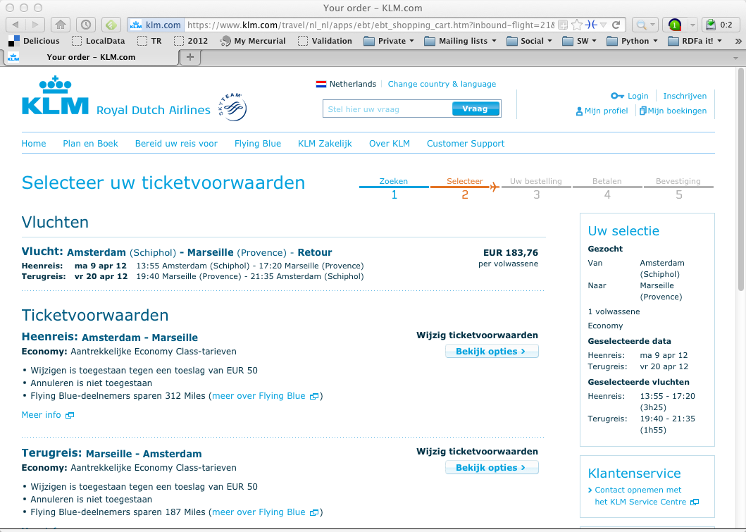
The Dutch airline

Slide 5
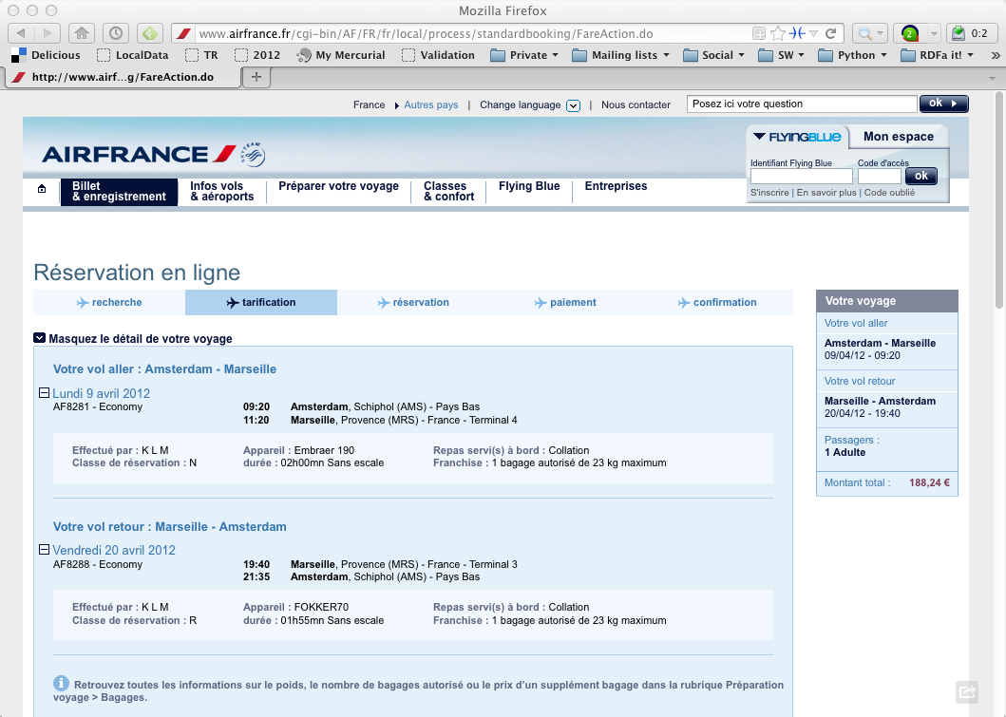
The French sister

Slide 6
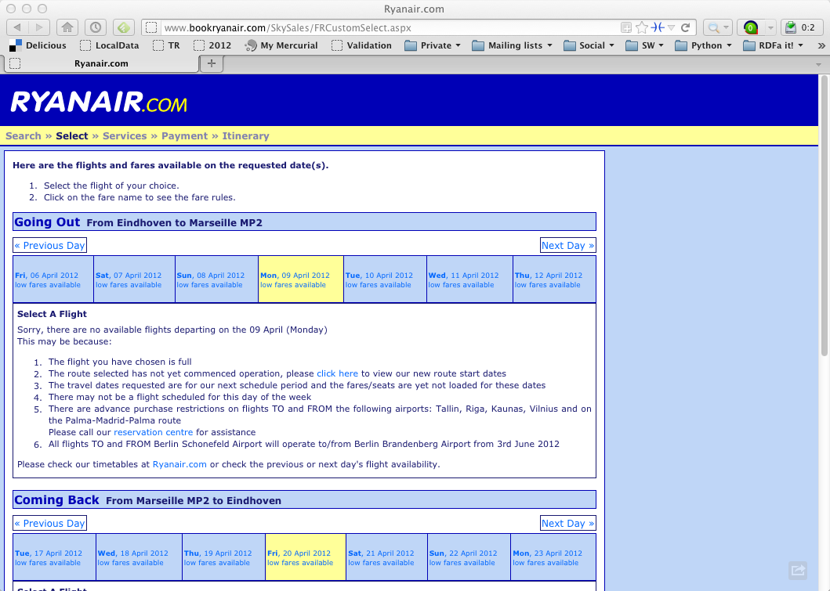
A low-cost alternative

Slide 7
You have to find a hotel, so you can look for…

Slide 8
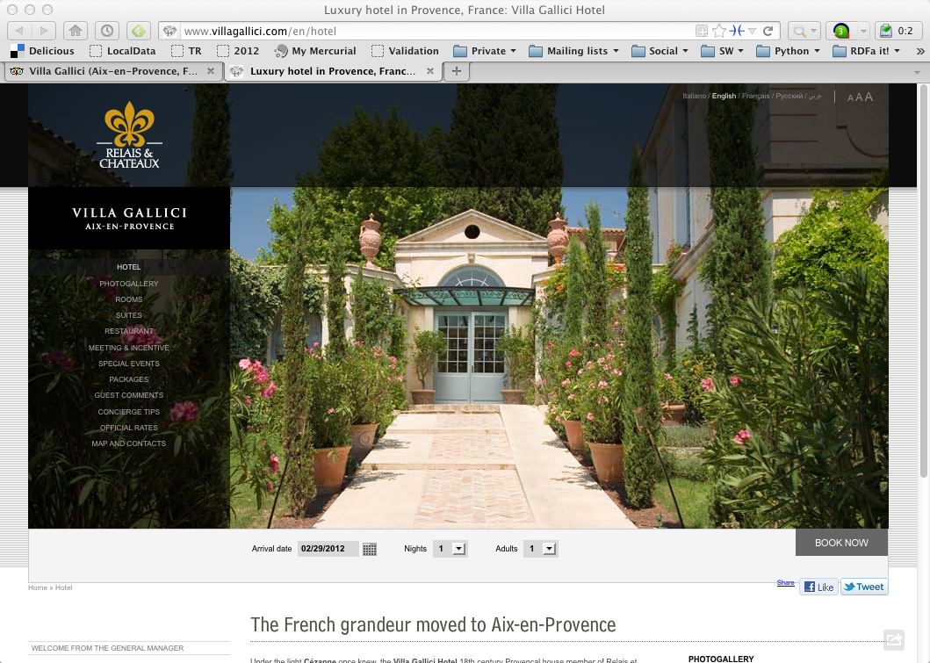
A luxury hotel

Slide 9
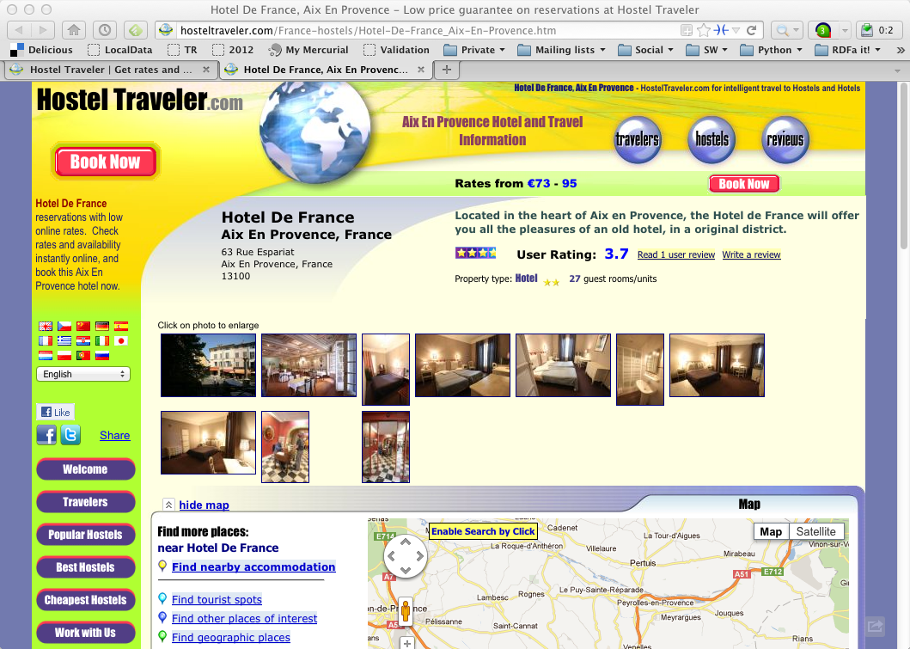
A cheap alternative

Slide 10
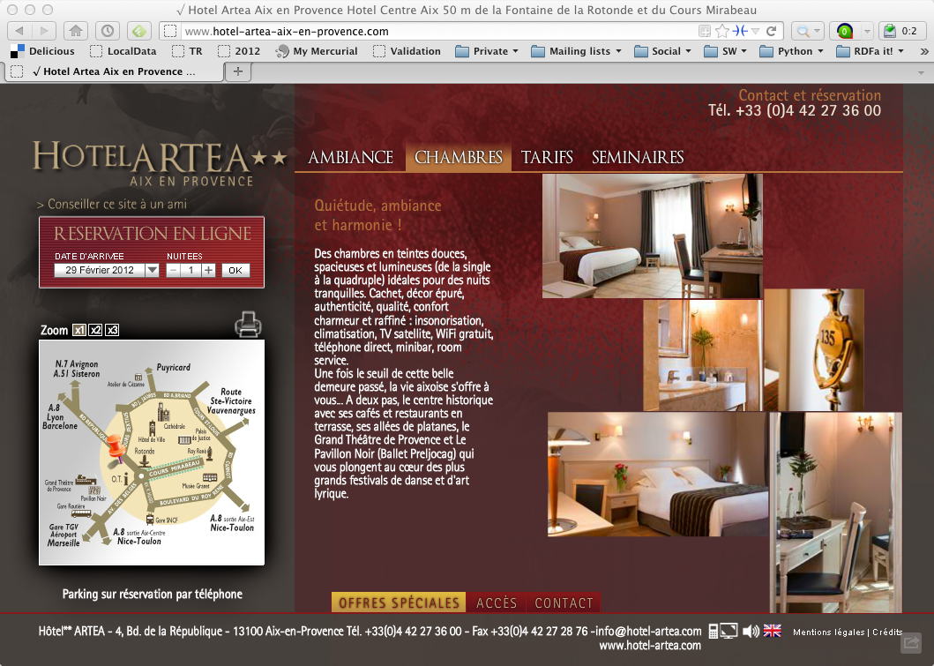
Or a nice, intermediate solution

Slide 11
Of course, you could decide to trust a specialized site…

Slide 12
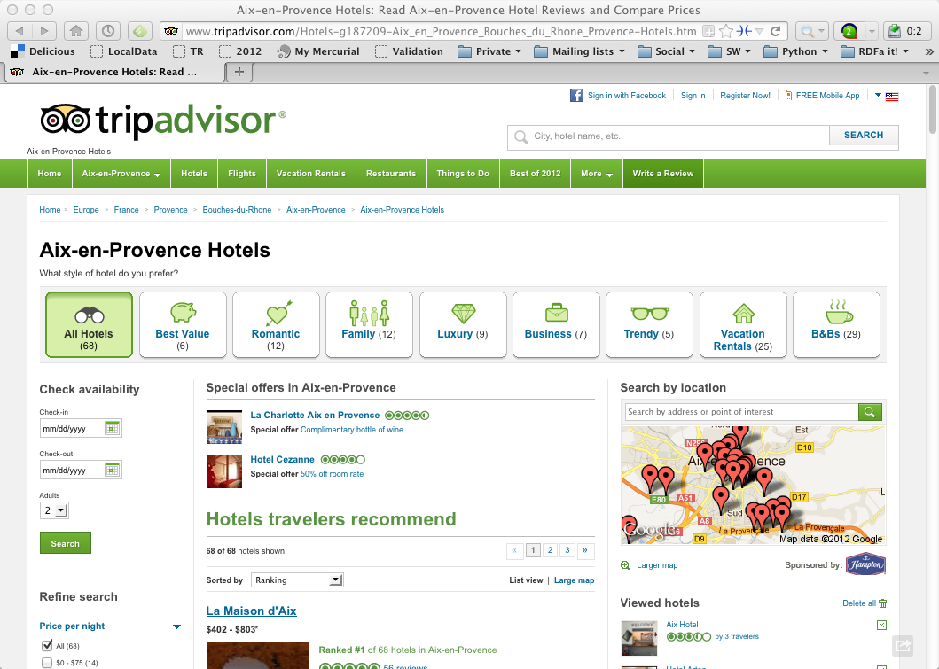

Slide 13
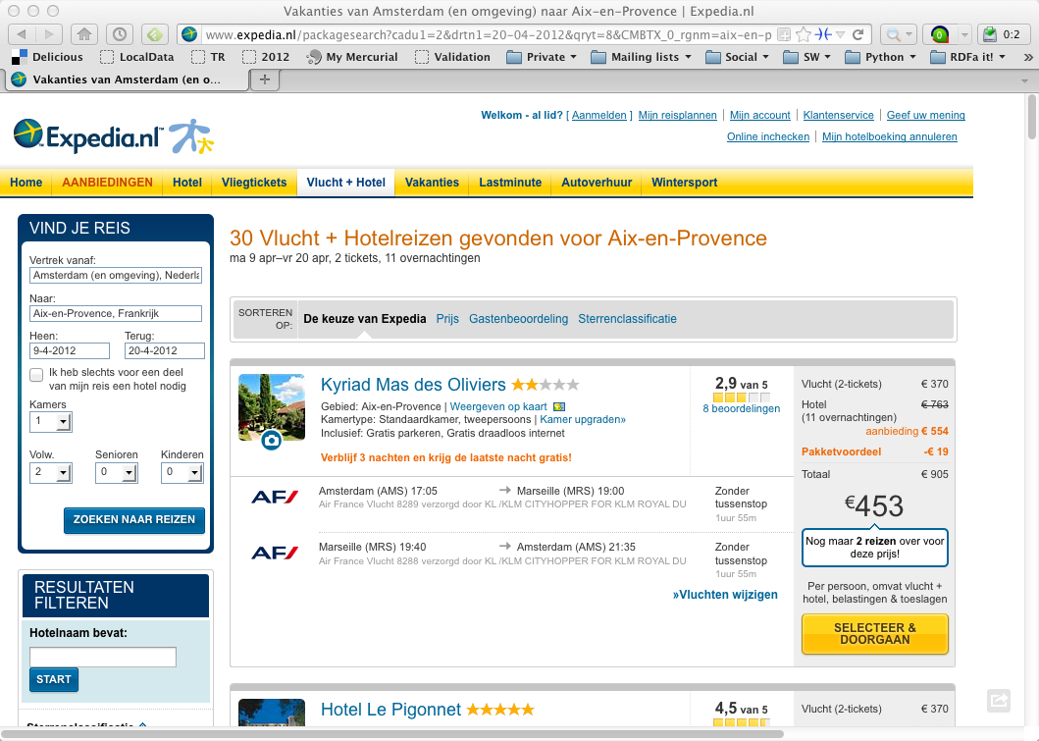

Slide 14
You may want to know something about Aix-en-Provence: look for some photographs…

Slide 15
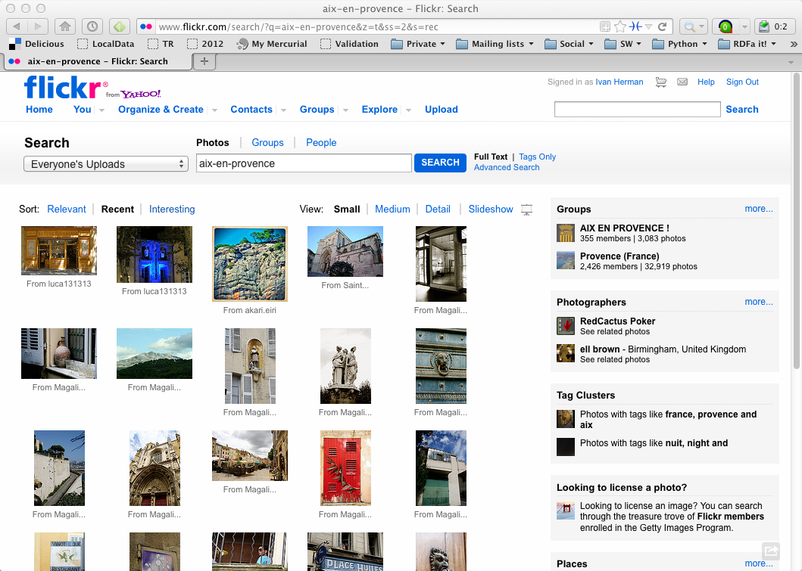

Slide 16
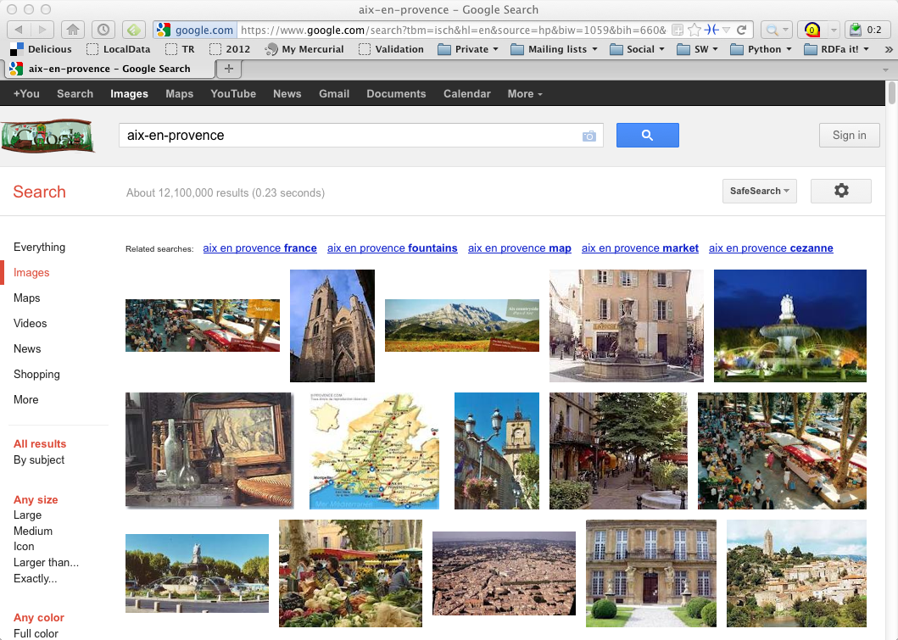

Slide 17
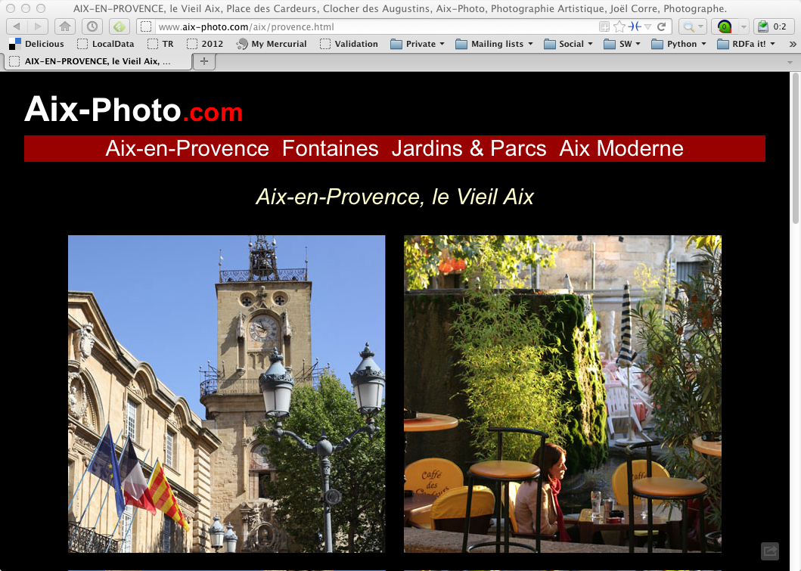

Slide 18
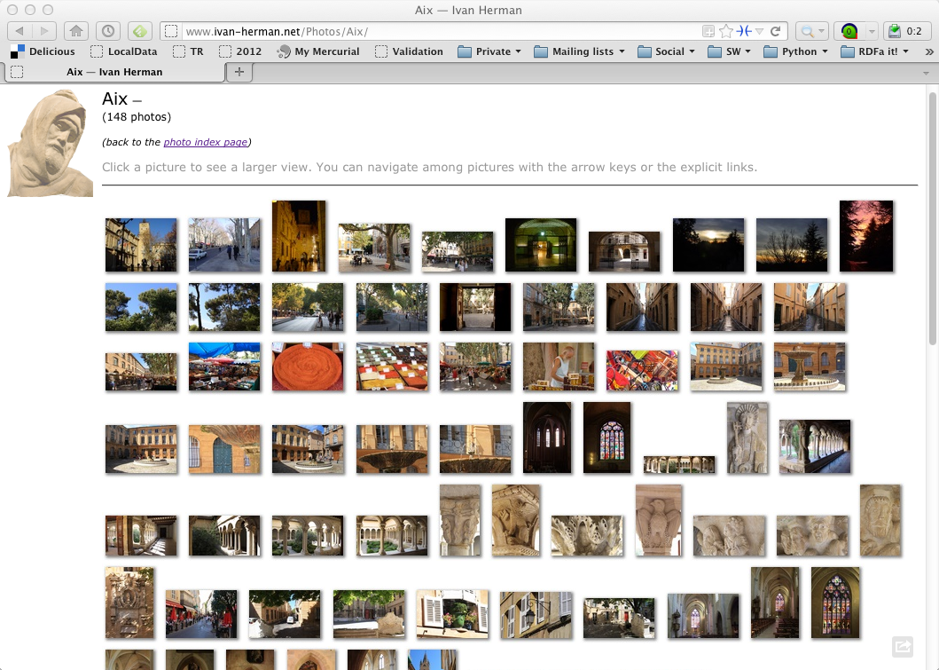
These are mine… ☺

Slide 19
What happened?
You had to consult a large number of sites, all different in style, purpose, possibly language…
You had to mentally integrate all those information to achieve your goals
We all know that, sometimes, this is a long and tedious process!

Slide 20

The real “meat” is the data!
All those pages are only tips of respective icebergs:
the real data is hidden in databases, XML files, Excel sheets, …
you only have access to what the Web page designers allow you to see

Slide 21
Specialized sites (Expedia, TripAdvisor) do a bit more:
they gather and combine data from other sources (usually with the approval of the data owners)
but they still control how you see those sources
But sometimes you want to personalize: access the original data and combine it yourself!

Slide 22
Another example: social sites. I have a list of “friends” by…

Slide 23
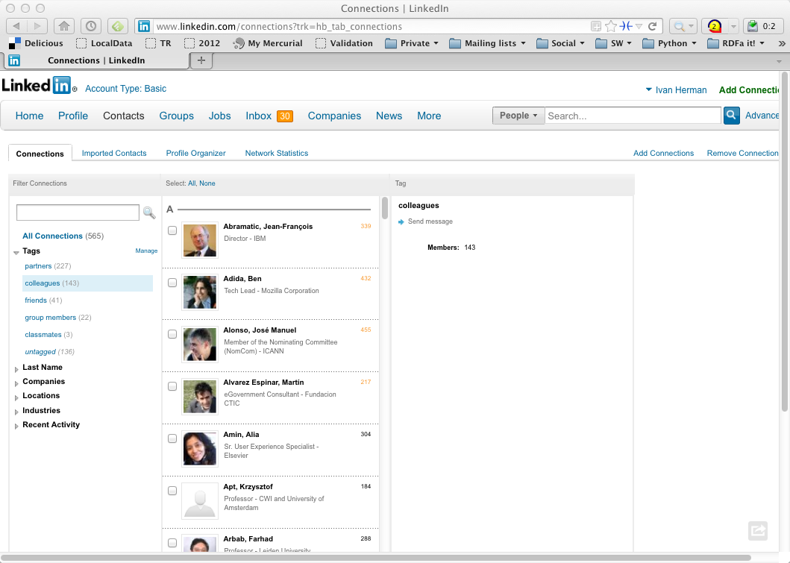

Slide 24
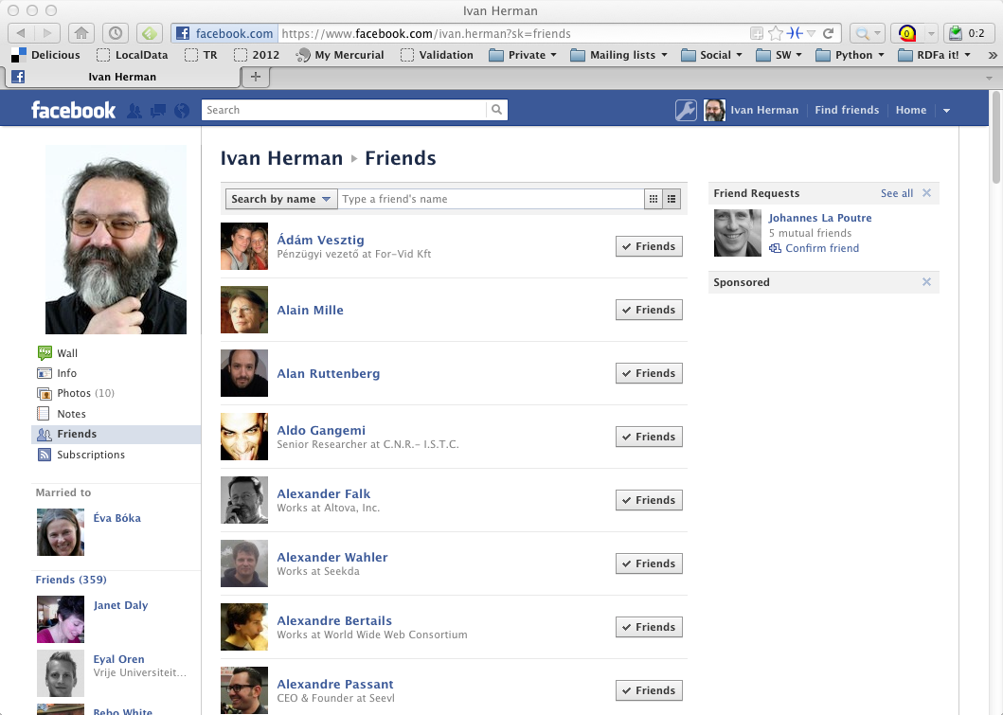

Slide 25
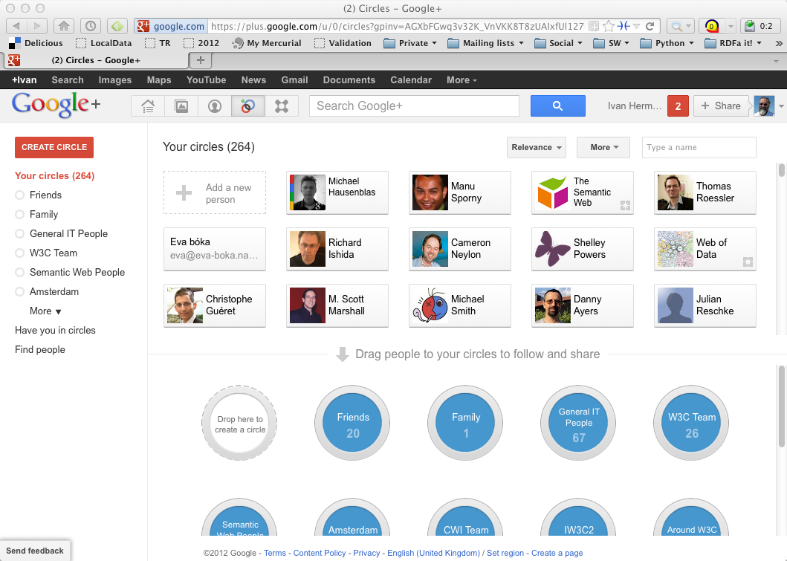

Slide 26
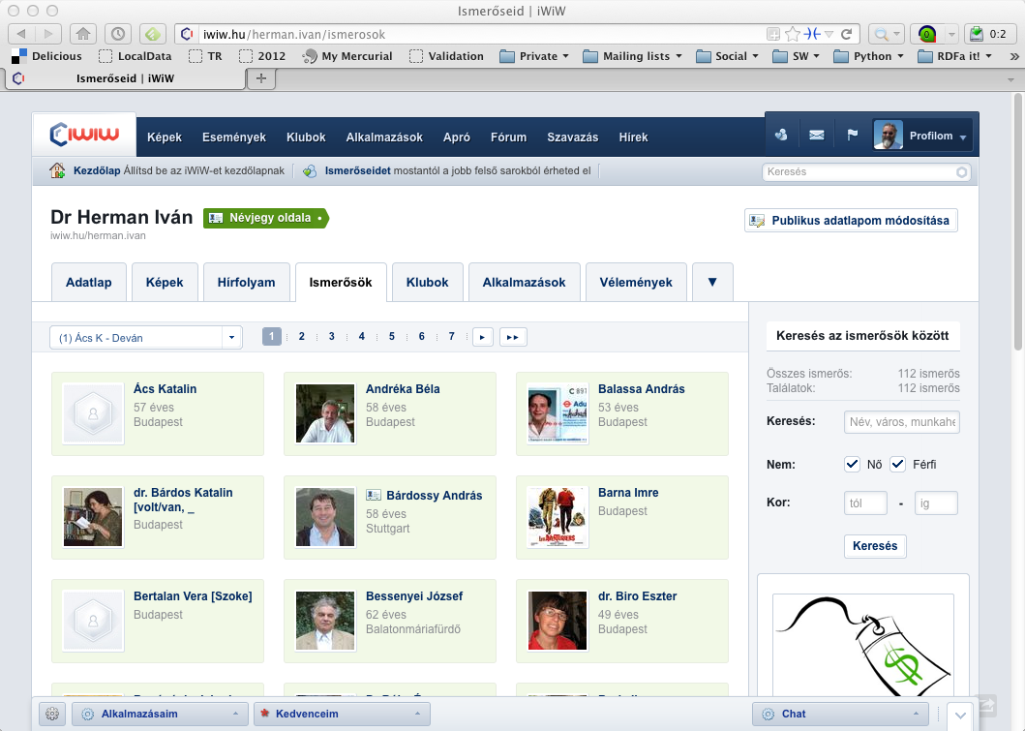

Slide 27

and it gets boring…
I have to type the same data again and again…
And this is even worse: I feed the icebergs…☹

Slide 28
What would we like to have?
The raw data should be available on the Web
let the community figure out what applications are possible…

Slide 29
But wait! Isn’t what mashup sites are already using?

Slide 30
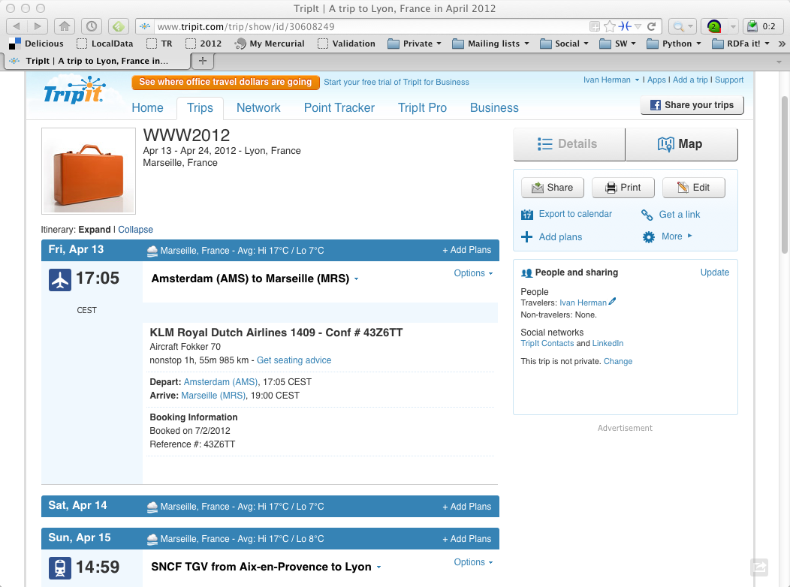

Slide 31
Yes, and it shows the power of accessing data directly!

Slide 32
but…
Mashup sites are forced to do very ad-hoc jobs
various data sources expose their data via Web Services, API-s
each with a different API, a different logic, different structure
mashup sites are forced to reinvent the wheel many times because there is no standard way getting to the data! ☹

Slide 33
What would we like to have?
The raw data should be available in a standard way on the Web
i.e., using URI-s to access data
dereferencing that data should lead to something useful

Slide 34
Why is that so important?
What makes the current (document) Web work?
people create different documents
they give an address to it (i.e., a URI) and make it accessible to others on the Web

Slide 35
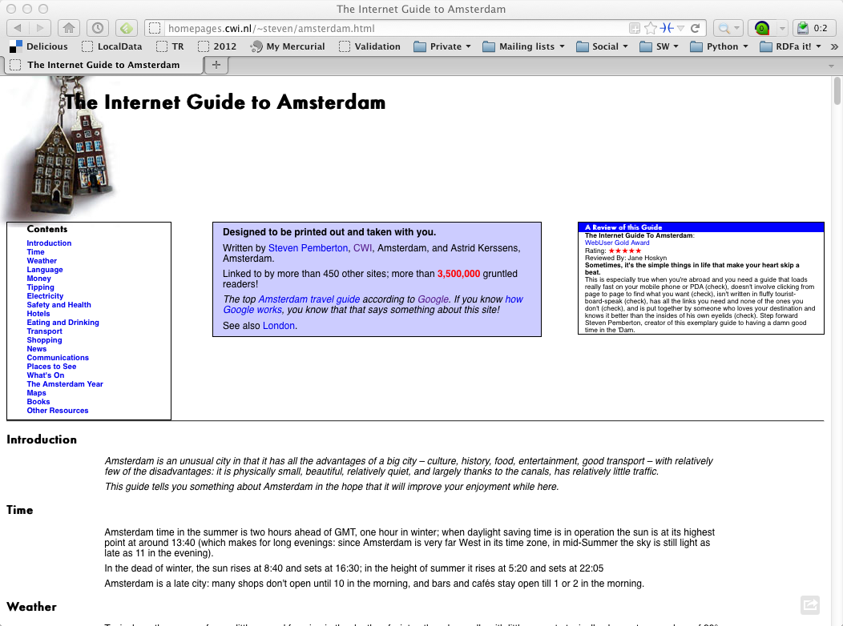

Slide 36
Then some magic happens…
Others discover the site and they link to it
The more they link to it, the more important and well known the page becomes
remember, this is what, eg, Google exploits!
This is the “Network effect”: some pages become important, and others begin to rely on it even if the author did not expect it…

Slide 37
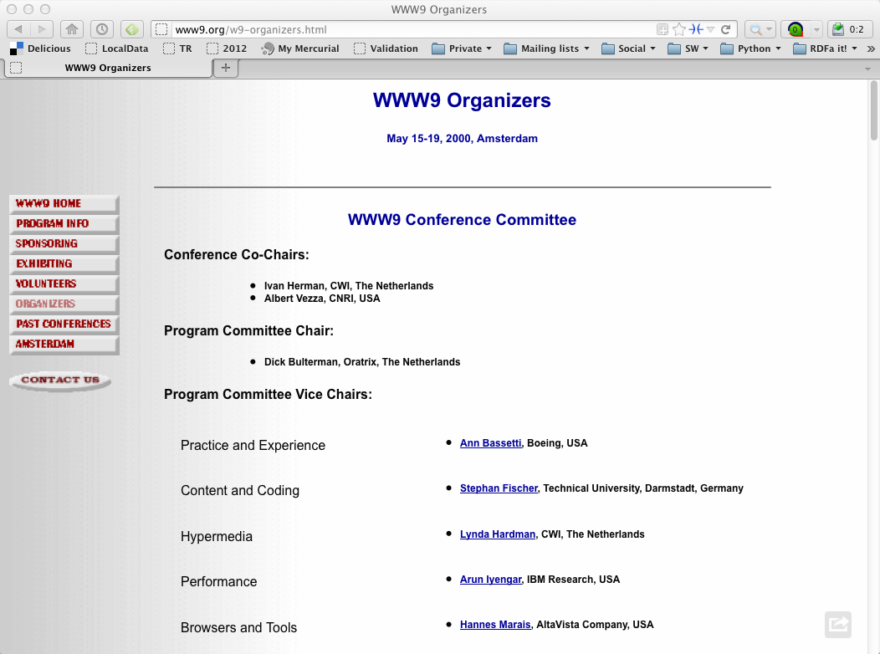
This could be expected…

Slide 38
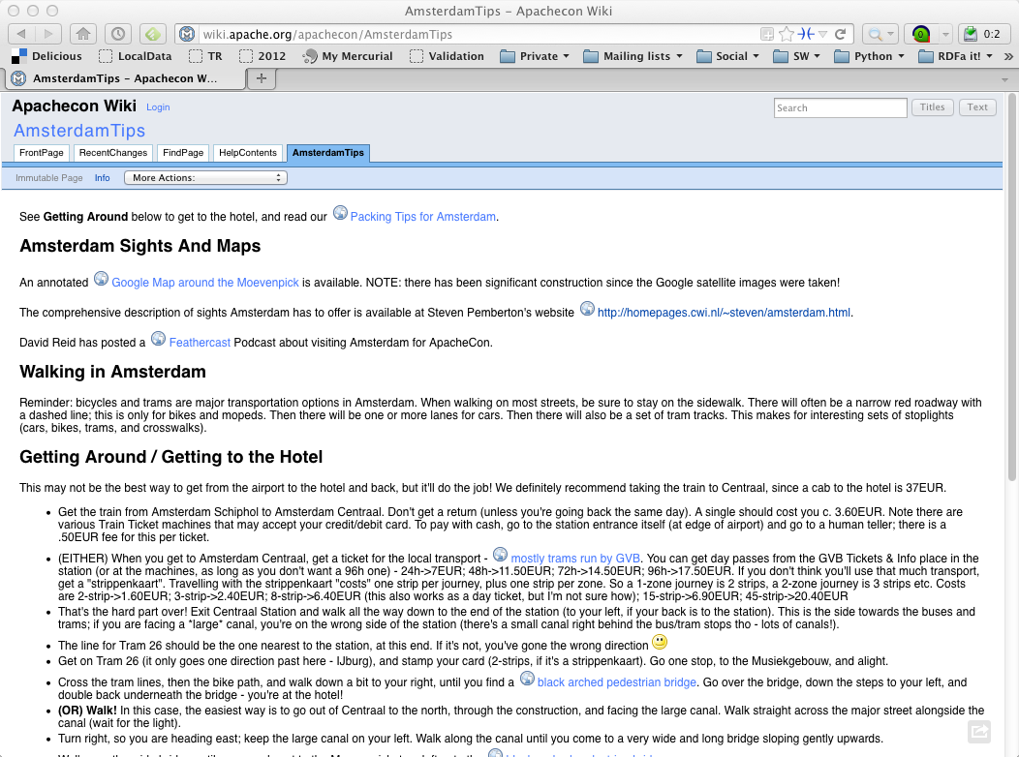
But this was not planned!

Slide 39
Network effect on the data
The same network effect works on the raw data
Many people link to the data, use it
Much more (and diverse) applications will be created than the “authors” would even dream of!

Slide 40
Is that it? Ie: let’s publish the data on the Web and we are done?

Slide 41
Not quite…

Slide 42
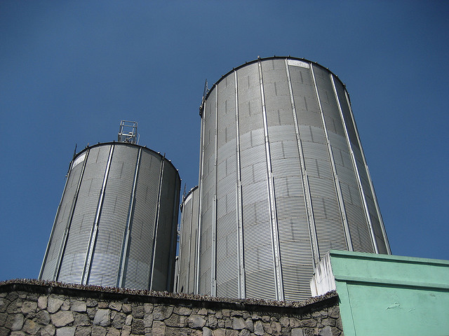
We do not want that!
Photo credit “nepatterson”, Flickr

Slide 43
Imagine…
A “Web” where
documents are available for download on the Internet
but there would be no hyperlinks among them
This is certainly not what we want!

Slide 44
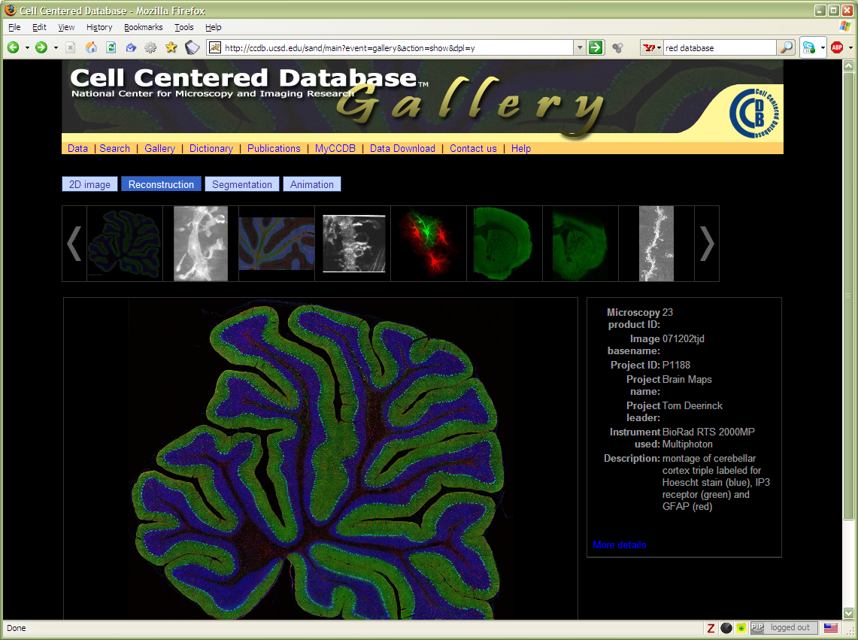
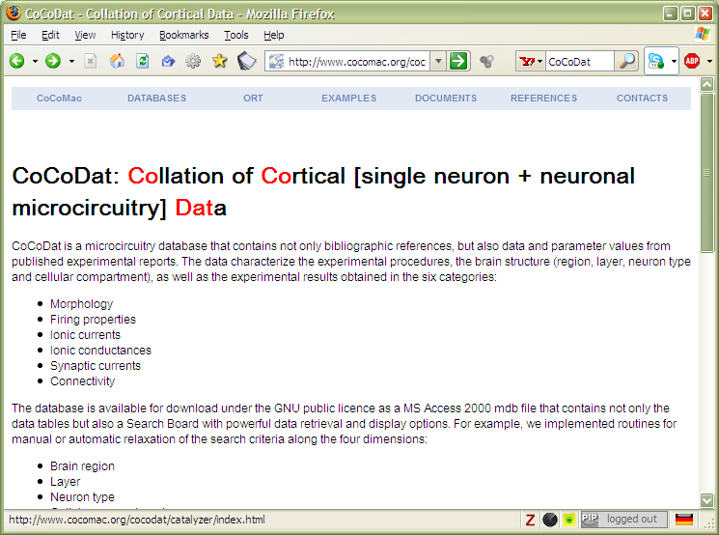
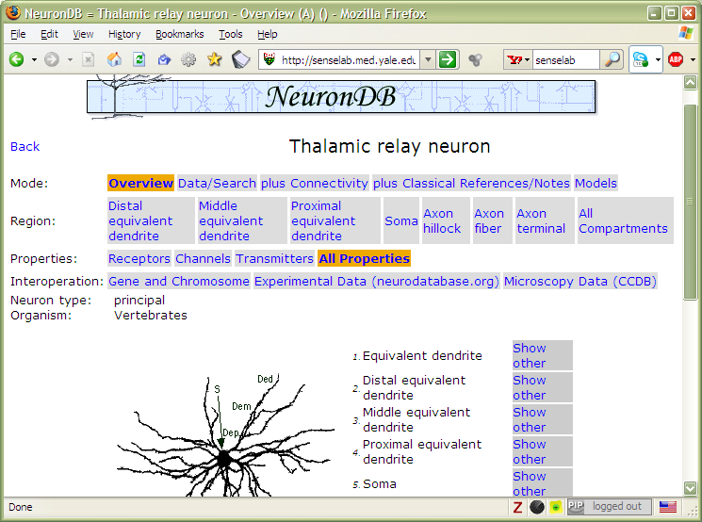

Slide 45
What would we like to have?
The raw data should be available in a standard way on the Web
There should be links among datasets

Slide 46
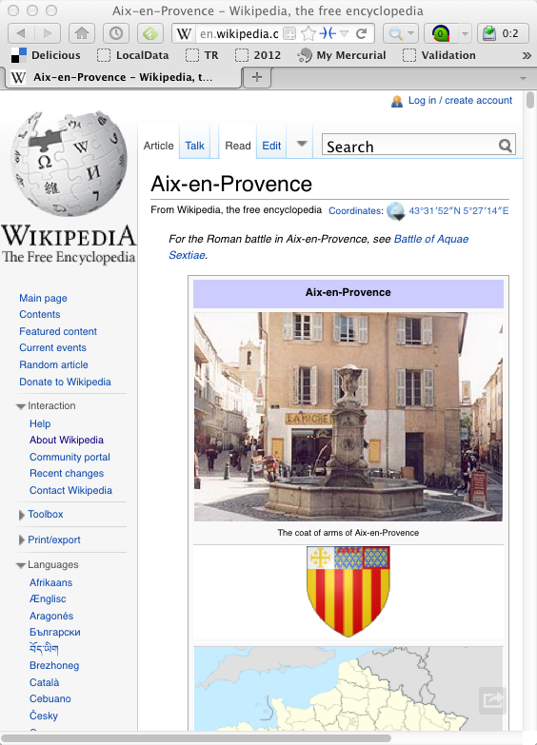
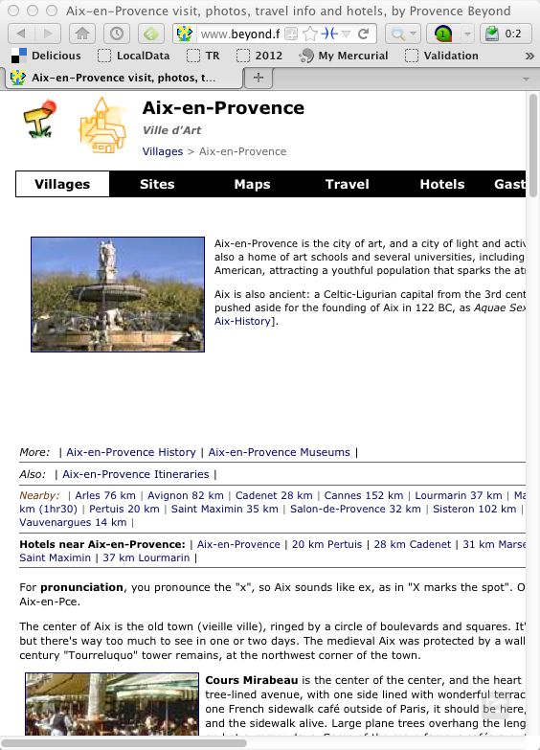
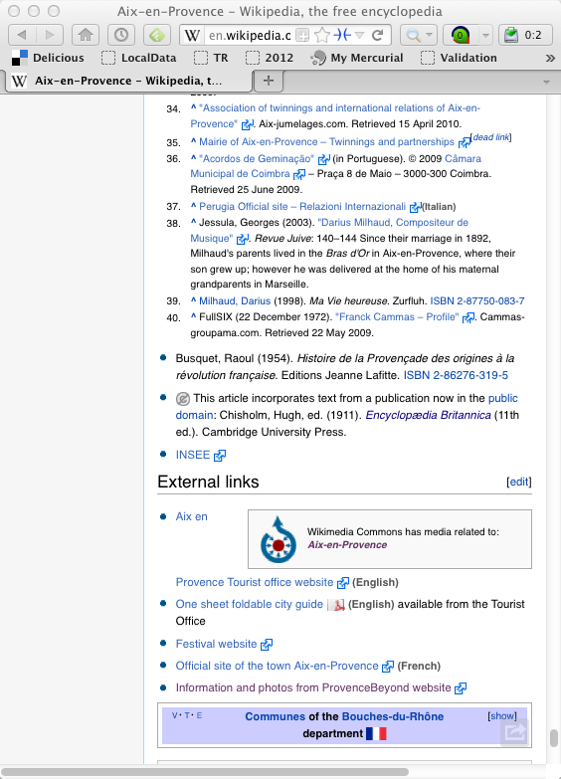
Some relationships already exist among the datasets!

Slide 47
Some relationships already exist among the datasets!
Aix-en-Provence on Wikipedia
Aix-en-Provence on “Provence and Beyond”

Slide 48
Those relationships should be exposed, too!

Slide 49
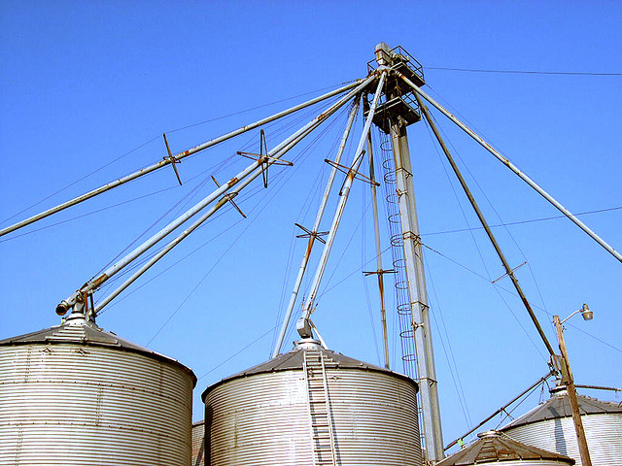
We want to link the silos!
Photo credit “kxlly”, Flickr

Slide 50
Is that it? Ie: let’s publish the data on the Web, add HTML-like hyperlinks and we are done?

Slide 51
Not quite… but almost!

Slide 52
But it is a little bit more complicated
On the traditional Web, humans are implicitly taken into account
A Web link has a “context” that a user implicitly uses ☹

Slide 53
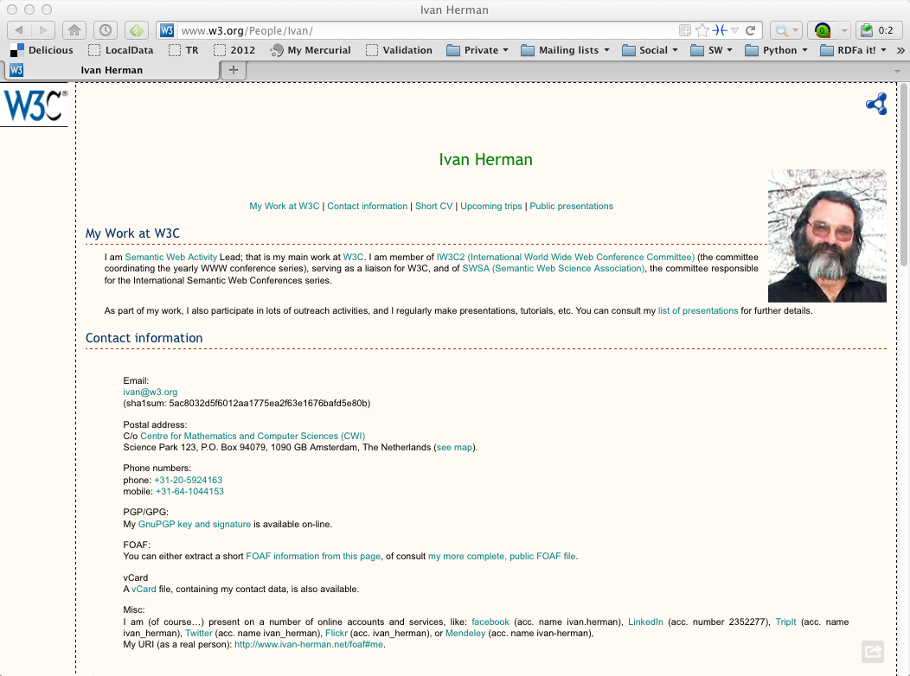

Slide 54
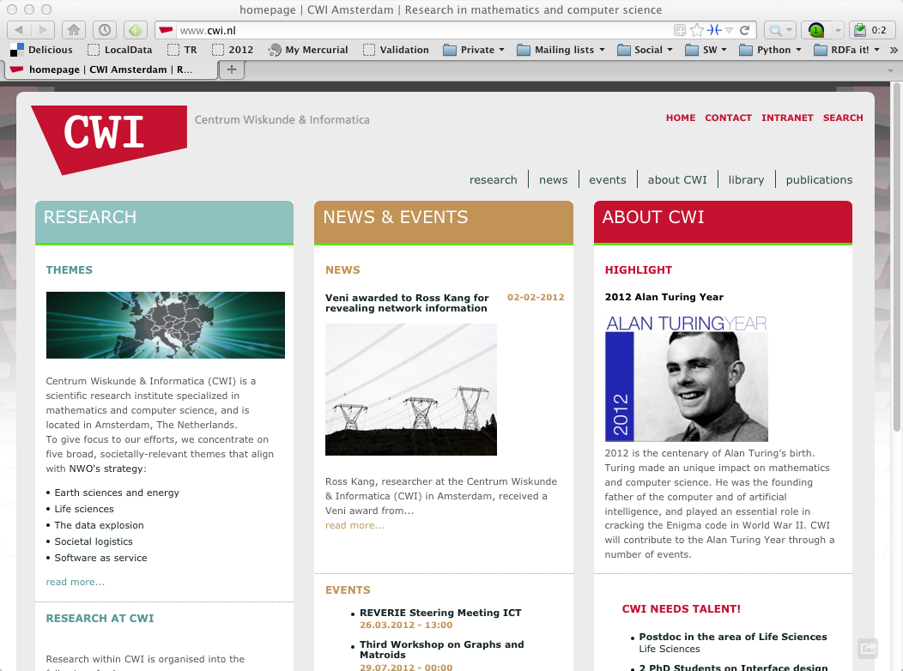

Slide 55
A human understands that this is where my office is, i.e/, the institution’s home page
He/she knows what it means
realizes that it is a research institute in Amsterdam
But, when handling data, something is missing; machines can’t make sense of the link alone

Slide 56
New lesson learned:
extra information (“label”) must be added to a link: “this links to my institution, which is a research institute”
this information should be machine readable
this is a characterization (or “classification”) of both the link and its target
in some cases, the classification should allow for some limited “reasoning”

Slide 57
What would we like to have?
The raw data should be available in a standard way on the Web
Datasets should be linked
Links, data, sites, should be characterized, classified, etc.
In future: possibility to write and change data…
but that is still further down the line
The result is a Web of Data

Slide 58
So What is the Semantic Web?

Slide 59
It is a collection of standard technologies to realize a Web of Data

Slide 60

It is that simple…
Of course, the devil is in the details
a common data model data has to be provided
the “classification” of the terms can become very complex
data in traditional databases should be reached
but these details are fleshed out by experts as we speak!

Slide 61

In the end…
More an more data should be “published” on the Web
this can lead to the “network effect” on data
New breeds of applications come to the fore
“mashups on steroids”
better representation and usage of community knowledge
new customization possibilities
…

