Slide 1
Scalable Label Assignment in Data Center Networks
Meg Walraed-Sullivan
University of California, San Diego
With: Radhika Niranjan Mysore, Malveeka Tewari, Ying Zhang (Ericsson Research),
Keith Marzullo, Amin Vahdat

Slide 2
Labeling in Distributed Networks
Group of entities that want to communicate
Need a way to refer to one another
Historically, a common problem
E.g. laptop has two labels (MAC address, IP address)
Labeling in data center networks is unique
Phone system
Snail mail
Internet
Wireless networks
Notes:
This way of referring to each other could be call a name, an address, an ID. I’m going to call it a “label.”

Slide 3
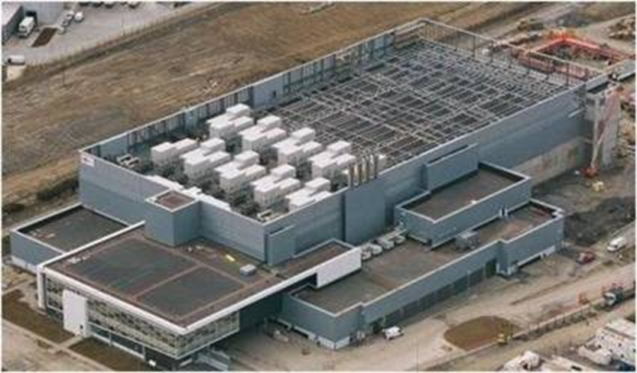
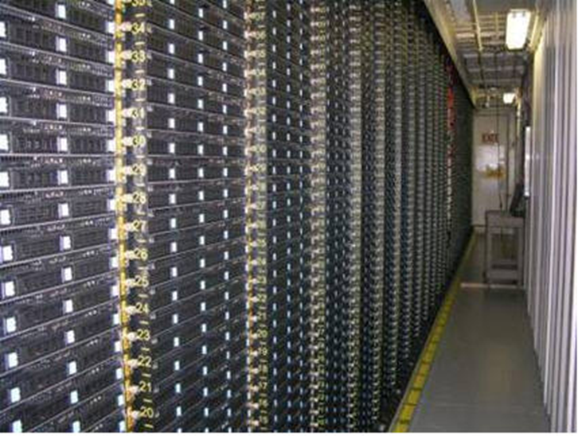
Data Center Network Size
Interconnect of switches connecting hosts
Massive in scale: 10k switches, 100k hosts, millions of VMs

Slide 4
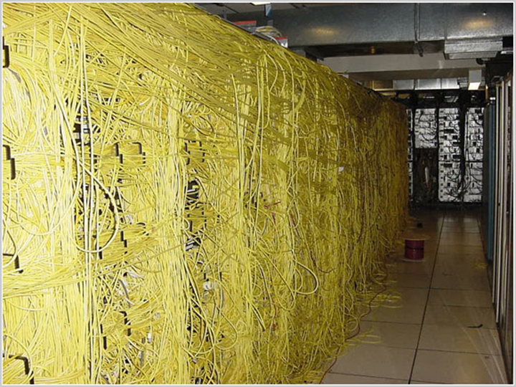
Data Center Network Structure
Designed with regular, symmetric structure
Often multi-rooted trees (e.g. fat tree)
Reality doesn’t always match the blueprint
Components and partitions are added/removed
Links/switches/hosts fail and recover
Cables are connected incorrectly

Slide 5
Labels in Data Center Networks
What gets labeled in a data center network?
Switch ports
Host NICs
Virtual machines at hosts
Etc.

Slide 6
Data Center Labeling Techniques
Flat Addressing
E.g. MAC Addresses (Layer 2)
Unique
Automatic
Scalability:
Switches have limited forwarding entries (say, 10k)
# Labels in forwarding tables = # Nodes

Slide 7
Data Center Labeling Techniques
Hierarchical Addressing
E.g. IP Addresses (Layer 3) with DHCP
Scalable forwarding state
# Labels in forwarding tables < # Nodes
Relies on manual configuration:
Unrealistic at scale

Slide 8
Combining L2 and L3 Benefits
PortLand’s LDP: Location Discovery Protocol
DAC: Data center Address Configuration
Manual configuration via blueprints
Rely on centralized control
Cannot directly connect controller to all nodes
Requires separate out-of-band control network or flooding techniques
PortLand: A Scalable Fault-Tolerance Layer 2 Data Center Network Fabric. Niranjan Mysore et al. SIGCOMM 2009
Generic and Automatic Address Configuration for Data Center Networks. Chen et al. SIGCOMM 2010

Slide 9
Scalability vs. Management
Hardware Limit:
Need Labels < Nodes
Flat Labels
Structured Labels
IP
Label Assignment Management Overhead
Automation
Ethernet
Target location
Network Size
Notes:
Like LDP and DAC, we want to try to move vertically down this line

Slide 10
Cost of Automation
Less management means more automation
Structured labels encode topology
Labels change with topology dynamics
IP
Management Overhead
Ethernet
Target
Network Size

Slide 11
ALIAS Overview
ALIAS: topology discovery and label assignment in hierarchical networks
Approach: Automatic, decentralized assignment of hierarchical labels
Benefits:
Scalability (structured labels, shared label prefixes)
Low management overhead (automation)
No out-of-band control network (decentralized)

Slide 12
ALIAS Evolution
Systems (Implementation/Evaluation)
ALIAS: Scalable, Decentralized Label Assignment for Data Centers. M. Walraed-Sullivan, R. Niranjan Mysore, M. Tewari, Y. Zhang, K. Marzullo, A. Vahdat. SOCC 2011
Theory (Proof/Protocol Derivation)
Brief Announcement: A Randomized Algorithm for Label Assignment in Dynamic Networks. M. Walraed-Sullivan, R. Niranjan Mysore, K. Marzullo, A. Vahdat. DISC 2011
ALIAS: topology discovery and label assignment in hierarchical networks

Slide 13
Data Center Network Topologies
Multi-rooted trees
Multi-stage switch fabric connecting hosts
Indirect hierarchy
May allow peer links
Labels ultimately used for communication
Multiple paths between nodes
Notes:
Labels should not preclude using these multiple paths for routing. In fact it’d be nice if they exposed path multiplicity so that routing protocols could use it

Slide 14
ALIAS Labels
Switches and hosts have labels
Labels encode (shortest physical) paths from the root of the hierarchy to a switch/host
Each switch/host may have multiple labels
Labels encode location and expose path multiplicity
g’s Labels
h’s Labels
a
d
g
a
d
g
h
a
b
c
b
e
g
b
e
g
h
b
f
g
b
f
g
h
d
e
f
c
f
g
c
f
g
h
g
h
Notes:
-As you can see, we’ve encoded not only information about the location of a node in its labels, but also the various ways to reach that node.
-Note that there is one label per path here, and a concern that mentioned is the limited capabilities of switches for storing large numbers of labels. In a few slides, we’ll see how to compact paths into fewer labels, without losing the encoding that we’ve created of locations and paths.

Slide 15
Communication over ALIAS Labels
Hierarchical routing leverages this info
Push packets upward, downward path is explicit
g’s Labels
h’s Labels
a
d
g
a
d
g
h
a
b
c
b
e
g
b
e
g
h
b
f
g
b
f
g
h
d
e
f
c
f
g
c
f
g
h
g
h
Notes:
-Any communication scheme would work. We made our own routing and forwarding protocols that leverage the hierarchical structure of ALIAS addresses cleverly. I won’t talk about that today, we’ll just talk about labels, but you can think of this as just general hierarchical forwarding

Slide 16
Distributed Protocol Overview
Continuously
Overlay appropriate hierarchy on network fabric
Group sets of related switches into hypernodes
Assign coordinates to switches
Combine coordinates to form labels
Periodic state exchange between immediate neighbors

Slide 17
Step 1. Overlay Hierarchy
Switches are at levels 1 through n
Hosts are at level 0
Level 3
Level 2
Level 1
Level 0
Only requires 1 host to begin
Notes:
Any size hierarchy

Slide 18
Distributed Protocol Overview
Continuously
Overlay appropriate hierarchy on network fabric
Group sets of related switches into hypernodes
Assign coordinates to switches
Combine coordinates to form labels

Slide 19
Step 2. Discover Hypernodes
Labels encode paths from a root to a host
Multiple paths lead to multiple labels per host
Aggregate for label compaction
Locate switches that reach same hosts
Level 4
Level 3
Level 2
(hosts omitted for space)
Level 1

Slide 20
Step 2. Discover Hypernodes
Hypernode (HN):
Maximal set of switches that connect to same HNs below
(via any member)
Base Case:
Each Level 1 switch is in its own hypernode
Level 4
Hypernode members are indistinguishable on downward path from root
Level 3
Level 2
Level 1

Slide 21
Distributed Protocol Overview
Continuously
Overlay appropriate hierarchy on network fabric
Group sets of related switches into hypernodes
Assign coordinates to switches
Combine coordinates to form labels

Slide 22
Step 3. Assign Coordinates
Coordinates combine to make up labels
Labels used to route downwards
Switches in a HN share a coordinate
HN’s with a parent in common need distinct coordinates
Notes:
Example from root: if it wants to get to a host that the yellow hypernode can reach, can send via either one. However, if the yellow switch is aiming for the bottom right of the tree, needs to send via dark blue HN

Slide 23
Step 3. Assign Coordinates
Can we make this problem simpler?
Switches in a HN share a coordinate
HN’s with a parent in common need distinct coordinates
deciders
choosers

Slide 24
Step 3. Assign Coordinates
To assign coordinates to hypernodes:
Define abstraction (choosers/deciders)
Design solution for abstraction
Apply solution throughout multi-rooted tree
deciders
choosers

Slide 25
Step 3. Assign Coordinates
a. Decider/Chooser abstraction
Label Selection Problem (LSP)
Chooser processes connected to Decider processes
In a bipartite graph
d₁
d₂
d₃
d₄
deciders
(parent switches)
c₁
c₂
c₃
c₄
c₅
c₆
Choosers
(hypernodes)

Slide 26
Step 3. Assign Coordinates
a. Decider/Chooser abstraction
Label Selection Problem Goals:
All choosers eventually select coordinates
Choosers sharing a decider have distinct coordinates
Multiple instances of LSP
d₁
d₂
d₃
d₄
deciders
c₁
c₂
c₃
c₄
c₅
c₆
choosers
x
y
z
y
y
q
z
z
z
x
Per-instance coordinates
Notes:
Choosers have a value per instance (could end up being the same across instances)
Choosers could instead select a value that worked with all instances. But it turns out to be useful to do multiple values, when we map this problem back to that of labeling in a multi-rooted tree.

Slide 27
Step 3. Assign Coordinates
a. Decider/Chooser abstraction
Label Selection Problem (LSP)
Difficulty: connections can change over time
d₁
d₂
d₃
d₄
c₁
c₂
c₃
c₄
c₅
c₆
x
y
z
z
r
y
q
z
z
x
Notes:
Coordinate domain:
Need as many are there are choosers in the largest instance. Can be all choosers at level, but can do better.
Complicated tradeoff between convergence time and label space because it’s probabilistic. That is for a given label space, convergence time is a probability distribution.
Paxos: changing instances, liveness

Slide 28
Step 3. Assign Coordinates
b. Design Solution for Abstraction
Decider/Chooser Protocol (DCP)
Distributed algorithm that implements LSP
Las-Vegas style randomized algorithm
Probabilistically fast, guaranteed to be correct
Practical: Low message overhead, quick convergence
Reacts quickly and locally to topology dynamics
Transient startup conditions
Miswirings
Failure/recovery, connectivity changes

Slide 29
Step 3. Assign Coordinates
b. Design Solution for Abstraction
Algorithm:
Choosers select coordinates randomly and send to deciders
Deciders reply with [yes] or [no+hints]
One no → reselect, All yeses → finished
yes
yes
yes
c₁:
c₂:
yes
c₁:
c₂:
c₁: x
c₂: y
c₁: x
c₂: y
d₁
d₂
Coord: x
Coord: y
c₁
c₂
c₁:x?
c₁:x?
c₂:y?
c₂:y?

Slide 30
Step 3. Assign Coordinates
c. Apply DCP through Hierarchy
Hypernodes are choosers for their coordinates
Switches are deciders for neighbors below
1 decider
3 deciders
2 choosers
2 choosers
3 deciders
3 choosers

Slide 31
Step 3. Assign Coordinates
c. Apply DCP through Hierarchy
DCP assigns level 1 coordinates
← 3 deciders
← 3 choosers

Slide 32
Step 3. Assign Coordinates
c. Apply DCP through Hierarchy
DCP for upper levels:
HN switches cooperate (per-parent restrictions)
Not directly connected
Communicate via shared L1 switch
← 3 deciders
← 2 choosers
“Distributed-Chooser DCP”

Slide 33
Distributed Protocol Overview
Continuously
Overlay appropriate hierarchy on network fabric
Group related switches into hypernodes
Assign per-hypernode coordinates
Combine coordinates to form labels

Slide 34
Step 4. Assign Labels
Concatenate coordinates from root downward
(For clarity, assume labels same across instances of LSP)
Notes:
Red switch would have 6 labels without hypernode compaction

Slide 35
Step 4. Assign Labels
Hypernodes create clusters of hosts that share label prefixes

Slide 36
Relabeling
Topology changes may cause paths to change
Which causes labels to change
Evaluation:
Quick convergence
Localized effects
Notes:
Recall that all information is passed via periodic state exchange. Where there is nothing new to send, still send this as a heartbeat.

Slide 37
Using ALIAS labels
Many overlying communication protocols
Hierarchical-style forwarding makes most sense
E.g. MAC address rewriting
At sender’s ingress switch: dest. MAC → ALIAS label
At recipient’s egress switch: ALIAS label→dest. MAC
Up*/down* forwarding (AutoNet, SOSP91)
Proxy ARP for resolution
E.g. encapsulation, tunneling

Slide 38
Evaluation Methodology
“Standard” systems approach
Implementation, experimentation, deployment
Theoretical approach
Proof, formalization, verification via model checking
Goal:
Verify correctness, feasibility
Assess scalability

Slide 39
Evaluation: Correctness
Does ALIAS assign labels correctly?
Do labels enable scalable communication?
Implemented in Mace (www.macesystems.org)
Used Mace Model Checker to verify
Label assignment: levels, hypernodes, coordinates
Sample overlying communication: pairs of nodes can communicate when physically connected
Ported to small testbed with existing communication protocol for realistic evaluation

Slide 40
Evaluation: Correctness
Does DCP solve the Label Selection Problem?
Proof that DCP implements LSP
Implemented in Mace and model checked all versions of DCP
Is LSP a reasonable abstraction?
Formal protocol derivation from basic DCP→ALIAS
Notes:
Formal derivation:
A set of steps wherein each step is a small permutation on the actual code, in order words a series of mechanical transforms

Slide 41
Evaluation: Feasibility
Is overhead (storage, control) acceptable?
Resource requirements of algorithm
Memory: ~KBs for 10k host network
Control overhead: agility/overhead tradeoff
Memory usage on testbed deployment (<150B)
Ports/Switch | Hosts | Cycle (ms) | Control Overhead (Mbps, %10G link)
64 | 65k | 100 | 31.5 (0.3%)
 |  | 500 | 6.29 (0.06%)
128 | 524k | 1000 | 25.16 (0.25%)
 |  | 2000 | 12.58 (0.12%)
Notes:
Portland between 50-400 Mbps to controller depending on various protocol settings, for 30k hosts

Slide 42
Evaluation: Feasibility
Is the protocol practical in convergence time?
DCP: Used Mace simulator to verify that “probabilistically fast” is quite fast in practice
Measured convergence on tested deployment
On startup
After failure (speed and locality)
Used Mace model checker to verify locality of failure reactions for larger networks

Slide 43
Evaluation: Scalability
Does ALIAS scale to data center sizes?
Used Mace model checker to verify labels and communication for larger networks than testbed
Wrote simulation code to analyze network behavior for enormous networks

Slide 44
Result: Small Forwarding State
Topology |  |  |  | ALIAS Forwarding Table Entries
Levels | Ports | % Fully Provisioned | Servers
3 | 32 | 100 | 8,192 | 45
 |  | 80 |  | 262
 |  | 50 |  | 173
 |  | 20 |  | 86
 | 64 | 100 | 65,653 | 90
 |  | 80 |  | 1028
 |  | 50 |  | 653
 |  | 20 |  | 291
4 | 32 | 100 | 131,072 | 46
 |  | 80 |  | 1278
 |  | 50 |  | 2079
 |  | 20 |  | 2415
5 | 16 | 100 | 65,653 | 23
 |  | 80 |  | 492
 |  | 50 |  | 886
 |  | 20 |  | 1108
e.g. IP, LDP/DAC
e.g. MAC

Slide 45
Conclusion
Scale and complexity of data center networks make labeling problem unique
ALIAS enables scalable data center communication by:
Using a distributed approach
Leveraging hierarchy to form topologically significant labels
Eliminating manual configuration

Slide 46
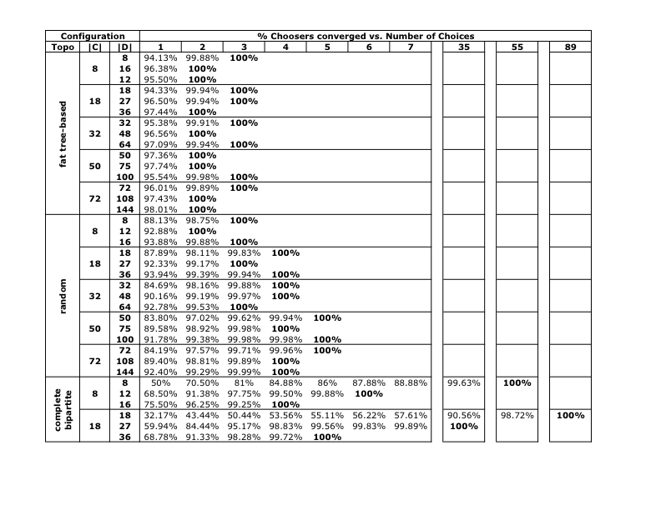
Convergence of DCP

Slide 47
Convergence vs. Coord. Domain

Slide 48
Convergence vs. Coord. Domain

Slide 49
Convergence vs. Coord. Domain

Slide 50
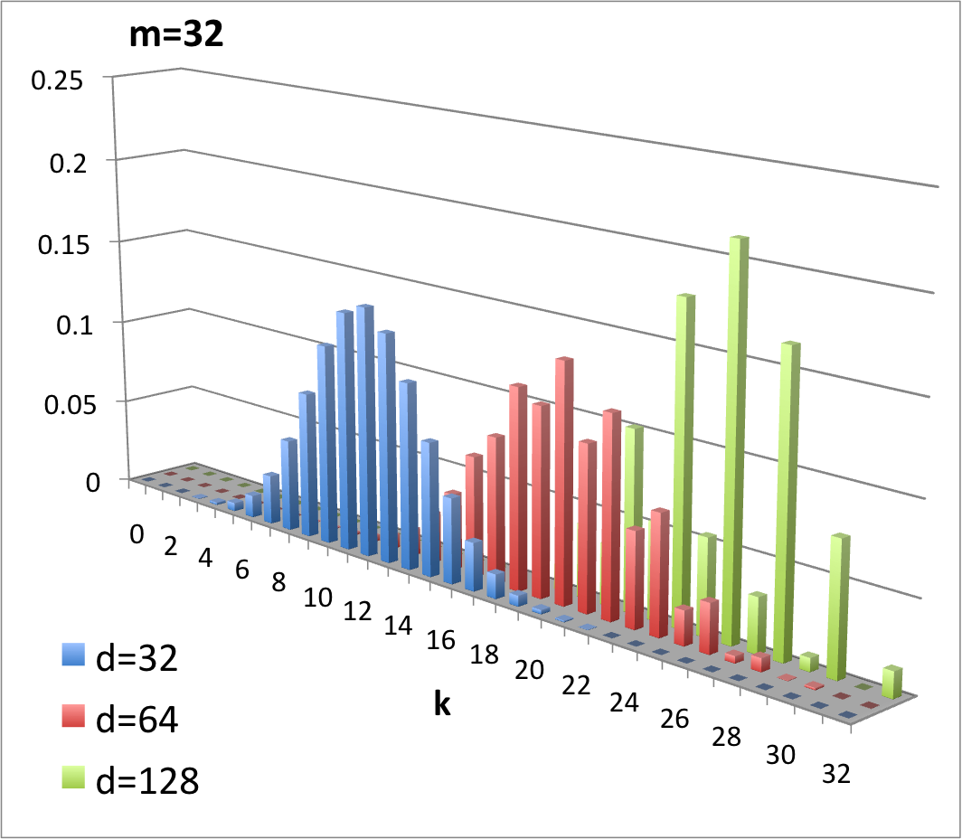
Convergence vs. Coord. Domain

