Slide 1
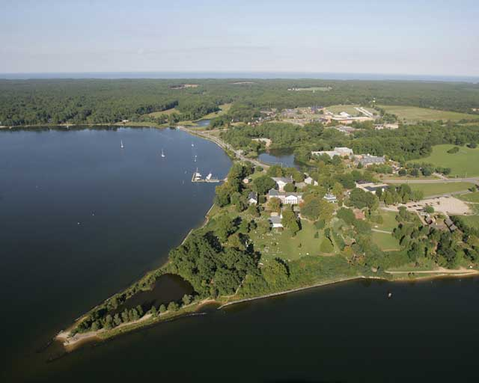
Closer to Fair:
Social Justice in Mathematics
Math for Social Justice
Dr. David Kung
St. Mary's College of Maryland
(Notes/slides/activites – on my webpage soon!)

Slide 2
A Talk in Two Acts:
Social Justice in Mathematics
Mathematics for Social Justice

Slide 3
Imagine this is the first day of Calculus. The students wander in talking/laughing, and then sit down. You start class.
Five minutes later, a student walks.
Where does the student sit?

Slide 4
What if…
… the student is:
your strongest student – everyone knows it?
an African-American male, the only black student in the class?
female President of the Math Club?
a female Mexican immigrant with a strong accent?
a female 35-year old returning student?

Slide 5
Equal treatment of students
≠
Equal Experience for students
“He doesn’t treat his students equally, he treats them fairly.”
- anonymous student
Our goal should be equal opportunity!
Equal vs. Fair

Slide 6
Act I (Social Justice in Math) - Outline
Activity: walking into class late
Statistics: the state of women and minorities in STEM (college-level)
Arguments for change
The Story of Emerging Scholars (ESP)
Reasons for poor performance
Ways to improve performance
What You Can Do

Slide 7
Statistics: Women and Minorities in STEM
Q: How are we doing graduating STEM majors?
Source: NSF
Bachelor's degrees awarded, by field, citizenship, and race/ethnicity of recipients:
http://www.nsf.gov/statistics/degrees/

Slide 8
Statistics: Women and Minorities in STEM
Q: How are we doing with women in STEM?

Slide 9
Statistics: Women and Minorities in STEM
Q: How are we doing with minorities in STEM?
NSF: Minorities = African-Amer., Hispanic, Native Amer., SE Asian

Slide 10
Statistics: Women and Minorities in STEM
Q: How are we doing with minorities in math?
U.S.
13.4%
14.8%

Slide 11
Statistics: Big Picture
What do the national data say?
We lose women and minorities in math and the science at every step of the pipeline from middle school through professorships, even when controlling for:
preparation
motivation
The problem isn’t the students,
it’s us (STEM communities).

Slide 12
Arguments for Change
Why should we want to improve things?
Equity: Math (and STEM) should look like our communities/states/country/world
Access: everyone accepted should have the opportunity to study any subject
Role models: we produce teachers/profs
STEM progress: equal abilities means we are missing out on great discoveries
Today: What can you do to help?

Slide 13
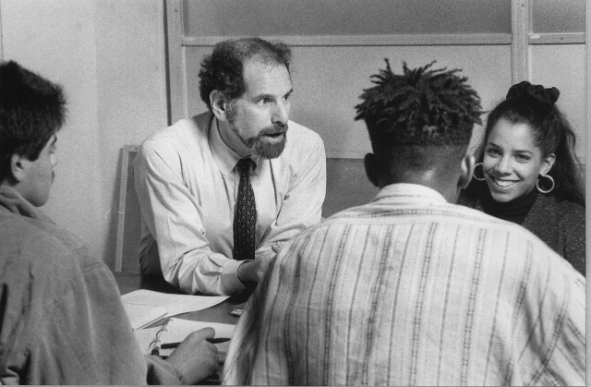
The Story of Emerging Scholars Programs (ESP)
Why do (college) minority students fail in Calculus?
(Uri Treisman, UC-Berkeley, 1970’s)
Common guesses:
Poor preparation
Lack of motivation
Lack of family support
Socio-economic forces
Data: These guesses are all wrong!
(and all about the students.)

Slide 14
The Story of Emerging Scholars Programs (ESP)
Treisman’s observations:
Successful Chinese-Amer. Students:
Worked alone, got stuck
Studied together
Helped each other
Formed social bonds that supported their STEM interests
Unsuccessful Black Students:
High motivation, solid preparation
Excellent family support
Worked alone
Formed social bonds separate from STEM interests

Slide 15
The Story of Emerging Scholars Programs (ESP)
Treisman’s idea:
Put students in positions where
they are challenged (not remediated)
they build social networks that support their interests in mathematics
they get “the good stuff”

Slide 16
Research supporting ESPs
Stereotype Threat (Steele & Aronson)
Q: What affects underrepresented students’ performance?
A: The thought that they are underrepresented.
Replicated in sciences, math for minorities, women…
Antidote: “This test doesn’t differentiate by race, gender, etc.”

Slide 17
The Story of Emerging Scholars Programs (ESP)
Workshop Model
students attend regular lectures
ESP workshops 4-6 hrs/wk
collaborative work on challenging problems
social events to create cohesion
helped by graduate TA and undergrad assistant
Help students build social support networks related to STEM classes!

Slide 18
The Story of Emerging Scholars Programs (ESP)
ESP Results:
higher grades (0.5 to 1.0 higher GPA) compared with
historically matched groups
students who turn down ESP invite
other students in same lecture
lower drop-out rates
higher retention in STEM majors
more minority math majors

Slide 19
ESP at SMCM (small liberal arts college)
SMCM (public liberal arts college, 2000 students)
Fall 2003: 10 African-Americans start Calc I
5 drop, 3 C’s, 2 D’s
no Afr-Amer. or Latino/a math majors
Now:
> 50% of Afr-Amer. and Latino/a students get B or better in Calc I
1-2 Afr-Amer. or Latino/a math majors each year!

Slide 20
Guiding Philosophy
Lessons of ESPs and SMCM
It’s not them, it’s us
Avoid remediation – psychologically damaging
Students rise to meet academic challenges – fill in holes when necessary
Use students’ social interactions to leverage better academic performance

Slide 21
What You Can Do
Work to level the playing field by ….
Providing support to underrepresented students
Structuring social interactions (in and out of class) to help all students build supportive social networks
Find opportunities for your (underrepresented) students (like the ESP-REU @ SMCM)
What’s the goal?
Closer to fair!

Slide 22
End of Act I
(Social Justice in Mathematics)
You: (applause)
Dave: Thanks, we’re going to take a short intermission, but before we go to Act II, are there any questions on Act I?
You: Dave, this is interesting, but I have a question … (ad lib)

Slide 23
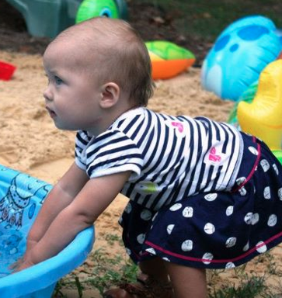
Intermission
Ellie
(now
15 months)

Slide 24

Teaching Mathematics for Social Justice
Act II: Mathematics for Social Justice
Sample Activity:
Annual Hospital Report
Administrator: 90% of patients who spend the night check out within a week.
Nurses: 80% of the patients who stayed last night have been here over a year!
Q: Can they both be right?

Slide 25
Teaching Mathematics for Social Justice
Both can be right!
Similar statistics hold for people:
welfare
unemployed
without health insurance
Your agenda determines the statistics you use!

Slide 26
Teaching Mathematics for Social Justice
Act II – Outline
Sample Activity: Hospital Admin.
What our students need vs.
What we give them
Description of Math for Social Justice courses (mine and others)
Example Activities:
Occupy Math (inequality & Gini coeffs.)
Critical Thinking (wind energy/percentages)
Obesity in Schools (correlations)

Slide 27
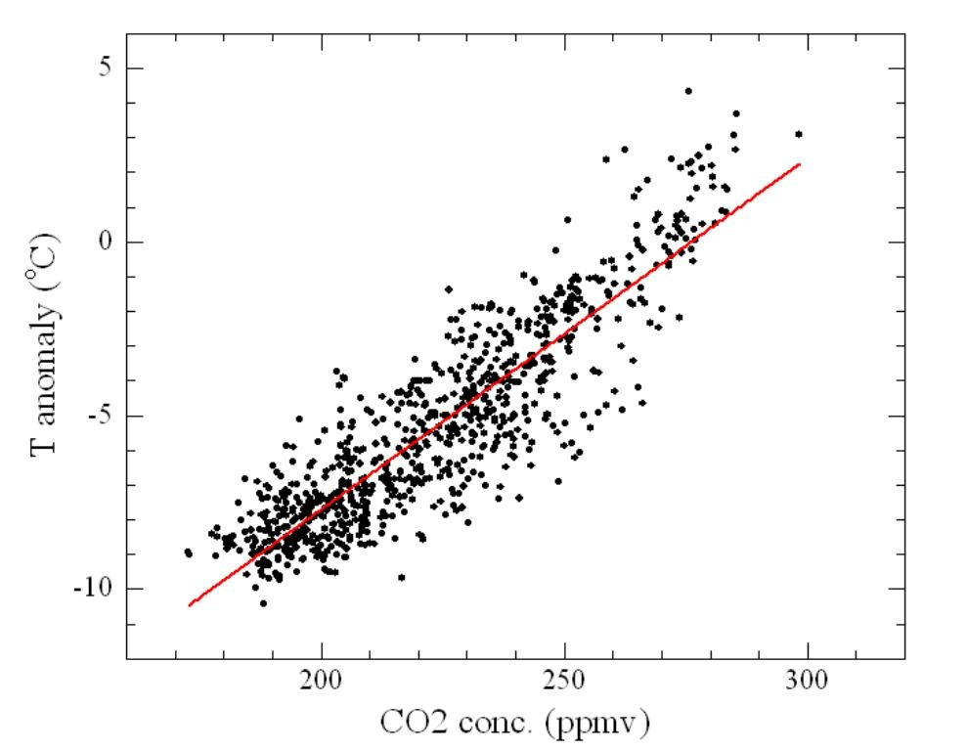
Teaching Mathematics for Social Justice
What students citizens need:
Global Temps and
CO2 emissions
positively correlated
(corr. coeff. = 0.86)
What does this
mean?
(www.skepticalscience.com)

Slide 28


Teaching Mathematics for Social Justice
What we give them:

Slide 29
Teaching Mathematics for Social Justice
What our students need: Presidential Debate
McCain: "Sen. Obama's secret that you don't know is that his tax increases will increase taxes on 50% of small business revenue.“
Obama: "Only a few percent of small businesses make more than $250,000 a year. So the vast majority of small businesses would get a tax cut under my plan." "98% percent of small businesses make less than $250,000"
Can you reconcile these statements or is one of them lying?

Slide 30
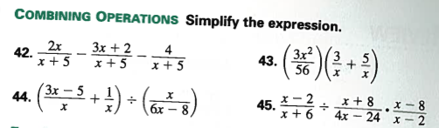
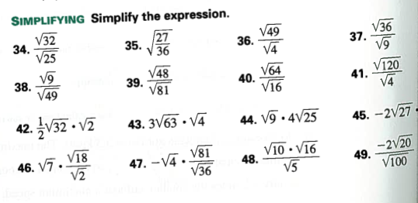

Teaching Mathematics for Social Justice
Here’s the math we give them:
Notes:
Math of the 19th century – or before!

Slide 31
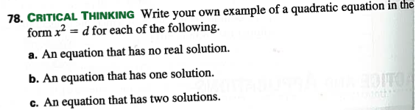
Teaching Mathematics for Social Justice
Here’s the math we give them:
Critical Thinking?

Slide 32
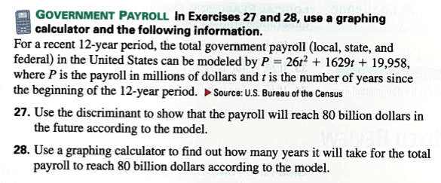
Teaching Mathematics for Social Justice
Here’s the math we give them:
Applications? (Discriminant)
Notes:
Algebra has a death grip on mathematics!

Slide 33
Teaching Mathematics for Social Justice
Where is our HS math curriculum from?
1892 – National Education Association
Science: biology, chemistry, then physics
Math: Algebra, Geometry, Trig
Everyone gets a “college prep” curriculum (aimed at Calculus)
(See Nils Ahbel “Reflections on a 119-Year
Old Curriculum”)

Slide 34
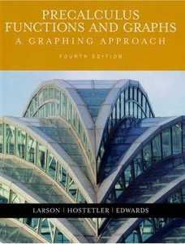

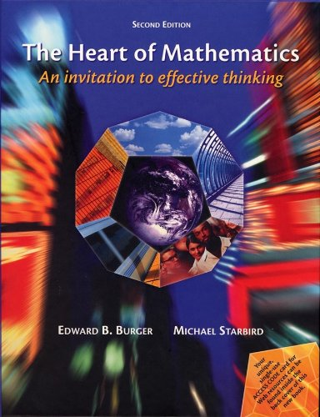
Teaching Mathematics for Social Justice
College? Students’ Last Math Class:
Pre-Calculus
Consumer Math (student = consumer?)
Watered-down Hard Math (4th Dim., ∞)
We can (and must!) do better!
* esp. for non-science students

Slide 35
Teaching Mathematics for Social Justice
Math for Social Justice – different models
Service learning, First Year Seminar
Rob Root, Lafayette College
Focus on education
Readings: What the Numbers Say, Algebra Project (Bob Moses)
Service learning (tutoring middle school students

Slide 36
Teaching Mathematics for Social Justice
Math for Social Justice – different models
Statistics
Lily Khadjavi, Loyola Marymount Univ.
Structure course around meaningful data
LAPD traffic stop data (over 900,000 traffic stops)
Main question: does the LAPD have racially biased practices?
Driving While Black in the City of Angels

Slide 37
Teaching Mathematics for Social Justice
Math for Social Justice – different models
Sustainability
Tom Pfaff, Ithaca College
adding sustainability issues in
Calculus
Statistics
(Google “Pfaff Sustainability”)
Notes:
Taking a derivative? Why not have the function be meaningful?

Slide 38


Teaching Mathematics for Social Justice
Other efforts to loosen Algebra’s grip:
Carnegie Foundation:
Goal: Improve Community College completion
Tactic: Replace Algebra requirement with:
Statway (stats-based)
Quantway (QR-based)
(not necessarily w/ Soc. Just. bent)
“students will have greater motivation to succeed and persist if their math is engaging, meaningful, relevant and useful.”

Slide 39
Teaching Mathematics for Social Justice
Math 131 - Survey of Mathematics: Mathematics for Social Justice
(TR, 10am, Kung)
In this section of Survey we will use mathematics to better understand justice, fairness, and equality. Then we will use that new knowledge to improve the world.
Audience: non-science majors
in their last math class…ever.

Slide 40
Teaching Mathematics for Social Justice
Email to class:
In this class, you will be expected to change the world. If you aren't interested in doing any world-changing, I believe that the other section of Survey will involve much less.
Happy with the world as it is (seriously?) or signed up for this section only because it fit your schedule? You might want to consider switching classes.

Slide 41
Teaching Mathematics for Social Justice
Math for Social Justice goals:
Develop the ability to question numbers
Develop the inclination to question numbers
Knowledgably participate in our democracy
Be an effective activist
Positive last math course

Slide 42
Teaching Mathematics for Social Justice
Math for Social Justice course topics:
Quantitative literacy
Large Numbers & Estimation
Percentages
Statistics
Distributions (wealth, health care spending, etc.)
Surveys
Voting
Financial mathematics

Slide 43
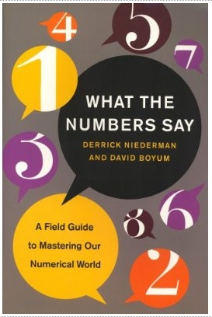
Teaching Mathematics for Social Justice
What the Numbers Say, Niederman & Boyum
10 Habits of Highly Effective Quantitative Thinkers
1. Only Trust Numbers
2. Never Trust Numbers
3. Play Jeopardy (what
question does the # answer?)
4. Pareto’s Law (80/20)
…
Great for HS or college!

Slide 44
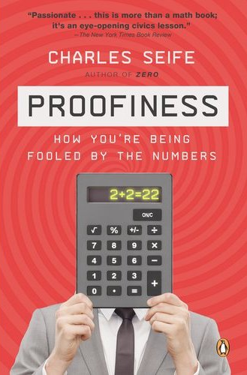
Teaching Mathematics for Social Justice
Proofiness, Charles Seife (author of Zero)
How you’re being fooled by the numbers
risk – financial meltdown
polls – statistical & systemic
errors
gerrymandering
voting – different systems &
counting ballots
Great read!

Slide 45
Teaching Mathematics for Social Justice
Reading the News – discussion boards
Idea: practice questioning numbers (inclination)
Early in Semester:
A’s: post article, highlight numbers
B’s: post questions about the numbers
End of the Semester:
A’s: post article, questions
B’s: use outside resources to answer those questions

Slide 46
Teaching Mathematics for Social Justice
Semester Projects: Use Math to Improve the World
Proposal: each student proposes a project, pitches it to the class
Voting: students rank top 10
Groups of 2-4 carry out project, write paper, present work.

Slide 47
Teaching Mathematics for Social Justice
Semester Project Examples:
solar water heating on dorms
(solving linear equations)
accessible student housing
free trade products in coffee shop
campus composting program
fair funding of public schools
video game about credit cards
shortening student shower times

Slide 48
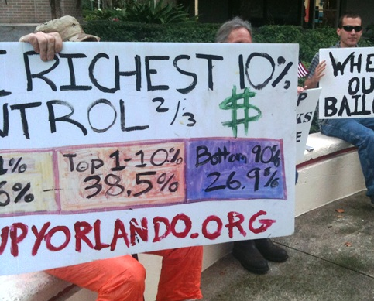
Teaching Mathematics for Social Justice
Sample Activities
Occupy Math
(Inequality: Lorenz Curves & Gini coeffs.)
Critical Thinking (wind energy/percentages)
Obesity in Schools (correlations)

Slide 49
Sample Activity: Occupy Math
Tools to Measure Inequality:
Lorenz Curve
Gini Coefficient (Gini Index)

Slide 50
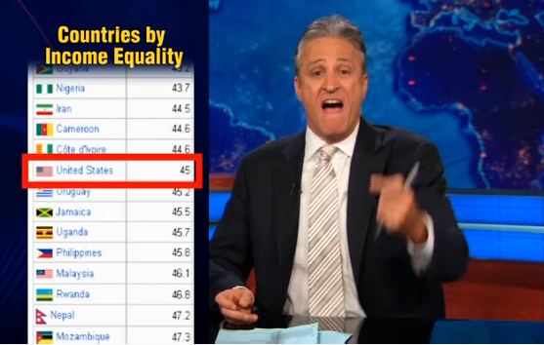
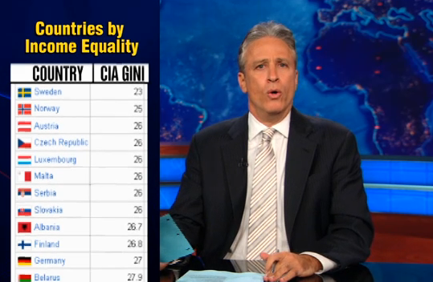
Gini in the News
“…income inequality where [the US] ranks worse than the
Ivory Coast, worse than Cameroon.
64th – In your face, Uruguay, Jamaica & Uganda!”
Notes:
Today: Gini Coefficients – explained!

Slide 51
Gini in the News
August 18th, 2011 (www.thedailyshow.com)

Slide 52
Gini Coeff’s in the US
(0=equal distribution, 1=complete concentration)
US Income: 0.469
MD Income: 0.443
VA Income: 0.459
DC Income: 0.532 (highest in US)
(www.census.gov, 2010)
US Wealth (not Income)
0.82 (2003 – Edward Wolff, NYU)

Slide 53
Lorenz Curve
Top 1% control 38% of wealth
Top 10% control 70% of wealth
Bottom 40% control 1% of wealth
(99,62)
(90,30)
(40,1)

Slide 54
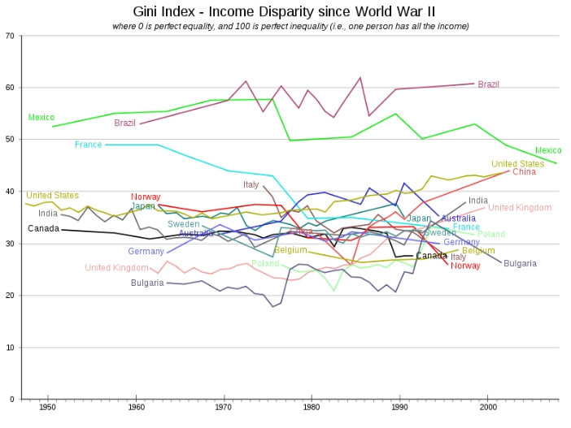
Gini Coefficients Across the World (income)
Source: Wikipedia

Slide 55
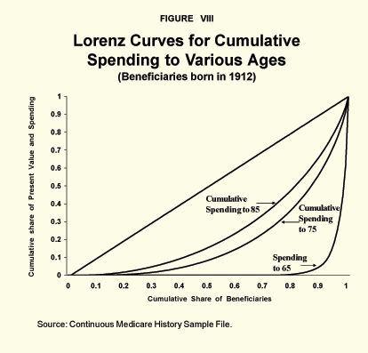
National Center for Policy Analysis http://www.ncpa.org/pub/st261?pg=7

Slide 56
Sample Activity: Critical Thinking (%)
Goal: Critical Thinking & Facility with Percentages
US Wind Energy Production
(see handout)

Slide 57
Sample Activity: Critical Thinking (%)
May 2007 press release:
“U.S. Continues to Lead the World in Wind Power Growth,” “U.S. wind power capacity increased by 27 percent in 2006” and that “the U.S. had the fastest growing wind power capacity in the world in 2005 and 2006.” “As we work to implement President Bush's Advanced Energy Initiative by increasing the use of home-grown, clean, affordable and renewable energy, we are eager to continue the trend of increasing the use of wind power at unprecedented rates,”

Slide 58
Sample Activity: Critical Thinking (%)
“Another record-breaking year of the United States installing more wind generating capacity than any other nation is indicative of the President's durable, pro-growth energy policy. In 2006, for the second straight year, the U.S. led the world by installing 2,454 MW of wind power capacity, enough to power the homes in a city the size of Philadelphia. The U.S. produced roughly 16 percent of the worldwide wind market, followed by Germany, India, Spain, and China.”

Slide 59
Sample Activity: Fast Food & Obesity
Goal: Critical Thinking & Understanding Correlation
(see handout)

Slide 60
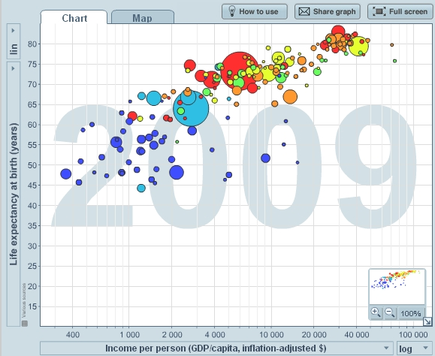
Teaching Mathematics for Social Justice
Gapminder (www.gapminder.org/)

Slide 61
Teaching Mathematics for Social Justice
Takehome message:
Move away from Calculus to math students can – and will – use as citizens.
engaging!
interesting!
sparks critical thinking!
ties math together with other subjects!
Make the world a better, more just place.
Closer to Fair

Slide 62
Closer to Fair: Mathematics & Social Justice
(curtains close – End of Act II)
You: (applause)
Dave: Thanks, really you’ve been a great group. Thanks for all of your fantastic questions and comments. Drop me a note anytime.
You: [ad lib as needed]
Contact: dtkung@smcm.edu

