Slide 1
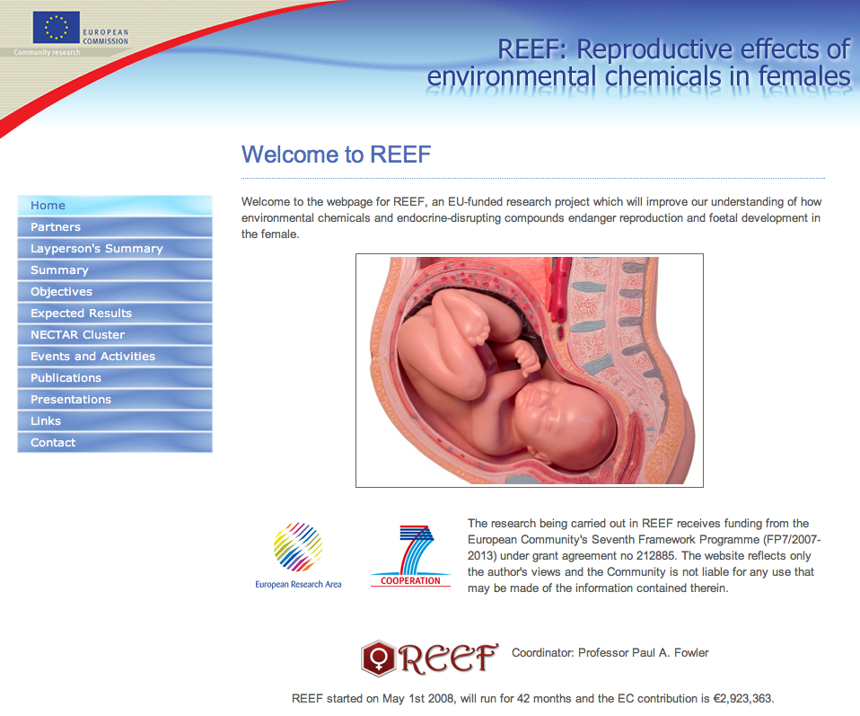
http://www.abdn.ac.uk/reef/

Slide 2
Measurement & selection of key ECs preferentially partitioned to the fetus in a real-life sewage sludge exposure model
SHEEP - already completed with Wellcome Trust funding to PAF, SR, CC (P1,P2,P3)
DEHP PCB101 PCB118
Real-life sewage-sludge exposure model
Fetal ovary organotypic culture mechanistic model
F0
SHEEP
In-vivo focused EC exposure models F1
Windows of fetal sensitivity to exposure model F1
SHEEP (EC cocktail)
Transgenerational effects
F2/F3
MOUSE
SHEEP
MOUSE
(focused EC)
SHEEP
(EC cocktail)
Morphological, genomic, transcriptomic and proteomic investigation of exposed ovaries and mechanistic models
SHEEP
MOUSE
Mechanistic studies: MOUSE
Ovarian effects of in-utero exposure F1
Human fetal ex-vivo model
F0
HUMAN
SMOKING
Linking animal model to human
REEF TASKS
Imprinting/embryonic development effects of in-utero exposure F1
Concepts/Data flow
Flow of samples
Generation studied
F0,F1,F2, F3
REEF OUTPUT
Mechanisms underpinning real-life chemical exposure effects on fetal development in the human female
Identification/validation of sensitive markers for detection of EC action

Slide 3
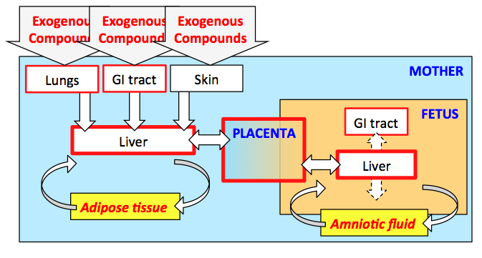
Why is exposure during pregnancy unique?

Slide 4
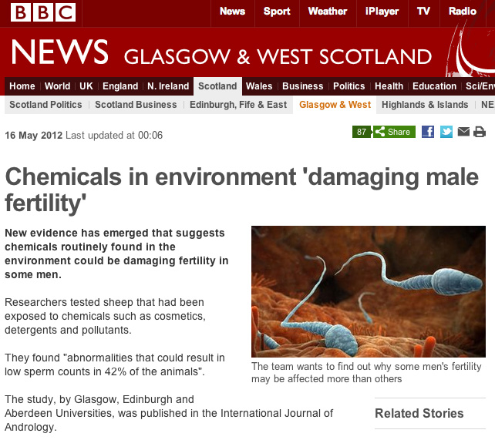
Focus was female, but males were a critical component of analyses and implicitly compared with females

Slide 5
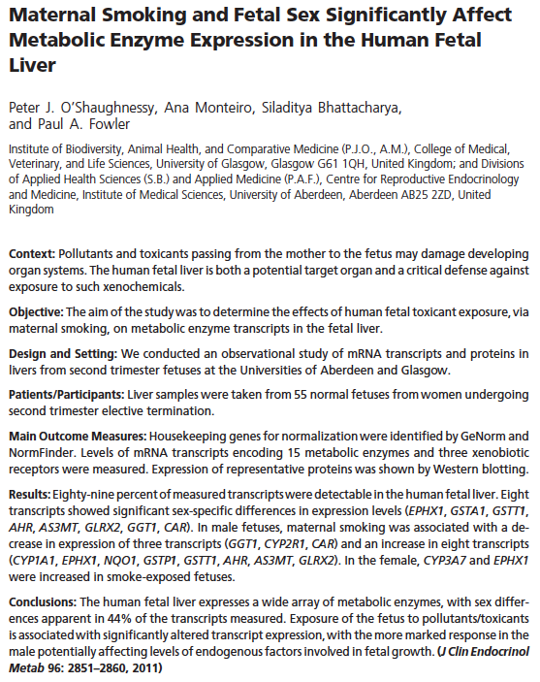
Sex differences in 44% of genes quantified
Sex differences in response to toxicants
Males more affected

Slide 6
How should we best express the two Gendered Innovations to emphasize that they are truly innovative (new)? The innovative nature of REEF may be elusive because it is a potentially-unique combination of non-unique techniques. REEF has the following characteristics:
Study of both male and female animals; much research into environmental chemicals is based on studies of males alone.
Environmental chemical research using a realistic (dietary + inhalation) route of exposure and realistic levels of exposure; laboratory experiments often involve much higher levels of chemical exposure than would occur in the environment.
Research using a mixture of chemicals rather than a single agent; laboratory experiments usually employ a single agent.
Study of multiple generations of animals, including those not directly exposed to a given environmental chemical mixture; most lab studies are single-generation.
Direct translation of animal findings to a human fetal model of exposure (maternal cigarette smoking).
None of these study methodologies is unique to REEF, but REEF may be innovative in combining them. How should we communicate this?

Slide 7
Gendered innovation 1
Environmental scientists designed health and biomedical research, combining established approaches in a novel way, in order to study the effects of EC exposure during pregnancy on pregnant females and both their female and male offspring.

Slide 8
Gendered Innovation 2
By implicitly analyzing sex, researchers have compared in-utero EC effects in females and males, including humans. Further studies of post-natal animal have likely significance for monitoring EC effects in humans.

