Slide 1

Timesheet And Payment System (TAPS)
Timesheets, Total Hours, and Gross payments for Casual and Overload employees

Slide 2
Project Overview
Provide hourly employees (Casuals and Overloads) a web interface to input hours worked in order to get paid.
Provide a means to submit total hours, for employees that track daily time via some other method (punch clock).
Provide a means to submit gross payments, for employees paid in lump sum or semi-monthly.

Slide 3
Timesheet Workflow
Hourly Employee creates timesheet document and submits it to Supervisor.
Supervisor approves/denies timesheet
Business Office approves/denies timesheet
Submits
Approves
Employee
Supervisor
Business Office
Approves
Payroll

Slide 4
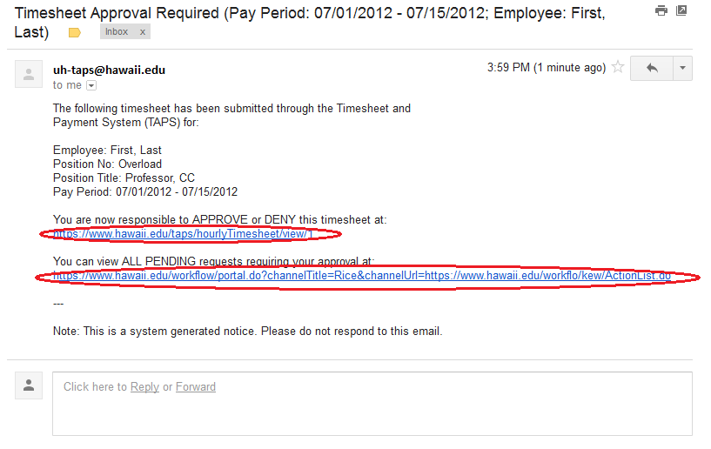
Email Notifications
Clicking on link in email notification.

Slide 5
Setups
Casual and Overload loaded into PeopleSoft: http://ps.hawaii.edu
TAPS Business Office role setup: Timesheet Approvers defined on FO Groups page within Profiler:
http://www.hawaii.edu/profiler
Hourly Casuals that don’t have UH Username will have to register at: http://www.hawaii.edu/account

Slide 6
Logging On
http://www.hawaii.edu/timesheets

Slide 7
Site walkthru

Slide 8
Target Date
UH Systemwide Production rollout in May 2012

Slide 9
Site URL and Contact
http://www.hawaii.edu/timesheets
uh-taps-help@lists.hawaii.edu

