Slide 1
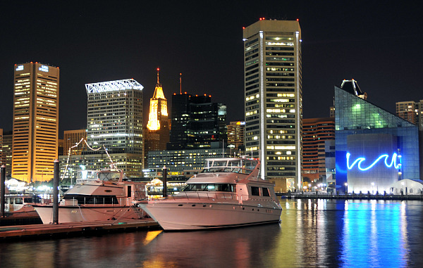
Welcome to Baltimore, hon
From http://kathika.com/baltimore-inner-harbor-hotels/

Slide 2
The Basics
ESEM 2013 in the Inner Harbor, Baltimore, MD, USA
October 10-11, 2013
ESEIW (October 7-12) includes ISERN, ESEM, IDOESE, IASESE
Co-located events TBD
Website: http://umbc.edu/eseiw2013/

Slide 3
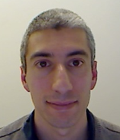
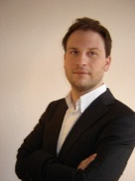
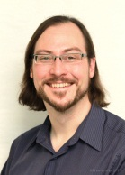
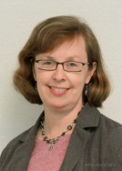
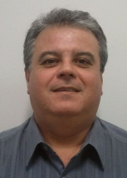
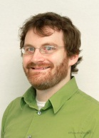
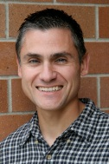
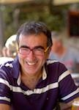
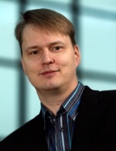
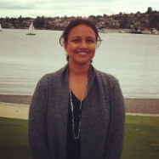
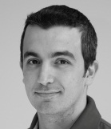
A Star-Studded Cast of Characters
Lorin Hochstein
Forrest Shull
Stefan Wagner
Carolyn Seaman
Guilherme Travassos
Lucas Layman
Clemente Izurieta
Oscar Pastor
Sreedevi Sampath
Davide Falessi
Tomi Männistö

Slide 4
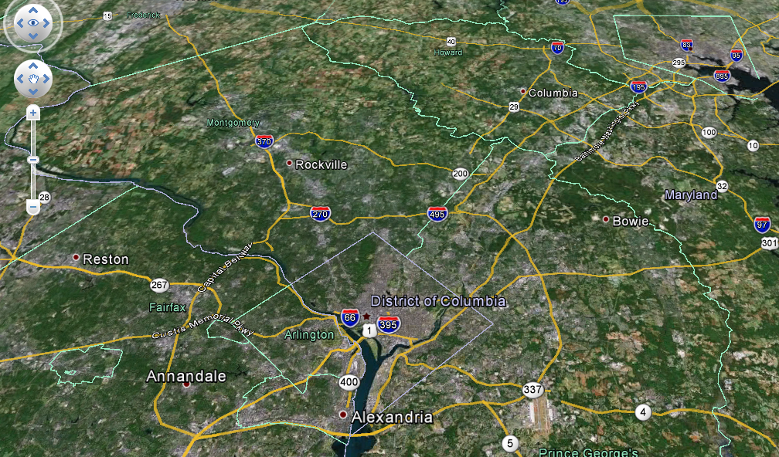
Getting There…
Multiple airports:
Inner Harbor
BWI (Baltimore)
IAD (Dulles)
DCA (Reagan)

Slide 5
Getting There…
An easy drive from any airport on the Beltway & I95
Just avoid rush hour.
Super Shuttle from any airport will connect to Inner Harbor
Inner Harbor also connects to railway (MARC or Amtrak)
From IAD: Take a bus or shuttle to Washington Union Station
From DCA: Metro runs from airport to Union Sta.
From BWI: Shuttle to the airport rail station.

Slide 6
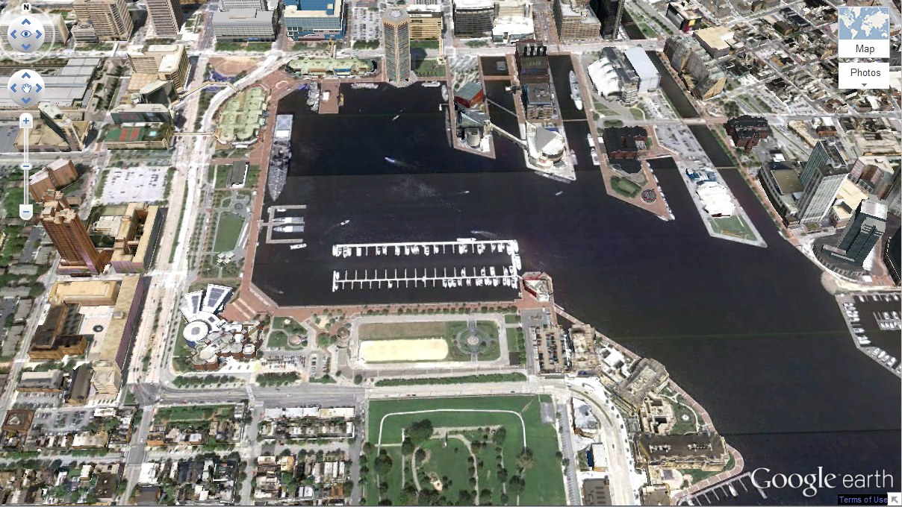
The Inner Harbor
Camden Yards
Street performances
Hard Rock Cafe
Fells Point & Little Italy
Shops & Dining
Aquarium
Seafood Restaurants
Visionary Arts
Museum
Science
Museum
Federal Hill Park
Water Taxi to Fort McHenry

Slide 7
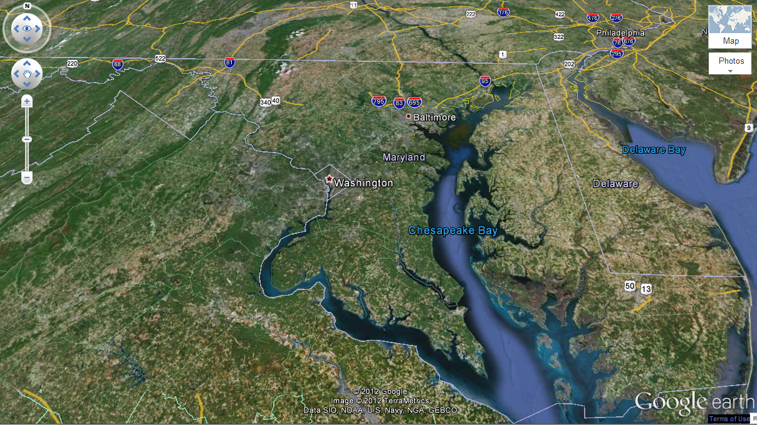
Nearby Day Trips
Fallingwater
Philadelphia
Historic City of
Frederick
National Capital Area
Beaches
Shenandoah Mtns. National Park & Skyline
Drive
The Eastern Shore

Slide 8
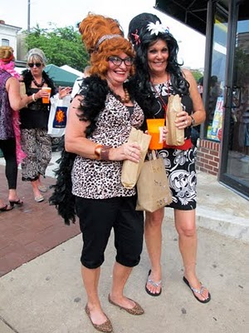

Cities have personalities…
Baltimore
Washington, DC

Slide 9
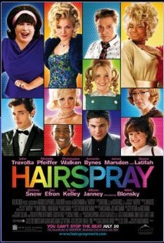
Your Homework
Do excellent research
Write awesome papers
Buy a ticket to Baltimore
Watch Hairspray
Original movie (1988)
Broadway musical (2002)
Re-make (2007)

Slide 10
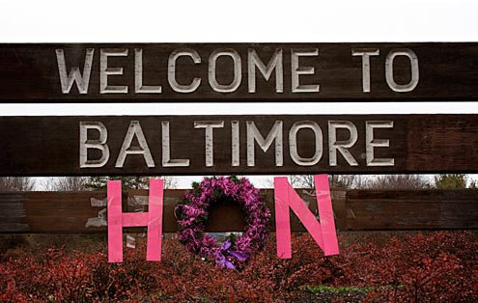
See you in Bawlmer!

