Slide 1
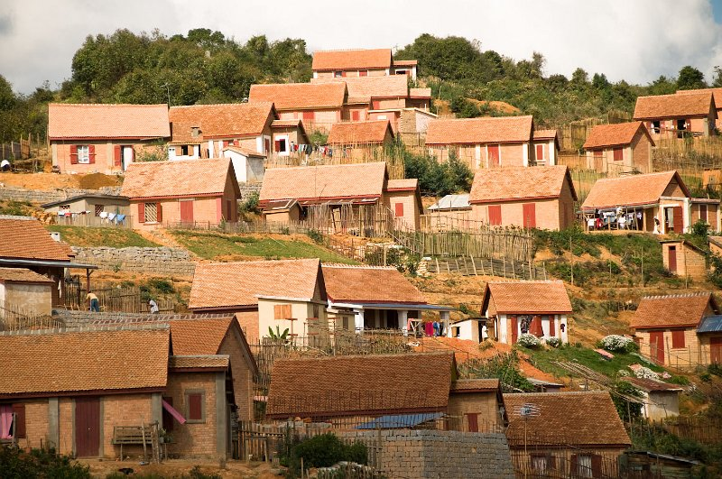


Slide 2

Who We Are
Habitat for Humanity International is a nonprofit, nondenominational Christian housing ministry.
We build and repair simple, decent, affordable houses for those who lack adequate shelter.

Slide 3
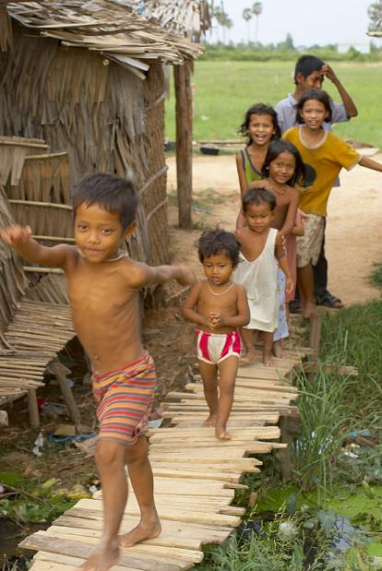
Who we serve
Habitat selects homeowners based on their need for housing, their ability to repay mortgage, and their willingness to work in partnership with Habitat.
Habitat does not discriminate on the basis of race, religion, ethnicity or any other difference.

Slide 4
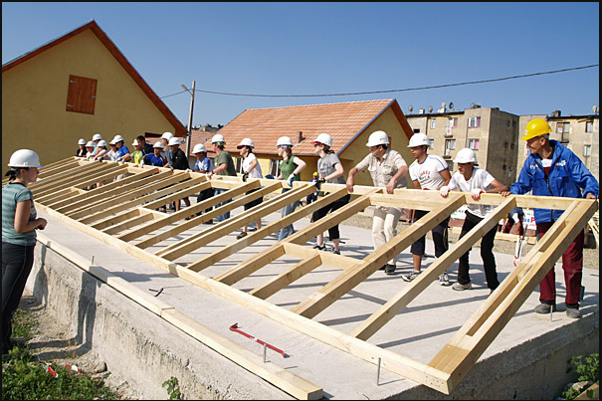
How it’s possible
Houses are sold through a no-profit mortgage
Individuals, corporations, and other groups provide financial support
Homeowners work with volunteers to build or repair under trained supervision

Slide 5
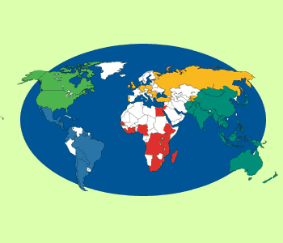
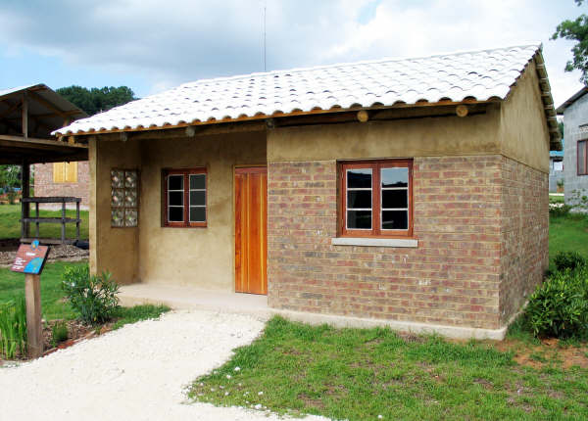
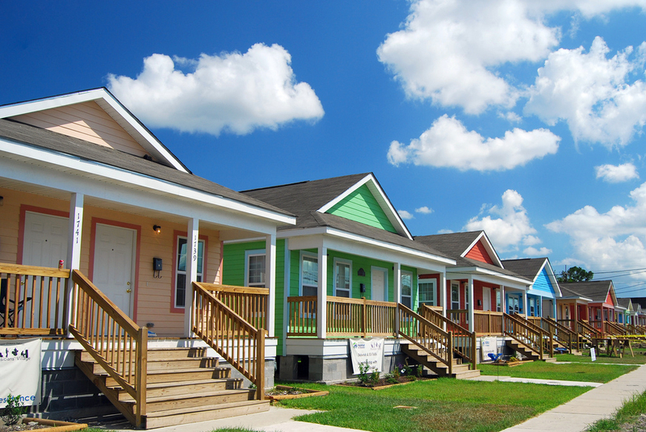
Where we build
Since its founding in 1976, Habitat for Humanity has helped build or repair over 500,000 houses and serve over 2.5 million people around the world.

Slide 6



Special Programs
Global Village Programs
National Service Programs
Disaster Response Programs

Slide 7
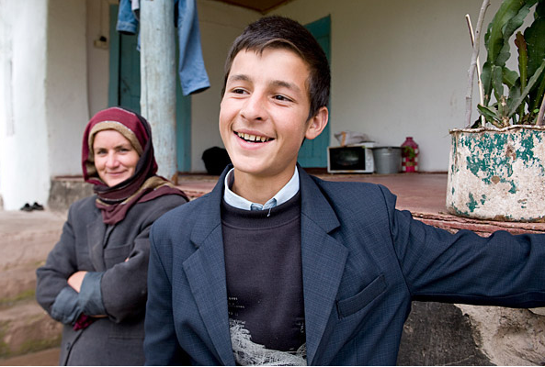

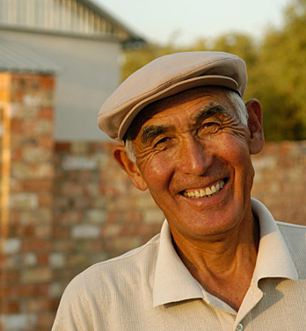
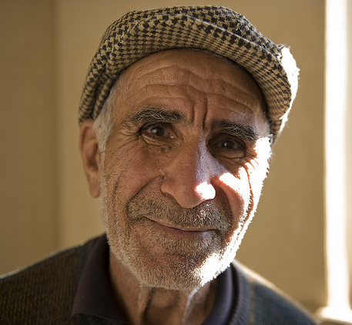
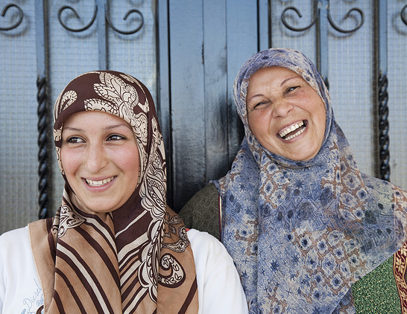

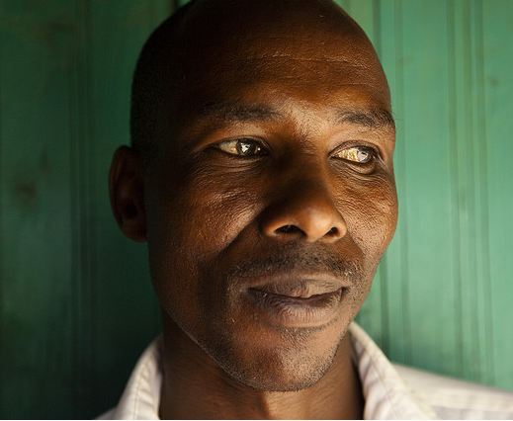


For more information, please visit www.habitat.org

