Slide 1
Tracking Linguistic Variation in Historical Corpora
David Bamman
The Perseus Project, Tufts University

Slide 2
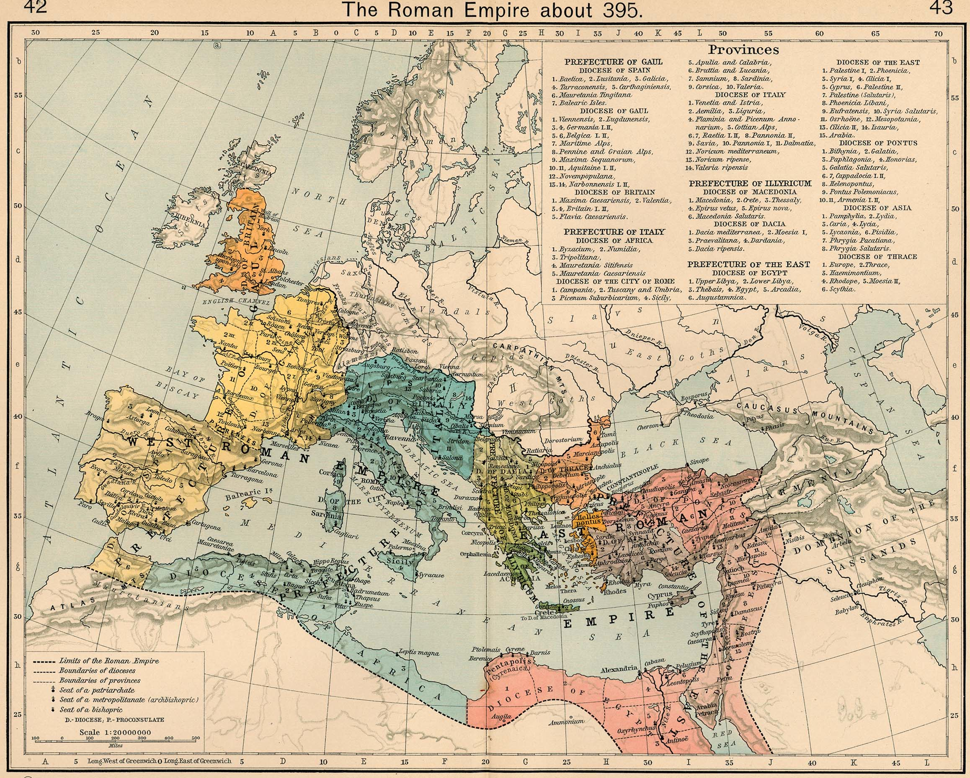
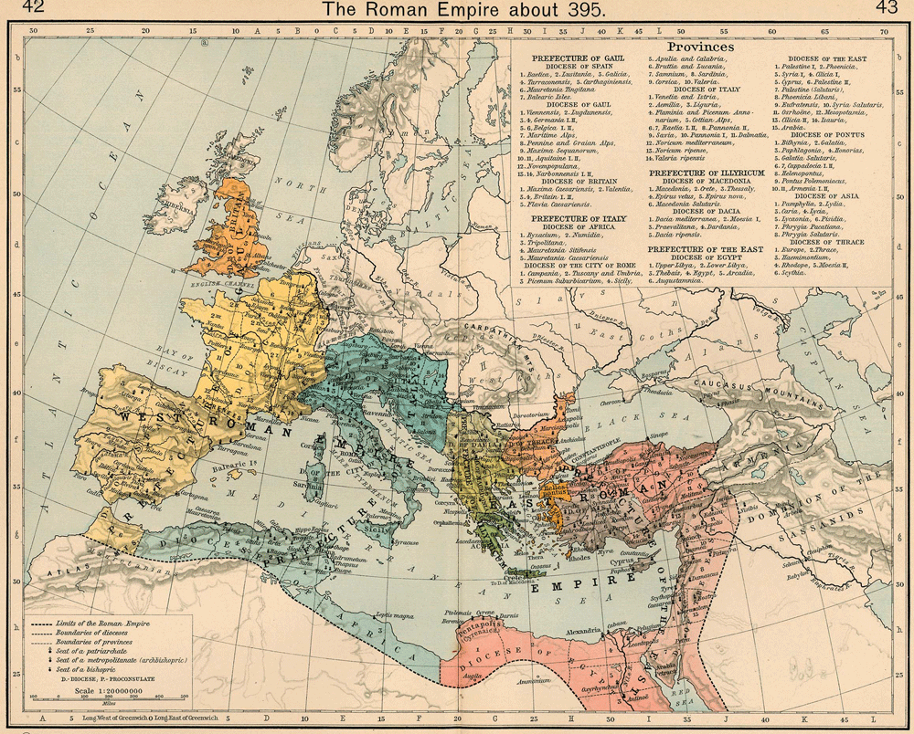

Slide 3
2000+ Years of Latin
Classical Latin: 200 BCE – 200 CE
Vergil, Caesar, Cicero
Late/Medieval Latin (200 CE – 1300 CE)
Augustine, Thomas Aquinas
Renaissance/Neo-Latin (1300 CE – present)
Erasmus, Luther
Tycho Brahe, Galileo, Kepler, Newton, Euler, Bernoulli, Linnaeus
Thomas Hobbes, Leibnitz, Spinoza, Francis Bacon, Descartes

Slide 4
Goal: Tracking Language Change
Lexical change (new vocabulary, shift in the meanings of words)
Syntactic change (including the influence of the author’s L1 on the Latin syntax)
Topical change (the rise of new genres)
Identifying the flow of information. E.g., Cicero + Augustine influencing Petrarch; Petrarch influencing Leonardo Bruni.

Slide 5
Data
1.2M books from the Internet Archive (snapshot of collection from 2009)
27,014 works catalogued as Latin
Problems:
1. Many of these works are not Latin.
2. Recorded dates = dates of publication, not dates of composition.

Slide 6
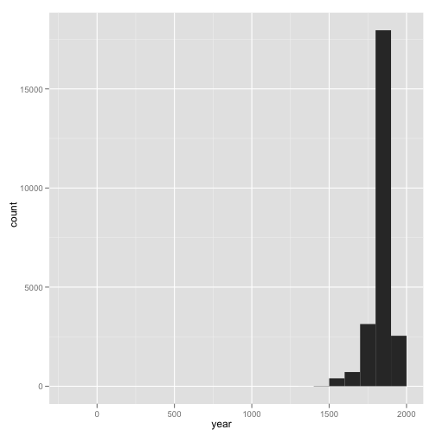
27,014 works catalogued as Latin in the IA, charted by “date.”

Slide 7
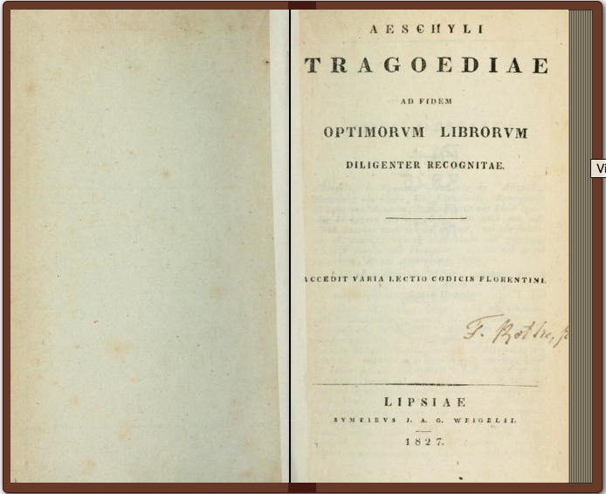

Slide 8
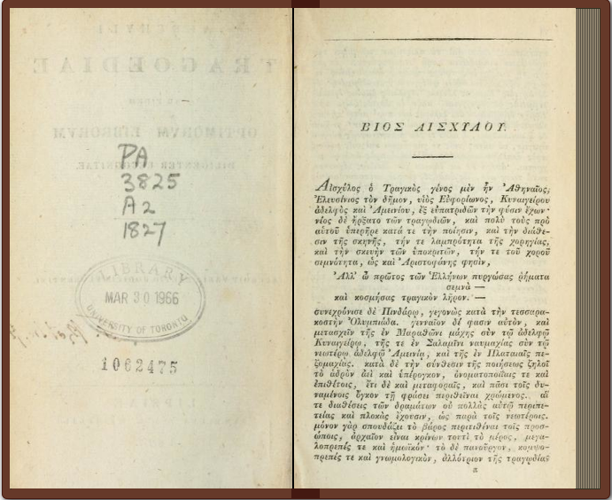

Slide 9
Language ID
Language ID to identify which of these works actually have Latin as a major language.
Trained a language classifier on:
24 editions of Wikipedia
Perseus classical corpus
Known badly-OCR’d Greek in the IA.
Results
~20% of 27,014 books catalogued as “Latin” are not (mostly Greek)
4,581 books not catalogued as Latin in the 1.2M collection are in fact so.

Slide 10
Composition dating
With undergraduate students, currently establishing the dates of composition for each Latin text. So far, considered 10,398 (38%) of them:
7,055 dated
3,343 excluded as not Latin or reference works (dictionaries, catalogues, lists of manuscripts)
From these 7,055 works, we extract just the Latin to create a dated historical corpus

Slide 11
27,014 works catalogued as Latin in the IA, charted by “date.”

Slide 12
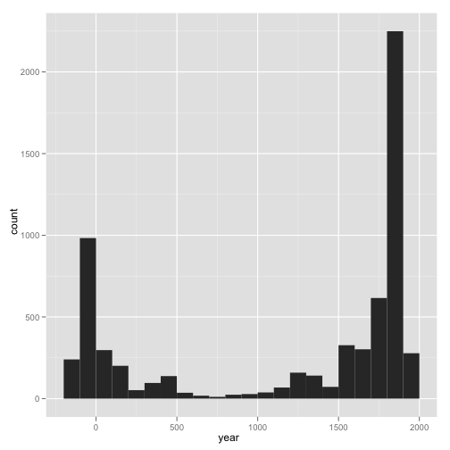
7,055 Latin works in the IA, charted by date of composition.

Slide 13
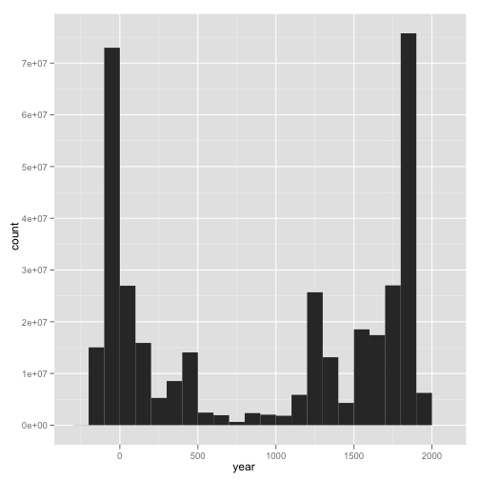
Word counts by century.
364,000,000 total.

Slide 14
Atomic variables
Track lexical trends
(“America” used more after 1508)
Track syntactic change
(SOV -> SVO)
Track lexical change
(“oratio” used more and more to mean “prayer” rather than “speech”)

Slide 15
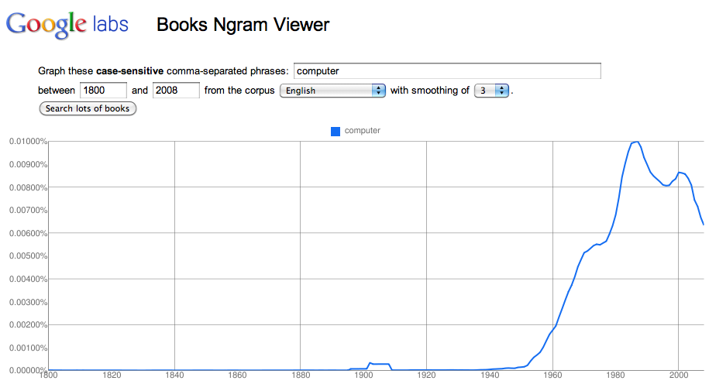
Lexical trends: Google Ngram Viewer

Slide 16
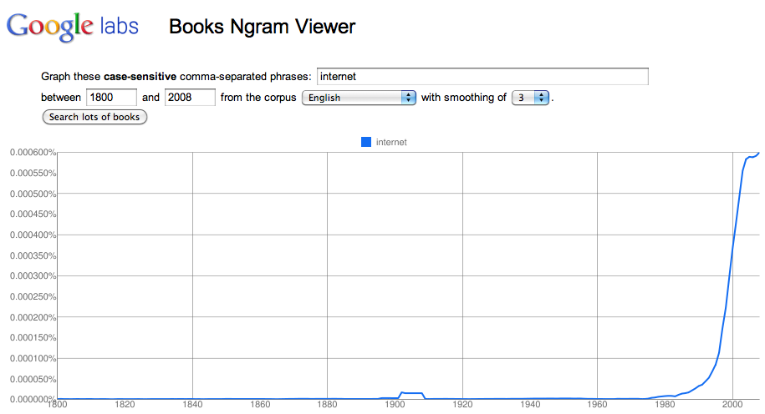
Lexical trends: Google Ngram Viewer

Slide 17
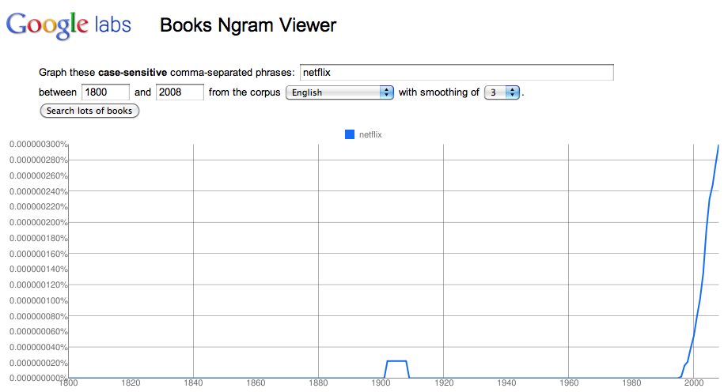
Lexical trends: Google Ngram Viewer

Slide 18
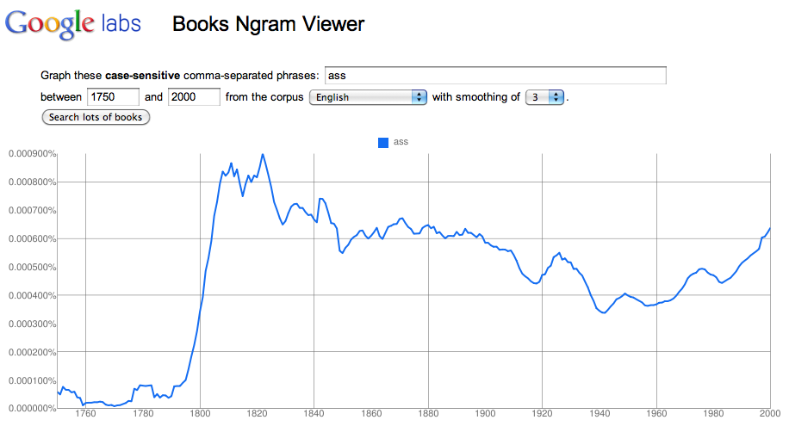
Lexical trends

Slide 19
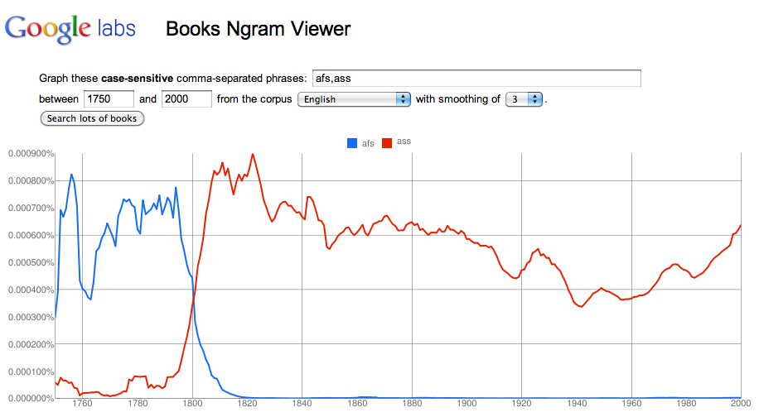
Lexical trends

Slide 20
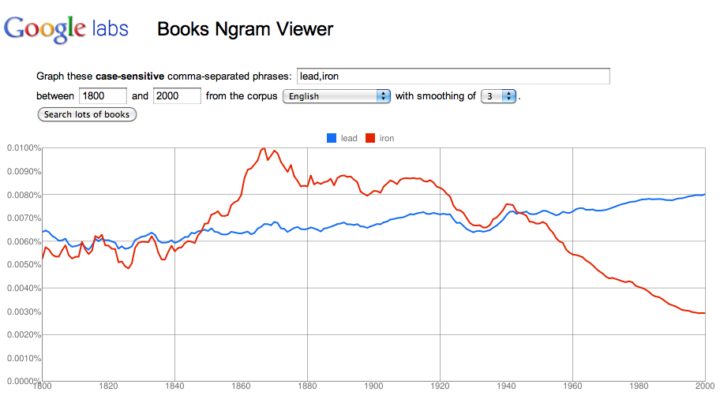
Lexical trends

Slide 21
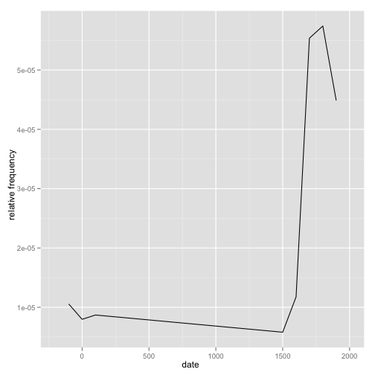
“America”
(1066)

Slide 22
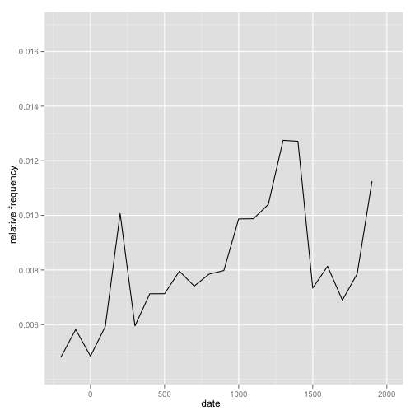
“de”
(2,955,462)

Slide 23
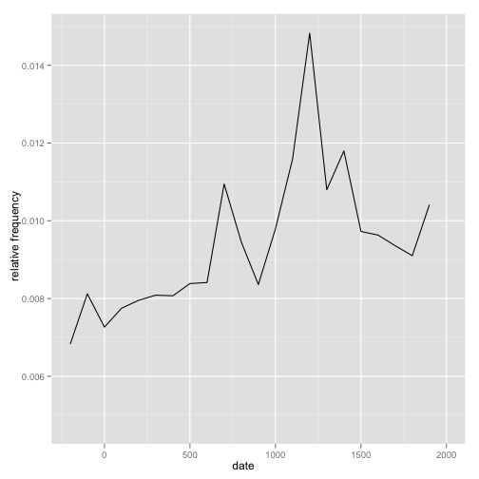
“ad”
(3,655,191)

Slide 24
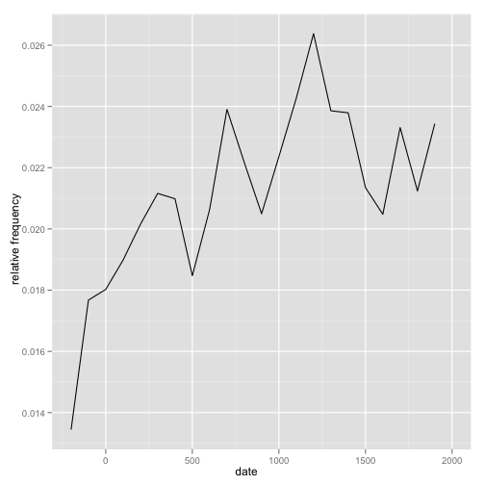
“in”
(8,126,487)

Slide 25
Atomic variables
Track lexical trends
(“America” used more after 1508)
Track syntactic change
SOV word order (“The dog me bit”) -> SVO (“The dog bit me”).
Track lexical change
(“oratio” used more and more to mean “prayer” rather than “speech”)

Slide 26
Historical treebanks
Most recent research and investment in treebanks has focused on modern languages, but treebanks for historical languages are now arising as well:
Middle English (Kroch and Taylor 2000)
Medieval Portuguese (Rocio et al. 2000)
Classical Chinese (Huang et al. 2002)
Old English (Taylor et al. 2003)
Early Modern English (Kroch et al. 2004)
Latin (Bamman and Crane 2006, Passarotti 2007)
Ugaritic (Zemánek 2007)
New Testament Greek, Latin, Gothic, Armenian, Church Slavonic (Haug and Jøhndal 2008)

Slide 27
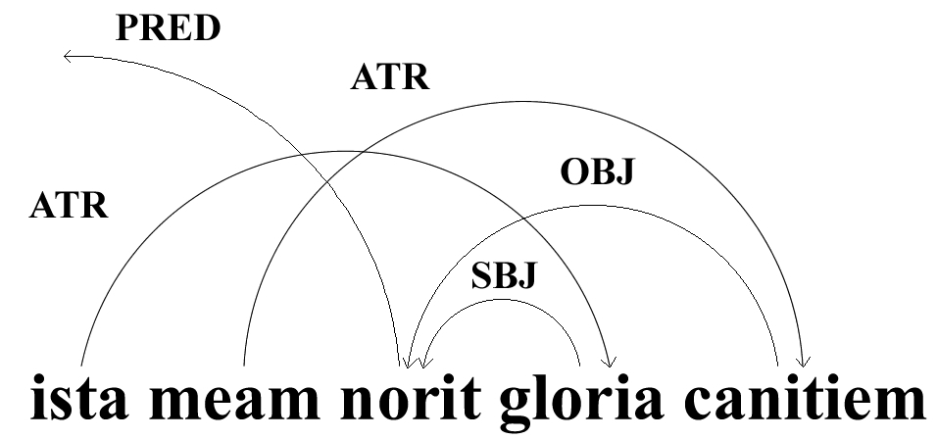
Design
Latin and Greek are heavily inflected languages with a high degree of variability in its word order: constituents of sentences are often broken up with elements of other constituents, as in ista meam norit gloria canitiem (“that glory will know my old age”). Because of this flexibility, we based our annotation standards on the dependency grammar used by the Prague Dependency Treebank (of Czech).

Slide 28
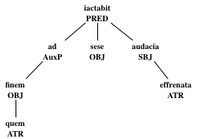
Latin Dependency Treebank
Author | Words
Caesar | 1,488
Cicero | 6,229
Sallust | 12,311
Vergil | 2,613
Jerome | 8,382
Ovid | 4,789
Petronius | 12,474
Propertius | 4,857
Total | 53,143
http://nlp.perseus.tufts.edu/syntax/treebank/

Slide 29
Ancient Greek Dependency Treebank
Work | Words
Aeschylus (complete) | 48,172
Hesiod, Shield of Heracles | 3,834
Hesiod, Theogony | 8,106
Hesiod, Works and Days | 6,941
Homer, Iliad | 128,102
Homer, Odyssey | 104,467
Sophocles, Ajax | 9,474
Total | 309,096
http://nlp.perseus.tufts.edu/syntax/treebank/

Slide 30
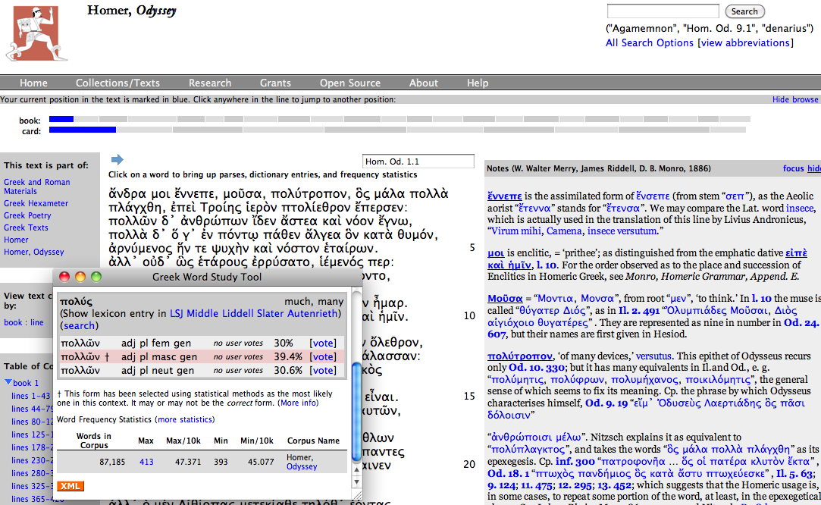
Perseus Digital Library

Slide 31
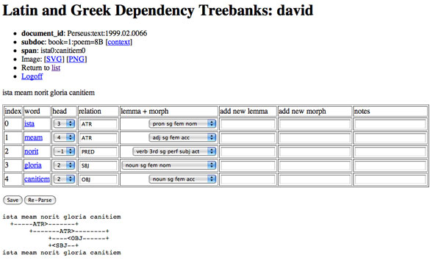
Treebank Annotation

Slide 32
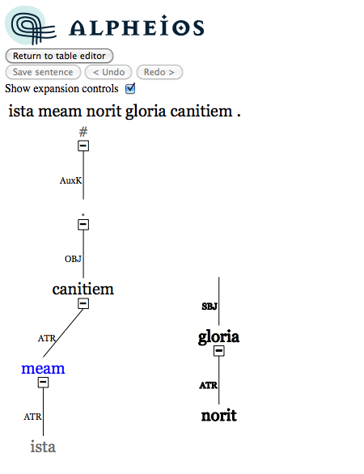
Treebank Annotation
Graphical editor: build a syntactic annotation by dragging and dropping each word onto its syntactic head.

Slide 33
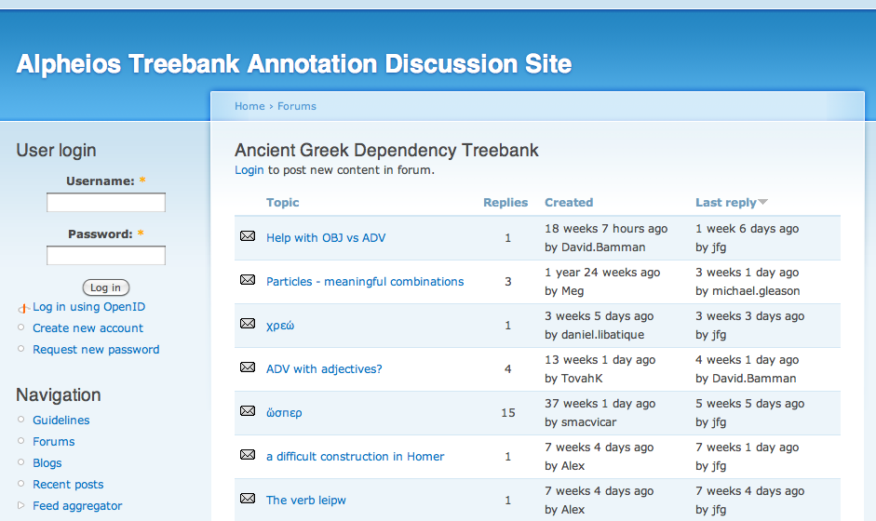
Annotator forum

Slide 34
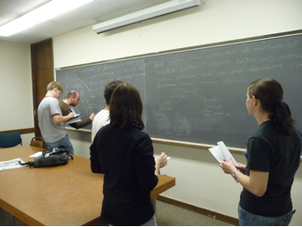
Class treebanking
Currently being used in 9 universities in the United States, Argentina and Australia.

Slide 35
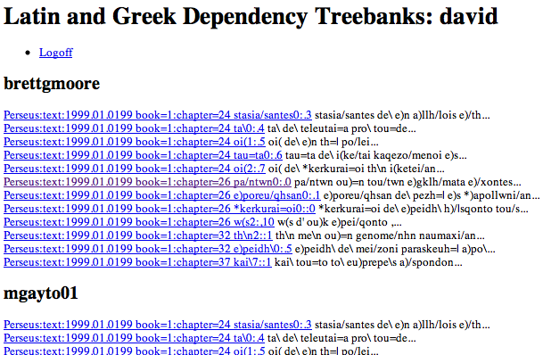
Perseus Digital Library

Slide 36
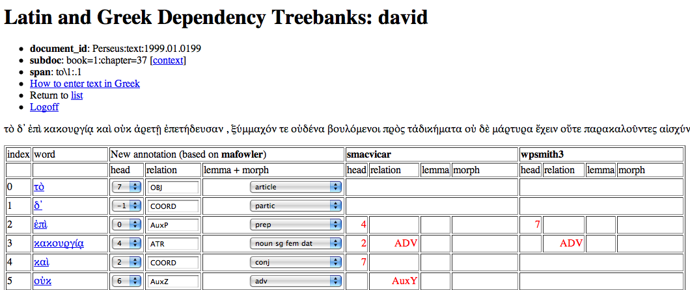
Perseus Digital Library

Slide 37
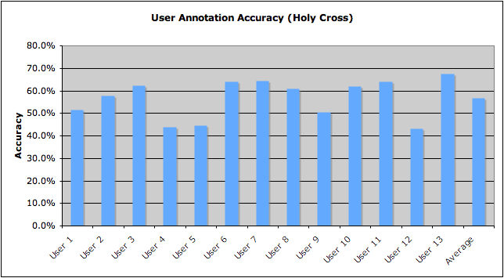
Undergraduate Contributions

Slide 38
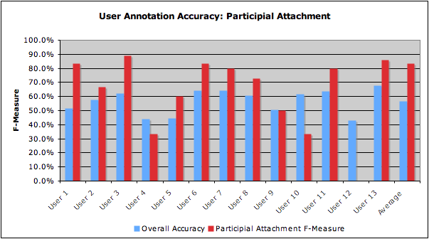
Undergraduate Contributions

Slide 39
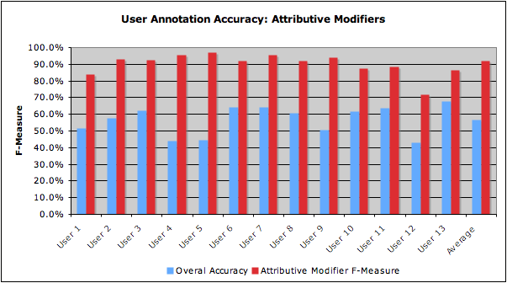
Undergraduate Contributions

Slide 40

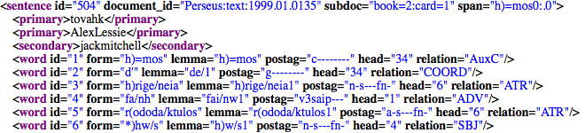
Ownership Model
...

Slide 41
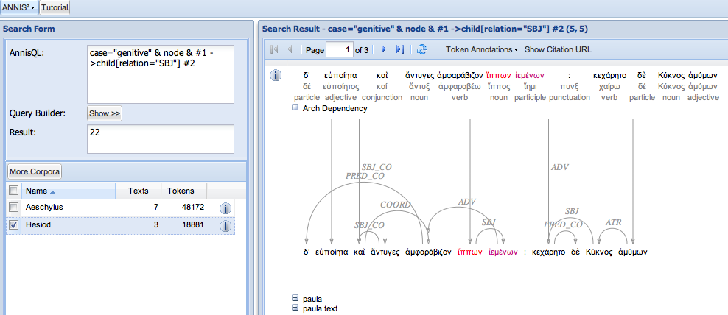
Treebank data

Slide 42
Syntactic variation
 | Cicero | Caesar | Vergil | Jerome
SVO | 5.3% | 0% | 20.8% | 68.5%
SOV | 26.3% | 64.7% | 18.8% | 4.7%
VSO | 5.3% | 0% | 6.3% | 16.5%
VOS | 0% | 0% | 10.4% | 3.1%
OSV | 52.6% | 35.3% | 25.0% | 3.9%
OVS | 10.5% | 0% | 18.8% | 3.1%
Word order rates by author (sentences with overt subjects and objects). Cicero, n=19; Caesar, n=17; Vergil, n=48; Jerome, n=127.

Slide 43
Syntactic variation
 | Cicero | Caesar | Vergil | Jerome
OV | 68.2% | 95.2% | 56.2% | 13.9%
VO | 31.8% | 4.8% | 43.8% | 86.1%
 | Cicero | Caesar | Vergil | Jerome
SV | 75.9% | 86.7% | 53.6% | 65.8%
VS | 24.1% | 13.3% | 46.4% | 34.2%
Word order rates by author (sentences with one zero-anaphor). OV/VO: Cicero, n=44; Caesar, n=63; Vergil, n=121; Jerome, n=309. SV/VS: Cicero, n=58; Caesar, n=90; Vergil, n=97; Jerome, n=404.

Slide 44
Atomic variables
Track lexical trends
(“America” used more after 1508)
Track syntactic change
(SOV -> SVO)
Track lexical change
(“oratio” used more and more to mean “prayer” rather than “speech”)

Slide 45
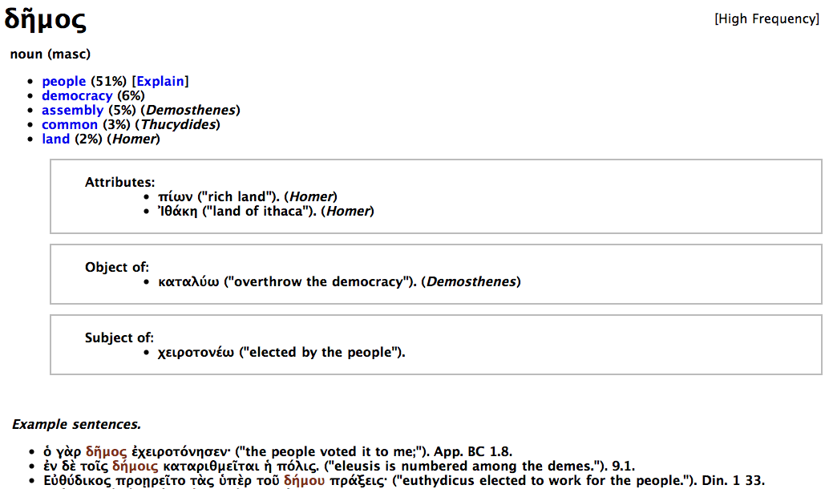
Dynamic Lexicon
http://nlp.perseus.tufts.edu/lexicon

Slide 46
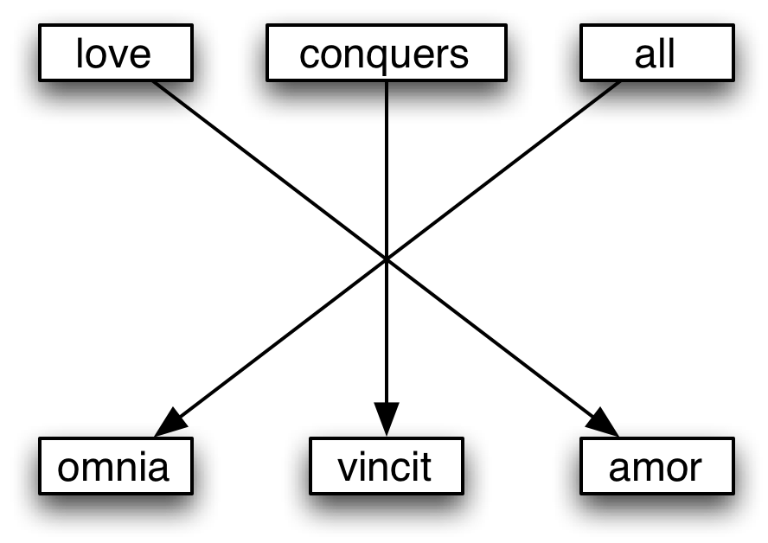
Tracking lexical change
SMT based on Brown et al (1990)
Different senses for a word in one language are translated by different words in another.
“Bank” (English)
financial institution = French “banque”
side of a river = French “rive” (e.g., la rive gauche)

Slide 47
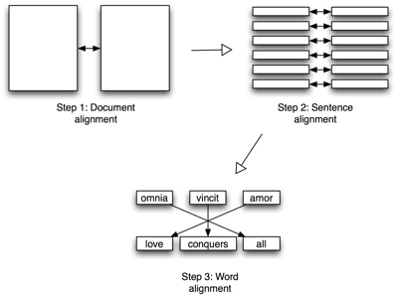
Dynamic Lexicon
Sentence level: Moore’s Bilingual Sentence Aligner (Moore 2002)
aligns sentences that are 1-1 translations of each other w/ high precision (98.5% on a corpus of 10K English-Hindi sentences)
Word level: MGIZA++ (Gao and Vogel 2008)
parallel version of: GIZA++ (Och and Ney 2003) - implementation of IBM Models 1-5.

Slide 48
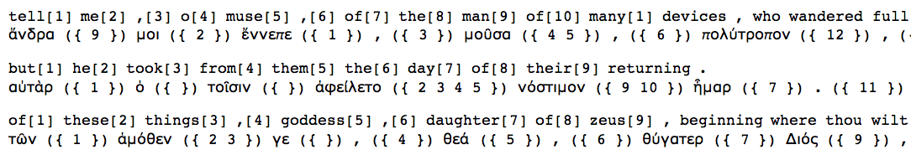
Multilingual Alignment
Word-level alignment of Homer’s Odyssey

Slide 49
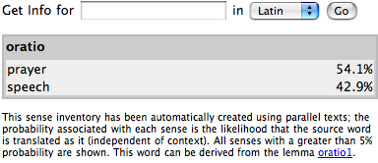
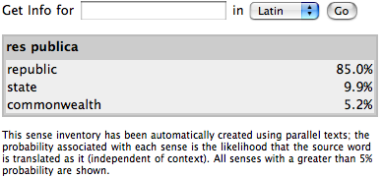
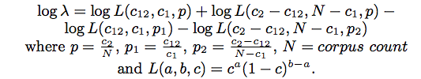
Latin/Greek ➔ English Senses

Slide 50
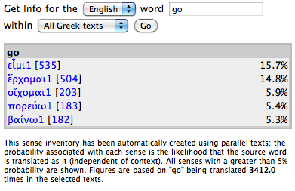
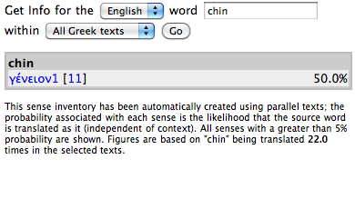
English ➔ Greek/Latin Senses

Slide 51
Dynamic Lexicon
http://nlp.perseus.tufts.edu/lexicon

Slide 52
Parallel Text Data
The Internet Archive alone contains editions of Horace’s Odes in eight different languages.
Latin: carpe diem quam minimum credula postero (Horace, Ode 1.11)
Italian: tu l’oggi goditi: e gli stolti al domani s’affidino (Chiarini 1916)
French: Cueille le jour, et ne crois pas au lendemain (De Lisle 1887)
English: Seize the present; trust tomorrow e’en as little as you may (Conington 1872)
German: Pflücke des Tag’s Blüten, und nie traue dem morgenden (Schmidt 1820)
Portuguese: colhe o dia, do de amanh ́a mui pouco confiando (Duriense 1807)
Spanish: Coge este dia, dando muy poco credito al siguiente (Campos and Minguez 1783)
Early Modern French: Jouissez donc en repos du jour present, & ne vous attendez point au lendemain (Dacier 1681)

Slide 53
Tracking sense variation in 2000 years of Latin
Identify translations
- (130 English translations manually identified by students from a representative range of dates)
Word align Latin text <-> English text
- (ca. 1.3M words)
Induce a sense inventory from the alignment
Train a WSD classifier on noisily aligned texts
Automatically classify remaining 365M words
Track lexical change

Slide 54
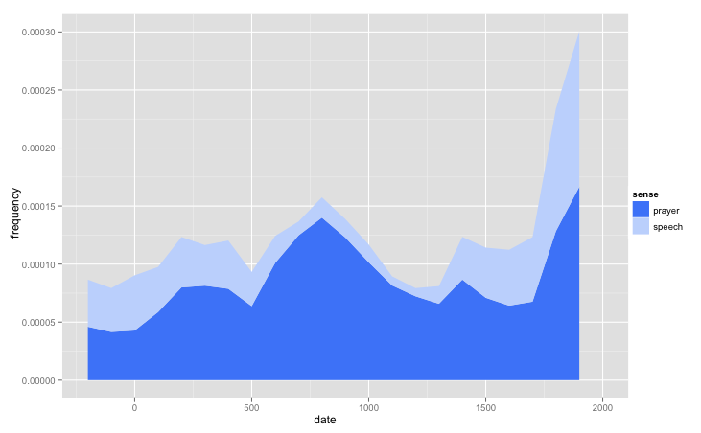
Oratio

Slide 55
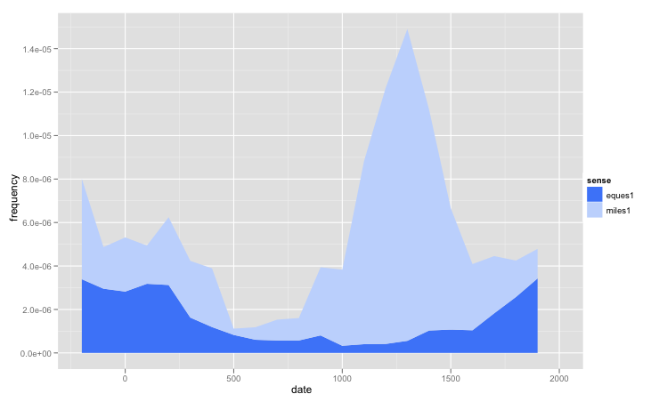
Knight

Slide 56
URLs
Treebank data
http://nlp.perseus.tufts.edu/syntax/treebank/
Treebank annotation environment
http://nlp.perseus.tufts.edu/hopper/
Translation information
http://nlp.perseus.tufts.edu/hopper/sense.jsp
Greek lexicon
http://nlp.perseus.tufts.edu/lexicon/

