Slide 1
Evaluation of VoIP QoS over WiBro
Keon Jang
KAIST
PAM 2008
April 29
Joint work with
Mongnam Han, Youngseok Lee, Sue Moon, Dooyoung Lee

Slide 2
Overview
WiBro’s baseline performance measurement
UDP throughput, loss, jitter
Comparison between mobile and fixed
VoIP quality measurement over WiBro
ITU-T E-model (R-Factor)
Impact of mobility on VoIP quality

Slide 3
What Is WiBro?
Subset of mobile WiMax (802.16e)
Targeting market between WLAN and cellular technologies
 | WLAN | WiBro | Cellular (HSDPA)
Coverage | Some hot spots | Seoul City | Nation-Wide
Bandwidth | 54Mbps(802.11g) | 5.5Mbps/ 2.0Mbps | 3.6Mbps/ 384kbps
Cost | N/A | $40(6GB) | $45(4GB)
Mobility | Walking Speed | 60km/h | 350km/h

Slide 4
Our Motivation
Is WiBro attractive enough to users?
In terms of performance: throughput, delay, loss
Good enough for VoIP streaming?
Most prior work is based on simulation
Link-level simulation to evaluate throughput [Ghosh 05]
Evaluation of QoS scheduling algorithms [Cicc 06]

Slide 5
Measurement Methodology

Slide 6
Network Configuration
KREONET
RAS
Corresponding Node
ACR
RAS
Mobile Node
KT’s
IP Network
RAS
ACR
ACR: Access control router
RAS: Radio Access Station
Sector 3
Sector 1
Sector 2

Slide 7
Measurement Experiment Design
Scenarios
Fixed: on KAIST Seoul campus
Mobile: on Subway Line #6
Traffic types
UDP Constant Bit Rate (CBR) traffic (iperf)
VoIP (D-ITG software)
Data collection
Packet trace using WinDump
Base Station ID (BSID) logs

Slide 8
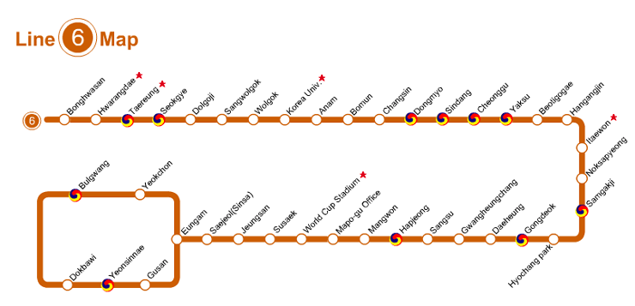
Seoul Subway Line 6
Total length: 35km
Maximum speed: 90km/h
WiBro support up to 60km/h
1 ACR, 6 RASes, 18 Sectors

Slide 9
Baseline Performance Measurement

Slide 10
Baseline Performance Measurement
Objective
Obtain baseline performance of the wireless link
Compare variability of link state in mobile vs fixed
Generate full-throttle CBR traffic
10 long-lived (5min) sessions
Total 50 minutes
Performance Analysis
Throughput / Variability
Jitter
Loss

Slide 11
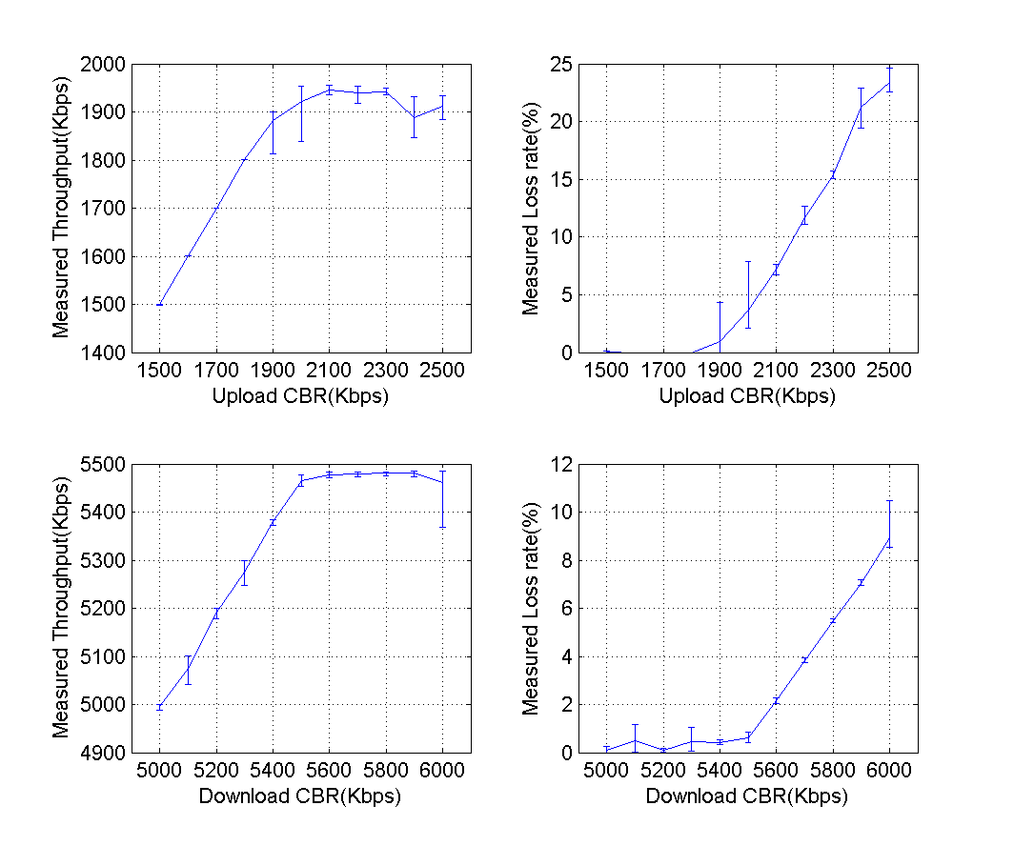
Finding Achievable Throughput
Measure UDP throughput in without mobility
Varying UDP rates
Downlink: 5~6Mbps
Uplink : 1.5~2.5Mbps
X=Y
Downlink B/W Peaks at 5.5Mbps
Uplink B/W Peaks at 2Mbps

Slide 12
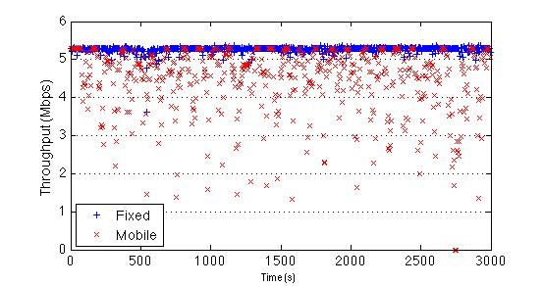
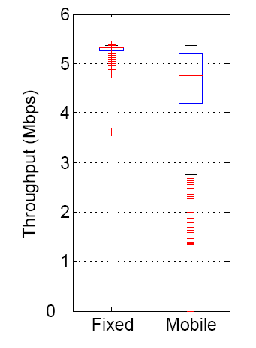
CBR Throughput
Experiment with 5.3Mbps UDP CBR traffic on downlink
Throughput remains almost constant w/o mobility
Throughput fluctuates much from 4.1 to 5.1 Mbps when mobile

Slide 13
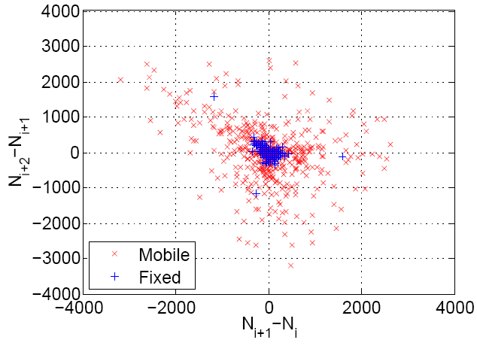
CBR Throughput Variability
Variability visualization
Throughput = N_{i,} i = 1, ..., n
Plot (N_{i+1}-N_{i}, N_{i+2}-N_{i+1} )
Represents 2nd order difference in throughput
Assessment
Median of distances
from center is
44 : 575
13 Times more variable!

Slide 14
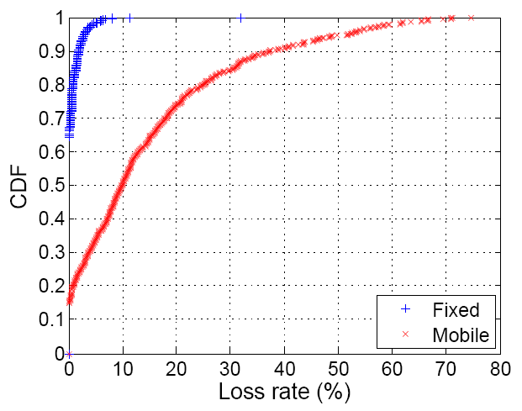
CBR Loss
Significant increase in loss when Mobile

Slide 15
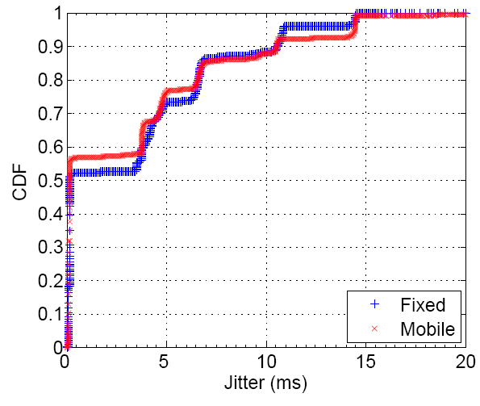
CBR Jitter
Zero jitter for 50% of packets
Mobile and fixed case shows similar jitter
Jitter: difference between sending interval and receiving interval

Slide 16
VoIP Traffic

Slide 17
Voice Evaluation Method
ITU-T E-model
Unlike MOS(Mean Opinion Score), it is a computational model
Output R-factor only dependent on delay, loss, codec type
Generate VoIP traffic using D-ITG with G.711 codec
R-Factor | MOS | Describtion
90-100 | 4.3-5.0 | Very Satisfied
80-90 | 4.0-4.3 | Satisfied
70-80 | 3.6-4.0 | Some users satisfied
60-70 | 3.1-3.6 | Many users dissatisfied
50-60 | 2.6-3.1 | Nearly all users dissatisfied
One-way Delay
ITU-T
E-Model
Loss Rate
Land line phone quality = 70
MOS
1~5
R-Factor
0~100
Src: http://www.voiptroubleshooter.com/basics/mosr.html

Slide 18
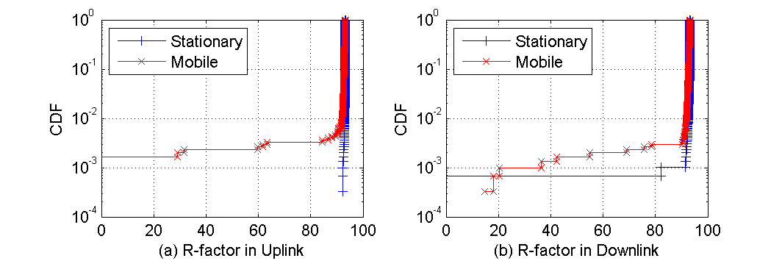
R-Factor
70
70
Fixed
Mobile
Fixed
Mobile
0.4%
0.4%
Uplink
Downlink
Less than 0.4% below 70 (toll quality)

Slide 19
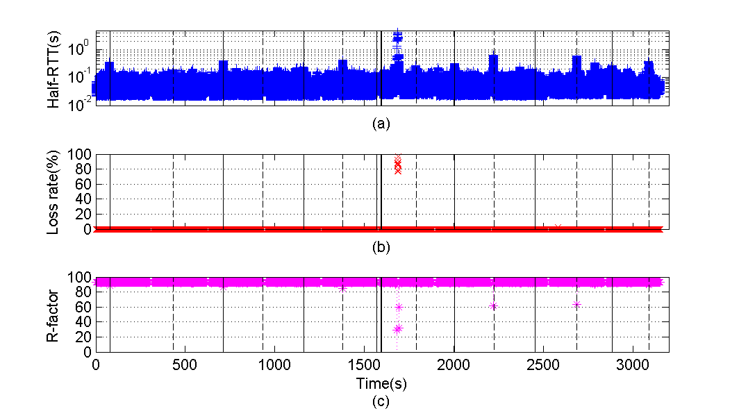
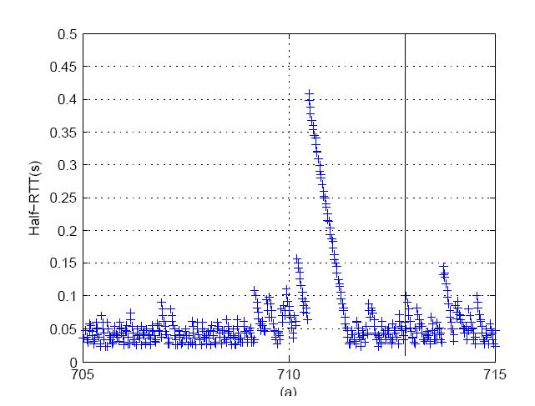
Impact of Mobility on VoIP
Inter RAS
Inter sector
17 handoffs during 50 minutes of experiment
Most delay spikes are correlated with handoff

Slide 20
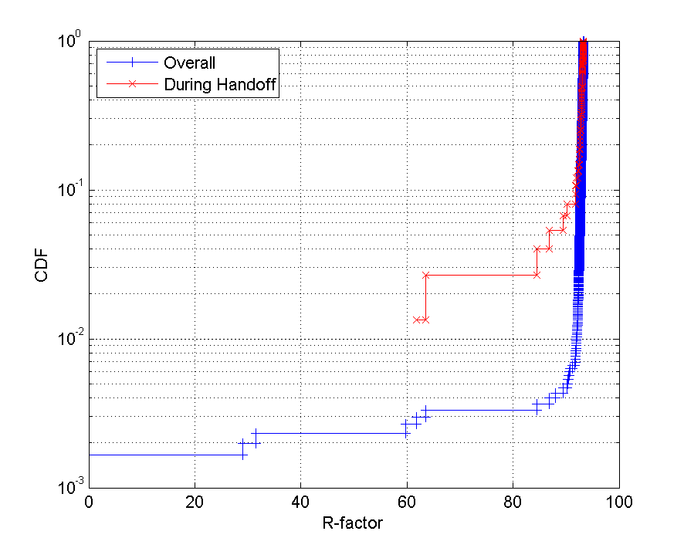
Impact of Handoff on VoIP
70
97%
R-factor is above 70(toll-quality) for more than 97% of time of handoff

Slide 21
Summary and Future Work
In this work we show
5.5Mbps downlink and 2Mbps uplink of achievable throughput
Throughput much more varies when mobile
VoIP over WiBro is better than toll-quality most of the time
Handoffs cause delay spikes of about 400ms Half-RTT and impact VoIP quality
In future we will investigate
Impact of cross traffic on VoIP
TCP behavior over WiBro
Video streaming quality
Correlation of performance with link-layer/physical layer information

Slide 22
Questions?

Slide 23
References
[Ghosh 05] Ghosh, A., Wolter, D.R., Andrews, J.G., Chen, R., “Broadband wireless access with WiMax/802.16: current performance benchmark and future potential”
[Cicc 06] Cicconeti, C., Lenzini, L., Mingozzi, E., Enklund, C., “Quality of service support in 802.16 networks”
[Kim 08] Dongmyoung Kim, Hua Cai, and Sunghyun Choi, “Measurement and Analysis of One-Way Delay over Mobile WiMAX Network”
[Cai 08] Hua Cai, Youngkyu Choi, Dongmyoung Kim, and Sunghyun Choi, “A Measurement Study of VoIP over WiBro Networks”

