Slide 1
Progress in D=4, N=2 Field Theory
Strings-Math, Bonn, July, 2012
Gregory Moore, Rutgers University
Collaborators:
D. Gaiotto & A. Neitzke
P. Aspinwall,W.-y. Chuang,E.Diaconescu,J. Manschot,
Y. Soibelman
D. Van den Bleeken, A. Royston

Slide 2
Outline
Basic Definitions and the No-Exotics Conjecture
Old techniques give new results on BPS spectra
Spectral Networks
Applications of spectral networks
Spin lifts
Categorification
Conclusion

Slide 3
Abelian Gauge Theory and Charge Lattice
Low Energy Effective Theory: U(1)^{r} =2 Gauge Theory
Local system of charges over the Coulomb branch:
Symplectic lattice of (elec,mag) charges of IR abelian gauge theory

Slide 4
BPS States
Little group contains so(3) _{spin}  su(2)_{R}

Slide 5
No-exotics conjecture
Study by GMN of line defect vev’s suggested the
No-exotics conjecture: Exotic BPS states do not exist in field theories (with good UV fixed point).
Definition: ``Exotic states’’ are vectors in h^{BPS} where su(2)_{R} acts non-trivially
N.B. There are counterexamples in non-asymptotically free theories engineered by string theory

Slide 6
Indices & Positivity Conjectures
No exotics conjecture
h contains only integer spin representations of su(2)_{R}
Protected spin character = naïve spin character
 is a positive integral linear combination of spin characters (c.f. positivity in cluster algebras).

Slide 7
Line Defects & Framed BPS States
A line defect L (say along R_{t} x {0 } ) is of type ζ =e^{i☺}
if it preserves the susys:
Example:
Framed BPS States:
Notes:
SAY AS AN ASIDE THAT A COROLLARY OF OUR WORK ARE EXACT RESULTS ON THESE SUSY LINE DEFECTS

Slide 8
Surface Defects
Preserves a d=2 (2,2) supersymmetry subalgebra
Coupled 2d/4d system
IR Description:

Slide 9
Solitons in Coupled 2d4d Systems
Flux:
2D soliton degeneracies:

Slide 10
2d/4d Degeneracies: ω
Flux:
One can define :
Knowing  determines 

Slide 11
Supersymmetric Interfaces
UV:
Flux:
IR:

Slide 12
Susy Interfaces: Framed Degeneracies
Our interfaces preserve two susy’s of type ζ and hence we can define framed BPS states and form:

Slide 13
Outline
Basic Definitions and the No-Exotics Conjecture
Old techniques give new results on BPS spectra
Spectral Networks
Applications of spectral networks
Spin lifts
Categorification
Conclusion

Slide 14
Old Techniques – New Results
2
1. Semiclassical field theory of monopoles and dyons. (See A. Royston’s talk.)
2. Quivers
3. Exceptional collections

Slide 15
Geometric Engineering
Recall geometric engineering of pure SU(K) gauge theory (Aspinwall; Katz,Morrison,Plesser; Katz, Klemm, Vafa)
Family of resolved A_{K-1} singularities X_{K}  P¹
Take a scaling limit of Type IIA on X_{K} x R^{1,3}
Recover N=2 SU(K) SYM

Slide 16
Exceptional Collections & Quivers
(Aspinwall, Chuang, Diaconescu, Manschot, Moore, Soibelman)
We exhibit a strong exceptional collection of line bundles L on X_{K}
Compute Ext⁰ (L ) quiver:

Slide 17
Remarks
Coincides with B. Fiol/0012079 and mutation equivalent to
Alim, Cecotti, Cordova, Espabohdi, Rastogi, Vafa, (2011)
There is a chamber with 2 BPS HM’s for each root.
Now go exploring with the KSWCF
In the weak coupling regime in the field theory: ``SU(2) cohort’’ only for simple roots, AND there are higher spin BPS states.
1. Direct analysis of D^{b}(X_{K})
2. Semiclassical analysis: Royston’s talk

Slide 18
Wild Wall Conjecture
As we move from chamber to chamber we apply the KSWCF: For ₁,₂  = m
According to a conjecture of Weist,  _{a,b} (m) grows exponentially with charge for
Exponential growth contradicts well-established thermodynamics of field theory!
So the only physical wall-crossings occur for m=1,2 (j=0,1/2)

Slide 19
Proof of No-Exotics for SU(K)
BPS states can be viewed as cohomology classes in moduli space M() of quiver representations.
The cohomology has a (generalized) Hodge decomposition with components of dimension
h^{r,s}(M), r,s  ½ Z
The physical U(1)_{R} charge is identified as
In the SU(K) examples, using the relation to “motives” and framed BPS degeneracies one can show that h^{r,s} ( M ) = 0 unless r=s
Absence of exotics
Generalize to all toric CY3 ??

Slide 20
But it seems these techniques are not powerful enough for more general theories….
We need a systematic approach:
Spectral Networks will do this for “theories of class S”.
The remainder of this talk reviews work done with
D. Gaiotto and A. Neitzke:
Spectral Networks, arXiv:1204.4824
Spectral Networks and Snakes, to appear

Slide 21
Outline
Basic Definitions and the No-Exotics Conjecture
Old techniques give new results on BPS spectra
Spectral Networks
Applications of spectral networks
Spin lifts
Categorification
Conclusion

Slide 22
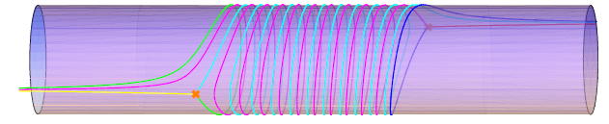
What are spectral networks?
3
Spectral networks are combinatorial
objects associated to a branched covering of Riemann surfaces   C
Spectral network
C
branch point

Slide 23
What are spectral networks good for?
They give a systematic approach to BPS degeneracies in D=4, N=2 field theories of class S.
They give a “pushforward map” from flat U(1) gauge fields on  to flat nonabelian gauge fields on C.
They determine cluster coordinates on the moduli space of flat GL(K,C) connections over C.
“Fock-Goncharov coordinates’’
“Higher Teichmuller theory”
Higher rank WKB theory
:Stokes lines

Slide 24
Theories of Class S
Consider 6d nonabelian (2,0) theory S[g] for ``gauge algebra’’ g
The theory has half-BPS codimension two defects D
Compactify on a Riemann surface C with D_{a} inserted at punctures z_{a}
Twist to preserve d=4,N=2
Witten, 1997
GMN, 2009
Gaiotto, 2009
Type II duals via ``geometric engineering’’
KLMVW 1996

Slide 25
Relation to Hitchin System
5D g SYM
σ-Model:

Slide 26
Defects
&
Physics depends on choice of
Physics of these defects is still being understood: Recent progress: Chacaltana, Distler & Tachikawa

Slide 27
Now we will make the cast of characters from Part 1 much more explicit

Slide 28
UV Curve
Seiberg-Witten Curve
SW differential
For g=su(K)
is a K-fold branched cover

Slide 29
Coulomb Branch & Charge Lattice
Coulomb branch
{ Meromorphic differential with prescribed singularities at z_{a} }
Local system of charges
(Actually,  is a subquotient. Ignore that for this talk. )

Slide 30
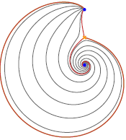
BPS States: Geometrical Picture
BPS states come from open M2 branes stretching between sheets i and j. Here i,j, =1,…, K.
Klemm, Lerche, Mayr, Vafa, Warner; Mikhailov; Mikhailov, Nekrasov, Sethi,
A WKB path of phase ☺ is an integral path on C
Generic WKB paths have both ends on singular points z_{a}
Separating WKB paths begin on
branch points, and for generic ☺,
end on singular points

Slide 31
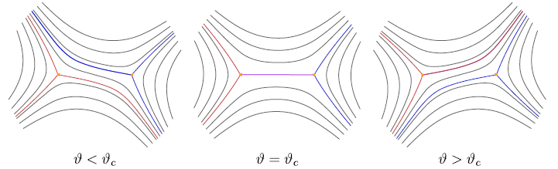
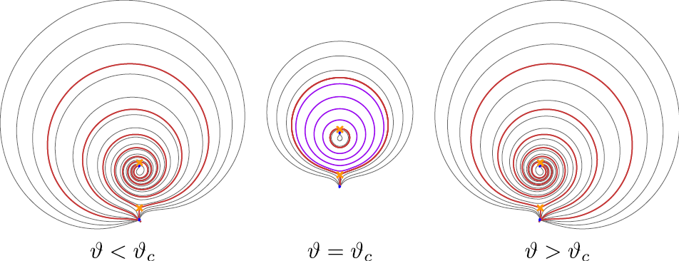
String Webs – 4/4
At critical values of ϑ= ϑ_{c} get string webs :
A ``string web’’ is a union of WKB paths with endpoints on branchpoints or such junctions.
(Webs without endpoints are allowed.)
These webs lift to closed cycles γ in Σ and represent BPS states with

Slide 32
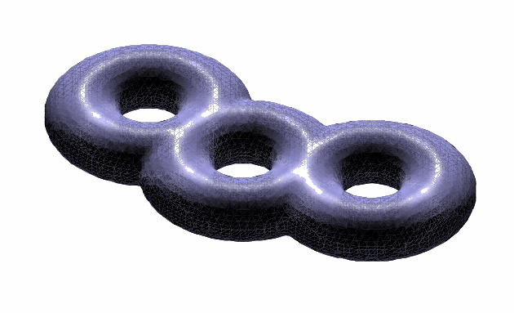
Line defects in S[g,C,D]
6D theory S[g] has supersymmetric
surface defects:
For S[g,C,D] consider
Line defect in 4d labeled by isotopy class of a closed path ℘.
k=2:
Drukker, Morrison,
Okuda

Slide 33
Canonical Surface Defect in S[g,C,D]
For z ∈ C we have a canonical surface defect S_{z}
It can be obtained from an M2-brane ending at x¹=x²=0 in R⁴ and z in C
In the IR the different vacua for this M2-brane are the different sheets in the fiber of the SW curve over z.
Therefore the chiral ring of the 2d theory should be the same as the equation for the SW curve!
Alday, Gaiotto, Gukov, Tachikawa, Verlinde; Gaiotto

Slide 34
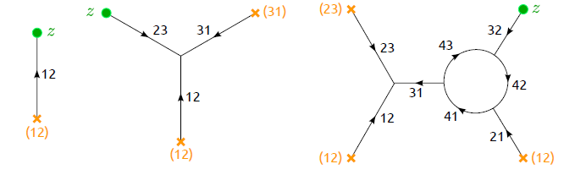
Solitons as open string webs
Solitons for S_{z} correspond to open string webs on C which begin and end at z
For solitons on S_{z} we define an index μ := signed sum over open string webs beginning and ending at z

Slide 35
Soliton Charges in Class S
_{ij}(z) has endpoints covering z
x_{i}
x_{j}
z

Slide 36
Susy interfaces for S[g,C,D]
Interfaces between S_{z} and S_{z’} are labeled by open paths ℘ on C
L,☺ only depends on the homotopy class of 

Slide 37
IR Charges of framed BPS
Framed BPS states are graded by homology of open paths γ_{ij’} on Σ with endpoints over z and z’

C

Slide 38
SUMMARY SLIDE
FIELD THEORY
BPS DEGENERACY
CLASS S REALIZATION
string webs on C lifting to   H₁()
4d BPS PARTICLES
LINE DEFECT & Framed BPS
UV:closed  C
IR: closed   
UV: S_{z}
SURFACE DEFECT & Solitons
IR: Open paths on  joining sheets i and j above z.
SUSY INTERFACE
UV: Open path  on C z to z’
IR: Open path on  from
x_{i} to x_{j’}

Slide 39
Spectral Networks
We will now show how the technique of spectral networks allows us to compute all these BPS degeneracies.
Definition: Fix ☺. The spectral network ☺ is the collection of points on z  C such that on S_{z} there is some 2d soliton of phase =e^{i☺}:

Slide 40
S-Walls
☺ contains the endpoints z of open string webs of phase ☺
These webs are made of WKB paths:
The path segments are ``S-walls of type ij’’

Slide 41
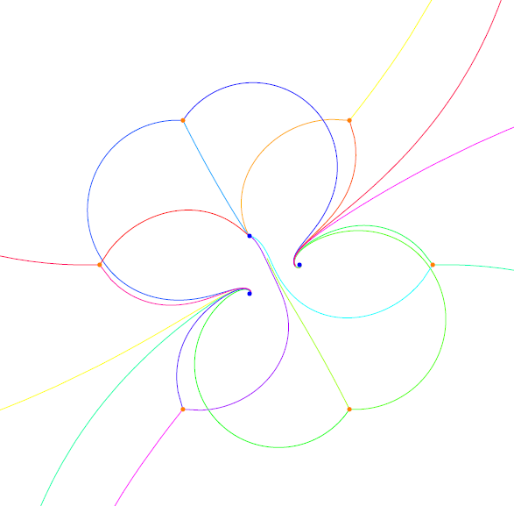
12
32
32
21
21
23
But how do we choose which WKB paths to fit together?

Slide 42
Formal Parallel Transport
Introduce the generating function of framed BPS degeneracies:

C

Slide 43
Homology Path Algebra
To any relative homology class
a  H₁(,{x_{i}, x_{j’} }; Z) assign X_{a}
defines the “homology path algebra” of 

Slide 44
Four Defining Properties of F
1
2
Homotopy invariance
=
3
If  does NOT intersect ☺ :
4
If  DOES
intersect ☺ :
``Wall crossing formula’’

Slide 45
Wall Crossing for F(,☺)
ij

Slide 46
Theorem: These four conditions completely determine both F(,☺) and 
Proof:
The mass of a soliton with charge _{ij}
increases monotonically along the S-walls.
Natural mass filtration defines [☹]:

Slide 47
Evolving the network -1/3
For small ☹ the network simply consists of 3 trajectories emitted from each ij branch point,
ji
ij
ji
Homotopy invariance implies (_{ij})=1

Slide 48
Evolving the network -2/3
As we increase ☹ some trajectories will intersect. The further evolution is again determined by homotopy invariance
₁
and,
(_{ik}) is completely determined (CVWCF)
₂

Slide 49
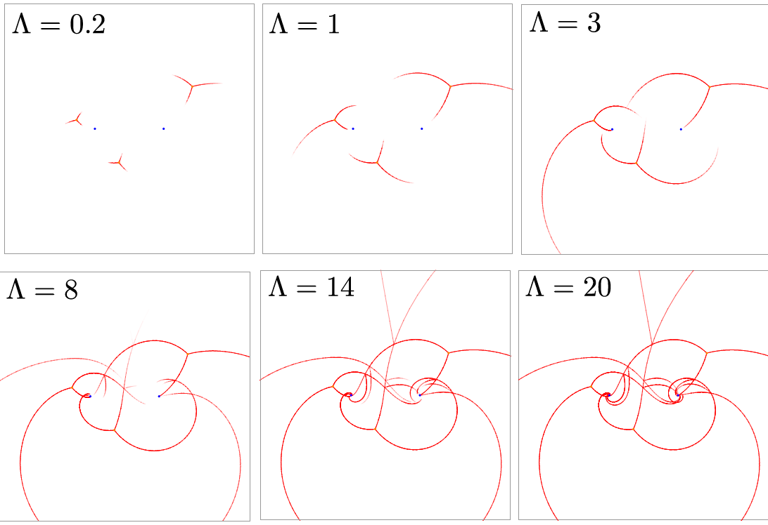

Slide 50
Outline
Basic Definitions and the No-Exotics Conjecture
Old techniques give new results on BPS spectra
Spectral Networks
Applications of spectral networks
Spin lifts
Categorification
Conclusion

Slide 51
Three Applications
4
1. Determination of BPS spectrum
2. Nonabelianization map & cluster coordinates on the moduli spaces of flat connections
3. Higher rank WKB

Slide 52
Determine the 2d spectrum
Now vary the phase :
This determines the entire 2d spectrum:
for all
But, the spectral network also changes discontinuously for phases ☺_{c} corresponding
to 4d BPS states!

Slide 53
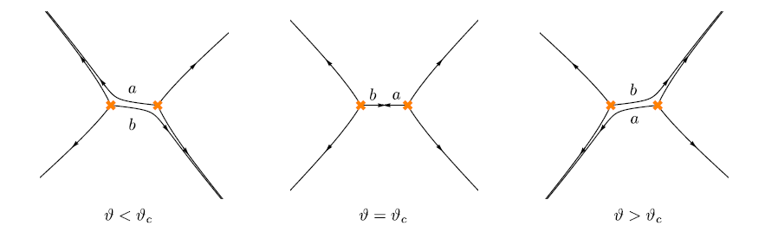
Movies: http://www.ma.utexas.edu/users/neitzke/spectral-network-movies/

Slide 54
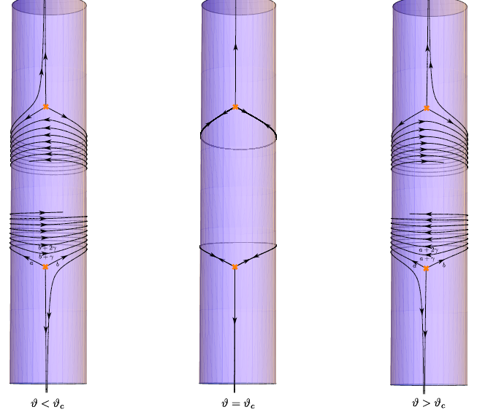

Slide 55
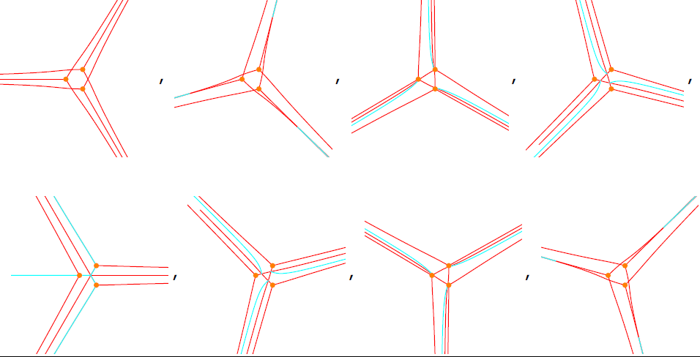

Slide 56
Explicit Formula for 
L(n) is explicitly constructible from the spectral network.
N.B. This determines the BPS degeneracies!

Slide 57
Nonabelianization Map
Given Data:
1.
A spectral network W subordinate to a K:1 branched cover
2.
Flat connection on line bundle L  
We construct a rank K vector bundle E_{W} over C,
together with a flat connection  on E_{W}
Nontrivial because of the branch points!

Slide 58
True Parallel Transport
Defines parallel transport of  along  on a rank K vector bundle E_{W}  C.

Slide 59
Cluster Coordinate Conjecture
1. We prove _{W} is symplectic (hence locally 1-1)
Coordinates:
2. Invariant under “small” deformations of W.
3. KS transformations
Conjecture: This is a generalization of Fock & Goncharov’s cluster coordinates on moduli spaces of higher rank local systems.

Slide 60
Outline
Basic Definitions and the No-Exotics Conjecture
Old techniques give new results on BPS spectra
Spectral Networks
Applications of spectral networks
Spin lifts
Categorification
Conclusion

Slide 61
Spin Lifts
5
Consider an su(2) spectral curve:
T_{j} := Spin j rep. of sl(2)
K = 2j +1

Slide 62
Spin Lifts - B
is a degenerate su(K) spectral curve
Small perturbations deform it to a smooth SW curve of an su(K) theory
These are the SW curves of su(K) theories of
class S in special regions of their Coulomb branch.

Slide 63
A Nontrivial Special Case
The level K lift of the trivial theory ² = z(dz)² is highly nontrivial!
It’s SW moduli space is the moduli space of three flags in C^{K}
Our Y coordinates can be shown rigorously to coincide with the Fock-Goncharov coordinates.
Our algorithm gives the BPS spectrum of this su(K) theory in this neighborhood of the Coulomb branch.

Slide 65
Outline
Basic Definitions and the No-Exotics Conjecture
Old techniques give new results on BPS spectra
Spectral Networks
Applications of spectral networks
Spin lifts
Categorification
Conclusion

Slide 66
Categorification
6
(D. Gaiotto, G.M. , E. Witten)
To each Sz there is associated a category of branes and boundary conditions. Can generalize to Sz1,z2,…
Study these categories and their relations to the solitons.
Find interesting structure of related to Fukaya-Seidel A categories
F()  A functor, depending only on homotopy class of 
Already nontrivial for the empty 4d theory and 2d “surface defect” given by a Landau Ginzburg model

Slide 67
Conclusions
1. We are still learning qualitatively new things about the BPS spectrum of 4D N=2 theories.
2. Surface defects and supersymmetric interfaces can be very useful auxiliary tools for determining the BPS spectrum.
Slogan: 2d spectrum determines the 4d spectrum

Slide 68
Conclusions
3. There are many nontrivial applications to
Physical Mathematics: .
Hyperkahler geometry, cluster algebras, moduli spaces of flat connections, Hitchin systems,…
Remarkably, some of the same mathematics of cluster algebras has recently proven very effective in the theory of perturbative scattering amplitudes.

