Slide 1
Maintaining Career Aspirations in Science, Technology, Engineering, & Mathematics (STEM) among College Students
ASHE
Annual Conference
November 17, 2011
Felisha Herrera
Sylvia Hurtado
Mitch Chang
Higher Education Research Institute
University of California, Los Angeles

Slide 2
Background
Total Workforce vs. STEM Workforce Demographics
Sources: National Science Foundation, 2009 & U.S. Bureau of Labor Statistics, 2009

Slide 3
Literature
Background Characteristics
Prior Academic Achievement
Undergraduate Experiences
Institutional Structural Influences

Slide 4
Social Cognitive Career Theory (SCCT)
Person Inputs
Background Affordances
Learning Experiences
Self-efficacy
Outcome Expectations
Interests
Contextual Influences

Slide 5
Purpose
Students’ retained STEM career aspirations
To explore the associations between measures of students’ perceptions and motivations, college experiences and institutional contexts, while controlling for student’s background characteristics and pre-college preparation

Slide 6
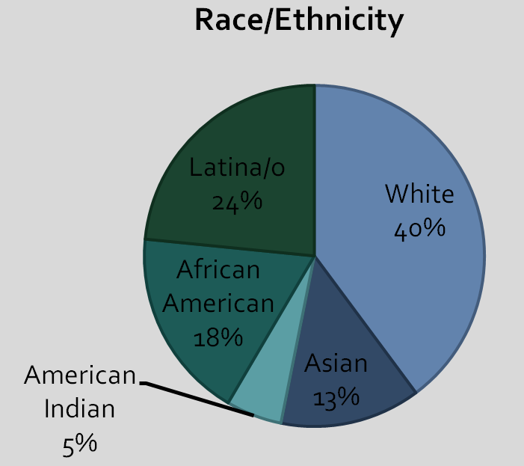
Methodology
Data Sources
2004 Freshman Survey (TFS)
2008 College Senior Survey (CSS)
Sample
3,156 students
217 institutions
62% female
47% URM
Analysis
Multi-level Structural
Equation Modeling

Slide 7
Institutional Level Variables
Contextual Influences
Percent of STEM majors
Institutional Selectivity
Student Level Variables
Faculty Interaction
Satisfaction w/ math
& science courses
Worked on professor’s research project
Person Inputs/
Background
URM
Gender (Female)
Self-efficacy
Academic Self Concept
Mother’s
Education
Learning Experiences
Interests
Retained
STEM
Career
Aspiration
Senior Year
High School GPA
Intention to change major
Outcome Expectations
Importance of making a theoretical contribution to science
Figure 1. Hypothesized Model Utilizing SCCT Framework

Slide 8
Institutional Level Variables
Percent of STEM majors
Institutional Selectivity
Student Level Variables
Satisfaction w/ math
& science courses
b .42
Faculty Interaction
b .26
Worked on professor’s research project
URM
b -.16
b .13
.11
b .09
b .32
-.04
.66
-.29
-.16
b .13
Gender (Female)
b -.08
b -.18
Academic Self Concept
.22
.20
b .11
Mother’s
Education
.05
b .13
Retained
STEM
Career
Aspiration
Senior Year
.02
.40
b -.07
b .53
-.09
.19
-.13
High School GPA
Intention to
change major
b .18
-.04
Importance of making a theoretical contribution to science
Figure 2. Final Model
a N=3156; X²(df=47; p<0.001) = 2241.80; CFI = .96; TLI = .93; RMSEA = .03
b parameter added based on modification indices and theoretical/empirical review.
Note: All paths are significant at p<.05. Negative effects are noted in red.

Slide 9
Direct Effects: Predicting Retained STEM Career Aspirations
 | β (sig)
Underrepresented minority student | -0.08***
High School GPA | 0.10***
2004 Academic self-concept | 0.05*
Intention to change major field | -0.13***
Satisfaction w/ science and mathematics courses | 0.22***
Worked on a professor’s research project | 0.11***
Faculty mentorship | -0.04***
Institutional selectivity | -0.29***
Percent of students majoring in STEM in 2006 | 0.66***
*** p<0.001, ** p<0.01, * p<0.05

Slide 10
Indirect Effects: Predicting Retained STEM Career Aspirations
 | β (sig)
Gender (Female) | -0.01*
Underrepresented minority student | -0.22***
Mother’s education | 0.02***
High School GPA | 0.07***
2004 Academic self-concept | 0.10***
Faculty mentorship | 0.02***
*** p<0.001, ** p<0.01, * p<0.05

Slide 11
Discussion & Implications
Implications for URM students
Early interventions
Academic self-concept
Psychological motivations
Major intentions
Introductory STEM classrooms
Role of faculty
Institutional contexts
Future Research
Disaggregation and group comparison (i.e. URM; Non-URM)
Specific STEM careers (i.e. engineers, medical)

Slide 12
Institutional Level Variables
Percent of STEM majors
Institutional Selectivity
Student Level Variables
Satisfaction w/ math
& science courses
Faculty Interaction
Worked on professor’s research project
URM
b -.16
.11
b .09
-.16
Gender (Female)
b -.08
Academic Self Concept
Mother’s
Education
.05
b .13
Retained
STEM
Career
Aspiration
Senior Year
.40
b -.07
-.09
High School GPA
Intention to
change major
-.13
b .18
-.04
Importance of making a theoretical contribution to science

Slide 13


Contact Information
Postdoctoral Scholars:
Kevin Eagan
Josephine Gasiewski
Faculty and Co-PIs:
Sylvia Hurtado
Mitchell Chang
Administrative Staff:
Dominique Harrison
Graduate Research Assistants:
Tanya Figueroa
Gina Garcia
Juan Garibay
Felisha Herrera
Bryce Hughes
Cindy Mosqueda
Papers and reports are available for download
from project website:
http://heri.ucla.edu/nih
Project e-mail: herinih@ucla.edu
Acknowledgments: This study was made possible by the support of the National Institute of General Medical Sciences, NIH Grant Numbers 1 R01 GMO71968-01 and R01 GMO71968-05 as well as the National Science Foundation, NSF Grant Number 0757076. This independent research and the views expressed here do not indicate endorsement by the sponsors.

