Slide 1
On the role of six-dimensional (2,0) theories in recent developments in Physical Mathematics
Gregory W. Moore
Rutgers University
Strings 2011, Uppsala, June 29
Notes:
If we can get notes together add web address.

Slide 2
Preface
``… Would you be interested in giving the review 5-hour talk on the applications of six-dimensional (2,0) theories to Physical Mathematics ? …’’
``… Would you be interested in giving the review 1-hour talk on the relation between math physics and strings? …’’
``… O.K. I’ll give a 1-hour talk, but I’m going to make some heterodox choices …’’
``Nobody goes there anymore; it’s too crowded.’’ -- Yogi Berra
My presentation is strongly influenced by many discussions with a number of great physicists.
Particular thanks go to
Notes:
Need to mention AGT + Verlinde operators.

Slide 3
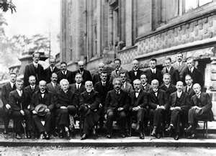








Slide 4
Superconformal Algebras
1
Nahm’s Theorem (1977): Classifies superconformal algebras.
Existence relies on special isomorphisms of Lie algebras related to Clifford algebras, and in particular they only exist in dimensions D  6.
Poincare subalgebra:
Howe,Lambert,
West (1997)
BPS strings
BPS codimension two objects

Slide 5
The Abelian Tensormultiplet
Fields:
There is a generalization to theories of many tensormultiplets: H  ³(M₆;V)

Slide 6
Subtleties
But, already these free field theories are subtle when put on arbitrary manifolds:
Action principle
Partition functions
Charge lattice & Dirac quantization
Hilbert space & Hamiltonian formulation
Formulating these properly is nontrivial and even points to the need to generalize the standard notion of ``field theory.’’

Slide 7
Some key papers
E. Witten, The five-brane partition function 1996; Duality Relations 1999; Geometric Langlands from Six Dimensions, 2009
M. Hopkins and I. Singer, Quadratic Functions in Geometry, Topology and M-Theory, 2002
Dolan and Nappi, 1998
M. Henningson, et. al. 2000-2010
E. Diaconescu, D. Freed, G. Moore 2003; G. Moore, Strings 2004
D. Freed, G. Moore, and G. Segal; D. Belov & G. Moore 2006
S. Monnier, 2010
N. Seiberg and W. Taylor, 2011
Applications to Alexandrov, Persson, Pioline, Vandoren on Sugra HMs.

Slide 8
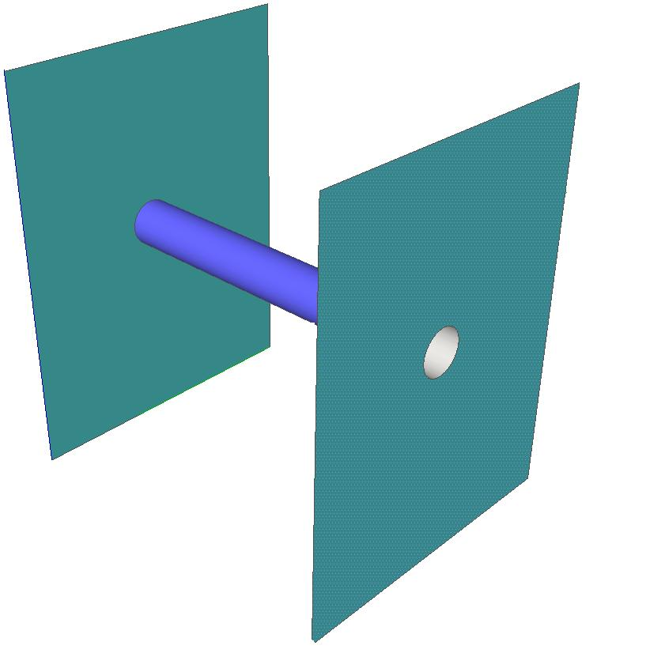
String/M-theory constructions of interacting theories
Witten, 1995, ``Some comments on string dynamics,’’ IIB theory on a hyperkahler ADE singularity with a decoupling limit.
Strominger, 1995: ``Open p-branes.’’
M2
M5

Slide 9
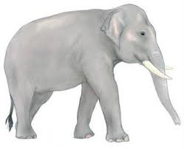
But is it field theory?
Little
Following some important works on probe-brane theories (Seiberg; Seiberg & Witten), and three-dimensional mirror symmetry (Intriligator-Seiberg), Seiberg stressed in 1996 that the decoupled theories should be viewed as local quantum field theories.
String
Theory
Note this is not obvious, given the elephant in the room.

Slide 10
Summary of Section 1
So we conclude that
Already the free abelian theories are very nontrivial on general backgrounds.
10
There are hypothetical interacting theories S[g], for simply laced g -- we are going to try to learn something about their dynamics.

Slide 11
Outline
Introduction: Abelian & Nonabelian (2,0) Theories
Extended Topological Field Theory
Characteristic properties of S[g]
Theories of class S
BPS States
Line defects and framed BPS States
Surface defects
Hyperkahler geometry
N=2, d=4 Geography
Egregious Omissions

Slide 12
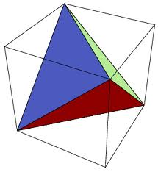
Extended Field Theories
2
A key idea of the Atiyah-Segal definition of TFT is to encode the most basic aspects of locality in QFT.
Axiomatics encodes some aspects of QFT locality: Gluing = composition of ``morphsims’’.
Unsatisfactory: In a truly local description we should be able to build up the theory from a simplicial decomposition.
``If you don’t go to other peoples’ funerals, they won’t go to yours.’’ -- Yogi Berra

Slide 13
What is the axiomatic structure that would describe such a completely local decomposition?
D. Freed; D. Kazhdan; N. Reshetikhin; V. Turaev; L. Crane; Yetter; M. Kapranov; Voevodsky; R. Lawrence; J. Baez + J. Dolan ; G. Segal; M. Hopkins, J. Lurie, C. Teleman,L. Rozansky, K. Walker, A. Kapustin, N. Saulina,…
Example: 2-1-0 TFT:
Partition Function
Hilbert Space
Boundary conditions

Slide 14
Why are boundary conditions objects in a category?
a
a
a
b
b
c
b
a
c
b
b
associative
c
c
Clay volume: Branes & Mirror Symmetry
d
Notes:
Say that this is an argument from Moore&Segal

Slide 15
N-Categories
Definition: An N-category is a category C whose morphism spaces are N-1 categories.
Bord_{n}:
Objects = Points; 1-Morphisms = 1-manifolds;
2-Morphisms = 2-manifolds (with corners); …
Definition: An N-extended field theory is a ``homomorphism’’ from
Bord_{n} to a symmetric monoidal N-category.

Slide 16


N

Slide 17
Defects
A nice physical way to approach this topic is to study defects in QFT – i.e. local disturbances of positive codimension.
Kapustin’s ICM 2010 talk argues that F(M_{n-k}) is the category of (k-1)-dimensional defects .
Categories of boundary conditions have been very important in homological mirror symmetry (Kontsevich 1994), whose physical significance was elucidated by Douglas and collaborators around 2001-2002.
Subsequently, these categories have been important in the physical approach to the Geometric Langlands Program in the work of Kapustin-Witten and Gukov-Witten.

Slide 18
Defects Within Defects
P
β
B
A
α
Q
Conclusion: Spatial boundary conditions in an n-dimensional ETFT are objects in an (n-1)-category:
k-morphism = (n-k-1)-dimensional defect in the boundary.
Notes:
So, the lesson that we can take away is that at least part of the notion of extended field theory is to include defects in the definition of a qft.

Slide 19
The Cobordism Hypothesis
Partition Function
Hilbert Space
Boundary conditions
Cobordism Hypothesis of Baez & Dolan: An n-extended TFT is entirely determined by the n-category attached to a point.
For TFTs satisfying a certain finiteness condition this was
proved by Jacob Lurie. Expository article. Extensive books.

Slide 20
Generalization: Theories valued in field theories
DEFINITION: An m-dimensional theory H valued in an
n-dimensional field theory F , where n= m+1, is one such that
H(N_{j} )∈ F(N_{j})
j= 0,1,… , m
The ``partition function’’ of H on N_{m} is a vector in a vector space, and not a complex number . The Hilbert space…
The chiral half of a RCFT.
The abelian tensormultiplet theories

Slide 21
Important characteristics of the six-dimensional (2,0) theories S[g]
3
These theories have not been constructed – even by physical standards - but some characteristic properties of these hypothetical theories can be deduced from their relation to string theory and M-theory.
Three key properties + Four important ingredients
These properties will be treated as axiomatic.
Later they should be theorems.

Slide 22
1: What sort of theory is it?
It should be defined on 6-manifolds with certain topological data:
Orientation
Spin structure
Quadratic functions on various cohomology theories
But we require a generalization of the notion of field theory.
(Witten 1998; Witten 2009)
The theory of singletons suggests that it is a ``six-dimensional field theory valued in a 7-dimensional topological field theory. ‘’
For S[u(N)] it is 7-dimensional Chern-Simons field theory
C is a 3-form gauge potential in
Notes:
JUST SAY: THERE IS SOME TOPOLOGICAL DATA.

Slide 23
2: Why is it interacting?
When S[g] is KK reduced on R^{1,4} x S¹ ,
where S¹ has radius R, with nonbounding, or Ramond spin structure, the long distance dynamics is governed by a maximally supersymmetric five-dimensional Yang-Mills theory with a gauge Lie algebra g
g²_{YM}=R
Notes:
Say, ``as has been stressed in Witten in similar discussions, the 1/R in the action is very striking. ‘’

Slide 24
3: Low Energy Physics
The theory in Minkowski space has a moduli space of vacua given by  = (R⁵  t)/W
Low energy dynamics is described by N free tensormultiplets and we view the space of vacua as parametrizing:

Slide 25
Important Ingredients: Charged Strings
There are dynamical string-like excitations around generic vacua which are simultaneously electric and magnetic sources for the free tensormultiplets H^{i}:

Slide 26
Important Ingredients: Surface Defects
There are surface defects S[R,S] associated to representations R of u(N). Far out on the moduli space they are well approximated by

Slide 27
Important Ingredients: Chiral Operators
Study short representations of osp(6,2|4).
Chiral operators are labeled by Casimirs of degree d.
Operators of lowest conformal dimension =2d transform in irreps of so(5)
In 5D SYM:
Aharony, Berkooz, Seiberg (1997)
J.Bhattacharya, S.Bhattacharyya, S.Minwalla and S.Raju (2008)

Slide 28
Important Ingredients: Codimension 2 Defects
There are codimension two supersymmetric defects preserving half the susy.
There is an important class D(,m) determined by

Slide 29

Characterizing D(,m)
Reduction on longitudinal circle  5D SYM + 3D defect.
5D SYM weak in IR  3D defect = T[G] theory of
Gaiotto & Witten.
Reduction on linking circle: (compactification on cigar):
5DSYM + Boundary condition:
D
y

Slide 30
Defects and S-Duality
y
5D SYM + T[G]
y
y
T[G]
Gaiotto & Witten

Slide 31
Taxonomy of Defects
Name | Partition of N | ❒ | Global Symmetry
Full Defect | [1^{N}] | ❒ = 0 | SU(N)
Simple Defect | [N-1,1] | ``Sub-regular’’ | U(1)
Trivial Defect | [N] | ``Regular’’ ``Principal’’ | 1

Slide 32
Correspondences
Compactify and Compare
2d/4d, or, 6=4+2
Nakajima
Geometric Langlands (Kapustin & Witten)
Alday-Gaiotto-Tachikawa; Gaiotto-Moore-Neitzke; Nekrasov-Shatashvili
Cecotti, Neitzke, & Vafa
6= 3 + 3
Domain walls, three-dimensional compactification & non-compact Chern-Simons theory: Drukker, Gaiotto, Gomis; Hosomichi, Lee, Park; Dimofte & Gukov et. al. ; Terashima & Yamazaki

Slide 33
Outline
Introduction: Abelian & Nonabelian (2,0) Theories
Extended Topological Field Theory
Characteristic properties of S[g]
Theories of class S
BPS States
Line defects and framed BPS States
Surface defects
Hyperkahler geometry
N=2, d=4 Geography
Egregious Omissions

Slide 34
Theories of Class S
4
Consider nonabelian (2,0) theory S[g] for ``gauge algebra’’ g
The theory has half-BPS codimension two defects D
Compactify on a Riemann surface C with D_{a} inserted at punctures z_{a}
Twist to preserve d=4,N=2
Witten, 1997
GMN, 2009
Gaiotto, 2009
Type II duals via ``geometric engineering’’
KLMVW 1996
Notes:
SAY: This brings us to the core of the talk: Theories of Class S, also known as
``Gaiotto theories.’’ The ``S’’ is for ``six.’’
At the end: These theories have been very popular and a bonanza of results have been obtained in the past two years. Which ones should I present? Look, it’s like being a kid in a candy shop, or on a visit to the zoo. You can’t see everything! We have to make choices! Let’s try to make some…

Slide 35

S-Duality
Higgs branches
Coulomb branch & Hitchin moduli
Aut(g)twists
HK geometry
AGT & Toda CFT
-backgrounds, Nekrasov partition functions, Pestun localization.
BPS states & wall-crossing
Cluster algebras
Holographic duals
Quantum Integrable
Line & Surface defects
Z(S³ x S¹) Scfml indx
N=4 scattering
Domain walls &
3D Chern-Simons
Notes:
Important to describe here AGT as identifying conformal blocks and Nekrasov partition functions. Also, mention Rastelli et. Al. and 2d q-YM + deformations; mention Tachikawa for Aut(g) twists and Benini, Benvenuti, Tachikawa for (p,q) 5-brane webs; and finally
Duality domain walls, 3D compactifications and 3D noncompact Chern-Simons theory.

Slide 36

Generalized Conformal Field Theory
Twisting
S[g,C,D] only depends on the conformal structure of C.
For some C, D there are subtleties in the 4d limit.
``Conformal field theory valued in d=4 N=2 field theories’’
(AGT  Non-rational CFT!)
Space of coupling constants = _{g,n}
Go to the boundaries of moduli space….
Notes:
The key organizing principle in our trip to the zoo is….

Slide 37
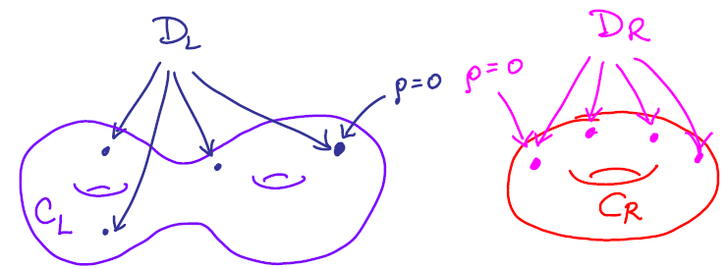
Gaiotto Gluing Conjecture -A
D. Gaiotto, ``N=2 Dualities’’
Slogan: Gauging = Gluing
Gauge the diagonal G ⊂ G_{L} x G_{R} symmetry with q = e^{2πiτ} :

Slide 38
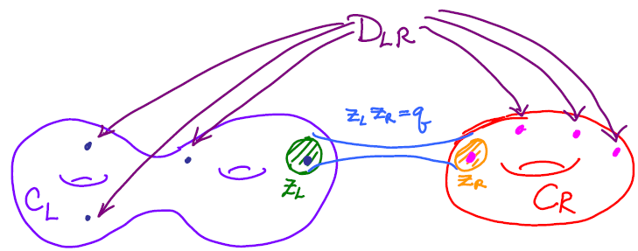
Gaiotto Gluing Conjecture - B
Glued surface:
Nevertheless, there are situations where one gauges just a subgroup – the physics here could be better understood. (Gaiotto; Chacaltana & Distler; Cecotti & Vafa)

Slide 39
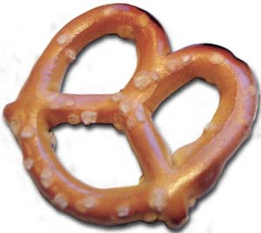
S-Duality - A
Cut C into pants = 3-hole spheres = trinions.
(More precisely, consider embedded trivalent graphs.)
Presentation of S[g,C,D]
as a gauging of
``trinion theories.’’
Trivalent graphs label asymptotic regions of Teich_{g,n}[C], hence correspond to weak-coupling limits.

Slide 40
S-Duality - B
Two different points in Teich_{g,n} can project to the
same point in _{g,n}
When we have two different presentations of the same theory we call it a duality.
This is an S-duality.

Slide 41
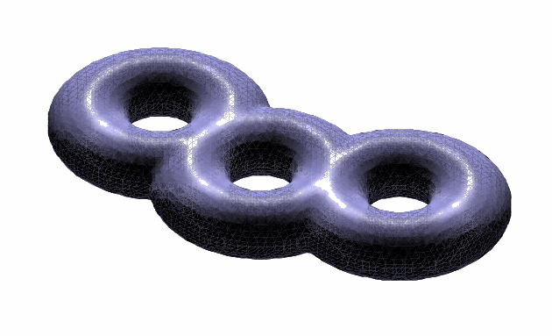
S-Duality - C
More generally, in conformal field theory it is useful to introduce a ``duality groupoid’’:
Braiding, Fusing and S – moves generate the morphisms.
In this context there is therefore an ``S-duality groupoid.’’
It was usefully applied to the AGT correspondence in:
Alday, Gaiotto, Gukov, Tachikawa; Drukker, Gomis, Okuda, Teschner

Slide 42

Trinion Theories
Gaiotto (2009)
TRIN(N) :=
S[su(N), ]
N=2: Free ``half’’ hypermultiplet in (2,2,2) of SU(2)³
N=3: E₆ SCFT of Minahan-Nemeschansky
Geometrical description of Argyres-Seiberg duality, and a generalization to SU(N).
Notes:
SAY: Outstanding application

Slide 43
Moduli of Vacua
Higgs branches of theories with Lagrangian presentation are linear hyperkahler quotients
But Higgs branches of the non-Lagrangian TRIN(N) theories are unknown and interesting.
Benini, Tachikawa, Xie 2010
Hanany & Mekareeya, 2010
Gaiotto, Neitzke, Tachikawa 2009
Benini, Benvenuti, Tachikawa, 2009
Tachikawa:
http://www.math.upenn.edu/StringMath2011/notespt.html
Moore & Tachikawa, to appear

Slide 44
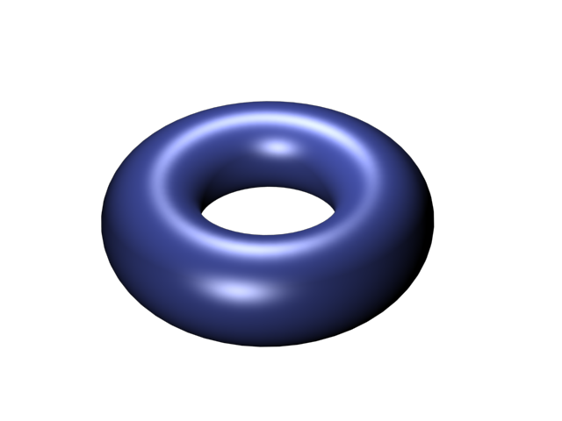
Seiberg-Witten Moduli Space
Compactify R³ x S¹
Get a 3d sigma model with hyperkahler target space:
Wilson loop scalars
A torus fibration
over the Coulomb branch.
Seiberg & Witten (1996)
The relation to integrable systems goes back to:
Gorsky, Krichever, Marshakov, Mironov, Morozov; Martinec & Warner; Donagi & Witten (1995)
Which one?
Notes:
Say: When thinking about the Coulomb branch it is best to compactify on a circle to three dimensions. Then, as pointed out by Seiberg & Witten … electric and magnetic Wilson lines become periodic scalars in a torus – roughly speaking the Jacobian of the Seiberg-Witten curve, and the torus fibration fits together into a HK manifold which I will call the Seiberg-Witten moduli space.
The dimension of the torus is the dimension of the base, a geometry reminiscent of
Integrable systems. A simple argument tells us, at least for class S, WHICH integrable
System we should get:

Slide 45
Coulomb branch & Hitchin moduli
5D g SYM
σ-Model:

Slide 46

Effects of Defects
Regular singular punctures:
Nature of the puncture is determined by the complex orbit of residue r.
Irregular singular punctures:

Slide 47
UV Curve
Seiberg-Witten Curve
SW differential
For g= su(N)
is an N-fold branch cover

Slide 48
Outline
Introduction: Abelian & Nonabelian (2,0) Theories
Extended Topological Field Theory
Characteristic properties of S[g]
Theories of class S
BPS States
Line defects and framed BPS States
Surface defects
Hyperkahler geometry
N=2, d=4 Geography
Egregious Omissions

Slide 49
BPS States and Indices (in general)
5
Lattice of flavor + electromagnetic charges

Slide 50
Wall-Crossing (in general)
 jumps across the walls of marginal stability:
BPS states can form BPS boundstates: CFIV, CV, SW
Cecotti & Vafa (1992): Computed analogous jumps for BPS solitons in 2d (2,2) models.
Denef & Moore (2007) , Kontsevich & Soibelman (2007) , Joyce & Song (2007)
Most complete and conceptually simple formulation: KSWCF, but we will see that the halo configurations of F. Denef capture the essential physics.
Nice recent development: Manschot, Pioline, and Sen: Apply localization to Denef’s multi-centered solution moduli space. See Pioline review.
Notes:
Recommend Boris Pioline review.

Slide 51

BPS States for S[g,C,D]:
BPS states come from finite open M2 branes ending on  . Here This leads to a nice geometrical picture with string networks:
Klemm, Lerche, Mayr, Vafa, Warner; Mikhailov; Henningson & Yi; Mikhailov, Nekrasov, Sethi,
Combining wall crossing techniques with line and surface defects leads to an algorithm for determining
the BPS spectrum. (GMN 2009; to appear).

Slide 52
Outline
Introduction: Abelian & Nonabelian (2,0) Theories
Extended Topological Field Theory
Characteristic properties of S[g]
Theories of class S
BPS States
Line defects and framed BPS States
Surface defects
Hyperkahler geometry
N=2, d=4 Geography
Egregious Omissions

Slide 53
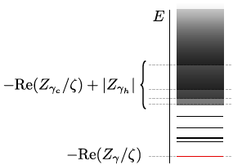
Line Defects & Framed BPS States (in general)
6
A line defect L (say along R_{t} x {0 } ) is of type ζ if it preserves the susys:
Example:

Slide 54

Framed BPS States saturate this bound, and have framed protected spin character:
Piecewise constant in ζ and u, but has wall-crossing
across ``BPS walls’’ (for Ω(γ)≠ 0):
Particle of charge γ binds to the line defect:
Similar to Denef’s halo picture

Slide 55
Wall-Crossing for
Across W(γ_{h}) Denef’s halo picture leads to:
constructed from

Slide 56
Wall-Crossing for
Consistency of wall crossing of framed BPS states implies the Kontsevich-Soibelman WCF for unframed states
We simply compare the wall-crossing associated to two different paths relating F(L)(u₁,ζ₁) and F(L)(u₂,ζ₂)
u₂,ζ₂
u₁,ζ₁

Slide 57
References
GMN, ``Framed BPS States,’’ 2010
Andriyash, Denef, Jafferis, Moore, 2010: Supergravity
Dimofte & Gukov; Dimofte, Gukov & Soibelman 2009: ``motivic’’ vs. ``refined’’
Cecotti & Vafa, 2009; Cecotti, Neitzke, & Vafa 2010:
Use topological strings in non-compact Calabi-Yau
R-symmetry generator as Hamiltonian
Appearance of Heisenberg algebra is natural and physical.

Slide 58
Line defects in S[g,C,m]
6D theory S[g] has supersymmetric
surface defects S(, σ )
For S[g,C,D] consider
Line defect in 4d labeled by isotopy class of a closed path ℘ and 

Slide 59

Classifying Line Defects
For g=su(2) and R = fundamental , the Dehn-Thurston classification of isotopy classes of closed curves matches nicely with the classification of simple line operators as Wilson-’t Hooft operators: Drukker, Morrison & Okuda.
The generalization of the Drukker-Morrison-Okuda result to higher rank has not been
done, and would be good to fill this gap.

Slide 60
Outline
Introduction: Abelian & Nonabelian (2,0) Theories
Extended Topological Field Theory
Characteristic properties of S[g]
Theories of class S
BPS States
Line defects and framed BPS States
Surface defects
Hyperkahler geometry
N=2, d=4 Geography
Egregious Omissions

Slide 61
Surface defects (in general)
7
UV Definition:
Preserves d=2 (2,2) supersymmetry subalgebra
Twisted chiral multiplet :
IR Description:
Coupled 2d/4d system

Slide 62
Canonical Surface Defect in S[g,C,m]
Alday, Gaiotto, Gukov, Tachikawa, Verlinde (2009); Gaiotto (2009)
For z ∈ C we have a canonical surface defect S_{z}
It can be obtained from an M2-brane ending at x¹=x²=0 in R⁴ and z in the UV curve C
In the IR the different vacua for this M2-brane are the different sheets in the fiber of the SW curve  over z.
Therefore the chiral ring of the 2d theory should be the same as the equation for the SW curve!

Slide 63

Example of SU(2) SW theory
Chiral ring of the CP¹ sigma model.
2d-4d instanton effects
Twisted mass
Gaiotto

Slide 64
Superpotential for S_{z} in S[g,C,m]
x_{i}
x_{j}
z
Homology of an open path on Σ joining x_{i} to x_{j} in the fiber over S_{z}

Slide 65
Coupled 2d/4d: New BPS States
Flux:
Flux:

Slide 66

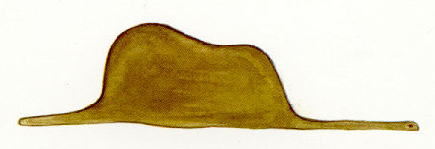
Supersymmetric Interfaces
UV:
IR:
Flux:

Slide 67
Susy interfaces for S[g,C,m]
Interfaces between S_{z} and S_{z’} are labeled by open paths ℘ on C between z and z’:
UV:
IR: Framed BPS states are graded by open paths γ_{ij’} on Σ with endpoints over z and z’

Slide 68
2D/4D Wall-Crossing
Consistency of WC for framed BPS indices implies a
generalization of the KSWCF: ``2d/4d WCF’’ (GMN 2011).
Studying WC as functions of z, and interpreting (z,z’) as a Janus configuration makes contact with the new work of Gaiotto & Witten, and gives some nice new perspectives on old work of
Hori, Iqbal, & Vafa.
Finally, very recently, GMN used the study of framed BPS states to give an algorithm for computing the BPS spectrum of A_{N} theories of class S in a certain region of the Coulomb branch.

Slide 69
Outline
Introduction: Abelian & Nonabelian (2,0) Theories
Extended Topological Field Theory
Characteristic properties of S[g]
Theories of class S
BPS States
Line defects and framed BPS States
Surface defects
Hyperkahler geometry
N=2, d=4 Geography
Egregious Omissions

Slide 70

Coulomb branch Hyperkahler Geometry - A
8
1.
2.
_{γ} define a system of holomorphic Darboux coordinates for SW moduli spaces. They can be constructed from a TBA-like integral equation.
From these coordinates we can construct the HK metric on .
3.
4.
1-instanton confirmed via direct computation: Chen, Dorey, & Petunin 2010;2011; Multi-instanton?

Slide 71
Coulomb branch HK Geometry - B
5.
For S[su(2),C,m], _{γ} turn out to be closely related to the Fock-Goncharov coordinates
which appear in the F&G work on quantum Teichmuller theory.
6.
For S[su(2),C,m] the analogous functions:
are sections of a bundle over , and allow us moreover to construct hyper-holomorphic connections (BBB branes).
``Hyper-holomorphic’’: F^{2,0}=0 in all complex structures

Slide 72
Outline
Introduction: Abelian & Nonabelian (2,0) Theories
Extended Topological Field Theory
Characteristic properties of S[g]
Theories of class S
BPS States
Line defects and framed BPS States
Surface defects
Hyperkahler geometry
N=2, d=4 Geography
Egregious Omissions

Slide 73
Geography of d=4,N=2 Theories
9
Many theories are simply classified by their Lagrangian:
G, R, m, ζ
Infinitely many Lagrangian theories are class S .
But infinitely many class S theories are non-Lagrangian.
Some Lagrangian theories appear to be outside class S
3N
|
N -2N -3N -4N -5N -6N-4N-2N
Many N=2 theories can be geometrically engineered by considering type II theories on noncompact Calabi-Yaus with singularities…
``You gotta be careful if you don’t know where you’re going, otherwise you might not get there.’’ -- Yogi Berra

Slide 74
Approaches to classification - A
A fast-developing mathematical subject of cluster algebras* and cluster varieties can be usefully applied to the study of class S theories. (GMN 2009; GMN 2010; Cecotti, Neitzke , & Vafa 2010; Cecotti & Vafa 2011)
CNV suggested a classification via a 2d/4d correspondence: Engineer the 4d theory with a noncompact CY and extract a (2,2) massive QFT from the worldsheet of the string. Apply old classification of d=2 (2,2).
C&V then combined the 2d/4d correspondence with math results on cluster algebras to classify a subclass of ``complete N=2 theories.’’ The resulting list is ``mostly’’ of class S but has exceptional cases which appear to be outside class S.
* http://www.math.lsa.umich.edu/~fomin/cluster.html

Slide 75

Approaches to classification - B
Gaiotto (2009) has suggested a different approach:
Use the geometry associated to a pair (T,S) there is a Seiberg-Witten-like geometry, based on
Hitchin-like equations, as an invariant.
Any reasonable theory should have surface defects….

Slide 76
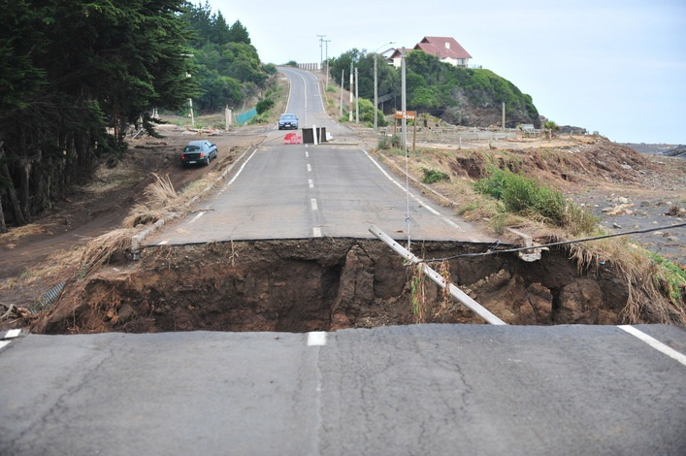
Large N Geography of d=4,N=2 Theories
Large N limits with M-theory duals are described by bubbling geometries of Lin, Lunin, and Maldacena.
Gaiotto & Maldacena showed that large N class S theories, with regular punctures, fit into the LLM bubbling geometry scheme.
A ``classification’’ would require a classification of physically sensible boundary conditions of the 3d Toda equation at the heart of the LLM construction.
In particular, what is the large N description of superconformal class S theories with irregular punctures (e.g. Argyres-Douglas theories) ?
What about large N limits with IIB duals?

Slide 77
Outline
Introduction: Abelian & Nonabelian (2,0) Theories
Extended Topological Field Theory
Characteristic properties of S[g]
Theories of class S
BPS States
Line defects and framed BPS States
Surface defects
Hyperkahler geometry
N=2, d=4 Geography
Egregious Omissions

Slide 78
Egregious Omissions - A
10
Applications to strong coupling scattering in N=4
For a particular (Argyres-Douglas) theory of class S, the functions _{γ} appearing in the twistor construction of the HK geometry of  are the cross-ratios solving the Alday-Maldacena minimal area problem in AdS.
Past and future Technology Transfer
TBA, Y-systems, small flat sections, …
Alday-Maldacena; Alday, Gaiotto, Maldacena; Alday, Maldacena, Sever, Vieira; Lukyanov & Zamolodchikov; Lukyanov; ….

Slide 79
Egregious Omissions - B
2. AGT correspondence: Nekrasov partition functions =
Conformal blocks  Connections to Liouville and Toda theory!
KITP workshop: http://online.itp.ucsb.edu/online/duallang-m10/
3. Witten: Combining work on the analytic continuation of Chern-Simons theory, he uses class S theories to obtain a new gauge-theoretic/Morse-theoretic approach to the ``categorification of knot polynomials.’’
4. 2D Quantum Integrability & 4D SYM: Nekrasov-Shatashvili; Nekrasov-Witten; Nekrasov,Rosly,Shatashvili
SCGP Workshop on Branes and Bethe Ansatz: http://scgp.stonybrook.edu/?p=145
KITP Workshop: http://www.kitp.ucsb.edu/activities/dbdetails?acro=integral11

Slide 80

Un-omittable Omission
But how do we construct the theory S[g] ?
Aharony, Berkooz,Seiberg (1997): Matrix theory & DLCQ
→ Super QM on instanton moduli space.
Lambert-Papageorgakis (2010): Try to generalize the susy transformations of the abelian tensormultiplet to a nonabelian version (following Bagger & Lambert and Gustavsson ).
They were partially successful – Perhaps they just rediscovered the D4 brane, but there is more to understand.
Lambert,Pagageorgakis & Schmidt-Sommerfeld; Douglas:
Try to define the theory by flowing up the RG from 5D SYM and guessing at a UV completion.

Slide 81

Summary and the Future
11
``It’s tough to make predictions, especially about the future.’’
– Yogi Berra
The hypothetical existence and properties of the six-dimensional (2,0) theories leads to many exact results for partition functions, line and surface defect correlators, BPS spectra, etc.
There are several ``2d-4d correspondences’’ and other remarkable interrelations in this area of Physical Mathematics.
And these theories even push the envelope, challenging what should be the proper definition of a ``quantum field theory.’’
Notes:
At the end say: Clearly this is a fertile area capable of much further development.
What are some possible applications:

Slide 82

Other Potential applications:
P1: Three dimensional quantum field theory & three dimensional gravity.
P2: Compactification on 4-manifolds: Applications to the MSW (0,4) theories might have applications to the study of supersymmetric black holes.
P3: Supergravity and string compactification.
M1: Relation to the work of Fock & Goncharov, cluster algebras, and geometric Langlands suggests possible deep connections to number theory (motives, polylogs, Bloch groups, algebraic K-theory, …)
M2: Knot homology and categorification:
Will physicists beat the mathematicians?

Slide 83

A Central Unanswered Question
Can we construct S[g]?

Slide 84

NOT

