Slide 1


Computational Sprinting
Arun Raghavan*, Yixin Luo⁺, Anuj Chandawalla⁺, Marios Papaefthymiou⁺, Kevin P. Pipe^{+#},
Thomas F. Wenisch⁺, Milo M. K. Martin*
University of Pennsylvania, Computer and Information Science*
University of Michigan, Electrical Eng. and Computer Science⁺ University of Michigan, Mechanical Engineering#

Slide 2
This work licensed under the Creative Commons Attribution-Share Alike 3.0 United States License
You are free:
to Share — to copy, distribute, display, and perform the work
to Remix — to make derivative works
Under the following conditions:
Attribution. You must attribute the work in the manner specified by the author or licensor (but not in any way that suggests that they endorse you or your use of the work).
Share Alike. If you alter, transform, or build upon this work, you may distribute the resulting work only under the same, similar or a compatible license.
For any reuse or distribution, you must make clear to others the license terms of this work. The best way to do this is with a link to:
http://creativecommons.org/licenses/by-sa/3.0/us/
Any of the above conditions can be waived if you get permission from the copyright holder.
Apart from the remix rights granted under this license, nothing in this license impairs or restricts the author's moral rights.

Slide 3
Overview of My (Other) Research
Multicore memory systems
Adaptive cache coherence protocols
Memory consistency: specification & implementation
“Why On-chip Cache Coherence is Here to Stay” Communications of the ACM, July 2012
Transactional memory
Semantics (what does “atomic” really mean?)
Extending transaction sizes & handling overflow
Conflict avoiding hardware via repair (true & false sharing)
Hardware support for security
Goal: C/C++ as safe and secure as Java
Hardware/compiler co-design to provide memory safety

Slide 4
Talk Overview: Computational Sprinting
Computational Sprinting
Unsustainable power for short, intense bursts of compute
Feasibility study [HPCA’12]
Explored thermal, electrical, and architectural feasibility
Simulation results:
Significant responsiveness improvements in short bursts
With same dynamic energy consumption
Preliminary results with sprinting on prototype-proxy
Characterize real energy/performance behavior
Sprinting can improve energy efficiency due to race to halt

Slide 5
Computational Sprinting and Dark Silicon
A Problem: “Dark Silicon” a.k.a. “The Utilization Wall”
Increasing power density; can’t use all transistors all the time
Cooling constraints limit mobile systems
One approach: Use few transistors for long durations
Specialized functional units [Accelerators, GreenDroid]
Targeted towards sustained compute, e.g. media playback
Our approach: Use many transistors for short durations
Computational Sprinting by activating many “dark cores”
Unsustainable power for short, intense bursts of compute
Responsiveness for bursty/interactive applications
Our goal: responsiveness of 16W chip in 1W platform
Is this feasible?
Notes:
Transition

Slide 6
Sprinting Challenges and Opportunities
Thermal challenges
How to extend sprint duration and intensity?
Latent heat from phase change material close to the die
Electrical challenges
How to supply peak currents? Ultracapacitor/battery hybrid
How to ensure power stability? Ramped activation (~100μs)
Architectural challenges
How to control sprints? Thermal resource management
How do applications benefit from sprinting?
10.2x responsiveness for vision workloads via a 16-core sprint within 1W TDP

Slide 7
Outline
Motivation: “Dark Silicon” and interactive apps
Computational Sprinting
Feasibility Study
Performance Evaluation
Simulation results
Characterization of a real system
Conclusion

Slide 8
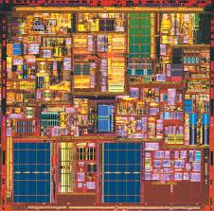
Power Density Trends for Sustained Compute
power
> 10x
time
temperature
Thermal limit
T_{max}
time
How to meet thermal limit despite
power density increase?

Slide 9
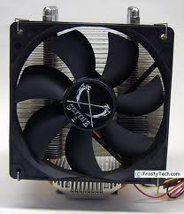
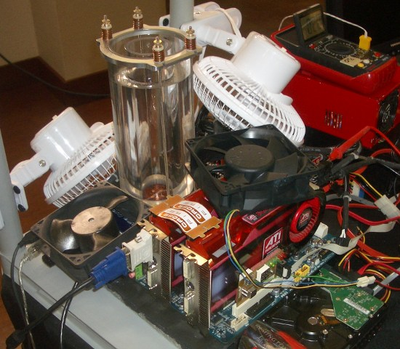
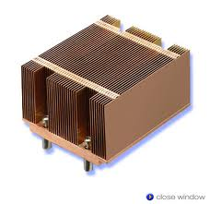
Option 1: Enhance Cooling?
⇧
temperature
T_{max}
time
Mobile devices limited to passive cooling

Slide 10
Option 2: Decrease Chip Area?
Reduces cost, but sacrifices
benefits from Moore’s law

Slide 11
Option 3: Decrease Active Fraction?
How do we extract application performance
from this “dark silicon”?

Slide 12
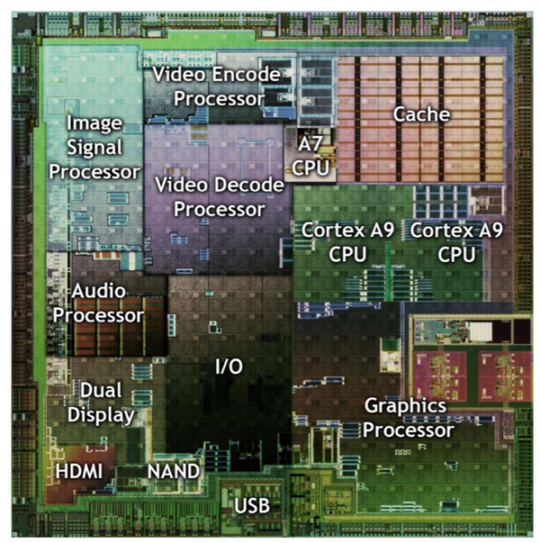
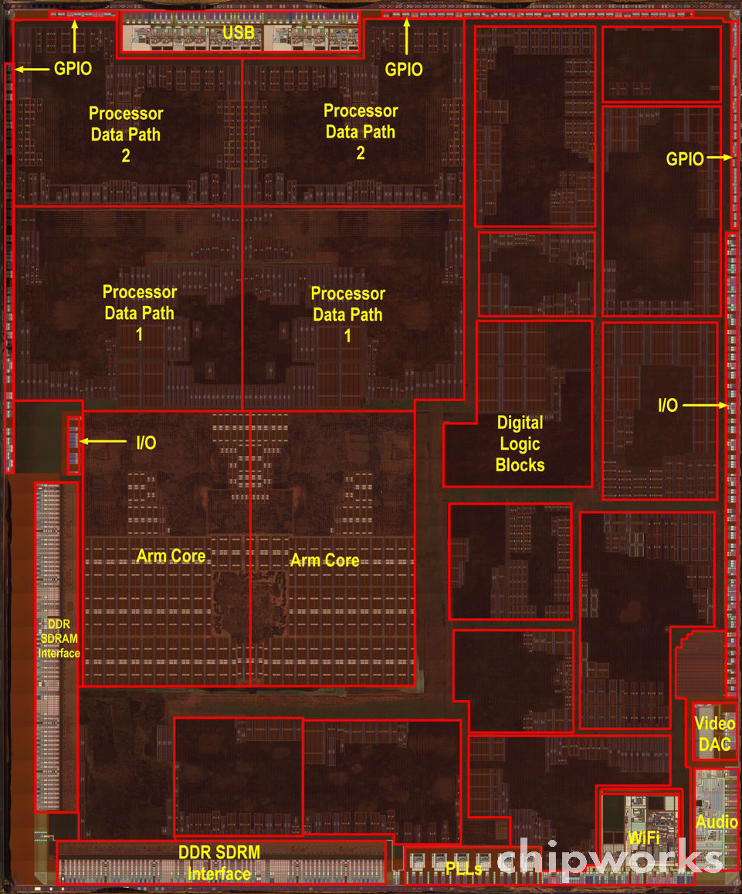
Accelerator Cores?
Heterogeneous cores [Conservation Cores ASPLOS’10, GreenDroid IEEE Comm., QsCores MICRO’11]
Activate different parts of chip based on application
Mobile chips already employ accelerators
NVIDIA Tegra 2 (49 mm²)
Apple A5 (122 mm²)

Slide 13

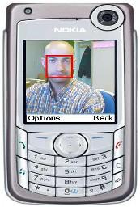
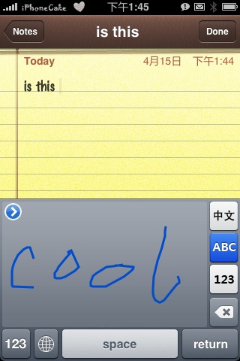
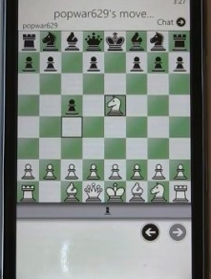
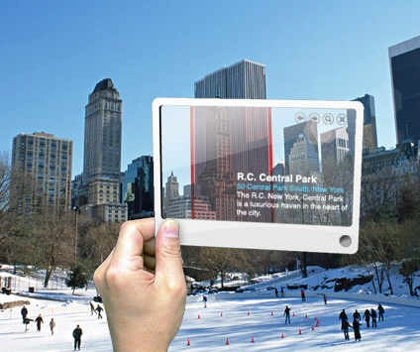
Design for Responsiveness
Observation: today, design for sustained performance
But, consider emerging interactive mobile apps… [Clemons+ DAC’11, Hartl+ ECV’11, Girod+ IEEE Signal Processing’11]
Intense compute bursts in response to user input, then idle
Humans demand sub-second response times [Doherty+ IBM TR ‘82, Yan+ DAC’05, Shye+ MICRO’09, Blake+ ISCA’10]
Peak performance during bursts limits what applications can do

Slide 14
Computational Sprinting
Designing for Responsiveness

Slide 15
Parallel Computational Sprinting
power
T_{max}
temperature

Slide 16
Parallel Computational Sprinting
power
Effect of thermal capacitance
T_{max}
temperature

Slide 17
Parallel Computational Sprinting
power
Effect of thermal capacitance
T_{max}
temperature

Slide 18
Parallel Computational Sprinting
power
Effect of thermal capacitance
T_{max}
temperature

Slide 19
Parallel Computational Sprinting
power
Effect of thermal capacitance
T_{max}
State of the art:
Turbo Boost 2.0 exceeds sustainable power with DVFS (~25% for 25s)
Our goal: 10x, ~1s
temperature

Slide 20

Extending Sprint Intensity & Duration: Role of Thermal Capacitance
Current systems designed for thermal conductivity
Limited capacitance close to die
To explicitly design for sprinting, add thermal capacitance near die
Exploit latent heat from phase change material (PCM)
Die
PCM
Die

Slide 21
Augmented Sprinting with PCM
power
T_{max}
Melting
Point
temperature

Slide 22
Augmented Sprinting with PCM
Sustainable
(single core)
power
T_{max}
Melting
Point
temperature

Slide 23
Augmented Sprinting with PCM
Sustainable
(single core)
power
T_{max}
Melting
Point
Re-solidification
temperature

Slide 24
Outline
Motivation
Computational Sprinting
Feasibility Study
Thermal
Electrical
Hardware/software
Performance Evaluation
Conclusion

Slide 25
Thermal Challenges
Goal: 1s of 16x sprinting (16 1W cores)
How much thermal capacitance does sprinting need?
16W for 1s = 16J of heat, for PCM with latent heat 100J/g
150mg, which is 2mm thick on 64mm² die
Study based on thermal model of mobile phone
1s of sprint time
~22s cool down time
temperature (ºC)
time (s)
time (s)
Heat flux and transient similar to desktop chips

Slide 26
Electrical Challenge #1: Peak Current Demands
16x sprinting exceeds limits of today’s phone batteries
Requires 16x peak current over baseline
In contrast, ultracapacitors have high peak currents
Promising for sprinting (25F, 6.5g, 182J)
But today, lower energy density than batteries
Leverage recent research on battery-ultracap hybrids [Mirhoseini+ ‘11, Palma+ ‘03, Pedram+ ’10]
Active research at all levels (batteries, ultracaps, hybrids)
Cost of extra power/ground pins
Voltage
Regulator
+
Battery
Ultracap
Sprinting
Chip
-

Slide 27
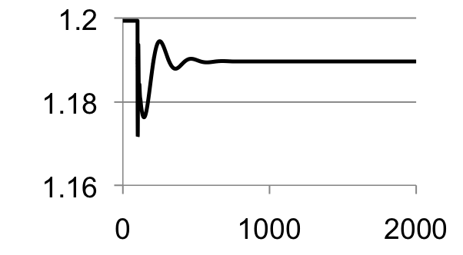
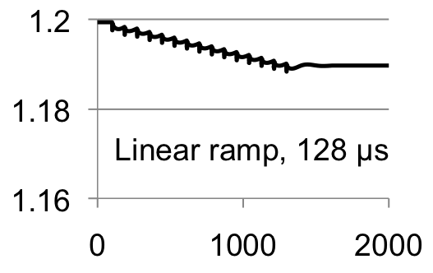
Electrical Challenge #2: On-chip Voltage Stability
16x current spike can cause supply voltage instability
Potential timing errors and state loss
Study of core activation induced instability
SPICE model of board, package, chip
Abrupt activation violates; gradual activation ok
supply voltage
supply voltage
Instantaneous
time
time
Core activation latency << sprint duration

Slide 28
Hardware/Software Challenges
Activation
Sprinting activated when parallel work available
Deactivation
Hardware detects impending overheating
Monitor thermal budget
Energy from activity count + thermal model of system
If thermal budget nearing, ask runtime to migrate
If software is unable to respond
Drastically cut frequency to sustainable
Throttle by factor of “number of cores”

Slide 29
Performance Evaluation

Slide 30
Methodology
In-order x86 many-core simulator
16 cores
32K, 8-way L1, 4MB 16-way shared LLC, directory cache coherence, 60ns memory latency, dual-channel 4GB/s memory interface
Energy estimates from McPAT (1GHz, 1W, LOP)
Used to drive thermal model
Workloads:
Vision kernels [SD-VBS], feature extraction app. [MEVBench]

Slide 31
Sprinting Responsiveness
normalized speedup
Lack of thermal capacity
Too little work
image size (Megapixels)
⬅ Less compute
More compute ➔

Slide 32
Responsiveness Evaluation
normalized speedup
feature
disparity
sobel
texture
segment
kmeans
Average 10.2x improvement in responsiveness

Slide 33
Parallelism & Energy
feature
disparity
sobel
texture
segment
kmeans
normalized speedup
normalized energy
No dynamic energy penalty when speedup linear
Overall, 12% average dynamic energy increase

Slide 34
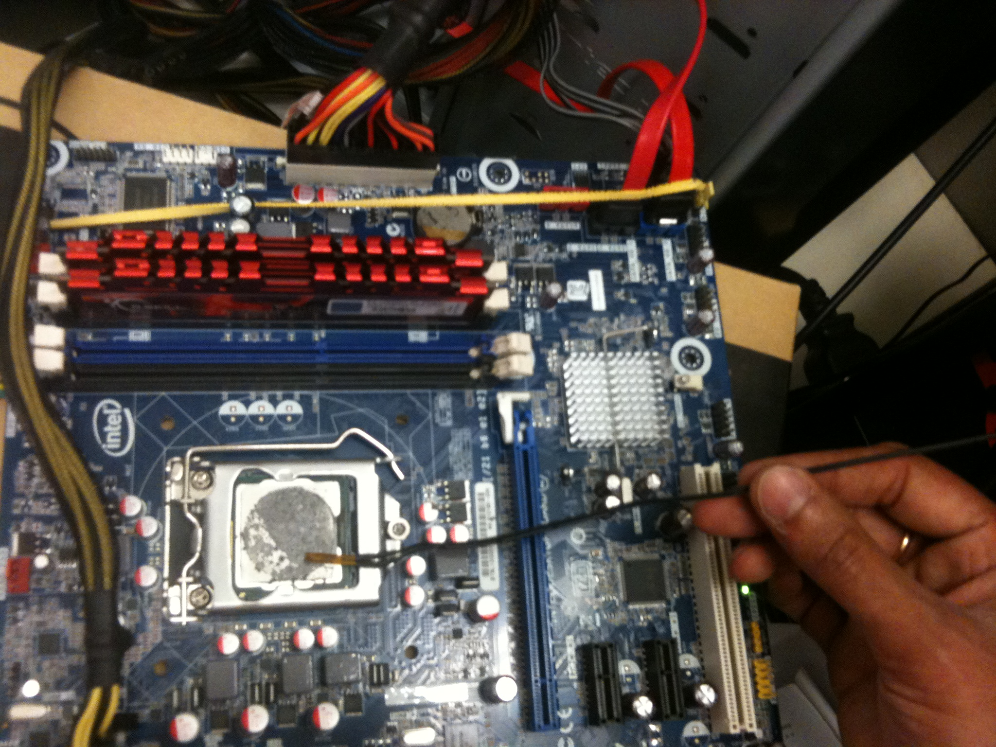
Moving Beyond Simulation: Can we make a real system sprint?

Slide 35
Characterize real system energy/performance
How might sprinting behave on real system?

Slide 36
Multiple Cores: Energy and Performance
4x
normalized speedup
Power increases with core count
But < 2x for 4 cores
Why? background power
1 core
2 cores
4 cores
2x
power
1 core
2 cores
4 cores
Energy consumption improves due to early completion
Race to halt
normalized energy
1 core
2 cores
4 cores

Slide 37
DVFS: Energy and Performance
Power increases by ~3x for 2x speedup
2x
normalized speedup
Frequency | Voltage
1.6 GHz | 0.95V
3.2 GHz | 1.25V
frequency
3x
Min frequency is not always min energy
power
frequency
normalized energy
frequency

Slide 38
Energy/Performance/Power Tradeoffs
4 cores, 3.2 GHz
Max speedup
4 cores, 1.6 GHz
normalized speedup
Min energy
1 core, 3.2 GHz
1 core, 1.6 GHz
normalized energy
What if this is the maximum sustainable power?
4 cores, 3.2 GHz
4 cores, 1.6 GHz
Sprinting enables higher responsiveness and greater energy efficiency
normalized speedup
Min power
1 core, 3.2 GHz
1 core, 1.6 GHz
power

Slide 39
Emulating Sprinting with Limited Energy Budget
Emulate effect of being thermally constrained
Not currently physically limiting cooling constraints
Estimate thermal capacity for sprinting based on energy
Sprint operation:
Execute with all cores at maximum frequency
Monitor energy consumption via MSR
Terminate sprinting when energy capacity is exceeded
Migrate threads to single core
Shutdown additional cores
Lower frequency to minimum

Slide 40
Effect of Thermal Capacity
Speedup sensitive to amount of computation within sprint
normalized speedup
Longer sprints enable greater energy saving
Thermal Capacity (J)
Energy overhead from extremely short sprints
Caveat: mobile system background power characteristics likely differ
normalized energy
Work in progress: constrain cooling system
Thermal Capacity (J)

Slide 41
Conclusions
Computational Sprinting
Targets responsiveness by far exceeding sustainable operation
Exploit phase change material as thermal buffer
Explored feasibility of sprinting
Promising avenues for managing electrical, thermal and architectural barriers to sprinting
Order-of-magnitude improvements in responsiveness
Within the constraints of a 1W device
Opportunity to rethink the stack around responsiveness

Slide 42


Slide 43
Backup

Slide 44
Thermal Design Considerations
Case
Package
R_{conv.}
C_{case}
PCM
C_{PCM}
R_{pack.}
Die
Interval between
sprints
C_{junction}
R_{PCM}
Case
PCB
Maximum sprint
duration
Maximum sprint power
150mg of PCM close to die allows for sprints ~1s
16x wait time between sprints
Model based on [Luoa+ Appll. Thermal Eng’08]
PCM parameters based on [Alawadhi+ IEEE Trans. Comp. Pack.’03, Chiu+ ISAPM’00,Wirtz+ SEMITHERM’99]

Slide 45
Responsiveness Evaluation
normalized speedup
feature
disparity
sobel
texture
segment
kmeans
Average 10.2x improvement in responsiveness
Smaller capacity results in smaller speedups
Only small part of computation carried out in parallel

Slide 46
Bursty Applications
Temperature rises transiently
at rate α thermal capacitance
power
T_{max}
temperature
Exploit thermal transient for bursts of computation

Slide 47
Responsiveness Evaluation
sobel (edge detection filter)
normalized speedup
DVFS exhausts thermal capacity faster
1.5mg
image size (Megapixels)
DVFS Model: Voltage proportional to frequency
Equivalent power = ³√16

Slide 48
Technology and Mobile Application Trends
Technology trends ➔ Increasing power density
10x increase over next few generations (“dark silicon”)
Limited to passive cooling in mobile devices
Application trends ➔ Bursty applications
Interactive, separated by relatively long idle durations
Need fast response times
But, conventional designs focus on sustained perf.
How would we design systems differently to focus on responsiveness?

Slide 49
Designing for Responsiveness
Computational Sprinting
Briefly exceed Thermal Design Power (TDP)
Exploit transient via thermal capacitance
State of the art: boost voltage (and frequency)
Limit boost in recent designs (e.g., Sandy Bridge)
But, limited benefit and energy inefficient
Alternative: parallel sprinting
Sustained operation of 1 core
Sprint by activating 10s of otherwise idle cores
Our goal: responsiveness of 16W chip in 1W platform
Is this feasible?

