Slide 1

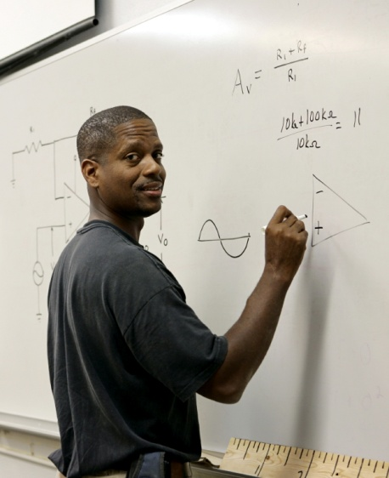

Examining Undergraduates’ Departure from STEM: Findings from a National Study
Kevin Eagan, Ph.D.
Improving Undergraduate STEM Education Workshop
Association of American Universities
May 22, 2012

Slide 2
Overview of Project
Following entering cohort of students in 2004
Baseline sample: 63,000 aspiring STEM majors across 350 institutions
Multiple surveys
2004 Freshman Survey
2005 Your First College Year Survey
2008 College Senior Survey
2011 Post-Baccalaureate Survey
Merged with IPEDS, National Student Clearinghouse, Registrar, MCAT, College Board, and Faculty Survey data
Qualitative data collection
Introductory STEM classroom mixed methods study
STEM Pioneers qualitative data collection

Slide 5
The Role of Introductory STEM Courses
Resistance to innovation – both students and faculty
Authentic lab experiences – identifying as a scientist
Faculty accessibility cues and ethic of care
Engaging pedagogy
Affirming student participation and engagement

Slide 6
Persistence in Science through the First Year
Prior preparation and achievement*
Identifying as a scientist
Research opportunities
Science clubs
Early academic success

Slide 7
STEM Persistence through Four Years
Prior preparation*
Pre-med phenomenon
Identifying as a scientist
Undergraduate research
STEM-related clubs
Full-time work during college

Slide 8
The Role of Institutional Selectivity
Positively related to degree completion (any field)
Negatively related to STEM persistence
Sorting twice
Admission to the institution
Acceptance/admission into the major

Slide 9
Three Key Takeaways
Innovation in introductory STEM courses
Identifying
Scaling up
Undergraduate research opportunities
Being more targeted in allocation of institutional grants
Scaling existing effective programs
Institutional selectivity – addressing institutional capacity for STEM

Slide 10

Contact Info
Faculty/Co-PIs:
Sylvia Hurtado
Mitchell Chang
Postdoctoral Scholars:
Kevin Eagan
Josephine Gasiewski
Administrative Staff:
Dominique Harrison
Graduate Research Assistants:
Tanya Figueroa
Gina Garcia
Juan Garibay
Felisha Herrera
Bryce Hughes
Cindy Mosqueda
Papers and reports are available for download from project website:
http://heri.ucla.edu/nih
Project e-mail: herinih@ucla.edu
This study was made possible by the support of the National Institute of General Medical Sciences, NIH Grant Numbers 1 R01 GMO71968-01 and R01 GMO71968-05, the National Science Foundation, NSF Grant Number 0757076, and the American Recovery and Reinvestment Act of 2009 through the National Institute of General Medical Sciences, NIH Grant 1RC1GM090776-01. This independent research and the views expressed here do not indicate endorsement by the sponsors.

