Slide 1
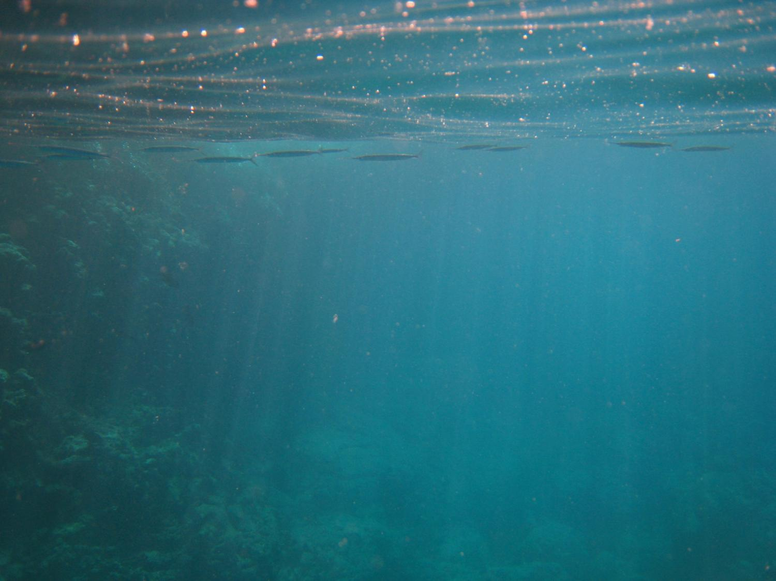
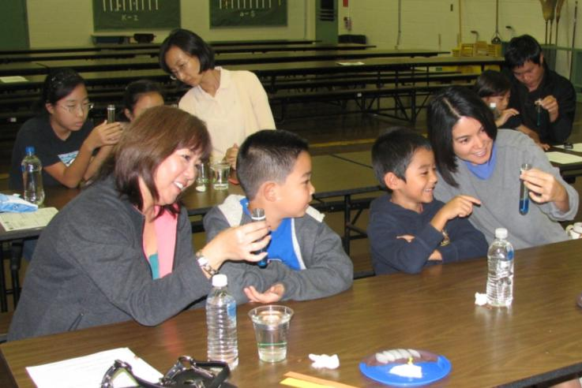


Welcome to
Ocean FEST
Our Goals
Have fun with hands-on science
Share about science careers
Our Model:
Space FEST (created by Art & Rene Kimura for Hawaii’s kids)
Our Sponsors:
National Science Foundation
C-MORE
COSEE-Island Earth
Ocean FEST is based on the research of:
Notes:
We suggest viewing this powerpoint as a slideshow (rather than just clicking through the slides) because it has animations

Slide 2
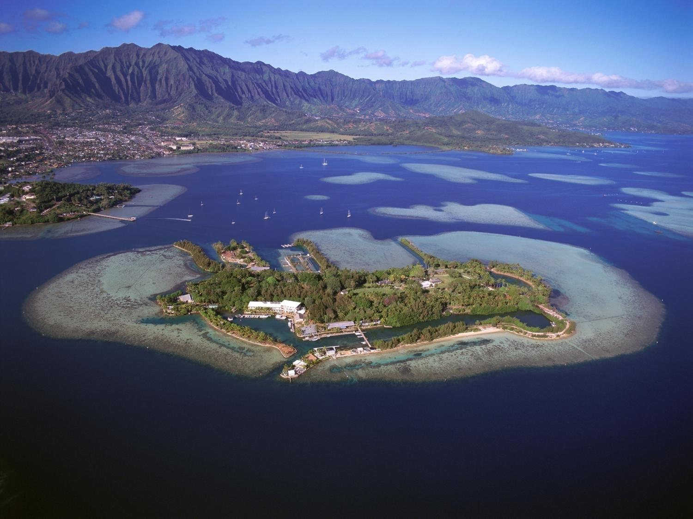
Notes:
The Hawaii Institute of Marine Biology (HIMB) on Coconut Island

Slide 3
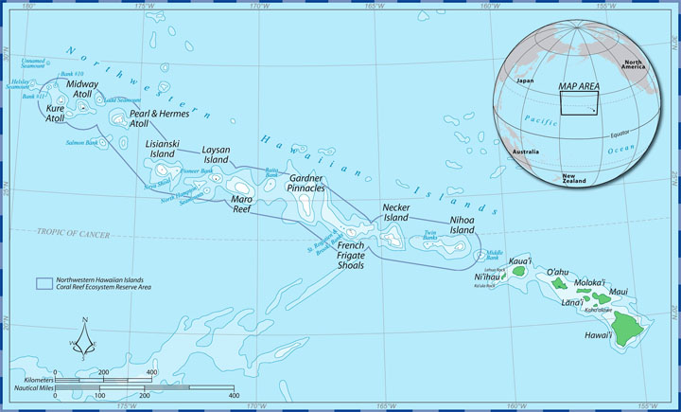
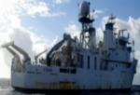
Papahānaumokuākea Marine National Monument
Notes:
The Hawaii Institute of Marine Biology works in partnership with the Papahānaumokuākea Marine National Monument

Slide 4
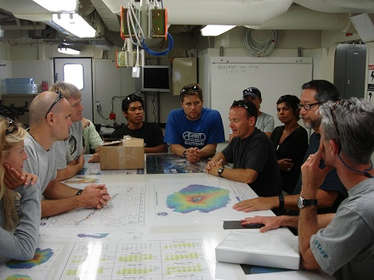
Notes:
Researchers at sea

Slide 5
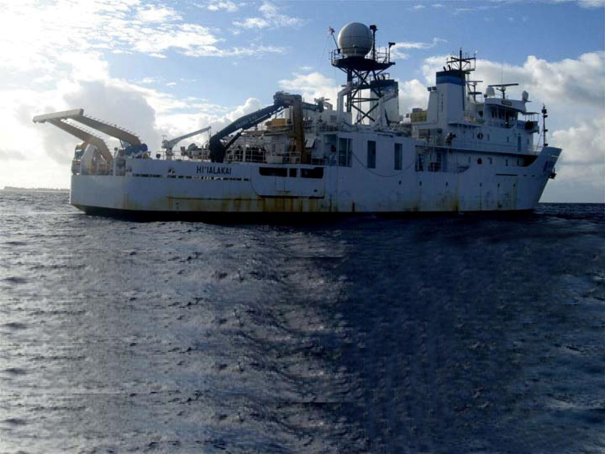
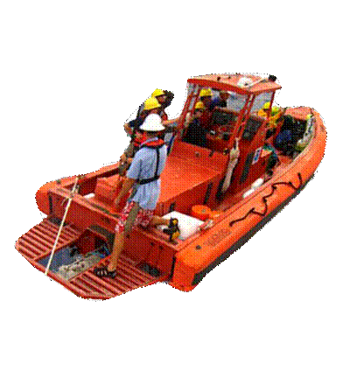
Notes:
Researchers board smaller craft in Papahānaumokuākea

Slide 6
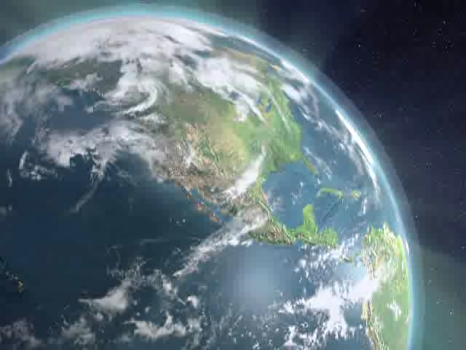
Notes:
Center for Microbial Oceanography: Research and Education (C-MORE) animation showing an artist’s view of microbes in the ocean.

Slide 7
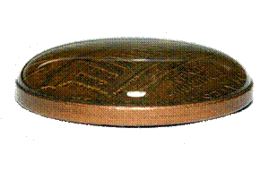
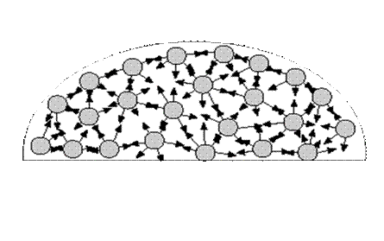
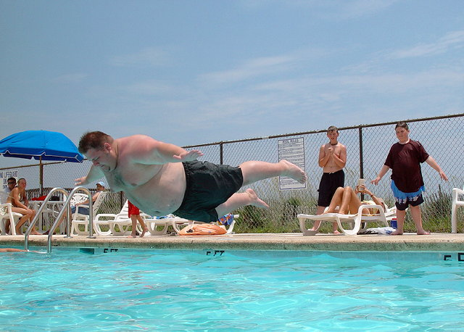
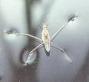
Activity #1
PENNY PLOP
Surface Tension What causes water to form a dome?
http://static.zooomr.com/images/3807652_fd4f4001e5.jpg
http://quest.nasa.gov/space/teachers/microgravity/image/66.gif
http://blogs.browardpalmbeach.com/juice/bellyflop.jpg,
http://www.space-matters.info/img/waterstrider.jpg

Slide 8

Activity #1 PENNY PLOP
How many drops of water fit on a penny?
Before you start, make a prediction!
Key Concepts:
Surface Tension, Scientific Method
Notes:
For an online version of this activity, go to
http://cmore.soest.hawaii.edu/education/kidskorner/ur_q1.htm
We’ve talked a little bit about microbes, but who can tell me what a microbe is? Small (microscopic), single-celled;
Examples: Viruses, bacteria, algae,
Microbes are super abundant: If you fill a coke can with sea water, it contains hundreds of millions of microbes
But that is okay -- most microbes are good for us
Now we are going to find out what kind of microbe we are each most similar to. Afterwards: read the description -- did anyone’s microbe do anything bad? (probably not)

Slide 9
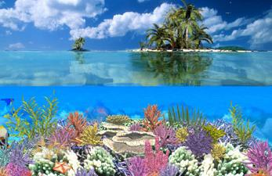
Activity #2a DROWNING ISLAND
Key Concept: Climate change is causing sea level to rise.
Notes:
For an online version of this activity, go to
http://cmore.soest.hawaii.edu/education/kidskorner/ur_q1.htm
We’ve talked a little bit about microbes, but who can tell me what a microbe is? Small (microscopic), single-celled;
Examples: Viruses, bacteria, algae,
Microbes are super abundant: If you fill a coke can with sea water, it contains hundreds of millions of microbes
But that is okay -- most microbes are good for us
Now we are going to find out what kind of microbe we are each most similar to. Afterwards: read the description -- did anyone’s microbe do anything bad? (probably not)

Slide 10
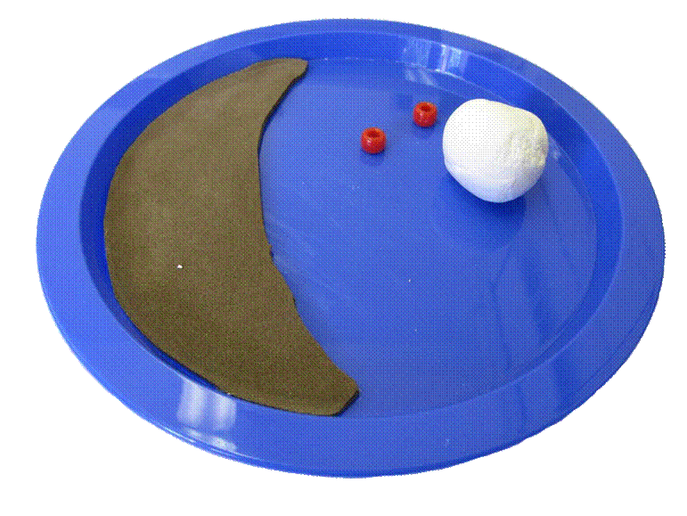
4. Teacher volunteers put ice on the “land” to represent continental ice.
1. Make an island out of this clay ball and put in the “ocean”.
2. Put 2 houses (red beads) on your island -- one on the coast and one inland.
3. Use your pipette to squeeze 10 pipettes full of water onto the “ocean”.

Slide 11
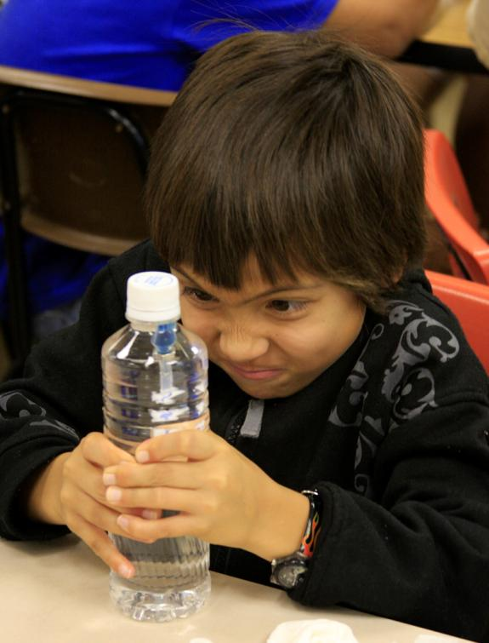
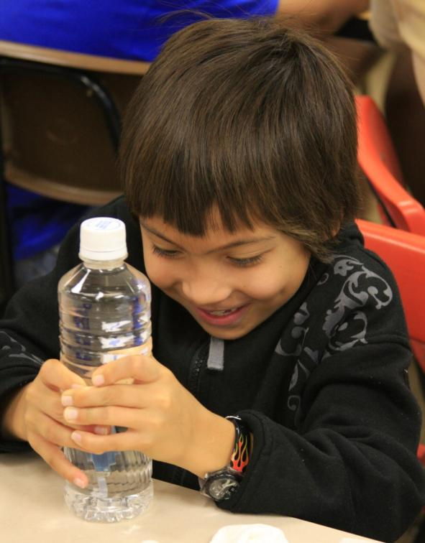
Activity #3 CARTESIAN DIVERS
Key Concept: Density determines whether an object sinks or floats.

Slide 12
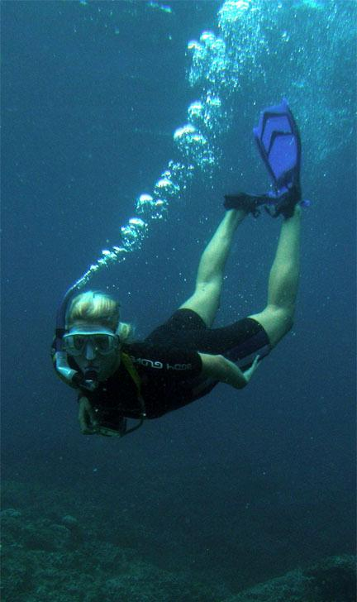
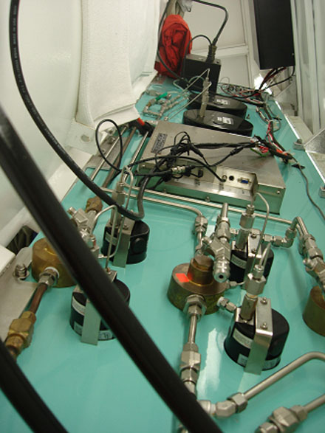
Scuba Diving & Pressure

Slide 13
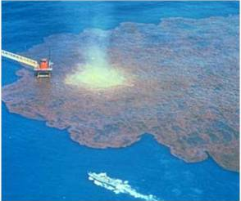

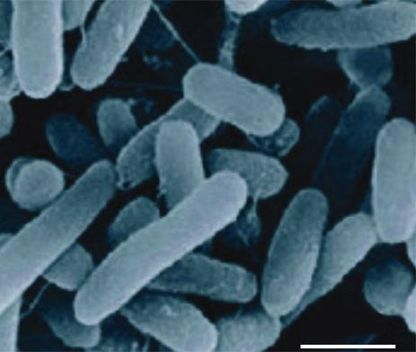
Activity #4 OIL & WATER TUBE
Key Concepts: The different densities of oil and water, along with some microbes, help clean up oil spills.

Slide 14
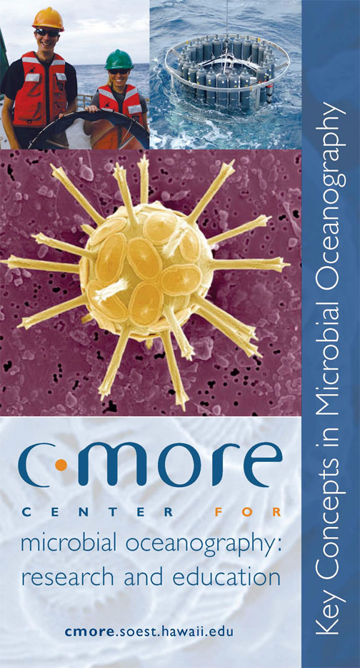
MARINE MICROBES: WE CAN’T LIVE WITHOUT THEM
Produce oxygen
Help moderate the Earth’s climate
Our planet’s main decomposers
Base of food web

Slide 15
Activity #4 OIL & WATER TUBE
Key Concepts: The different densities of oil and water, along with some microbes, help clean up oil spills.

Slide 16
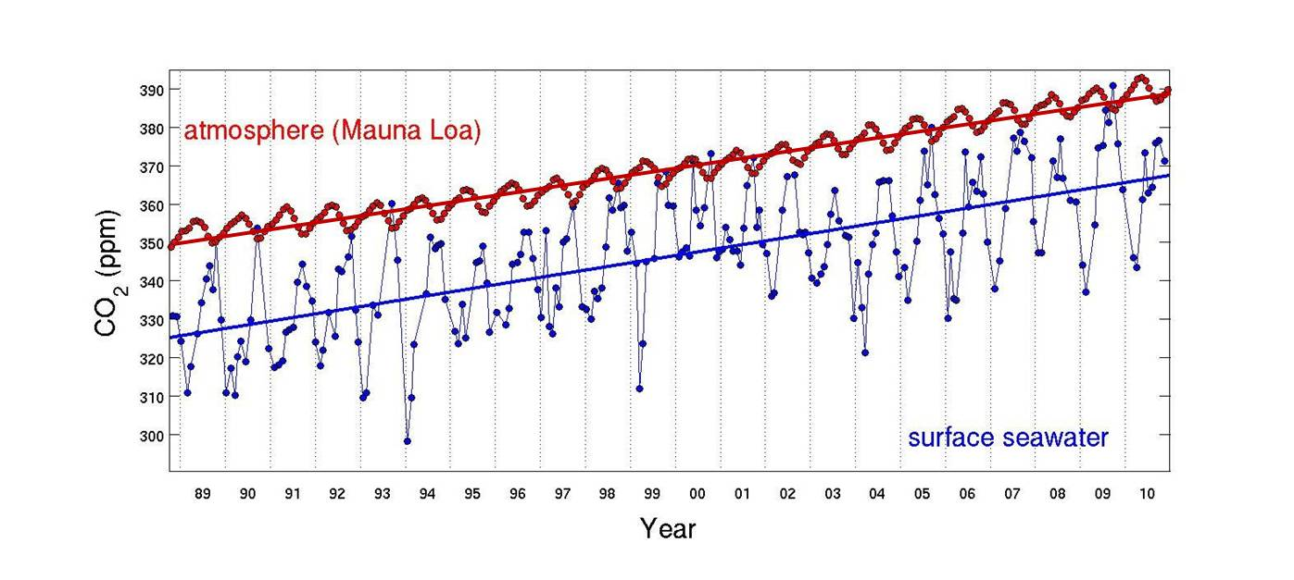
Our oceans are becoming more acidic.
Red: CO₂ is increasing in the atmosphere Blue: CO2 is increasing in the ocean
http://hahana.soest.hawaii.edu/hot/

Slide 17
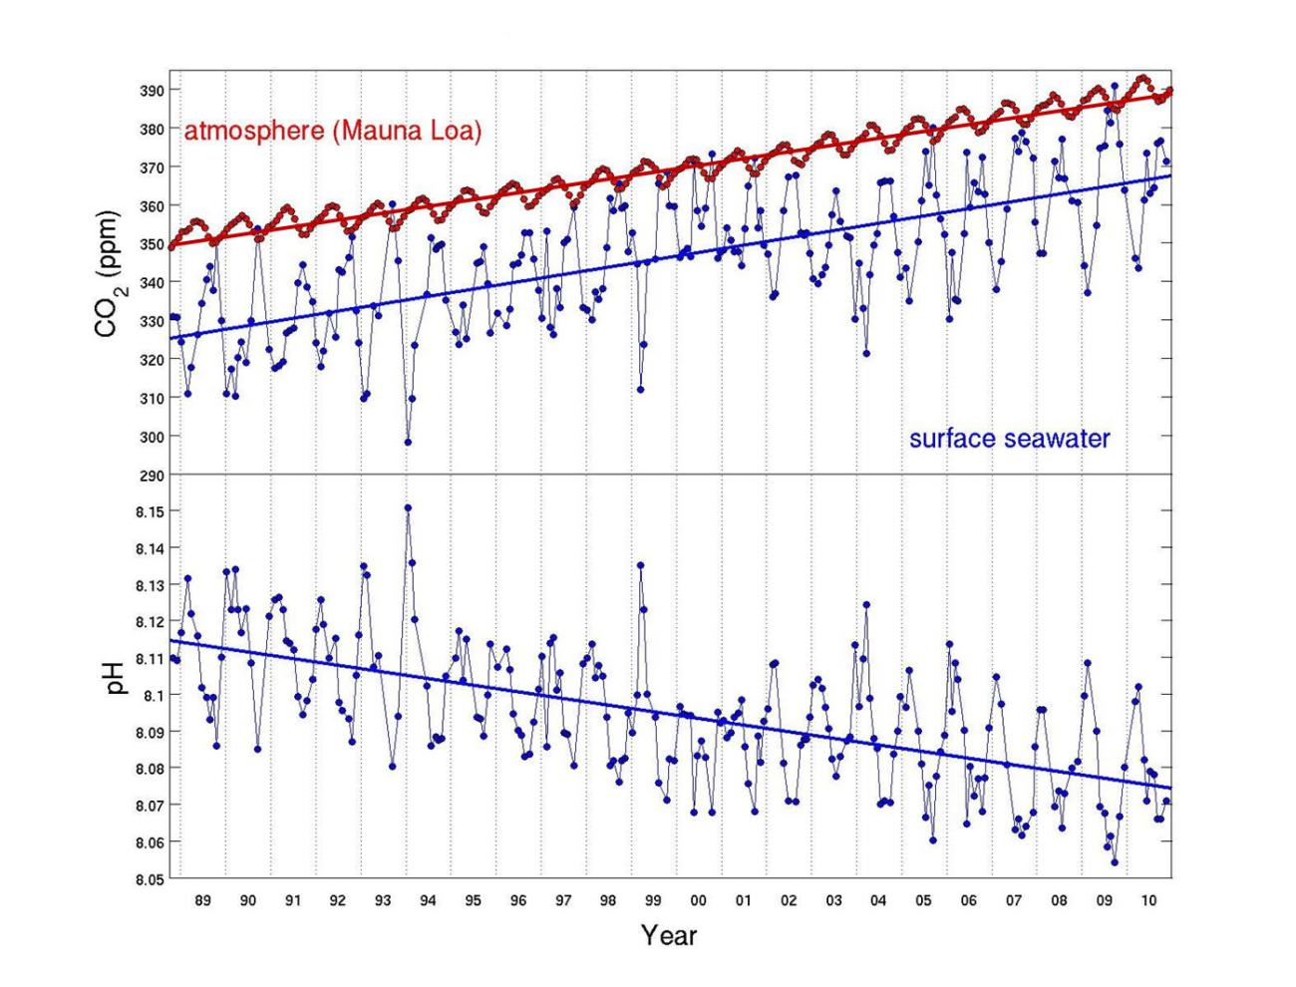
Our oceans are becoming more acidic.
http://hahana.soest.hawaii.edu/hot/

Slide 18
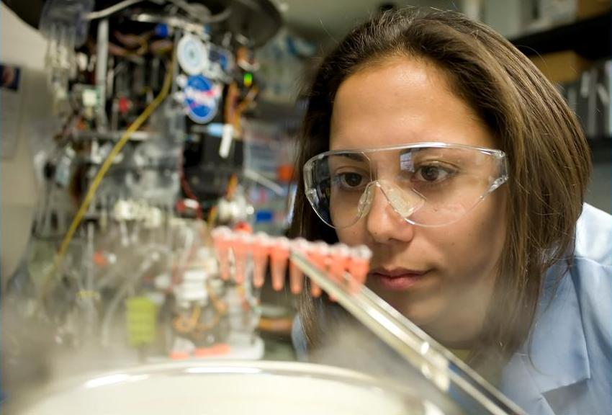
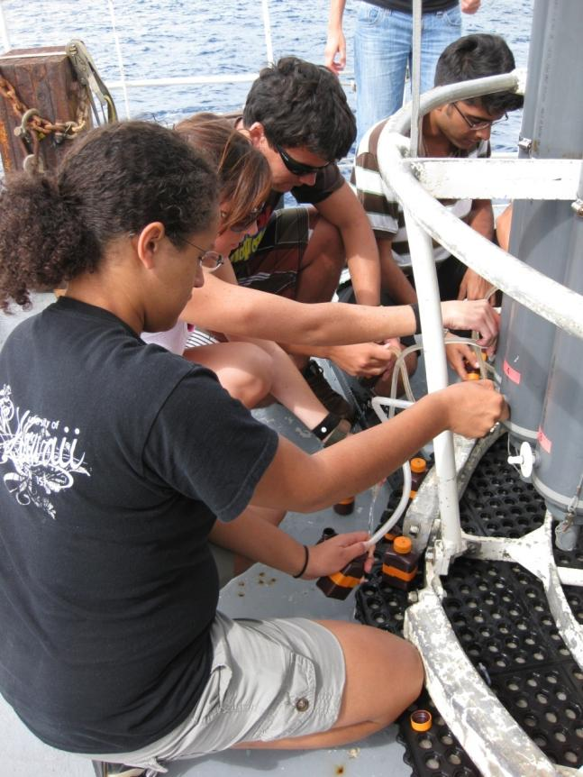
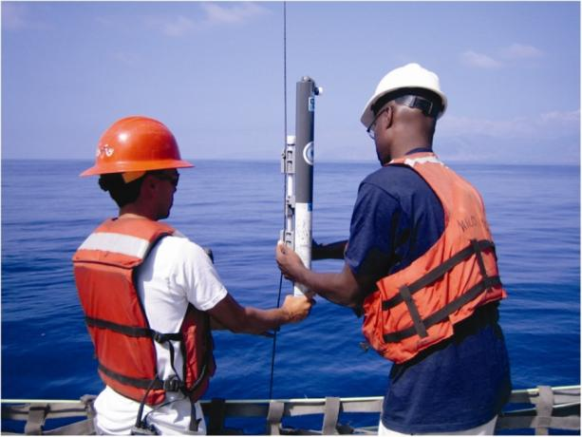
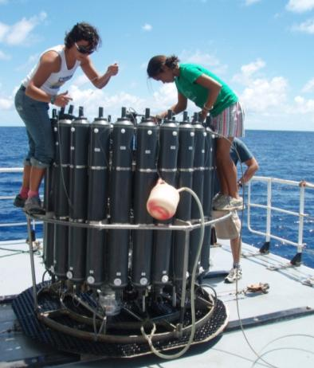
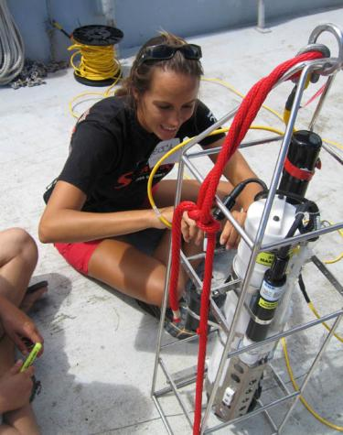
CAREERS IN OCEANOGRAPHY
Notes:
There are many exciting careers in oceanography, both on ships and in the lab.

Slide 19
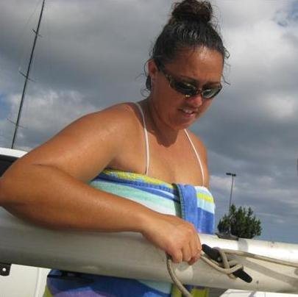
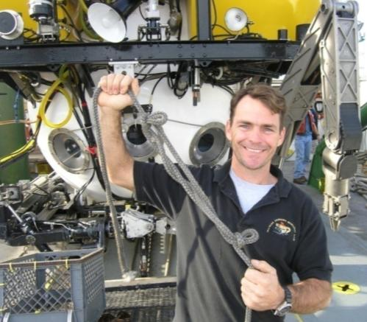
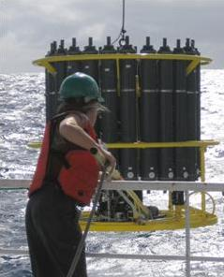
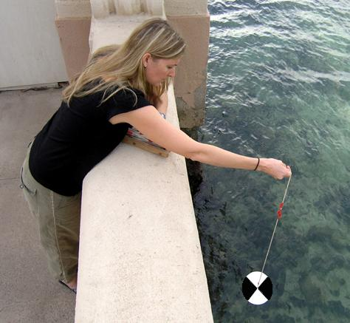
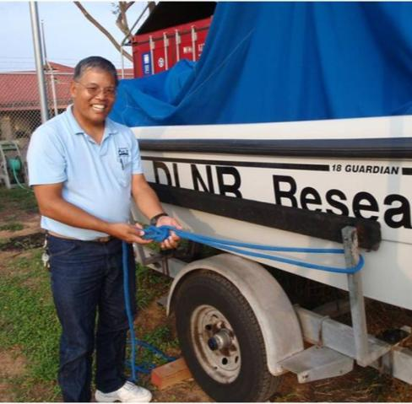
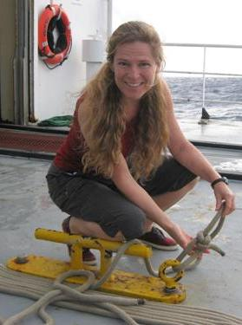
CAREERS IN OCEANOGRAPHY
Notes:
There are many exciting careers in oceanography, both on ships and in the lab.

Slide 20
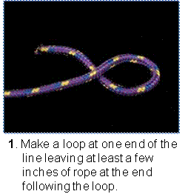
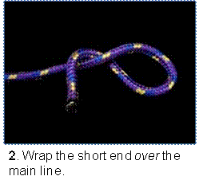
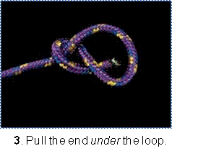
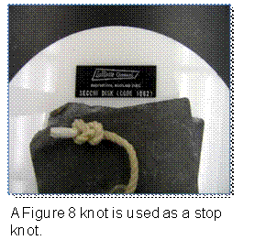
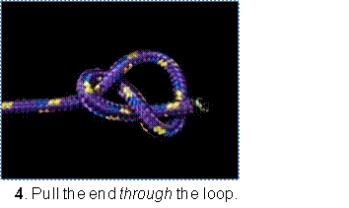
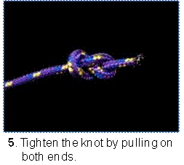
Figure 8 Knot
Activity #5
Key Concept: Learn to tie knots that scientists use on ships.

Slide 21
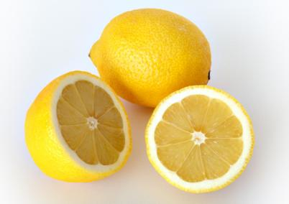
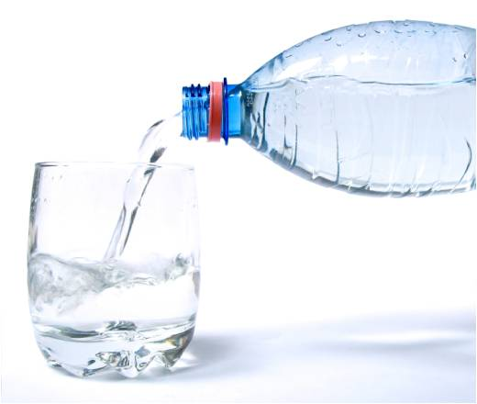
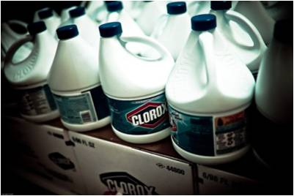
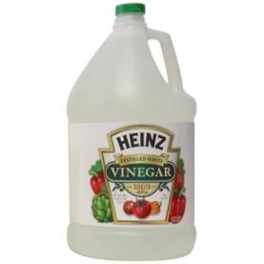
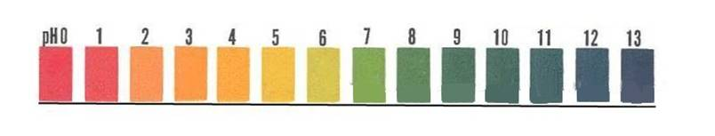
What is an acid?
Acid
Neutral
Base

Slide 22
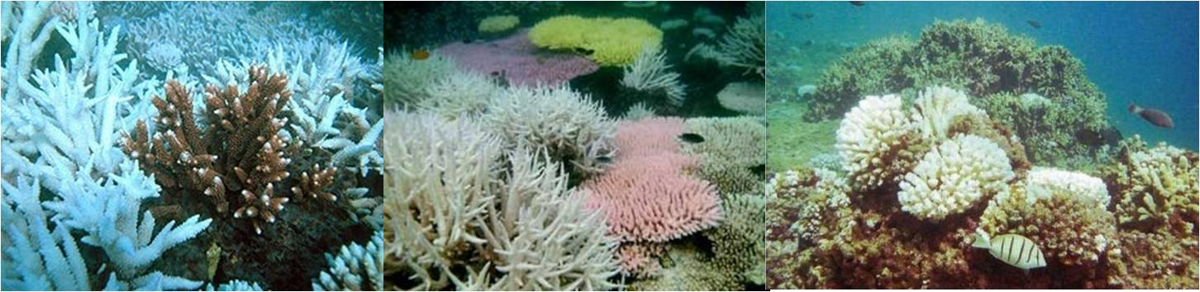
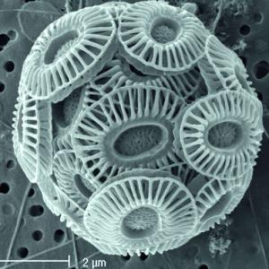
Activity #6 CORAL SAND & VINEGAR
How does acid affect coral and certain microbes?
Key Concept: Coral & certain microbes dissolve in acid.

Slide 23
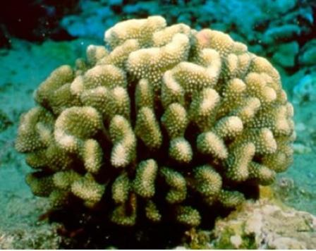
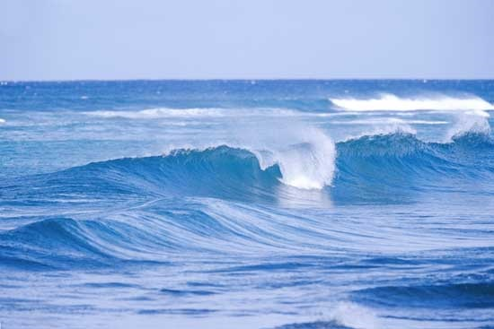


Where does Hawaii’s sand come from?
+
=

Slide 24

Guess this sound!
Hint: It is in the ocean

Slide 25

Answer: Parrot Fish (Uhu) munching on coral

Slide 26
Activity #6 CORAL SAND & VINEGAR
How does acid affect coral and certain microbes?
Key Concept: Coral & certain microbes dissolve in acid.

Slide 27


1. Take a pinch of sand and place it on your dish.
2. Drop vinegar from the bottles onto the sand. Add enough vinegar to cover all the sand.
3. Using your magnifying glass, observe what happens!

Slide 28



Activity # 7a WHAT MICROBE ARE YOU?
Discover your microbe personality!
In each pair of statements, choose the one that best describes you.
Images: http://microscope.mbl.edu
Key Concept: There are many different kinds of microbes. Most of them are good for us.
Notes:
For an online version of this activity, go to
http://cmore.soest.hawaii.edu/education/kidskorner/ur_q1.htm
We’ve talked a little bit about microbes, but who can tell me what a microbe is? Small (microscopic), single-celled;
Examples: Viruses, bacteria, algae,
Microbes are super abundant: If you fill a coke can with sea water, it contains hundreds of millions of microbes
But that is okay -- most microbes are good for us
Now we are going to find out what kind of microbe we are each most similar to. Afterwards: read the description -- did anyone’s microbe do anything bad? (probably not)

Slide 29




Activity # 7b MAKE A MICROBE
that sinks or floats and is protected
Images: http://microscope.mbl.edu
Key Concept: Microbes use diverse strategies to protect themselves and are found everywhere in the water column.
Notes:
Photos from left: A) Coccolithophore; B) Radiolaria ; C) Dinoflagellate ; D) diatoms
Some microbes have shells that help protect them from predators. For example, the coccolithophores (A - left) have armor made of calcium carbonate plates. Other microbes have long spines to protect themselves from predators (B, C). Long spines also increase drag. Increasing drag is important because microbes that photosynthesize need to stay in the upper layers of the ocean where there is sunlight. If they sink too far, there will not be enough light for them to photosynthesize and produce energy. Another way to increase drag is to form colonies, such as chains (D) or puffs (like trichodesmium, not shown)
29

Slide 30

Activity # 2b DROWNING ISLAND
What Happened to Your Island?
Key Concept: Climate change is causing sea level to rise.

Slide 31

http://www.soest.hawaii.edu/hmrg/FloodingOahu/stepbystep_oahu.php

Slide 32

http://www.soest.hawaii.edu/hmrg/FloodingOahu/stepbystep_oahu.php

Slide 33

Effect of a 1 Meter (3 Feet) Sea Level Rise in Honolulu
National Memorial
Cemetery of the Pacific
Ala Moana
Beach Park
Ala Wai
Notes:
33
33
Everything makai (oceanward) of blue line is below 1m above sea level, so it would become submerged if sea level rises 1m
(as some climate scientists predict will happen by 2100)

Slide 34

What can YOU do to limit climate change?
Ride your bike, walk, or catch the bus
Don’t waste electricity
Reuse and recycle
Buy products with less packaging
Plant trees

Slide 35
CAREERS IN OCEANOGRAPHY
Notes:
There are many exciting careers in oceanography, both on ships and in the lab.

Slide 36


What makes a scientist a scientist??
Problem solving
Curiosity
Curiosity
Patience
Passion for learning
Exploration
Good observation skills

Slide 37


What makes a scientist a scientist??
Problem solving
Curiosity
Patience
Passion for learning
Exploration
Good observation skills

Slide 38


What makes a scientist a scientist??
Problem solving
Curiosity
Patience
Passion for learning
Exploration
Good observation skills

Slide 39


What makes a scientist a scientist??
Problem solving
Curiosity
Patience
Passion for learning
Exploration
Good observation skills

Slide 40


What makes a scientist a scientist??
Problem solving
Curiosity
Patience
Passion for learning
Exploration
Good observation skills

Slide 41


What makes a scientist a scientist??
Problem solving
Curiosity
Patience
Passion for learning
Exploration
Good observation skills

Slide 42



Ocean FEST Take Home Science
Folder from UH Manoa (SOEST)
Marine Book Mark
Postcards
C-MORE Poster/Brochure
Knot-tying hand-out
Ocean FEST sticker
Ocean FEST Matching Game
Cartesian Diver In A Bottle
Oil & Water Tube
Rope
Microbe “arts and crafts” supplies
Ocean FEST Pencil
Magnifying Glass
Biodegradable Utensil
Key Chain with “magic” beads

Slide 43



MAHALO TO: Our Sponsors Art and Rene Kimura Your School Coordinator Teachers & Volunteers Parents & Families You!

