Slide 1



Supercomputing in Plain English High Throughput Computing
Henry Neeman, Director
OU Supercomputing Center for Education & Research
University of Oklahoma Information Technology
Tuesday April 19 2011

Slide 2
This is an experiment!
It’s the nature of these kinds of videoconferences that FAILURES ARE GUARANTEED TO HAPPEN! NO PROMISES!
So, please bear with us. Hopefully everything will work out well enough.
If you lose your connection, you can retry the same kind of connection, or try connecting another way.
Remember, if all else fails, you always have the toll free phone bridge to fall back on.

Slide 3
Access Grid
If you aren’t sure whether you have AG, you probably don’t.
Tue Apr 19 | Mosaic
Tue Apr 26 | Monte Carlo
Tue May 3 | Helium
Many thanks to Patrick Calhoun of OU for setting these up for us.

Slide 4
H.323 (Polycom etc)
From an H.323 device (e.g., Polycom, Tandberg, Lifesize, etc):
If you ARE already registered with the OneNet gatekeeper: Dial 2500409
If you AREN'T registered with the OneNet gatekeeper (probably the case):
Dial: 164.58.250.47
Bring up the virtual keypad. On some H.323 devices, you can bring up the virtual keypad by typing: #
When asked for the conference ID, enter: 0409
On some H.323 devices, you indicate the end of conference ID with: #
Many thanks to Roger Holder and OneNet for providing this.

Slide 5
H.323 from Internet Explorer
From a Windows PC running Internet Explorer:
You MUST have the ability to install software on the PC (or have someone install it for you).
Download and install the latest Java Runtime Environment (JRE) from here: http://www.oracle.com/technetwork/java/javase/downloads/ (Click on the Java Download icon, because that install package includes both the JRE and other components.)
Download and install this video decoder: http://164.58.250.47/codian_video_decoder.msi
Start Internet Explorer.
Copy-and-paste this URL into your IE window: http://164.58.250.47/
When that webpage loads, in the upper left, click on “Streaming.”
In the textbox labeled Sign-in Name, type your name.
In the textbox labeled Conference ID, type this: 0409
Click on “Stream this conference.”
When that webpage loads, you may see, at the very top, a bar offering you options. If so, click on it and choose “Install this add-on.”

Slide 6
H.323 from XMeeting (MacOS)
From a Mac running MacOS X:
Download XMeeting from http://xmeeting.sourceforge.net/
Install XMeeting as follows:
Open the .dmg file.
Drag XMeeting into the Applications folder.
Open XMeeting from Applications.
Skip the setup wizard.
In the call box, type 164.58.250.47
Click the Call button.
From the Remote Control window, when prompted to join the conference, enter : 0409#

Slide 7
EVO
There’s a quick tutorial on the OSCER education webpage.

Slide 8
QuickTime Broadcaster
If you cannot connect via the Access Grid, H.323 or iLinc, then you can connect via QuickTime:
rtsp://129.15.254.141/test_hpc09.sdp
We recommend using QuickTime Player for this, because we’ve tested it successfully.
We recommend upgrading to the latest version at:
http://www.apple.com/quicktime/
When you run QuickTime Player, traverse the menus
File -> Open URL
Then paste in the rstp URL into the textbox, and click OK.
Many thanks to Kevin Blake of OU for setting up QuickTime Broadcaster for us.

Slide 9
WebEx
We have only a limited number of WebEx connections, so please avoid WebEx unless you have NO OTHER WAY TO CONNECT.
Instructions are available on the OSCER education webpage.
Thanks to Tim Miller of Wake Forest U.

Slide 10
Phone Bridge
If all else fails, you can call into our toll free phone bridge:
US: 1-800-832-0736, *6232874#
International: 303-330-0440, *6232874#
Please mute yourself and use the phone to listen.
Don’t worry, we’ll call out slide numbers as we go.
Please use the phone bridge ONLY if you cannot connect any other way: the phone bridge is charged per connection per minute, so our preference is to minimize the number of connections.
Many thanks to Amy Apon and U Arkansas for providing the previous toll free phone bridge.

Slide 11
Please Mute Yourself
No matter how you connect, please mute yourself, so that we cannot hear you.
At OU, we will turn off the sound on all conferencing technologies.
That way, we won’t have problems with echo cancellation.
Of course, that means we cannot hear questions.
So for questions, you’ll need to send some kind of text.

Slide 12
Questions via Text: iLinc or E-mail
Ask questions via e-mail to sipe2011@yahoo.com.
All questions will be read out loud and then answered out loud.

Slide 13
Thanks for helping!
OSCER operations staff: Brandon George, Dave Akin, Brett Zimmerman, Josh Alexander
Horst Severini, OSCER Associate Director for Remote & Heterogeneous Computing
OU Research Campus staff (Patrick Calhoun, Mark McAvoy)
Kevin Blake, OU IT (videographer)
John Chapman, Jeff Pummill and Amy Apon, U Arkansas
James Deaton and Roger Holder, OneNet
Tim Miller, Wake Forest U
Jamie Hegarty Schwettmann, i11 Industries

Slide 14
This is an experiment!
It’s the nature of these kinds of videoconferences that FAILURES ARE GUARANTEED TO HAPPEN! NO PROMISES!
So, please bear with us. Hopefully everything will work out well enough.
If you lose your connection, you can retry the same kind of connection, or try connecting another way.
Remember, if all else fails, you always have the toll free phone bridge to fall back on.

Slide 15
Supercomputing Exercises
Want to do the “Supercomputing in Plain English” exercises?
The first exercise is already posted at:
http://www.oscer.ou.edu/education.php
If you don’t yet have a supercomputer account, you can get a temporary account, just for the “Supercomputing in Plain English” exercises, by sending e-mail to:
hneeman@ou.edu
Please note that this account is for doing the exercises only, and will be shut down at the end of the series.
This week’s N-Body exercise will give you experience using a Condor pool.

Slide 16
Summer Workshops 2011
In Summer 2011, there will be several workshops on HPC and Computational and Data Enabled Science and Engineering (CDESE) across the US.
These will be weeklong intensives, running from Sunday evening through Saturday morning.
We’re currently working on where and when those workshops will be held.
Once we’ve got that worked out, we’ll announce them and open up the registration website.
One of them will be held at OU.

Slide 17
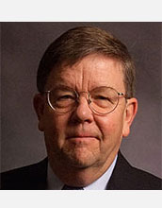
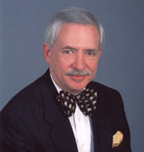
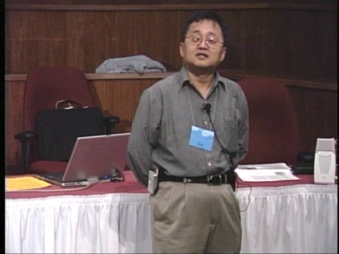
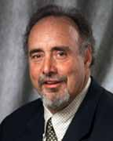
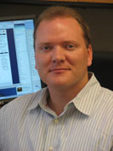
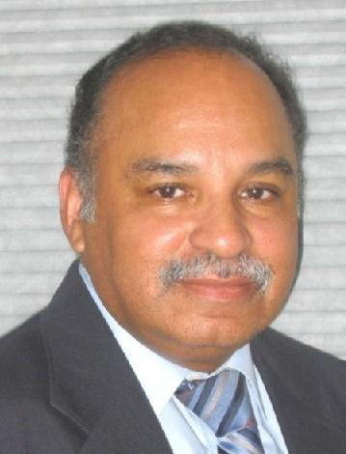
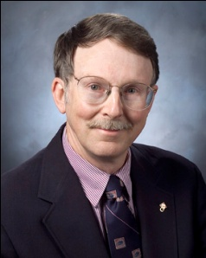
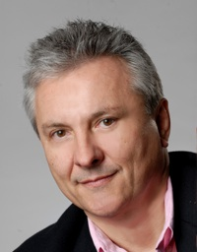
OK Supercomputing Symposium 2011
2003 Keynote:
Peter Freeman
NSF
Computer & Information
Science & Engineering
Assistant Director
2004 Keynote:
Sangtae Kim
NSF Shared
Cyberinfrastructure
Division Director
2005 Keynote:
Walt Brooks
NASA Advanced
Supercomputing
Division Director
2006 Keynote:
Dan Atkins
Head of NSF’s
Office of
Cyberinfrastructure
2007 Keynote:
Jay Boisseau
Director
Texas Advanced
Computing Center
U. Texas Austin
2008 Keynote: José Munoz Deputy Office Director/ Senior Scientific Advisor NSF Office of Cyberinfrastructure
?
FREE! Wed Oct 12 2011 @ OU
Over 235 registratons already!
Over 150 in the first day, over 200 in the first week, over 225 in the first month.
http://symposium2011.oscer.ou.edu/
Parallel Programming Workshop FREE! Tue Oct 11 2011 @ OU
FREE! Symposium Wed Oct 12 2011 @ OU
2009 Keynote: Douglass Post Chief Scientist US Dept of Defense HPC Modernization Program
2010 Keynote: Horst Simon Deputy Director Lawrence Berkeley National Laboratory
2011 Keynote to be announced

Slide 18
SC11 Education Program
At the SC11 supercomputing conference, we’ll hold our annual Education Program, Sat Nov 12 – Tue Nov 15.
You can apply to attend, either fully funded by SC11 or self-funded.
Henry is the SC11 Education Chair.
We’ll alert everyone once the registration website opens.

Slide 19
Outline
What is High Throughput Computing?
Tightly Coupled vs Loosely Coupled
What is Opportunistic Computing?
Condor
Grid Computing

Slide 20
What is High Throughput Computing?

Slide 21
High Throughput Computing
High Throughput Computing (HTC) means getting lots of work done per large time unit (for example, jobs per month).
This is different from High Performance Computing (HPC), which means getting a particular job done in less time (for example, calculations per second).

Slide 22
Throughput vs Performance
Throughput is a side effect of how much time your job takes from when you first submit it until it completes.
Performance is the factor that controls how much time your jobs takes from when it first starts running until it completes.
Example:
You submit a very big job at 1:00am on January 1.
It sits in the queue for a while.
It starts running at 5:00pm on January 2.
It finishes running at 6:00pm on January 2.
Its performance is fast; its throughput is slow.

Slide 23
High Throughput on a Cluster?
Is it possible to get high throughput on a cluster?
Sure – it just has to be a cluster that no one else is trying to use!
Normally, a cluster that is shared by many users is fully loaded with jobs all the time. So your throughput depends on when you submit your jobs, and even how many jobs you submit at a time.
Depending on a variety of factors, a job you submit may wait in the queue for anywhere from seconds to days.

Slide 24
Tightly Coupled vs Loosely Coupled

Slide 25
Tightly Coupled vs Loosely Coupled
Tightly coupled means that all of the parallel tasks have to advance forward in lockstep, so they have to communicate frequently.
Loosely coupled means that the parallel tasks can largely or completely ignore each other (little or no communication), and they can advance at different rates.

Slide 26
Tightly Coupled Example
Consider weather forecasting.
You take your simulation domain – for example, the continental United States – split it up into chunks, and give each chunk to an MPI process.
But, the weather in northern Oklahoma affects the weather in southern Kansas.
So, every single timestep, the process that contains northern Oklahoma has to communicate with the process that contains southern Kansas, so that the interface between the processes has the same weather at the same time.

Slide 27
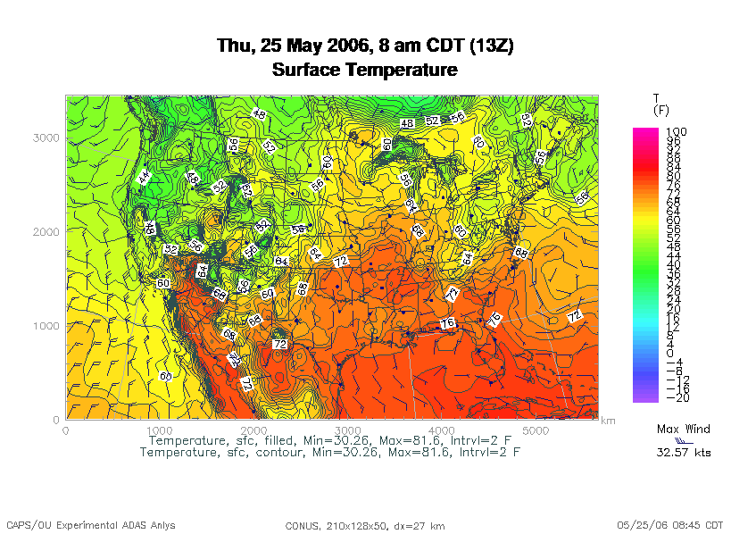
Tightly Coupled Example
OK/KS boundary
http://www.caps.ou.edu/wx/p/r/conus/fcst/

Slide 28
Loosely Coupled Example
An application is known as embarrassingly parallel, or loosely coupled, if its parallel implementation:
can straightforwardly be broken up into roughly equal amounts of work per processor, AND
has minimal parallel overhead (for example, communication among processors).
We love embarrassingly parallel applications, because they get near-perfect parallel speedup, sometimes with only modest programming effort.

Slide 29
Monte Carlo Methods
Monte Carlo is a city in the tiny European country Monaco.
People gamble there; that is, they play games of chance, which involve randomness.
Monte Carlo methods are ways of simulating (or otherwise calculating) physical phenomena based on randomness.
Monte Carlo simulations typically are embarrassingly parallel.

Slide 30
Monte Carlo Methods: Example
Suppose you have some physical phenomenon. For example, consider High Energy Physics, in which we bang tiny particles together at incredibly high speeds.
BANG!
We want to know, say, the average properties of this phenomenon.
There are infinitely many ways that two particles can be banged together.
So, we can’t possibly simulate all of them.

Slide 31
Monte Carlo Methods: Example
Suppose you have some physical phenomenon. For example, consider High Energy Physics, in which we bang tiny particles together at incredibly high speeds.
BANG!
We want to know, say, the average properties of this phenomenon.
There are infinitely many ways that two particles can be banged together.
So, we can’t possibly simulate all of them.
Instead, we can randomly choose a finite subset of these infinitely many ways and simulate only the subset.

Slide 32
Monte Carlo Methods: Example
Suppose you have some physical phenomenon. For example, consider High Energy Physics, in which we bang tiny particles together at incredibly high speeds.
BANG!
We want to know, say, the average properties of this phenomenon.
There are infinitely many ways that two particles can be banged together.
So, we can’t possibly simulate all of them.
The average of this subset will be close to the actual average.

Slide 33
Monte Carlo Methods
In a Monte Carlo method, you randomly generate a large number of example cases (realizations) of a phenomenon, and then take the average of the properties of these realizations.
When the realizations’ average converges (that is, doesn’t change substantially if new realizations are generated), then the Monte Carlo simulation stops.
This can also be implemented by picking a high enough number of realizations to be sure, mathematically, of convergence.

Slide 34
MC: Embarrassingly Parallel
Monte Carlo simulations are embarrassingly parallel, because each realization is completely independent of all of the other realizations.
That is, if you’re going to run a million realizations, then:
you can straightforwardly break up into roughly 1M / N_{p} chunks of realizations, one chunk for each of the N_{p} processes, AND
the only parallel overhead (for example, communication) comes from tracking the average properties, which doesn’t have to happen very often.

Slide 35
Serial Monte Carlo
Suppose you have an existing serial Monte Carlo simulation:
PROGRAM monte_carlo
CALL read_input(…)
DO realization = 1, number_of_realizations
CALL generate_random_realization(…)
CALL calculate_properties(…)
END DO
CALL calculate_average(…)
END PROGRAM monte_carlo
How would you parallelize this?

Slide 36
Parallel Monte Carlo: MPI
PROGRAM monte_carlo_mpi
[MPI startup]
IF (my_rank == server_rank) THEN
CALL read_input(…)
END IF
CALL MPI_Bcast(…)
number_of_realizations_per_process = &
& number_of_realizations / number_of_processes
DO realization = 1, number_of_realizations_per_process
CALL generate_random_realization(…)
CALL calculate_realization_properties(…)
CALL calculate_local_running_average(...)
END DO
IF (my_rank == server_rank) THEN
[collect properties]
ELSE
[send properties]
END IF
CALL calculate_global_average_from_local_averages(…)
CALL output_overall_average(...)
[MPI shutdown]
END PROGRAM monte_carlo_mpi

Slide 37
Parallel Monte Carlo: HTC
Suppose you have an existing serial Monte Carlo simulation:
PROGRAM monte_carlo
CALL read_input(…)
number_of_realizations_per_job = &
& number_of_realizations / number_of_jobs
DO realization = 1, number_of_realizations_per_job
CALL generate_random_realization(…)
CALL calculate_properties(…)
END DO
CALL calculate_average_for_this_job(…)
CALL output_average_for_this_job(…)
END PROGRAM monte_carlo
To parallelize this for HTC, simply submit number_of_jobs jobs, and then at the very end run a little program to calculate the overall average.

Slide 38
What is Opportunistic Computing?

Slide 39
Desktop PCs Are Idle Half the Day
Desktop PCs tend to be active during the workday.
But at night, during most of the year, they’re idle. So we’re only getting half their value (or less).

Slide 40
Supercomputing at Night
A particular institution – say, OU – has lots of desktop PCs that are idle during the evening and during intersessions.
Wouldn’t it be great to put them to work on something useful to our institution?
That is: What if they could pretend to be a big supercomputer at night, when they’d otherwise be idle anyway?
This is sometimes known as opportunistic computing: When a desktop PC is otherwise idle, you have an opportunity to do number crunching on it.

Slide 41

Supercomputing at Night Example
SETI – the Search for Extra-Terrestrial Intelligence – is looking for evidence of green bug-eyed monsters on other planets, by mining radio telescope data.
SETI@home runs number crunching software as a screensaver on idle PCs around the world (2+ million PCs in 252 countries):
http://setiathome.berkeley.edu/
There are many similar projects:
folding@home (protein folding)
climateprediction.net
Einstein@Home (Laser Interferometer Gravitational wave Observatory)
Cosmology@home
…

Slide 42

BOINC
The projects listed on the previous page use a software package named BOINC (Berkeley Open Infrastructure for Network Computing), developed at the University of California, Berkeley:
http://boinc.berkeley.edu/
To use BOINC, you have to insert calls to various BOINC routines into your code. It looks a bit similar to MPI:
int main ()
{ /* main */
…
boinc_init();
…
boinc_finish(…);
} /* main */

Slide 43
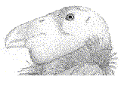
Condor

Slide 44
Condor is Like BOINC
Condor steals computing time on existing desktop PCs when they’re idle.
Condor runs in background when no one is sitting at the desk.
Condor allows an institution to get much more value out of the hardware that’s already purchased, because there’s little or no idle time on that hardware – all of the idle time is used for number crunching.

Slide 45
Condor is Different from BOINC
To use Condor, you don’t need to rewrite your software to add calls to special routines; in BOINC, you do.
Condor works great under Unix/Linux, but less well under Windows or MacOS (more on this presently); BOINC works well under all of them.
It’s non-trivial to install Condor on your own personal desktop PC; it’s straightforward to install a BOINC application such as SETI@home.

Slide 46
Useful Features of Condor
Opportunistic computing: Condor steals time on existing desktop PCs when they’re otherwise not in use.
Condor doesn’t require any changes to the software.
Condor can automatically checkpoint a running job: Every so often, Condor saves to disk the state of the job (the values of all the job’s variables, plus where the job is in the program).
Therefore, Condor can preempt running jobs if more important jobs come along, or if someone sits down at the desktop PC.
Likewise, Condor can migrate running jobs to other PCs, if someone sits at the PC or if the PC crashes.
And, Condor can do all of its I/O over the network, so that the job on the desktop PC doesn’t consume the desktop PCs local disk.

Slide 47
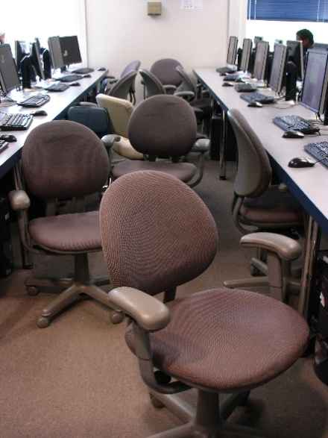
Condor Pool @ OU
OU IT has deployed a large Condor pool (795 desktop PCs in dozens of labs around campus).
OU’s Condor pool provides a huge amount of computing power – more than OSCER’s big cluster:
if OU were a state, we’d be the 17th largest state in the US;
if OU were a country, we’d be the 10th largest country in the world.
The hardware and software cost is zero, and the labor cost is modest.
Also, we’ve been seeing empirically that lab PCs are available for Condor jobs about 80% of the time.

Slide 48
Condor Limitations
The Unix/Linux version has more features than Windows or MacOS, which are referred to as “clipped.”
Your code shouldn’t be parallel to do opportunistic computing (MPI requires a fixed set of resources throughout the entire run), and it shouldn’t try to do any funky communication (for example, opening sockets).
For a Red Hat Linux Condor pool, you have to be able to compile your code with gcc, g++, g77 or NAG f95 (which is a Fortran90-to-C translator that then calls gcc).
Also, depending on the PCs that have Condor on them, you may have limitations on, for example, how big your jobs’ RAM footprint can be.

Slide 49
Running a Condor Job
Running a job on Condor pool is a lot like running a job on a cluster:
You compile your code using the compilers appropriate for that resource.
You submit a batch script to the Condor system, which decides when and where your job runs, magically and invisibly.

Slide 50
Sample Condor Batch Script
Universe = standard
Executable = /home/hneeman/NBody/nbody_compiled_for_condor
Notification = Error
Notify_User = hneeman@ou.edu
Arguments = 1000 100
Input = /home/hneeman/NBody/nbody_input.txt
Output = nbody_$(Cluster)_$(Process)_out.txt
Error = nbody_$(Cluster)_$(Process)_err.txt
Log = nbody_$(Cluster)_$(Process)_log.txt
InitialDir = /home/hneeman/NBody/Run001
Queue
The batch submission command is condor_submit, used like so:
condor_submit nbody.condor

Slide 51
Linux Condor on Windows PCs?
If OU’s Condor pool uses Linux, how can it be installed in OU IT PC labs? Don’t those run Windows?
Yes.
Our solution is to run Linux inside Windows, using a piece of software named Vmware (“virtual machine”), but there are other software packages that can be used (for example, VirtualBox).

Slide 52
Condor inside Linux inside Windows
Number Crunching Applications
Condor
Linux
Desktop Applications
VMware Server
Windows

Slide 53
Advantages of Linux inside Windows
Condor is full featured rather than clipped.
Desktop users have a full Windows experience, without even being aware that VMware exists.
A little kludge helps Condor watch the keyboard, mouse and CPU level of Windows, so that Condor jobs don’t run when the PC is otherwise in use.

Slide 54
Grid Computing

Slide 55
What is Grid Computing?
The term grid computing is poorly defined, but the best definition I’ve seen so far is:
“a distributed, heterogeneous operating system.”
A grid can consist of:
compute resources;
storage resources;
networks;
data collections;
shared instruments;
sensor networks;
and so much more ....

Slide 56
Grid Computing is Like and Unlike ...
IBM’s website has a very good description of grid computing:
“Like the Web, grid computing keeps complexity hidden: multiple users enjoy a single, unified experience.
“Unlike the Web, which mainly enables communication, grid computing enables full collaboration toward common ... goals.
“Like peer-to-peer, grid computing allows users to share files.
“Unlike peer-to-peer, grid computing allows many-to-many sharing – not only files but other resources as well.
“Like clusters and distributed computing, grids bring computing resources together.
“Unlike clusters and distributed computing, which need physical proximity and operating homogeneity, grids can be geographically distributed and heterogeneous.
“Like virtualization technologies, grid computing enables the virtualization of IT resources.
“Unlike virtualization technologies, which virtualize a single system, grid computing enables the virtualization of vast and disparate IT resources.”
http://www.thocp.net/hardware/grid_computers.htm

Slide 57
Condor is Grid Computing
Condor creates a grid out of disparate desktop PCs.
(Actually, they don’t have to be desktop PCs; they don’t even have to be PCs. You can use Condor to schedule a cluster, or even on a big iron supercomputer.)
From a user’s perspective, all of the PCs are essentially invisible; the user just knows how to submit a job, and everything happens magically and invisibly, and at some point the job is done and a result appears.

Slide 58
Summer Workshops 2011
In Summer 2011, there will be several workshops on HPC and Computational and Data Enabled Science and Engineering (CDESE) across the US.
These will be weeklong intensives, running from Sunday evening through Saturday morning.
We’re currently working on where and when those workshops will be held.
Once we’ve got that worked out, we’ll announce them and open up the registration website.
One of them will be held at OU.

Slide 59
OK Supercomputing Symposium 2011
2003 Keynote:
Peter Freeman
NSF
Computer & Information
Science & Engineering
Assistant Director
2004 Keynote:
Sangtae Kim
NSF Shared
Cyberinfrastructure
Division Director
2005 Keynote:
Walt Brooks
NASA Advanced
Supercomputing
Division Director
2006 Keynote:
Dan Atkins
Head of NSF’s
Office of
Cyberinfrastructure
2007 Keynote:
Jay Boisseau
Director
Texas Advanced
Computing Center
U. Texas Austin
2008 Keynote: José Munoz Deputy Office Director/ Senior Scientific Advisor NSF Office of Cyberinfrastructure
?
FREE! Wed Oct 12 2011 @ OU
Over 235 registratons already!
Over 150 in the first day, over 200 in the first week, over 225 in the first month.
http://symposium2011.oscer.ou.edu/
Parallel Programming Workshop FREE! Tue Oct 11 2011 @ OU
FREE! Symposium Wed Oct 12 2011 @ OU
2009 Keynote: Douglass Post Chief Scientist US Dept of Defense HPC Modernization Program
2010 Keynote: Horst Simon Deputy Director Lawrence Berkeley National Laboratory
2011 Keynote to be announced

Slide 60
SC11 Education Program
At the SC11 supercomputing conference, we’ll hold our annual Education Program, Sat Nov 12 – Tue Nov 15.
You can apply to attend, either fully funded by SC11 or self-funded.
Henry is the SC11 Education Chair.
We’ll alert everyone once the registration website opens.

Slide 61
Thanks for your attention! Questions? www.oscer.ou.edu

