Slide 1
From OBO to OWL and back again – a tutorial
David Osumi-Sutherland, Virtual Fly Brain/FlyBase
Chris Mungall – GO/LBL

Slide 2
Links to software downloads and tutorial ontology can be found here:
http://www.bioontology.org/wiki/index.php?title=From_OBO_to_OWL_and_back
Please note that the tutorial ontology has been designed for teaching purposes and should NOT be used as a reference for classes or relations.

Slide 3
I use OBO, why should I care about OWL?
OWL 2 is a W3C standard with a large and growing ecosystem of developers.
Using OWL ontologies in Protégé 4 you can use fast reasoners to:
Query your ontology
This could be the basis for sophisticated queries on your website
Quickly find mistakes
Automate classification
Non-lossy round tripping from OBO to OWL and back is now easy
continue developing in OBO while taking advantage of OWL and Protégé for reasoning
This may be a first step to developing in OWL/Protégé

Slide 4
Oort
OBO ontology release tool:
Starting from ontology requiring a reasoner, uses OWL reasoning to:
Roll OBO file that needs no reasoner – supporting current users.
Automatically make slims

Slide 5
Intro to ontology building
An ontology is a classification
There are lots of useful ways to classify stuff
Maintaining multiple classification schemes by hand is impractical
So automate what you can
Everybody makes mistakes
So get the computer to find errors for you
Re-use other people’s work where possible
import class hierarchies
use common patterns

Slide 6
Reasoning in Protégé 4.1 with the Drosophila anatomy ontology
Live demo of www.virtualflybrain.org and underlying queries

Slide 7
What is an ontology ?
A set of defined, inter-related terms to use in annotation/metadata/knowledge bases.
A classification
A query-able store of (scientific) knowledge that uses logical inference.
Notes:
Not interested in philosophical debates about this – want to keep it practical.

Slide 8
What is an ontology ?
A set of defined, inter-related terms to use in annotation/metadata/knowledge bases.
A classification
A query-able store of (scientific) knowledge that uses logical inference.
depends on
depends on
depends on

Slide 9
What (use) is an ontology?
A set of defined, inter-related terms to use in annotation.
Relations between terms allow annotations to be grouped in scientifically meaningful ways
requires an ontology to be an accurate and scientifically meaningful classification and store of scientific knowledge.

Slide 10
What is an ontology ?
A classification
There are lots of scientifically useful ways to classify a bit of anatomy.
its parts and their arrangement
its relation to other structures
what is it: part of; connected to; adjacent to, overlapping?
its shape
its function
its developmental origins
its species or clade
its evolutionary history?

Slide 11
What is an ontology ?
The scientific knowledge an ontology contains can make the reasons for classification explicit.
e.g.
Any sense organ that functions in the detection of smell is an olfactory sense organ
All large basiconic sensilla of the antenna function in detection of smell
Therefore all large basiconic sensilla of the antenna are are olfactory sense organs

Slide 12
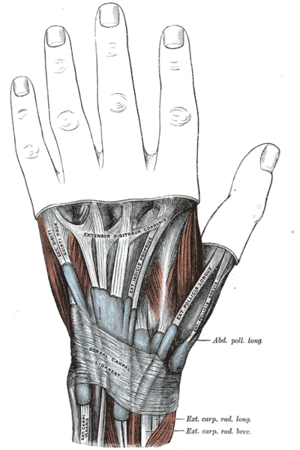
What is an (OBO-foundry) ontology ?
An ontology contains terms
Terms refer to (denote) types (classes)
Types are classifications of things (instances) in the real world, based on some set of criteria.
My left hand is an instance of the type hand
The criteria for class membership is recorded using textual definitions, at least some elements of which are formalized as relationships.
name: hand
def: “An anatomical structure that has four fingers and a thumb and is attached to the end of an arm.” [reference: DOS]
relationship: hand has_part finger
relationship: hand has_part thumb
relationship: part_of arm
Image from Gray’s Anatomy (copyright expired)

Slide 13




OBO-OWL cheat sheet: classification
OWL Manchester Syntax
antenna SubClassOf appendage
OBO format :
name: antenna
is_a: appendage
Protégé
OBO-Edit:

Slide 14
class – class relationships are quantified
Class:Class relationships are many to many
Does the relation apply to all or just some of the class ?
we specify this with quantifiers:
∀: for all, all, only, every
∃: there exists, some

Slide 15
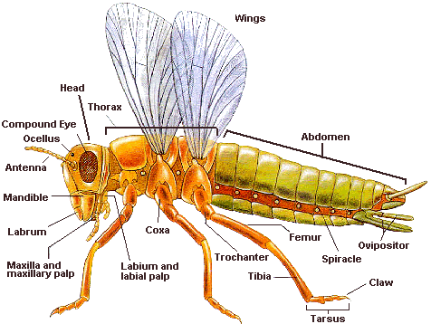
relationships specify necessary conditions for class membership
Being part of an insect thorax is a necessary condition of being in the class ‘insect leg’
OBO (quantifiers hidden)
name: insect leg
relationship: part_of thorax
OWL (MS):
‘insect wing’ SubClassOf part_of some thorax

Slide 16
relationships specify necessary conditions for class membership
Being part of an insect thorax is a necessary condition of being in the class ‘insect leg’
OWL (MS):
‘insect wing’ SubClassOf part_of some thorax
the class of insect wings is a subclass of all the class of all things that are part of a thorax.

Slide 17


OBO-OWL cheat sheet: necessary conditions for class membership
OWL Manchester Syntax
antenna SubClassOf part_of some head
OBO format :
name: antenna
relationship: part_of head
Protégé
OBO-Edit:

Slide 18
Directionality and quantifiers
True: all ‘insect wing’ part_of some ‘insect thorax’
False: all ‘insect thorax’ has_part some ‘insect wing’
True: all ‘claw’ connected_to some ‘tarsal segment’
False: all ‘tarsal segment’ connected_to some claw

Slide 19
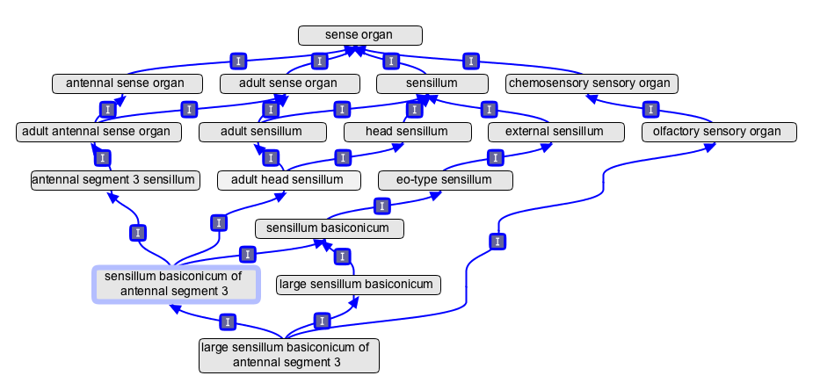
Manually maintaining an ontology with multiple classification schemes is impractical
It is difficult to keep track of multiple classification chains to:
ensure completeness;
avoid redundancy;
avoid introducing error due to inheritance of classification criteria from a distant ancestor

Slide 20
Automating multiple classification.
The scientific knowledge an ontology contains can make the reasons for classification explicit.
e.g.
Any sense organ that functions in the detection of smell is an olfactory sense organ
All large basiconic sensilla of the antenna function in detection of smell
Therefore all large basiconic sensilla of the antenna are are olfactory sense organs

Slide 21
Automating multiple classification.
We can specify that some set of necessary conditions for class membership are sufficient to determine class membership
English
Any sense organ that functions in the detection of smell is an olfactory sense organ
OWL (MS):
olfactory sense organ’ EquivalentTo: sense organ that capable_of some ‘detection of chemical stimulus involved in sensory perception of smell’
OBO
name: olfactory sense organ
intersection_of: sense organ
intersection_of: capable_of ‘detection of chemical stimulus involved in sensory perception of smell’

Slide 22

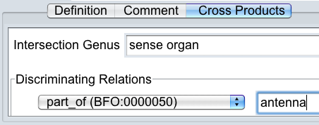
OBO-OWL cheat sheet: necessary and sufficient conditions for class membership
OWL Manchester Syntax
antennal sense organ EquivalentTo ‘sense organ’ that part_of some antenna
(that / and are interchangable in MS)
OBO format :
name: antennal sense organ
intersection_of: sense organ
intersection_of: part_of antenna
Protégé
OBO-Edit:

Slide 23
ERROR MESSAGES ARE YOUR FRIENDS! – They tell you you’ve screwed up before you get embarrassing emails complaining that you’ve screwed up
Some classes don’t overlap:
Nothing is both a space and an object with mass
Nothing is a both a muscle and a blood vessel
Nothing is both a smell and a nose
Some relations only apply between particular classes:
A nose is capable of smelling ✔
A smelling is capable of a nose ✗

Slide 24
ERROR MESSAGES ARE YOUR FRIENDS! – They tell you you’ve screwed up before you get embarrassing emails complaining that you’ve screwed up
Some classes don’t overlap. OWL DisjointWith OBO: disjoint_from
Nothing is both a space and an object with mass
anatomical space DisjointWith anatomical structure
‘lumen of gut’ SubClassOf ‘anatomical structure’ ✗
Nothing is a both a muscle and a blood vessel
muscle DisjointWith blood vessel
bicep SubClassOf aorta ✗
Nothing is both a smelling and a nose
process DisjointWith object
smelling* SubClassOf nose ✗

Slide 25
ERROR MESSAGES ARE YOUR FRIENDS! – They tell you you’ve screwed up before you get embarrassing emails complaining that you’ve screwed up
Some relations only apply between particular classes.
We can record this using domain* and range*:
capable_of relates objects to processes
capable_of domain: object
capable_of range: process
Combining these with disjoint declarations => error checking
process DisjointWith object; nose SubClassOf Object; smelling SubClassOf process
nose capable_of smelling ✔
smelling capable_of nose ✗
* Same in OBO and OWL

Slide 26
Quick guide to OBO-Edit

Slide 27
Basic OBO-Edit2 editing setup
- 2 x Ontology Tree Editor (OTE)
- One parent editor
- One text editor
- One search panel
- One reasoner manager

Slide 28
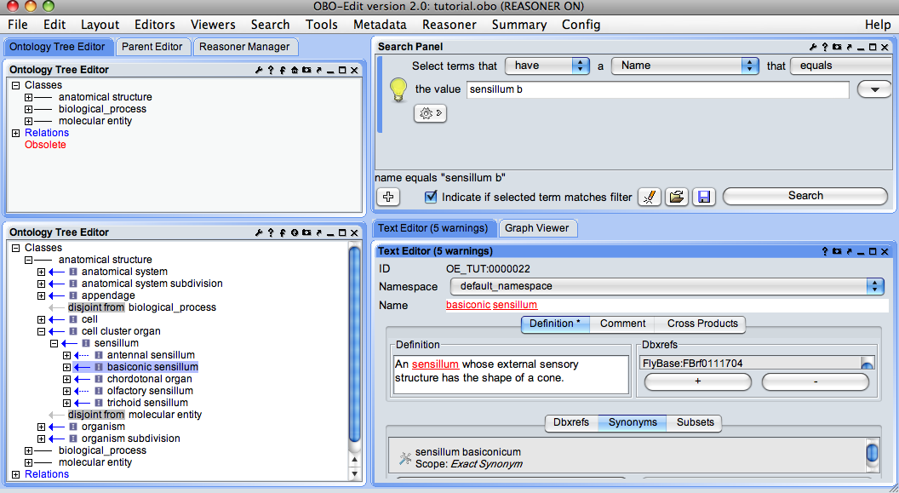

Slide 29
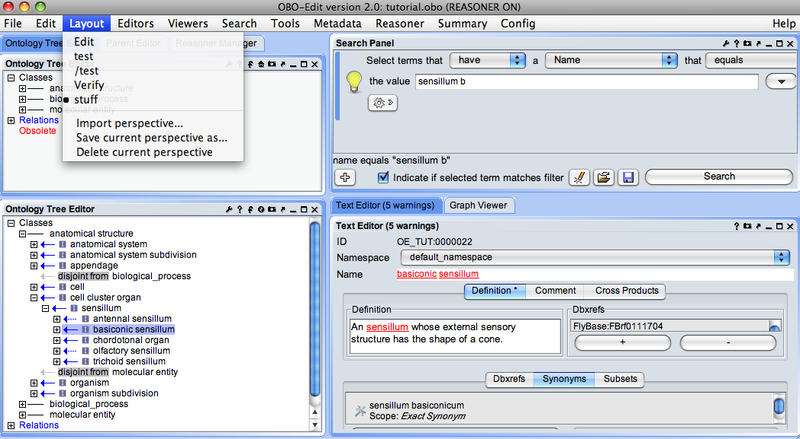

Slide 30
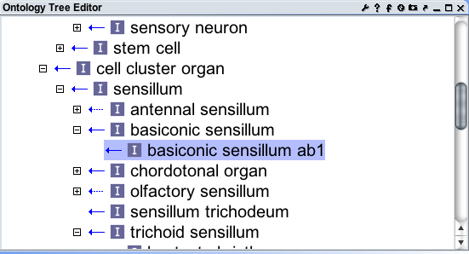
Browsing - Trees
The ontology tree editor is a good way to browse down the ontology graph, but not all are parents visible in one view
Click to expand or contract branch

Slide 31
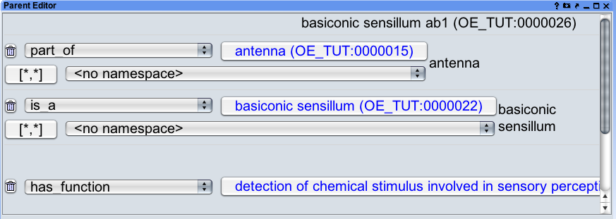
Browsing - parents
The parent editor provides a quick way to check all parental relationships – usually these are not all visible in a single tree view

Slide 32
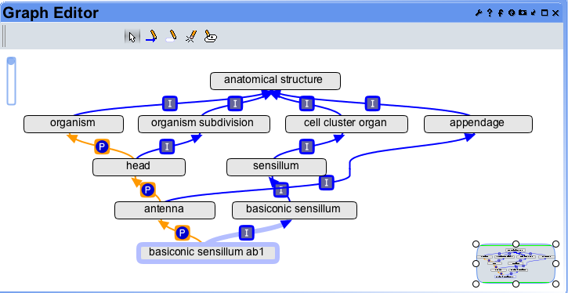
Browsing - Graph Editor
WARNING:– GRAPH EDITOR CAN CAUSE CRASHES. SAVE YOUR WORK !

Slide 33
Browsing - Graph Editor
Hide parent terms
show parent terms
Hide child terms
show child terms
hide term
Right click provides editing options and hide-all
Choosing quick filtering => manageable view

Slide 34
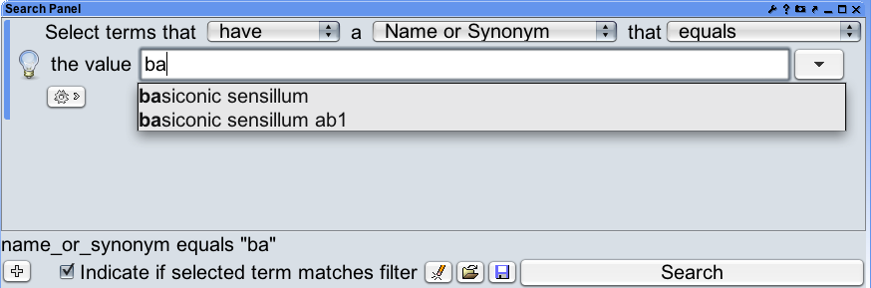
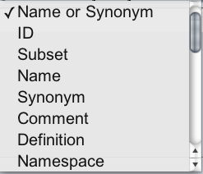
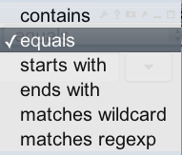

Basic Searching - single leg

Slide 35
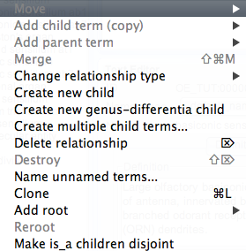
The ontology tree editor menu
Right clicking on the ontology tree editor prompts an extensive editing menu:

Slide 36
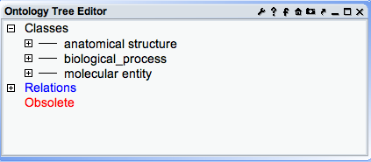
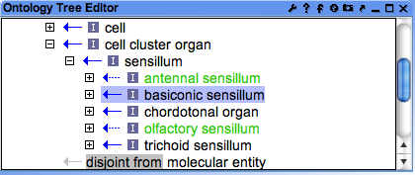
Global vs local selection modes
local mode
-selection in other components doesn’t affect selection here
global mode
- 2 way auto sync with other components

Slide 37
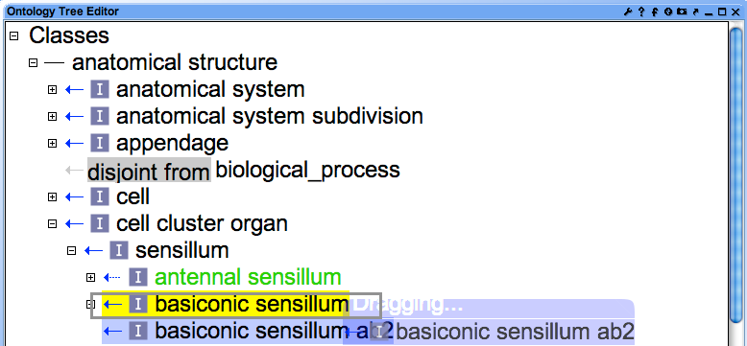
Drag and drop term move – changes classification or necessary conditions for class membership

Slide 38


Drag and drop term move

Slide 39

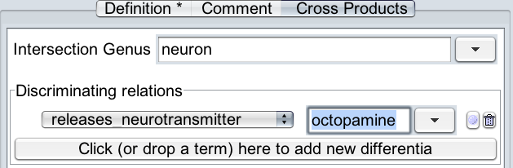
Making new cross product terms
Add a new root class:

Slide 40
Very Quick Guide to Protégé

Slide 41
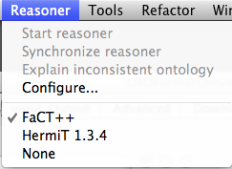
Running a reasoner

Slide 42
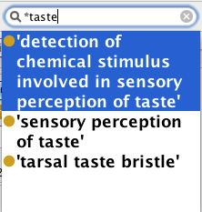
Searching for terms
Use wild-card (*) before a search string to search in term

Slide 43
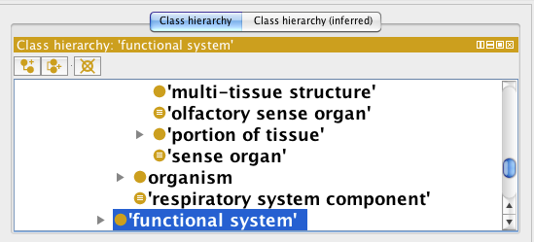
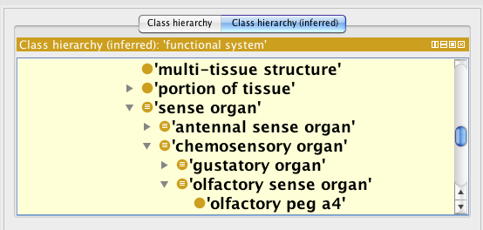
Class tree +/- inference
Easily check what
classification is
asserted
Easily check that
inferred classification
is what you intend

Slide 44
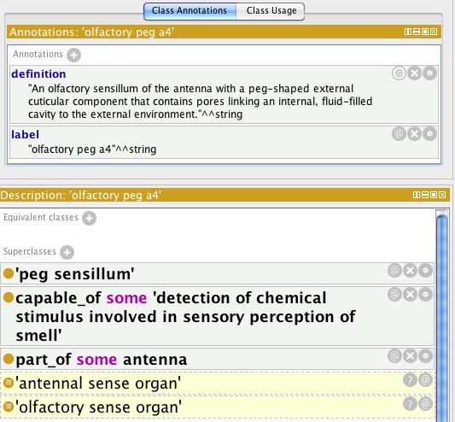
Inferred
classification

Slide 45
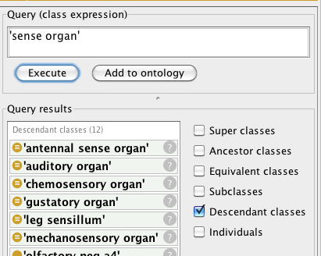
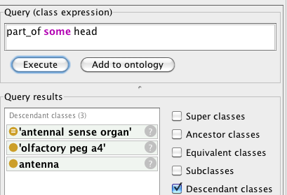
DL Query Tab
Use to check inference is correct and complete

Slide 46

Editing in Protégé
Add (annotation, superclass, equivalent class etc)
Annotate; Delete; Edit
Add child; Add sibling; Delete

Slide 47
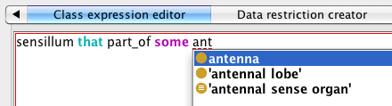
Editing in Protégé
Class expression editor
Type DL expressions.
Autocomplete names with tab
quote names with spaces

Slide 48
OBO-OWL cheat sheet: classification
OWL Manchester Syntax
antenna SubClassOf appendage
OBO format :
name: antenna
is_a: appendage
Protégé
OBO-Edit:

Slide 49
OBO-OWL cheat sheet: necessary conditions for class membership
OWL Manchester Syntax
antenna SubClassOf part_of some head
OBO format :
name: antenna
relationship: part_of head
Protégé
OBO-Edit:

Slide 50
OBO-OWL cheat sheet: necessary and sufficient conditions for class membership
OWL Manchester Syntax
antennal sense organ EquivalentTo ‘sense organ’ that part_of some antenna
(that / and are interchangable in MS)
OBO format :
name: antennal sense organ
intersection_of: sense organ
intersection_of: part_of antenna
Protégé
OBO-Edit:

Slide 51
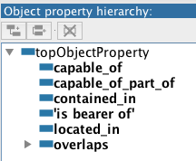
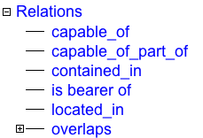
OBO-OWL cheat sheet: relations / Object Properties
OWL
object property
OBO
relation
OBO format
Typedef
Protégé
OBO-Edit:

Slide 52
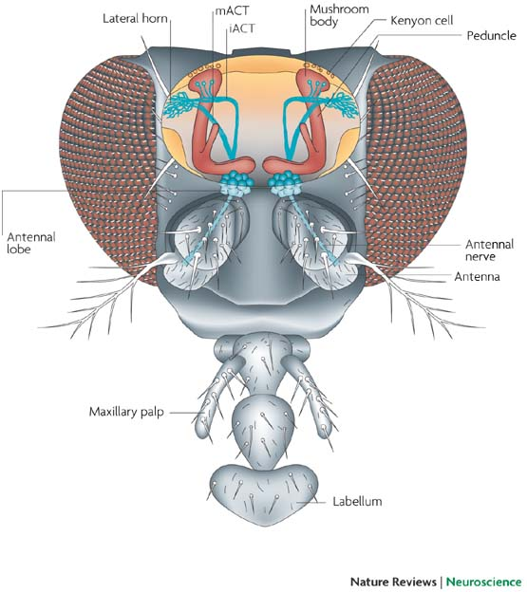
Introducing the tutorial ontology
Upper level classes
Basic Formal ontology – general abstract classes: process; object; quality
CARO 2.0 (draft) – abstract classes for anatomy (anatomical space; cell; acellular stucture…)
FUNCARO – Functional classifications using GO
Imported differentia
GO terms – imported for recording function
PATO terms – imported for recording qualities
tutorial: some specific insect anatomical classes

Slide 53
Exercise 1 – Tracing multiple classification of single sense organ Please open: OBO format converter OBO-Edit with tutorial.obo open Protégé 4.1

Slide 54
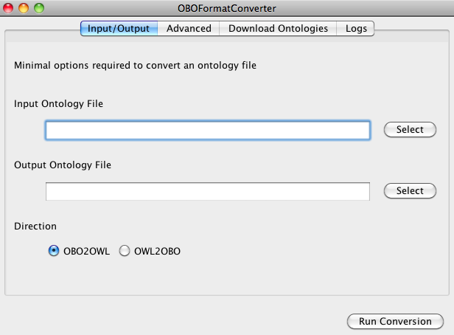
OBO Format Converter
Convert tutorial.obo to tutorial.owl

Slide 55
Quick live demo

Slide 56

tutorial.owl in Protégé
Open tutorial.owl in Protégé.
Run reasoner
search for ‘pedicel’

Slide 57


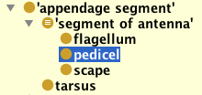
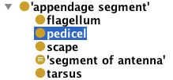
Auto-classification on partonomy

Slide 58
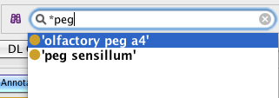
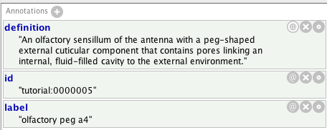
Multiple classification of single sense organ
Start search with wild card (*)

Slide 59
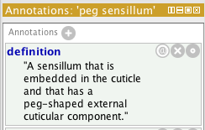
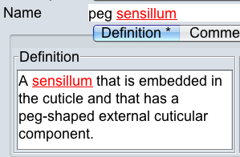
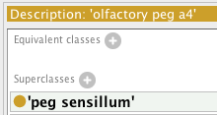

Asserting a classification
Protégé 4.1 OBO-Edit 2.1

Slide 60
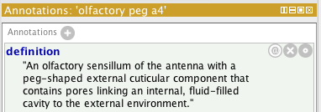
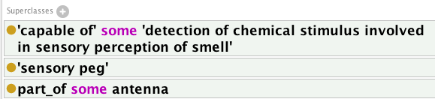
Adding some necessary conditions for class membership
*
* Strictly speaking, this is a useful fudge, but strict translation of capable_of from OBO to OWL is beyond the scope of this tutorial

Slide 61
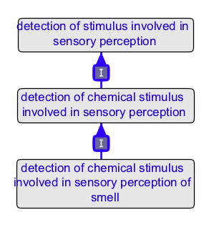
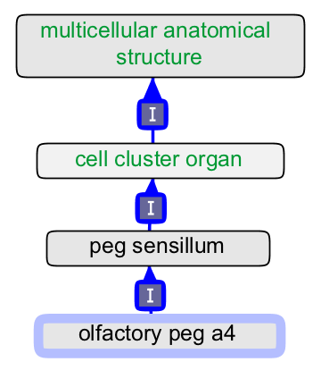
Some classification - OBO-Edit graph editor view
CARO terms ; tutorial terms
GO terms

Slide 62



Some necessary and sufficient definitions

Slide 63
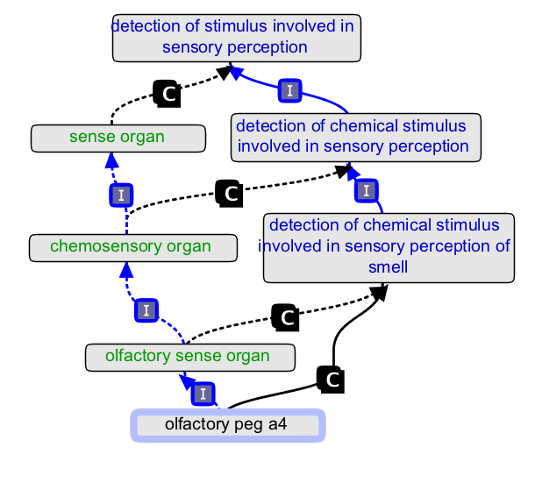
Auto-classification - OBO-Edit graph editor view
GO terms
FUNCARO terms
= capable_of

Slide 64
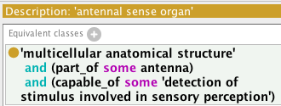
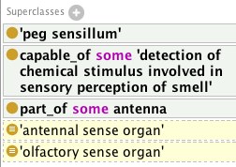
Autoclassification using partonomy

Slide 65
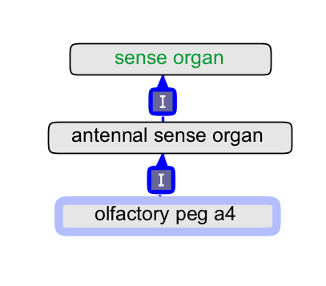
Auto-classification

Slide 66
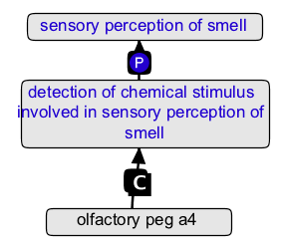
Some context

Slide 67
Linking relations with rules (property chains)
Meaning: If X capable_of Y and Y part_of Z then X capable_of_part_of Z
In OBO format (not currently displayed or editable in OBO-Edit)
name: capable_of_part_of
holds_over_chain: capable_of part_of

Slide 68
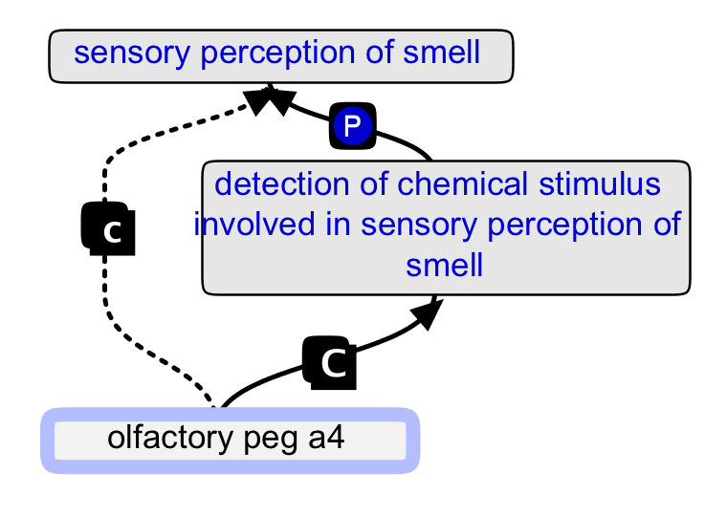
Inferring capable_of_part_of
If X 'capable of' Y and Y part_of Z then X capable_of_part_of Z
part_of
capable_of_part_of
capable_of

Slide 69


A class for populating the partonomy of the olfactory system
Note – in OWL this could be done without making the ugly class ‘olfactory system component’:
(‘anatomical structure’ that capable_of_part_of some ‘sensory perception of smell’) SubClassOf (part_of some ‘olfactory system’)

Slide 70
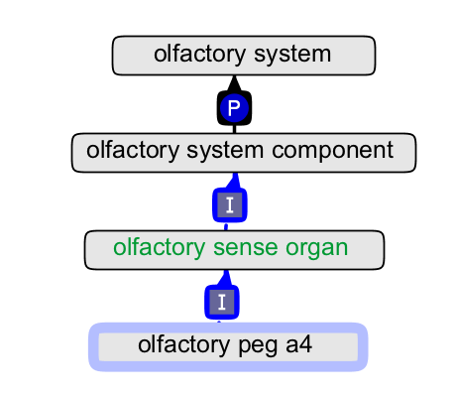

Slide 71
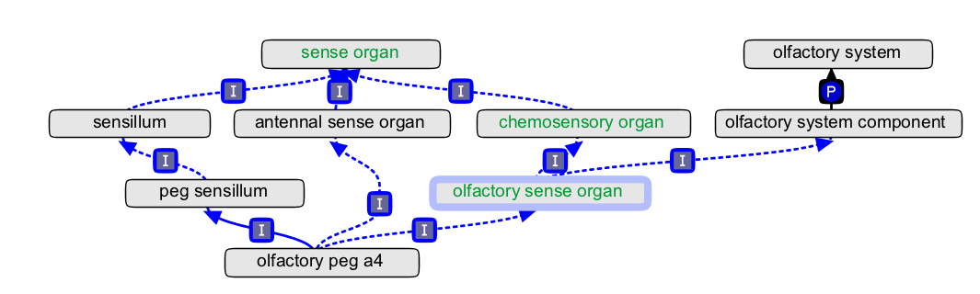
Putting it all together

Slide 72

Adding some more components to the olfactory system

Slide 73
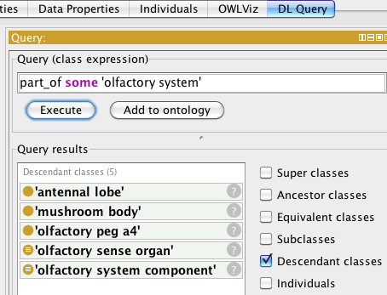
What structures are part of the olfactory system?

Slide 74
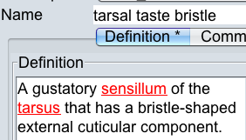

Exercise – auto-classify ‘taste bristle 1’

Slide 75

Adding a functional restriction
name: tarsal taste bristle
relationship: capable_of detection of chemical stimulus involved in sensory perception of taste
With drag and drop editing in OBO-Edit:

Slide 76


Make new class – leg sensillum

Slide 77
save convert to OWL open in Protégé run the reasoner

Slide 78
Quick live demo

Slide 79



Check classification

Slide 80


Slide 81





Consistency checking

Slide 82


Checking for inconsistency

Slide 83
Checking for inconsistency
In OBO-Edit, add the following relationship:

Slide 84
save convert to OWL open in Protégé run the reasoner

Slide 85


Checking for inconsistency
*
* Warning – domain and range more tightly specified than official relation.

Slide 86
Release manager
Over to Chris - using OWL (behind the scenes) to make a pre-reasoned release.

Slide 87
Optional final exercise 1
“olfactory peg a4” and “tarsal taste bristle” have asserted classifications
‘olfactory peg a4’ SubClassOf (is_a) ‘peg sensillum’
‘tarsal taste bristle’ SubClassOf (is_a) ‘sensory bristle’
Look at the definitions of ‘peg sensillum’ and ‘sensory bristle’
Given that the following classes also exist:
cuticular bristle; cuticular peg
how would you automate this asserted classification ?
* answer on final slide, after acknowledgments.

Slide 88
Optional final exercise 2
Try adding some terms from your own anatomy ontology, using CARO2 to classify, and perhaps auto-classifying with FUNCARO.

Slide 89
Acknowledgments
Michael Ashburner; Suzi Lewis
OBO converter and Oort developers:
Shahid Manzoor
Heiko Deitze
OBO-Edit developers
Current: Chris Mungall; Nomi Harris
Former: Amina Abdulla; John Day-Richter
Discussion and comments:
Alan Ruttenberg; Melissa Haendel; Terry Meehan

Slide 90
Complete autoclassification
name: peg sensillum
EquivalentTo: ‘cell cluster organ’ that has_part some ‘cuticular peg’ and capable_of some ‘detection of stimulus involved in sensory perception’
name: olfactory peg a4
SubClassOf: ‘cell cluster organ’
SubClassOf: has_part some ‘cuticular peg’
SubClassOf: capable_of some ‘detection of chemical stimulus involved in sensory perception of smell’

