Slide 1
Investigation of Triangular Spamming: a Stealthy and Efficient Spamming Technique
Zhiyun Qian, Z. Morley Mao (University of Michigan)
Yinglian Xie, Fang Yu (Microsoft Research Silicon Valley)

Slide 2
Introduction
Security is an arms race, so is spam
New spamming techniques invented
New prevention/detection proposed
Notes:
People always say security is an arms race, we think so is spam. If we look at the history of battling spam, it always goes through the loop where new spamming techniques are invented and then corresponding prevention and detection are proposed.

Slide 3
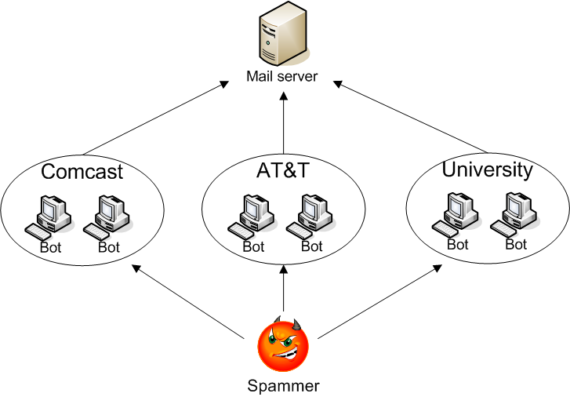

Network-level spamming arms race
Attack: Botnet-based spamming to hide real identity
Defense:
IP-based blacklist: making IP addresses important resources, limit spammer’s throughput
Port 25 blocking: limit end-user IP addresses for spamming
Notes:
An example of arms race from the network’s perspective is that today’s spam are mostly sent from botnets which hides the real identity of spammers. The large scale of the distributed botnets can effectively deliver spam messages at a very high rate. As shown in the figure, the spammer instructs bots in various networks to send spam.
One of the corresponding defenses is IP-based blacklist. The idea is that if one IP address sends too many spam, it will be listed on the blacklist and subsequent emails delivered from this IP address will be marked as spam. IP-based blacklisting effectively makes IP addresses important resources and limits the spammer’s throughput because if an IP address sends too many spam, it will be blacklisted very quickly. The problem with this approach though is that it can be incomplete.
Port 25 blocking: a little bit of background of port 25. Port 25 is used by SMTP protocol for communication between mail servers. Many ISPs are blocking port 25 in an attempt to reduce the spam traffic originated from their network. For example, ISPs like comcast or AT&T may block such traffic. This defense effectively limits the end-user IP addresses for spamming. However, not all of the ISPs will do that.

Slide 4

Yet another new attack: Triangular spamming
Relatively unknown but real attack [NANOG Mailing list Survey]
Not proposing a new attack
But studying “how serious it can be? how prevalent it is?”
Normal mail server communication
Src IP
Dst IP
Msg Type
Legend
1.1.1.1
2.2.2.2
SYN
2.2.2.2
1.1.1.1
SYN-ACK
1.1.1.1
2.2.2.2
ACK
Notes:
It is a relatively unknown but real attack. We actually have done a survey on nanog mailing list and found out that some network operators do know about this attack. So we are not proposing a new attack. Instead, we are interested in knowing How serious this attack can be? How big of an impact it can have? And how prevalent this attack is?
In normal cases without triangular spamming, there would be two entities involved – one sending mail server and one receiving mail server. In the normal case, the sending mail server would send TCP SYN packet to the mail server and then the receiving mail server would respond with a SYN-ACK packet. Based on the TCP sequence number in the SYN-ACK packet, the sending mail server will reply with the appropriate ACK packet to complete the TCP connection.
DDoS attack using IP spoofing, reverse traceroute
Important to explain how it works and requirement
Different color for Src and Dst IP
Add two machines setup

Slide 5
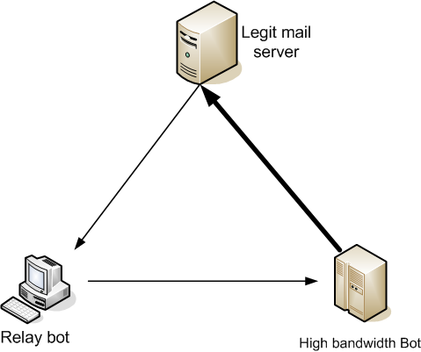
Yet another new attack: Triangular spamming
How it works
IP spoofing
Network-level packet relay
Legend
Src IP
Dst IP
Msg Type
3.3.3.3
3.3.3.3
2.2.2.2
SYN-ACK
2.2.2.2
3.3.3.3
SYN
2.2.2.2
1.1.1.1
SYN-ACK
2.2.2.2
1.1.1.1
Notes:
With triangular spamming, there are three entities involved – high bandwidth bot on the right, which has a high bandwidth to deliver spam at a high rate. And there is relay bot on the left which relays packets from the mail server to the high bandwidth bot. Finally, there is the mail server which is the victim.
The attack has two requirements: IP spoofing and network-level packet relay. As shown in the figure, the high bandwidth bot sends the TCP SYN packet to the mail server. Instead of putting its own IP address as source IP, it puts the relay bot’s IP address as source IP. When mail server receives the packet, it will respond to the relay bot since the IP is spoofed. The relay bot will then relay the packet back to the high bandwidth bot so that it can send ACK packet to complete the TCP connection. Note that relay bot is necessary because the high bandwidth bot needs the sequence number in the SYN-ACK packet in order to send a correct ACK packet.
DDoS attack using IP spoofing, reverse traceroute
Important to explain how it works and requirement

Slide 6
Benefits of triangular spamming
Stealthy and efficient
Evade IP-based blacklist
High bandwidth bot will not be blacklisted (due to IP spoofing)
Yet can send at high throughput (can use multiple relay bots)
Evade port 25 blocking
Relay bot can potentially bypass port 25 blocking
Src Port: 25
Dst Port: *
Src Port: *
Dst Port: 25
Src Port: *
Dst Port: *
Notes:
Packet format (src and port 25).
We consider that the network of the relay bot is vulnerable

Slide 7
Questions of interest
How to evade IP-based blacklist?
Two techniques to improve spam throughput while hiding high-bandwidth bot IP addresses
How to evade port 25 blocking?
A large-scale measurement on port 25 blocking policy
97% of the blocking networks are vulnerable
Is there evidence in the wild?
Implement and deploy proof-of-concept attack on planetlab
Collected evidence at a mail server

Slide 8
Questions of interest
How to evade IP-based blacklist?
Two techniques to improve spam throughput while hiding high-bandwidth bot IP addresses
How to evade port 25 blocking?
A large-scale measurement on port 25 blocking policy
97% of the blocking networks are vulnerable
Is there evidence in the wild?
Implement and deploy proof-of-concept attack on planetlab
Collected evidence at a mail server

Slide 9
Spamming high throughput analysis
Strategy 1: All bots directly send spam at their full speed
Can achieve good throughput
Expose high-bandwidth bots
Strategy 2: Triangular spamming is used where only high bandwidth bots send spam
Hide the high bandwidth bots’ IP addresses
Evade IP-based blacklist
Present two new techniques to improve throughput
Notes:
Show pictures instead of text
Triangular spamming exists! Say it in the upfront.

Slide 10
Technique 1 – Selectively relaying packets
No need to relay response data packets
Intuition: always succeed in common cases
Save bandwidth for high-bandwidth bot (Response traffic constitutes 15% - 25% traffic)
3.3.3.3
Legend
Src IP
Dst IP
Msg Type
3.3.3.3
2.2.2.2
Welcome
2.2.2.2
3.3.3.3
HELO
2.2.2.2
1.1.1.1

Slide 11
Technique 2 – aggressive pipelining
Pipelining – send multiple commands without waiting for response from previous commands
- Normal Pipelining
send(command1);
send(command2);
recv_and_process(response);
send(command3);
send(command4);
- Aggressive Pipelining
send(command1);
send(command2);
sleep(t);
send(command3);
send(command4);
Minimize t (improve throughput of individual connection)
Subject to constraint:
t > processing time on the server
- Can be learned in triangular spamming easily
Notes:
Control packets (SYN-ACK packets need to be relayed)
Multiple connections to increase throughput
Multiple relay bots

Slide 12
Questions of interest
How to evade IP-based blacklist?
Two techniques to improve spam throughput while hiding high-bandwidth bot IP addresses
How to evade port 25 blocking?
A large-scale measurement on port 25 blocking policy
97% of the blocking networks are vulnerable
Is there evidence in the wild?
Implement and deploy proof-of-concept attack on planetlab
Collected evidence at a mail server

Slide 13

Port 25 blocking study
Hypothesis on current ISP’s policy
Directional traffic blocking
Blocking outgoing traffic with dst port 25 (OUT)
NOT blocking incoming traffic with src port 25 (IN)
Relay bot’s IP can be used to send spam
Src Port: 25
Dst Port: *
X
Src Port: *
Dst Port: 25
Src Port: *
Dst Port: 25
Src Port: *
Dst Port: *
Notes:
Port 25 blocking background
Explain OUT blocking is more common
Focus on the ISP of relay bots22
Remove the incoming firewall
If incoming blocking, then relay bot won’t be able to relay packets for high bandwidth bot and triangular spamming would not work.

Slide 14
Port 25 blocking experiments
Step 1: Obtain candidate network/prefixes that enforce port 25 blocking
Step 2: Answer whether they are vulnerable to triangular spamming
Notes:
To verify our hypothesis, we conduct experiments in two steps

Slide 15
Port 25 blocking experiments
Step 1: Obtain candidate network/prefixes that enforce port 25 blocking
Instrument multiple websites
Verify via active probing
Step 2: Answer whether they are vulnerable to triangular spamming

Slide 16
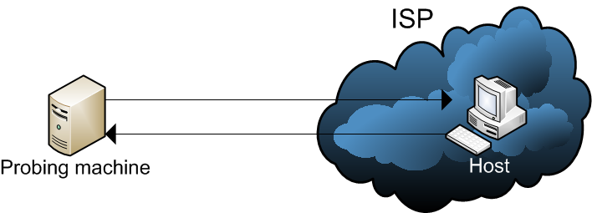
Step 1: Obtain candidate network/prefixes that enforce port 25 blocking
Inserted a flash script in educational websites in US and China for two months
Flash script: try to connect to our server on port 25
If connection unsuccessful, two possible reasons:
1) host firewall blocking
2) ISP-level blocking (either IN or OUT)
More data points needed to distinguish the 1) and 2) via active probing
Active probing
Src: 25 Dst: 80
Src: 80 Dst: 25
Notes:
Assumption: ISP level policy is similar in a large IP range

Slide 17
Port 25 blocking networks
Results
21,131 unique IPs, 7016 BGP prefixes
688 prefixes (9.8%) have port 25 blocked
More detailed analysis in the paper
Total number of prefixes
% of blocking prefixes
Notes:
Mention US and CN
Order the table
Add highlights on both figures

Slide 18
Port 25 blocking experiments
Step 1: Obtain candidate network/prefixes that enforce port 25 blocking
Instrument multiple websites
Verify via active probing
Step 2: Answer whether they are vulnerable to triangular spamming
Conduct novel active probing

Slide 19
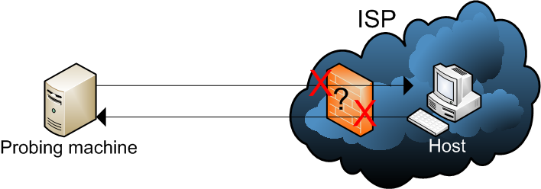
IN or OUT blocking?
Src: 25 Dst: 80
Src: 25 Dst: 80
Src: 80 Dst: 25
IPID value (unique identifier in IP header)
Monotonically increasing
Src: 25 Dst: 80
Src: 25 Dst: 80
Src: 25 Dst: 80
Src: 25 Dst: 80
Src: 80 Dst: 80
Src: 80 Dst: 80
Src: 25 Dst: 80
Src: 80 Dst: 25
IPID: 2
Src: 80 Dst: 25
IPID: 3
Src: 80 Dst: 25
IPID: 4
Src: 80 Dst: 25
IPID: 5
Src: 80 Dst: 25
IPID: 6
Src: 80 Dst: 80
IPID: 1
Src: 80 Dst: 80
IPID: 7

Slide 20
IN or OUT blocking results
Only 22 out of 688 prefixes performed IN blocking (3.2%)
The remaining 666 prefixes are vulnerable to triangular spamming
Next step
Are these prefixes usable to the spammers?
Are they listed on the blacklists?
Notes:
Directly say whether triangular spamming is allowed or not

Slide 21
Defense in depth – IP blacklisting
Spamhaus Policy Blocking List (PBL)
End-user IP address ranges which “should not deliver unauthenticated SMTP email” (e.g. dynamic IP)
Maintained by voluntary ISPs and PBL team
Only 296 out of 666 (44%) vulnerable prefixes on PBL
Not covered by port 25 blocking or IP-based blacklist
Still exploitable by spammers via triangular spamming

Slide 22
Questions of interest
How to evade IP-based blacklist?
Two techniques to improve spam throughput while hiding high-bandwidth bot IP addresses
How to evade port 25 blocking?
A large-scale measurement on port 25 blocking policy
97% of the blocking networks are vulnerable
Is there evidence in the wild?
Implement and deploy proof-of-concept attack on planetlab
Collected evidence at a mail server

Slide 23
Prevention and detection
Prevention – ISP side
Do not allow IP spoofing
Operationally challenging (one reason: multi-homing)
Block incoming traffic with src port 25
More feasible
Stateful firewall to disable relay bot
Overhead
Detection – mail server side, look for
IP addresses that are blocked for port 25 (they should not send emails, so likely use triangular spamming)
Different network characteristics (network topology and network delay)
No ground truth

Slide 24
Detection results at a mail server
Data
7-day network traces at our departmental mail server
Methodology
For any incoming connection, active probing to look for port 25 blocking behavior (These IPs should not be delivering emails in the first place)
May be incomplete
Results
1% of all IP addresses have port 25 blocking behavior
Spam ratio for these IP addresses: 99.9%
Other analysis in the paper
Notes:
Remove the figures
Compare with baseline spam ratio

Slide 25
Conclusion
A new stealthy and efficient spamming technique – triangular spamming
Present techniques to improve throughput under triangular spamming
Demonstrate today’s ISP port 25 blocking policy allows triangular spamming
Collect evidence for triangular spamming in the wild

Slide 26
Thanks
Q/A

