Slide 1
Graph cuts for maximum a posteriori inference with Markov random field priors
Simon Prince
s.prince@cs.ucl.ac.uk

Slide 2
Plan of Talk
Denoising problem
Markov random fields (MRFs)
Max-flow / min-cut
Binary MRFs (exact solution)
Multi-label MRFs – submodular (exact solution)
Multi-label MRFs - non-submodular (approximate)

Slide 3
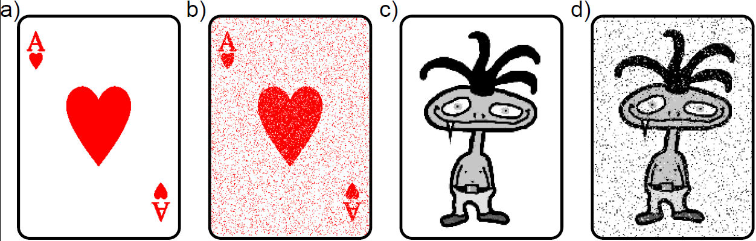
Binary Denoising
Before
After
Image represented as binary discrete variables. Some proportion of pixels randomly changed polarity.

Slide 4
Multi-label Denoising
Before
After
Image represented as discrete variables representing intensity. Some proportion of pixels randomly changed according to a uniform distribution.

Slide 5
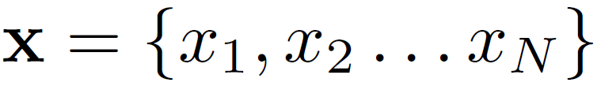
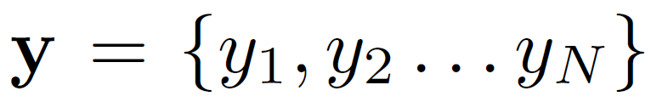
Denoising Task
Observed Data
Uncorrupted Image

Slide 6
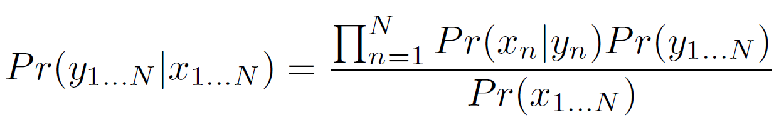
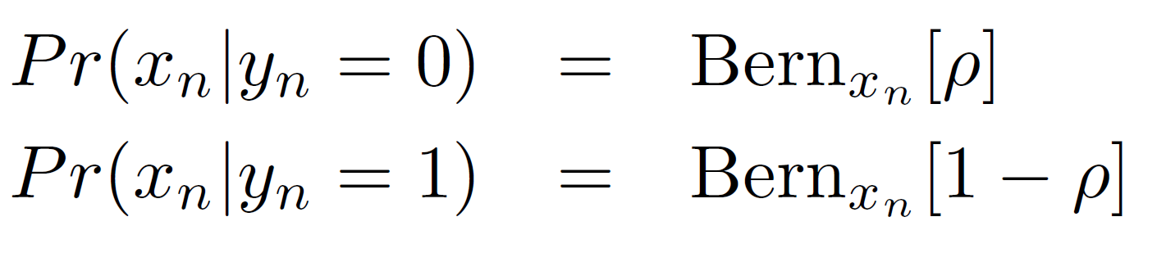
Denoising
Bayes’ rule:
Likelihoods:
Prior: Markov random field (smoothness)
MAP Inference: Graph cuts
Many other vision tasks have this structure (stereo, segmentation etc.)

Slide 7
Plan of Talk
Denoising problem
Markov random fields (MRFs)
Max-flow / min-cut
Binary MRFs –submodular (exact solution)
Multi-label MRFs – submodular (exact solution)
Multi-label MRFs - non-submodular (approximate)

Slide 8

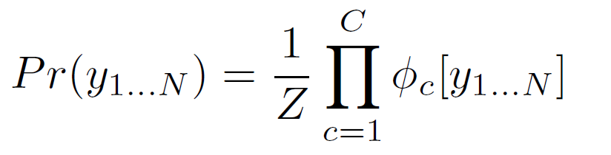
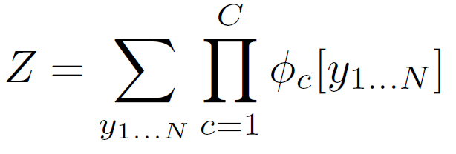
Undirected Models
MRF is an example of an undirected model
Product of positive potential functions
Z is a normalizing constant
Z referred to as “partition function”

Slide 9

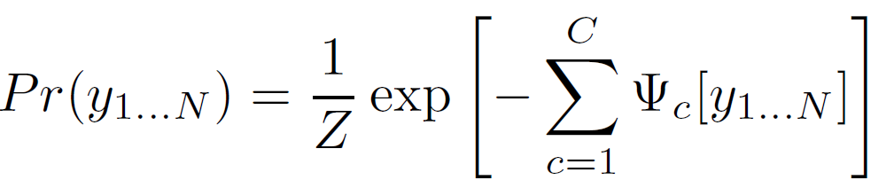

Alternate Formulation
Product of positive potential functions
or product of exponential costs
where

Slide 10
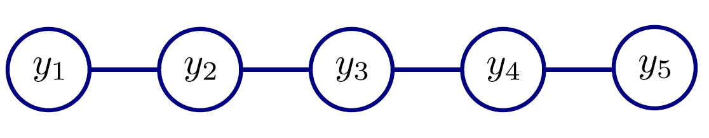
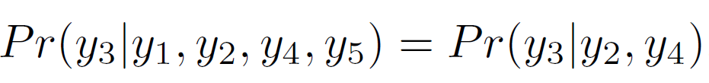
MRF Example
Consider a product of functions over neighbours
In this model a variable is conditionally independent of all the others given its neighbours
For example
So connections in graphical model (top) tell us about independence relations

Slide 11
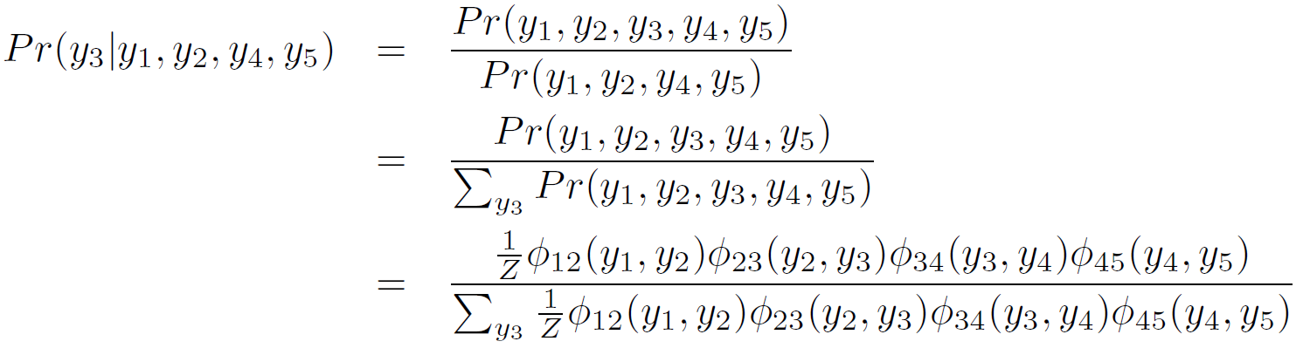
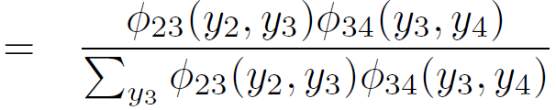
Proof of Markov Property
Using conditional probability relation
(only depends on neighbours)

Slide 12
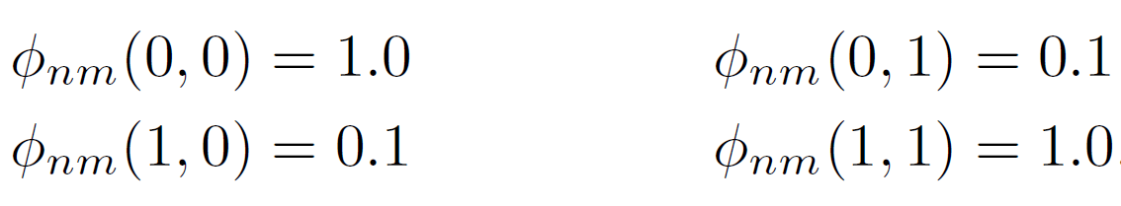
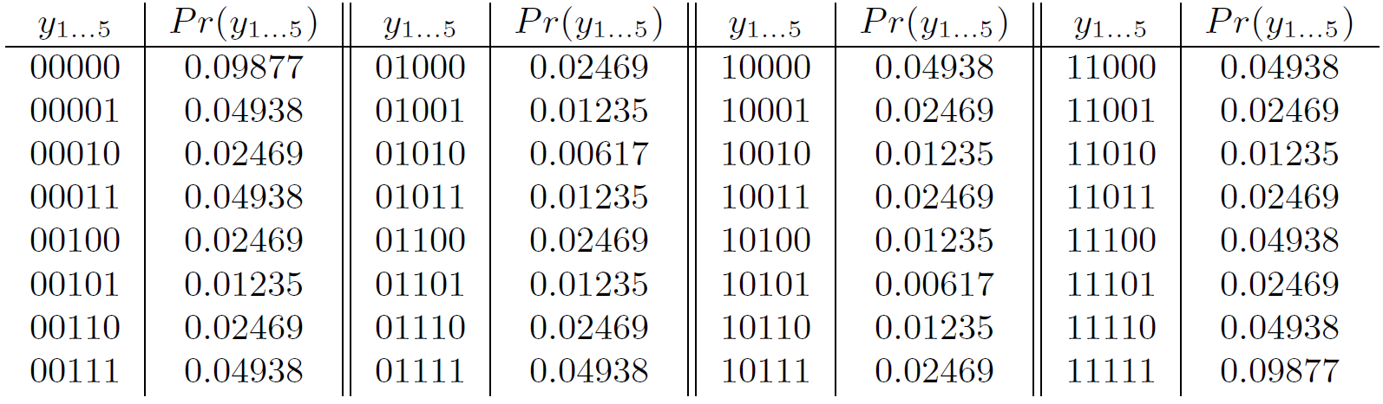
MRF Example
Consider the case where variables are binary, so functions return 4 different values depending on the combination of neighbours. Let’s choose

Slide 13
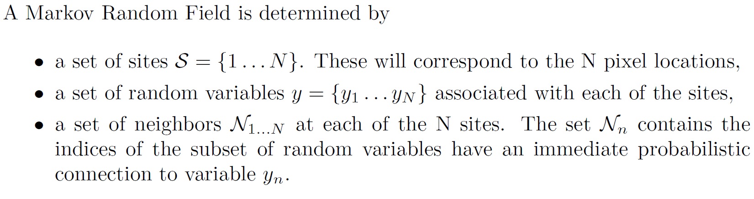
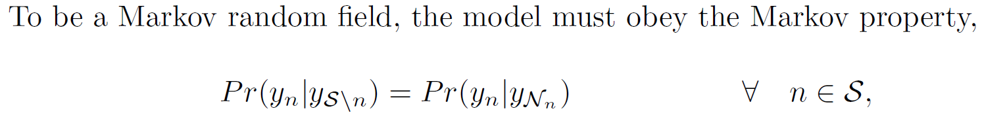
MRF Definition

Slide 14
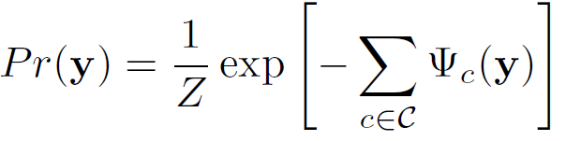
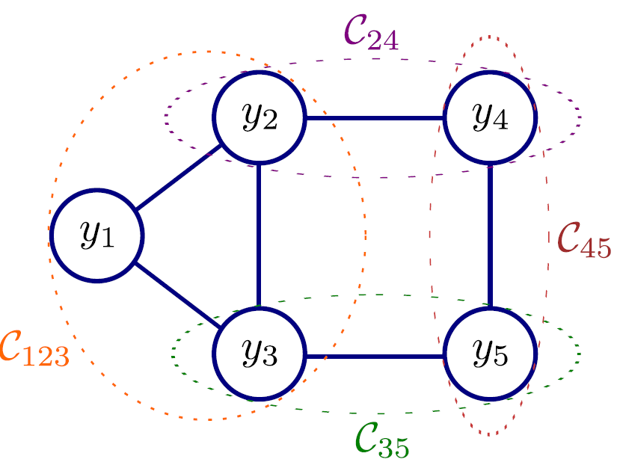
Hammersley Clifford Theorem
Any distribution that obeys the Markov property
can be written in the form
Where the c terms are maximal cliques
Cliques = subsets of variables that all connect to each other.
Maximal = cannot add any more variables and still be a clique

Slide 15
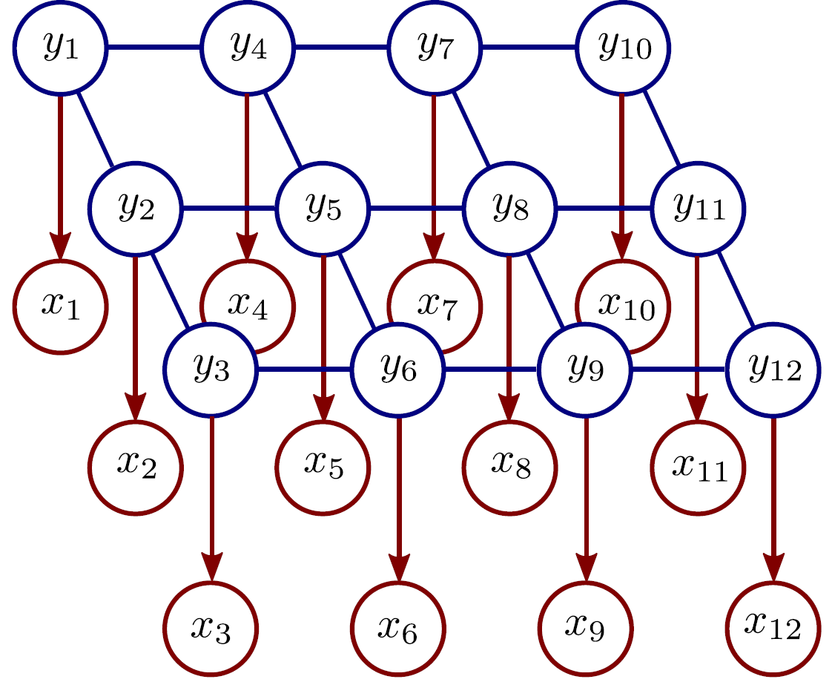
Denoising with MRFs
MRF Prior (pairwise cliques)
Original image, y
Likelihoods
Observed image, x
Inference via Bayes’ rule:

Slide 16
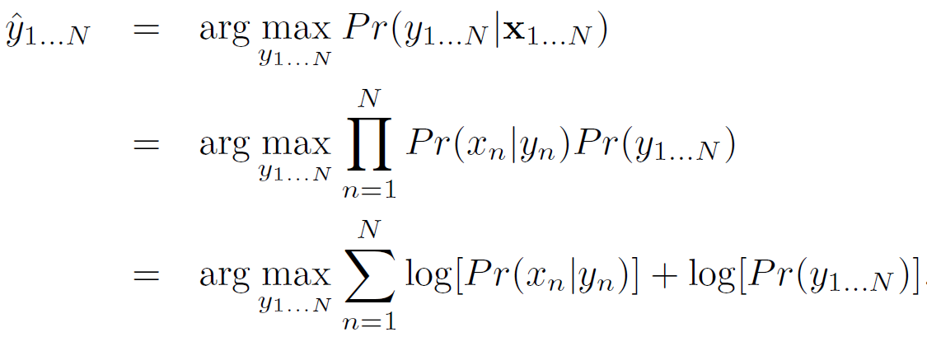
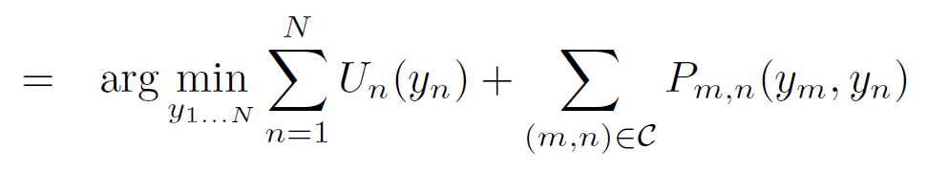
MAP Inference
Unary terms
(compatability of data with label y)
Pairwise terms
(compatability of neighboring labels)

Slide 17
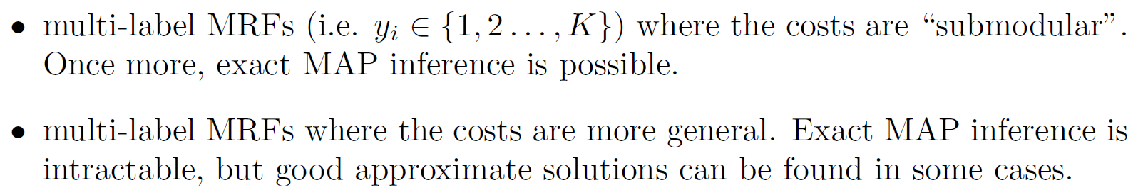
Graph Cuts Overview
Graph cuts used to optimise this cost function:
Unary terms
(compatability of data with label y)
Pairwise terms
(compatability of neighboring labels)
Three main cases:

Slide 18
Graph Cuts Overview
Graph cuts used to optimise this cost function:
Unary terms
(compatability of data with label y)
Pairwise terms
(compatability of neighboring labels)
Approach:
Convert minimization into the form of a standard CS problem,
MAXIMUM FLOW or MINIMUM CUT ON A GRAPH
Low order polynomial methods for solving this problem are known

Slide 19
Plan of Talk
Denoising problem
Markov random fields (MRFs)
Max-flow / min-cut
Binary MRFs - submodular (exact solution)
Multi-label MRFs – submodular (exact solution)
Multi-label MRFs - non-submodular (approximate)

Slide 20
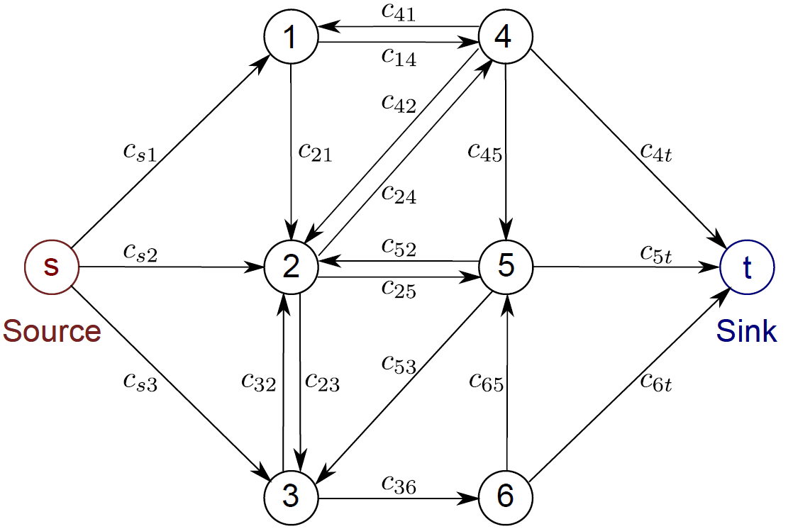
Max-Flow Problem
Goal:
To push as much ‘flow’ as possible through the directed graph from the source to the sink.
Cannot exceed the (non-negative) capacities c_{ij} associated with each edge.

Slide 21
Saturated Edges
When we are pushing the maximum amount of flow:
There must be at least one saturated edge on any path from source to sink
(otherwise we could push more flow)
The set of saturated edges hence separate the source and sink

Slide 22
Min Cut
Define a cut on the graph as a set of edges that separate the source and sink.
Cost of cut = total capacity of these edges
Edges that saturate in the maximum flow solution form the minimum cost cut
Can talk interchangeably about max-flow or min-cut

Slide 23
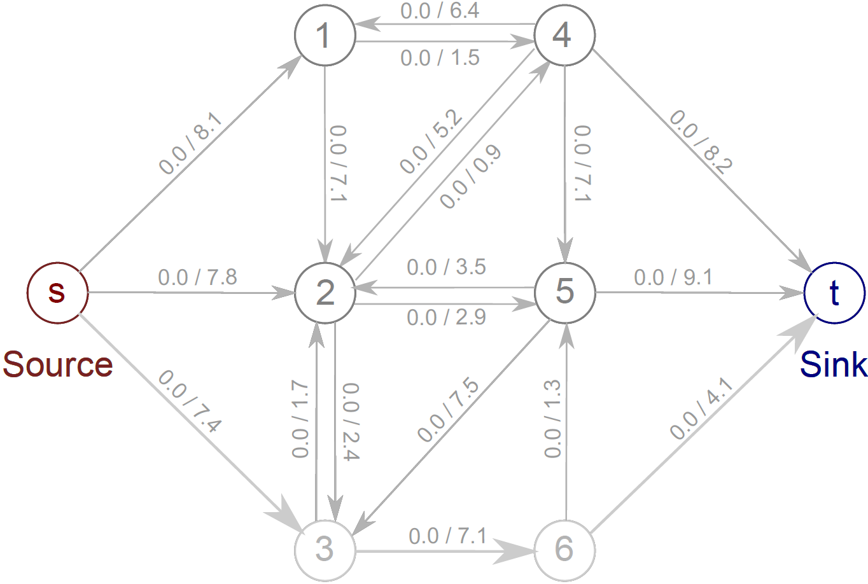
Augmenting Paths
Two numbers represent: current flow / total capacity

Slide 24
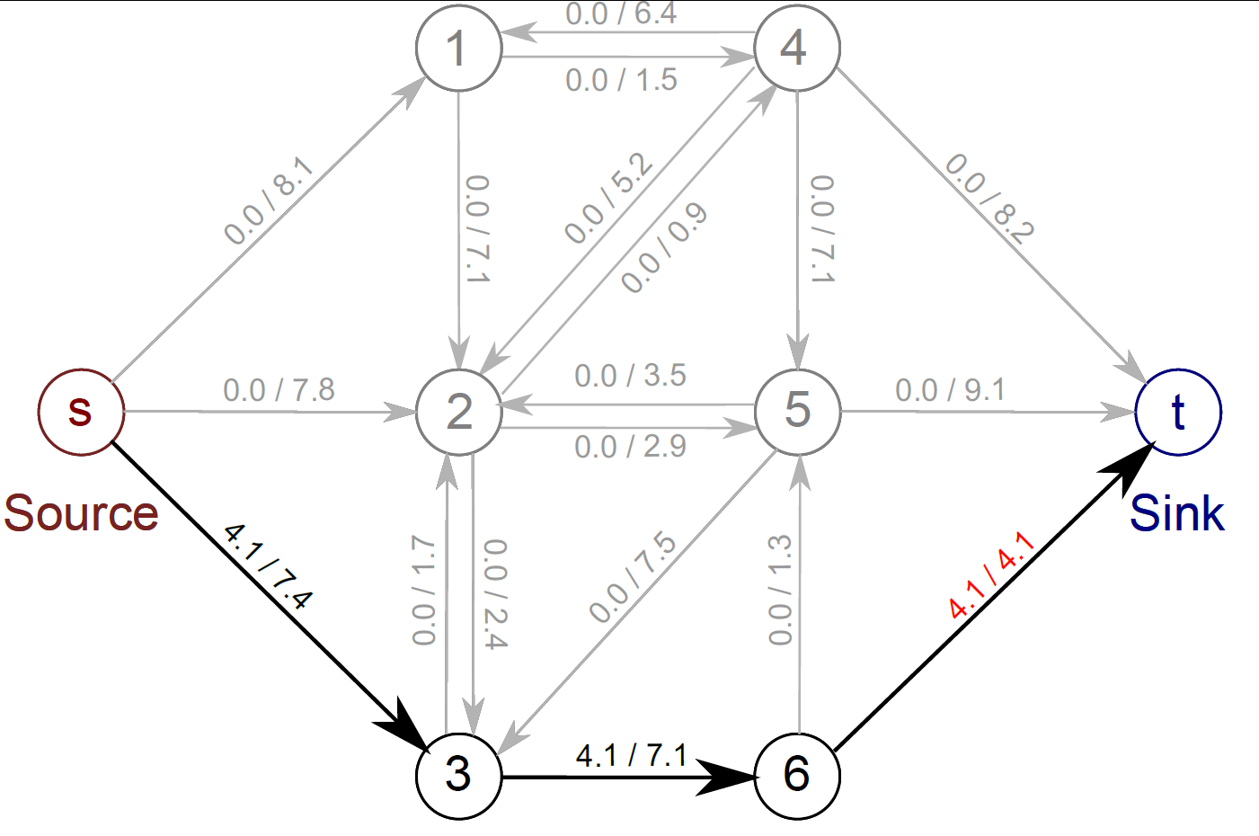
Augmenting Paths
Choose any route from source to sink with spare capacity and push as much flow as you can. One edge (here 6-t) will saturate.

Slide 25
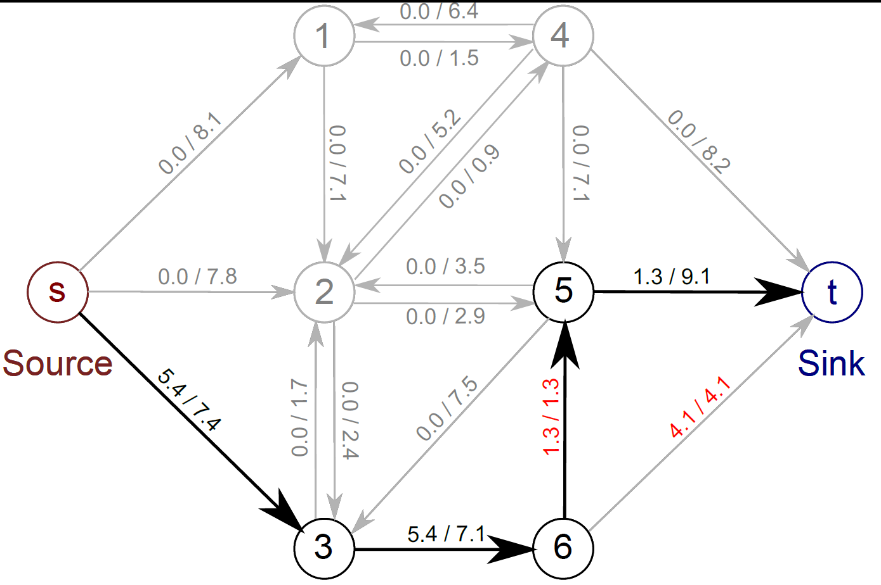
Augmenting Paths
Choose another route, respecting remaining capacity. This time edge 5-6 saturates.

Slide 26
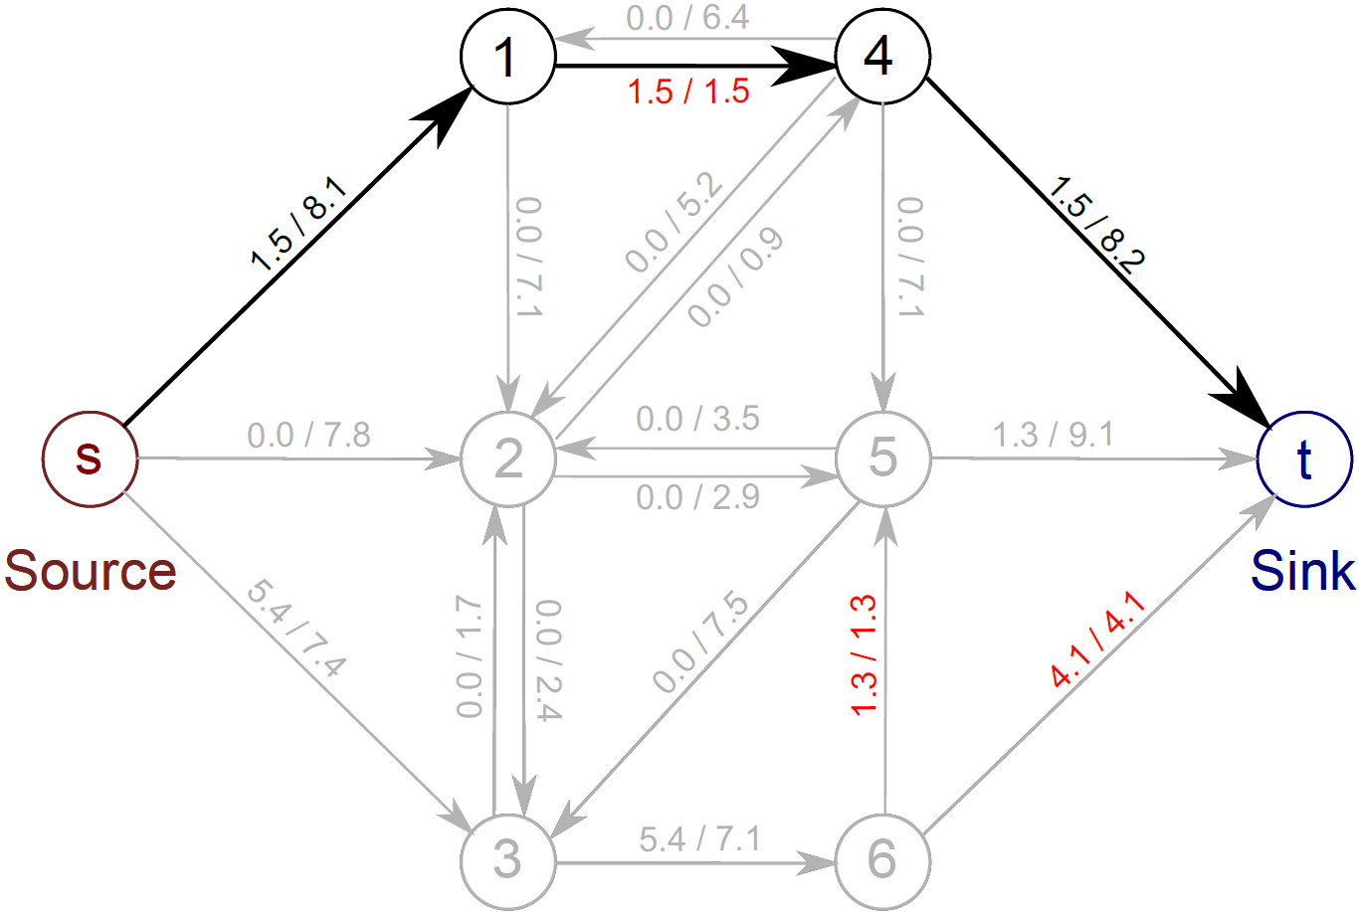
Augmenting Paths
A third route. Edge 1-4 saturates

Slide 27
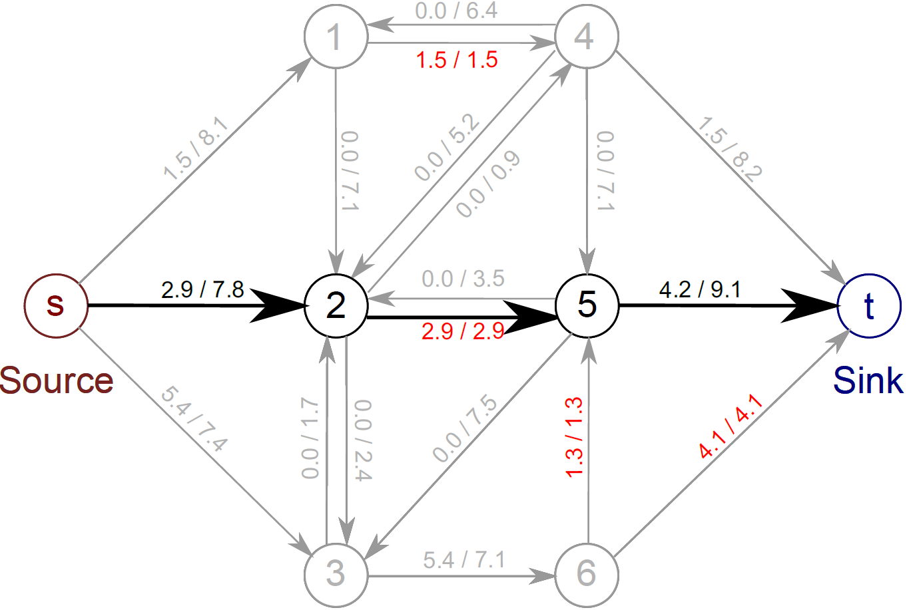
Augmenting Paths
A fourth route. Edge 2-5 saturates

Slide 28
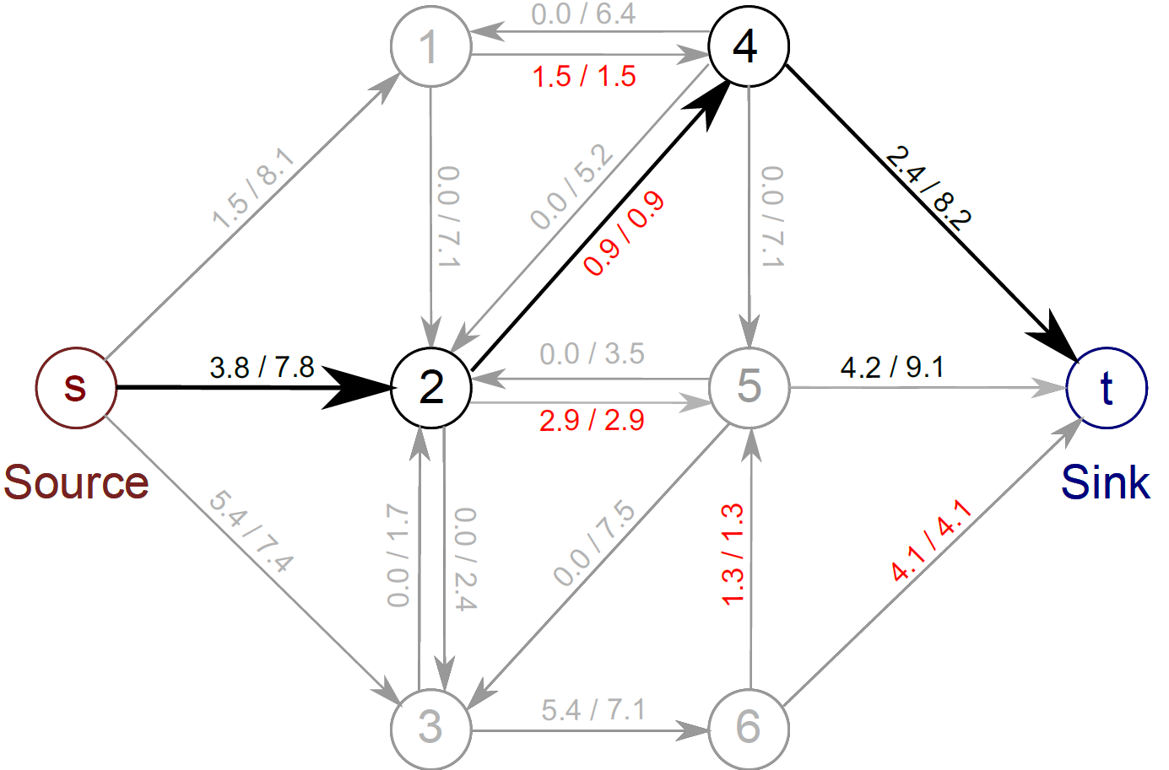
Augmenting Paths
A fifth route. Edge 2-4 saturates

Slide 29
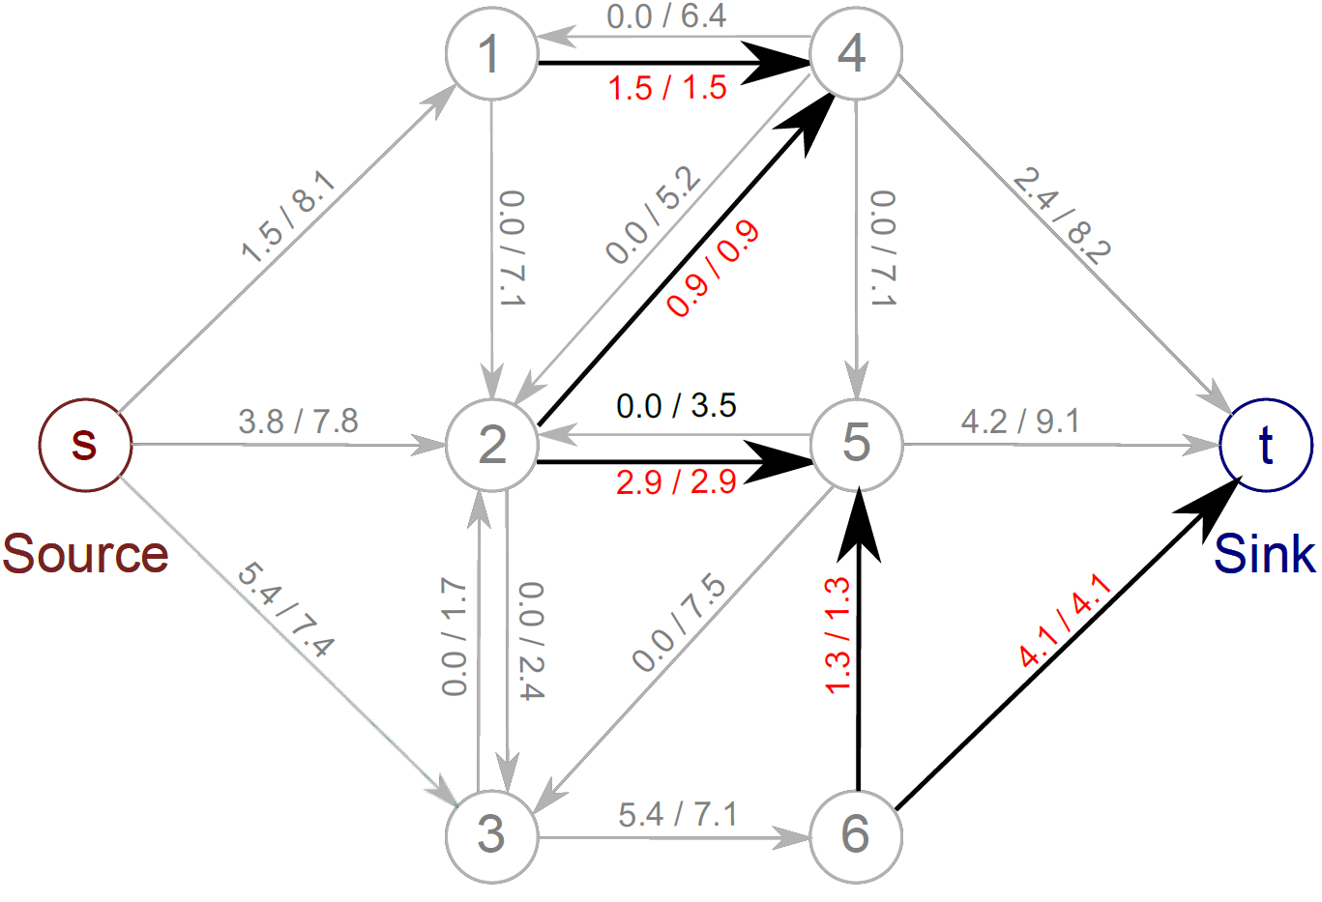
Augmenting Paths
There is now no further route from source to sink – there is a saturated edge along every possible route (highlighted arrows)

Slide 30
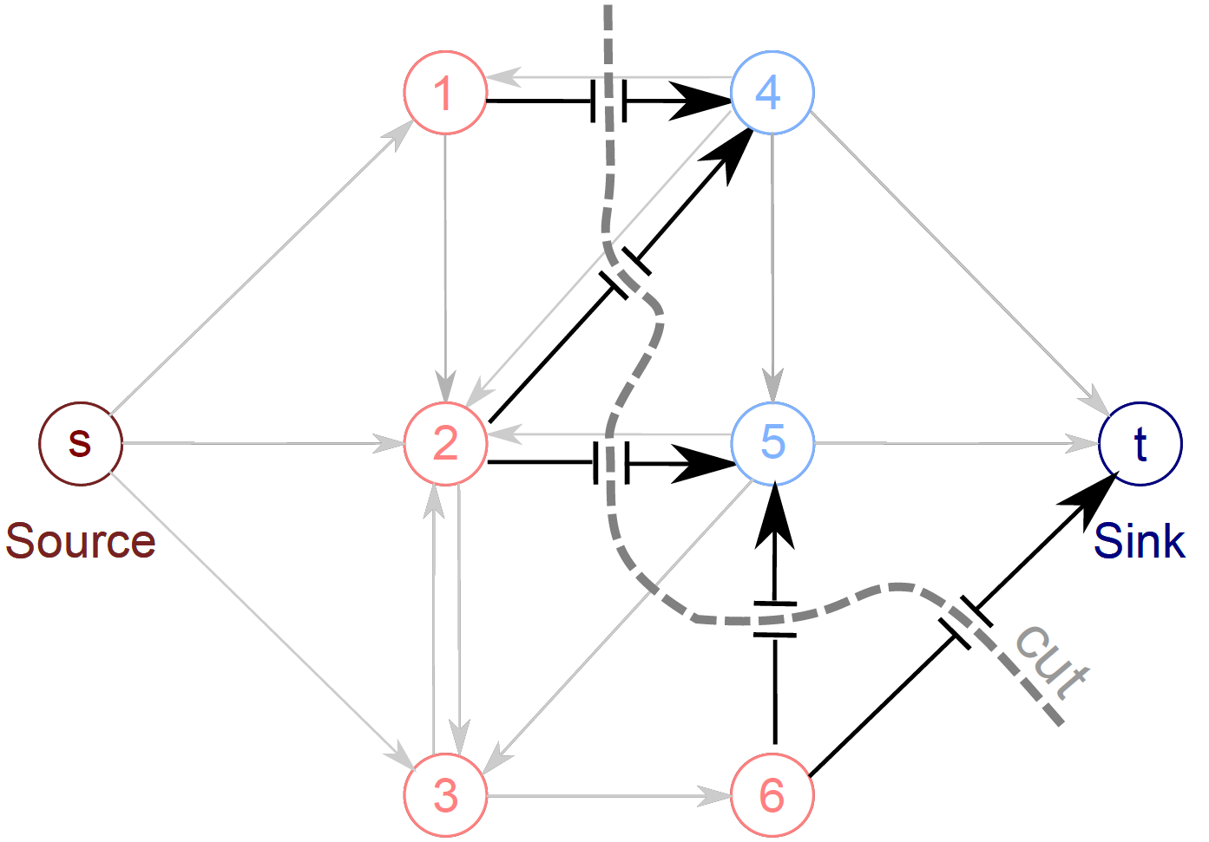
Augmenting Paths
The saturated edges separate the source from the sink and form the min-cut solution. Nodes either connect to the source or connect to the sink.

Slide 31
Plan of Talk
Denoising problem
Markov random fields (MRFs)
Max-flow / min-cut
Binary MRFs – submodular (exact solution)
Multi-label MRFs – submodular (exact solution)
Multi-label MRFs - non-submodular (approximate)

Slide 32
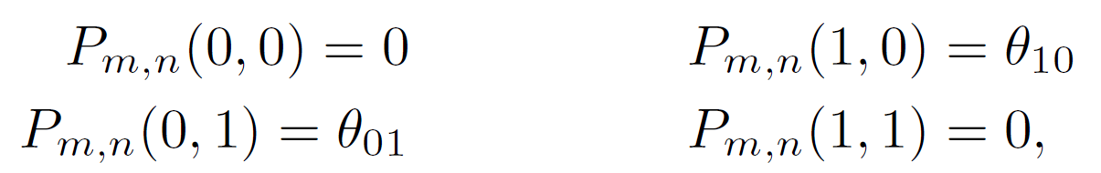
Graph Cuts: Binary MRF
Graph cuts used to optimise this cost function:
Unary terms
(compatability of data with label y)
Pairwise terms
(compatability of neighboring labels)
First work with binary case (i.e. True label y is 0 or 1)
Constrain pairwise costs so that they are “zero-diagonal”

Slide 33
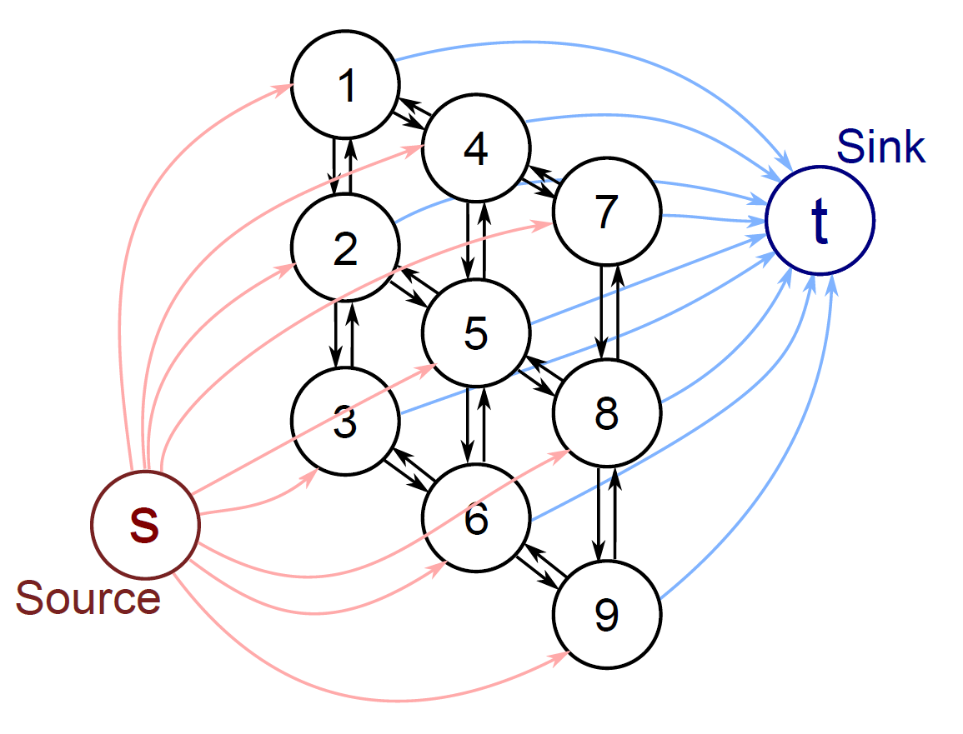
Graph Construction
One node per pixel (here a 3x3 image)
Edge from source to every pixel node
Edge from every pixel node to sink
Reciprocal edges between neighbours
Note that in the minimum cut EITHER the edge connecting to the source will be cut, OR the edge connecting to the sink, but NOT BOTH (unnecessary).
Which determines whether we give that pixel label 1 or label 0.
Now a 1 to 1 mapping between possible labelling and possible minimum cuts

Slide 34
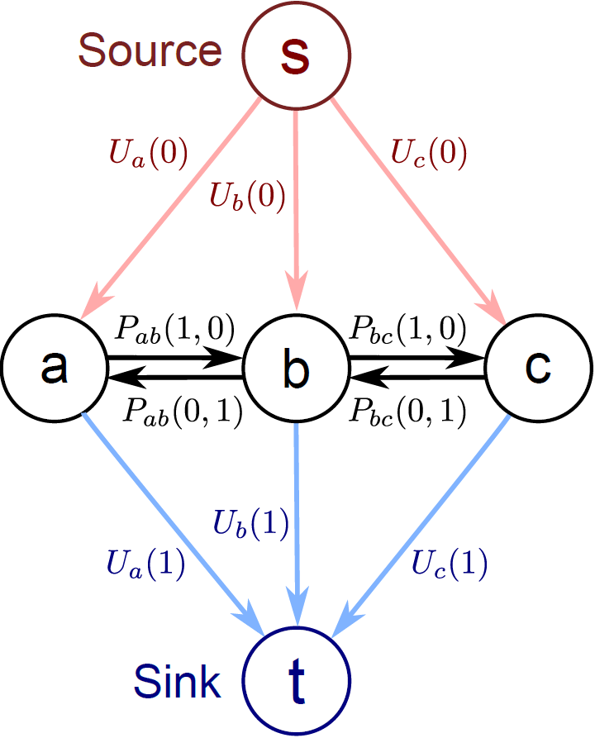
Graph Construction
Now add capacities so that minimum cut, minimizes our cost function
Unary costs U(0), U(1) attached to links to source and sink.
Either one or the other is paid.
Pairwise costs between pixel nodes as shown.
Why? Easiest to understand with some worked examples.

Slide 35
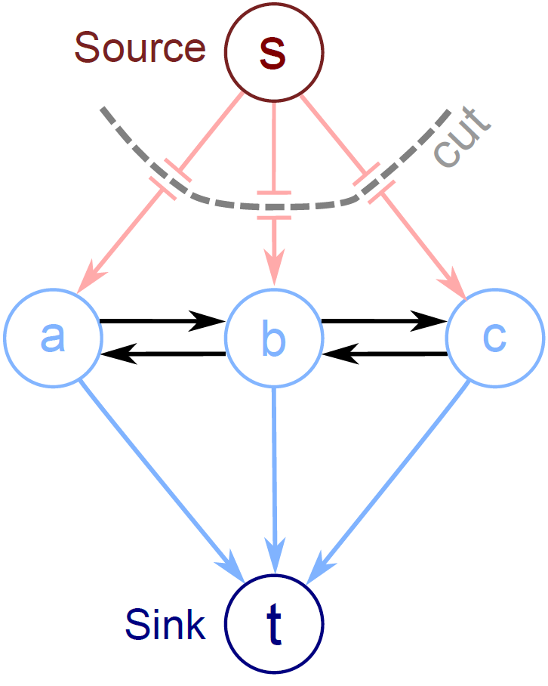
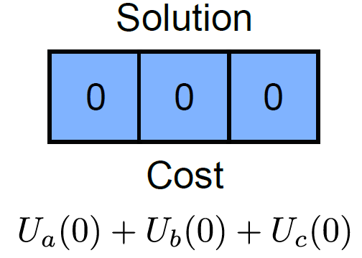
Example 1

Slide 36
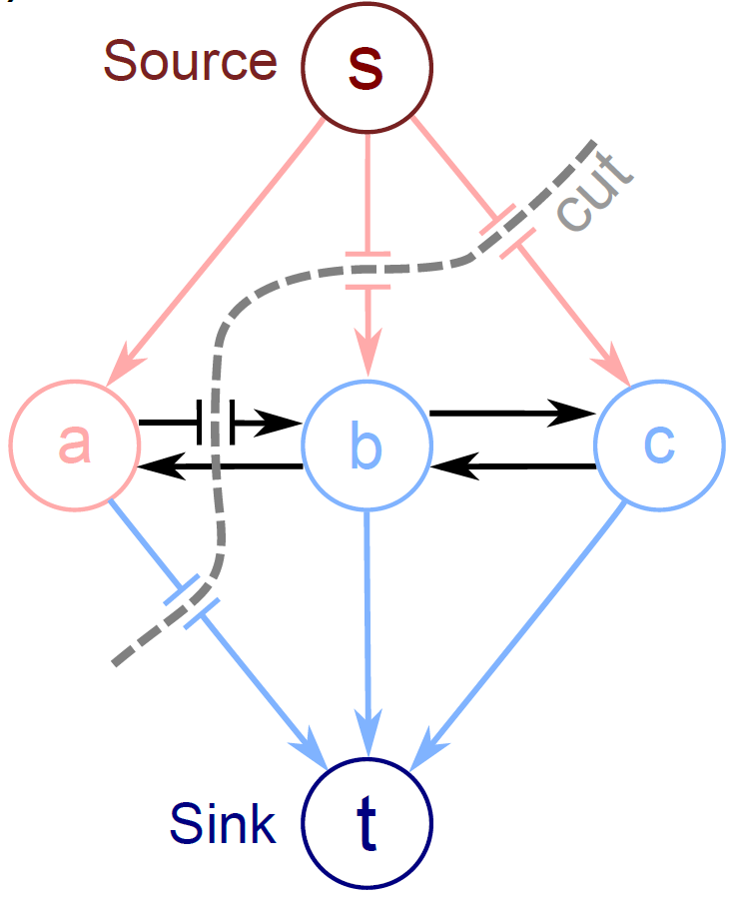
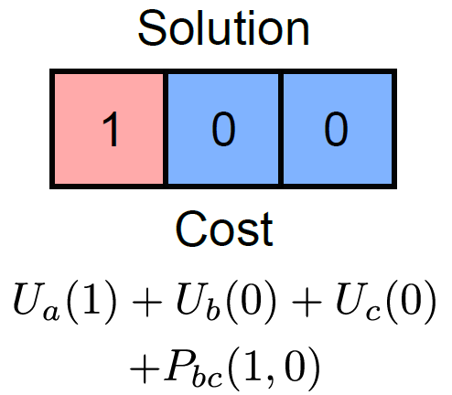
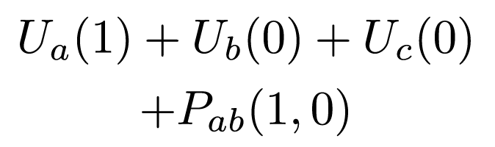
Example 2

Slide 37
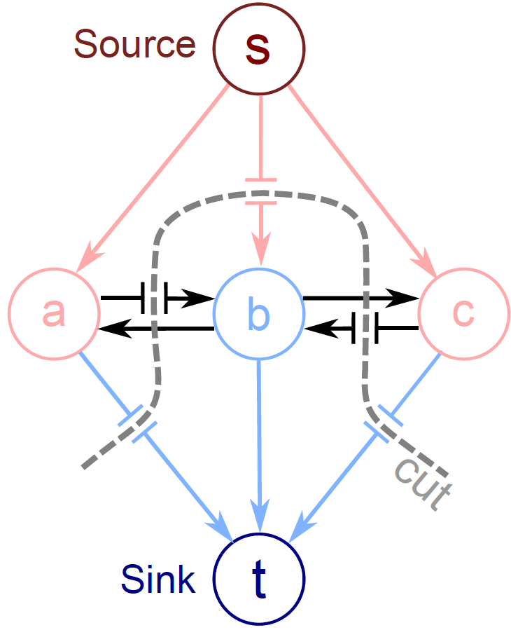
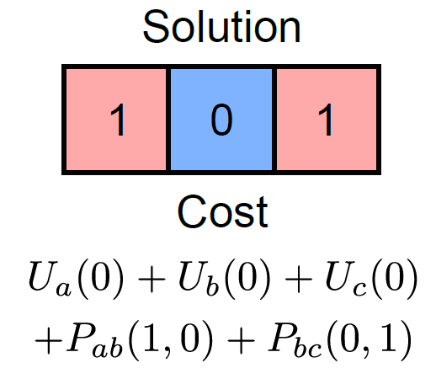
Example 3

Slide 38
Graph Cuts: Binary MRF
Graph cuts used to optimise this cost function:
Unary terms
(compatability of data with label y)
Pairwise terms
(compatability of neighboring labels)
Summary of approach
Associate each possible solution with a minimum cut on a graph
Set capacities on graph, so cost of cut matches the cost function
Use augmenting paths to find minimum cut
This minimizes the cost function and finds the MAP solution

Slide 39
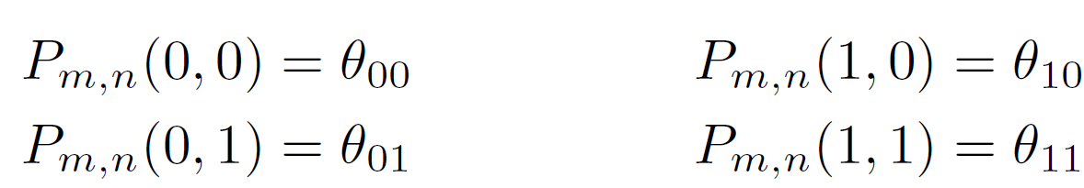
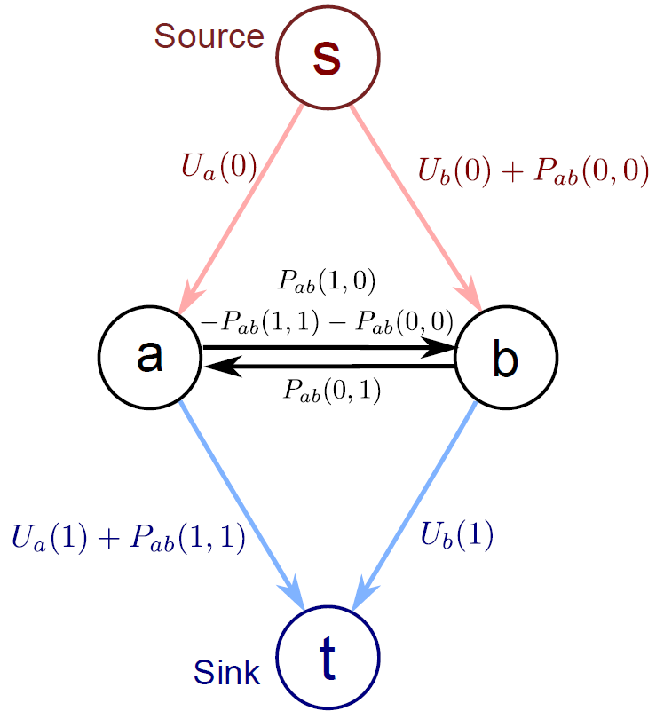
General Pairwise costs
Modify graph to
Add P(0,0) to edge s-b
Implies that solutions 0,0 and 1,0 also pay this cost
Subtract P(0,0) from edge b-a
Solution 1,0 has this cost removed again
Similar approach for P(1,1)

Slide 40
Reparameterization
The max-flow / min-cut algorithms require that all of the capacities are non-negative.
However, because we have a subtraction on edge a-b we cannot guarantee that this will be the case, even if all the original unary and pairwise costs were positive.
The solution to this problem is reparamaterization: find new graph where costs (capacities) are different but choice of minimum solution is the same (usually just by adding a constant to each solution)

Slide 41
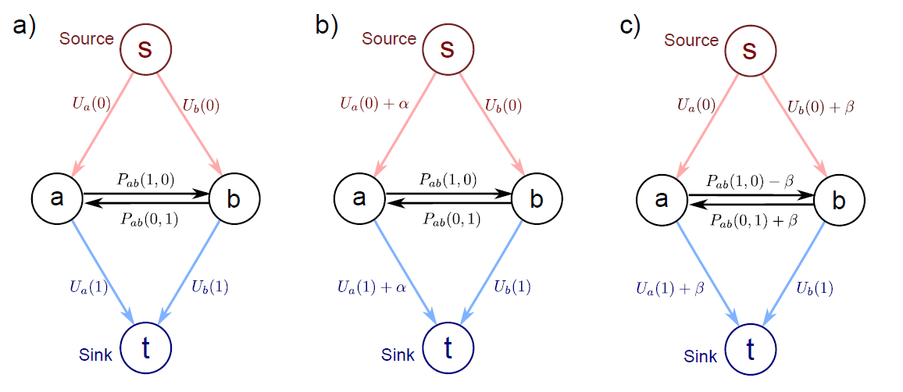
Reparameterization 1
The minimum cut chooses the same links in these two graphs

Slide 42
Reparameterization 2
The minimum cut chooses the same links in these two graphs

Slide 43
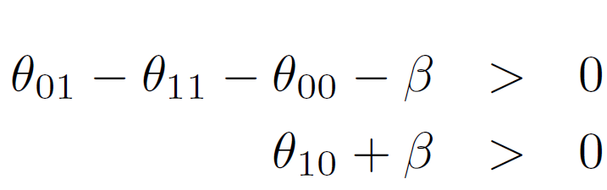

Submodularity
Subtract constant β
Add constant, β
Adding together implies

Slide 44
Submodularity
If this condition is obeyed, it is said that the problem is “submodular” and it can be solved in polynomial time.
If it is not obeyed then the problem is NP hard.
Usually it is not a problem as we tend to favour smooth solutions.

Slide 45
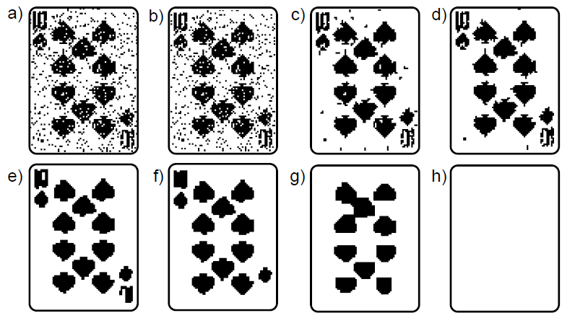
Denoising Results
Original
Pairwise costs increasing
Pairwise costs increasing

Slide 46
Plan of Talk
Denoising problem
Markov random fields (MRFs)
Max-flow / min-cut
Binary MRFs – submodular (exact solution)
Multi-label MRFs – submodular (exact solution)
Multi-label MRFs - non-submodular (approximate)

Slide 47
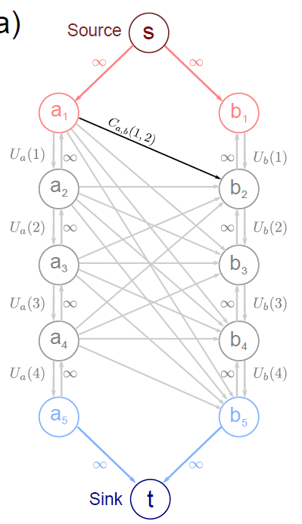
Multiple Labels
Construction for two pixels (a and b) and four labels (1,2,3,4)
There are 5 nodes for each pixel and 4 edges between them have unary costs for the 4 labels.
One of these edges must be cut in the min-cut solution and the choice will determine which label we assign.

Slide 48
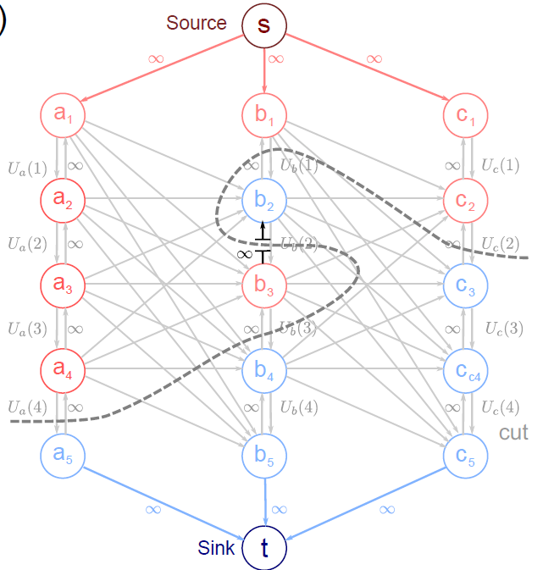
Constraint Edges
The edges with infinite capacity pointing upwards are called constraint edges.
They prevent solutions that cut the chain of edges associated with a pixel more than once (and hence given an ambiguous labelling)

Slide 49
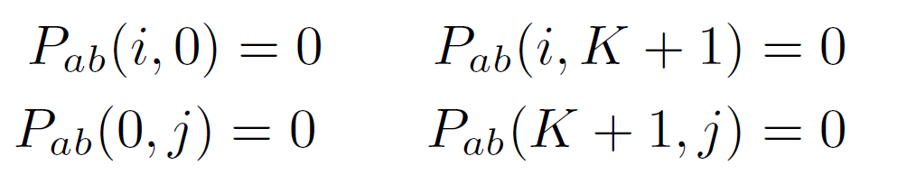
Multiple Labels
Inter-pixel edges have costs defined as:
Superfluous terms :
For all i,j where K is number of labels

Slide 50
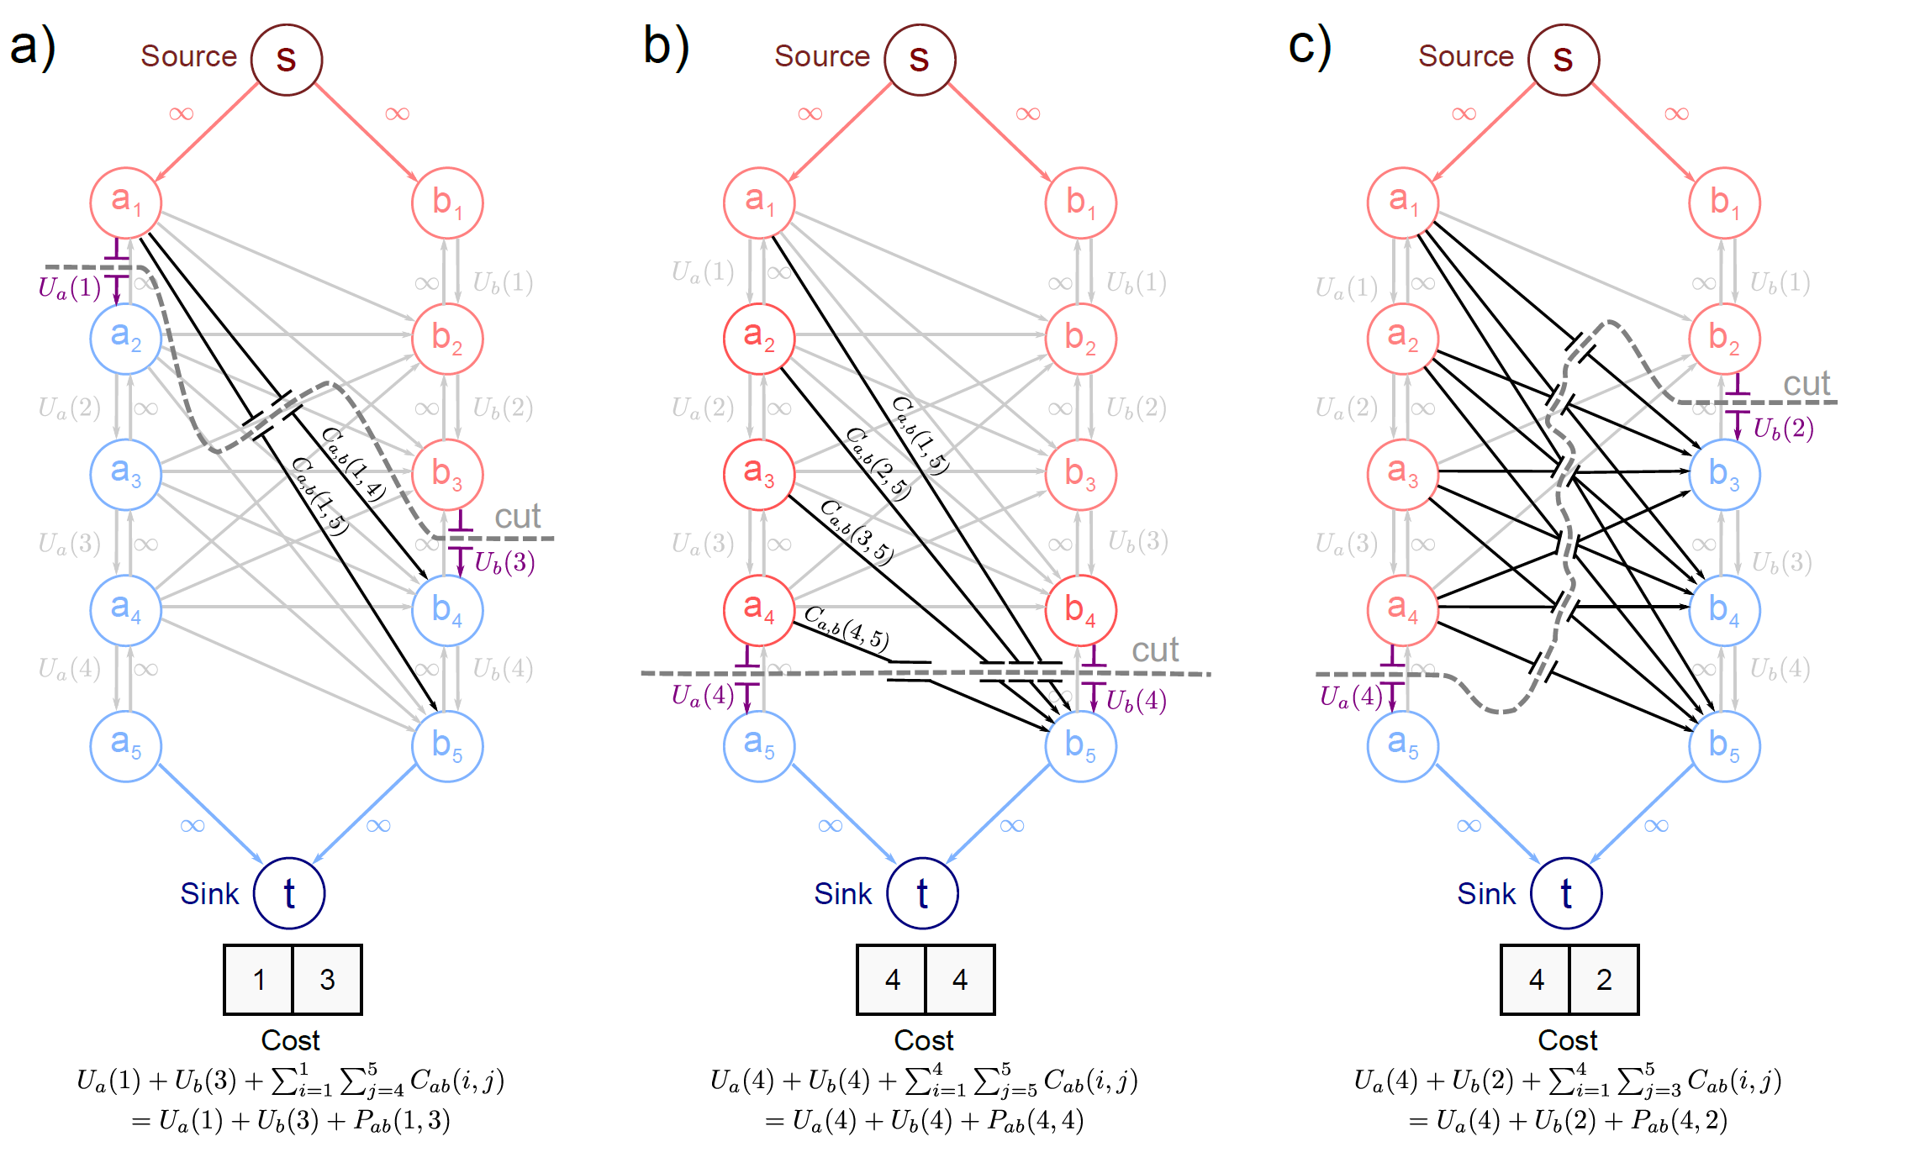
Example Cuts
Must cut links from before cut on pixel a to after cut on pixel b.

Slide 51

Pairwise Costs
Must cut links from before cut on pixel a to after cut on pixel b.
Costs were carefully chosen so that sum of these links gives appropriate pairwise term.
If pixel a takes label I and pixel b takes label J

Slide 52

Reparameterization

Slide 53
Submodularity
We require the remaining inter-pixel links to be positive so that
or
By mathematical induction we can get the more general result

Slide 54

Submodularity
If not submodular then the problem is NP hard.

Slide 55

Convex vs. non-convex costs
Quadratic
Convex
Submodular
Truncated Quadratic
Not Convex
Not Submodular
Potts Model
Not Convex
Not Submodular

Slide 56

What is wrong with convex costs?
Observed noisy image
Denoised result
Pay lower price for many small changes than one large one
Result: blurring at large changes in intensity

Slide 57
Plan of Talk
Denoising problem
Markov random fields (MRFs)
Max-flow / min-cut
Binary MRFs - submodular (exact solution)
Multi-label MRFs – submodular (exact solution)
Multi-label MRFs - non-submodular (approximate)

Slide 58

Alpha Expansion Algorithm
break multilabel problem into a series of binary problems
at each iteration, pick label α and expand (retain original or change to α)
Initial
labelling
Iteration 1
(orange)
Iteration 2
(yellow)
Iteration 3
(red)

Slide 59

Alpha Expansion Ideas
For every iteration
For every label
Expand label using optimal graph cut solution
Co-ordinate descent in label space.
Each step optimal, but overall global maximum not guaranteed
Proved to be within a factor of 2 of global optimum.
Requires that pairwise costs form a metric:

Slide 60

Alpha Expansion Construction
Binary graph cut – either cut link to source (assigned to α) or to sink (retain current label)
Unary costs attached to links between source, sink and pixel nodes appropriately.

Slide 61
Alpha Expansion Construction
Graph is dynamic. Structure of inter-pixel links depends on α and the choice of labels.
There are four cases.

Slide 62
Alpha Expansion Construction
Case 1:
Adjacent pixels both have label α already.
Pairwise cost is zero – no need for extra edges.

Slide 63
Alpha Expansion Construction
Case 2: Adjacent pixels are α,β.
Result either
α,α (no cost and no new edge).
α,β (P(α,β), add new edge).

Slide 64
Alpha Expansion Construction
Case 3: Adjacent pixels are β,β. Result either
β,β (no cost and no new edge).
α,β (P(α,β), add new edge).
β,α (P(β,α), add new edge).

Slide 65
Alpha Expansion Construction
Case 4: Adjacent pixels are β,γ. Result either
β,γ (P(β,γ), add new edge).
α,γ (P(α,γ), add new edge).
β,α (P(β,α), add new edge).
α,α (no cost and no new edge).

Slide 66

Example Cut 1

Slide 67
Example Cut 1
Important!

Slide 68

Example Cut 2

Slide 69

Example Cut 3

Slide 70

Denoising Results

Slide 71
Conclusions
Graph cuts help you find the MAP solution in models with pairwise MRF priors (also CRFs!)
Exact solution in binary case if submodular
Exact solution in multi-label case if submodular
Approximate solution in multi-label case if a metric
Contact me if you want slides or notes s.prince@cs.ucl.ac.uk

