Slide 1
Holism, Reduction and Consciousness
Anand Rangarajan
Dept. of Computer and Information Science and Engineering
University of Florida

Slide 2
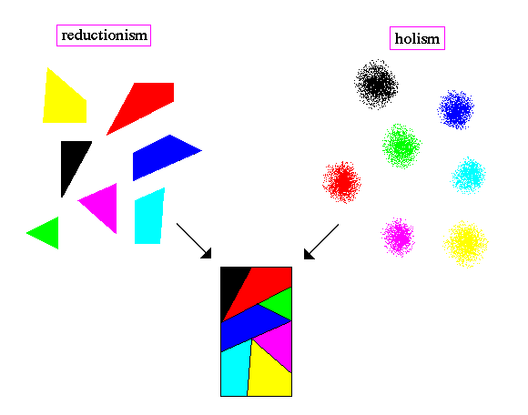
Holism and Reductionism
Relationship stranger than normally conceived
Source: http://abyss.uoregon.edu/~js/images/holism.gif

Slide 3
Holism and Emergence
Present day science recasts holism as systems thinking
System is a dynamic, complex whole
Structurally and functionally integrated
Exhibits complex behavior
Emergent properties not easily predicted in advance
Dominant theme in modern biology

Slide 4
Universe as a dynamical system
Science conceives of universe as a dynamical system with states evolving since big bang
Emergent properties of universe include us: bodies and minds
Universe as its own simulation
Where is consciousness in all this?

Slide 5
Experience and the physical
World of biology sits on top of the physical
No ontological gap between biology and the physical
Life is just a set of functions implemented by an evolving universe
Almost everything is logically supervenient on the physical
Exception: Experience

Slide 6
Lay criticisms
Intelligent design: Life is something over and beyond physical
Confusion over complexity (and the word theory)
Mainly driven by traditional religion
Naïve and unsophisticated in the extreme
New age and new paradigm: Holism is something over and beyond emergence
Confusion over emergence
Mainly driven by traditional mysticism
Less naïve but equally vague

Slide 7
Consciousness
Consciousness not reducible to the physical
Emergence only capable of producing novel functional properties out of starting states
Problem of consciousness qualitatively different from the problem of life
Intentionality and qualia create problems for present day scientific worldview

Slide 8
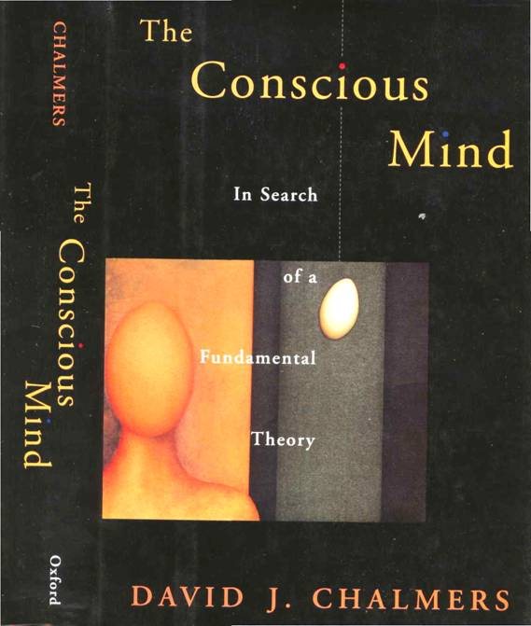
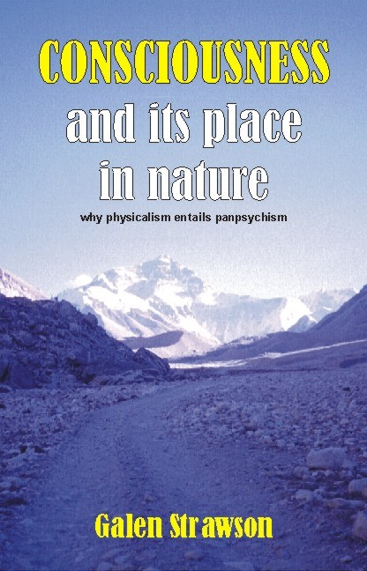
Chalmers and Strawson
Consciousness not logically supervenient on the physical (Chalmers ‘96)
Realistic physicalism entails panpsychism (Strawson 2006)
Disagree with both but not in the way you might think

Slide 9
Responses
Radical emergence:
Mind emerges from brain
Even though mind is an ontologically different type from brain (matter), radical emergence holds
Question begging
Worldview probably held by majority of scientists today
Want to postpone discussion of consciousness until “brain problem” is solved

Slide 10
Four Approaches
Radical Emergence
Non-reductive physicalism
Mind,
Culture
Mind and Culture
Life
Life
Matter
Matter
Mystery ingredient X
Idealism
Brahman
Dual-aspect panpsychism
Mind,
Culture
Life
Mind
Life
Matter and Proto-Phenomenal
Matter
Brahman

Slide 11
Panpsychism
Furious recent battle between radical emergence and panpsychism
Physicalism implies panpsychism: Strawson
Return mind to traditional premodern position: fundamental aspect of nature
Assumes too much
Combination problem

Slide 12
Idealism
Berkeley and Vedanta varieties
World of matter emanates from Brahman
Panpsychism seen as a variant of idealism
World as virtual reality (Matrix) and not merely illusory not exploited
Lack of differentiation between mysticism and idealism in Indic traditions

Slide 13
Non-reductive physicalism
Russellian physicalism
Dual-aspect theory
Ignorance (Stoljar) and inscrutables (Montero)
Categorical versus dispositional distinction
Umbrella term
Non-reductive physicalism preferred because of its open ended nature

Slide 14
Meditative phenomenology
Ordinary qualia: Sensation, perception, emotion, cognition, visualization
Meditative phenomenology: Hindu and Buddhist traditions agree on importance of awareness
Awareness leads to non-ordinary state in which self/world boundary reconfigured
Moments of awareness (MoA): evidence of construction of self or subject

Slide 15
Physicalism + X
A new ingredient in order to accommodate experience
Desiderata:
Must lead to nature with interior
Dynamic and temporally end-stopped
Non-mechanistic
Not mere addition of phenomenology
Intentionality and qualia logically supervenient on physicalism + X

Slide 16
Fleshing out the new ingredient
Set of basic physical entities assert a new relation: AM_A <natural category>
Low level physical facts become conditioned on AM_A assertions of membership
Natural categories need to exist but can evolve
Creation of interior
AM_A membership relation is dynamic
AM_A Presenter right now

Slide 17
Natural categories
Does the electron decide that it’s an electron?
Static categories and fixed membership in science (taxonomy and taxidermy)
Evolving categories and dynamic membership: Emergent categories?
Facts relative to AM_A <category>: Semantics
Facts interior to AM_A <category>: Qualia
Notes:
Anand (the lifeform) has high blood pressure. Yes and Anand the Presenter is temporarily excited:

Slide 18
AM_A Visualization
AM_A is dynamic,
non-mechanistic
Categories can evolve
AM_A membership restricts
set of possibilities for basic
elements
Return of Holism

Slide 19
Properties
AM_A <natural category> idea drawn from awareness state
Self and subject missing in old physical
Low level facts interpreted in light of AM_A membership: Meaning or semantics
High level facts occurring in newly formed interior: Qualia

Slide 20
Discussion
Emergence and complexity insufficient for consciousness
Non-reductive physicalism embraced
New mysterious ingredient X needed
AM_A <natural category> proposed
New holism concept separate from emergence and complexity
Creation of an interior: Intentionality and Qualia

