Slide 1
CFO Division Lunch-n-Learn:
Central Travel Management
Presented by Central Travel Office
August 28, 2012
CONNEXXUS TRAVEL

Slide 2
Peter Taylor
Chief Financial Officer
UC Central Travel Office:
Org chart
Dan Sampson
AVP Financial Services & Controls
Matt Golden Director
Debra Almason
External Relations Manager UC Travel Management Services
Giesel Velez
Connexxus Program
Analyst
Debra Stevens Project Manager CSU
Kate Muir
Special Assignment
Notes:
48

Slide 3
Connexxus Historical Timeline
2006
UC Travel Council was established
2007
Faculty & staff survey distributed regarding a managed travel program
2008
The Connexxus portal architecture completed
UC Regents approve managed systemwide travel program
2009
2010
2011
Connexxus program designed
Sourcing process – agency, air, car, hotel contracts executed
Signed contract with third party company to manage traveler profiles
First wave of Connexxus implementations launched at UCSD & UCR
Central Travel Office visits each campus introducing the Connexxus travel program
First airline ticket transaction took place May, 2008
President Yudof sends letters to Chancellors strongly recommending the use of the Connexxus program
Development & implementation of Connexxus data depository
National Nuclear Security Administrator joins the Connexxus program
Connexxus granted registered Trademark rights
Connexxus partners with UC Risk Services to integrate trip information to UC Traveler Insurance
SWABIZ (Southwest) business program added to Connexxus including personal Rapid Rewards incentive
First Connexxus program analysis (four campuses) showing actual savings of $871,000
Continued implementation and training initiatives by campus
Connexxus implementation completed at all UC campus locations
Continued focus on training and utilization
Connexxus noted in The Chronicle of Higher Education documenting UC past savings of $3 million
Developed small business travel program for trips using Federal Funds or EPA Grants
CSU joins Connexxus program
Customized SWABIZ program for UC Academic Senate
First Connexxus systemwide (ten campuses & UCOP) program evaluation showing annualized savings of $4.4 million
Student and Faculty abroad program launched August, 2011
Launched a customized Connexxus program for Agriculture and Natural Resources October, 2011
Connexxus savings and utilization added to President’s “Working Smarter” initiative
Systemwide evaluation of 2011 indicated savings success at $6,534,377 million
CONNEXXUS TRAVEL

Slide 4
Participation in Connexxus: 2010 vs 2011 Utilization
Utilization Goal
Data Source: iBank and Campus Estimated Air Travel Spend
CONNEXXUS TRAVEL

Slide 5
Connexxus Customer Service – Issue Resolution
January – December 2011
Total UC Connexxus Air Transactions: 52,663
Total Instances Reported: 249
Total Issues/Problems Reported: 83
Number of Issues Resolved as % of Total Transactions: 0.16%
Category | Count of Category
Access to the Connexxus portal | 5
Inability to complete or use the profile in preparation for making reservations | 8
Inability to identify the lowest fares/rates | 16
Inability to use Concur or GetThere as a reservation tool | 37
Inadequate service from a Connexxus provider | 4
Missed or inaccurate reservations | 7
Poor service by any preferred supplier | 6
Other / Not classified as error | 166
Total | 249
CONNEXXUS TRAVEL

Slide 6
What have we been up to?
Travel Council Charter approved and established by UC Travel Council
Implemented a customized travel program for ANR
STA becomes Connexxus service provider for student and faculty abroad program
Executed service level agreement between UCEAP and STA
Systemwide outer reach
Participation at campus supplier fairs
Ongoing educational sessions
Established Connexxus distribution list
Publishing quarterly Connexxus newsletter
CONNEXXUS TRAVEL

Slide 7
What are we up to?
Faculty travel program
Campus visits
Identifying faculty candidates to participate in focus groups
Conduct 3-4 focus group sessions comprised of 5-6 participants per group
Assess focus group results
Identify key indicators and components to design and develop program
Test, implement and promote program
Connexxus portal facelift
Develop cloud based library of promotional and educational tutorials
Introduce innovative travel technology
CONNEXXUS TRAVEL

Slide 8
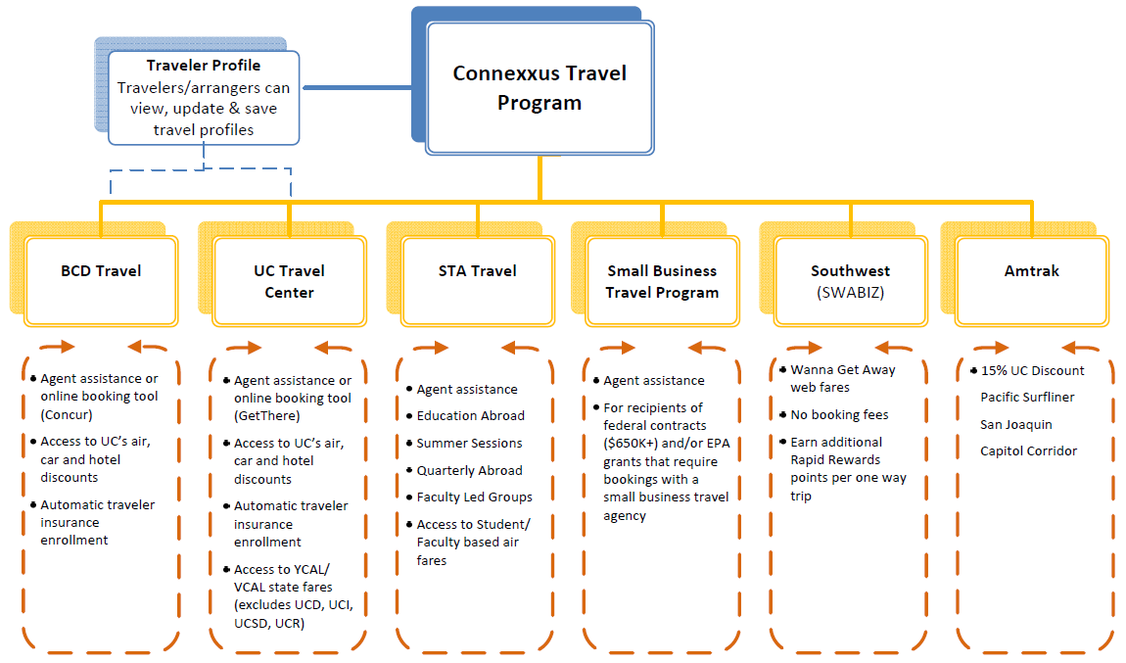
Connexxus Program Snapshot
CONNEXXUS TRAVEL

Slide 9
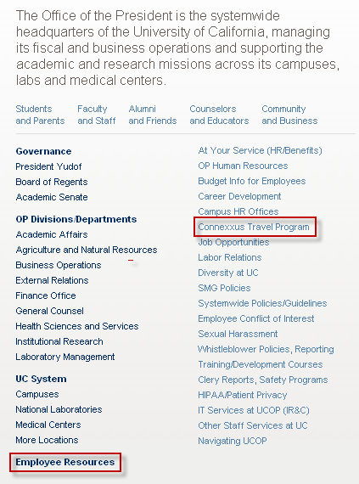
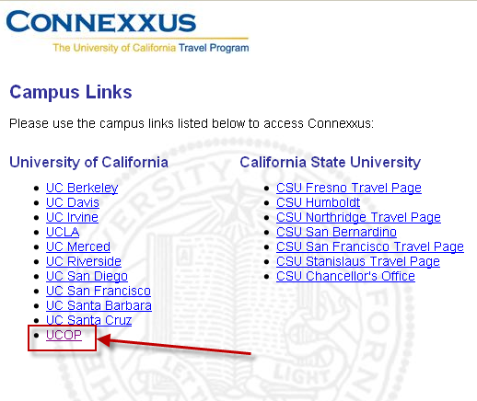
Getting to the Connexxus Portal
Visit the UCOP website home page
Hover over “Employee Resources”
Click “Connexxus Travel Program”
Select “UCOP” to access UCOP’s single sign on login page
Use your AD user id and password to navigate to the portal
CONNEXXUS TRAVEL

Slide 10
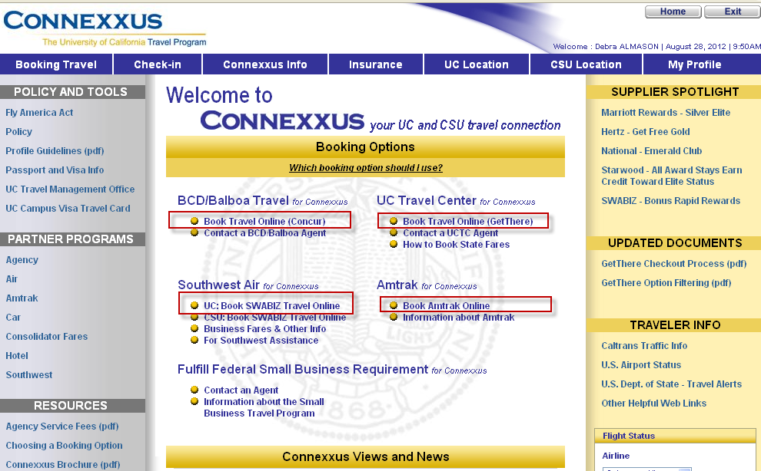
Travel Booking Options
CONNEXXUS TRAVEL

Slide 11
Connexxus Air Program Update
American Airlines
10% - 55% Discount
Discounts apply to AA One World Partners British Air, JAL, and Iberia Airlines
Recently amended AA contract to include discount program with Cathay and Qantas
American will allow name changes for non-refundable tickets that have been issued
Delta
Connexxus travelers qualify for a 2% - 55% discount
Discount also offered on Air France and KLM
Coming soon: Alitalia
LAN
Connexxus travelers qualify for a 5% - 35% discount
Singapore Air
Connexxus travelers qualify for a 8% - 15% discount
Emirates
Connexxus travelers qualify for a 5% - 30% discount
2011 Airline Program Savings: $4,739,670
2011 Savings Using Connexxus Online Booking Tools: $548,640
CONNEXXUS TRAVEL

Slide 12
Connexxus Hotel Program – Marriott/Starwood
Connexxus offers 10% - 40% savings through the preferred hotel program using Marriott or Starwood properties
Preferred hotels offer last room availability
Preferred hotels may offer additional savings opportunities:
Room upgrade (based on availability)
Free airport shuttle
Free internet access
Free Continental breakfast
Starwood hotels offer late check-out (4PM) based on availability
2011 Hotel Program Savings: $491,916
CONNEXXUS TRAVEL

Slide 13
Connexxus Car Program - Hertz
Connexxus travelers qualify for a 15% - 35% discount
Hertz will offer promotional rates, when available, if booked through Connexxus
Deeper discounts for car rentals are offered if booked off airport at one of the Hertz Local Edition suburban locations within California
Free enrollment for Hertz Gold Plus Rewards program ($60 value) allowing the traveler to bypass the rental counter
Earn free rental day for every 4 rental days purchased
Paperless PDF copy receipts via email
Mobile Gold Alerts: Sent car information prior to arrival
Gold Choice program allows traveler to select car of choice
UC discounts apply to Hybrid rentals
Renter’s age requirement lowered to 21
UC car insurance automatically included
CONNEXXUS TRAVEL

Slide 14
Connexxus Car Program- National/Enterprise
Connexxus travelers qualify for a 15% - 35% discount
National will offer promotional rates, when available, if booked through Connexxus (not offered by Enterprise)
Deeper discounts for car rentals are offered if booked off airport
Enterprise provides pick-up and drop-off service
Free enrollment for National’s Emerald Club ($60 value) allowing the traveler to bypass the rental counter
For intermediate car rentals, traveler may select any car available located at the Emerald Aisle
UC discounts apply to Hybrid rentals
Renter’s age requirement lowered to 21
UC car insurance automatically included
2011 Car Program Savings: $699,800
CONNEXXUS TRAVEL

Slide 15
Connexxus – Rail Program
Amtrak
Connexxus travelers qualify for a 15% discount
Reservations must be booked through Amtrak link located at Connexxus portal
CONNEXXUS TRAVEL

Slide 16
Connexxus Working With UC Risk Services
UC Trip Insurance and Security Advisements
Connexxus travelers who book travel through UC Travel Center or BCD Travel will be sent a traveler insurance card via email from iJet/WorldCue.
iJet/WorldCue will send security advisements if an incident occurs prior to trip date, or if the traveler is in an affected area and needs assistance with relocation or evacuation services.
UC security advisements do not apply to reservations made through UC’s Southwest (SWABIZ) or Amtrak reservation sites. Travelers must register through UC Trips.
CONNEXXUS TRAVEL

Slide 17
Connexxus – Did You Know?
UC Business Rule Compliance
Connexxus agencies are capable of managing unused non-refundable tickets and posts unused ticket information in the traveler’s profile for consideration of being applied for future travel needs.
UC saved $ $238,808 in 2011 as a result of the unused ticket management system.
CONNEXXUS TRAVEL

Slide 18
Connexxus Myth
Myth: Airfare is cheaper booking travel outside the Connexxus travel program.
Fact: BCD Travel and UC Travel Center use the same Global Distribution System (SABRE) conducting air schedule search and pricing options used by commercial travel companies such as Travelocity and Expedia. Airfare quotes should be equal or less expensive booked through one of the Connexxus travel service providers.
CONNEXXUS TRAVEL

Slide 19
Connexxus Myth
Myth: There are travelers and arrangers who prefer to book travel through an agent so using Connexxus is not convenient for those who do not wish to book travel online.
Fact: Connexxus provides users with the option of booking travel online or calling an agent. Agency contact information is listed on the Connexxus portal home page.
CONNEXXUS TRAVEL

Slide 20
Connexxus Myth
Myth: Travelers see no difference booking travel through Southwest.com so why book Southwest flights through the Connexxus portal?
Fact: The UC SWABIZ website offers the same exact flight schedules and web only airfare offered through Southwest.com. In fact, UC’s SWABIZ site is the same site as Southwest.com. The difference is that travelers who purchase Southwest tickets through the Connexxus portal will earn 250 extra Rapid Reward points per one way trip.
CONNEXXUS TRAVEL

Slide 21
Connexxus Myth
Myth: Southwest travel booked through one of the Connexxus travel agencies is often more expensive compared to Southwest.com.
Fact: On occasion, this may be true. Southwest offers “Wanna Get Away” rates that can only be purchased online through Southwest. Travel agencies, including Connexxus travel management companies, do not have access to the internet rates, so on occasion may be higher. If booking the Southwest internet rate, we suggest travel be booked through UC SWABIZ located at the Connexxus portal.
CONNEXXUS TRAVEL

Slide 22
Connexxus Myth
Myth: Because there is limited name recognition for BCD Travel, it’s assumed travelers are dealing with an agency that lacks experience or provides lackluster customer service.
Fact: BCD Travel is the third largest global travel management company behind American Express and Carlson Wagonlit. BCD Travel employs 14,000 worldwide and offers UC a dedicated staff of 12 with a minimum 15 years of industry experience each.
CONNEXXUS TRAVEL

Slide 23
Connexxus Myth
Myth: Rental car rates are sometimes cheaper if booked through a non-UC preferred car company.
Fact: Although the daily rate comparison may appear cheaper if offered by another car company, these rates do not include insurance coverage that can increase the daily rate by $15-$25. Purchase of additional insurance coverage is not a UC reimbursable expense so the renter may also assume liability, or at the very least the inconvenience of dealing with their personal insurance carrier in the event of an accident or damage incurred during the rental period.
CONNEXXUS TRAVEL

Slide 24
Connexxus Myth
Myth: Non-Connexxus preferred air suppliers such as United are not offered through Connexxus.
Fact: All accredited airline suppliers schedules and pricing are offered through the Connexxus agencies including United.
CONNEXXUS TRAVEL

Slide 25
Thank you for your interest and support of the Connexxus travel program!
For more information regarding the Connexxus travel program, including registration to the Connexxus supplier and travel information Distribution List, please visit:
The portal: ucal.uc/connexxus
Or contact UC’s Central Travel Office: uctravel@ucop.edu
For direct billing or travel expense questions please contact your BRC team or Karen Tomajan, UCOP’s Travel Manager
CONNEXXUS TRAVEL

