Slide 1
Learning about the world through social media
Emre Kıcıman
emrek@microsoft.com
Notes:
Abstract:
Social media, namely Twitter and Facebook, provides a finer-grained, larger-scale digital record of human interactions than has been available before. Unfortunately, social media is also a noisy, ambiguous and biased medium. In this talk, I will describe two projects that begin to untangle this messiness. The first is an entity recognition system that analyzes the Twitter firehose, adding structure to otherwise unstructured text. The second is a large-scale study of self-reporting bias that uses ground-truth data to analyze the factors that influence people to tweet about real-world events. I will touch on two very different applications of such social media analysis: how extracting information about people’s real-world activities can help us answer search queries; and a study of social media usage in the context of the Mexico drug war.

Slide 2
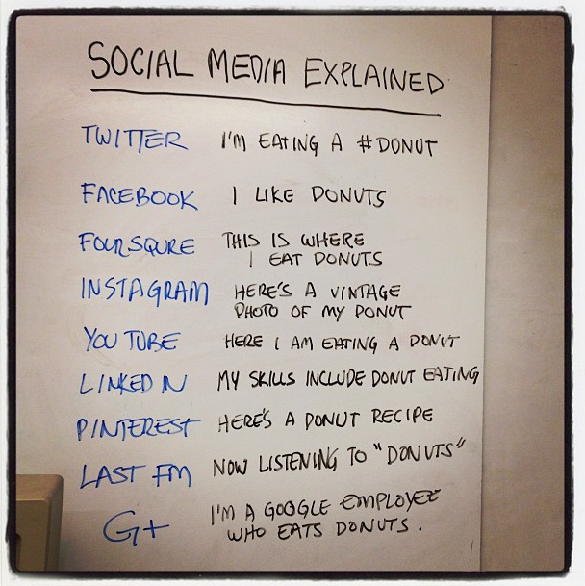
Douglas Wray - http://instagr.am/p/nm695/ @ThreeShipsMedia
Notes:
Big picture:
Learning about the real world through social media
Social media: largest fine-grained record of human activity ever

Slide 3
Where do people get donuts?

Slide 4
What do people drink with donuts?

Slide 5
What kind of donuts do people eat?

Slide 6
About the donuts data
~180k tweets containing “donut” or “doughnuts” from 7 days of twitter firehose (week of Feb 6)
No disambiguation
Associations are much sparser
1000s of tweets about stores, drinks, etc

Slide 7
Building a platform
Extract people’s interactions with each other and world
1) Building analysis functionality
I’ll talk about Flexible Named Entity Recognition
2) What can “real-world” info be used for?
I’ll describe 2 of the apps I’ve been working on
Also: What do we need to know about how people behave, to correctly interpret social media?

Slide 8
Societal, policy, and other external influences
Social media data analysis
Apps &
social experiences
Understanding social behavior of
individuals and groups
Notes:
One way to visualize the “purpose” of building a data mining platform is in the context of “the rest of social networking research”. Here’s my view.

Slide 9

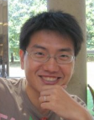

Flexible Named Entity Recognition with N-gram Markov Models
with
Chun-Kai Wang
Ming-Wei Chang
Paul Hsu

Slide 10
Flexible Named Entity Recognition
Goal:
Handle noisy text
Build recognizers for new entity classes
Without requiring labeled data
Approach:
HMM + language models for unsupervised NER
Training data from non-domain specific sources combined with seed list
Notes:
We define our model formally as given a word sequence W_{1…n} = w₁ w₂ … w_{n}, our goal is to find the stochastic optimal tag sequence T_{1…n} = t₁ t₂ … t_{n} with the standard BIO tagging schema (Beginning, Inside and Outside of an entity). By applying Bayes’ rule we have the following generative model
$${argmax}_{T}P\left(T_{1…n} | W_{1…n}\right)={argmax}_{T}\frac{P\left(T_{1…n},W_{1…n}\right)}{P\left(W_{1…n}\right)}$$
$$={argmax}_{T}P\left(T_{1…n},W_{1…n}\right)$$
We then model the above joint probability as follows:
$$P\left(T_{1…n},W_{1…n}\right)=P\left(T_{1…n}\right)P\left(W_{1…n}|T_{1…n}\right)$$
As shown in Figure 1, NLMM is very different from HMM because the latter does not directly model relationships between words and entity boundaries. While language models directly model relationships between words, the model does not have a notion of entities. NLMM combines the ideas from both models. To model the tag sequence without hand-labeled training data we introduce our contribution, the notion of a foreground and background language model. In Section 5 and 6, we formally explain these two language models but for now, think of the foreground language model as a collection of entity names responsible for tagging B and I while the background language model as a collection of non-entity names and responsible for tagging O in the BIO tagging schema.
We then use$θ$ to model transition probabilities from the background language model (${LM}_{B}$) to the foreground language model (${LM}_{F}$) and use the entity name boundary ending tokens (<>) in the foreground language model to model exit probabilities ($P_{{LM}_{F}}\left(<> | h_{v_{k}+1}\right)$) back to the background language model. In doing so, the NLMM explicitly models transitions into and out of the foreground language model an important feature that a traditional HMM does not model.
For entity classification, we directly compare the log-likelihood of entity $E$ with length $v_{k}$ for each entity class as follows:
$$E_{class}$$
$$={argmax}_{class}{ P}_{{LM}_{class}}\left(E_{v_{k}}\right)$$
$$={argmax}_{class}\left[\prod_{u=1}^{v_{k}}{P_{{LM}_{class}}\left(w_{u}|h_{u}\right)}\right]P_{{LM}_{class}}\left(<> | h_{v_{k}+1}\right)$$

Slide 11
B-I-O model
Standard beginning-inside-outside model
I am going to Krispy kreme. #hungry
O O O O B I O
Notes:
NLMM is very different from HMM because the latter does not directly model relationships between words and entity boundaries. While language models directly model relationships between words, the model does not have a notion of entities. NLMM combines the ideas from both models.

Slide 12
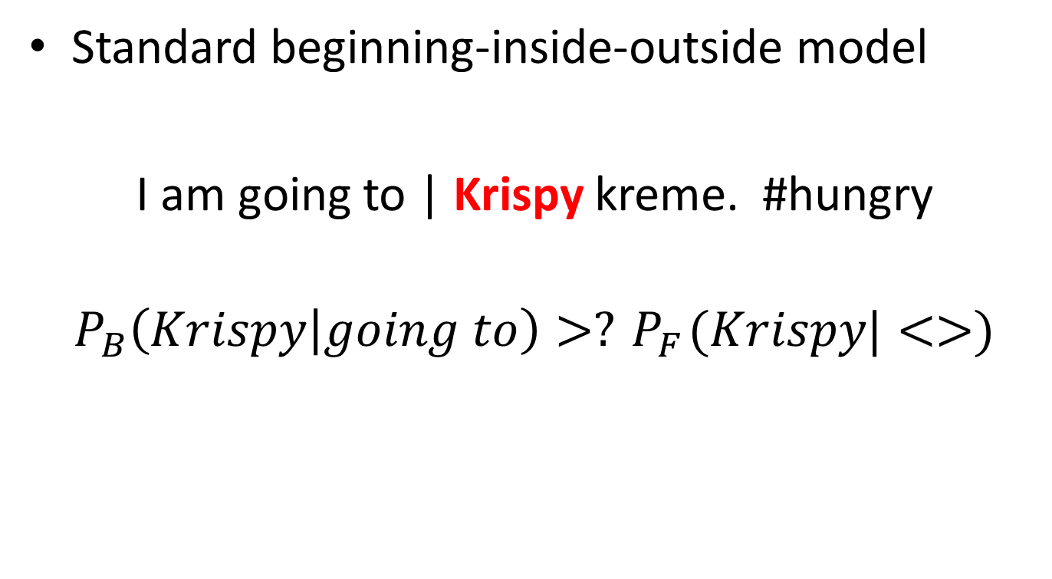
Combining with N-gram model
Standard beginning-inside-outside model
I am going to | Krispy kreme. #hungry
$$P_{B}\left(Krispy | going to\right)>?{ P}_{F}(Krispy|<>)$$
O O O O ??
Notes:
NLMM is very different from HMM because the latter does not directly model relationships between words and entity boundaries. While language models directly model relationships between words, the model does not have a notion of entities. NLMM combines the ideas from both models.

Slide 13
N-Gram Markov Model
B
I
O

Slide 14
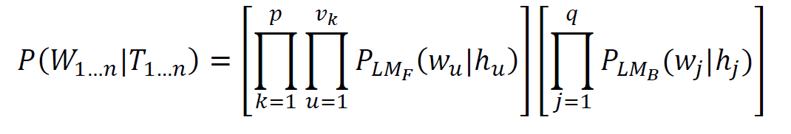
Joint probability of words and tags

Slide 15
NLMM
HMM + N-Gram Language model
Captures relationships between entity boundaries and words
Foreground & background language model allow unsupervised learning
Notes:
NLMM is very different from HMM because the latter does not directly model relationships between words and entity boundaries. While language models directly model relationships between words, the model does not have a notion of entities. NLMM combines the ideas from both models.

Slide 16
Building a foreground language model
Combine:
Domain-specific seed list
General-purpose relation entity
Random walk to find text similar to seed
Bias text by popularity

Slide 17
Evaluation
Person – Organization - Place
Baselines
Stanford NER (trained on formal text)
Ritter’s NER [EMNLP’11] (trained on Twitter)
Validate on randomly selected tweets
Note: selection criteria has strong effect on results
Notes:
In labeling our evaluation set, we follow the CoNLL 2003 annotation guidelines for PERSON, LOCATION and ORGANIZATION to hand-label 1300 randomly sampled English tweets across a few weeks with two-fold verification. We normalize all tweets to remove retweets (RT), @usernames and #hashtags as these are tokens that may easily confuse any of the NER systems but can also be easily recognized by simple regular expressions.

Slide 18
Overall Results
 | Precision | Recall | F₁ score
Stanford NER (CoNLL) | 0.35 | 0.43 | 0.39
Stanford NER (MUC) | 0.54 | 0.35 | 0.43
Ritter et al. NER | 0.62 | 0.42 | 0.50
NLMM (Title) | 0.26 | 0.28 | 0.27
NLMM (Title + Page view) | 0.52 | 0.46 | 0.49

Slide 19
People recognition results
 | Precision | Recall | F₁ score
Stanford NER (CoNLL) | 0.58 | 0.54 | 0.56
Stanford NER (MUC) | 0.78 | 0.42 | 0.54
Ritter et al. NER | 0.48 | 0.52 | 0.50
NLMM (Title) | 0.22 | 0.51 | 0.31
NLMM (Title + Page view) | 0.57 | 0.58 | 0.58

Slide 20
Location recognition results
 | Precision | Recall | F₁ score
Stanford NER (CoNLL) | 0.45 | 0.47 | 0.46
Stanford NER (MUC) | 0.68 | 0.45 | 0.55
Ritter et al. NER | 0.63 | 0.40 | 0.49
NLMM (Title) | 0.12 | 0.34 | 0.18
NLMM (Title + Page view) | 0.50 | 0.51 | 0.51

Slide 21
Organization
 | Precision | Recall | F₁ score
Stanford NER (CoNLL) | 0.17 | 0.28 | 0.21
Stanford NER (MUC) | 0.27 | 0.20 | 0.23
Ritter et al. NER | 0.60 | 0.34 | 0.43
NLMM (Title) | 0.09 | 0.33 | 0.14
NLMM (Title + Page view) | 0.37 | 0.42 | 0.39

Slide 22
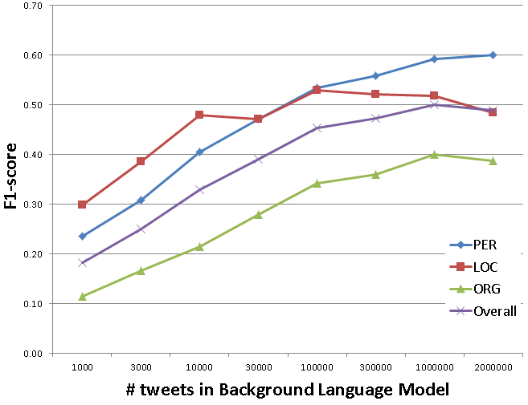
Effect of Background Corpus Size
Notes:
The most important aspect in training the background language model is the corpus size. This corpus needs to be large enough to be statistically representative of messages in the domain we want to analyze but beyond that yields diminishing returns. Exact corpus size should vary with domain but in Figure 4 we show the impact on F₁ score for corpus size (# tweets) of 1k, 3k, 10k, 30k, 100k, 300k, 1M and 2M. Notice that we start seeing diminished after 100k tweets and after 1M the gain is no longer statistically significant. It would be interesting to measure whether perplexity of the background language model is indicative of the marginal gain in increasing the corpus size. However, training language models efficiently is a well-understood problem [7,19,26,40] and a corpus of 2M tweets (24M tokens) and 2M restaurant reviews (28M tokens) took only 15 minutes on a single machine with little optimization so we leave the investigation to future work.

Slide 23
Adapting to a new class and domain
New class: recognize any food or drink in a restaurant review
Training data
Menu items crawled from web
Wikipedia food categories
Search queries that lead to Yelp.com
Evaluation
200 labeled CitySearch & Yelp reviews

Slide 24
Recognizing Food
 | Precision | Recall | F₁ score
NLMM (Query + MI-100) | 0.41 | 0.26 | 0.32
NLMM (Wiki) | 0.58 | 0.48 | 0.53
NLMM (Wiki + MI-100) | 0.58 | 0.64 | 0.61
Lookup (MI-10) | 0.00 | 0.02 | 0.01
Lookup (MI-100) | 0.27 | 0.27 | 0.27
Lookup (MI-1000) | 0.25 | 0.07 | 0.11
Lookup (Wiki + MI-100) | 0.10 | 0.37 | 0.16
Notes:
For recognizing food dishes from restaurant reviews we define the FOOD entity class broadly as including food, drinks and other edible things. To evaluate our food dishes NER we hand-label 200 reviews from the Yelp and Citysearch review corpus. We use 2M unlabeled restaurant reviews to build our background language mode. For the foreground language model, we provide insight into how different data sources perform for this recognition task.
Table 5 shows precision, recall, and F₁ score for NLMM when trained to recognize food dishes from restaurant reviews. The goal here is to show that domain adaptation and learning new entity classes is effortless compared to CRF-based or other methods that require a large amount of hand-labeled data. To provide insight into how different data sources perform for a given recognition task, we tried three data sources: menu items crawled from restaurant web sites (MI) with numbers designating cut-off frequency, query-URL-click logs from Bing (Query), and Wikipedia article titles from the same way we extract article titles for NER on tweets except with food categories (Wiki).
As baselines, we present four dictionary lookups each with a different list of food dishes. The entire menu items dataset has 980k unique menu items. Lookup (MI-10) represents items in this menu item corpus that have at least 10 occurrences (39k items) while Lookup (MI-1000) represents items in this menu item corpus that have at least 1000 occurrences (number). As shown from the Lookup baselines, the menu item dataset is extremely dirty.
We also try generating food dish names from queries issued to Bing resulting in a 19% improvement in F₁ score over the baseline. Our best performing model combines Wikipedia data with menu items improving F₁ score by 126% over the best dictionary lookup baseline. To verify that we did not just create a high quality gazetteer, we take the same corpus used to train our best performing foreground language model and use that in a dictionary lookup, Lookup (Wiki + MI-100). We find that this gazetteer is actually very dirty with a precision as low as 0.10 further reinforcing that our NLMM is working as intended.

Slide 25
Summary of Flexible NER
Easy to build NER for new classes and domains
Already built restaurants, games, movies, locations, …
Performs as well as state-of-the-art NER
Next steps: Adding additional context to improve recognition (class n-grams, co-occurrence models, related tweets)
Fast.

Slide 26
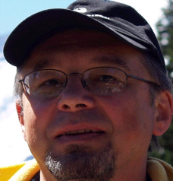
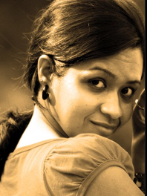




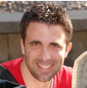
Querying Human Activities
with
Alex Bocharov
Scott Counts
Munmun De Choudhury
Danyel Fisher
Michael Gamon
Patrick Pantel
Bo Thiesson
Notes:
Ongoing project

Slide 27
Learning from the World’s Experiences
Use social media as a fine-grained, large-scale fresh record of people's actions, motivations and emotions
Our goal is to help people with their tasks and decisions by showing them what others have done in similar situations, why they did it, and how they felt afterwards.
Where to go wine tasting?
Where do healthy people eat out?
Find a café for studying
What’s funny right now?

Slide 28
Analysis Flow
1. Who is relevant?
(Everybody)
Experts/Authorities
2. What did they do?
Actions
3. How did they feel about it?
Mood and sentiment associated with these actions and entities
Entities
Behavior-based
Interests
Time

Slide 29
Analysis Flow
1. Who is relevant?
(Everybody)
Experts/Authorities
2. What did they do?
Actions
3. How did they feel about it?
Mood and sentiment associated with these actions and entities
Entities
Behavior-based
Interests
Time
“Where do healthy people go to eat?”
Experts on health
People who exercise regularly
People who Like/Follow health-related topics

Slide 30
Analysis Flow
1. Who is relevant?
(Everybody)
Experts/Authorities
2. What did they do?
Actions
3. How did they feel about it?
Mood and sentiment associated with these actions and entities
Entities
Behavior-based
Interests
Time
“Where to go wine tasting?”
What places are mentioned together with “wine tasting”?

Slide 31
Analysis Flow
1. Who is relevant?
(Everybody)
Experts/Authorities
2. What did they do?
Actions
3. How did they feel about it?
Mood and sentiment
Entities
Behavior-based
Interests
Time
“Where to go wine tasting?”
What mood and sentiment words were used to describe “Napa Valley”, “Loire”, …

Slide 32
Status
1. Who is relevant?
(Everybody)
Experts/Authorities
2. What did they do?
Actions
3. How did they feel about it?
Mood and sentiment
Entities
Behavior-based
Interests
Time

Slide 33
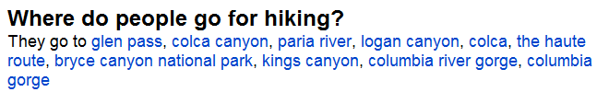

Simple results in a search
Notes:
This data is from 1 month of Twitter in April 2011.

Slide 34

Some fun results

Slide 35


Narco-Tweets: Social Media and Organized Crime
With
Andres Monroy-Hernandez
danah boyd
Scott Counts

Slide 36
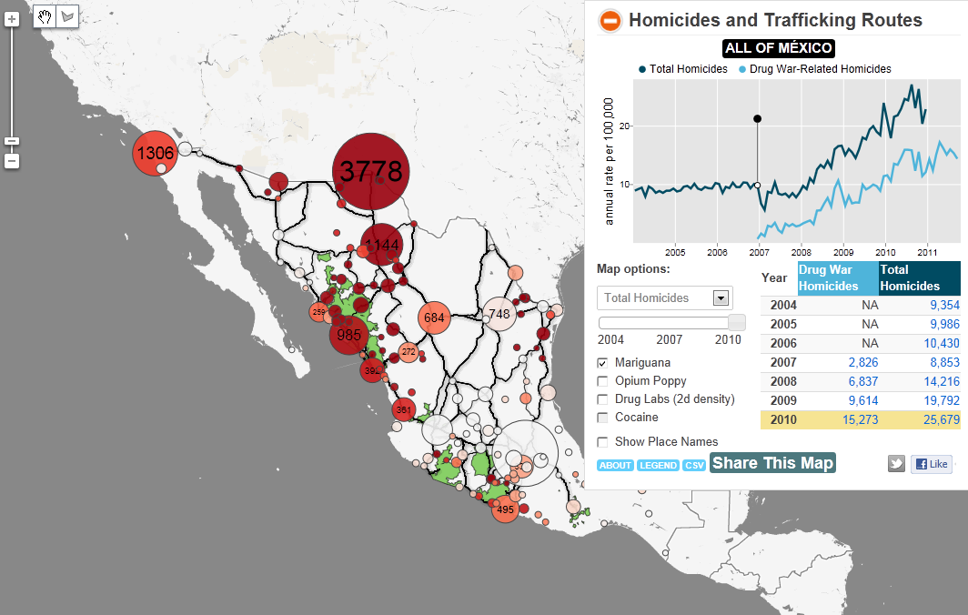
Mexican Drug War 2006-present
http://www.diegovalle.net/drug-war-map.html
Notes:
Control over information
The Mexican Drug War is an ongoing conflict of large magnitude that, from 2006 to 2011, took the lives of more than sixty thousand people (10% of them civilians), and has displaced between 230,000 and 1.6 million people (Internal Displacement Monitoring Centre, 2011, “Quinto año de gobierno: 60 mil 420 ejecuciones,” 2011). The frequent clashes between drug cartels, the military, and police forces often take place in urban areas, inducing panic and cases of post-traumatic stress disorder (Menchaca, 2011). In this paper we focus primarily on four cities notably affected by the violence: Monterrey, Reynosa, Saltillo, and Veracruz.

Slide 37
Social Media Usage
People turning to social media for information when government and news fails
We are applying “big data” analysis to better understand how people use social media; what role it plays; and how it can be improved
Participation patterns
Aggregators/curators
Effects of regulation and intimidation
Data study from Aug 2010 and Nov 2011
Notes:
Leveraging observations of the Mexican social and traditional media since 2010, we identified a set of words commonly used on Twitter in connection with the Mexican Drug War. Using the Twitter “firehose”, available to use through our company’s contract with Twitter, we collected the entirety of tweets containing those words posted in the 16 month period between August 2010 and November 2011. This resulted in a corpus of 3,851,575 tweets posted by 1,029,448 different users.

Slide 38
Platform-Building
Learning to add structure to noisy social media
Flexible named entity recognition
Relationships between activities and locations
Location inference
2 driving applications
Querying Human Activities
Social media analysis in context of ongoing crisis

Slide 39
Conclusions
Social media tells us how about how people interact with the world and each other
Building a platform to extract this knowledge
Technical challenges in understanding noisy, unstructured text
Entity recognition, location, relationships
At the same time, learning about app scenarios through two projects at different scales

Slide 40
Extra slides

Slide 41
What is Tweetable?
Not all events are tweeted at the same rate?
“I am drinking water”
Intuition: how interesting is it?
Can we quantify this intuition?
Is it “change”? Expectation? Extremeness?
Or sentiment, privacy, or something else?
“OMG, I have to Tweet that! A Study of Factors that Influence Tweet Rates” to be in ICWSM-12.

Slide 42
Experiment
12 months of weather-related tweets
Trained classifier, 0.83 F-Score (0.8 prec, 0
Infer location of users
Graph daily rate of tweets for 50+ major cities
Compare to underlying features of ground-truth weather
Extremeness
Expectation
Change

Slide 43
Zoom in on data…

