Slide 1
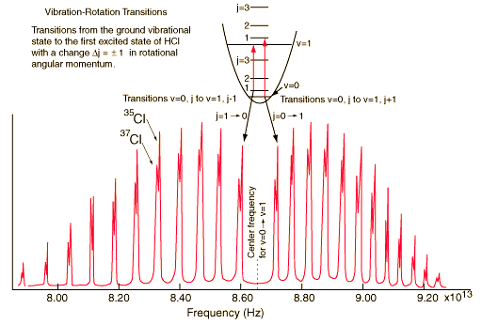
FROM LECTURE 8
Spectroscopy of Simple Molecules
Example 1. HCl
HCl has a strong dipole and strong transitions near 3.5 mm. There is only one degree of vibration freedom, and the observed transition corresponds to ν = 0 → ν = 1. Rotations have such a low energy that they are already excited at room temperature with the maximum J = 3 and J = 12 common. In diatomics, ΔJ = 0 is forbidden and there is no Q branch.
R branch
P branch

Slide 2
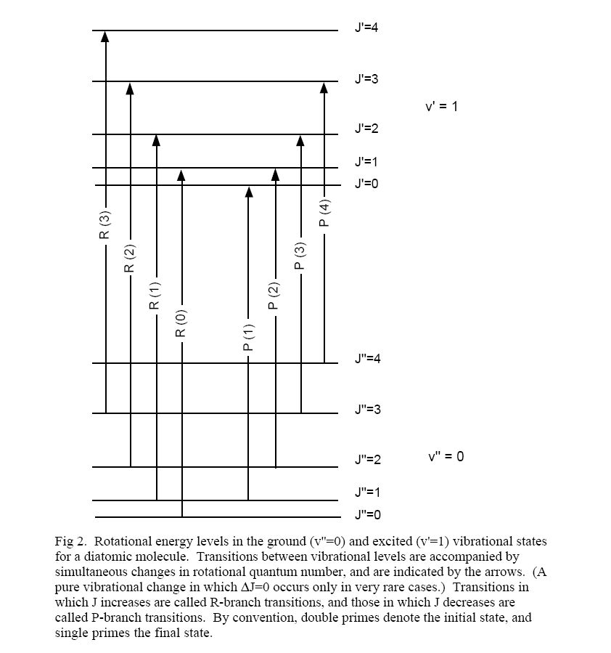
Energy levels associated with the
IR Spectrum of HCl Centered at 3.5 μm
↑
Big Gap
↓
Selection rules:
ΔJ = ± 1, not 0 for diatomics
Δv = ± 1

Slide 4
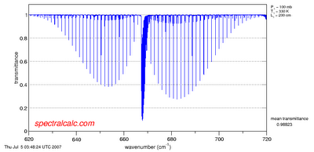
Transmission spectrum of CO₂
This is the bend; there is a a Q-Branch because ΔJ = 0 is allowed. Strong absorption means CO₂ is a greenhouse gas and NDIR spectroscopy is a great technique for detection. How are the wings related to temperature?

Slide 5
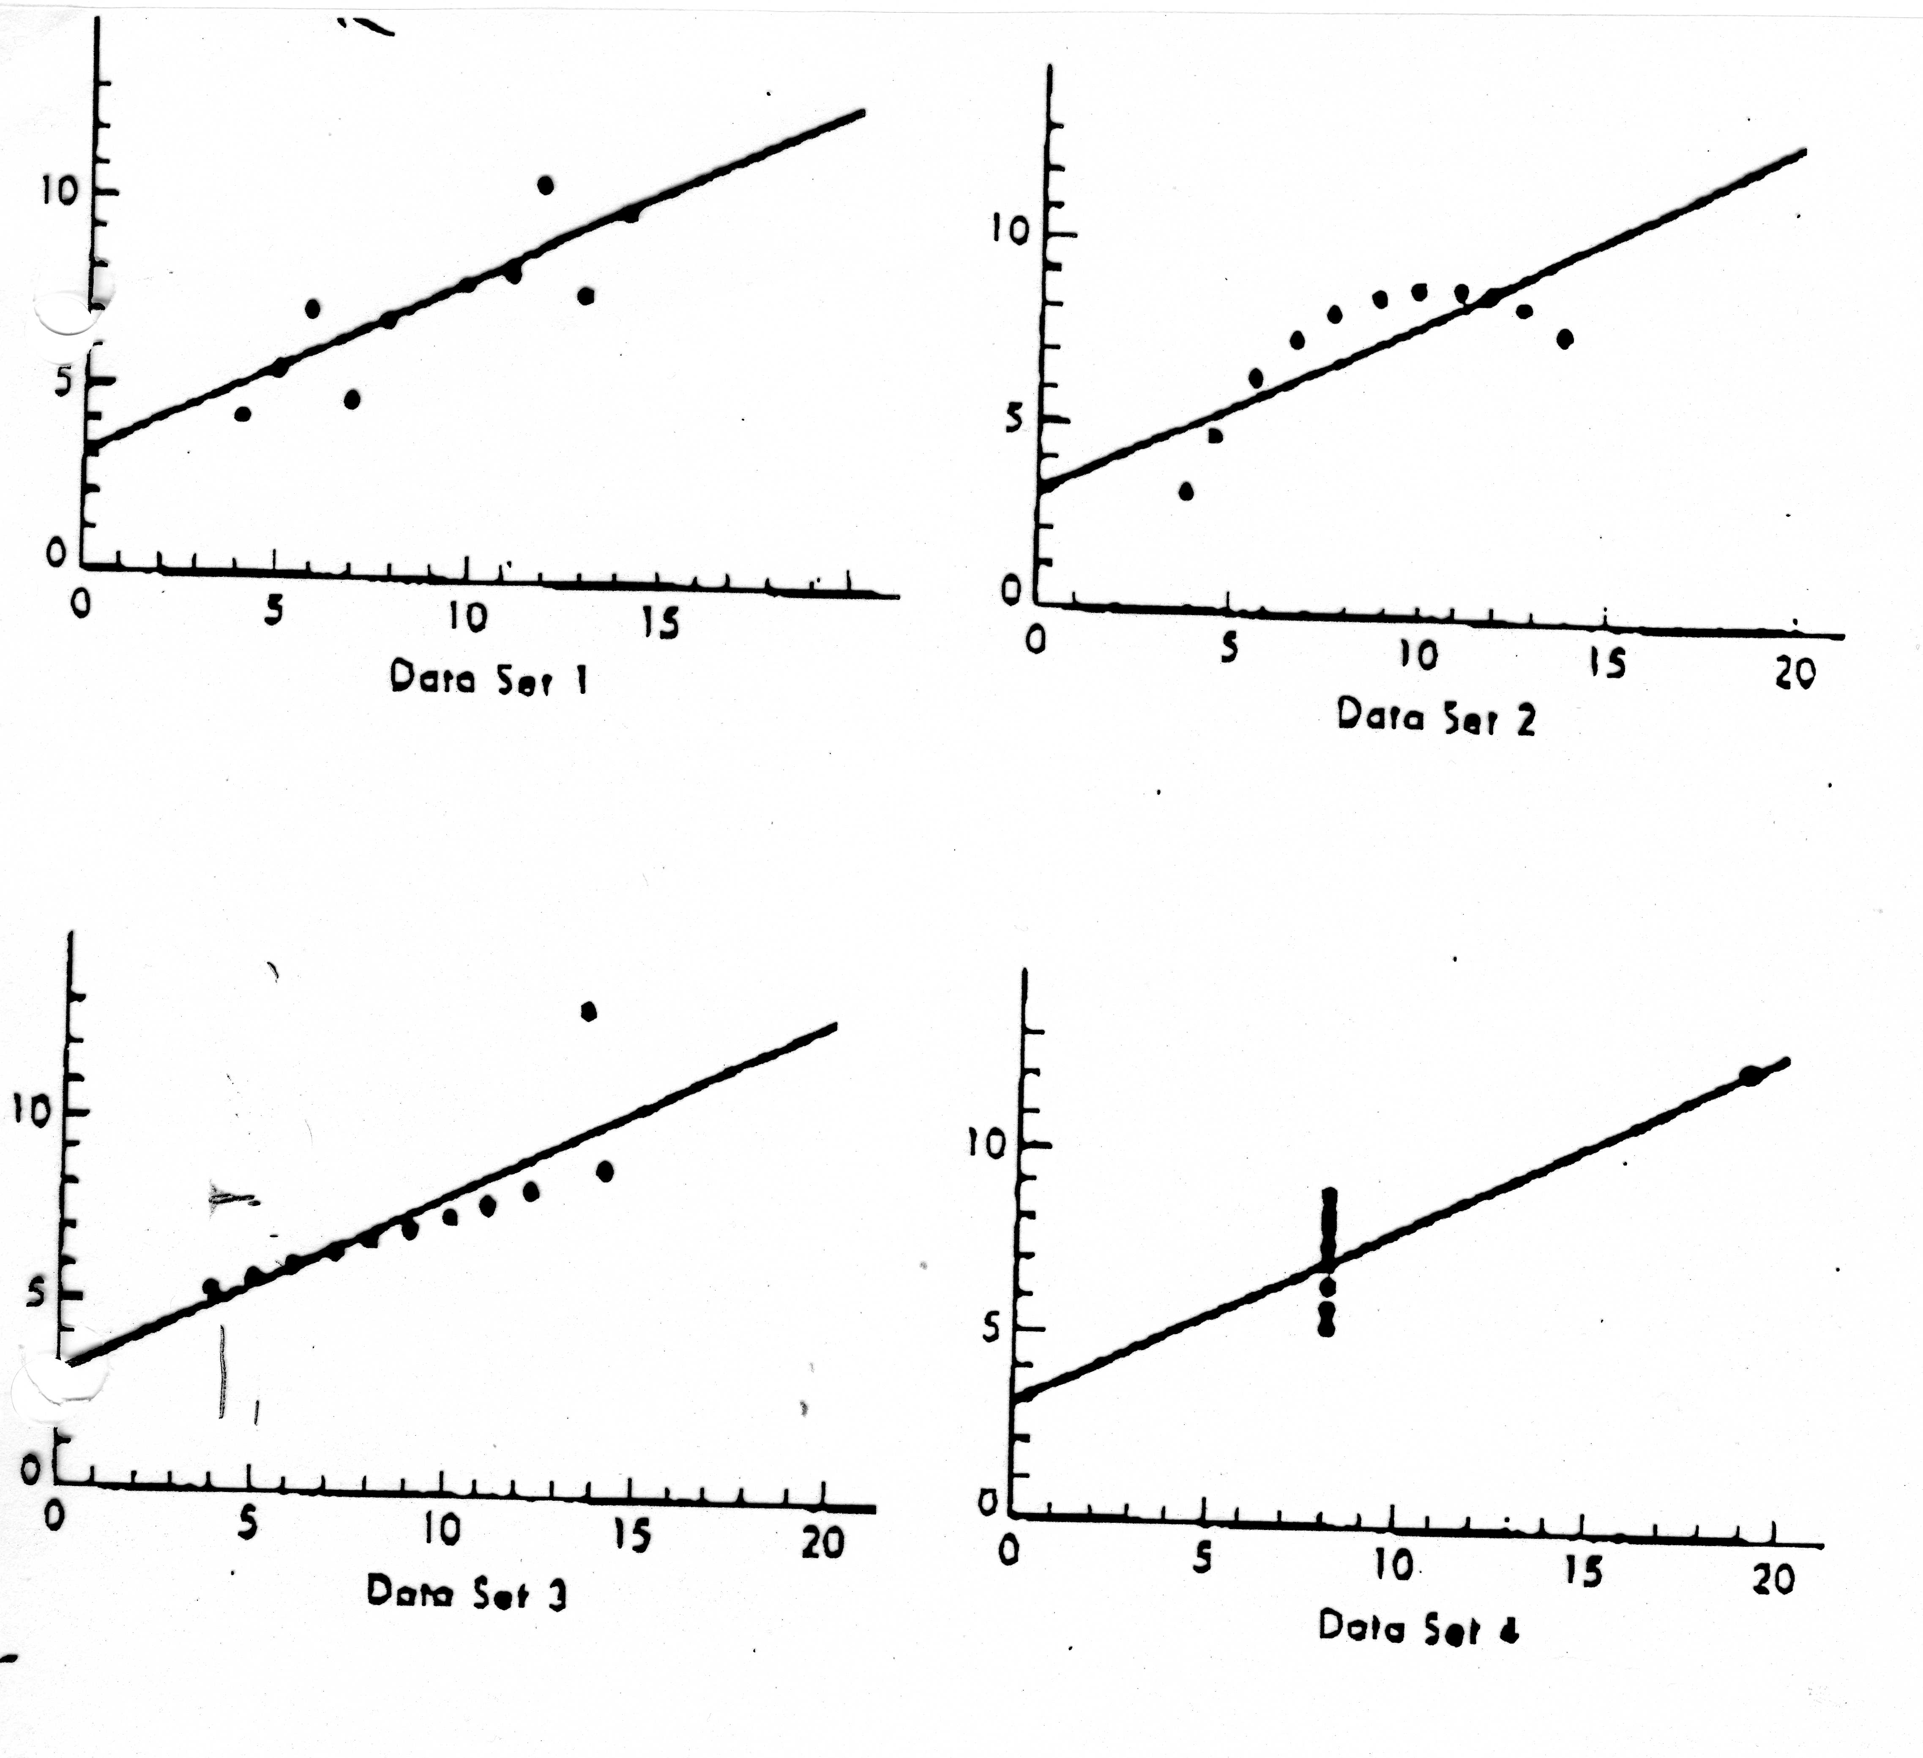
For Homework: bear in mind that correlation coefficient and slope do not tell the whole story.

Slide 6
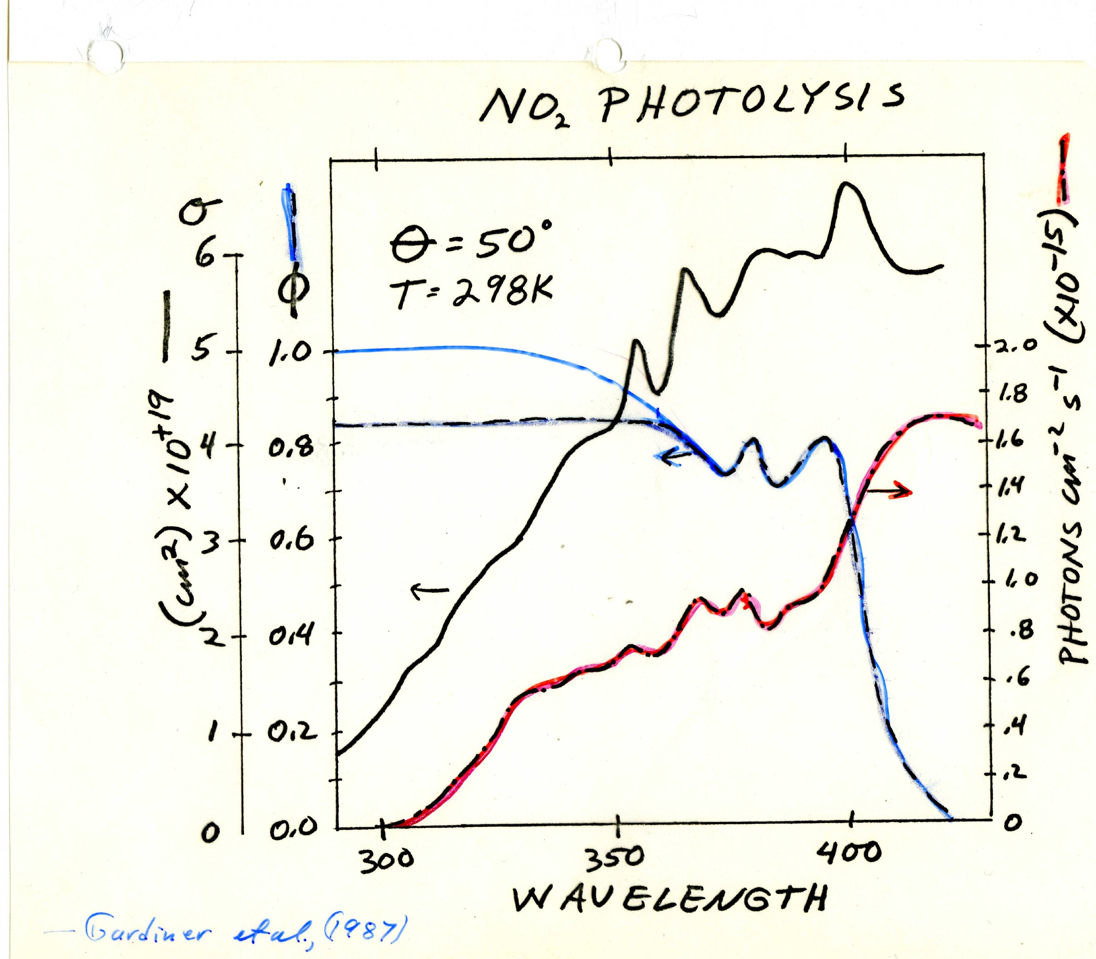

Slide 7
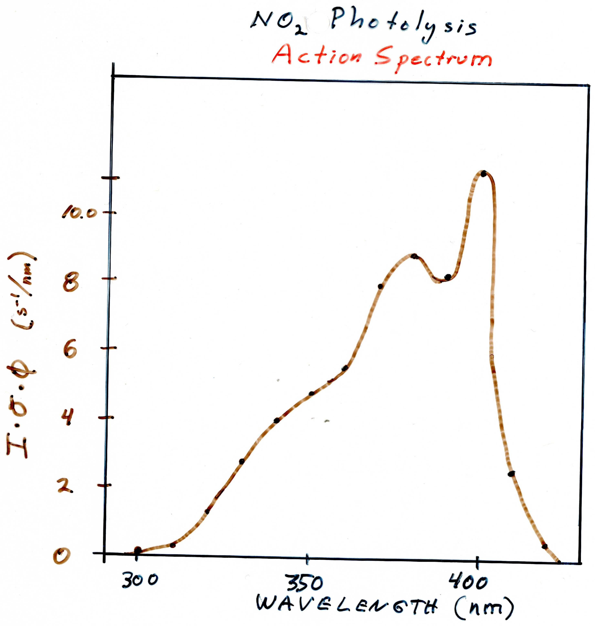

Slide 8
Is the photolysis of NO₂ sensitive to changes in stratospheric ozone?
Peak of the action spectrum ~ 390 nm.
Ozone Absorption Cross-section ~ 2E-22 cm²
I/I₀ = exp (-εcl)
300 DU = 0.3x2.7E19 cm⁻³ ~ 8E18 cm⁻²
A 5% change in O3 produces
I_{5%}/I = exp(-2E-22*(1.05*8E18)) = 1.0015
No significant change.

Slide 9
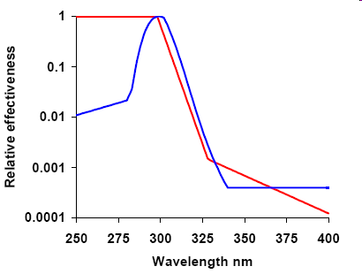
Erythema Action Spectrum (red) Human squamous cell carcinoma (blue)

Slide 10
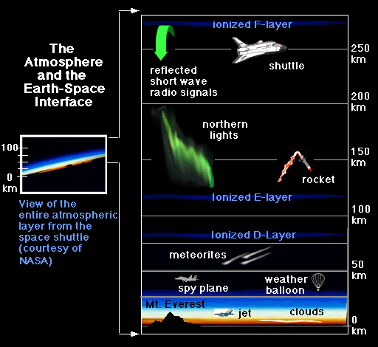
Layers in the atmosphere

Slide 11
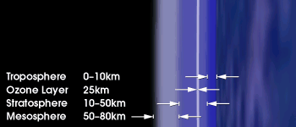
Actual depth of atmospheric layers.

Slide 14
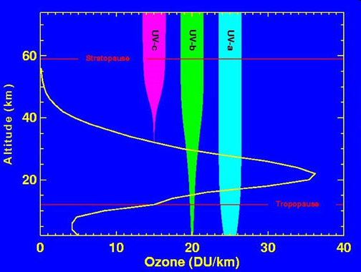

Slide 16
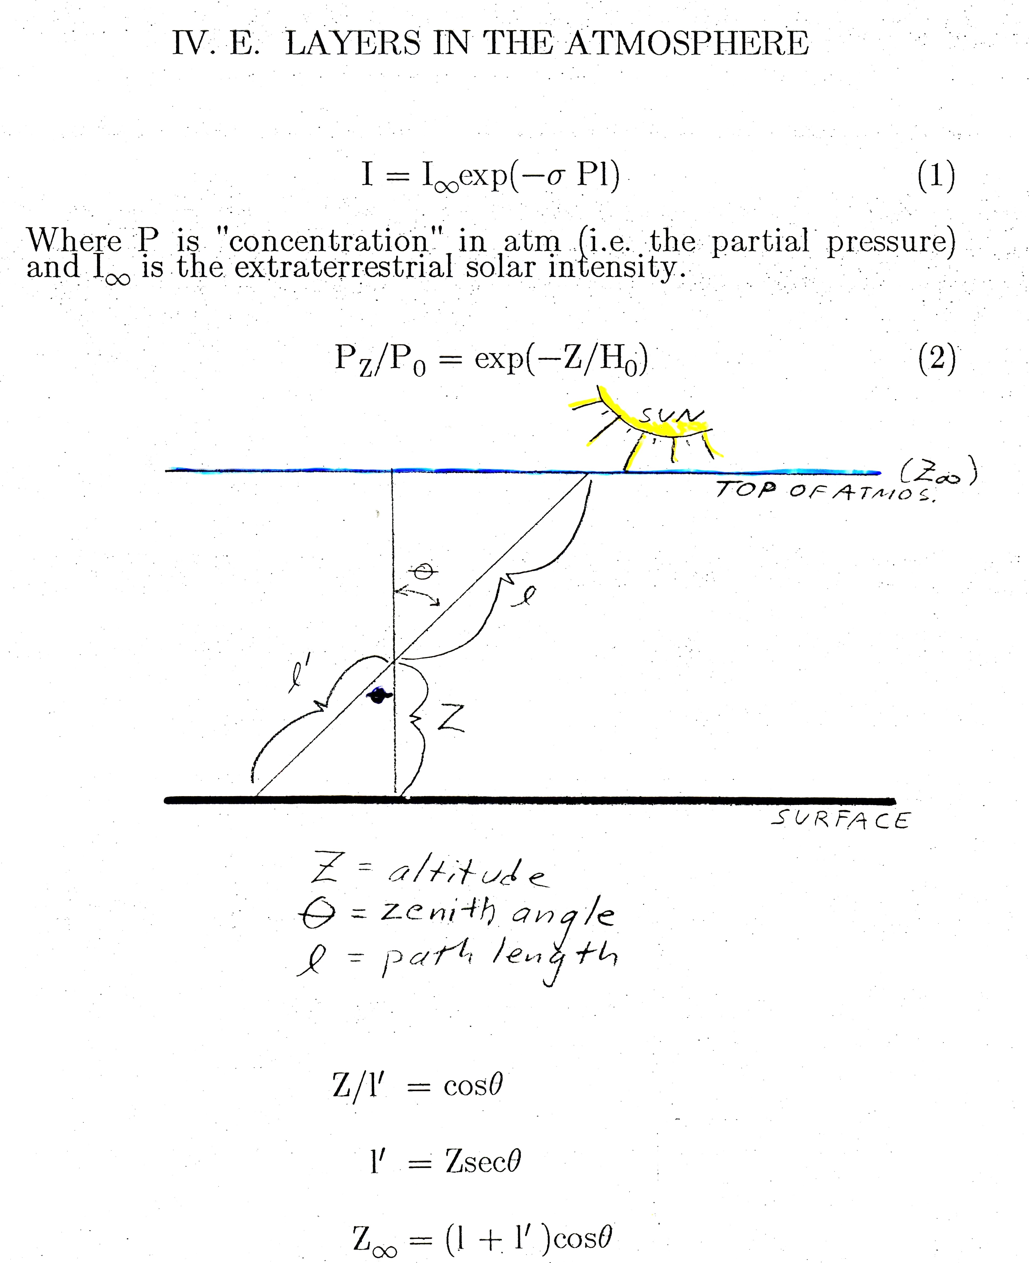

Slide 18
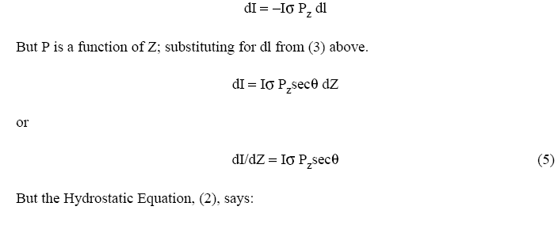

Slide 19
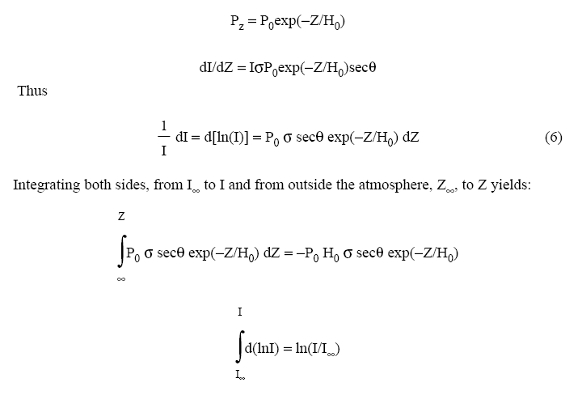

Slide 20
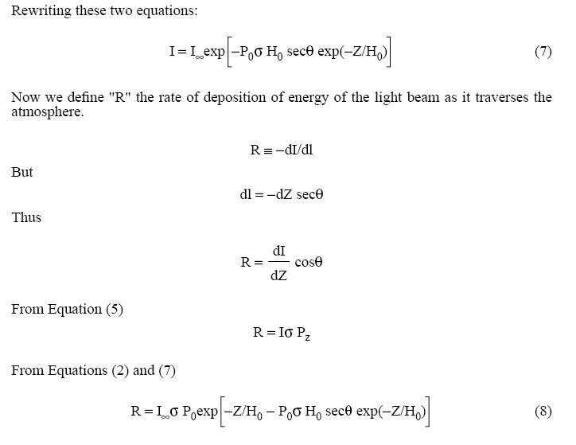

Slide 21


Slide 26
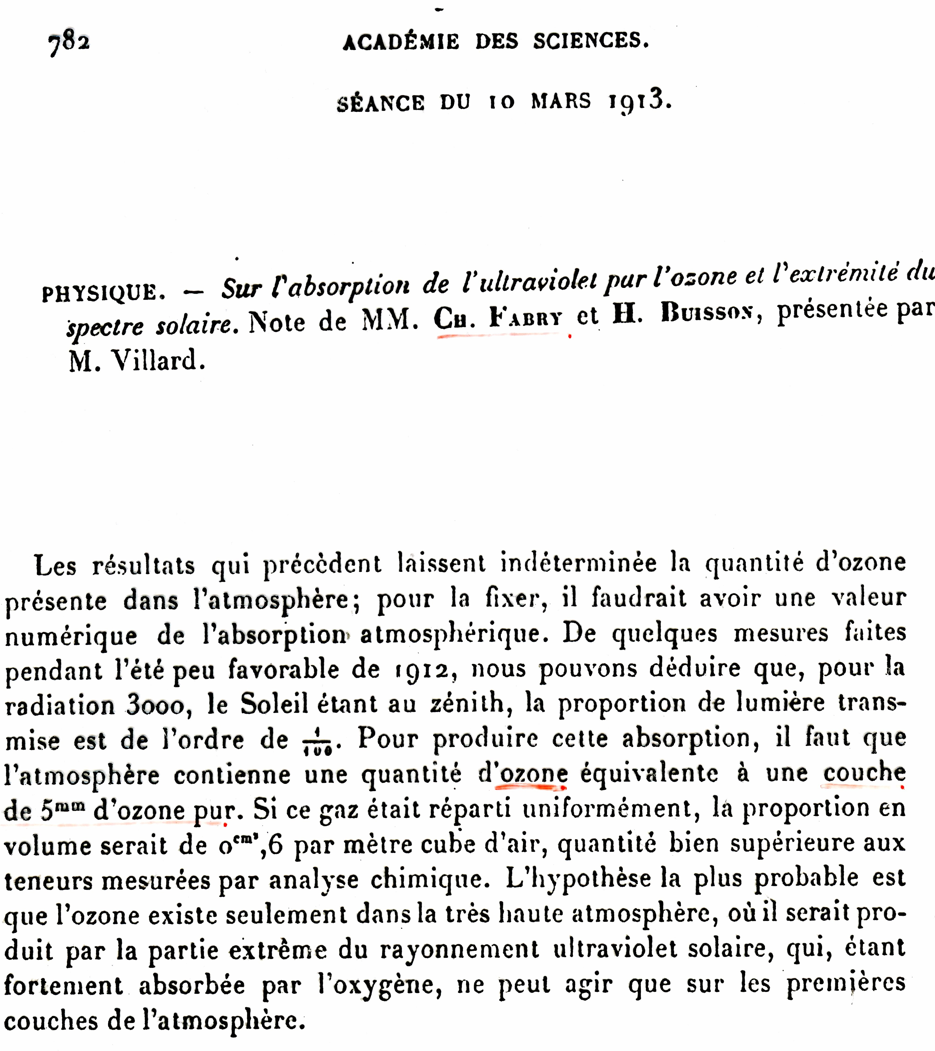
The Stratospheric Ozone Layer

Slide 27
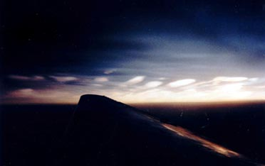
Multiphase Reactions
AOSC 637
R. Dickerson

Slide 28
Gas phase chemistry alone predicts negligible concentrations of HONO during the sunlit hours. None-the-less high concentrations are observed. What happened?
Stutz et al. (2004; 2009) measured a lot of HONO during the morning. They observed HONO/NO₂ ratios of 2 to 9%. Concentrations were in the range of 1 ppb for NOx of 20 ppb. The homogeneous chemistry alone will not explain HONO.

Slide 29
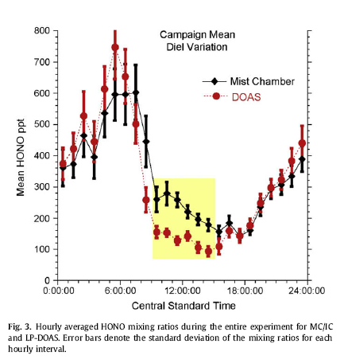
Stutz at al., Atmos. Environ., 2009.

Slide 30
From Stutz et al., (JGR, 2004)
d[HONO]/dt = γ_{NO2 →HONO} (RH) x S/V x v_{NO2}/4 x [NO₂]
− γ_{HONO} (RH) x S/V x v_{HONO}/4 x [HONO]
Where γ is the accommodation coefficient, S/V stands for Surface area to Volume ratio, related to the 1/PBL height; RH is relative humidity; v stands for the mean molecular velocities. This is due to just the multiphase reactions.

Slide 31
Reactions in Solution
(Also called multiphase or heterogeneous reactions)
Atmosphere contains aqueous phase material:
Clouds, fogs, rain, particulate matter
Aqueous solutions or film of water surrounding insoluble core
More on this stuff later in course
How do gases interact with these particles:
1. Gas phase diffusion to surface of droplet
2. Transport across air-water interface
3. Diffusion of solvated species into bulk phase of droplet
4. Reaction of species in aqueous phase or at interface

Slide 32
Finlayson-Pitts & Pitts.

Slide 33
Reactions in Solution
What are the steps involved?
1. Gas phase diffusion to surface of droplet controlled by molecular (Brownian) diffusion, D_{g}.
2. Transport across air-water interface or uptake at surface, controlled by accommodation coefficient, γ (Finlayson uses α). These are often the limiting factor and are highly temperature dependent.
3. Diffusion of solvated species into bulk phase of droplet – determined by the liquid diffusion coefficient D_{l}. Very slow but particles are small.
4. Henry’s Law equilibrium – gives the set point for gas, solution partitioning.
Reaction of species in aqueous phase – tend to be fast if favored thermodynamically and follow first or second order kinetics.
Or reactions at the interface – The surface of a particle or droplet can have a unique composition (micelle).

Slide 34
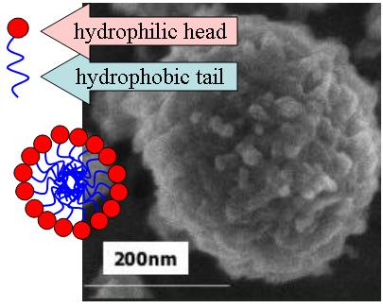
Micelles such as cell membrane or
soap, seen in EM image below.

Slide 35
Reactions of Gases and Solutions
Overall kinetics can be treated with a resistance model.
Gas-surface collisions can be estimated with molecular kinetics theory: Collisions per second per unit area of a gas with a surface are
= N_{g} √ (RT/2πM)
N_{g} is the gas conc in cm⁻³ amd M is molecular weight.
Net gas uptake probability (reactions/collision) γ_{net} is a function of individual steps.
1/γ_{net} = 1/Γ_{g} + 1/α + 1/(Γ_{rxn}+Γ_{sol})

Slide 36
Reactions of Gases and Solutions
Step 2 is uptake across the interface into soln.
The mass accommodation coefficient α determines the interface resistance 1/α.
Step 3 is Solubility and diffusion in the liquid:
F_{in} = -D_{l} δc/δx
Likewise for the flux out. Ultimately
Γ_{sol} = 4HRT/u_{av} √πt
Γ_{rxn} = 4HRT/u_{av} √D_{l}k

Slide 37
Take home messages:
Layers exist in the atmosphere where the absorption of energy reached one e-folding.
Multiphase reactions depend on the composition of both the gases and condensed phase as well as the surface area of the particles and kinetics. Simplifications can be made for spherical, aqueous particles such that heterogeneous reactions can be modeled.

