Slide 1
Learnability of DNF with Representation-Specific Queries Liu Yang
Joint work with Avrim Blum & Jaime Carbonell
Carnegie Mellon University

Slide 2
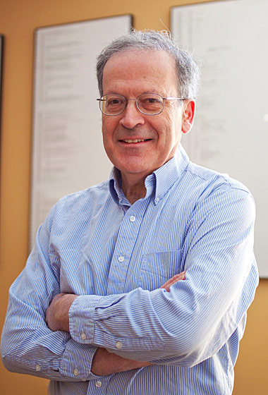
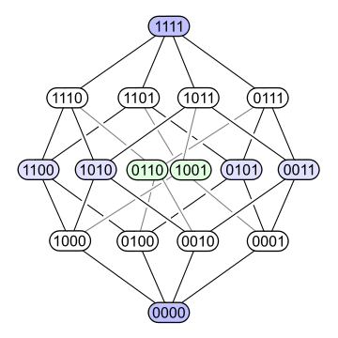
Learning DNF formulas
DNF formulas: n: # of var.s;
poly-sized DNF: # terms = n^{O(1)}
e.g. set of fn like f = (x1∧x2) ∨ (x1∧x4)
Natural form of knowledge representation
[Valiant 1984] a great challenge over 20 years
PAC-learning DNF appears to be very hard.
(x1∧x2)
(x1∧x4)

Slide 3

Best Known Alg.s in Standard Model
Learning DNF with MQ
- No effi. MQ-alg under general distri.
- Can improper-learn DNF by MQ under Unif. [Jac94]
PAC-learn General DNF
- Not known if we can effi. learn DNF from random ex.s
- cannot proper-learn 2-term DNF from random ex.s unless NP = RP [PV88]
- Fastest alg [KS01] PAC-learning poly(n)-term DNF run in time
PAC-learn DNF under Unif.
- Fastest known alg runs in time n^{O(log n)} [Ver90]
- Learning k-juntas: best known alg needstime (n^{k})^{w/(w+1),}w < 2.376 [MOS04]
PAC-learn Monotone DNF under Unif. (partial results)
- can effi. learn 2^{O(√log n)}-term monotone DNF under unif. [Ser04];
- can effi. learn monotone decision tree under unif. [OS07]

Slide 4
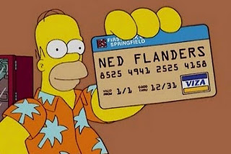
Query: Similarity about TYPE
What if you have similarity info about TYPE ?
Card Fraud detection : fraudulent of same type ?
- Identity theft/Skimming/Stolen cards
Type of Query for DNF learning:
- Binary: pair of POSITIVE ex.s from a random dataset, teacher says YES if they share a term
Can we efficiently learn DNF with this query?
Fraud Detection

Slide 5
Outline
Our model
Hardness Results
Positive Results: Uniform distri.
Positive Results: General distri.

Slide 6
Notations
Instance space X = {0, 1}^n
Concept space C: collection of fn h: X -> {-1,1}
Distribution D over X
Unknown target function h*: the true labeling function (Realizable case: h* in C)
Err(h) = Px~D[h(x) ~= h*(x)]

Slide 7
Warm Up: Disjoint DNF w/Boolean queries
Neighborhood Method
- Nice seed for Ti: ex. sat. T_{i} & no other term
- Get all its neighbors in the graph and learn a conjunc.
Lemma. Neighbor-method w.p. 1-δ, produce an ε-accu. DNF if, for each term Ti in target DNF having a pr. of sat ≥ε/2t, there is ≥ 1/poly(n, 1/ε) prob. a rand. ex. sat. T_{i} & no other term.
T1

Slide 8
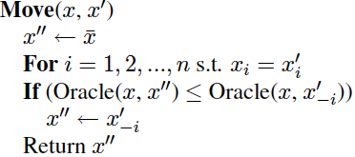
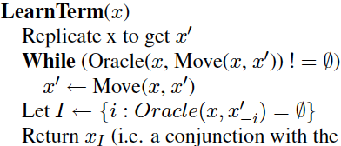
Warm Up: Adaptively Construct Ex.s.
Oracle(x, x’) -> #terms that x and x’ have in common.
Move(x, x’) moves x’ away from x by 1 bit, trying to maintain at least one common term.
LearnTerm(x) -> a term in target fn.
X 110111011
Y 110111011
K(x,y) = 1 initially
X 110111011
Y 001111011
K(x,y) = 0 change! X3 rel…
Flip x3 back …
X 110111011
Y 000000111
K(x,y) = 0 X7 rel…
Output
x₃ ∧x₇
+ or – s.t. x sat it)

Slide 9
Outline
Our model
Hardness Results
Positive Results: Uniform
Positive Results: General

Slide 10
Hardness Results Boolean (group learn)
Thm. Learning DNF from random data under arb. distri. w/ boolean queries is as hard as learning DNF from random data under arb. distri. w/ only labels (no queries).
Reduction from group-learn DNF in std. model to extended queries model.
How to use our alg (A: learn from a
poly #ex.s in extended model)
to group-learn ?
m
K (giant 1, giant 2) = 1

Slide 11
Hardness Results Approx numerical query
Thm. Learning DNF from random data under arbi. distri. w/ approx-numerical-queries is as hard as learning DNF from random data under arb. distri. w/ only labels i.e. if C is #terms x_{i} and x_{j} sat in common, oracle returns a value in [(1 – τ)C, (1 + τ)C].

Slide 12
Outline
Our model
Hardness Results
Positive Results: Uniform distri.
- Can learn DNF w/ numerical query
- Can learn Junta w/ boolean query
- Can learn DNF having ≤ 2^{O(√log(n))} terms
Positive Results: General distri.

Slide 13


Learning a sum of monotone terms
Thm. Can efficiently learn a sum of monotone t terms over unif. Distri., using time & samples poly(t, n, 1/ε).
- Fourier representation for single term T is simple:
- Fourier coeffi. for S of f:
- For each T_{i}, L1-length is 1, we have L1(f) ≤t.
=> for any thresh θ, at most t/θ coeffi. of mag. ≥ θ.
f(x) = T₁(x)+T₂(x)+ … +T_{t}(x)
Observations:
otw

Slide 14
Alg: learn DNF w/ numerical query
Examine each parity fn of size 1 & est its Fourier coeffi. from data (up to accu. θ/4). Set θ =ε/(8t)
Place all coeffi. of mag. ≥ θ/2 into a list L1.
For j = 2, 3, ... repeat:
- For each parity fn Φ_{S} in list L^{j-1} and each x_{i} not in S, est Fourier coeffi. of
- If est. is ≥ θ/2, add it to list L^{j} (if not already in)
- maintain list L^{j}: size-j parity fns w/ coeffi. mag. ≥ θ.
Construct fn g: weight sum of parities for identified coeff.
Output fn h(x) = [g(x)]

Slide 15
Alg: learn DNF w/ numerical query
Thm. Under the uniform distribution, with numerical pairwise queries, we can learn any poly(n)-term DNF.

Slide 16
r-Junta under Unif. (r = log n) Using Boolean Query
Lemma. For x and y ind. unif. samples, if target fn has r relevant variables, and the ith variable is relevant in target fn, then

Slide 17
Alg: Learn (log n)-Junta
Thm. Under Unif., with boolean queries, can properly learn any DNF having O(log(n)) relevant var.s (Junta).
- For each i, sample (16^{r} log(n/δ)) rand. pairs (x, y);
- Evaluate k(x, y)
- Calculate diff. of emp. prob.s.
- If (frac. of pairs with k(x, y) = 1 ∧ xi = yi
- frac. of pairs with k(x, y) = 1∧ x_{i} ≠ y_{i}) > (1/2)(1/4)^{r},
then var i is rel., otw irrel.

Slide 18




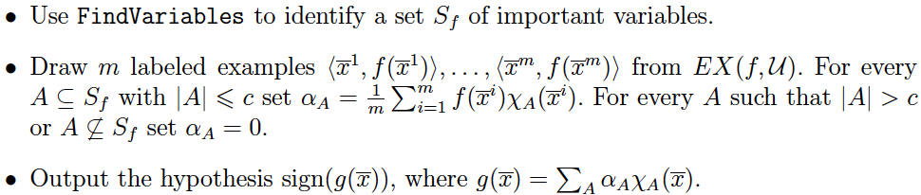
Learn DNF having ≤ 2^{O(√log(n))} terms
FindVarariables
[Ser04]: monotone dnf
MQ
For monotone f, simplified as:
Rand
data
LearnTerm
Notes:
Servedio gives an efficient algorithm for identifying the important variables of a monotone Boolean function. We refer to this algorithm as FindVariables
There is an algorithm, runs in poly-time steps for all eps delta > 0; and with probability at least 1 – delta; it outputs a set S_f subseteq [n] such that this property is sat.
The Learn-term algorithm thus estimates ^ f(A) for A subseteq S_f (size<c) by sampling and constructs a hypothesis using these approximate Fourier coefficients.
The idea is, Mansour’s lemma has dependency on t (log t): look at coeff for small set of rel variable. If do not have too many terms say 2^{o(sqrt(long))}, can just look at small set of variables. The key fact is the only part that requires monotonicity is find-var. So we Replace findvar with sth that works for non-monotone dnf. And use landmarks (landmark dnf is monotone: because flipping from 0 to 1, only makes them closer in K) to find relevant var. Given the S_f, we run learn-term (does not require monotone).

Slide 19

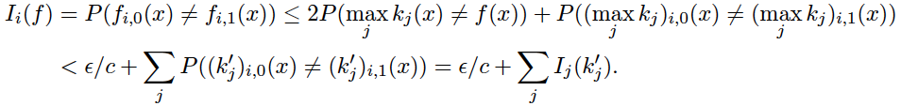
Learn DNF having ≤ 2^{O(√log(n))} terms: Unif. Distri.
sample m = poly(t/eps) labeled ex.s x⁽¹⁾,…, x^{(m)} at random.
for each j ≤ m, define
Kj is a monotone DNF after transforming feature space to: phi_j(y) = (I[y1=x(j)1], I[y2=x(j)2],…, I[yn=x(j)n]).
call it a landmark DNF
Terms in k_{j} correspond to terms in target sat. by x^{(j)},
Run FindVariables for each k_{j}
S_{f}: union of returned sets of variables.

Slide 20
Outline
Our model
Hardness Results
Positive Results: Uniform distri.
Positive Results: General distri.

Slide 21
Common Profile Approach
Common Profile Approach
- Take a sample of poly(n, 1/ε, log(1/δ)) rand. labeled ex.s,
- K(x, y): #terms sat in common for a pair pos ex. (x, y)
- “Profile”: set of terms T_{i} in target DNF satisfied by x.
- For each pos ex x, identify set S of ex.s y s.t..K(x; y) = K(x; x). So these points sat at least all the terms x sat.
- For each S, learn a minimal conjunction consistent w/ these ex.s.
Lemma. If target DNF has ≤ poly(n) possible profiles,
common-profile-approach, w.p. ≥1 -δ, produce a DNF
w/err rate ≤ ε.
Implication: w/numerical-valued queries, under arb. distri.
can proper-learn DNF w/ O(log(n)) rel. var..

Slide 22

Other Positive Results
 | Binary | Numeric
O(log(n)) terms DNF under any distrib. |  | ✔
2-term DNF under any distrib. | ✔ | ✔
DNF: all var in O(log(n)) terms (Unif) | ✔ | ✔

Slide 23
Thanks !

