Slide 1

PIPP: Promotion/Insertion Pseudo-Partitioning of Multi-Core Shared Caches
Yuejian Xie, Gabriel H. Loh
Notes:
Background
Slide number bigger.

Slide 2
Last Level Cache In Multi-Core
Core0
Core1
IL1
DL1
IL1
DL1
Core0’s Data
Core1’s Data
Last Level Cache (LLC)

Slide 3
Previous Work and Motivation
Capacity Management
Considering different cache space need, allocate proper space to each core.
Guo-MICRO07, Kim-PACT04, Srikantaiah-ASPLOS09, Qureshi-MICRO06 (UCP), …
Dead Time Management
Evict dead lines (blocks with no reuse) sooner.
Kaxiras-ISCA01, Qureshi-ISCA07, Jaleel-PACT07 (TADIP), …
PIPP: Do both capacity and dead time management better at the same time !
Notes:
.

Slide 4
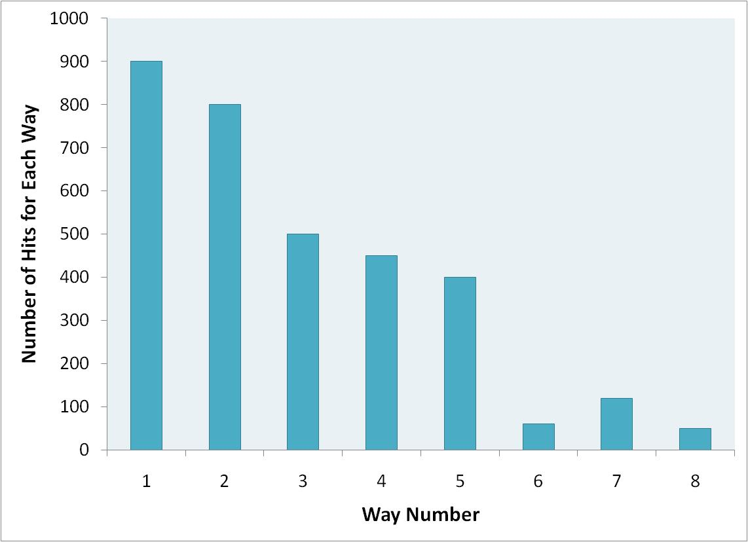
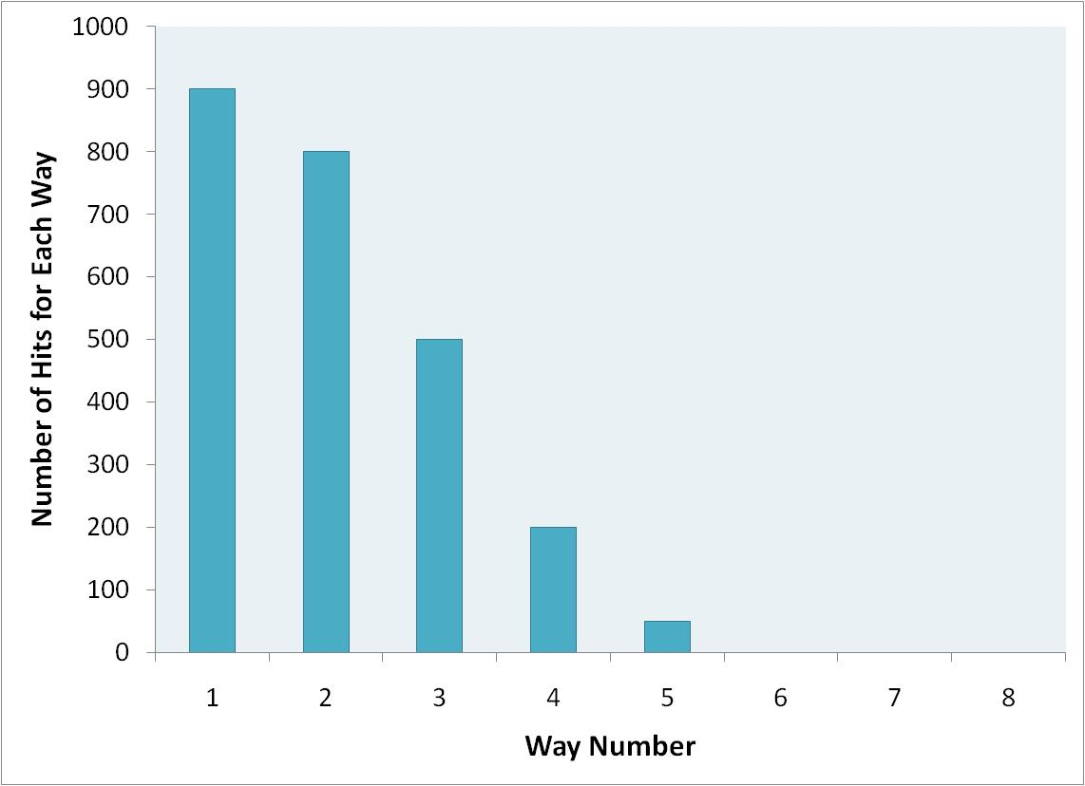
UCP Technique
Core0
Core1
Core 1 gets 3 ways
Core 0 gets 5 ways

Slide 5
TADIP Technique
MRU
LRU
Incoming Block

Slide 6
TADIP Technique
MRU
LRU
Occupies one cache block for a long time with no benefit!

Slide 7
TADIP Technique
MRU
LRU
Incoming Block
Notes:
Thread Aware

Slide 8

TADIP Technique
MRU
LRU
Useless Block | Evicted at next eviction
Useful Block | Moved to MRU position

Slide 9
TADIP Technique
MRU
LRU
Useless Block | Evicted at next eviction
Useful Block | Moved to MRU position

Slide 10
Break “Replacement” Into Three Pieces
Eviction
When replacing a block in a set, which should be evicted?
Insertion
For new blocks, where to insert the new block?
Promotion
When there is a hit in the cache, how to adjust the block’s position/priority?
PIPP: Novel scheme for Promotion and Insertion

Slide 11
Our Scheme: PIPP
What’s PIPP?
Promotion/Insertion Pseudo Partitioning
Achieving both capacity and dead-time management.
Eviction
LRU block as the victim
Insertion
The core’s quota worth of blocks away from LRU
Promotion
To MRU by only one.
New
Insert Position = 3 (Target Allocation)
Promote
To Evict
MRU
Hit
LRU
Notes:
Remove brace

Slide 12
PIPP Example
Core0 quota: 5 blocks
Core1 quota: 3 blocks
Core0’s Block
Core1’s Block
Request
D
Core1’s quota=3
1
A
2
3
4
B
5
C
MRU
LRU

Slide 13
PIPP Example
Core0 quota: 5 blocks
Core1 quota: 3 blocks
Core0’s Block
Core1’s Block
Request
6
Core0’s quota=5
1
A
2
3
4
D
B
5
MRU
LRU

Slide 14
PIPP Example
Core0 quota: 5 blocks
Core1 quota: 3 blocks
Core0’s Block
Core1’s Block
Request
7
Core0’s quota=5
1
A
2
6
3
4
D
B
MRU
LRU

Slide 15
PIPP Example
Core0 quota: 5 blocks
Core1 quota: 3 blocks
Core0’s Block
Core1’s Block
Request
D
1
A
2
7
6
3
4
D
MRU
LRU

Slide 16
PIPP Example
Core0 quota: 5 blocks
Core1 quota: 3 blocks
Core0’s Block
Core1’s Block
Request
E
Core1’s quota=3
1
A
2
7
6
3
D
4
MRU
LRU

Slide 17
PIPP Example
Core0 quota: 5 blocks
Core1 quota: 3 blocks
Core0’s Block
Core1’s Block
Request
2
1
A
2
7
6
E
3
D
MRU
LRU

Slide 18



How PIPP Does Both Managements
 | Core0 | Core1 | Core2 | Core3
Quota | 6 | 4 | 4 | 2
MRU
LRU
Insert closer to LRU position
Notes:
Intuition instead of “explanation”.

Slide 19
Pseudo-Partition Benefit
Core0 quota: 5 blocks
Core1 quota: 3 blocks
Core0’s Block
Core1’s Block
Request
New
Strict Partition
MRU₀
LRU₀
MRU₁
LRU₁
Notes:
Potentially useful.

Slide 20
Pseudo-Partition Benefit
Core0 quota: 5 blocks
Core1 quota: 3 blocks
Core0’s Block
Core1’s Block
Request
New
Pseudo Partition
MRU
LRU

Slide 21
Single Reuse Block
Directly to MRU
(TADIP)
New
MRU
LRU
Promote By One
(PIPP)
New
MRU
LRU

Slide 22
Algorithm Comparison
Algorithm | Capacity Management | Dead-time Management | Note
LRU |  |  | Baseline, no explicit management
UCP |  |  | Strict partitioning
TADIP |  |  | Insert at LRU and promote to MRU on hit
PIPP |  |  | Pseudo-partitioning and incremental promotion

Slide 23
Evaluation Methodology
Simulation environment
SimpleScalar-Zesto, Out-Of-Order, Intel Core2-like
32KB, 8way DL1 IL1, 4MB 16way LLC, 1.6GHz DDR2
Workloads Classification
“UCP2-5”
UCP-friendly, 2-core, 5th workload
“DIP4-3”
TADIP-friendly, 4-core, 3th workload
Notes:
Mention SPEC, …

Slide 24
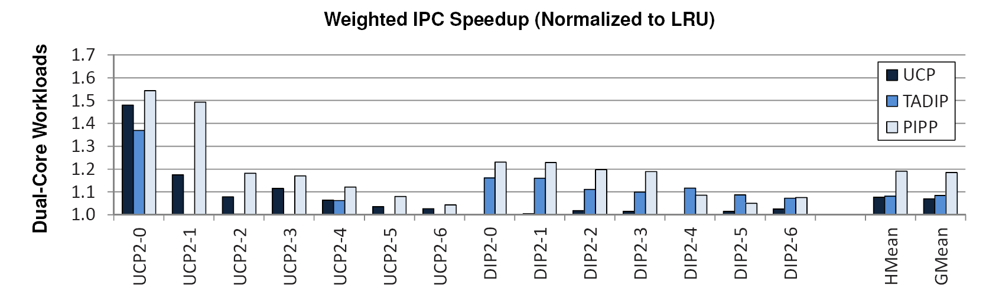
Dual-Core Weighted Speedup
PIPP is too cautious here.
UCP Friendly
TADIP Friendly
PIPP outperforms LRU, 19.0%, UCP 10.6%, TADIP 10.1%
Notes:
Promotion by only 1 position, does not keep the line in the cache for long enough to provide a hit on the next reuse.
One example, tadip does better.

Slide 25
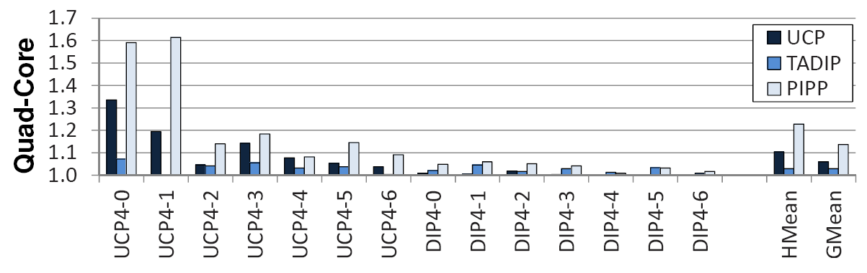
Quad-Core Weighted Speedup
UCP Friendly
TADIP Friendly
PIPP outperforms LRU 21.9%, UCP 12.1%, TADIP 17.5%
Notes:
In the paper, we have fair speedup, ipc throughput. (in backup slides)
Don’t read the numbers.
Positive. Similar.

Slide 26
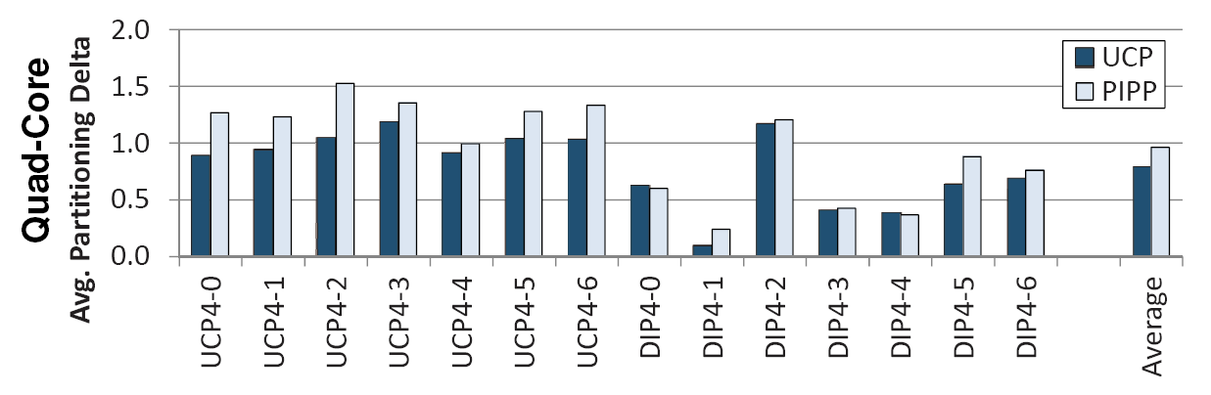
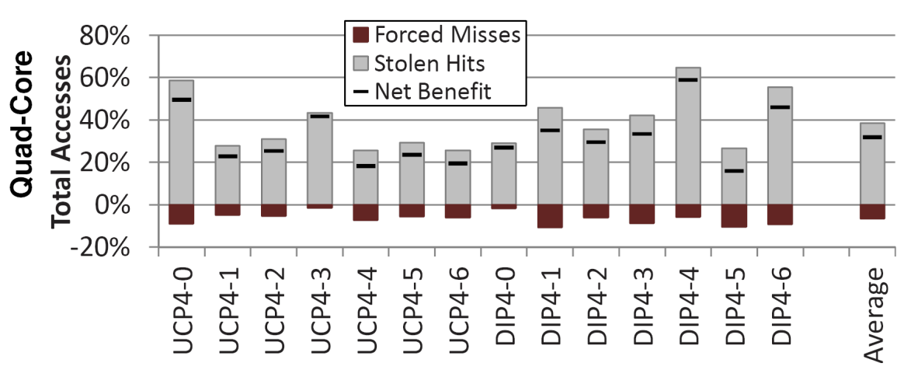
PIPP Behavior Analysis
Occupancy Control
Insertion Behavior | TADIP inserts no-reuse lines at 1.7 while PIPP inserts those at 1.3. (LRU position equals to 0.)
Pseudo-Partition Benefit

Slide 27
Conclusion
Novel proposal on Insertion and Promotion
A single unified mechanism provides both capacity and dead time management
Outperforms prior UCP and TADIP
In the full paper:
Special version of PIPP for streaming application
Reducing hardware overhead
Sensitivity analysis

Slide 28
BACKUP SLIDES

Slide 29
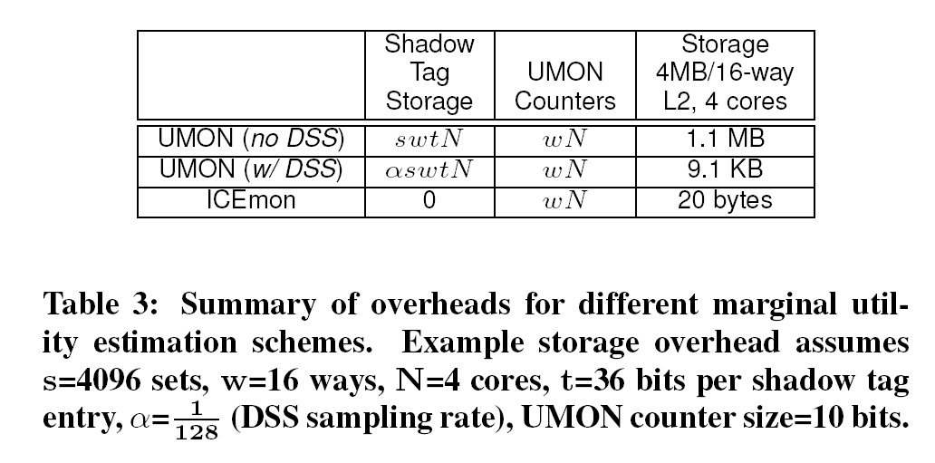
Hardware Cost

Slide 30
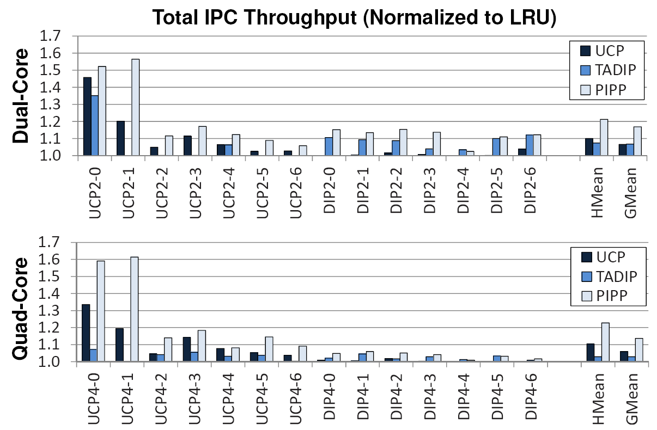
Total IPC Throughput

Slide 31
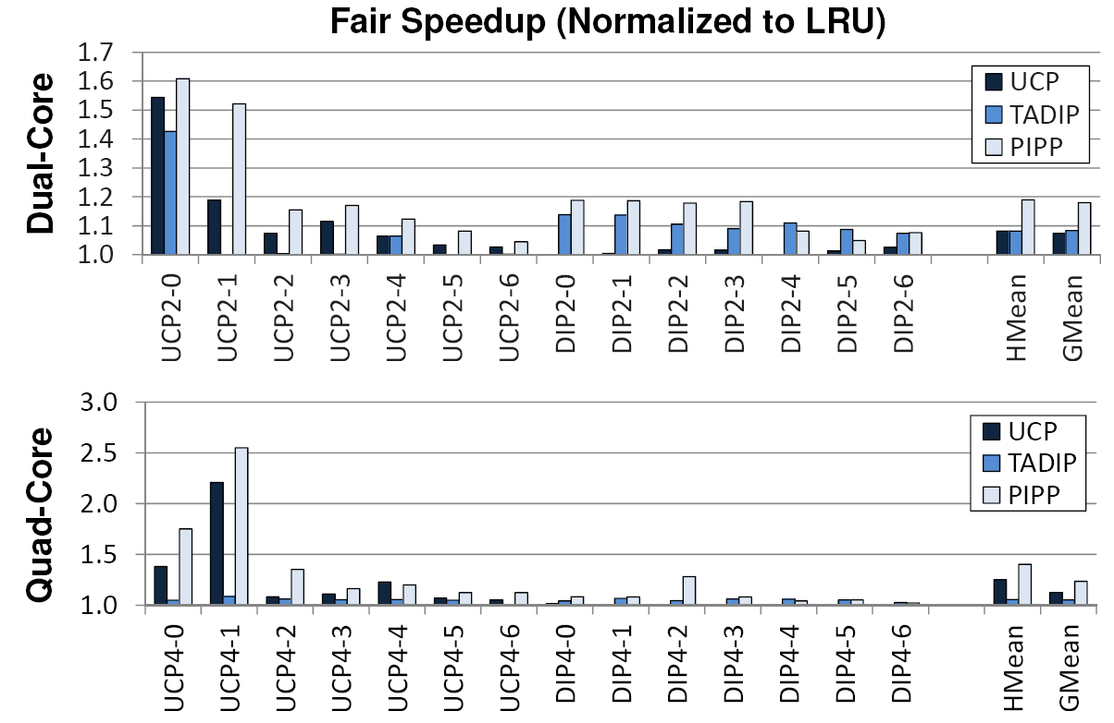
Fair Speedup

Slide 32
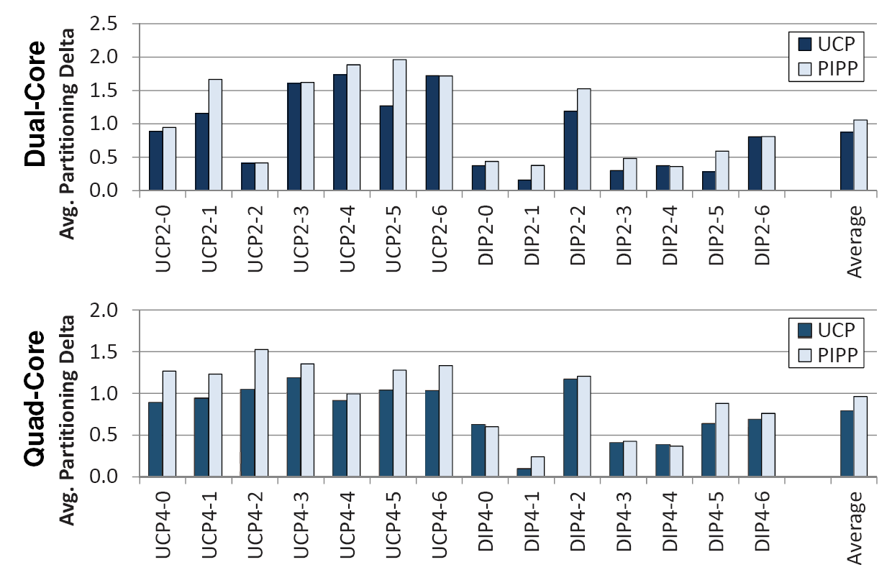
Occupancy Control
E.g. Target Partition {5,3} – Actual Occupancy {6,2} = 1

Slide 33
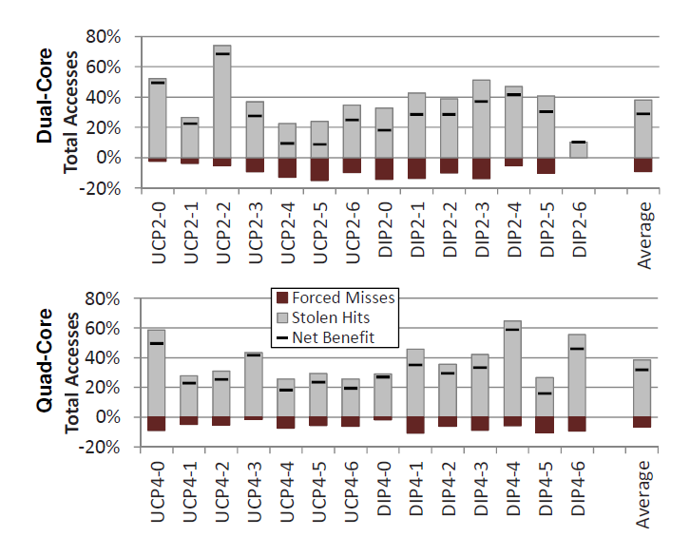
Stealing Benifit

Slide 34
Streaming-Sensitive PIPP
Streaming Application Detection
#Accesses, #Misses, MissRate > threshold
Insertion
At a fixed position (independent of quota)
#Streaming Apps blocks away from LRU position
Promotion
Promote by 1 with probability p_{stream}
p_{stream} « 1

Slide 35
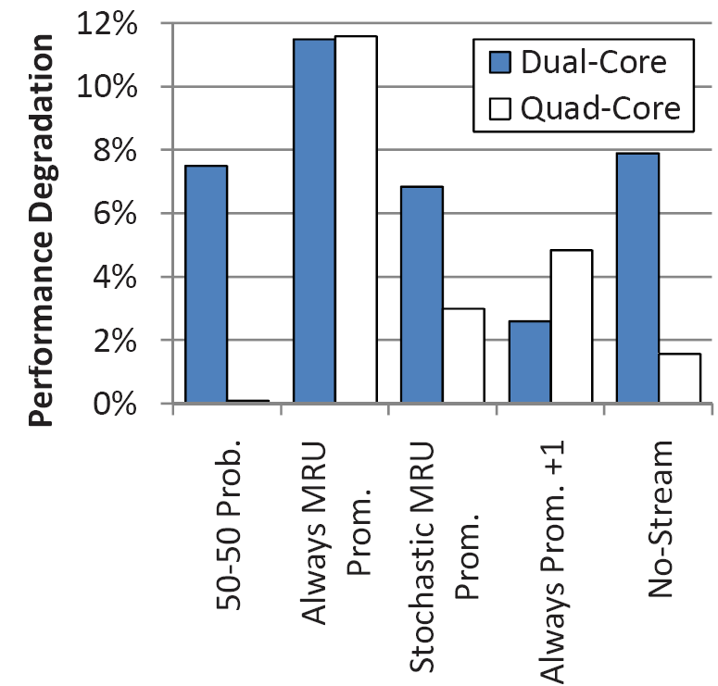
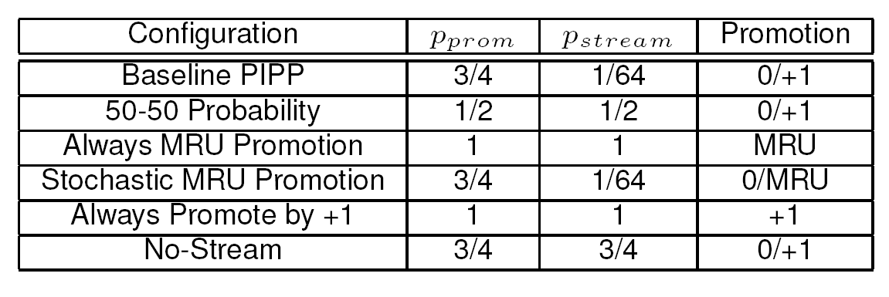
Importance of Components

Slide 36
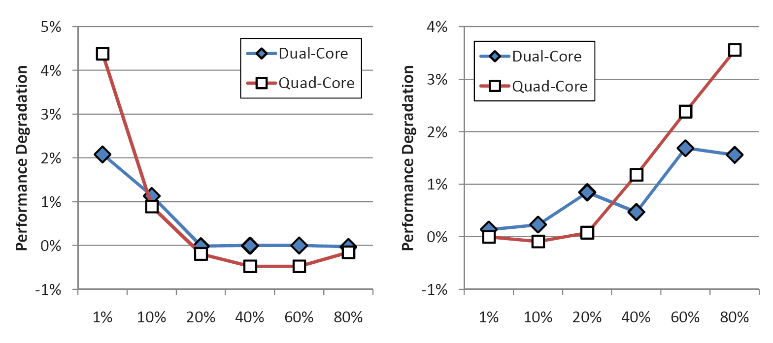
Sensitivity of Promotion Prob
Promotion Prob for General App
Promotion Prob for Streaming App

Slide 37
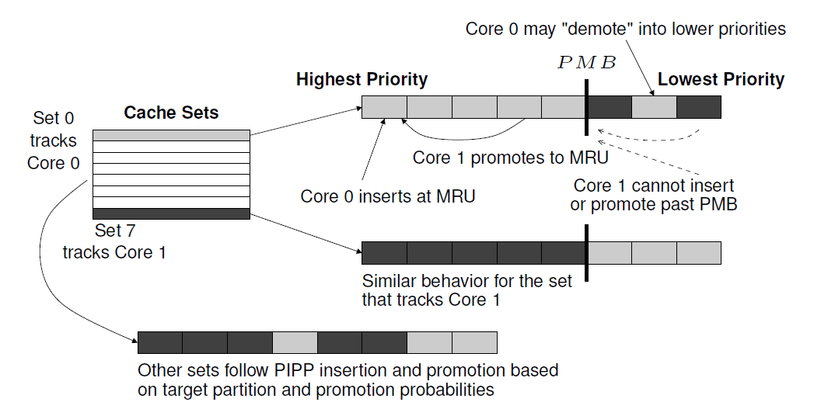
In-Cache UMON

Slide 38
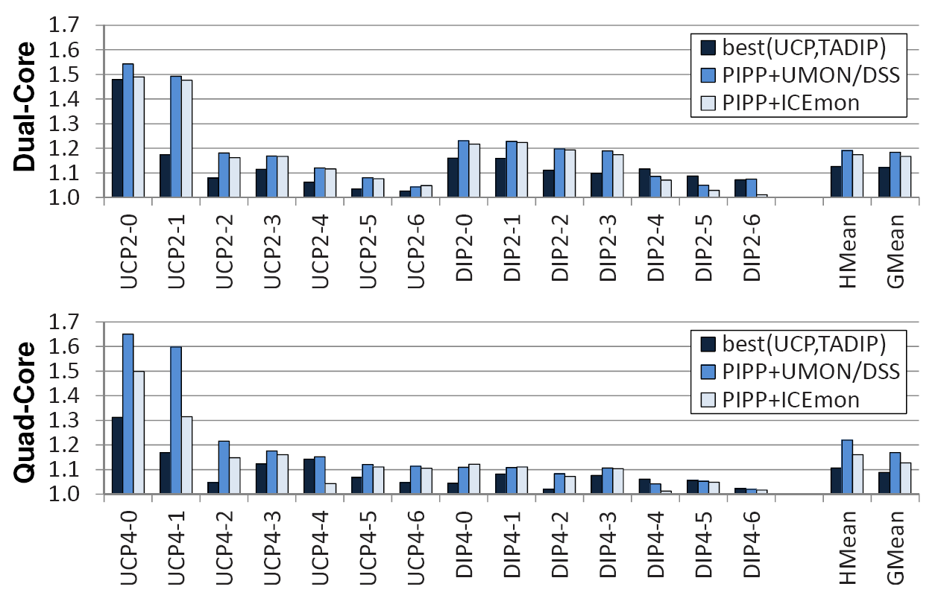
In-Cache UMON Performance

