Slide 1


Program Chairs’ Report
David Evans
University of Virginia
Giovanni Vigna
UC Santa Barbara

Slide 2
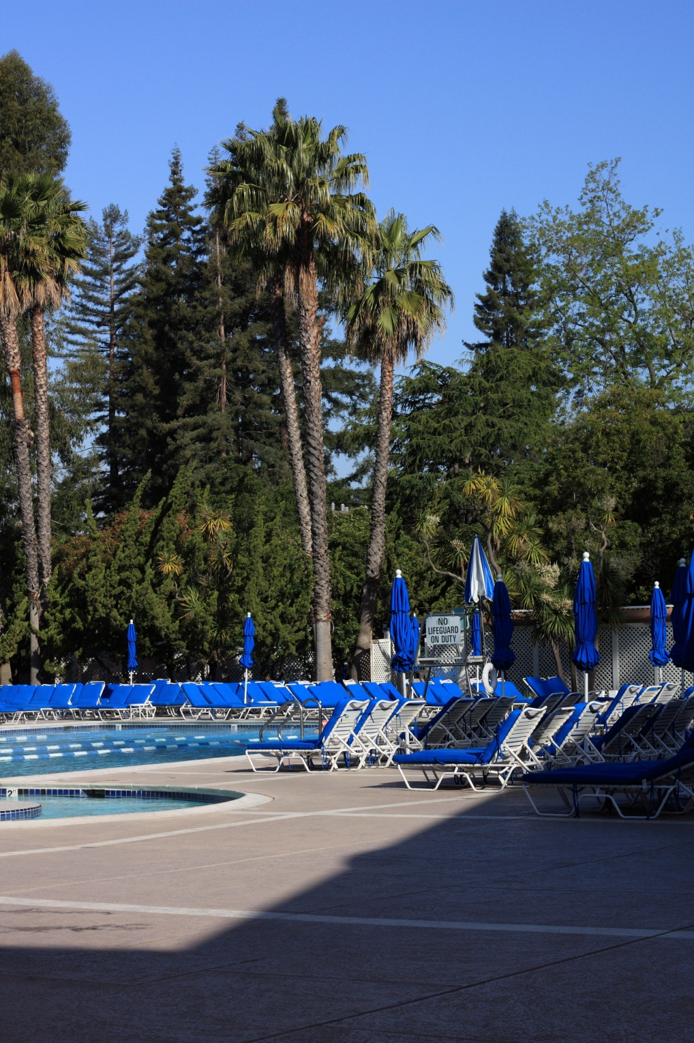
Agenda
Review Process
Some Statistics on the Papers
Awards

Slide 3
Program Committee
Giuseppe Ateniese, Johns Hopkins University
Michael Backes, Saarland University / Max Planck ISS
Adam Barth, University of California, Berkeley Nikita Borisov, University of Illinois at Urbana-Champaign David Brumley, Carnegie Mellon University Cristian Cadar, Imperial College London Shuo Chen, Microsoft Research Redmond Anupam Datta, Carnegie Mellon University Nick Feamster, Georgia Institute of Technology Debin Gao, Singapore Management University Jon Giffin, Georgia Institute of Technology Virgil Gligor, Carnegie Mellon University Michael Goodrich, University of California, Irvine J. Alex Halderman, University of Michigan Somesh Jha, University of Wisconsin Rob Johnson, Stony Brook University Engin Kirda, Eurecom, France Yoshi Kohno, University of Washington Shriram Krishnamurthi, Brown University Christopher Kruegel, University of California, Santa Barbara Ruby Lee, Princeton University Michael Locasto, George Mason University Sergio Maffeis, Imperial College London Z. Morley Mao, University of Michigan Jonathan McCune, Carnegie Mellon University David Molnar, Microsoft Research Redmond Cristina Nita-Rotaru, Purdue University Vern Paxson, University of California, Berkeley Mike Reiter, University of North Carolina Andrei Sabelfeld, Chalmers University Stuart Schechter, Microsoft Research Redmond Hovav Shacham, University of California, San Diego Vitaly Shmatikov, University of Texas at Austin Radu Sion, Stony Brook University Sean Smith, Dartmouth College Adam Smith, Pennsylvania State University Dawn Song, University of California, Berkeley Angelos Stavrou, George Mason University Ed Suh, Cornell University Patrick Traynor, Georgia Institute of Technology V. N. (“Venkat”) Venkatakrishnan, University of Illinois at Chicago Dan Wallach, Rice University Brent Waters, University of Texas at Austin Westley Weimer, University of Virginia XiaoFeng Wang, Indiana University Felix Wu, University of California, Davis Dongyan Xu, Purdue University Haifeng Yu, National University of Singapore Sencun Zhu, Pennsylvania State University
Giuseppe Ateniese, Johns Hopkins University
Michael Backes, Saarland University / Max Planck ISS
Adam Barth, University of California, Berkeley Nikita Borisov, University of Illinois at Urbana-Champaign David Brumley, Carnegie Mellon University Cristian Cadar, Imperial College London Shuo Chen, Microsoft Research Redmond Anupam Datta, Carnegie Mellon University Nick Feamster, Georgia Institute of Technology Debin Gao, Singapore Management University Jon Giffin, Georgia Institute of Technology Virgil Gligor, Carnegie Mellon University Michael Goodrich, University of California, Irvine J. Alex Halderman, University of Michigan Somesh Jha, University of Wisconsin Rob Johnson, Stony Brook University Engin Kirda, Eurecom, France Yoshi Kohno, University of Washington Shriram Krishnamurthi, Brown University Christopher Kruegel, University of California, Santa Barbara Ruby Lee, Princeton University Michael Locasto, George Mason University Sergio Maffeis, Imperial College London Z. Morley Mao, University of Michigan Jonathan McCune, Carnegie Mellon University David Molnar, Microsoft Research Redmond Cristina Nita-Rotaru, Purdue University Vern Paxson, University of California, Berkeley Mike Reiter, University of North Carolina Andrei Sabelfeld, Chalmers University Stuart Schechter, Microsoft Research Redmond Hovav Shacham, University of California, San Diego Vitaly Shmatikov, University of Texas at Austin Radu Sion, Stony Brook University Sean Smith, Dartmouth College Adam Smith, Pennsylvania State University Dawn Song, University of California, Berkeley Angelos Stavrou, George Mason University Ed Suh, Cornell University Patrick Traynor, Georgia Institute of Technology V. N. (“Venkat”) Venkatakrishnan, University of Illinois at Chicago Dan Wallach, Rice University Brent Waters, University of Texas at Austin Westley Weimer, University of Virginia XiaoFeng Wang, Indiana University Felix Wu, University of California, Davis Dongyan Xu, Purdue University Haifeng Yu, National University of Singapore Sencun Zhu, Pennsylvania State University

Slide 4
External Reviewers
Aditya Akella
Aslan Askarov
Thanassis Avgerinos
Lucas Ballard
Matthias Berg
Karthikeyan Bhargavan
Leyla Bilge
Arnar Birgisson
Prithvi Bisht
Raymond Buse
Juan Caballero
Stephen Checkoway
Joe Cooley
Scott Crosby
Deepak D’Souza
Pierre Malo Danielou
Matthew Davis
Manuel Egele
Jason Franklin
Matt Fredrikson
Deepak Garg
Paolo Gasti
Sebastian Gerling
Steven Gianvecchio
Kalpana Gondi
Xun Gong
Bill Harris
Pieter Hooimeijer
Amir Houmansadr
Sonia Jahid
Limin Jia
Aaron Johnson
Deborah Johnson
Joshua Juen
Boris Koepf
Louis Kruger
Andrea Lanzi
Claire Le Goues
JongHyup Lee
Peng Li
Zhou Li
Zhuowei Li
Zhiqiang Lin
Mike Ter Louw
Matteo Maffei
Stephen McCamant
Kazuhiro Minami
Prateek Mittal
Esfandiar Mohammadi
Madan Musuvathi
Chitra Muthukrishnan
Shishir Nagaraja
Arvind Narayanan
Giang Nguyen
Kim Pecina
Adrian Perrig
Michael Piatek
Willard Rafnsson
Raphael Reischuk
Eric Rescorla
Junghwan Rhee
Alejandro Russo
Brian Schulte
Edward Schwartz
Hendrik Schweppe
Dan Simon
Yingbo Song
Miroslava Sotakova
Ahren Studer
Christopher Szilagyi
Ankur Taly
Michael Tschantz
Dominique Unruh
Danny Walker
Qiyan Wang
Rui Wang
Xinran Wang
Bogdan Warinschi
Nicholas Weaver
Dinghao Wu
Ting-Fang Yen
Kehuan Zhang
Michelle Zhou

Slide 5
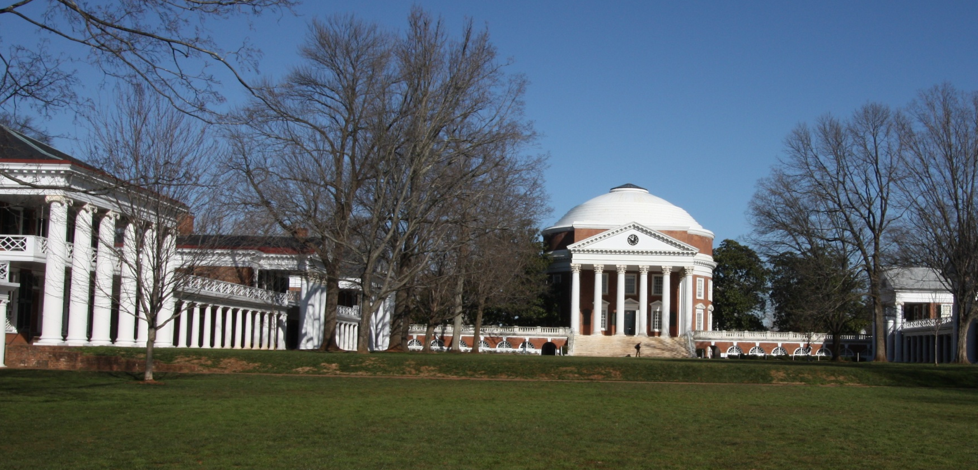
SoK
PC Meeting
Charlottesville, VA
Deadline
Round 1:
2 reviews
Round 2:
1-2 more reviews
Round 3:
1-2 more reviews
Online discussion, more reviews
PC Meeting
Nov 18
Dec 18
Jan 11
Jan 23
26-27 Jan
Review Process

Slide 7
Accepted Research Papers
3

Slide 8
Papers by Country
counting each contact author / number of authors
# accepted × 1/(acceptance rate)
Number of submissions

Slide 10
Submits/Accepts by Topic

Slide 11
Language-based security AND Web security: 100% (3/3)

Slide 12

Best Paper Awards
Paper Awards Committee
David Evans, University of Virginia
Somesh Jha, University of Wisconsin
Yoshi Kohno*, University of Washington
Mike Reiter, University of North Carolina
Giovanni Vigna, UC Santa Barbara
* Not for Best Practical Paper Award

Slide 13

Best Practical Paper
Presented by IEEE Security & Privacy Magazine to the “paper most likely to immediately improve the security of current environments and systems.”

Slide 14
Best Practical Paper
Chip and PIN is Broken
Steven J. Murdoch
Saar Drimer
Ross Anderson
Mike Bond
University of Cambridge

Slide 15
Best Student Paper
TaintScope: A Checksum-Aware Directed Fuzzing Tool for Automatic Software Vulnerability Detection
Tielei Wang, Peking University
Tao Wei, Peking University
Guofei Gu, Texas A & M University
Wei Zou, Peking University

Slide 16
Best Paper
SCiFI - A System for Secure Face Identification
Margarita Osadchy
Benny Pinkas
Ayman Jarrous
Boaz Moskovich
Univesity of Haifa

Slide 17

Thanks!
Organizers
Ulf Lindqvist (General Chair)
Deb Frincke (Registration)
Al Shaffer (Treasurer)
Jenny McNeill (Publications chair)
Carrie Gates (Poster and workshops chair)
Adrienne Felt (Web/design chair)
Angelos Stavrou (Short talks chair)
Peter Neumann (30th Anniversary papers)
Technical Committee: Hilarie Orman, Terry Benzel, Sven Dietrich, Cynthia Irvine
Giovanni Vigna
Program Committee members
External reviewers
Authors

Slide 18


